Slide 1
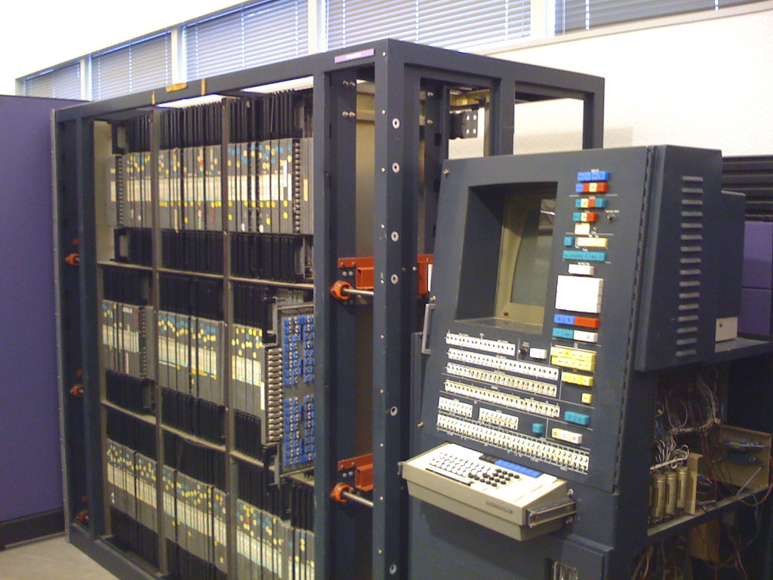
Development Preliminaries
Hoon School Live · Lesson 0

