Slide 1

APP SCHOOL LIVE @ LESSON 1
Aarvo services

Slide 2
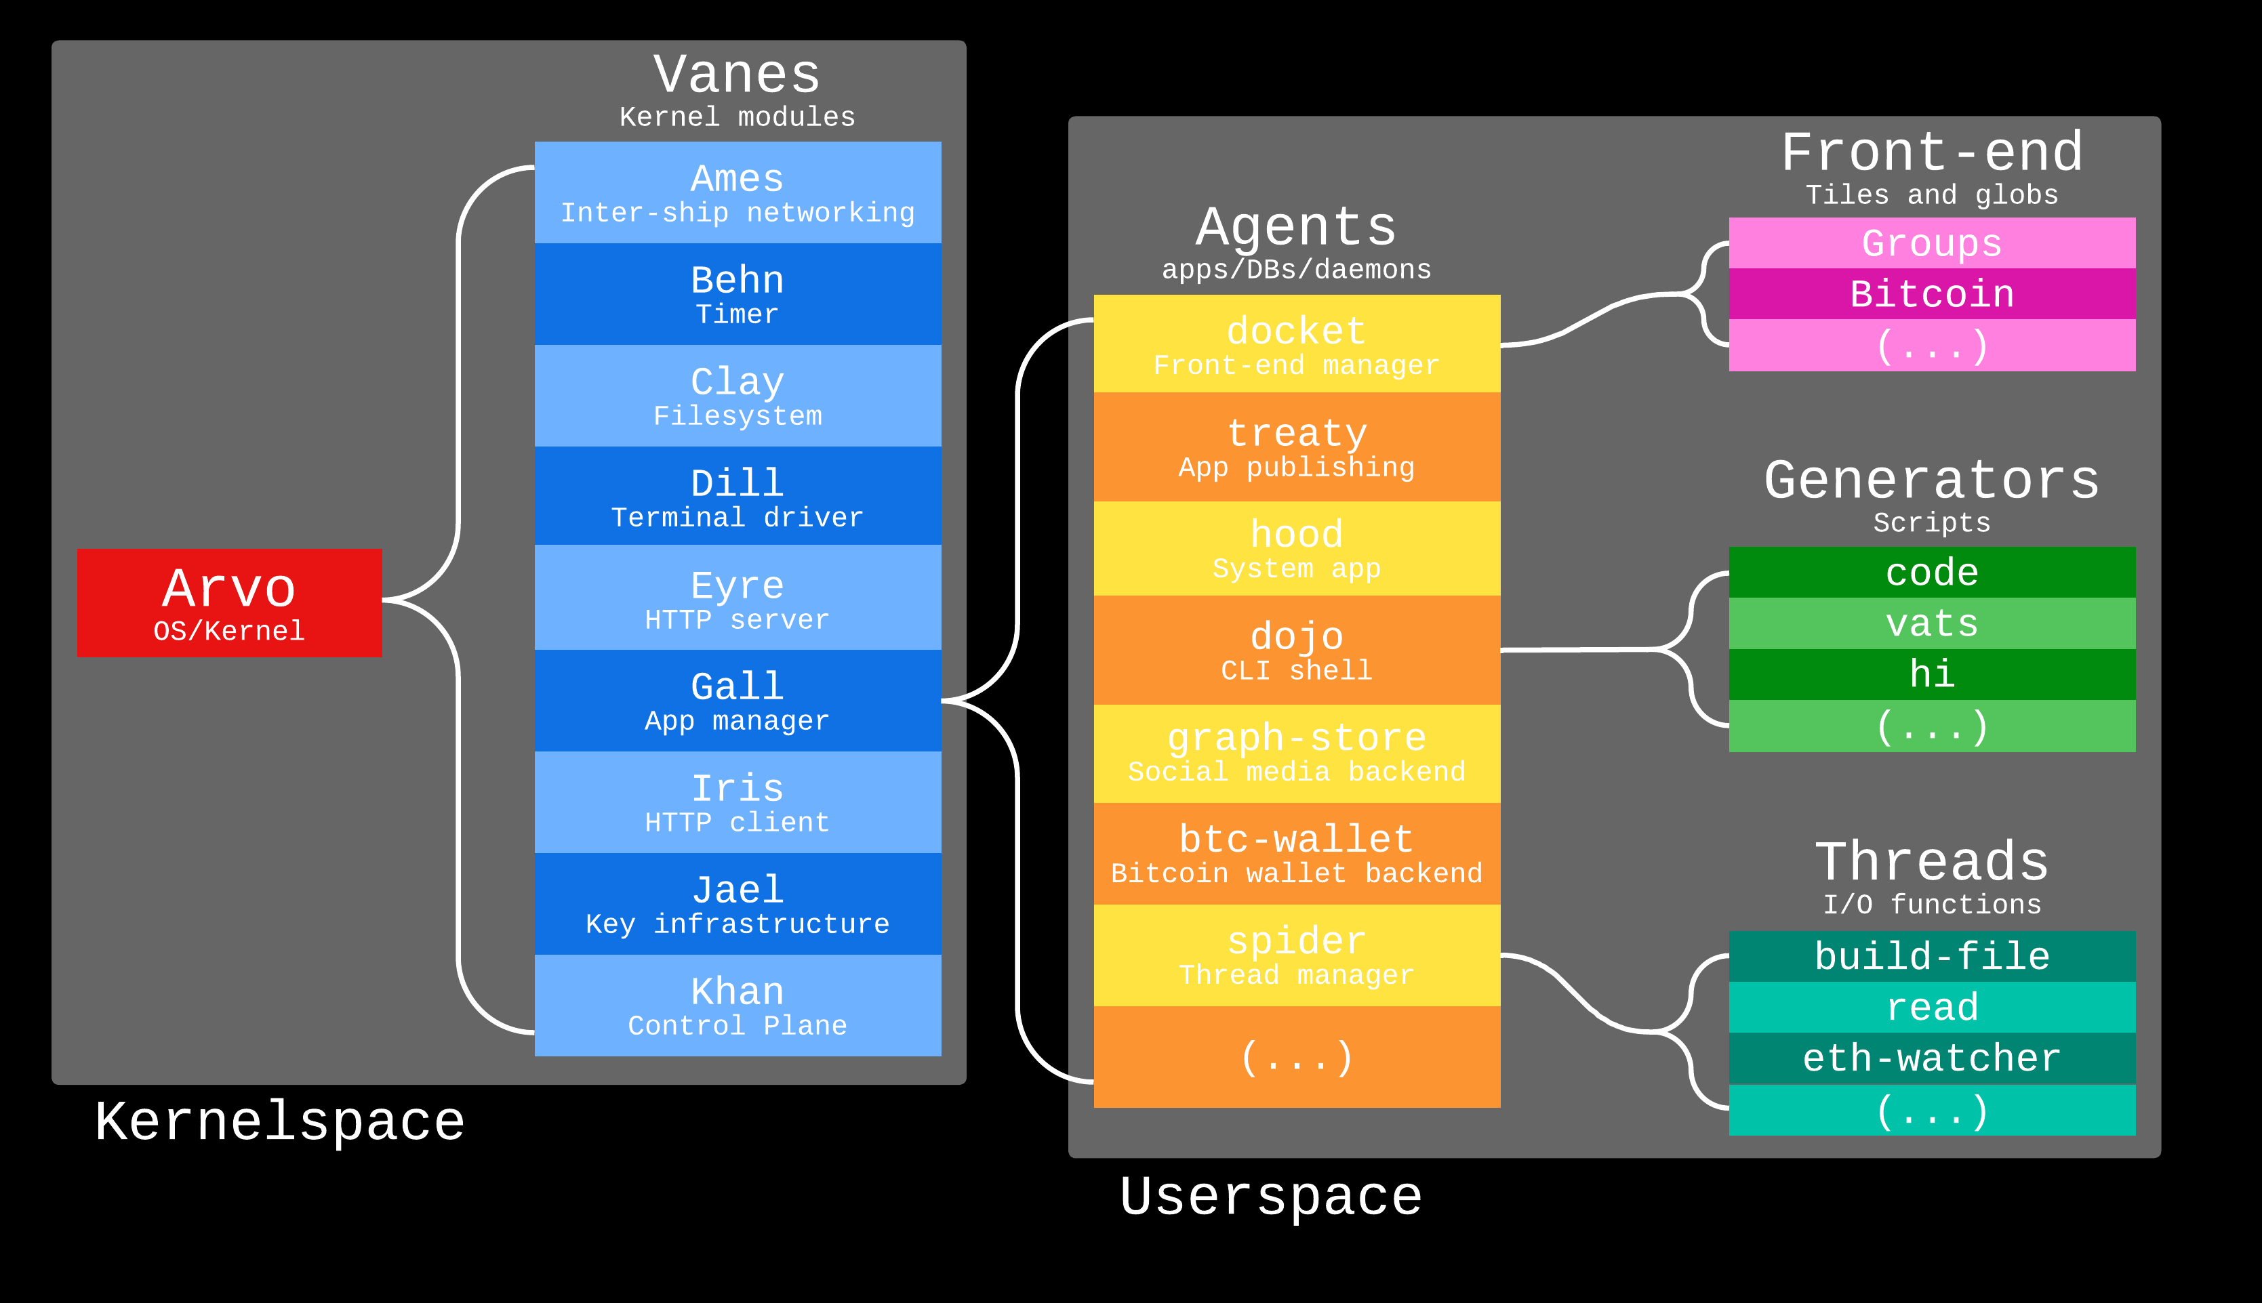

Slide 3
%a
%k
%j
%i
%g
arvo
zuse
hoon
%b
%c
%e
lull
%d

Slide 4
runtime
Nock
spec

Slide 5
event
handler
arvo
zuse
stdlib
hoon
lull
boot
stdlib
language

Slide 6
control
plane
cryptographic
secrets
networking
client
services
%a
%k
%j
%i
%g
userspace
timer
%b
%c
%e
server
services
%d
filesystem
terminal

Slide 7
Arvo
Event Handler
Arvo
Vane
Vane
Arvo

Slide 8
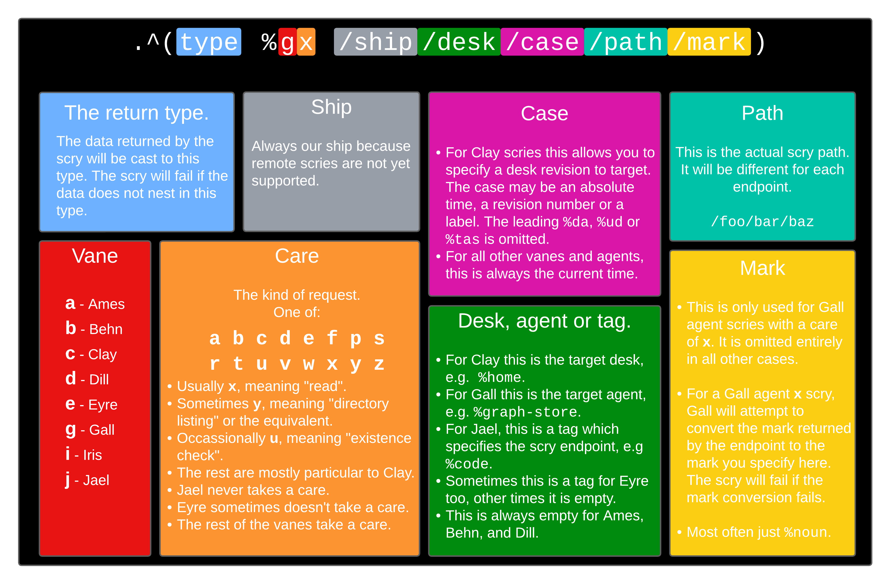
Scrying

Slide 9
Ames
UDP packets
end-to-end
encryption
routing, congestion
control
networking
%a

Slide 10
Behn
timer priority queue
guaranteed
notification after
wakeup time
timer
%b

Slide 11
Clay
typed filesystem
all files have marks
referentially
transparent
version-controlled
global namespace
2 GB limit currently
%c
filesystem

Slide 12
Dill
session and
keyboard handler
see Drum and Hood
%d
terminal

Slide 13
Eyre
HTTP API endpoints
data subscription
model preferred
(JSON-based
channels)
cookie-based
authentication
MIME types are
Arvo-level primitives
%e
server
services

Slide 14
Gall
persistent daemons
standard form
Gall brokers access
to Arvo services
communicates via
Eyre
%g
userspace

Slide 15
Iris
client vane for HTTP
requests
client
services
%i

Slide 16
Jael
verify identity
track public keys
(Azimuth state)
communicate with
sponsor
cryptographic
secrets
%j

Slide 17
Khan
external thread
control plane
brand new, likely
to evolve
control
plane
%k

