Slide 1

APP SCHOOL LIVE @ LESSON 2
Aagents

Slide 2
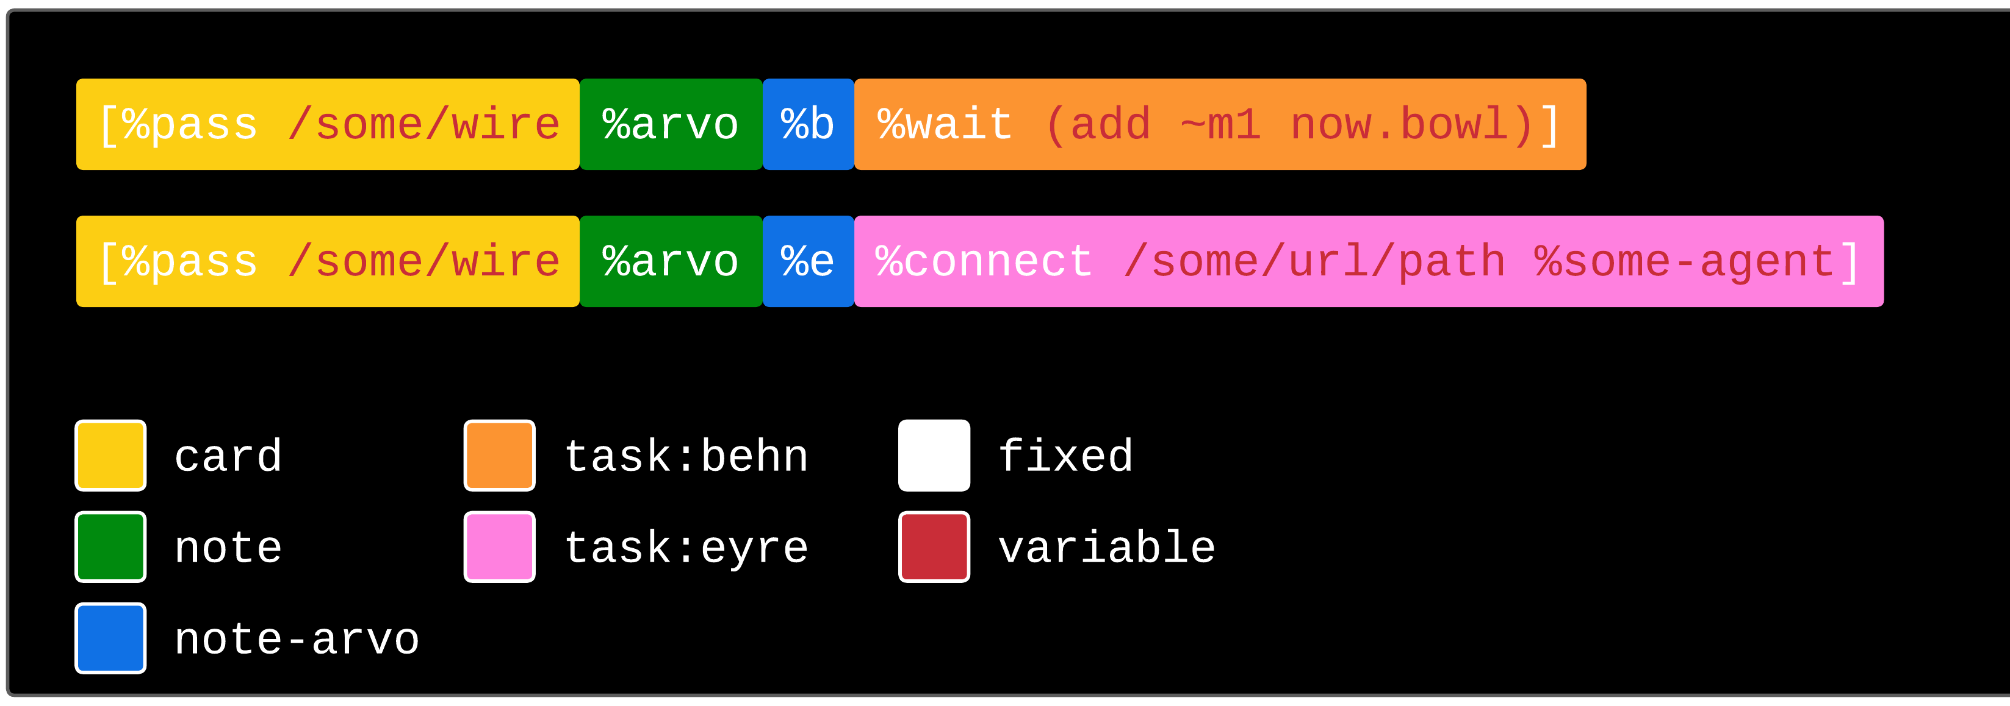

Slide 3
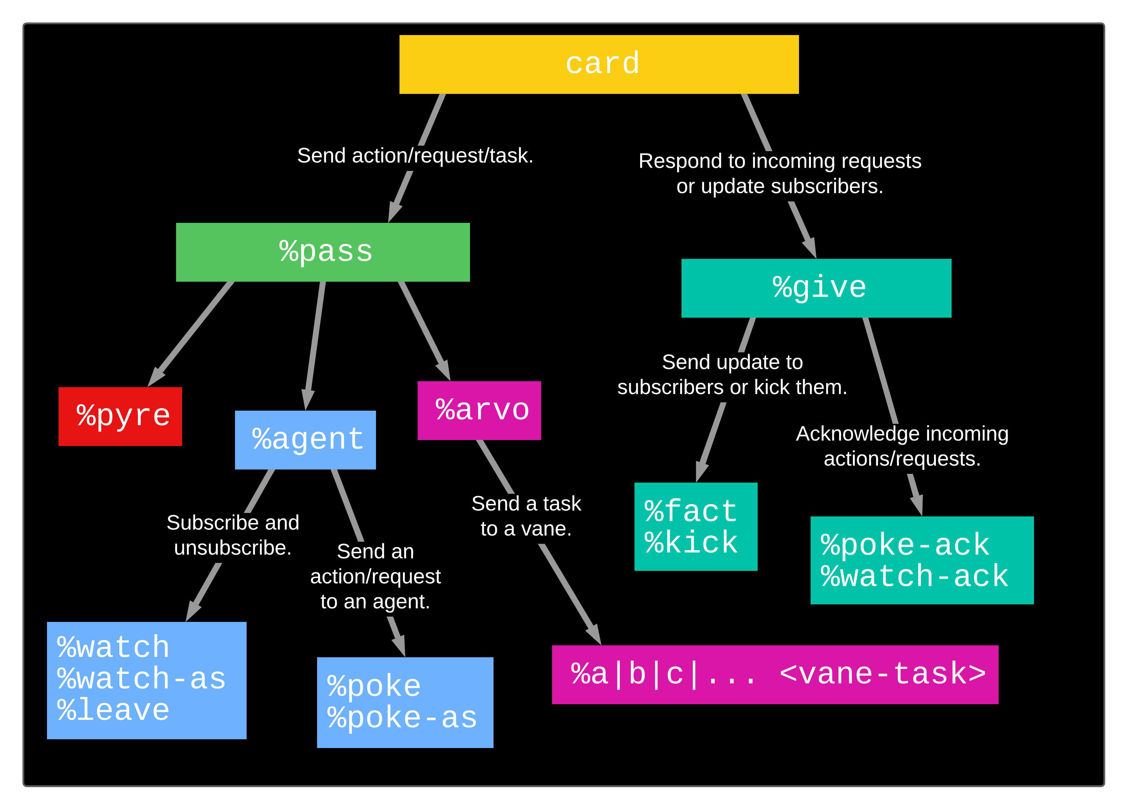

Slide 4
