Slide 1
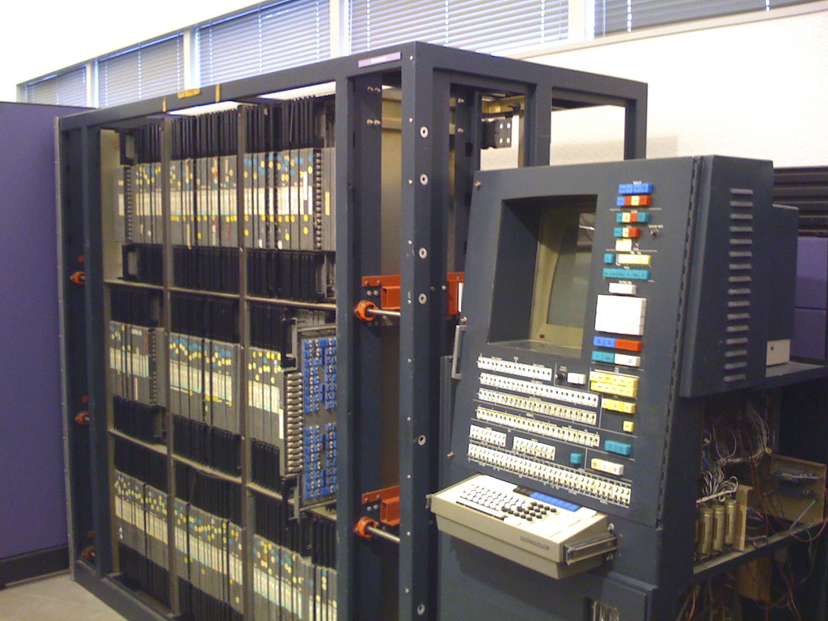
Hoon School Live · Lesson 0
Urbit Development
Preliminaries

