Slide 1
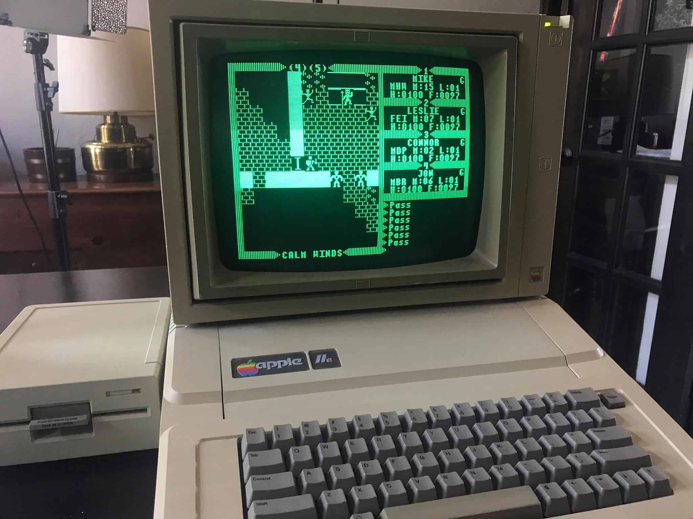
Hoon School Live · Lesson 2
Hoon Conventions

