Slide 1
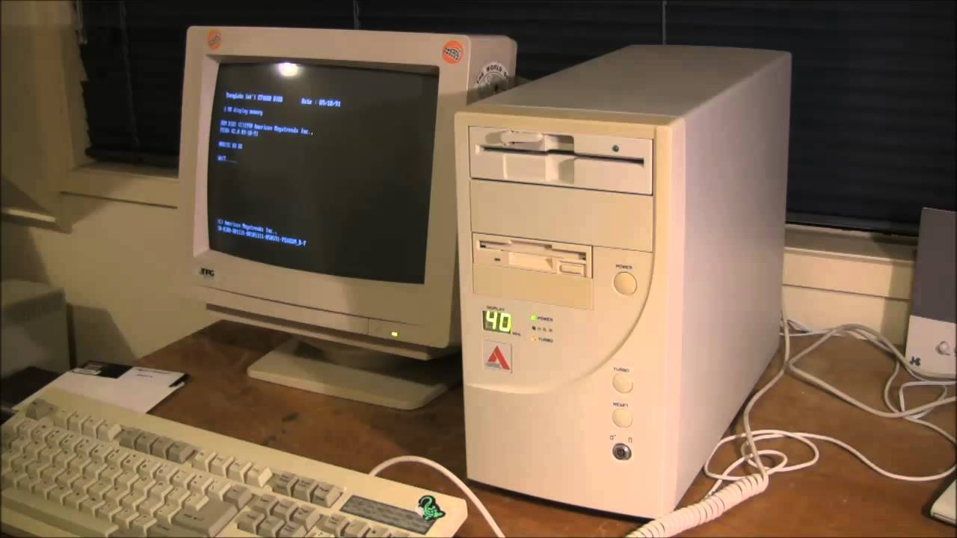
Hoon School Live · Lesson 3
Making Decisions

