Slide 1
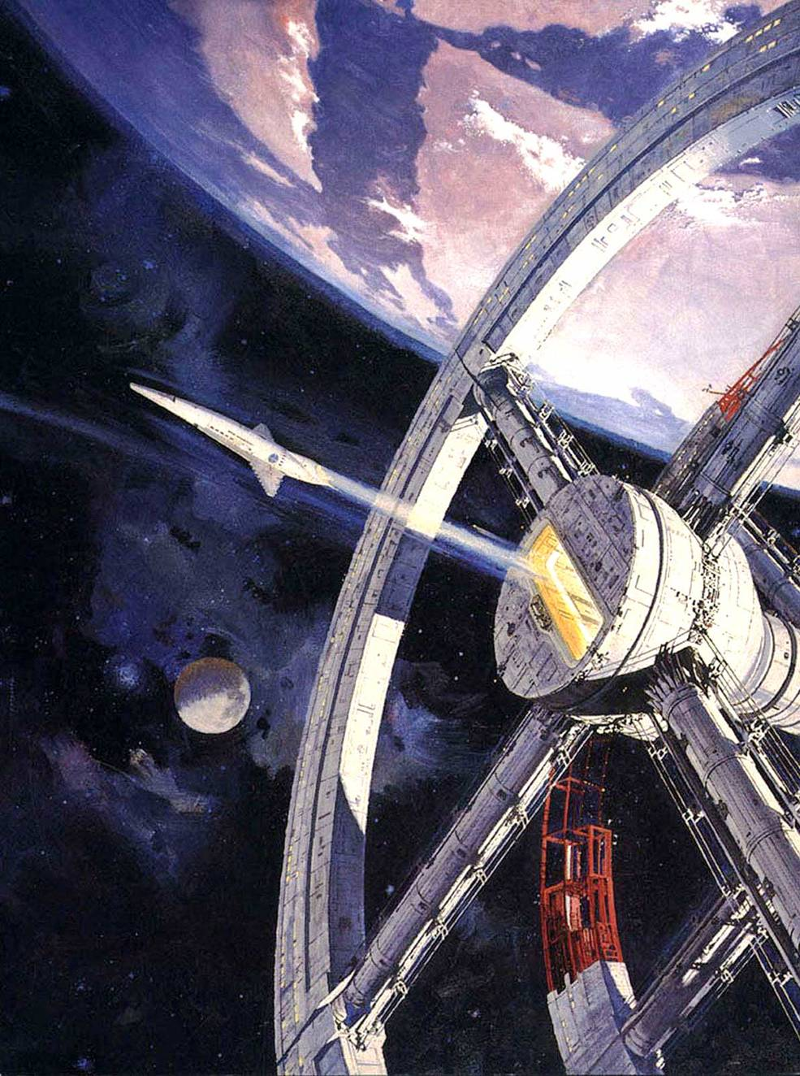
Encode x Urbit
Hackathon 2022
Urbit as a
Platform
N E Davis
~lagrev-nocfep

Slide 2
Cryptographic identity (Urbit ID/Azimuth)

Slide 3
Cryptographic identity (Urbit ID/Azimuth)
Associated off-chain state as persistent database (Urbit OS/Arvo)

Slide 4
Cryptographic identity (Urbit ID/Azimuth)
Associated off-chain state as persistent database (Urbit OS/Arvo)
Peer-to-peer, end-to-end-encrypted apps

Slide 5
Cryptographic identity (Urbit ID/Azimuth)
Associated off-chain state as persistent database (Urbit OS/Arvo)
Peer-to-peer, end-to-end-encrypted apps
Direct software distribution

Slide 6
Cryptographic identity (Urbit ID/Azimuth)
Associated off-chain state as persistent database (Urbit OS/Arvo)
Peer-to-peer, end-to-end-encrypted apps
Direct software distribution
HTTP interface

Slide 7
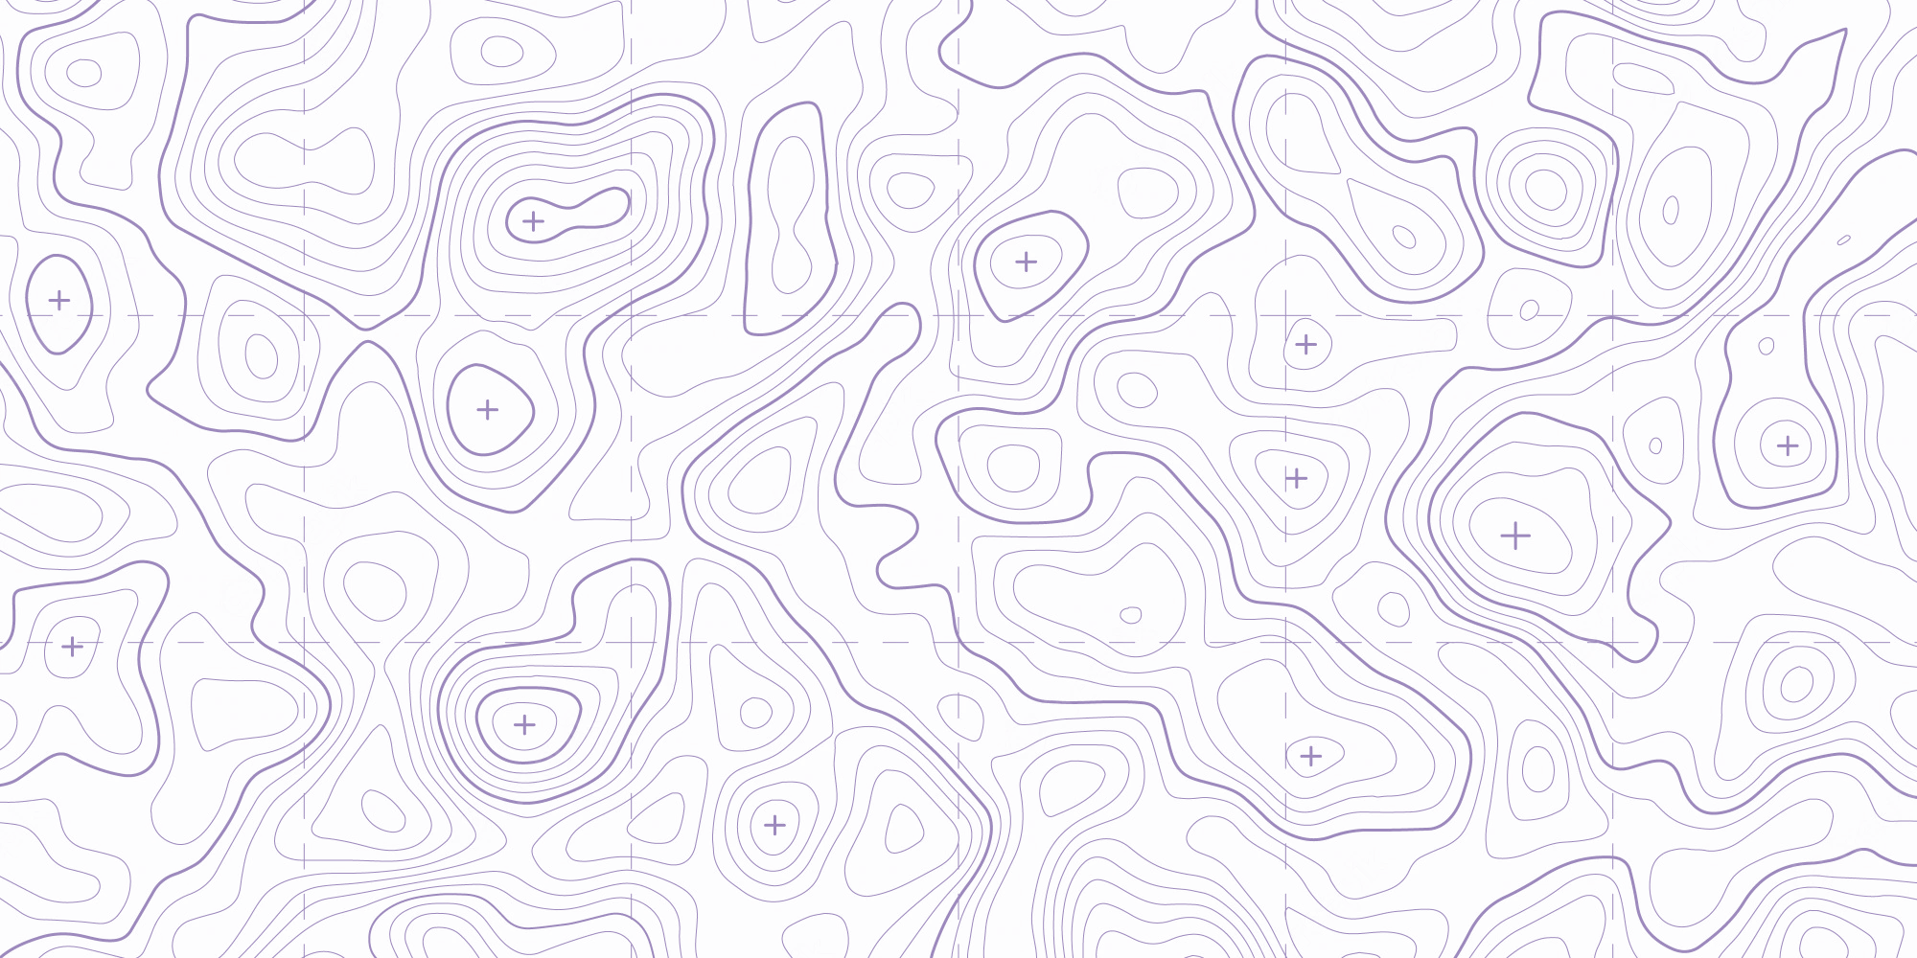
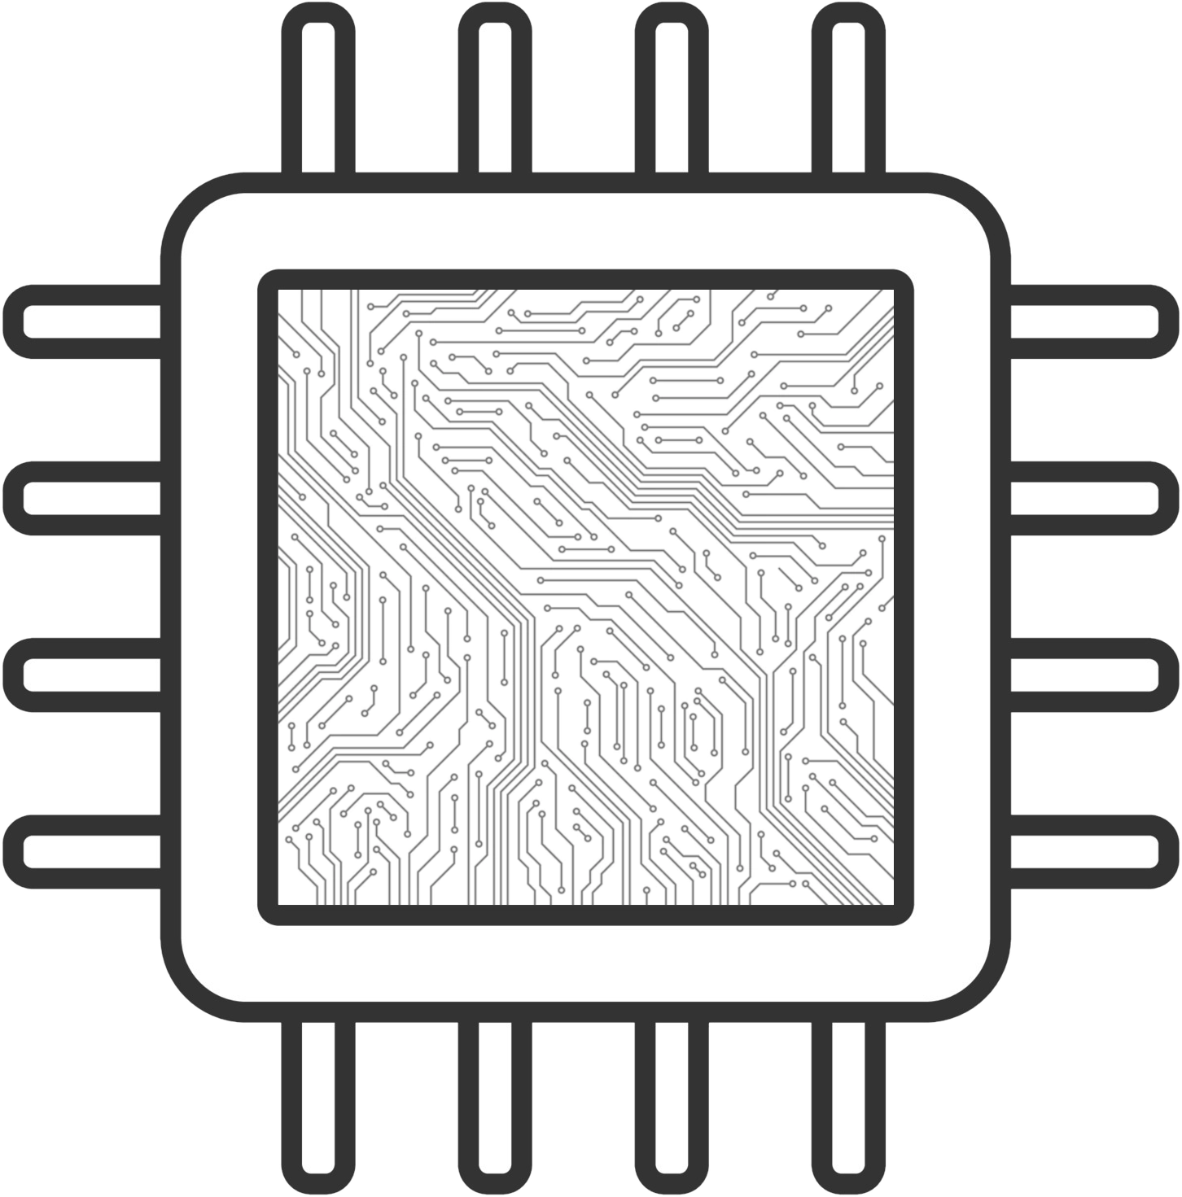

Slide 8
8088
80286
80386
80486
Pentium
IA64
x86-64
ARM64
SPARC
Cell BE
PowerPC
Apple M1

Slide 9
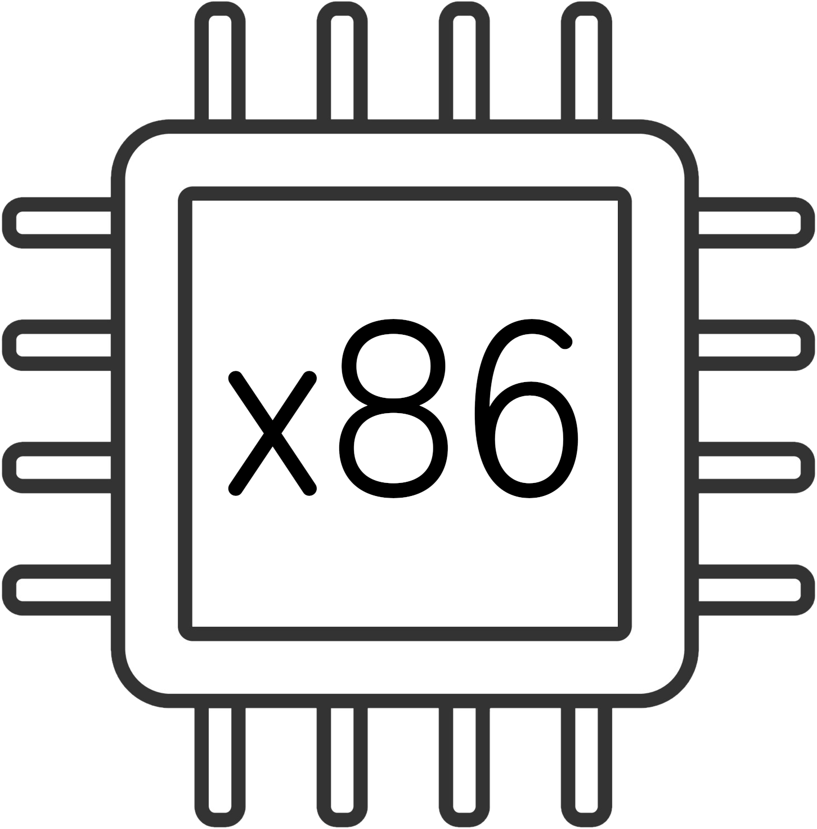
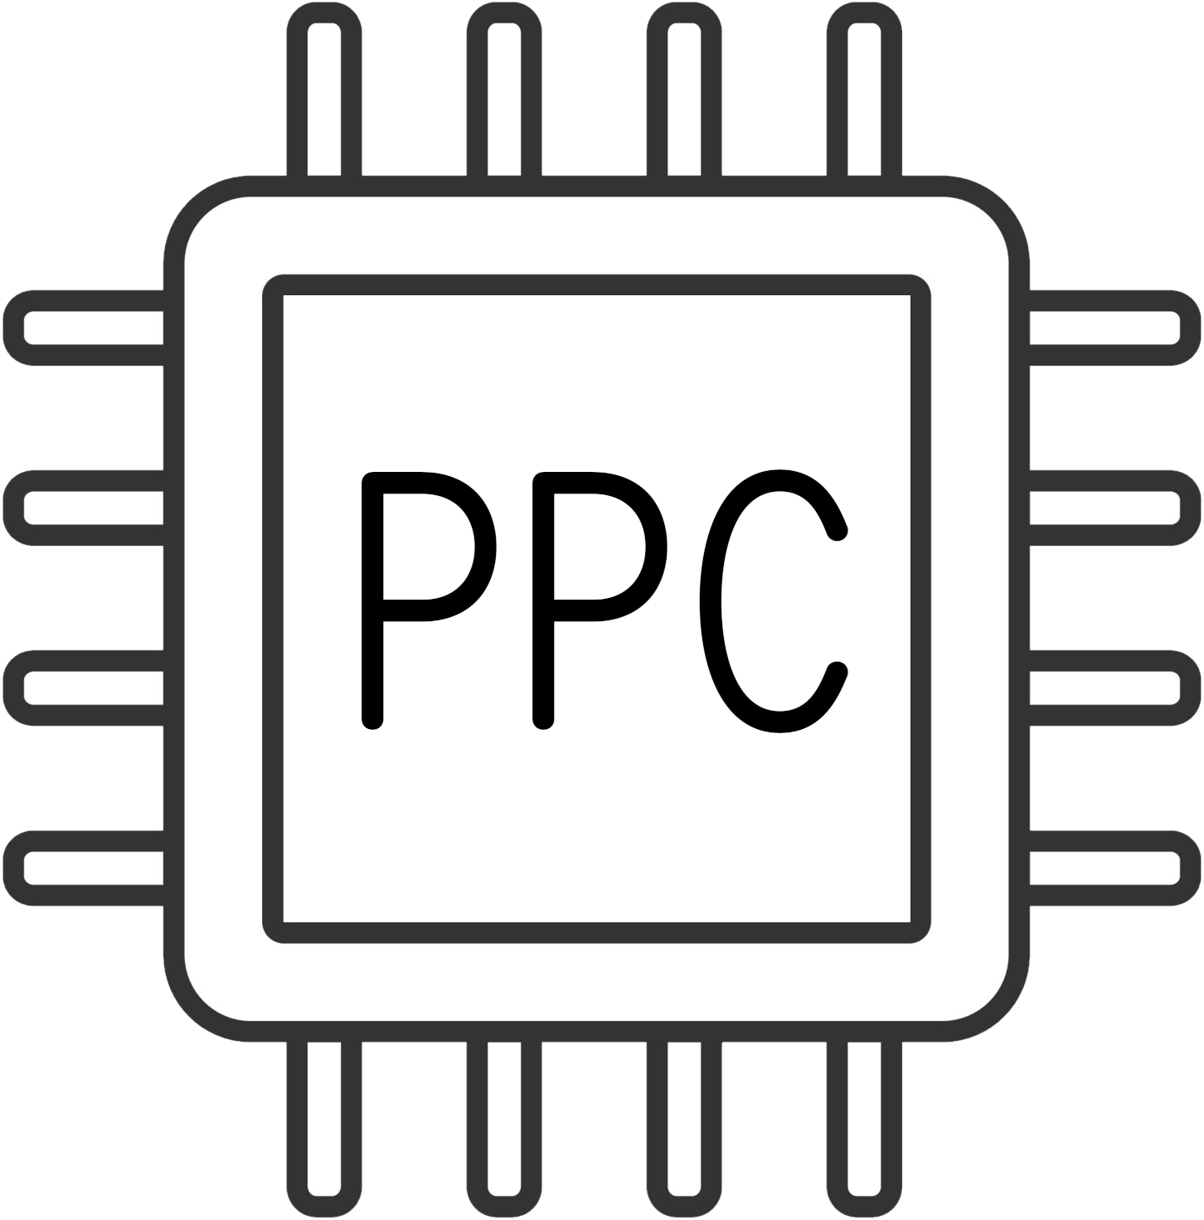
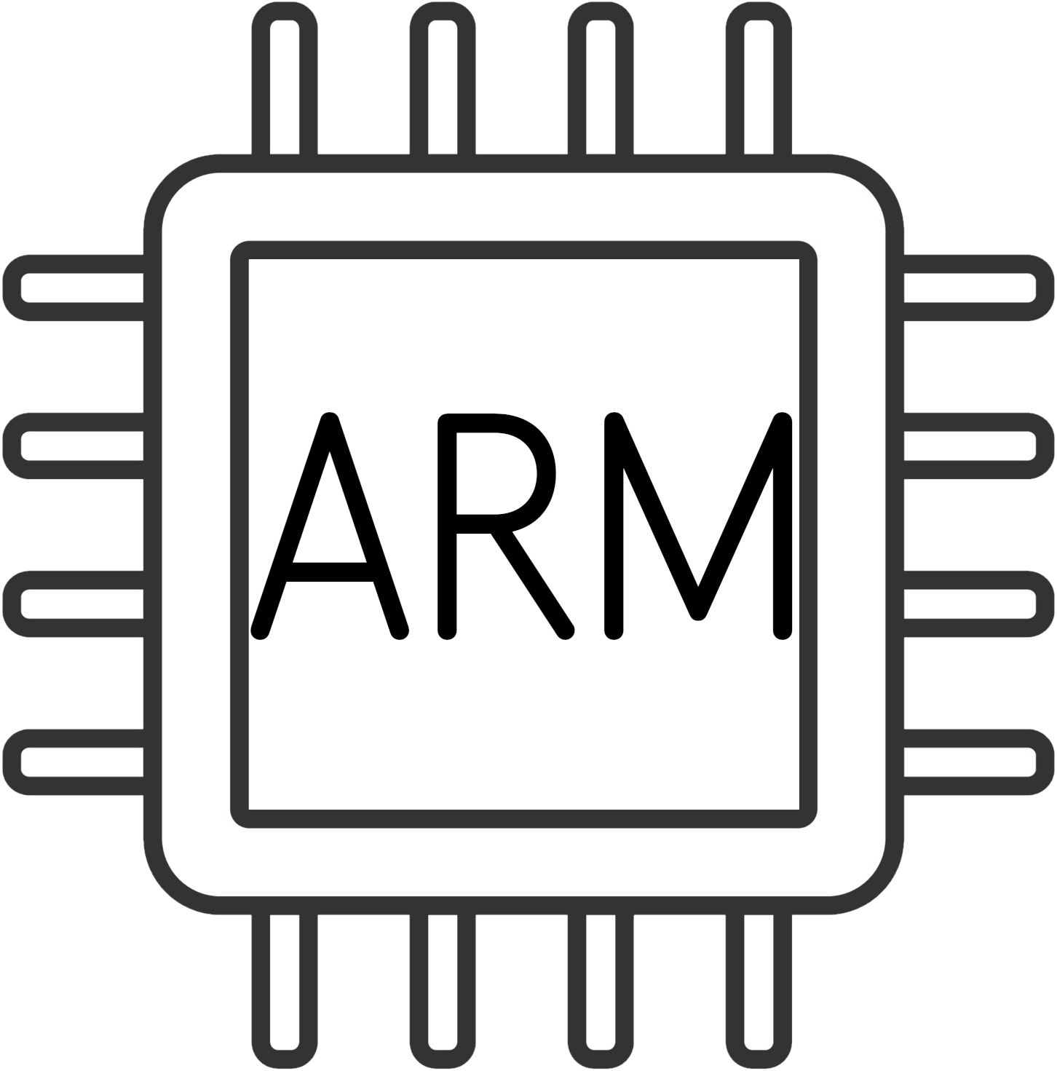
FNORDSOFT

Slide 10
FNORDSOFT
Virtual Machine Interpreter

Slide 11
FNORDSOFT

Slide 12

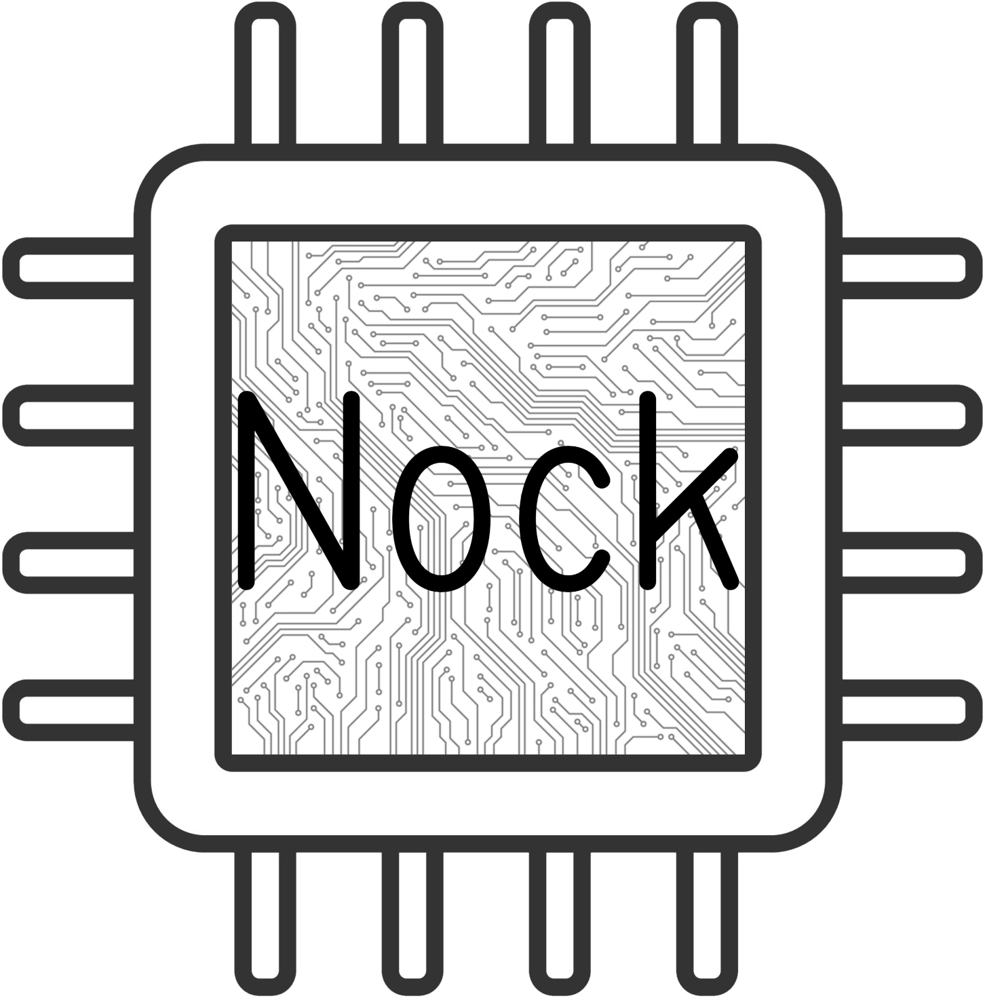

Slide 13
*[a [b c] d] [*[a b c] *[a d]]
*[a 0 b] /[b a]
*[a 1 b] b
*[a 2 b c] *[*[a b] *[a c]]
*[a 3 b] ?*[a b]
*[a 4 b] +*[a b]
*[a 5 b c] =[*[a b] *[a c]]
*[a 6 b c d] *[a *[[c d] 0 *[[2 3] 0 *[a 4 4 b]]]]
*[a 7 b c] *[*[a b] c]
*[a 8 b c] *[[*[a b] a] c]
*[a 9 b c] *[*[a c] 2 [0 1] 0 b]
*[a 10 [b c] d] #[b *[a c] *[a d]]
*[a 11 [b c] d] *[[*[a c] *[a d]] 0 3]
*[a 11 b c] *[a c]
*a *a

Slide 14

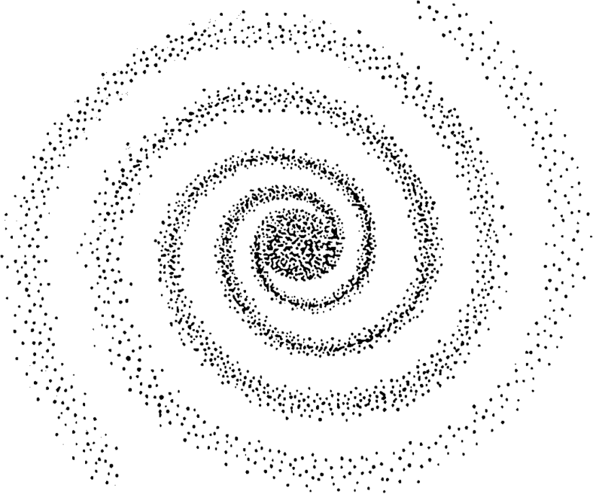

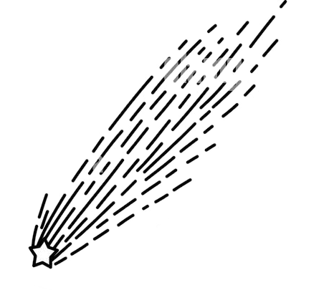
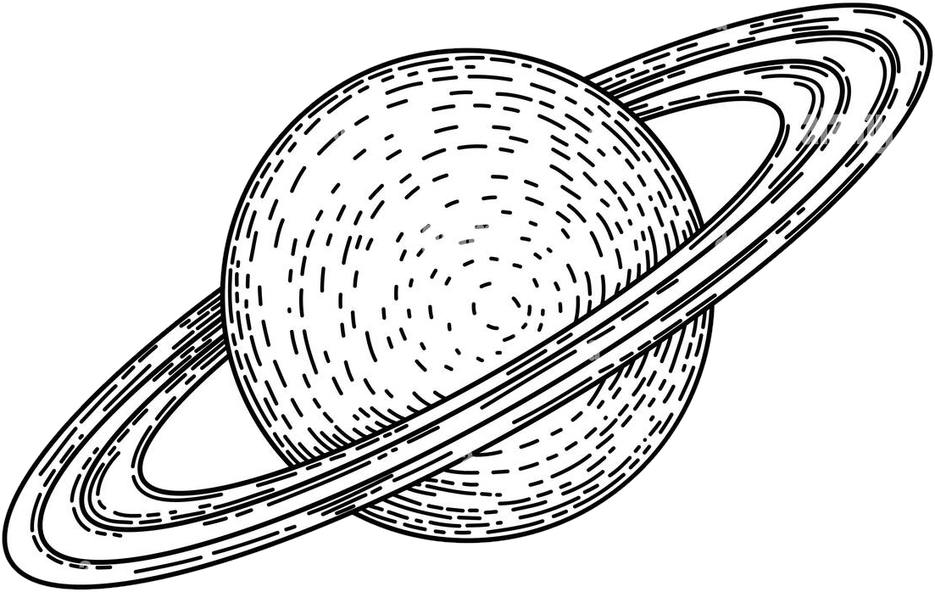
Galaxy
Network governance
Software updates
First-time routing
Star
Network routing (someday)
Infra-structure
Planet
Individual identity
Comet
Transient ID

Slide 15
Galaxy
~zod
Star
~marbud
Planet
~sampel-palnet
Comet
~sibtyv-sivnux-ropnul-fodten--fasnec-parlyt-wacpeg-litzod
@p “patp”

Slide 16
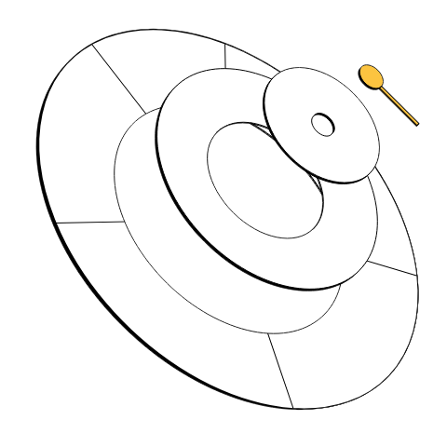
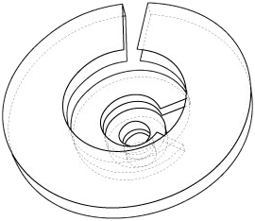
OS Structure
Nock VM engine
Hoon language
Arvo event processor+
state machine
System services
(“vanes”)
Userspace apps

Slide 18
Modalities for App Development
On-Urbit app development
Urbit-adjacent app development
Urbit ID-based project
Bridge app to Web3 chains etc.

Slide 19
Modalities for App Development
On-Urbit app development
  Hoon School, App School
Urbit-adjacent app development
  App Workbook, %flap; Urbit Visor
Urbit ID-based project
  Azimuth docs, Ecliptic smart contracts
Bridge app to Web3 chains etc.

