Slide 1
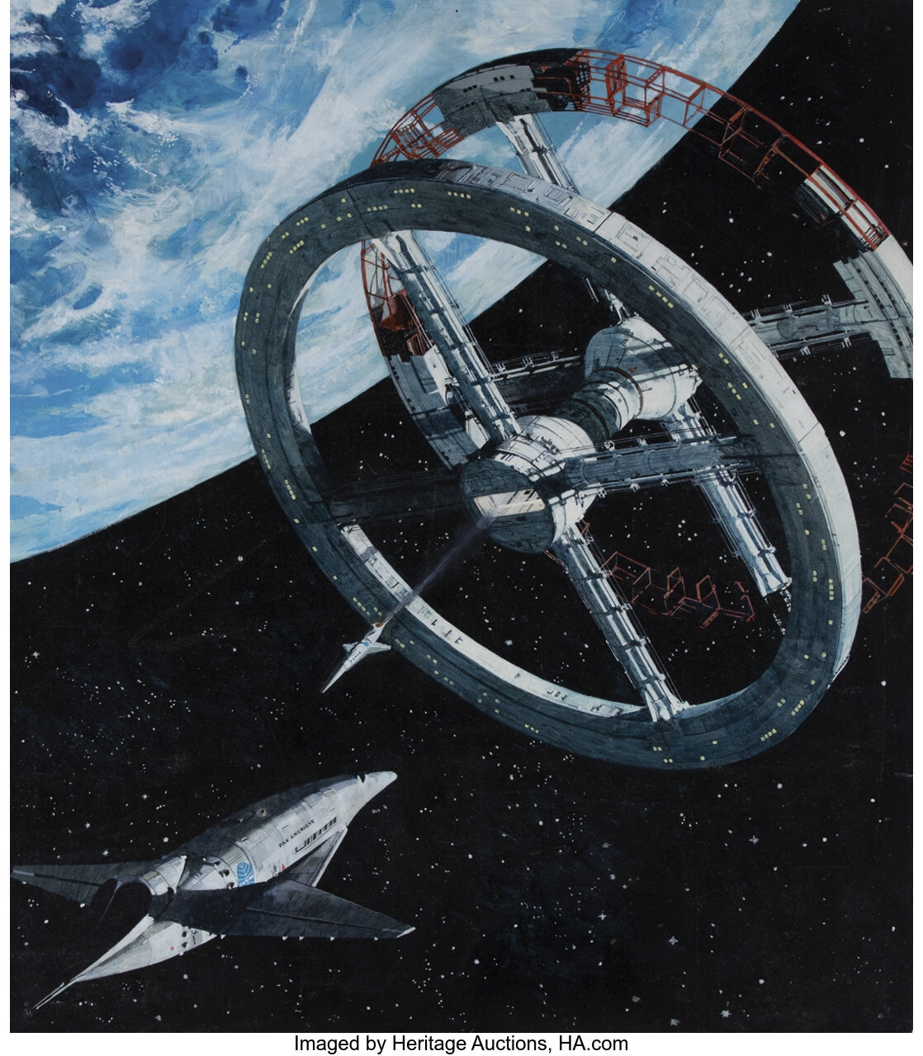
Encode x Urbit
Hackathon 2022
Building
Apps on Urbit
N E Davis
~lagrev-nocfep

Slide 5
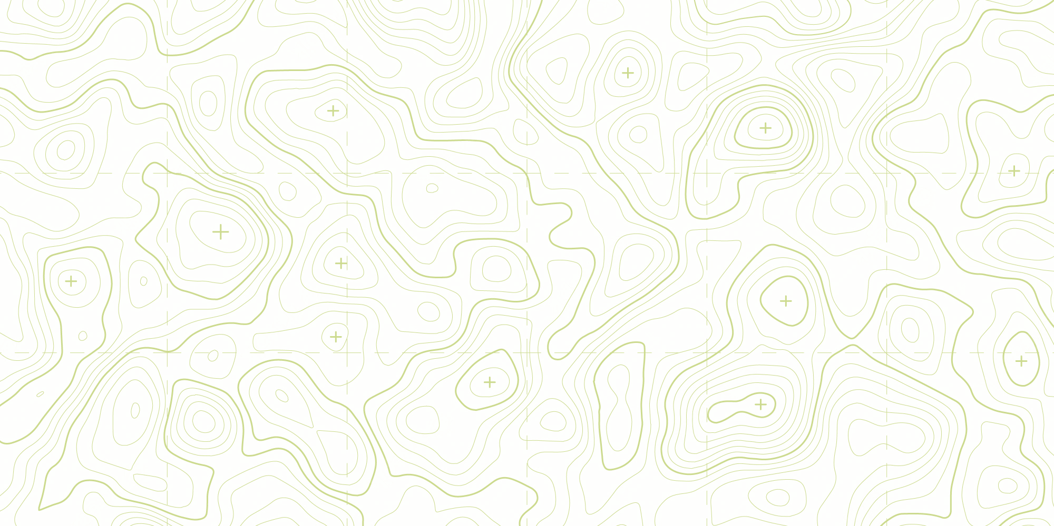

Slide 6


