Slide 1
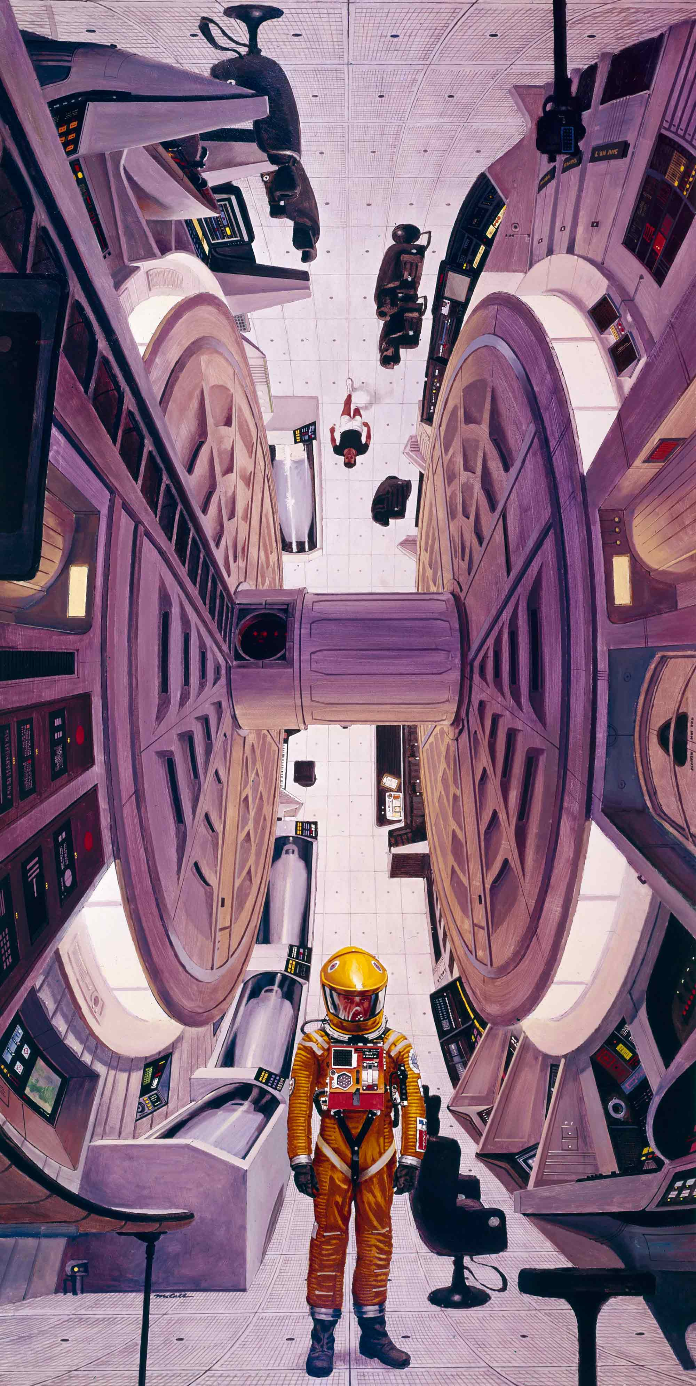
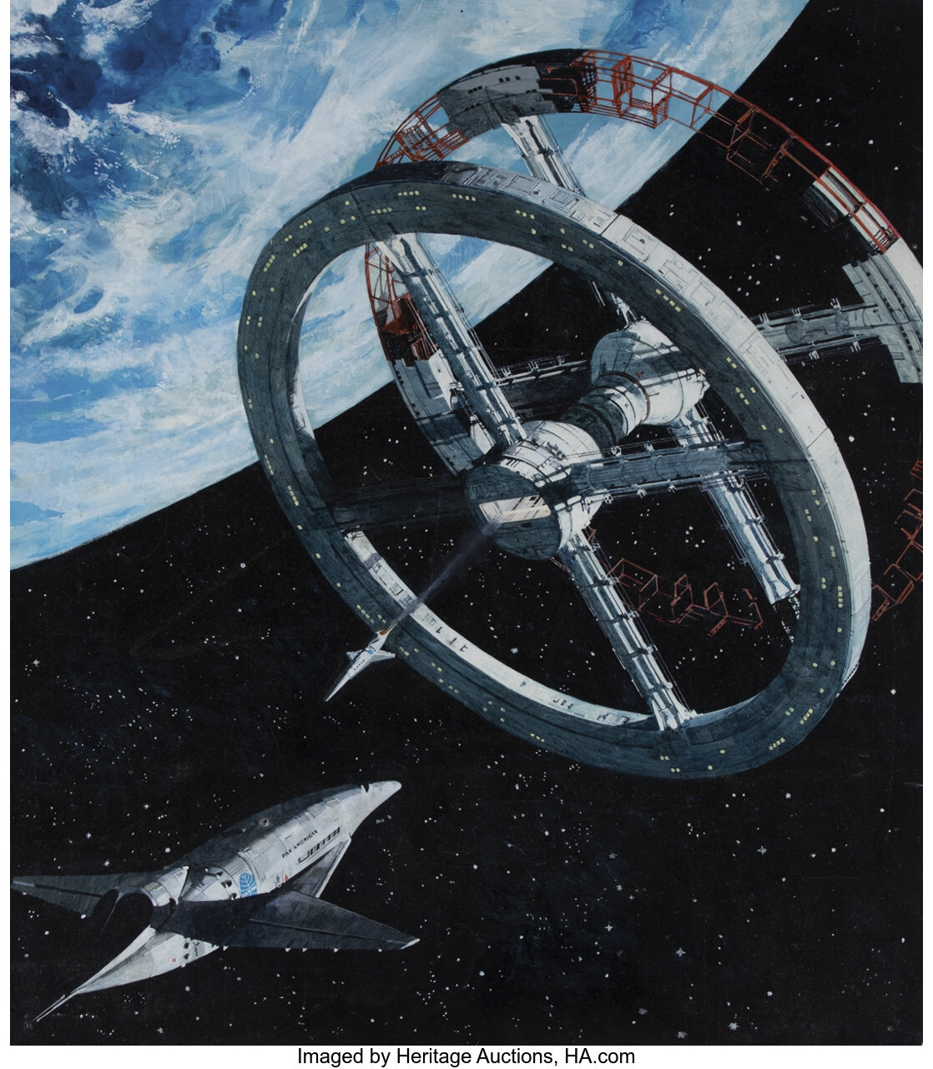
Encode x Urbit
Hackathon 2022
Bite-Size App
Ideas for Urbit
N E Davis
~lagrev-nocfep

Slide 5


Slide 6


