Slide 1

Hoon SCHOOL LIVE @ LESSON 3
Atext & Lists

Slide 2
:: Return which of
:: two numbers is
:: larger.
|= [a=@ud b=@ud]
?: (gth a b)
a
b
start generator
set a and b
?: a > b
%.n
%.y
a
b

Slide 3
?: cond
branch-if-true
branch-if-false
?: cond
%.n
%.y
if-true
if-false

Slide 4
|-
code-until-result
|-
if-result

Slide 5
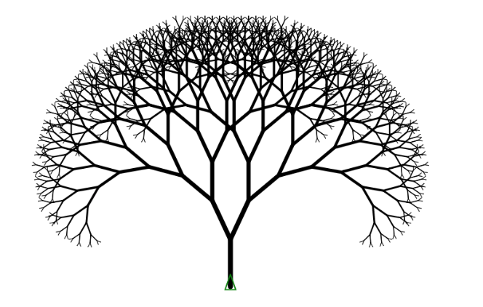

Slide 6
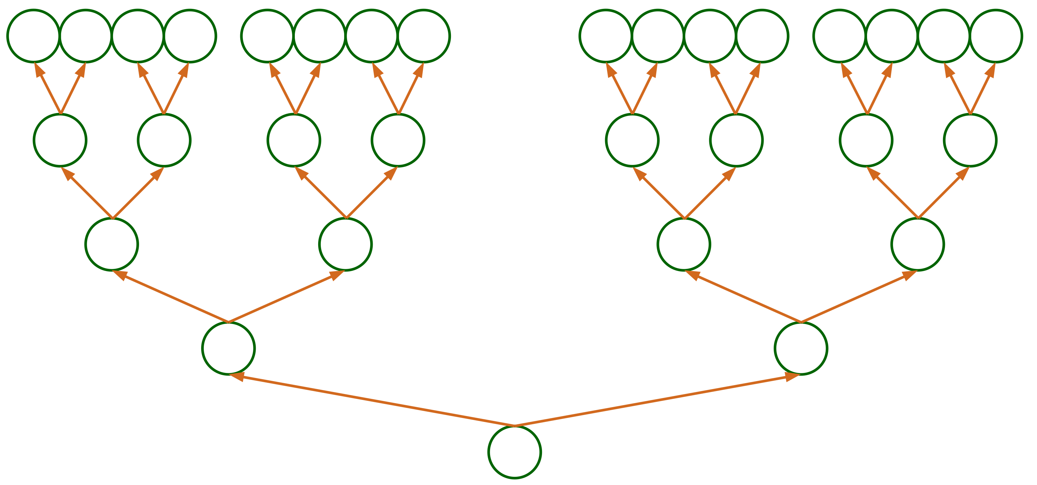

Slide 7
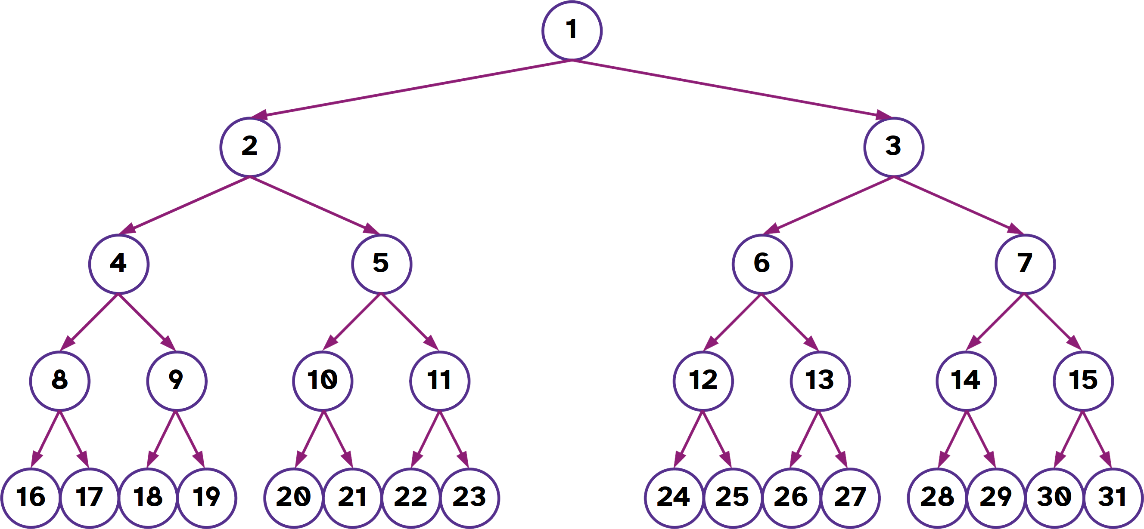

Slide 8
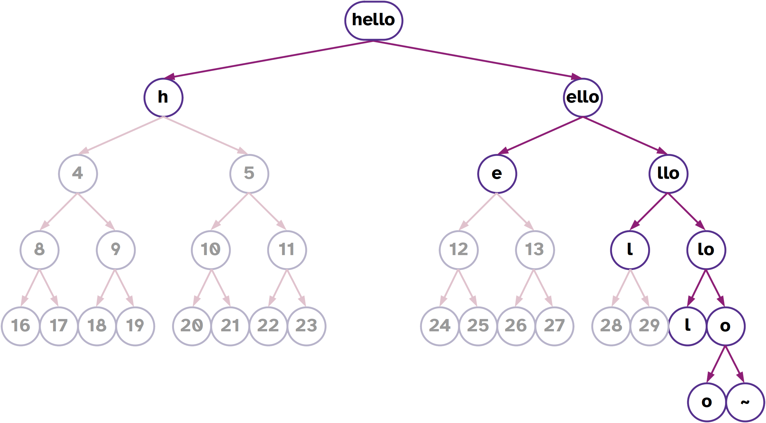

Slide 9
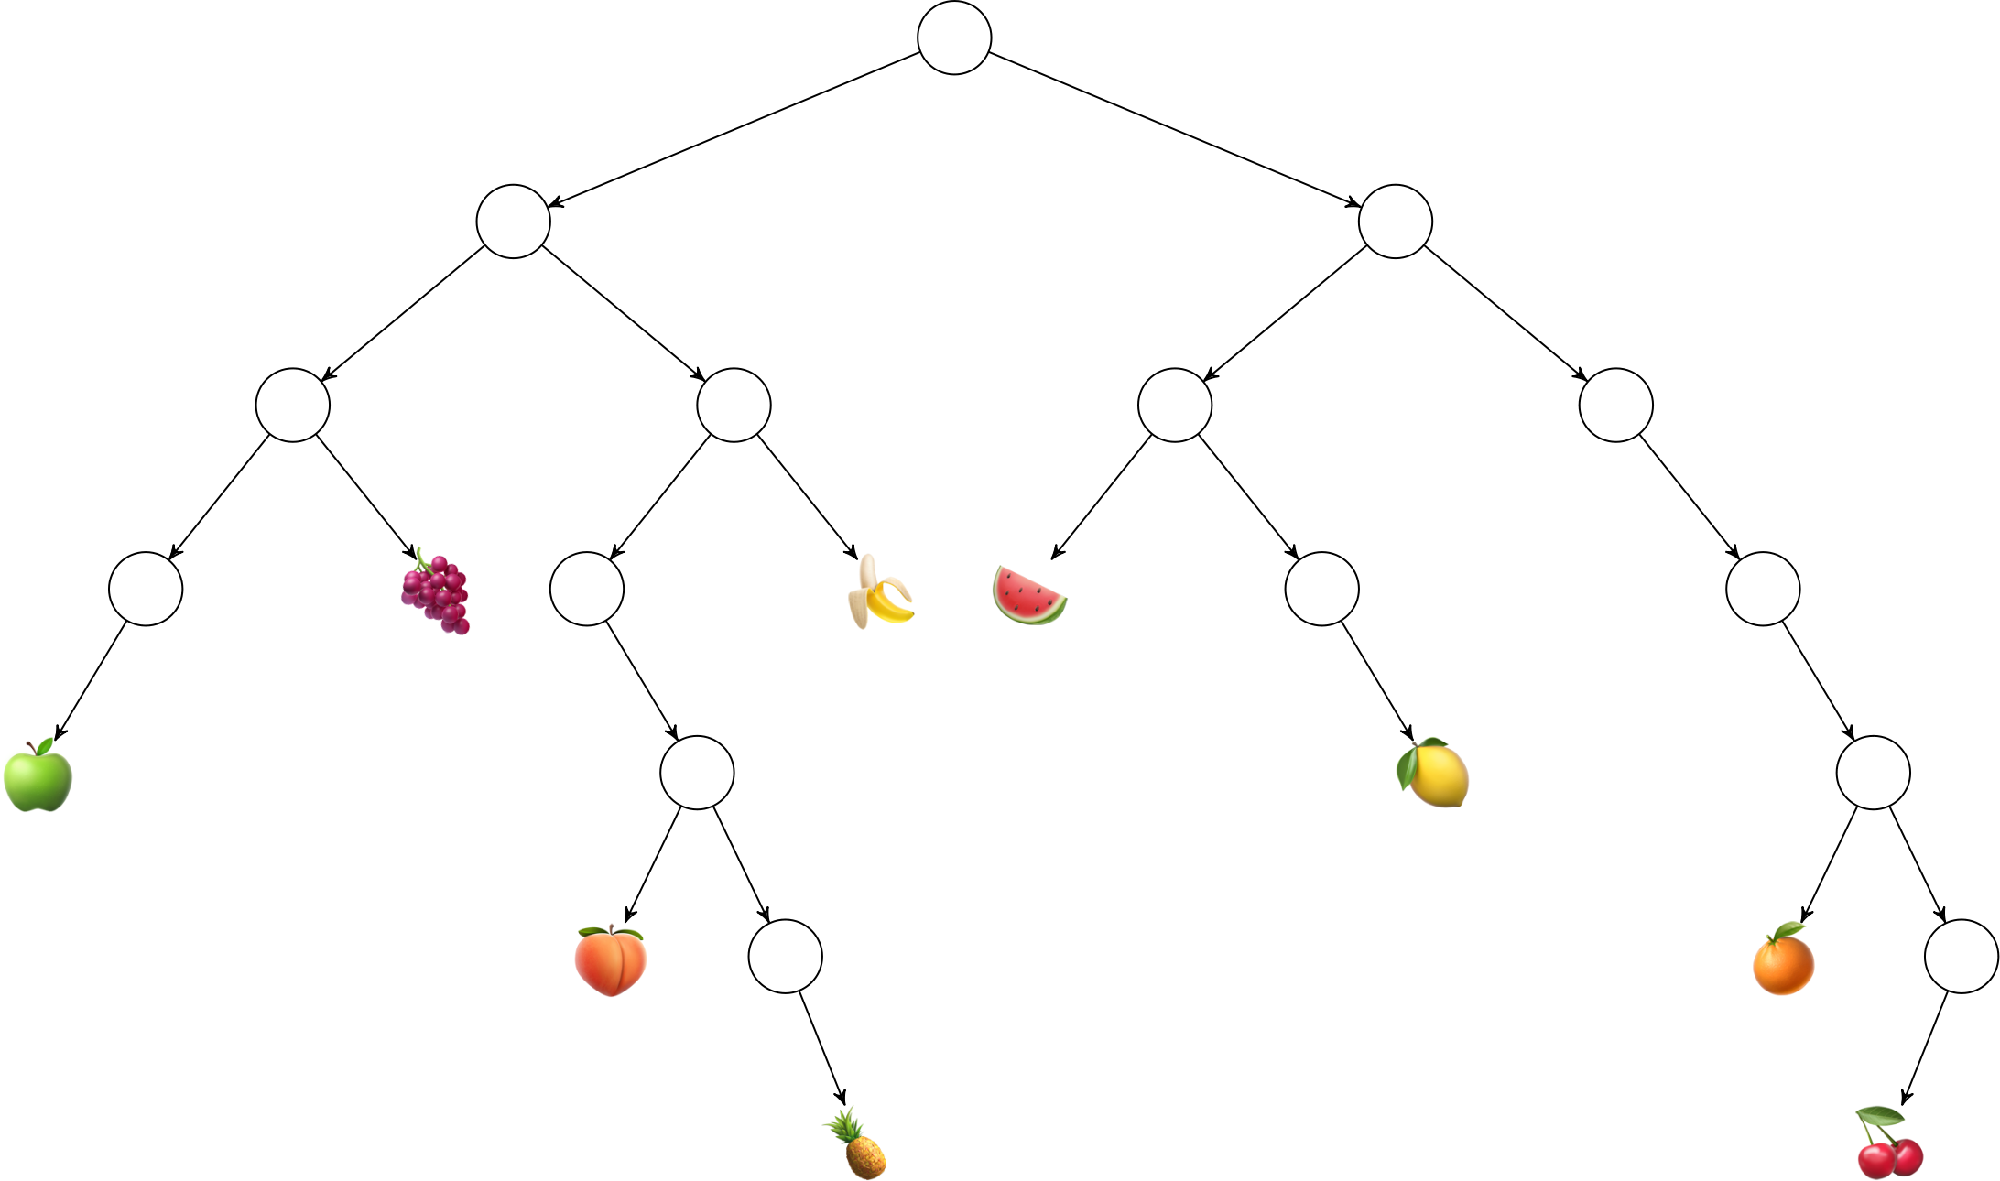

Slide 10
