Slide 1

Hoon SCHOOL LIVE @ LESSON 4
Aworking with text & lists

Slide 2
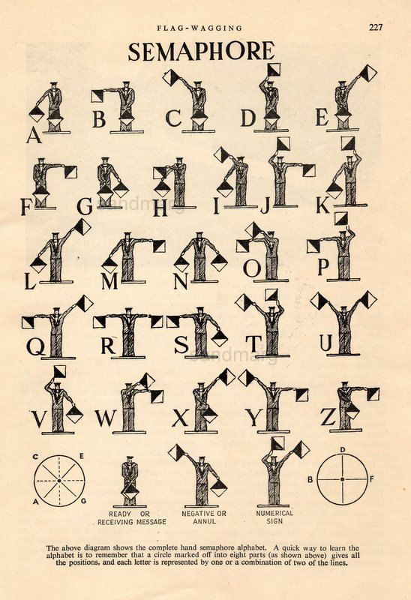

Slide 3
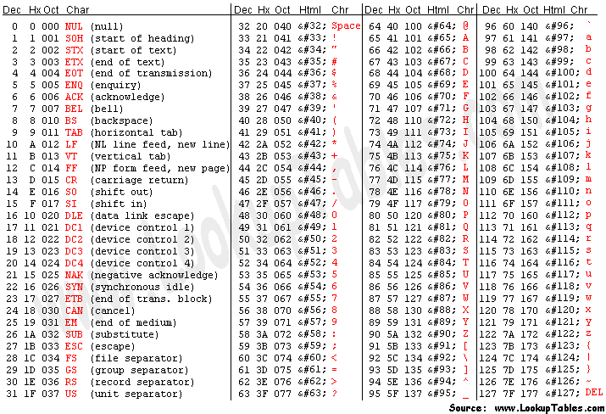

Slide 4
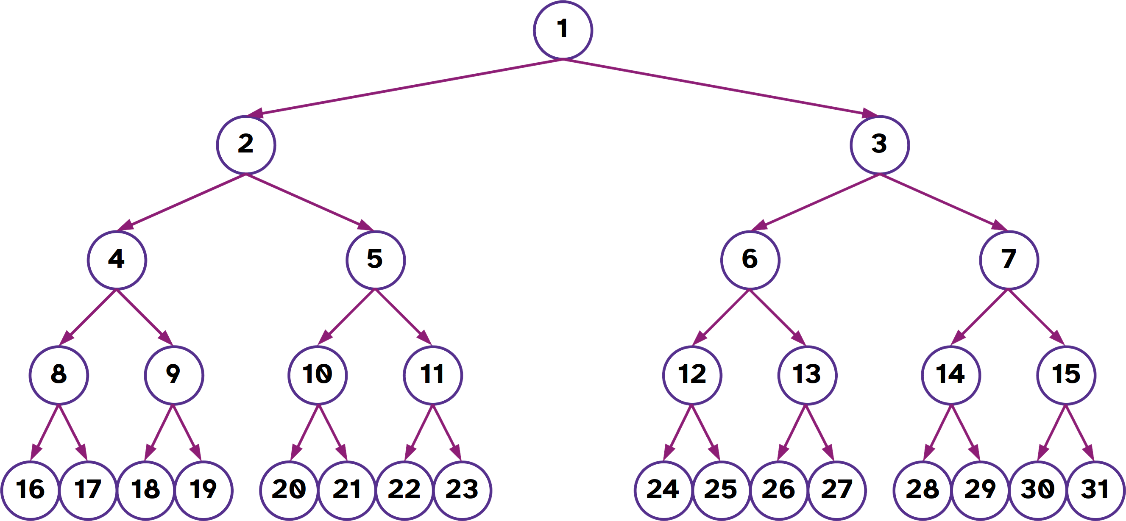

Slide 5
