Slide 1



Alioth

URSA MAJOR





Merak










A FUTURE FOR STARS ~lagrev-nocfep
 %reassembly-2023

Slide 2
URSA MINOR






Polaris


Slide 3
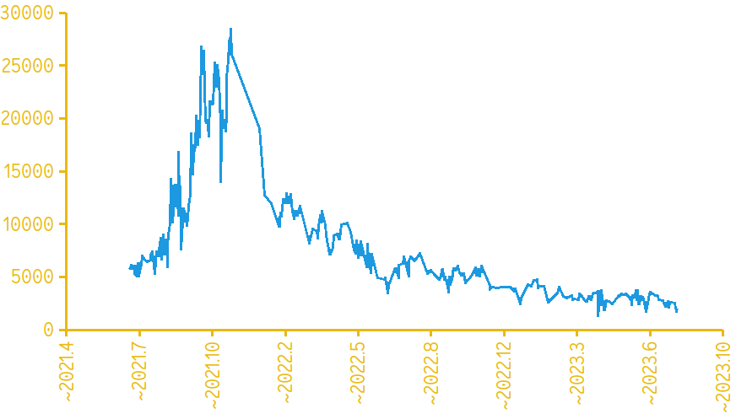
ASSEMBLY I
ASSEMBLY II
Price / USD

Slide 4



Alioth

URSA MAJOR





Merak











Slide 5
STELLAR EVOLUTION


Supergiants




Giants




LUMINOSITY
Main Sequence


Sun


Red Dwarfs

White Dwarfs


Brown Dwarfs
SURFACE TEMPERATURE

Slide 6
ARECIBO MESSAGE

Slide 7

L
NCP
ZENITH
90°–∂
STAR
EARTH
P.O.V.

h

∂
HORIZON
CELESTIAL
EQUATOR

Slide 8
ZENITH
CELESTIAL
EQUATOR




NORTH CELESTIAL
POLE













OMNES·NAVES·ÆSTVS·NATAT

Slide 9


Slide 10


Pleiades





TAURUS
Aldebaran





Slide 11
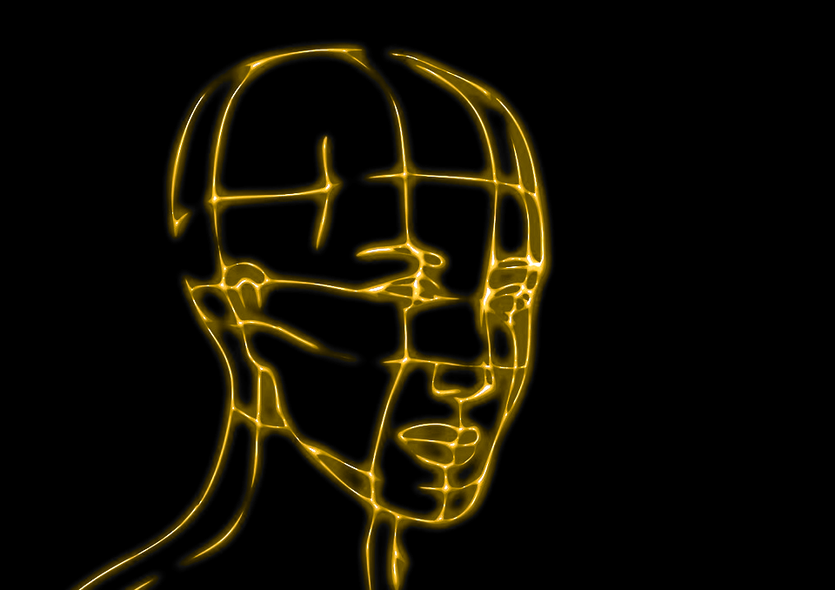
CONSCIOUSNESS ENERGY GRID





