Slide 1
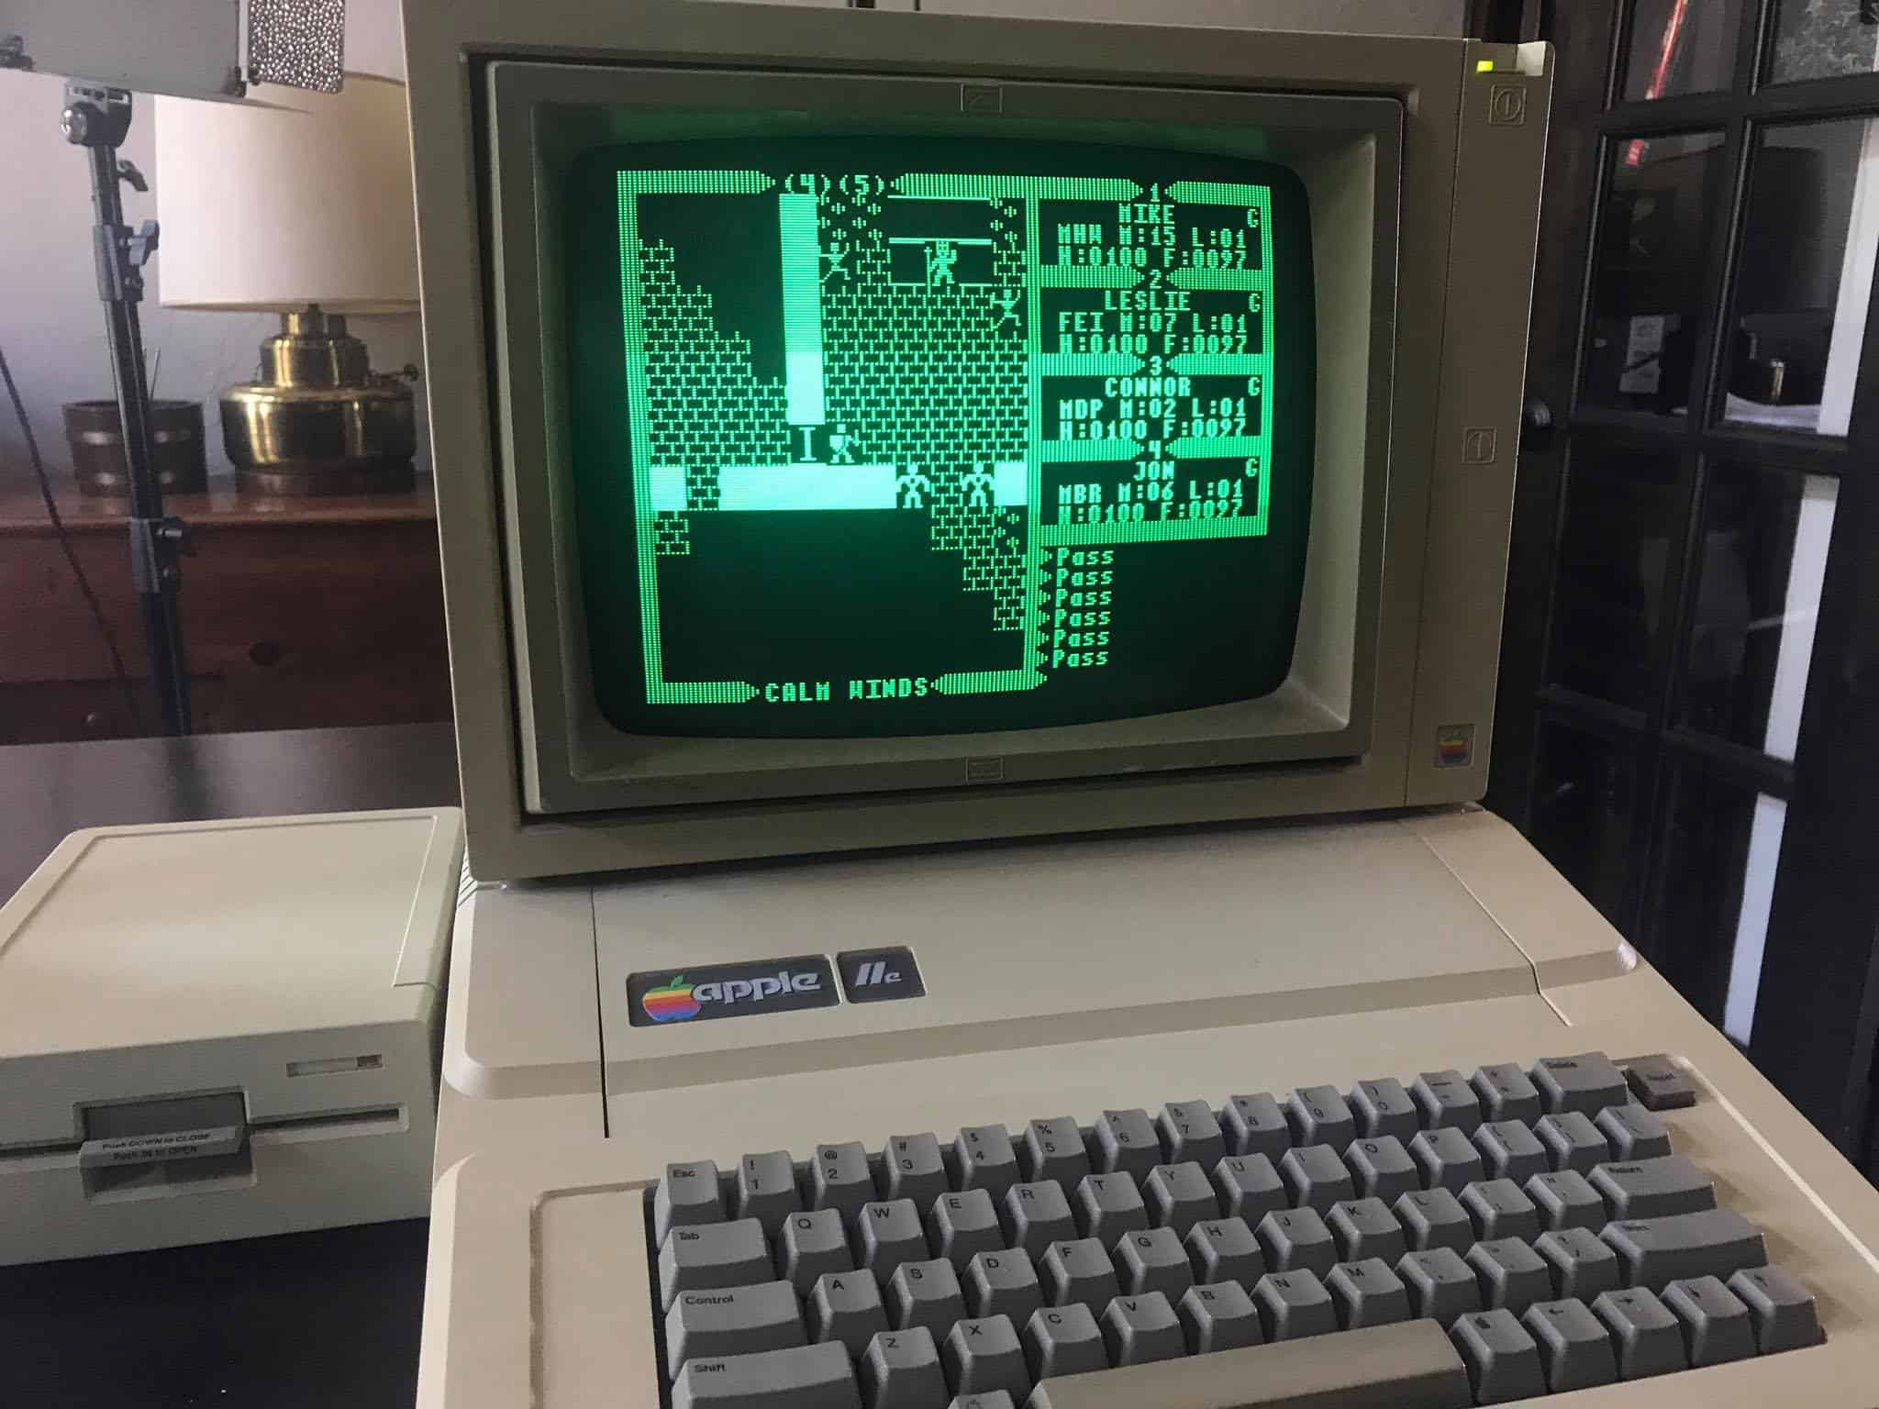

Hoon School Live · Lesson 4
Repeating Yourself

