Slide 1
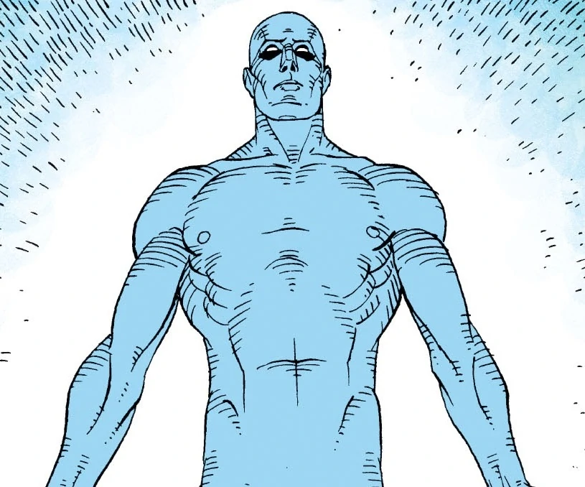
Hoon School Live · Lesson 9
Production Code

