Slide 1
Structures continued

Slide 2
Initializing a structure
Initializing, when the data is passed in original order of the declaration product item = {4.00, "Cucumber"};
You can specify the field and list them out of order product item = {.name = "Cabbage", .price = 0.25};
You can initialize an array of structures product items[] = { {0.75, "Banana"}, {1.90, "Tomato"} };

Slide 3
Sample 1
#include <stdio.h>
typedef struct product
{
float price;
char name[30];
} product;
int main(void)
{
product item = {.price = 0.25, .name = "Cabbage"};
product items[] = {{0.75, "Noodles"}, {1.90, "Tomato"}};
printf("%.2f eur - %s\n", item.price, item.name);
printf("%.2f eur - %s\n", items[0].price, items[0].name);
printf("%.2f eur - %s\n", items[1].price, items[1].name);
return 0;
}

Slide 4
Nested structures
You can put one structure inside of another
Remember – structure is just another data type
The order they’re defined is important
Point can be used as the separator between the name and the field
typedef struct date
{
unsigned day;
unsigned month;
unsigned year;
} date;
typedef struct person
{
char fName[25];
char lName[25];
date contractSigned;
} person;

Slide 5
Sample 2
int main(void)
{
person employee;
strcpy(employee.fName, "Andrus");
strcpy(employee.lName, "Haab");
employee.contractSigned.year = 1985;
employee.contractSigned.month = 4;
employee.contractSigned.day = 14;
printf("%s %s - %u.%u.%u", employee.fName, employee.lName, employee.coontractSigned.day, employee.contractSigned.month, employee.contractSigned.year);
return 0;
}
typedef struct date
{
unsigned day;
unsigned month;
unsigned year;
} date;
typedef struct person
{
char fName[25];
char lName[25];
date contractSigned;
} person;

Slide 6
Function returning a structure
Reminder: structure was a data type, albeit a complex one. This means that we can also use it as a return type for a function.
We can return one whole structure per function call.
Let’s create a new type for our structure for easier use
A prototype for our function
The function itself
typedef struct point
{
int x, y;
} point;
point EnterCoords();
point EnterCoords()
{
point temporary;
temporary.x = 5;
temporary.y = 7;
return temporary;
}

Slide 7
Sample 3
#include <stdio.h>
#include <math.h>
typedef struct point {
int x, y;
} point;
point EnterCoords(int nr);
int main(void) {
point segm[2];
segm[0] = EnterCoords(1);
segm[1] = EnterCoords(2);
printf("The length is %.2f", sqrt(pow(segm[1].x - segm[0].x, 2) + pow(segm[1].y - segm[0].y, 2)));
return 0;
}
point EnterCoords(int nr) {
point temporary;
printf("Enter the x and y coordinates for point %d\n> ", nr);
scanf("%d %d", &temporary.x, &temporary.y);
return temporary;
}

Slide 8
Pointers visualized
*p
num
0x0199FF8A
25
int num = 25;
int *p;
p = &num;
return 0;
0x0199FF86
0x0199FF8A

Slide 9
Pointers and arrays visualized
*p 48F9AC00
int array[] = {5, 3, 7, 3, 5};
int *p;
p = array;
array[0] 5
array[1] 3
array[2] 7
array[3] 3
array[4] 5
*(p + 0) 48F9AC00
*(p + 1) 48F9AC92
*(p + 2) 48F9AC94
*(p + 3) 48F9AC96
*(p + 4) 48F9AC98

Slide 10
Pointers and structures
You can point (refer) to the start of a structure or an element inside of it.
struct employee
{
int employeeCode;
char firstName[25];
char lastName[25];
float wage;
};
struct employee manager;
struct employee *pStr;
pStr = &employee;

Slide 11
Accessing members using pointers (1)
Both of these are equal!
(*pStr).employeeCode;
(*pStr).fName;
(*pStr).lName;
(*pStr).wage;
pStr->employeeCode;
pStr->fName;
pStr->lName;
pStr->wage;
However some are
more equal than others!

Slide 12
Accessing members using pointers (2)
Both of these are equal!
(*(pStr + i)).employeeCode;
(*(pStr + i)).fName;
(*(pStr + i)).lName;
(*(pStr + i)).wage;
(pStr + i)->employeeCode;
(pStr + i)->fName;
(pStr + i)->lName;
(pStr + i)->wage;
However some are
more equal than others!

Slide 13
Sample 4
#include <stdio.h>
typedef struct employee
{
int employeeCode;
char fName[25];
float wage;
} employee;
void PrintEmployee(employee *pStr);
int main(void)
{
employee manager = {75, "Indrek", 9.75};
PrintEmployee(&manager);
return 0;
}
void PrintEmployee(employee *pStr)
{
printf("Employee %06d, %s, earns %2.2f per hour", pStr->employeeCode, pStr->fName, pStr->wage);
}

Slide 14
Task general description
The data files are given
Read data from two files into two structure arrays:
Person – ID code, first name, last name, annual income
Motor vehicle – Person ID code, registration number, annual ownership tax
Store the eID as an integer! (look for a suitable data type)
One person can have multiple motorvehicles
Association is done by ID code (key)
Use the -> notation for referencing members of structure
Do not forget to separate your code into manageable functions

Slide 15
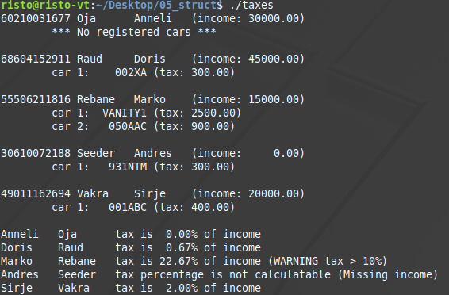
Sample of expected output

Slide 16
Tasks (graded separately)
Part 1 / 2: Print out the list of people and the motor vehicles they own.
List must be sorted alphabetically by last name.
Don’t print the person’s data multiple times if they have more than one vehicle (you must not sort the vehicles for this!).
If they have no registered vehicles, print a corresponding message
Part 2 / 2: Print out the list of people with the percentage of their income going to the car ownership tax (total for all cars)
Add a warning for those whose tax is more than 10% of their income

Slide 17
Advanced task
Task description:
Calculate the cost for parking for each car owner!
Create a new file for parking data
Must contain parking duration, license plate and parking zone
Must have at least one car parked multiple times in different zones
Parking zones must be strings as provided below (T1 – T11)
Add a column to the motor vehicles file to identify electric cars
Zones
T1, T2: 0.10 € per minute
T3, T4: 0.08 € per minute
T5 – T11: 0,025 € per minute (except electric vehicles – 0€)

