Slide 1
Qsort

Slide 2
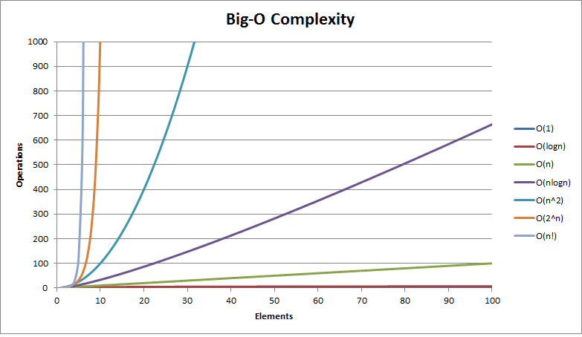
Complexity
Source: http://bigocheatsheet.com/

Slide 3
qsort
Simple to use and (typically) a quick way to sort arrays, including structure and string arrays.
Bubble sort was easy to learn, but horribly slow
How fast is it?
At the worst case, as fast as bubble sort (n²)
Typically much faster (n*log₂(n))
E.g. sorting 1000 numbers: 1000² = 1 000 000 operations 1000 * log₂(1000) = 1000 * 9.97 = 9 970 operations

Slide 4
qsort function
Function prototype:
void qsort (void *base, size_t num, size_t size, int (*compar)(const void*,const void*));
Parameters:
base – pointer to the first element of the array
num – how many elements in the array
size – size of a single element
compar – pointer to a compare function, returns an integer

Slide 5
Compare function
int compar (const void *var1, const void *var2);
Parameter: const void *var
const – shouldn’t be changed
void – type is not set, can accommodate any type, must cast to correct type
*var – beginning of element
Different compare functions for different types!
Return value: integer
< 0 var1 should be before var2
== 0 var1 is equivalent to var2
> 0 var1 should be after var2

Slide 6
Sample (generic)
#include <stdio.h>
#include <stdlib.h>
int ComparFunc(const void *a, const void *b);
int main(void)
{
int i, nums[] = {40, 10, 100, 90, 20, 25};
int numCount = sizeof(nums) / sizeof(int);
qsort(nums, (size_t)numCount, sizeof(int), ComparFunc);
for (i = 0; i < numCount; printf ("%3d ", nums[i]), i++);
return 0;
}
int ComparFunc(const void *a, const void *b)
{
if (*(int *)a > *(int *)b) return 1;
else if (*(int *)a < *(int *)b) return -1;
else return 0;
}

Slide 7
Sample (integers only)
#include <stdio.h>
#include <stdlib.h>
int ComparFunc(const void *a, const void *b);
int main(void)
{
int i, nums[] = {40, 10, 100, 90, 20, 25};
int numCount = sizeof(nums) / sizeof(int);
qsort(nums, (size_t)numCount, sizeof(int), ComparFunc);
for (i = 0; i < numCount; printf ("%3d\n", nums[i]), i++);
return 0;
}
int ComparFunc(const void *a, const void *b)
{
return *(int *)a - *(int *)b;
}

Slide 8
Lab task
Download and open the base code from the web
The data you are going to be working with is already initialized
The function prototypes are already set. Implement those functions!
Add your function calls to the switch menu
Once completed, show it and continue with the test revision task (points available)

