Slide 1
Recursions

Slide 2
Recursion
Recursion happens when a function calls itself
The purpose is to make a problem into smaller problems of the same type.
Unless provided a base case, the function will call itself out infinitely (or until the function call stack overflows)
Most recursive programs can be written iteratively and vice-verca
Iterative solution is often faster
Recursive solutions are often simpler
Recursions are memory intensive, can cause stack overflow

Slide 3
Factorial example
5! = 5 * 4 * 3 * 2 * 1
5! = 5 * 4!
n! = n * (n - 1)!
1! = 1 (base case)
factorial(5) = 5 * factorial(4) = 5 * 4 * factorial(3) = ……
factorial(n) = n * factorial(n - 1)

Slide 4
Problems that can be solved recursively
Factorials, exponents, multiplication, …
Number sequences (arithmetic and geometric progression, Fibonacci sequence, ...)
Hanoi tower
Search functions (binary search)
Trees (adding, searching, traversal, deletion)
Etc.

Slide 5
Lab tasks
Find the sum of all positive integers leading to the number given by the user
sum(0) = 0, sum(1) = 1, sum(2) = 3, sum(3) = 6, …
sum(-1) = 0
Find x to the power of y (e.g. x^{y}, nt 2¹⁰) recursively
Using math.h and exponent functions not allowed, write your own
Find the n-th (user specified) Fibonacci number
Find the number of times the recursive function was called and print it!
Use recursive functions and positive integers only!
Put all solutions in a single code file!

Slide 6
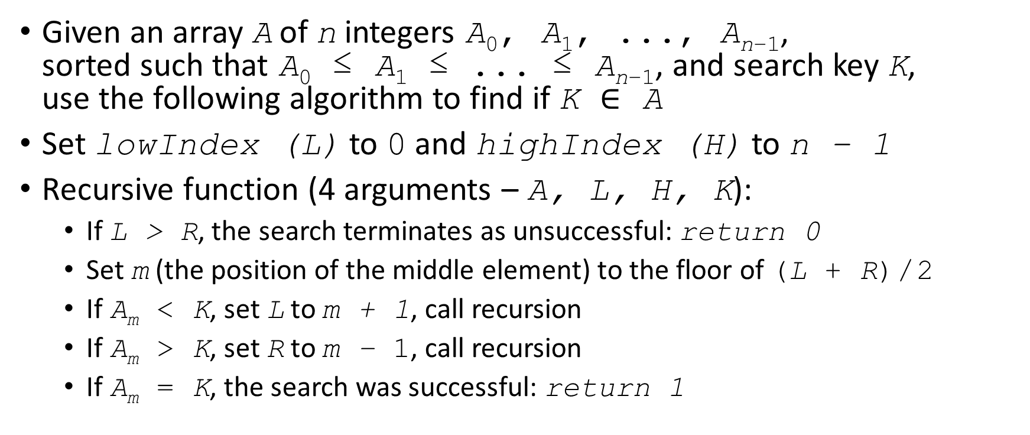
Advanced: Solve recursively and answer questions on next slide
Given an array A of n integers A₀, A₁, ..., A_{n−1}, sorted such that A₀ ≤ A₁ ≤ ... ≤ A_{n−1}, and search key K, use the following algorithm to find if K $∈$ A
Set lowIndex (L) to 0 and highIndex (H) to n − 1
Recursive function (4 arguments – A, L, H, K):
If L > R, the search terminates as unsuccessful: return 0
Set m (the position of the middle element) to the floor of (L + R) / 2
If A_{m} < K, set L to m + 1, call recursion
If A_{m} > K, set R to m − 1, call recursion
If A_{m} = K, the search was successful: return 1

Slide 7
Questions for advanced
Time complexity: Give numbers for both the described algorithm and linear search. How many times would it take to search from:
an array of 16 members
an array of 256 members
an array of 100 000 members
Give the big-o complexity for both linear search and the described algorithm (reminder: https://www.bigocheatsheet.com)
If the array was not sorted, would the algorithm still work?
Would it make sense to sort the array and then use the described searching method?

