Slide 1
Stack data structure

Slide 2
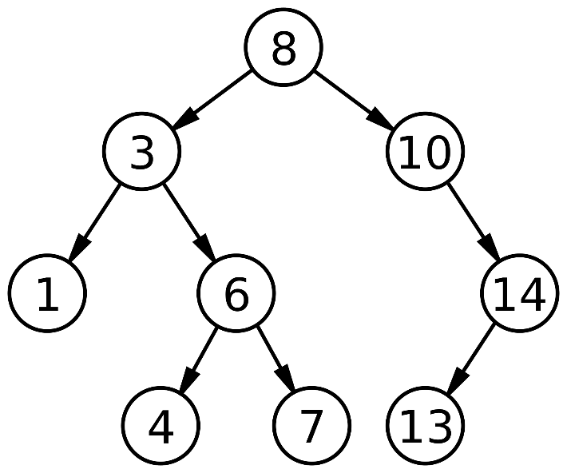
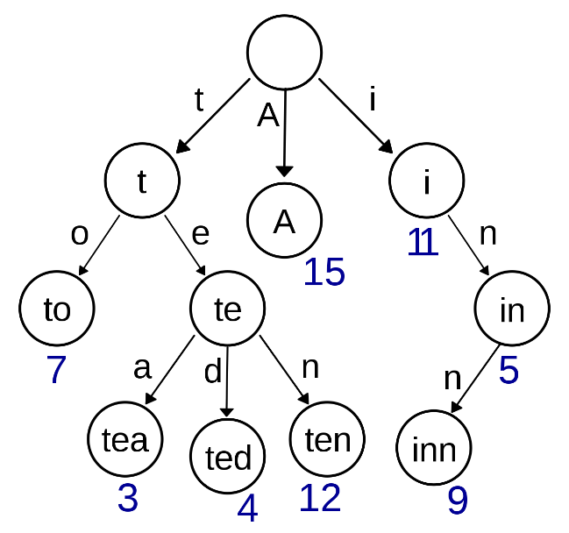

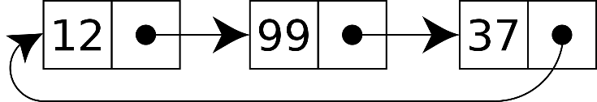
Abstract data type
An object, which is defined by the data and operations it supports
Interface is publicly visible
Internal representation and operations are typically hidden
Used for complex data structures, such as linked lists, trees, queues, stacks, graphs, …
images: wikipedia.org

Slide 3
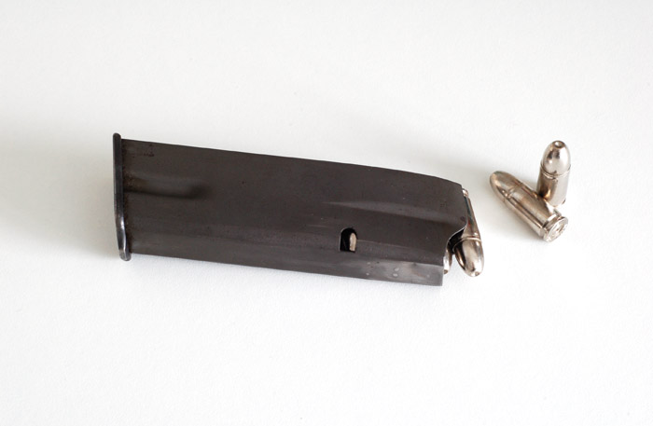
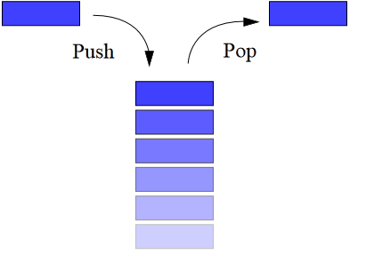
LIFO algorithm
LIFO - Last in, first out

Slide 4
Some principles
You can only access the top member of the stack
add to the top using push operation
remove from the top using pop operation
Because the way data is accessed (limited), operations on a stack are fast
Stack pointer (SP) is used to keep track of the top element
We’ve seen stack in use: function call stack

Slide 5
Operations on stack
Main operations:
Push() – add an element to the stack
Pop() – removes an element from the stack, returns the value
Optional:
Peek() – peek at the last element added without removing it
Duplicate() – duplicate the topmost element in the stack
Swap() – swap the 2 topmost elements in the stack
Rotate() – change the order the stack elements are in
Display() – display and clear all of the elements in the stack
etc.

Slide 6
Limitations of the stack
Access is only to the top member
Stack size is typically limited either by some previously agreed upon value or by the amount of resources available to it
Stack underflow – trying to remove an element from the stack when the stack is already empty (pop operation)
Stack overflow – trying to add a member to a stack which is already full (push operation)

Slide 7
Uses for stacks
Hanoi tower algorithm
Sorting algorithms
Conversions between Radixes (number base)
Syntax evaluation
Postfix notation
Backtracking
Function call stack
Hardware stacks
etc.

Slide 8
Data structure in memory
Array based stack
Linked list based stack
23
323
423
11
43
23
XXX
323
XXX
423
XXXXXXXX
11
XXXXXXX
43

Slide 9
Datatype declaration
Array based
Linked list based
typedef struct
{
unsigned size;
int *items;
} stack;
typedef struct node
{
int num;
struct node *pNext;
} stack;

Slide 10
Pseudocode for dynamic array based stack
Adding an element
Removing an element
Check for stack overflow
Yes: Output error
No: Reallocate Add data to the stack Increment stack pointer
Check for stack underflow
Yes: Output error
No: Decrement stack pointer Reallocate return the top element

Slide 11
Lab task
Create pop() and peek() functions
pop() – removes and returns the topmost element.
peek() – returns the topmost element, does not remove it
The returned item will be printed on the screen from where the functions were called from
Add menu logic so the user can choose between push/pop/peek operations.
Don’t forget to check for underflow, overflow and memory errors!

Slide 12
Advanced (3 tasks)
Pt1 and 2: Add functionality
(1) Implement Duplicate() and Swap() functions
(2) Implement Display() and Rotate() functions
All functions are limited to push and pop function calls.
Pt3: Make creating and destroying stacks dynamic
Both functions must use void as the return datatype and will have the stack parameter as a double pointer.
Create() – give memory to stack structure, initializes structure members
Destroy() – Clears all items and stack from memory. Must assign NULL to the pointer.

