Slide 1
Trees

Slide 2

Calculating time (unix)
Linux way: run your program through time:
real – time it took for the program
user – time in user mode
sys – time in kernel privileged mode
Kernel mode – system calls
Managing processes (forking, signals, memory, …)
Managing files (opening, reading, writing, managing attributes, …)
Managing devices (drivers)
etc

Slide 3
Calculating time in C
Include <time.h> library
Declare two clock_t type variables
clock_t start, end;
Store the time of start
start = clock();
Store the time of stop
stop = clock();
Calculate the duration (in seconds)
time = (double)(end - start) / CLOCKS_PER_SEC;

Slide 4
Sample: time
#include <stdio.h>
#include <time.h>
int main(void)
{
clock_t start, end;
int num;
double time;
start = clock();
printf("Enter an integer: ");
scanf("%d", &num);
end = clock();
time = (double)(end - start) / CLOCKS_PER_SEC;
printf("Time it took for you to enter a number: %lf s\n", time);
return 0;
}

Slide 5
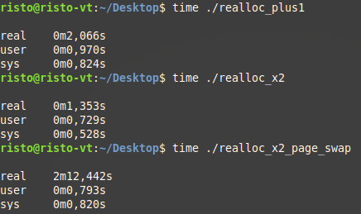
Some notable results (realloc)
realloc() strategy difference
Allocated 20 000 000 struct array, 84 bytes per item (~ 1.56 GB)
Filled with dummy data
User/sys ratio will depend on algorithm choice and dataset size
If you exceed the physical ram, page swapping may happen! Allocated 21 000 000 members (~ 1.64 GB)

Slide 6
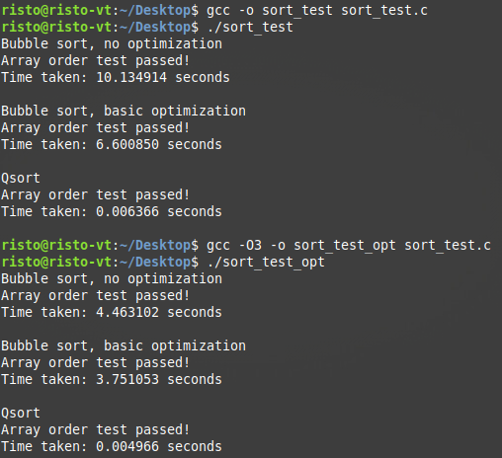
Some notable results (sorting)
Randomly generated 50 000 numbers
3 timed tests
Basic bubble sort
Optimized inner loop with (N - i)
Qsort using integer subtraction
Second run done with gcc -O3 optimization
Careful, it can break things!
It breaks debugging
It can skip a lot of operations
You can miss bugs
Optimization with -Ofast may be even faster
It disregards standards, breaks even more things

Slide 7
Terminology for trees
Each tree element is called a node, which carries a value
Root is the topmost node – where the tree begins
Child node is an immediate descendent of a node higher up
Parent node is the opposite – it can have child nodes
Leaf nodes are the terminal nodes – they have no children
Internal nodes are the opposite – they have at least 1 child node
Degree refers to the number of children
Depth is the number of nodes between the node and a root
Height of a tree is the longest path from the root the any node
…

Slide 8
Binary tree
Each node can have up to 2 children – left and right
Binary search tree is a binary tree, where
The value of the left child is lower than the parent
The value of the right child is higher than the parent
Balanced binary tree is a binary tree, where each of the left and right subtrees has a maximum difference of 1
Tree balancing operations are used during insertion
Optimal for binary search three
Traversal can be depth-first or breadth-first
Insertion, search, traversal, freeing functions are recursive!
When freeing, always destroy the children before the parent!

Slide 9
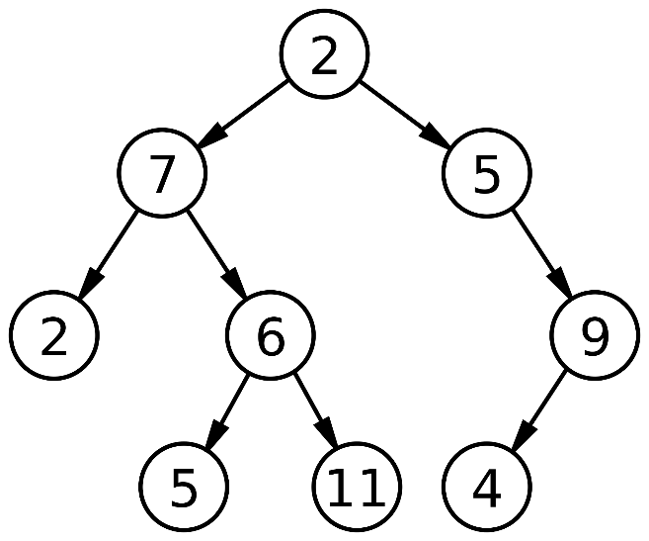
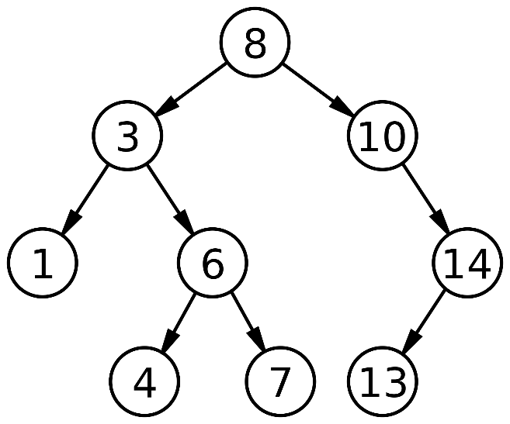
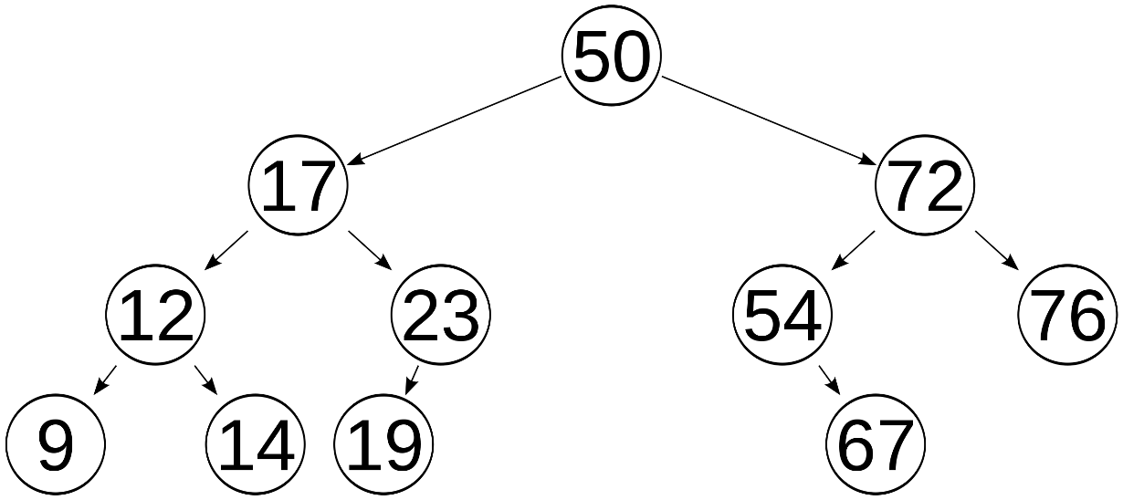
Trees
Binary tree
Binary search tree
Balanced binary search tree
images: wikipedia.org

Slide 10
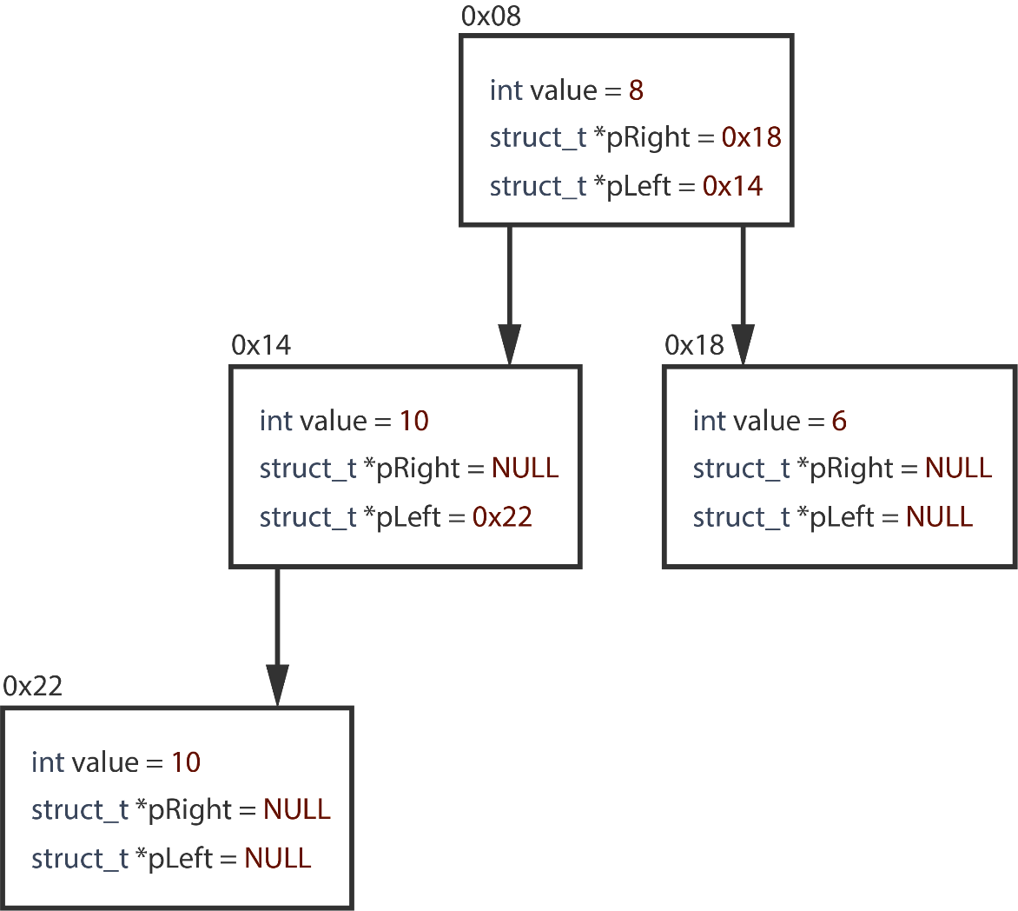
Binary tree data structure
typedef struct node
{
int value;
struct node *pLeft;
struct node *pRight;
} tree;

Slide 11
Binary tree traversal, depth first
void PrintTree(tree *t)
{
if (t != NULL)
{
printf("%d\n", t->value);
PrintTree(t->pLeft);
PrintTree(t->pRight);
}
}

Slide 12
Trie
A tree that is used for storing strings
Each node contains
A flag whether it’s an end node or not to determine end of a string
An array for each character in the alphabet as pointers to children
Possibly additional children for extra symbols – e.g. spaces, hyphens etc.
Sorted by design
Faster for strings compared to binary a tree – traversal time is linear to string length.
More memory intensive – each node has full set of pointers, each character is a node
More complicated code-wise

Slide 13
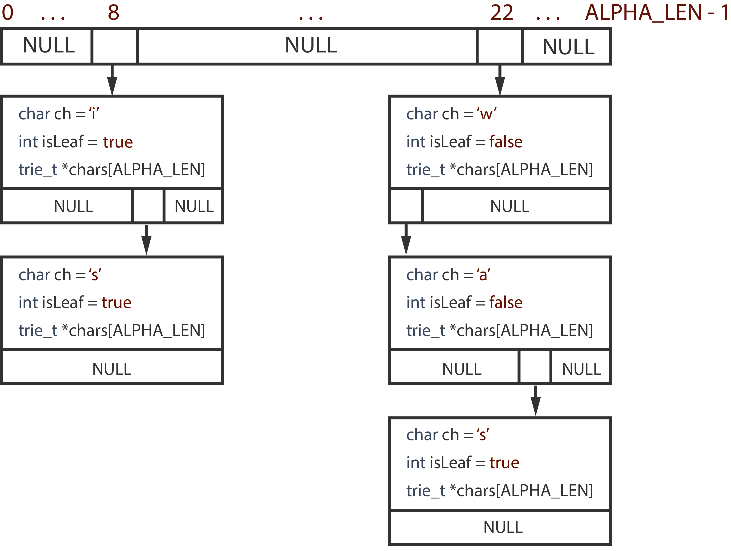
Trie data structure
typedef struct node
{
char ch;
int isLeaf;
struct node *chars[ALPHA_LEN];
} trie_t;

Slide 14
Lab task:
Find all the unique names in the input file
Find how many times each name occurred
Output the unique names and the number of occurrences to an output file
Do it twice – first with linear search, secondly with a binary search tree data structure. I recommend submitting them as separate code files!
Calculate the time for both and print it
Times must be comparable – if one includes reading from the file, other must as well
Focus on time, not memory efficiency – strings can be static
Don’t forget to check and free all the memory!
Data file and examples are provided as links

Slide 15
Advanced
Task 1: Do both a binary tree and a trie, find which is faster and by how much.
Write the results of your particular system and conclusion in the mini-report
What do you think – how will the differences between binary tree and trie become when adding more unique strings to our program? Explain your conclusion
Task 2: Add a search feature to one of your desings.
User will be able to enter a name until they choose to quit
Program will print out everyone by that name with their id code and city
The list of people by that name will be stored in a linked list, starting from the tree node

