Slide 1

By: Sigit Tunggul Waskito

Slide 2
Sigit Tunggul Waskito
Front End Developer ∙ 25 years old
By: Sigit Tunggul Waskito

Slide 3
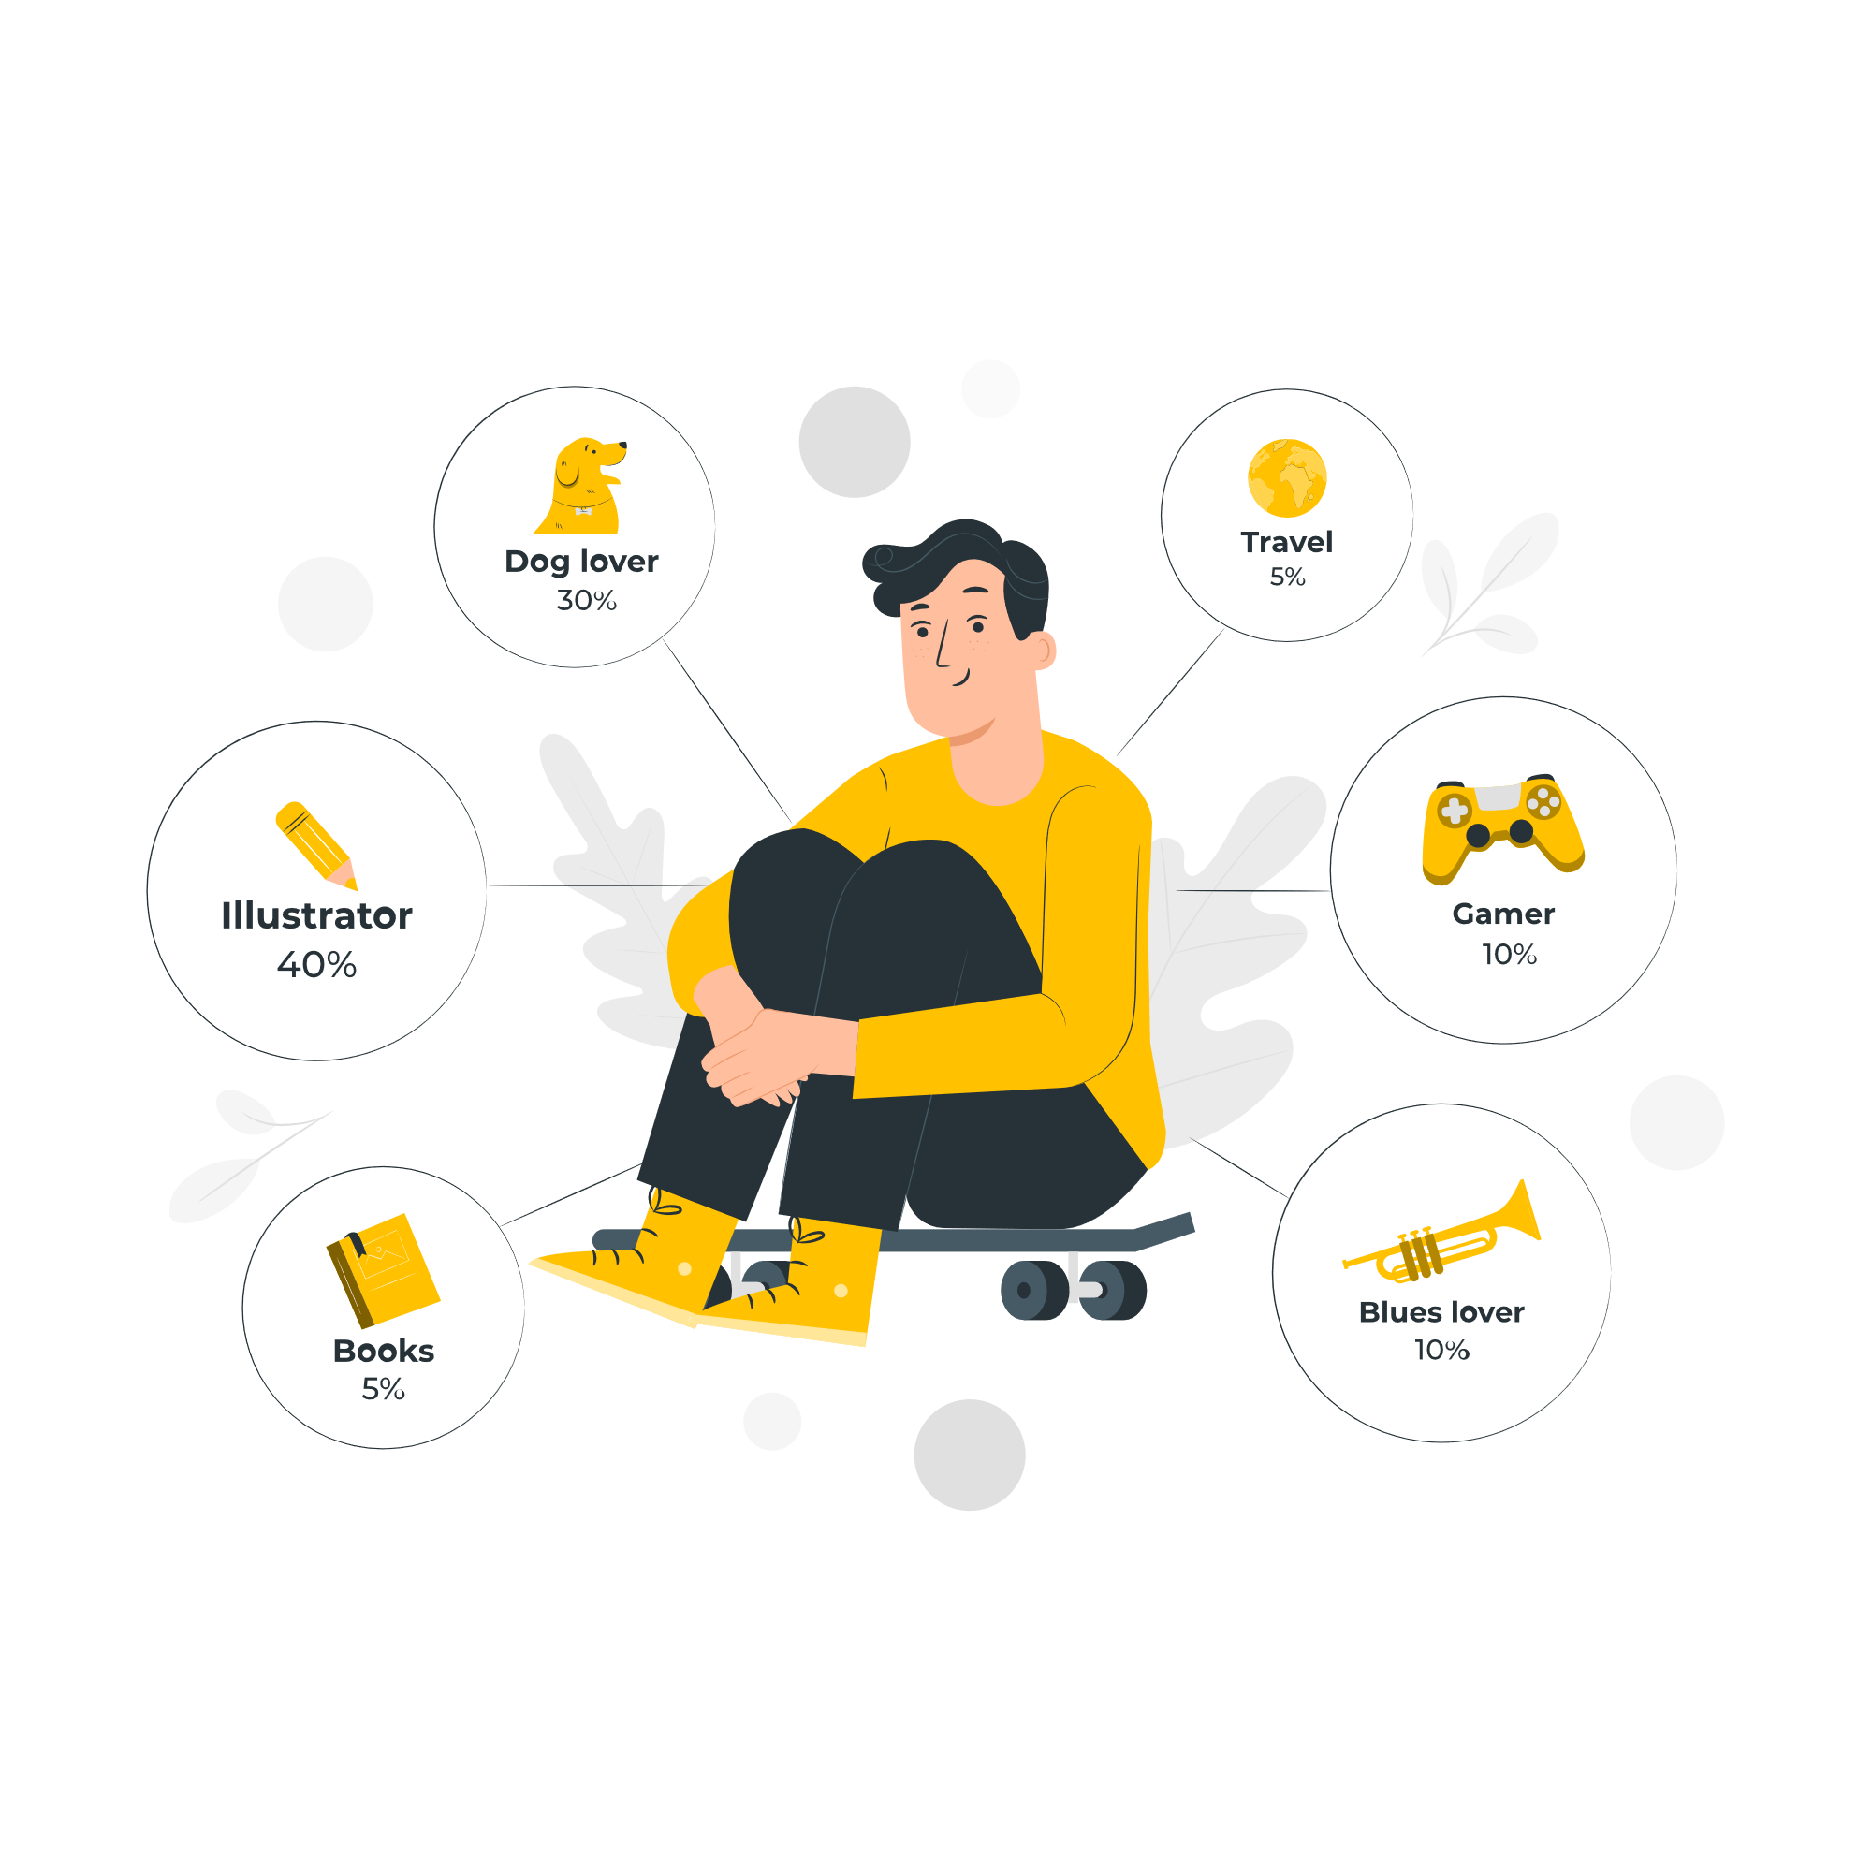
ABOUT ME
A passionate web developer especially in front end side. Love to collaborate with people and work as a team. Eager to learn and teach others. Giving full spirit to every projects that I've worked for.
Most of my projects are internal company projects and super secret but I have developed few apps to share with you.
By: Sigit Tunggul Waskito

Slide 4


INSTAGRANN
BAGI RESEP
By: Sigit Tunggul Waskito

Slide 5
BAGI RESEP
Bagi Resep is a user-friendly platform designed for food enthusiasts. Users can easily sign up with Google, Facebook, or email, creating and sharing their favorite recipes. Additionally, they can explore a wealth of food blogs and culinary inspiration, making it the go-to destination for all things delicious and creative in the world of cooking and cuisine.
By: Sigit Tunggul Waskito

Slide 6
FEATURES
FEATURES
Post recipes
Search Recipes
Update Profile
OAuth and Email Auth
Blog
Session expiration
By: Sigit Tunggul Waskito

Slide 7
Service Structure
Front End
Back End
DB
OAuth
News API
By: Sigit Tunggul Waskito

Slide 8



Front End
React JS
CRA
Bootstrap
By: Sigit Tunggul Waskito

Slide 9




Back End
Node Js
Express JS
MongoDB
JWT
By: Sigit Tunggul Waskito

Slide 10
User Interfaces
By: Sigit Tunggul Waskito

Slide 11
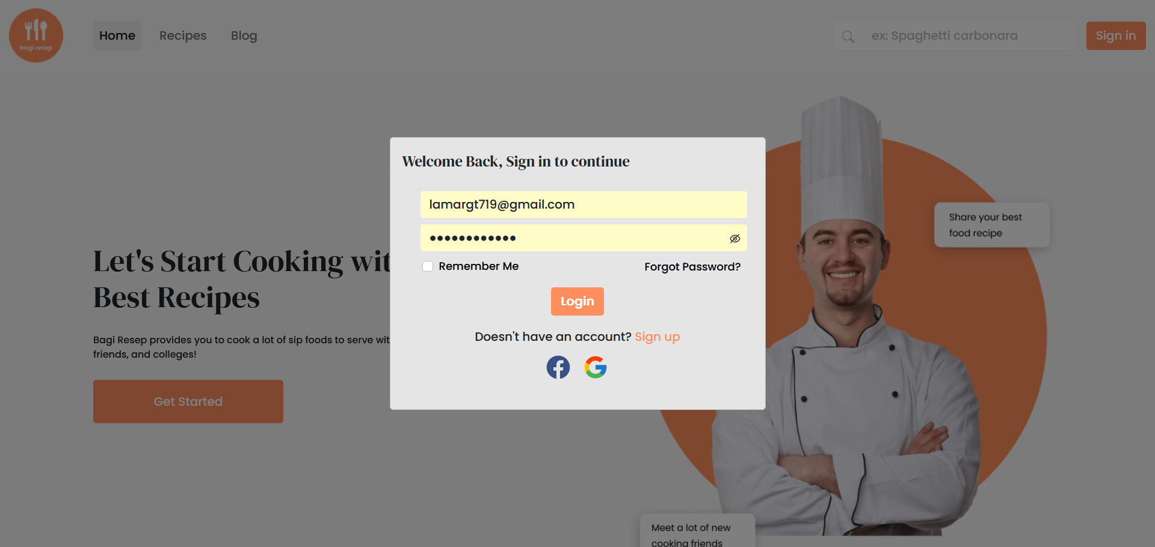
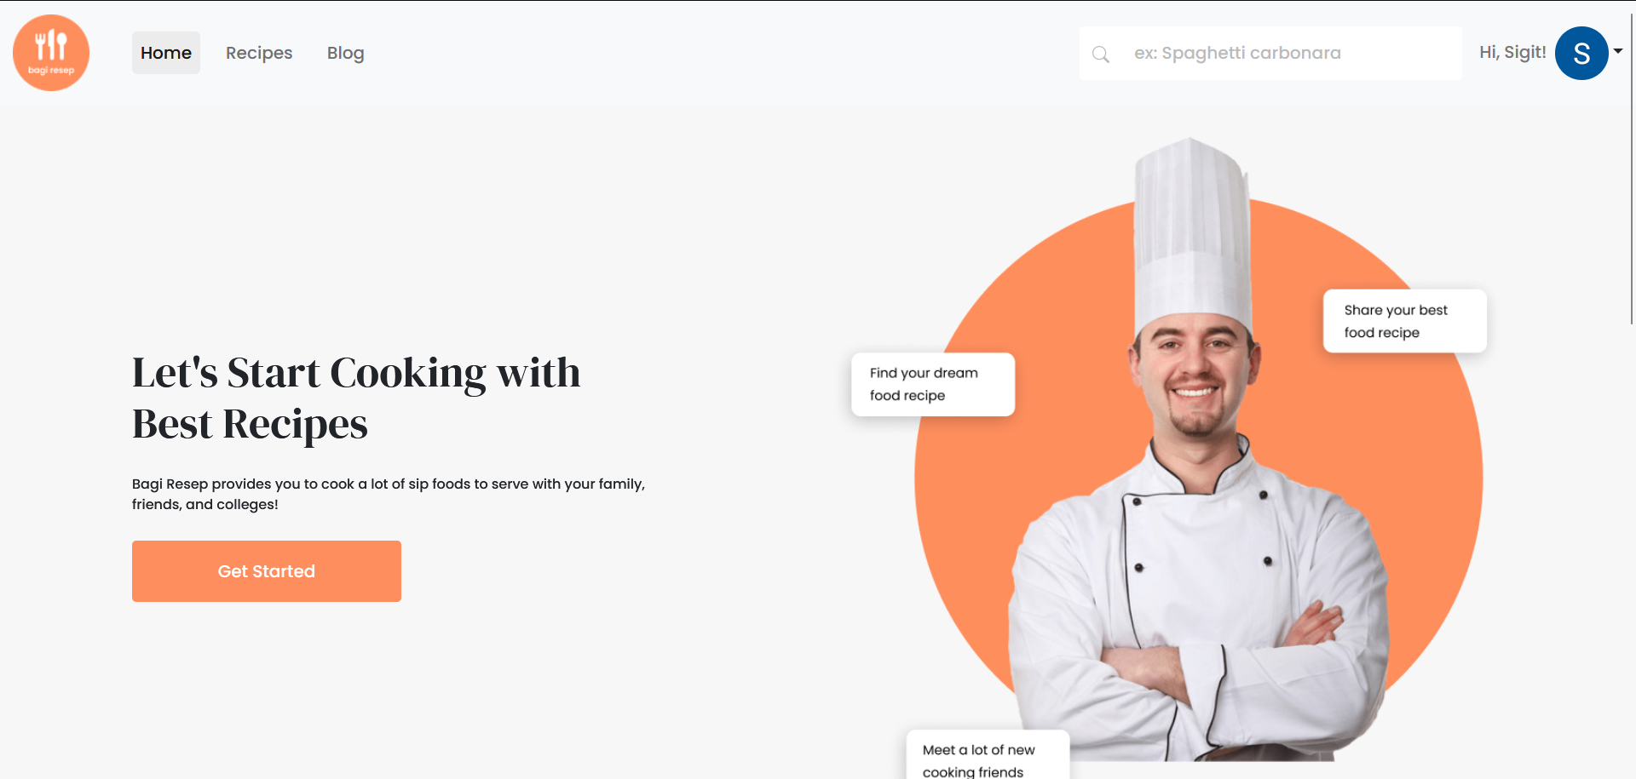
LOGIN
Our app offers seamless authentication options, allowing users to log in effortlessly using their Facebook or Google accounts for quick access. Alternatively, users can opt for manual login via email, ensuring flexibility and ease of use, and JWT.
By: Sigit Tunggul Waskito

Slide 12
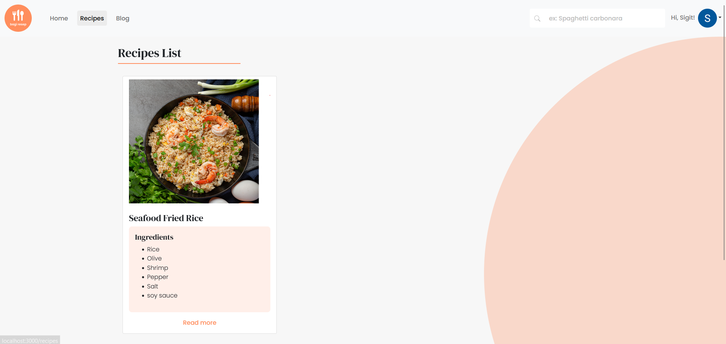
HOME
By: Sigit Tunggul Waskito

Slide 13
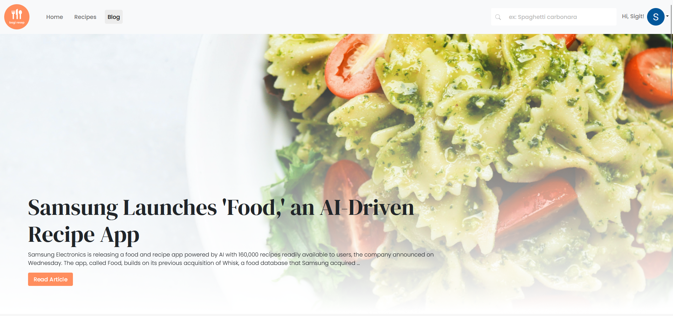
RECIPE LIST
By: Sigit Tunggul Waskito

Slide 14
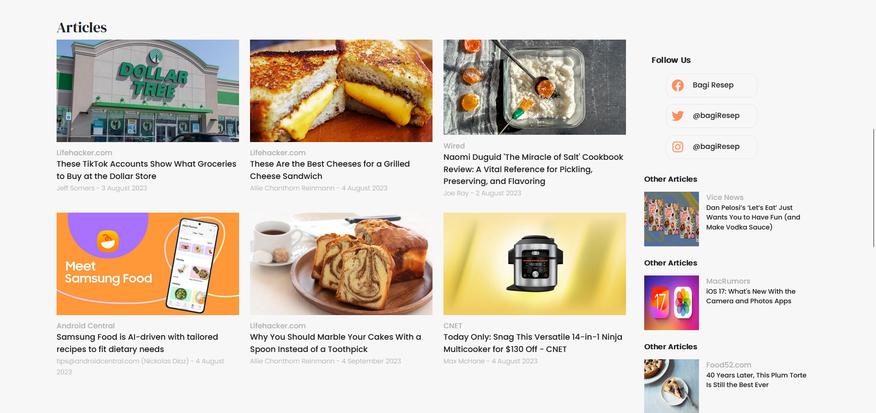
BLOG
By: Sigit Tunggul Waskito

Slide 15
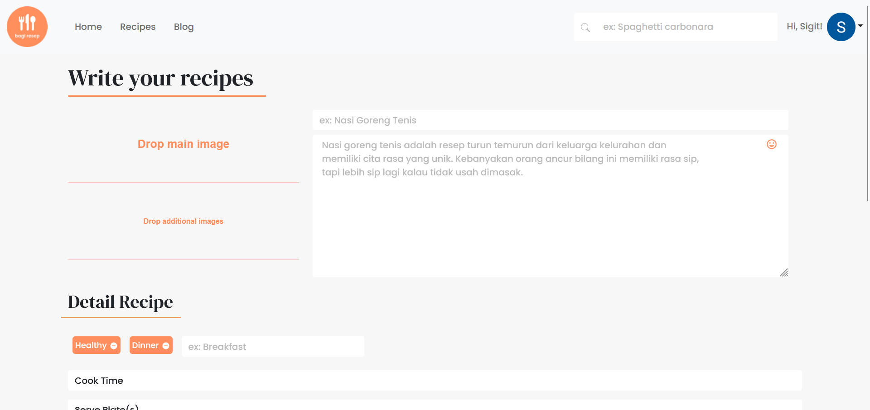
BLOG
By: Sigit Tunggul Waskito

Slide 16
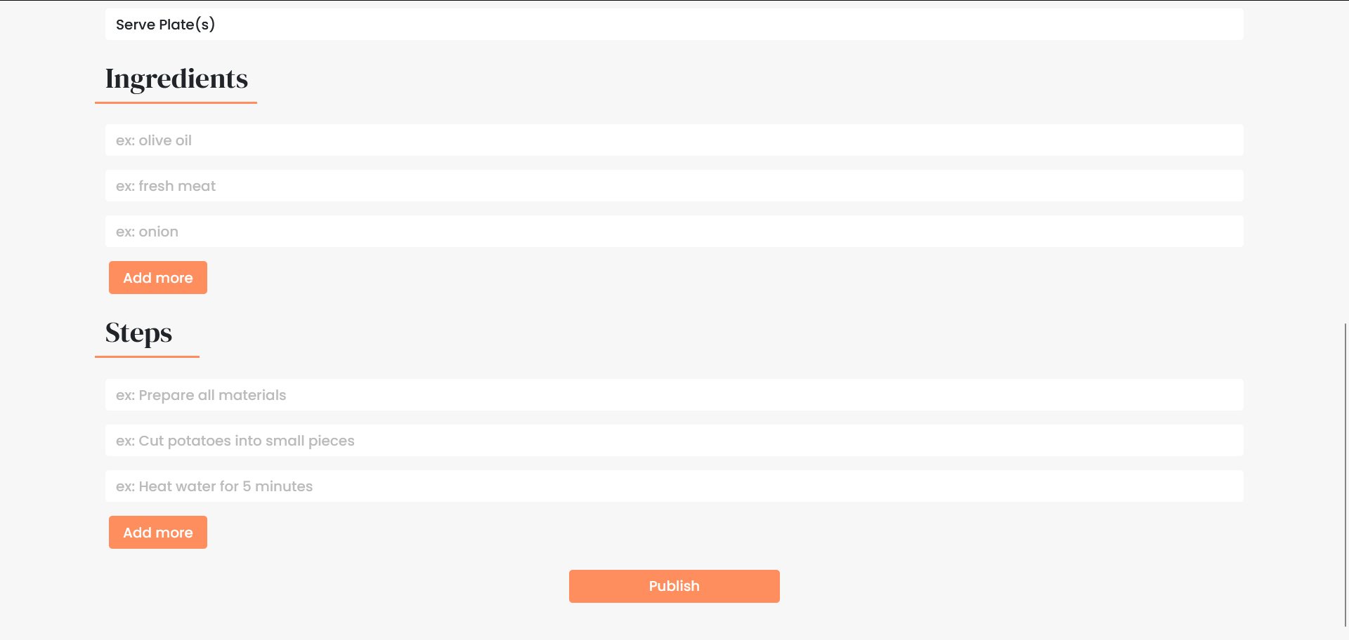
CREATE RECIPE
By: Sigit Tunggul Waskito

Slide 17
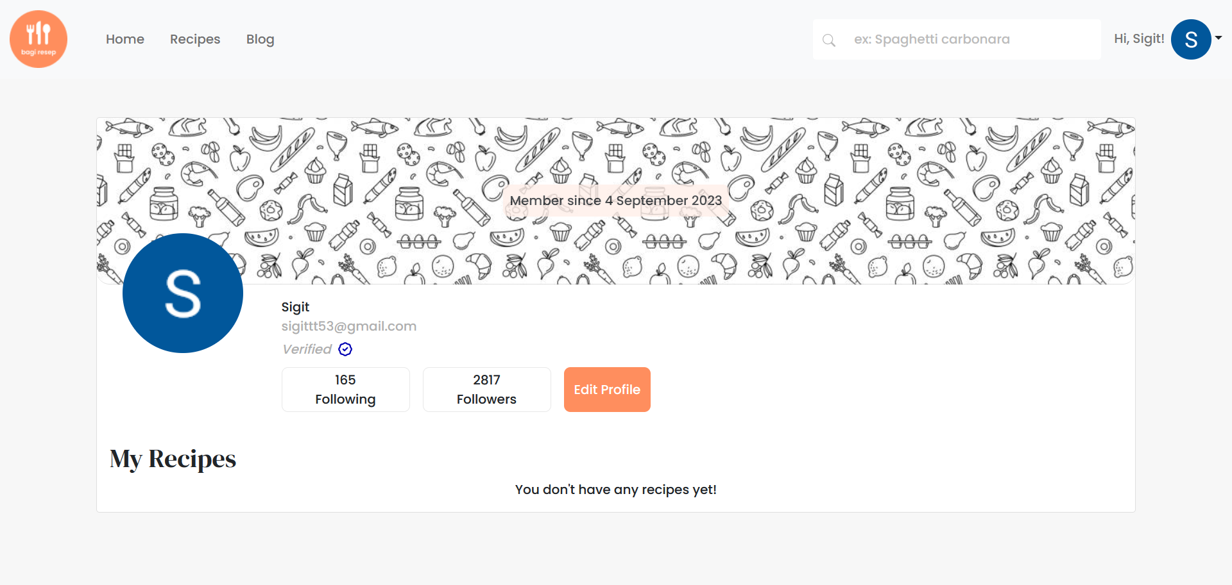
CREATE RECIPE
By: Sigit Tunggul Waskito

Slide 18
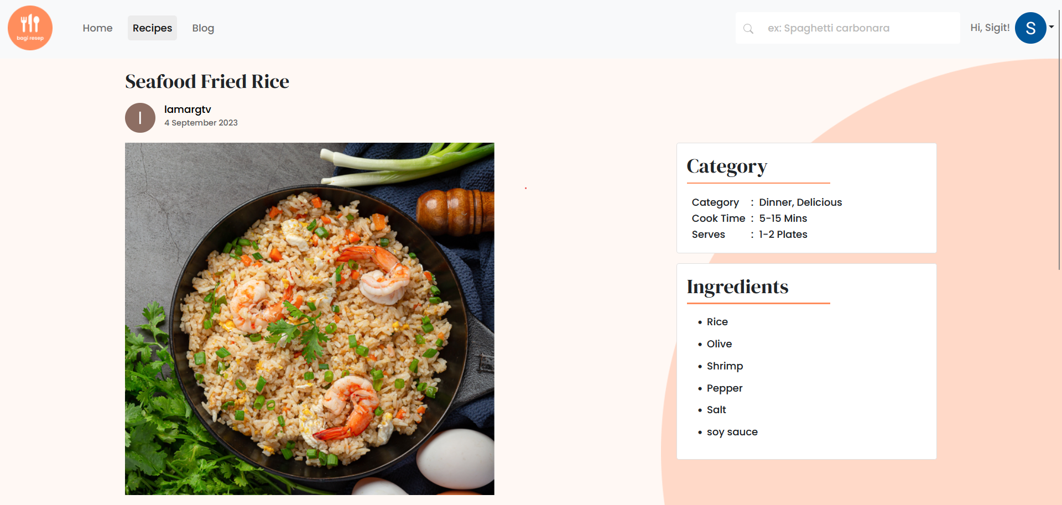
PROFILE
By: Sigit Tunggul Waskito

Slide 19
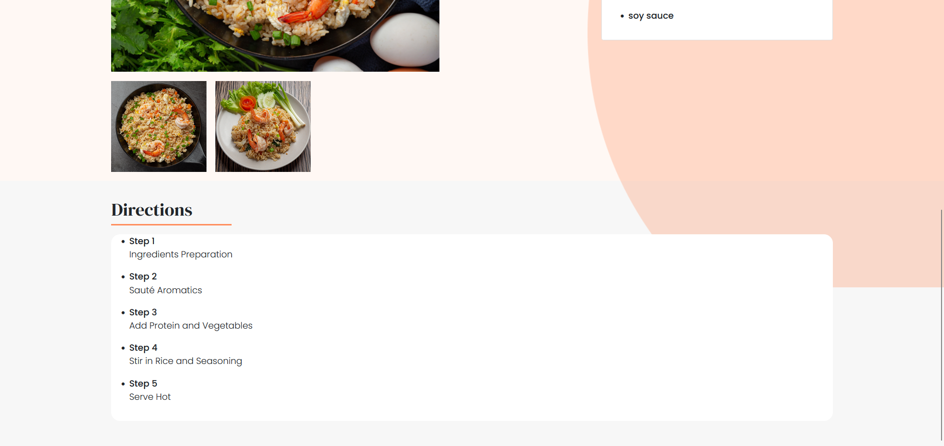
RECIPE DETAIL
By: Sigit Tunggul Waskito

Slide 20
RECIPE DETAIL
By: Sigit Tunggul Waskito

Slide 21
INSTAGRANN
BAGI RESEP
By: Sigit Tunggul Waskito

Slide 22
INSTAGRANN
Faithfully recreates the Instagram experience. Users can create and share posts, stories, follow others, update profiles, search, and chat with fellow users. It provides a seamless social media platform, mirroring Instagram's familiar and intuitive UI.
By: Sigit Tunggul Waskito

Slide 23
FEATURES
Authentication
Create a post and story
Like and comment
Follow users
Search users
Update Profile
Chatting
By: Sigit Tunggul Waskito

Slide 24
Service Structure
Front End
Back End
DB
Real time service
OAuth
By: Sigit Tunggul Waskito

Slide 25




Front End
React JS
Typescript
Vite
Bootstrap
Socket.io
Zustand
By: Sigit Tunggul Waskito

Slide 26

Back End
Node Js
Express JS
MySQL
Typescript
JWT
By: Sigit Tunggul Waskito

Slide 27
Real time service
Node Js
Express JS
MySQL
Typescript
JWT
Socket io
By: Sigit Tunggul Waskito

Slide 28
User Interfaces
By: Sigit Tunggul Waskito

Slide 29
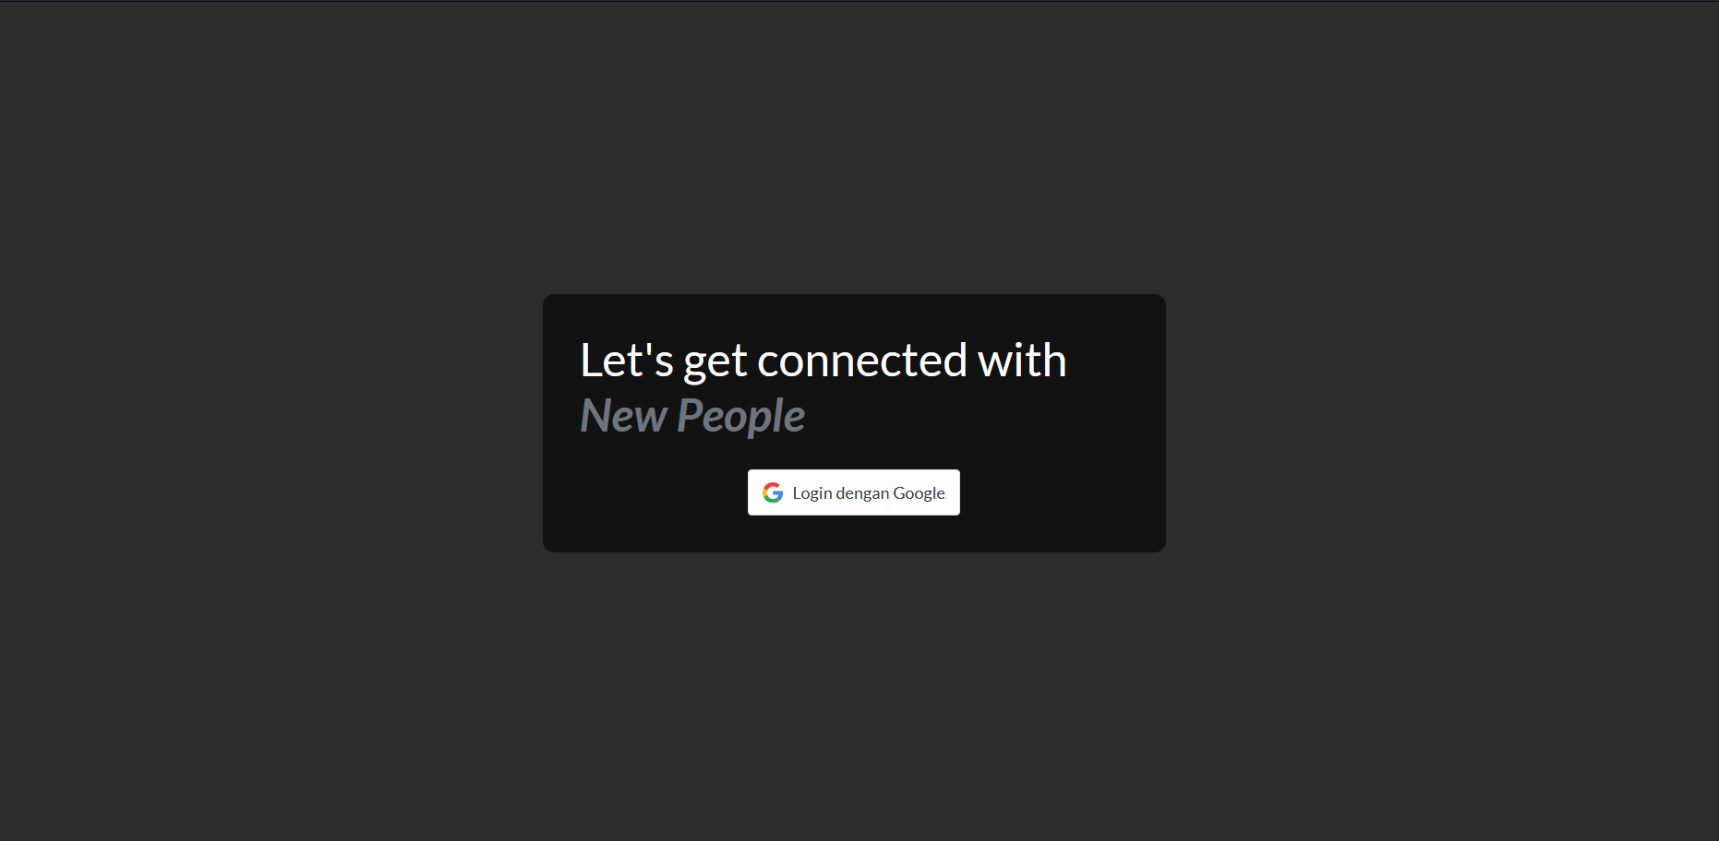
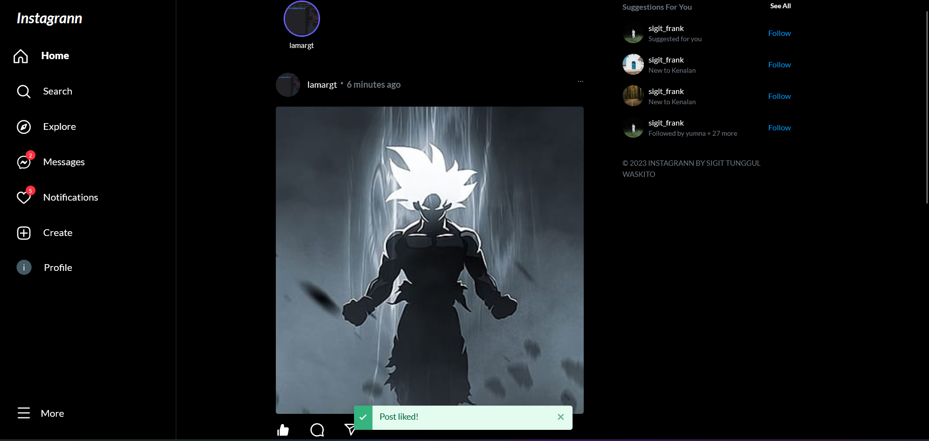
LOGIN
The app employs JWT authentication for ironclad security, safeguarding user data with encrypted tokens and ensuring a safe and seamless login experience.
By: Sigit Tunggul Waskito

Slide 30
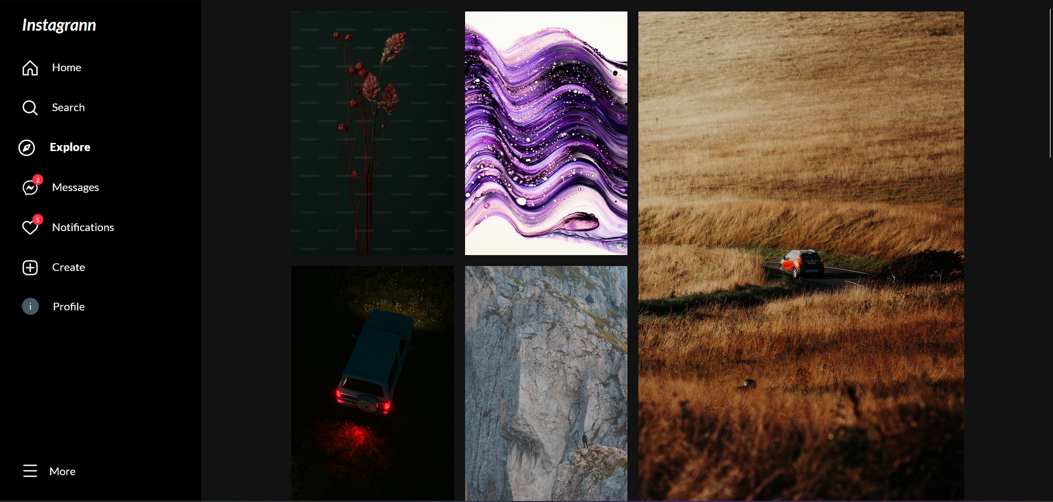
HOME
By: Sigit Tunggul Waskito

Slide 31
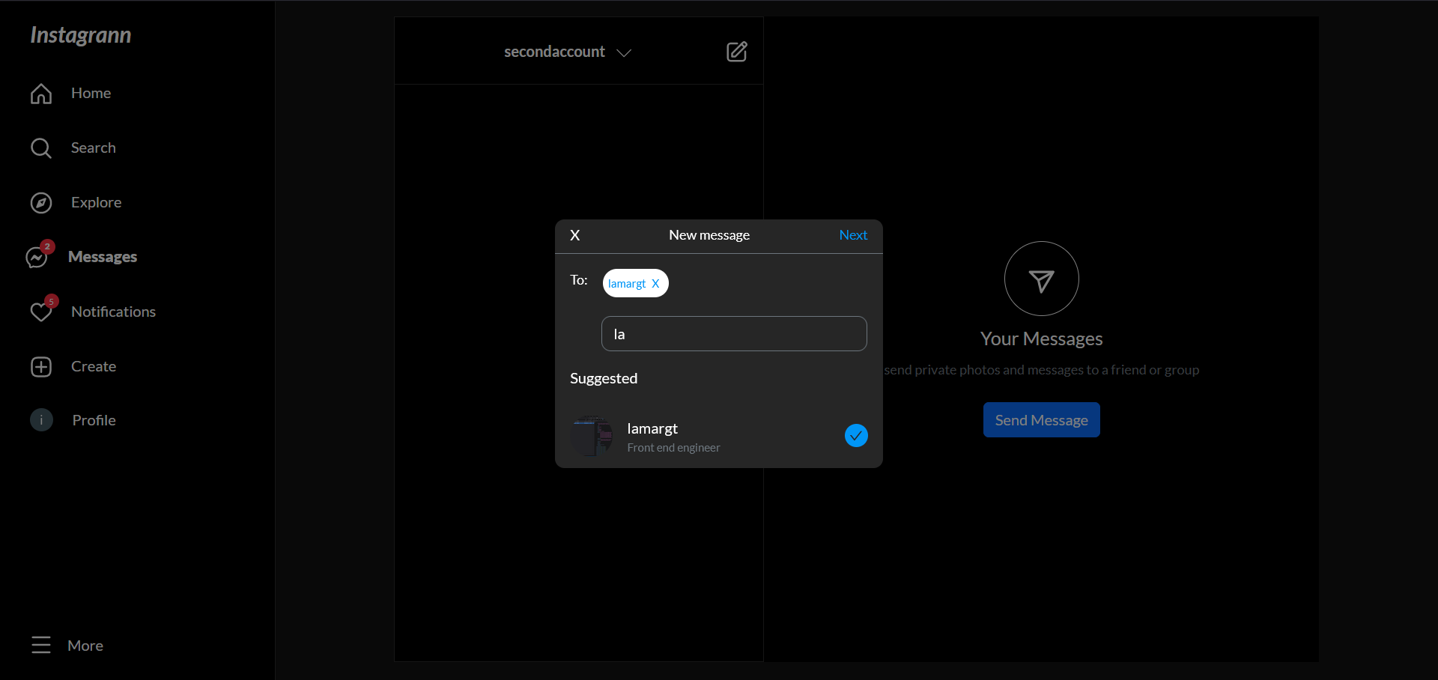
EXPLORE
By: Sigit Tunggul Waskito

Slide 32
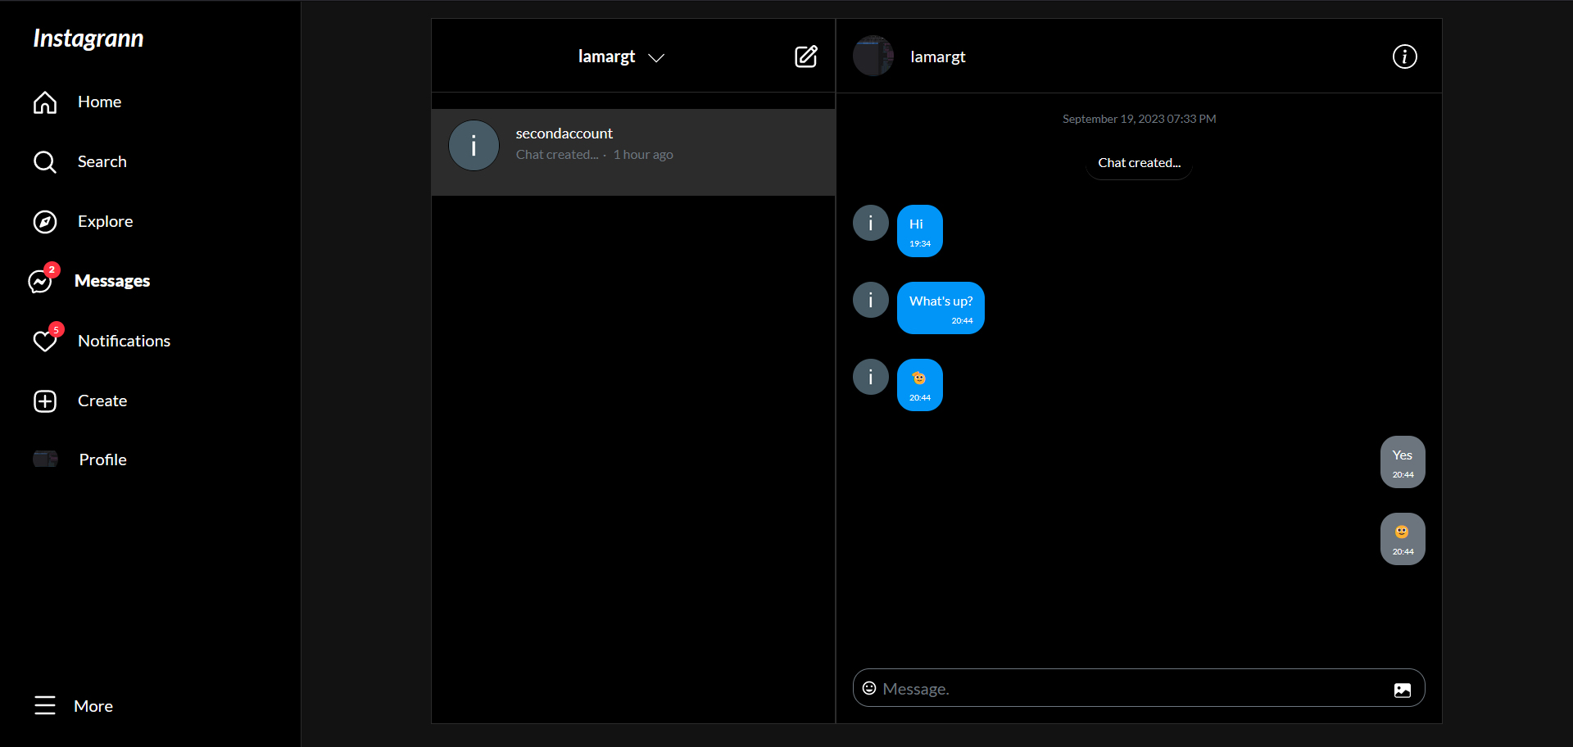
MESSAGE
By: Sigit Tunggul Waskito

Slide 33
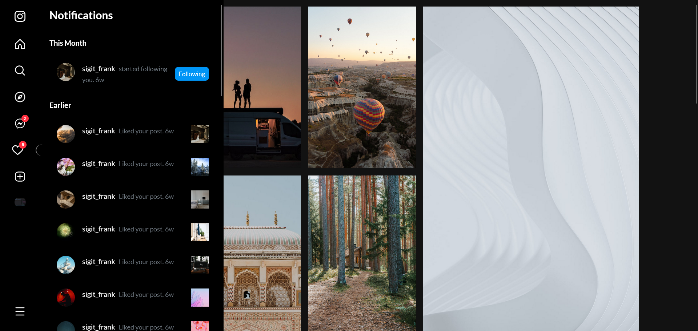
CHAT LIST
By: Sigit Tunggul Waskito

Slide 34
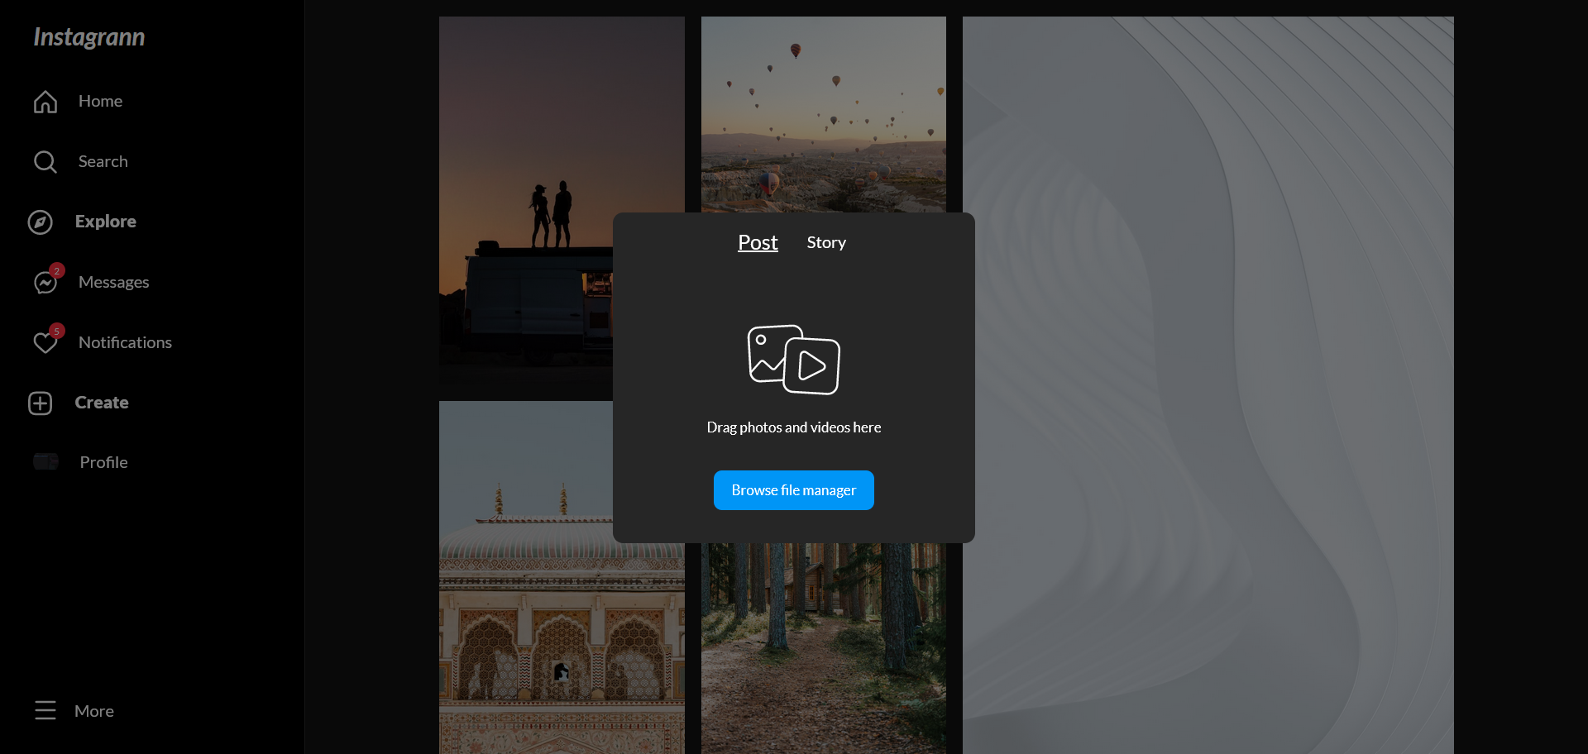
NOTIFICATION
By: Sigit Tunggul Waskito

Slide 35
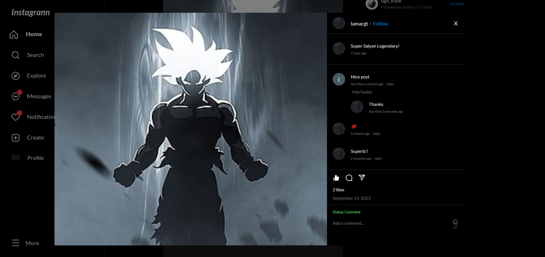
CREATE POST/STORY
By: Sigit Tunggul Waskito

Slide 36
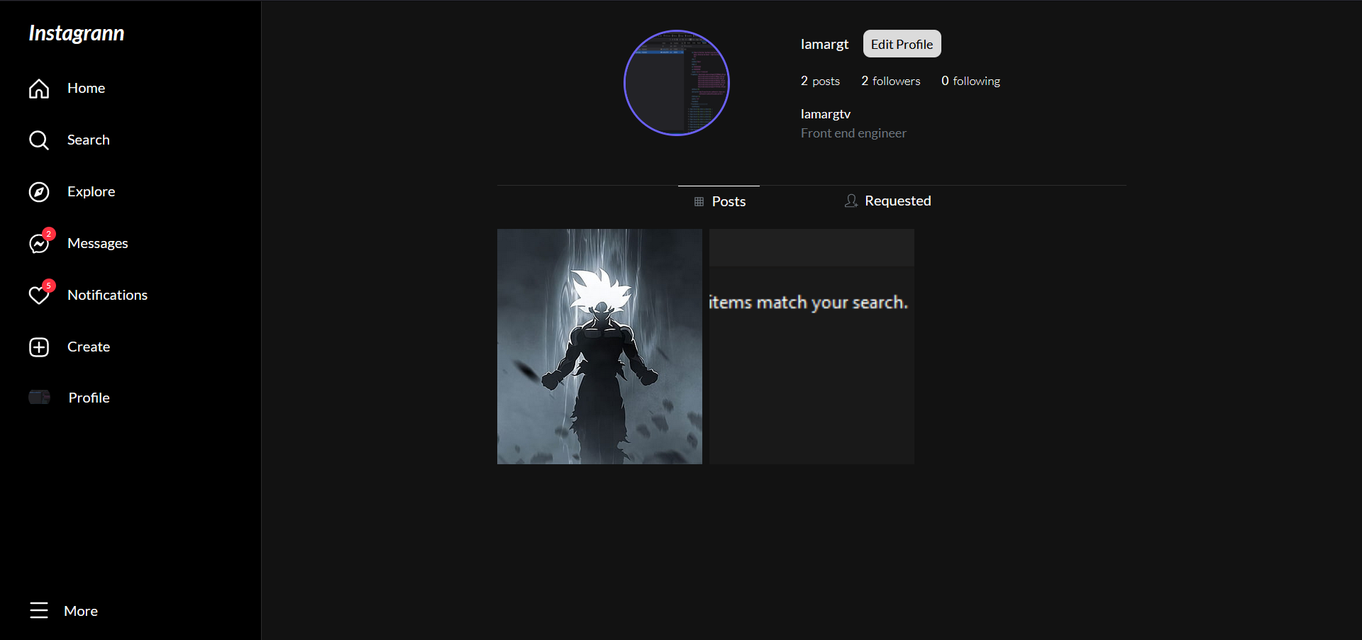
POST DETAIL
By: Sigit Tunggul Waskito

Slide 37
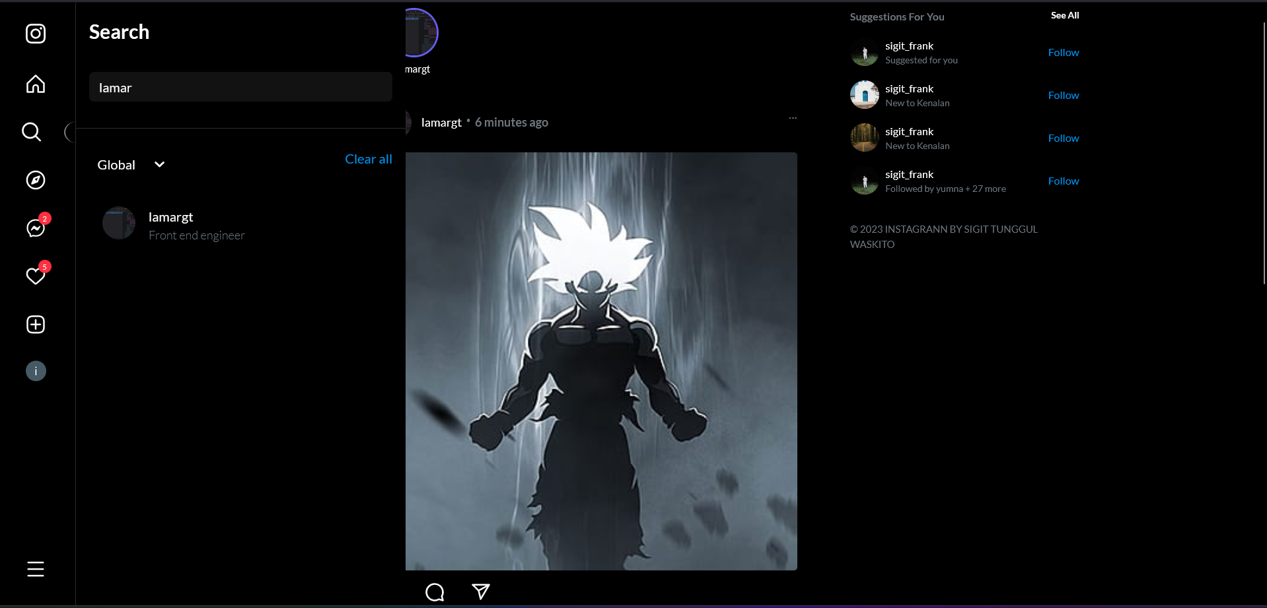
PROFILE
By: Sigit Tunggul Waskito

Slide 38
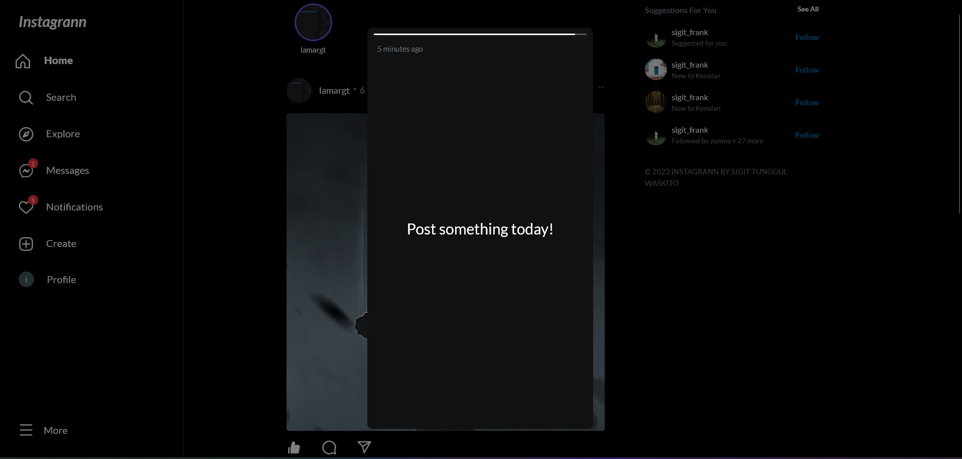
SEARCH
By: Sigit Tunggul Waskito

Slide 39
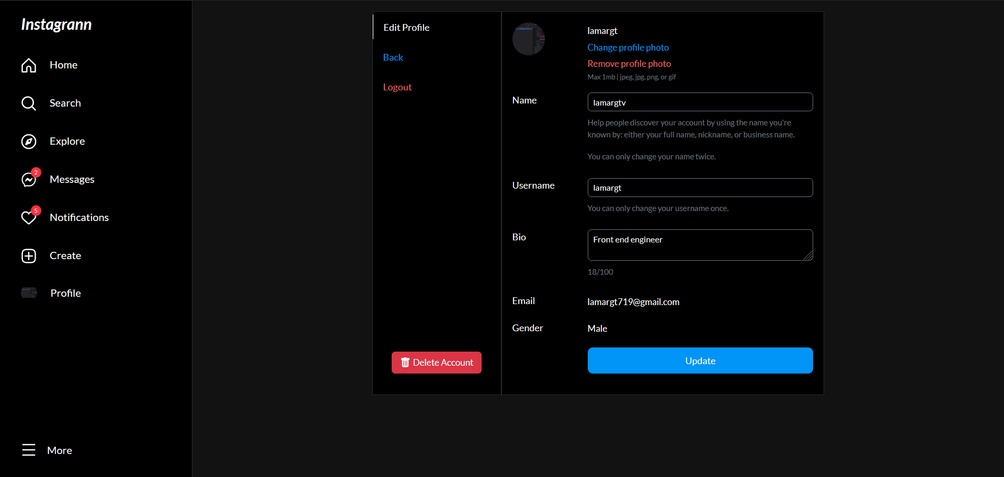
STORY
By: Sigit Tunggul Waskito

Slide 40
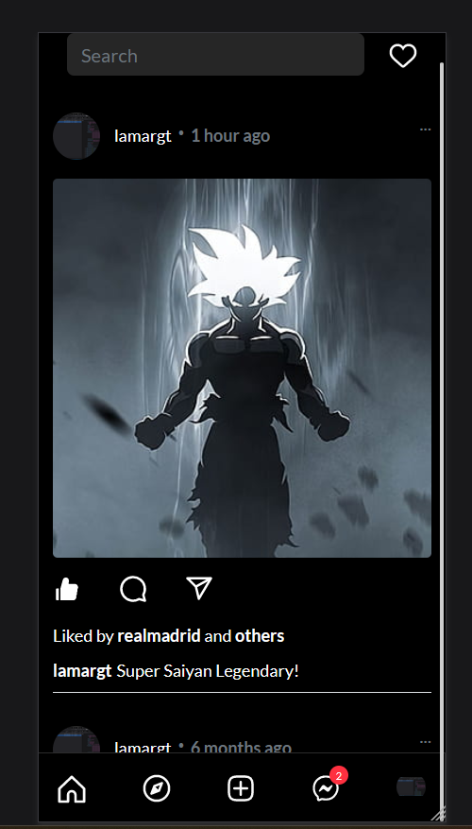
PROFILE SETTING
By: Sigit Tunggul Waskito

Slide 41
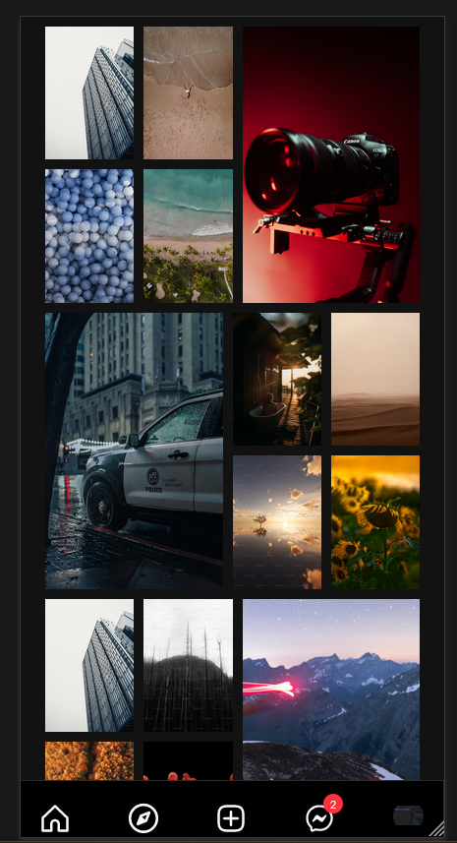
MOBILE VIEW
By: Sigit Tunggul Waskito

Slide 42




MOBILE VIEW
THANK
YOU
By: Sigit Tunggul Waskito

Slide 43
<THANK
YOU/>
By: Sigit Tunggul Waskito

Slide 44
Assets Sources
https://icons8.com/icons/set/react
https://storyset.com
https://icon-icons.com/icon/socket-io-logo/144874
https://github.com/pmndrs/zustand

