Slide 1
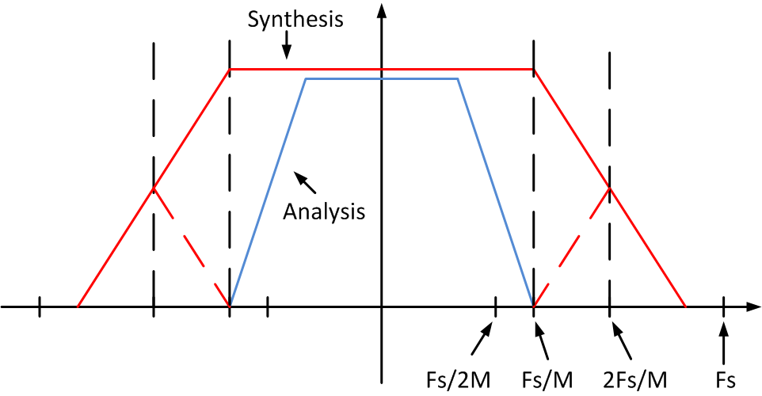
Analysis & Synthesis Filters
Analysis – Mth band windowed sinc
Synthesis – FIRPM with w_{p} = w_{s} of the Analysis Filter

Slide 2
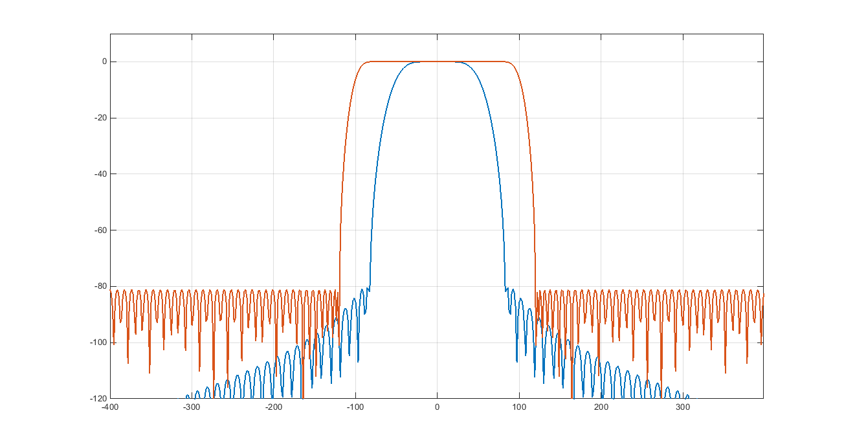
Analysis & Synthesis Filters

Slide 3
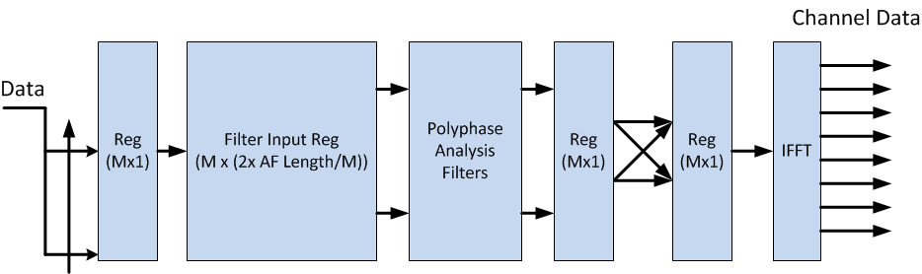
Analysis Architecture
Input Commutator Delivers M/2 input samples
Analysis Filter output halves swapped every other M/2 input samples

Slide 4
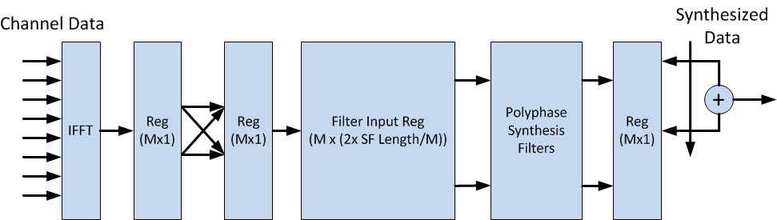
Synthesis Architecture
Directly fed by Analysis Architecture
Dual of Analysis Architecture except for Synthesis Filters

Slide 5
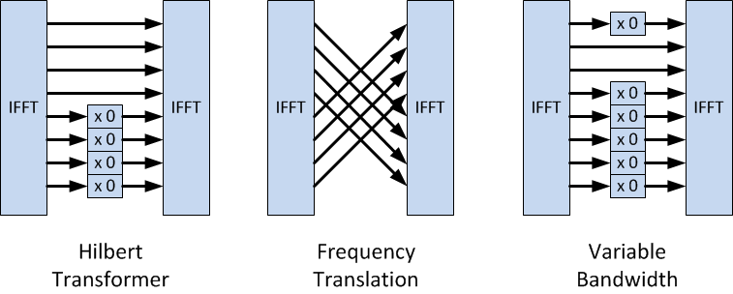
Architecture Modifications
Simple binary masking or wire crossing
Everything else remains the same

