Slide 1
Seminar(cs-19)
TOPIC: Data Visualization & COVID-19 Trend Analysis in India
Master of Computer Applications(MCA) 5th Semester
Presented by: Srijan Sareen
Under the guidance of Dr. Anu Gupta

Slide 2
Seminar objectives
Tools used for analysis.
Computing COVID-19 trends in India.
Checking the spread of the COVID-19 in accordance with:
Population,
Population Density,
Recovery Rate,
Hospitals Available in Rural and Urban Areas.
AIM
To analyze the tools for data visualization and compute the trends for the COVID-19 spread in India with respect to population, population density, recovery rate etc.

Slide 3
Potential Outcomes
Tools that can be used for data visualization and analysis,
COVID-19 Trends in India,
Detailed analysis of hospital and health infrastructure in the country,
State wise analysis of the hospital and beds available in rural and urban areas
Computing the factors on which the virus spread depends on different states.
Potential use of study
Analysis of state wise data can help the government on checking the virus spread,
Hospital beds as well as the number of hospital in rural and urban areas will help the states to analyze the health infrastructure,
Can help the government to analyze which area is more prone to virus spread,
Academically only tableau is used for this study but it encourages the use of other BI Tools and strongly recommends new forecasting trends.

Slide 4
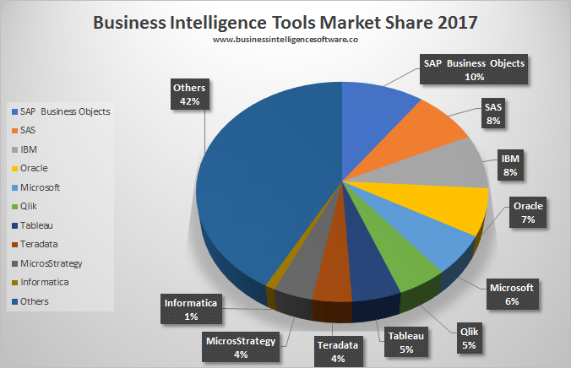
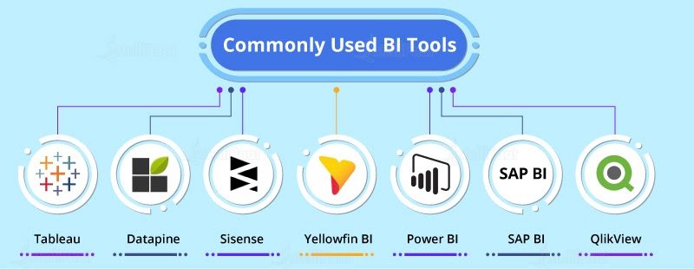
Tools for data analysis and Visualization
Data visualization tools provide data visualization designers with an easier way to create visual representations of large data sets. When dealing with data sets that include hundreds of thousands or millions of data points, automating the process of creating a visualization, at least in part, makes a designer’s job significantly easier.
These data visualizations can then be used for a variety of purposes: dashboards, annual reports, sales and marketing materials, investor slide decks, and virtually anywhere else information needs to be interpreted immediately.

Slide 5
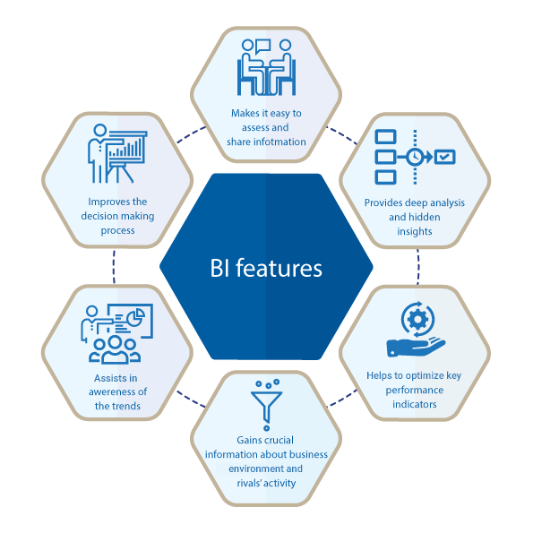
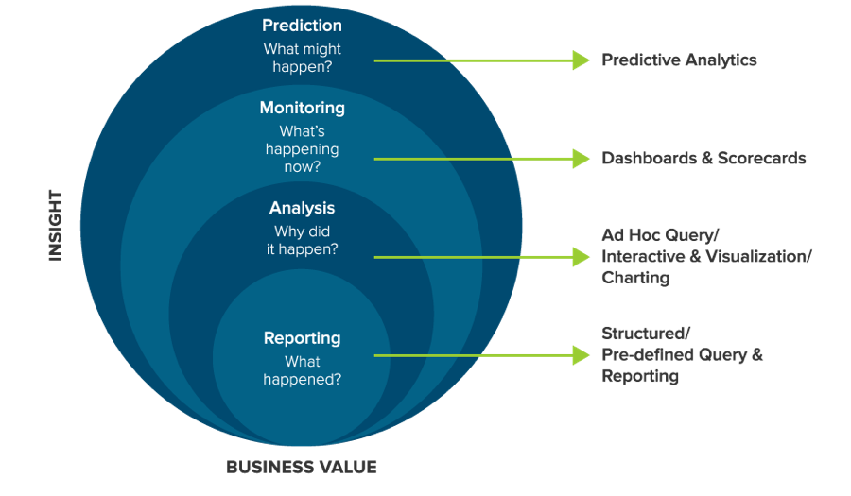
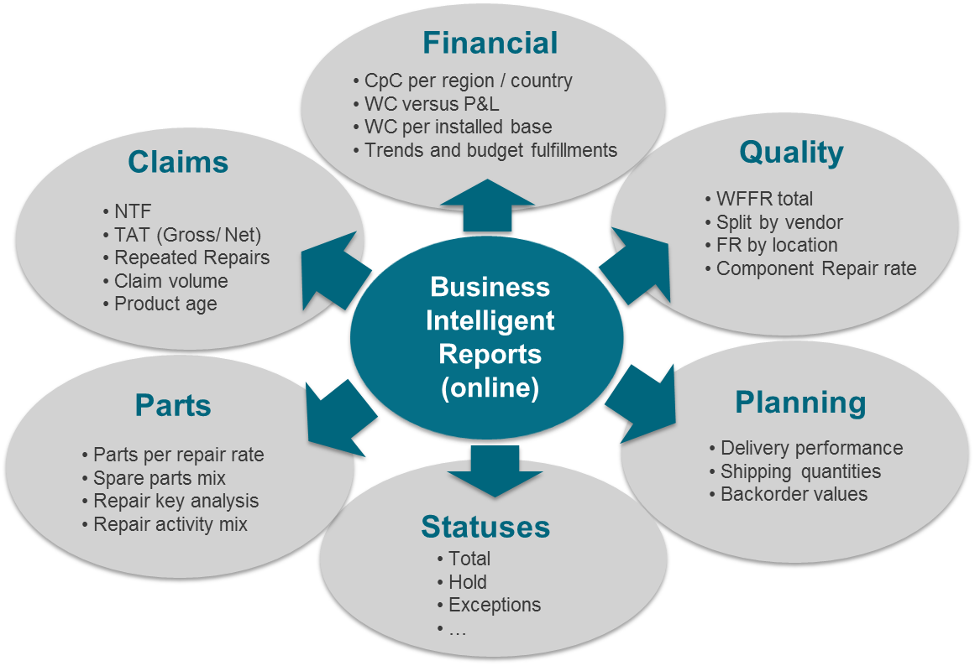
ABOUT BI TOOLS
How is it used?
Features?
Where are the BI tools used?

Slide 6

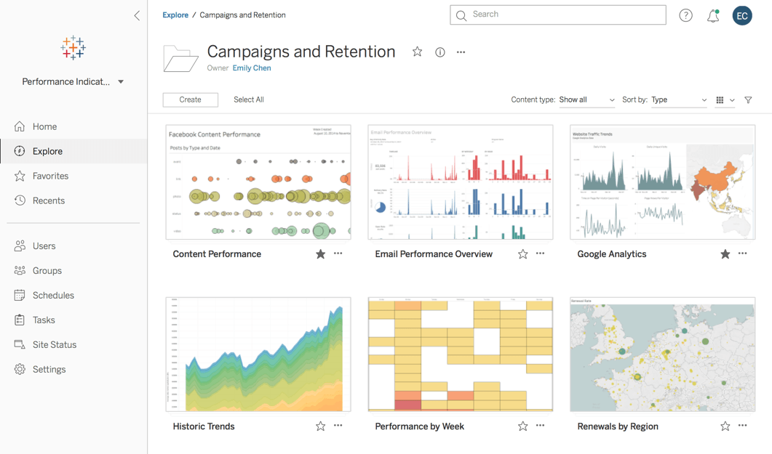
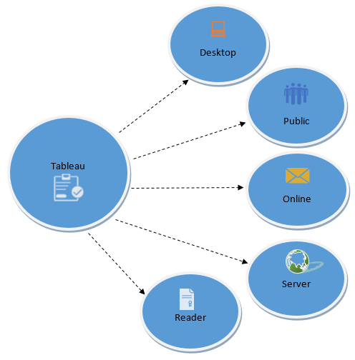
TabLEAU
Tableau is a powerful and fastest growing data visualization tool used in the Business Intelligence Industry. It helps in simplifying raw data into the very easily understandable format.
Data analysis is very fast with Tableau and the visualizations created are in the form of dashboards and worksheets. The data that is created using Tableau can be understood by professional at any level in an organization. It even allows a non-technical user to create a customized dashboard.
The best feature Tableau are
Data Blending
Real time analysis
Collaboration of data
Pros
Hundreds of data import options
Mapping capability
Free public version available
Cons
Non-free versions are expensive ($70/month/user for the
Tableau Creator software)
Public version doesn’t allow you to keep data analyses private

Slide 7
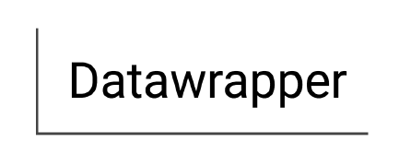
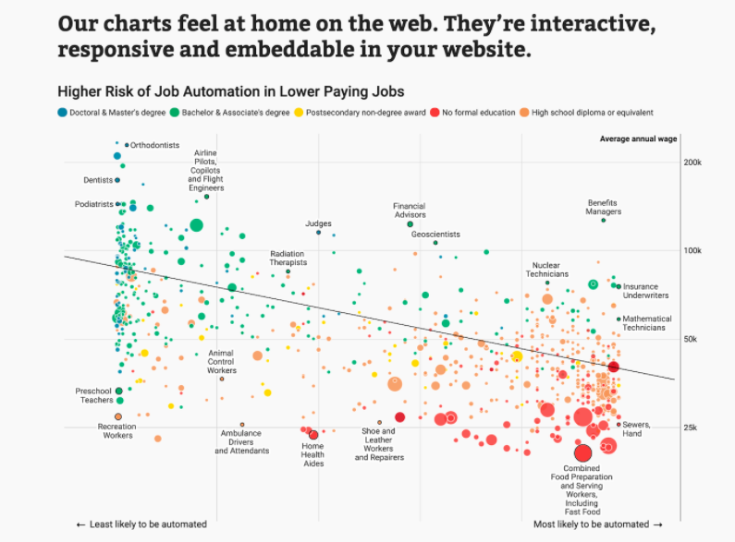
Datawrapper
Datawrapper was created specifically for adding charts and maps to news stories. The charts and maps created are interactive and made for embedding on news websites. Their data sources are limited, though, with the primary method being copying and pasting data into the tool.
Once data is imported, charts can be created with a single click. Their visualization types include column, line, and bar charts, election donuts, area charts, scatter plots, symbol maps, and locator maps, among others. The finished visualizations are reminiscent of those seen on sites like the New York Times or Boston Globe. In fact, their charts are used by publications like Mother Jones, Fortune, and The Times.
The free plan is perfect for embedding graphics on smaller sites with limited traffic, but paid plans are on the expensive side, starting at $39/month.
Pros
Specifically designed for newsroom data visualization
Free plan is a good fit for smaller sites
Tool includes a built-in color blindness checker
Cons
Limited data sources
Paid plans are on the expensive side

Slide 8
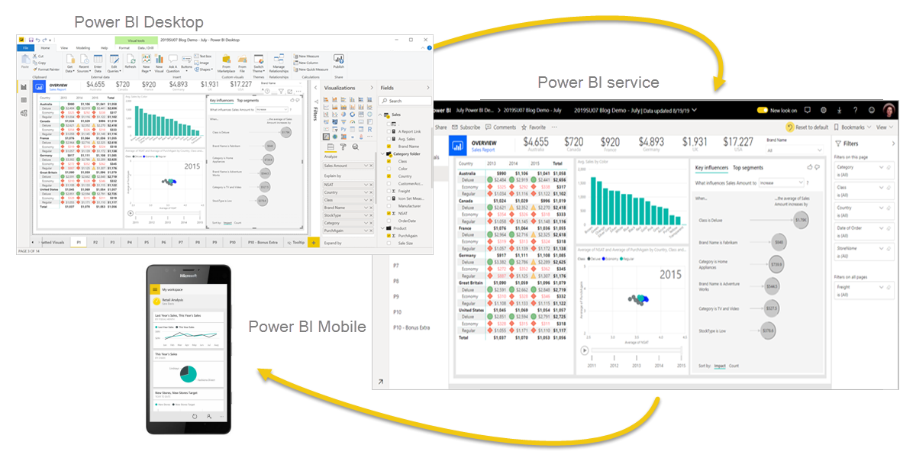

Power bi
Power BI is a collection of software services, apps, and connectors that work together to turn your unrelated sources of data into coherent, visually immersive, and interactive insights. Your data may be an Excel spreadsheet, or a collection of cloud-based and on-premises hybrid data warehouses. Power BI lets you easily connect to your data sources, visualize and discover what's important, and share that with anyone or everyone you want.
The parts of Power BI
Power BI consists of several elements that all work together, starting with these three basics:
A Windows desktop application called Power BI Desktop.
An online SaaS (Software as a Service) service called the Power BI service.
Power BI mobile apps for Windows, iOS, and Android devices.

Slide 9

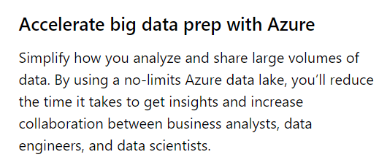

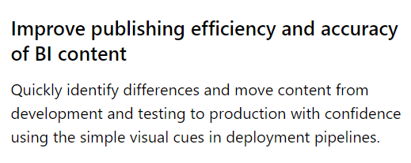
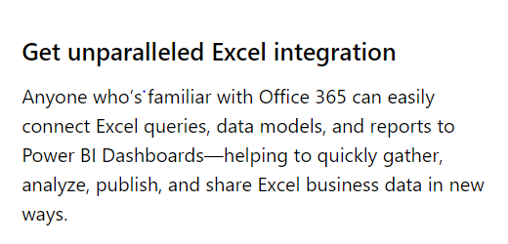
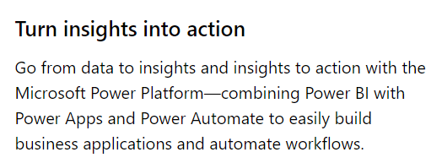
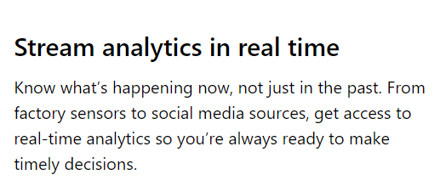

Power Bi features

Slide 10
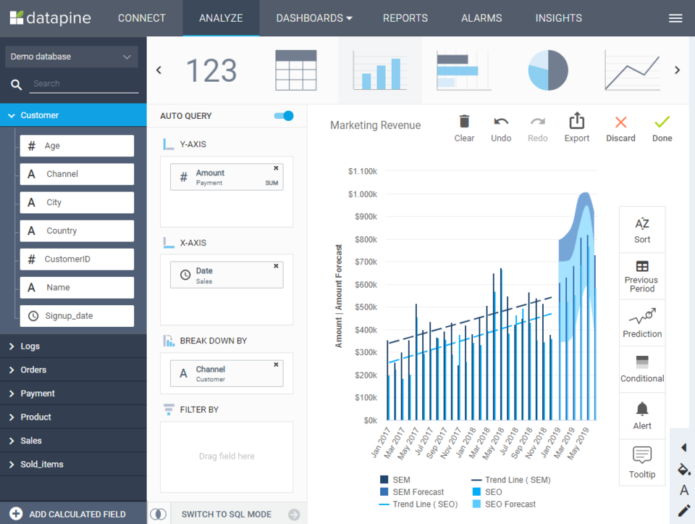
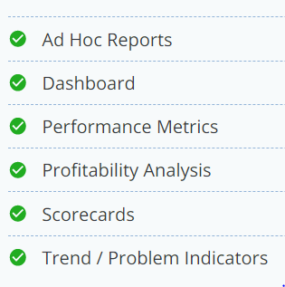
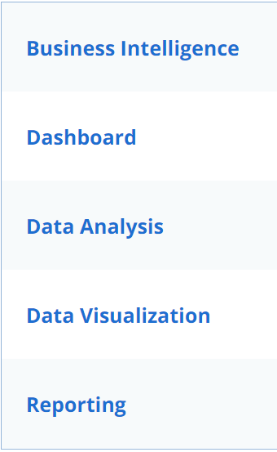
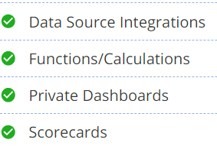
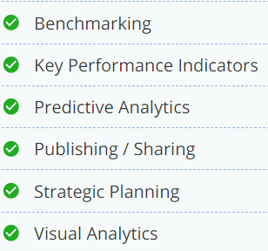
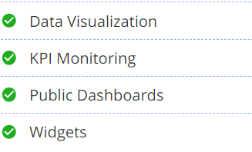

datapine
What is datapine?
Datapine helps companies transform data into valuable new insights and make data-driven decisions in real time. A user-friendly drag & drop interface allows non-technical users to understand complex data sets and answer important business questions. Datapine offers a variety of innovative BI 4.0 features such as intelligent alerts, predictive analytics and interactive dashboard functions.
Best For
Thanks to datapine's intuitive user interface, users across multiple departments & skill levels, from managers to data analysts, can analyze business data and create professional dashboards with ease.
Features

Slide 11
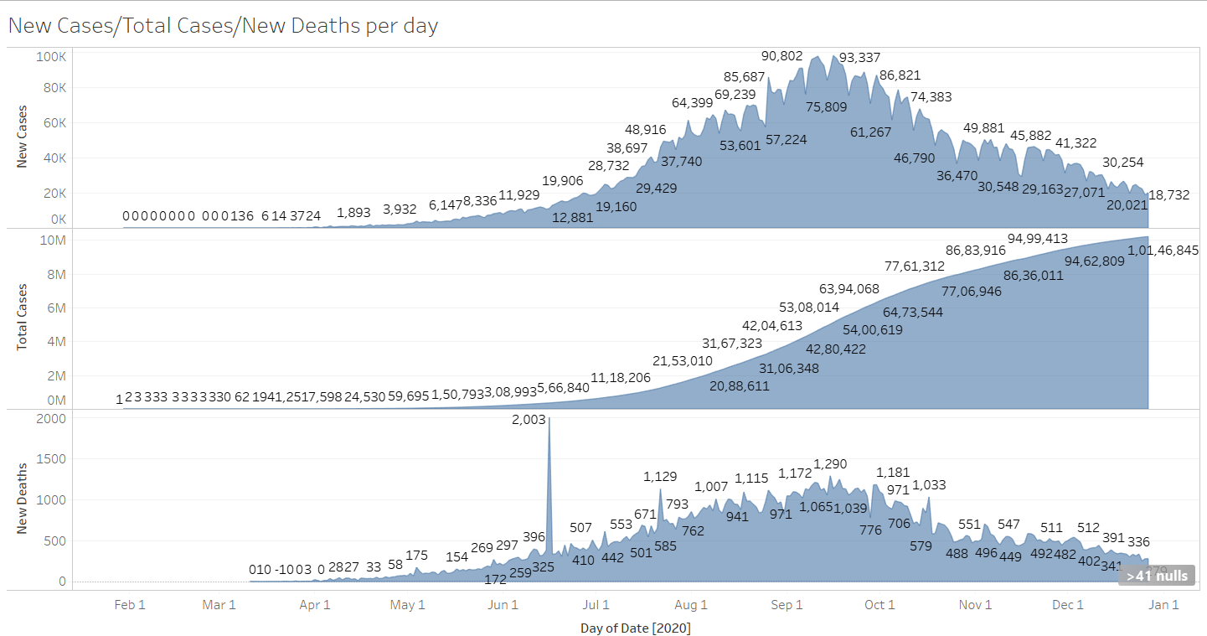
COVID-19 Trends in India
Interpretations:
New cases are decreasing, slope of total cases is decreasing as the rate at which new cases are coming have decreased.
The chart for deaths due to corona virus is similar to the variations in the new cases.

Slide 12
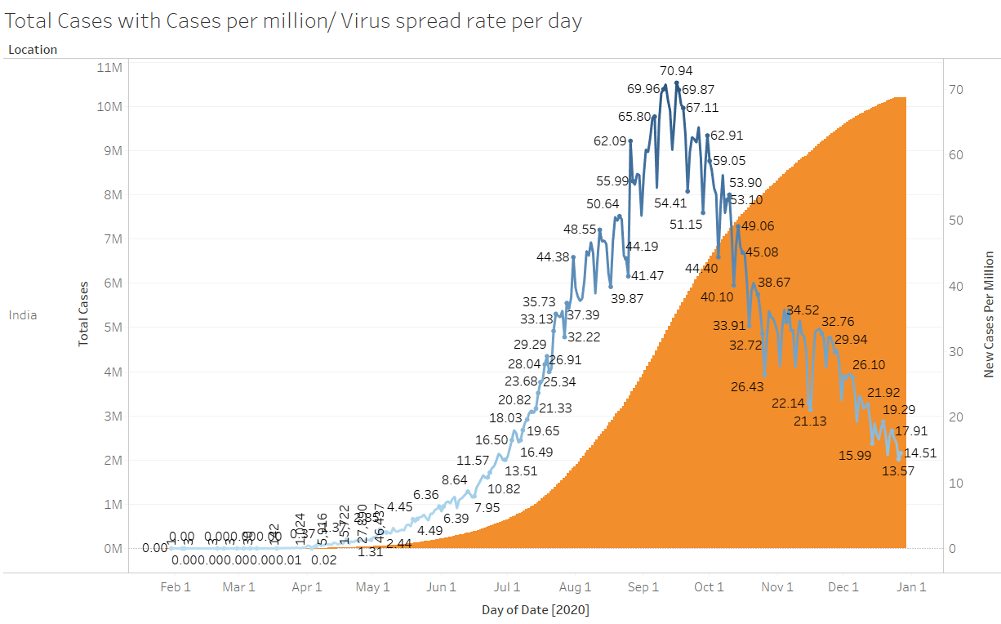
Virus Spread per million
Interpretations:
As the virus spread increases per million the slope of the total cases increases which signifies higher spreads of virus. The spread of the virus was the greatest in the month of September 2020 and has been decreasing.
Reasons for decrease: less testing in many states, less spread of the virus, more precautions are taken etc.

Slide 13
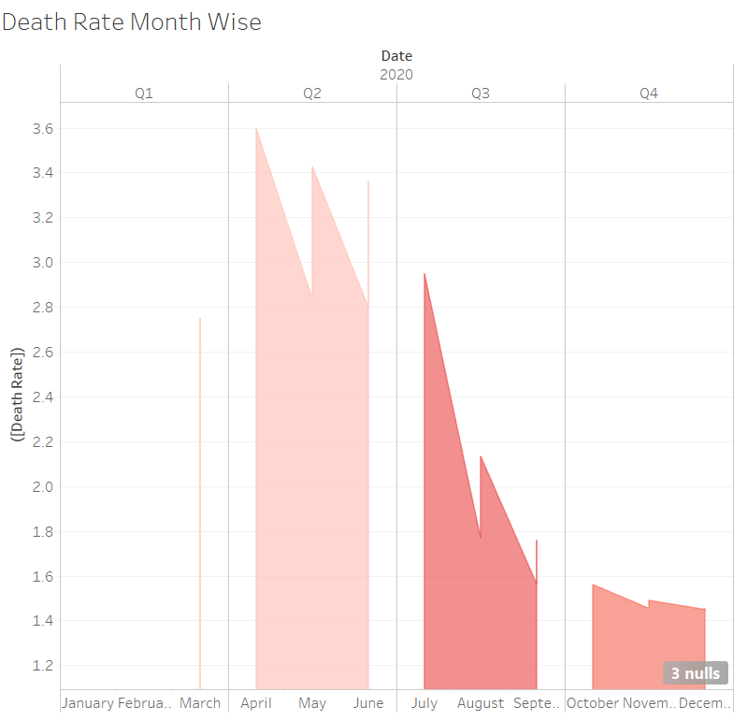
Death rate due to covid-19
Interpretations:
The death ratio are decreasing in every quarter.
However, the depth of the chart is increasing and hence the number of cases are increasing rapidly which is greater than the increase in the death rate. Since the number of cases are increasing rapidly so death rate is decreasing.

Slide 14
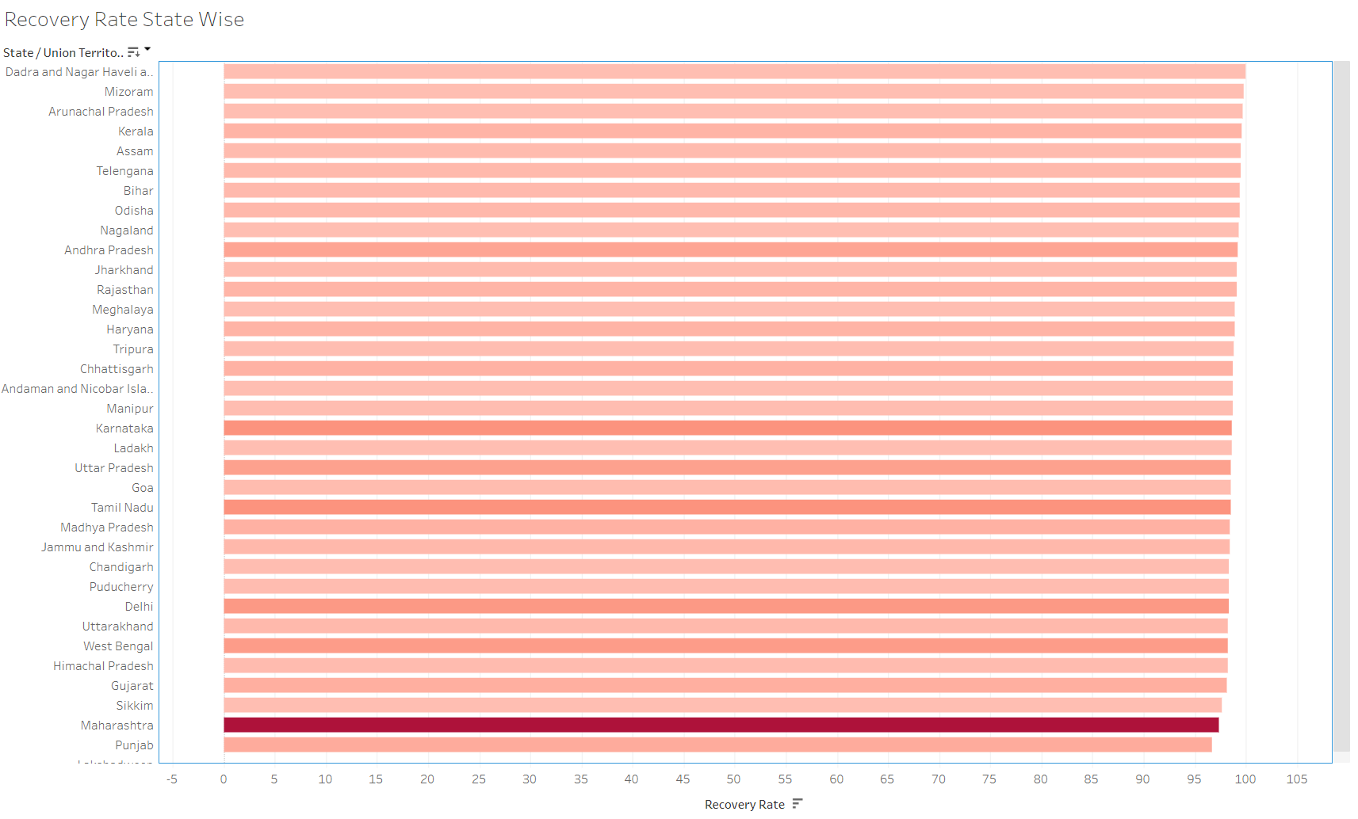
Recovery Rate
Interpretations:
Recovery rate is above 95% in all states.
However the depth of the colour shows the number of deaths. States/UT with higher number of cases have less recovery rates.

Slide 15
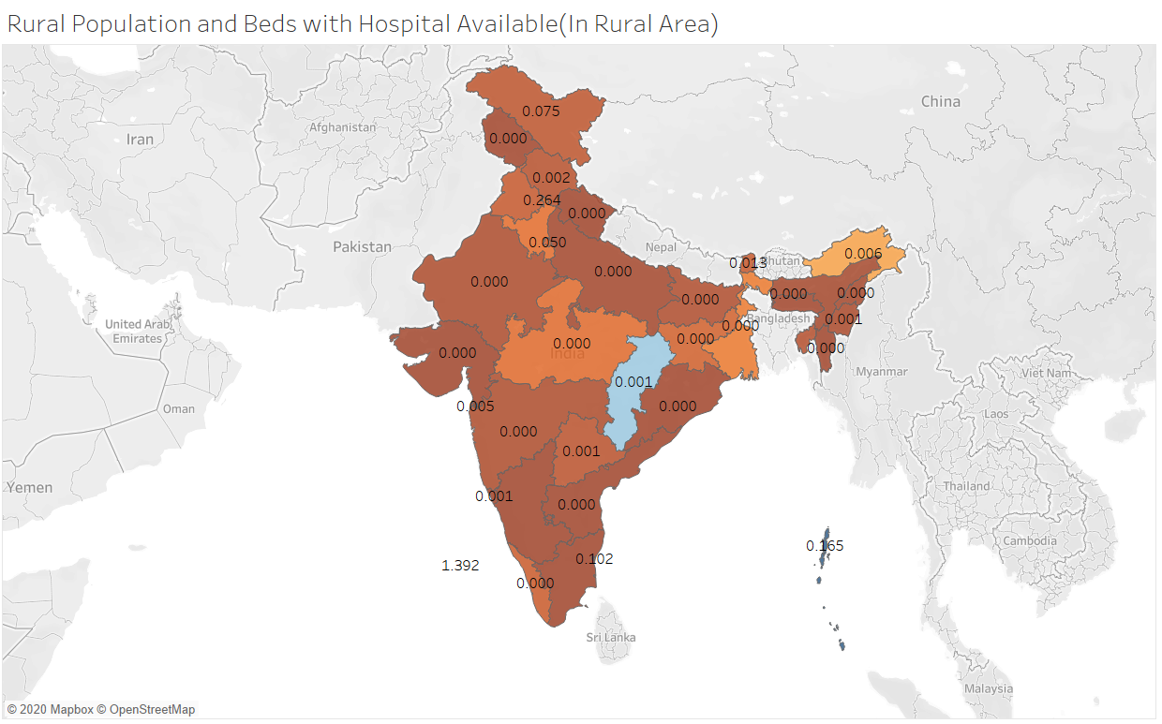
Rural area analysis
Interpretations:
Hospital Beds availability in rural area is less than 0.000 per person in more than 10 states.
Rural areas in many states do not have adequate hospitals if the virus is exposed to rural areas.
Government should isolate rural areas in the state like Gujrat, Karnataka, Tamil Nadu and Andhra Pradesh as less number of hospital beds/ hospitals are there.
Chhattisgarh is the most well equipped in term of number of hospitals as the are 2,471 hospitals present there.
Lakshadweep has 1.392 beds available per person followed by Chandigarh which has .256 beds available per person in rural areas.

Slide 16
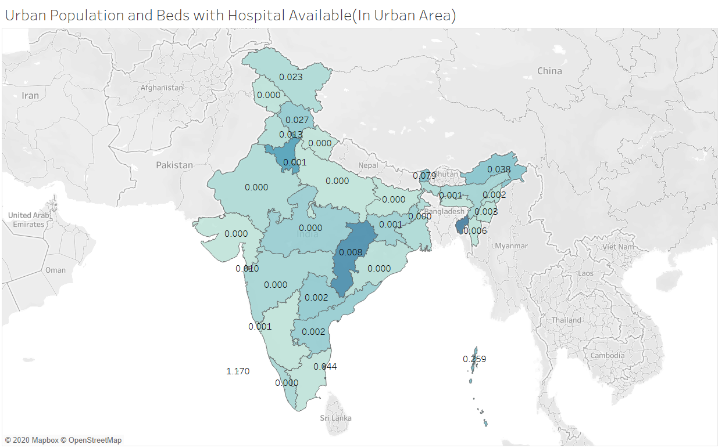
Urban Area Analysis
Interpretations:
Hospital Beds availability in urban area is less than 0.000 per person in more than 8 states.
Government should isolate states like Bihar, Odisha, Gujrat and Karnataka as less number of hospital beds/ hospitals are there.
Puducherry is the most well equipped in term of number of hospitals as the are 525 hospitals present there.
Lakshadweep has 1.170 beds available per person followed by Andaman and Nicobar Islands which has .259 beds available per person in urban areas.

Slide 17
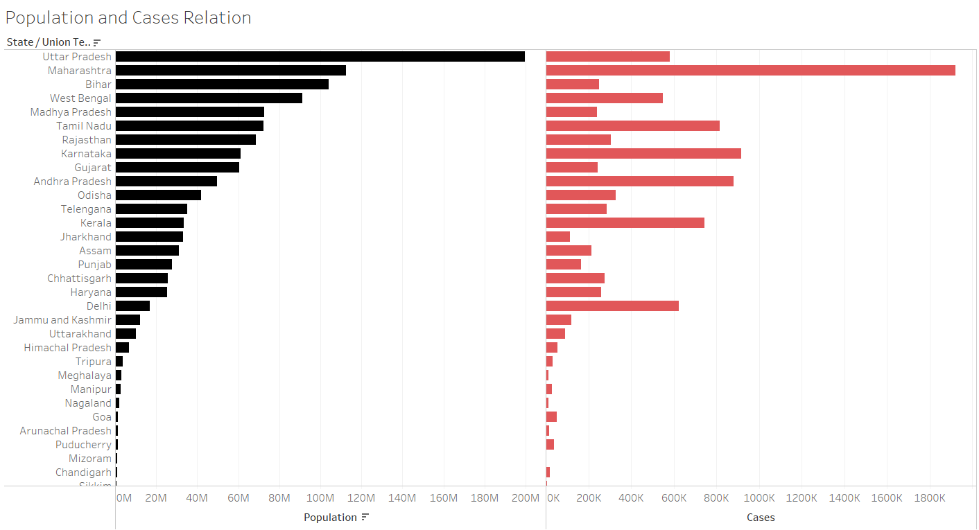
Correlation of cases with population
Interpretations:
Uttar Pradesh has the highest population but not the highest number of cases. However, Maharashtra has the highest number of cases and 2nd highest population.
Delhi has less population as compared to Bihar, West Bengal and Gujarat but more number of cases.
Population of a state/UT can not determine if the cases in the location.

Slide 18
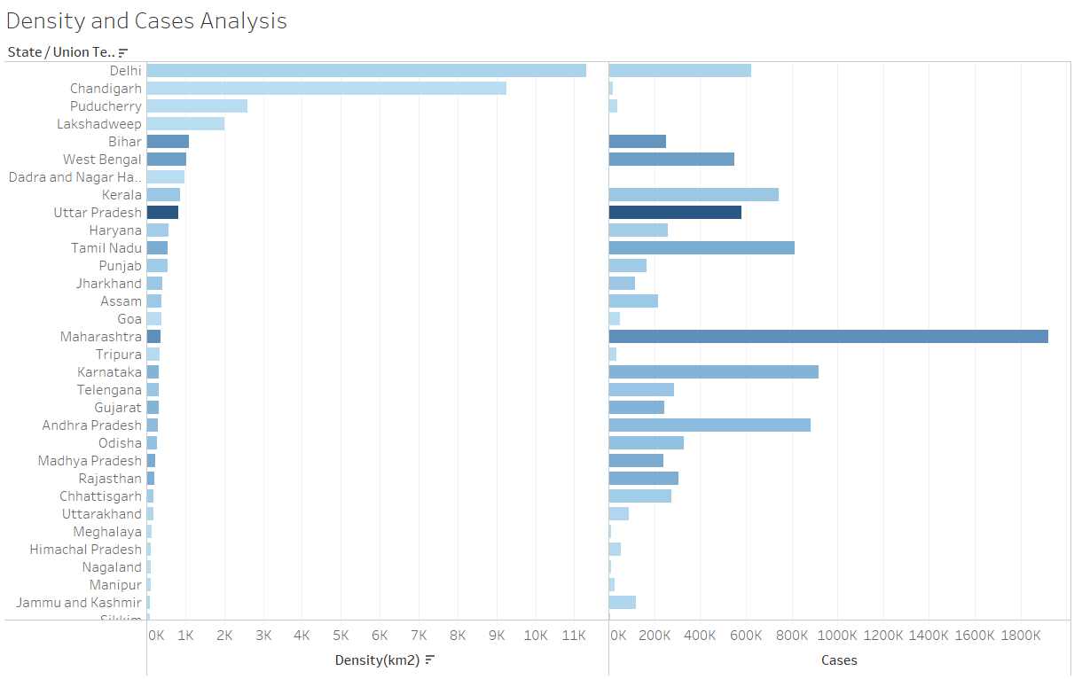
Correlation of cases with population
Interpretations:
Delhi has the highest population density followed by Chandigarh and Puducherry but not the highest number of cases .
Population and population density might increase the chances of higher spread of the virus but are not the only factors on which the spread of the virus depends on.

Slide 19
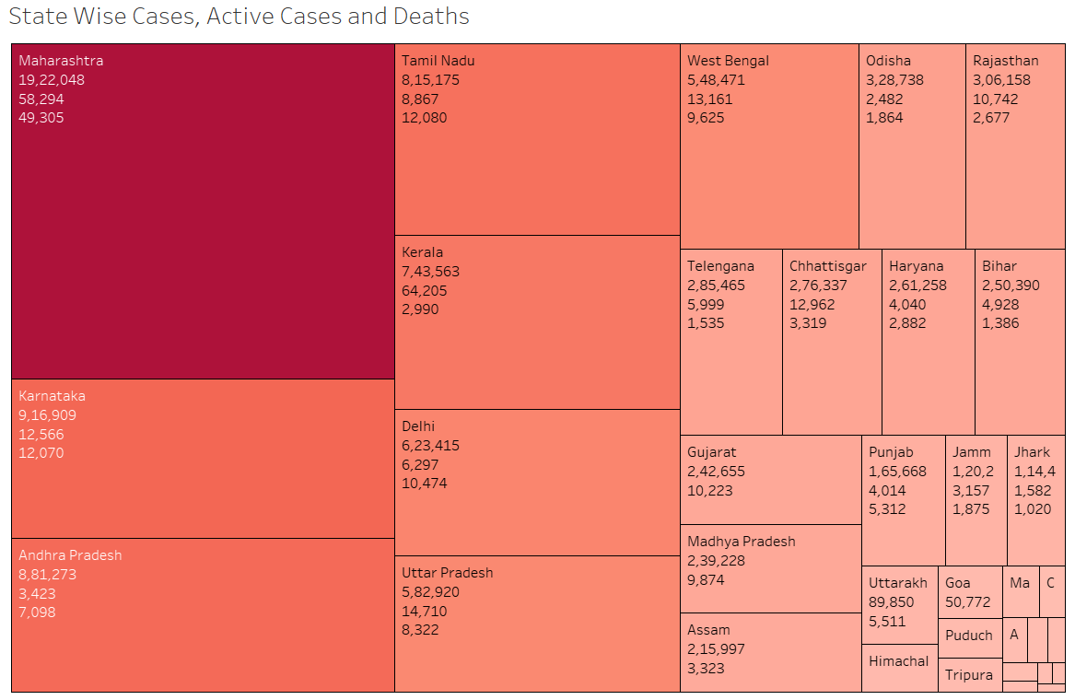
State wise cases
Interpretations:
Maharashtra is the state with the highest number of cases followed by Karnataka and Andhra Pradesh

Slide 20
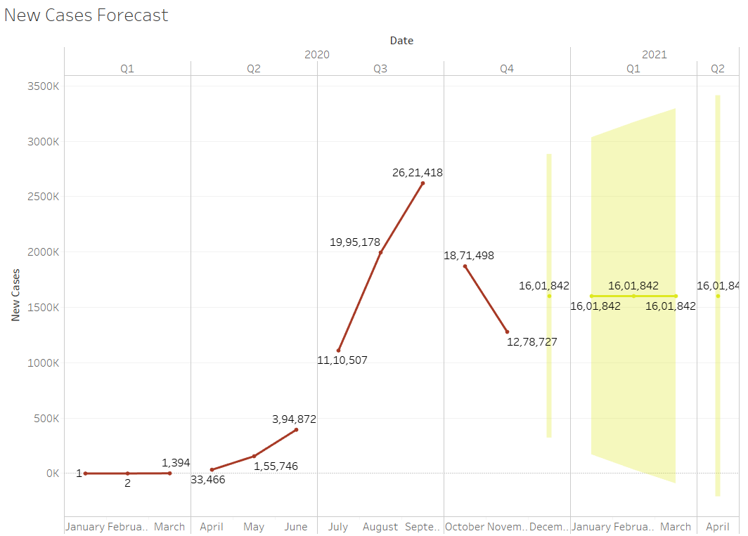
Forecast New cases covid-19
Interpretations:
New cases are set to revolve around 16,01,842 cases per month from January 2021 to April 2021.
January 2021
MAX: 28, 00, 000 cases
MIN: 30,000 cases
February 2021
MAX: 32,00,000 cases
MIN: 20,000 cases
March 2021
MAX: 34,00,000 cases
MIN: <1,000 cases

Slide 21
References Used
Sites for BI Tools:
https://public.tableau.com/en-us/s/, site for Tableau Public
https://www.toptal.com/designers/data-visualization/data-visualization-tools, Data visualization tools
https://powerbi.microsoft.com/en-us/, Microsoft Power BI
https://www.datawrapper.de/, datawrapper
Sites for dataset:
https://www.covid19india.org/, COVID 19 dataset
https://data.worldbank.org/indicator/SP.POP.TOTL?locations=IN, Population Dataset for India
https://censusindia.gov.in/Census_Data_2001/India_at_glance/variation.aspx, census data for population rural and urban
https://cddep.org/wp-content/uploads/2020/04/State-wise-estimates-of-current-beds-and-ventilators_24Apr2020.pdf, Number of beds available in India
Techniques Used:
Tableau for charts creation, using area charts, calculated fields like population density etc, treemaps, side-by-side bars, symbol maps and maps by longitude and latitude information.
Forecasting is done on linear model.

