Slide 1
UNIT 5
ENVIRONMENTAL PROTECTION
ROLE OF GOVERNMENT
LEGAL ASPECTS
INITIATIVES BY NGOs
ENVIRONMENTAL EDUCATION

Slide 2
Law for Environmental Protection
International concern for environmental protection
International concern for Sustainable Development
UN conference on Human Environment and Development-Stockholm-1972
Result-Stockholm Declaration on the Human Environment

Slide 3
Law for Environmental Protection (Cont)
The Earth Summit-
The United Nations conference on Environment and Development (UNCED) popularly known as Earth Summit-1992 at Rio de Janeiro-
150 Governments participated
Earth summit was inspired by Brundtland report 1987

Slide 4
Law for Environmental Protection (Cont)
The Result of Summit-Agenda 21
Agenda 21-a comprehensive Blue print for Global actions for Sustainable Development
Agenda 21-a voluntary action plan

Slide 5
Law for Environmental Protection (Cont)
Role of India
Constitution-Indian constitution is perhaps one of the rare constitutions of the world which contains specific provisions relating to Environmental protection
India is a signatory to many Environmental treaties

Slide 6
Law for Environmental Protection (Cont)
ENVIRONMENTAL PROTECTION
1. Environmental Legislation
2. Environmental Education
A. Constitutional Provisions
Goals, Objectives and
Guiding Principle of EE
B. Non- Government Organizations
B. Environmental
Education Program
C. Environmental
Education in India

Slide 7
Environmental Legislation
Law for Environmental Protection (Cont)
India is the first country to take initiatives.
5th June, 1972 – First discussion about environment in UN
Constitutional Provisions
The Provision for environmental protection in the constitution were made in 1976, through the 42nd amendment.
Article 48-A of the constitution provides:
“The state shall endeavor to protect and improve the environment and to safeguard forests and Wildlife of the country”.
Article 51A(g) of the constitution provides:
“It shall be the duty of every citizen of India to protect and improve the natural environment Including forests, lakes, rivers and Wildlife and to have compassion for living creatures”.

Slide 8
Law for Environmental Protection (Cont)
Indian constitution Article 51 (c ) provides that India shall respect International treaties
Devolves duty on the citizen also to preserve the nature
Article 48-A puts duty on the state regarding the protection of Environment

Slide 9
ENVIRONMENTAL LEGISLATION
Important Acts passed by the Government of India
Wildlife (protection) Act, 1972
Water (prevention and control of pollution) Act, 1974
Forest (conservation) Act, 1980
The Air (prevention and control of pollution) Act, 1981
The Environment (protection) Act, 1986

Slide 10
ENVIRONMENTAL LEGISLATION
Salient features of the Act (Water Act)- objectives
To prevent and control water pollution
To maintain wholesomeness of water
To establish control on State Boards for prevention and control of pollution
To empower the Boards for prevention/control of pollution
To provide penalties for contravention of the provisions of the Act
To establish control on state water testing laboratories.

Slide 11
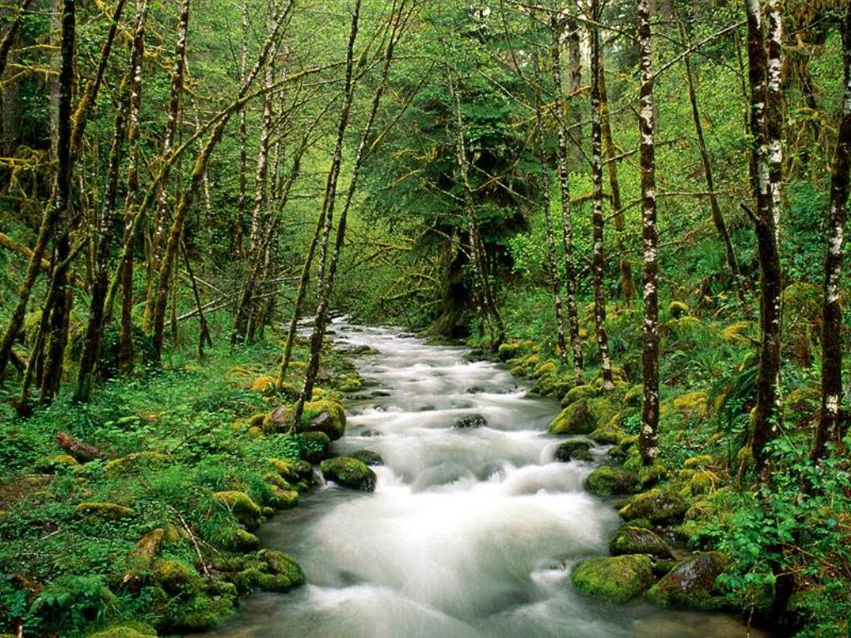
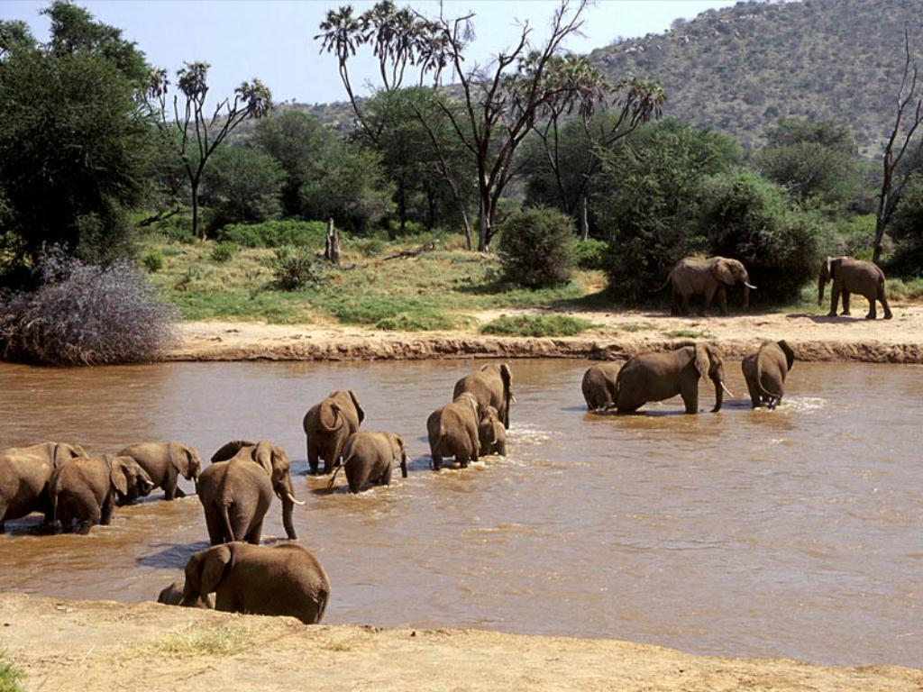

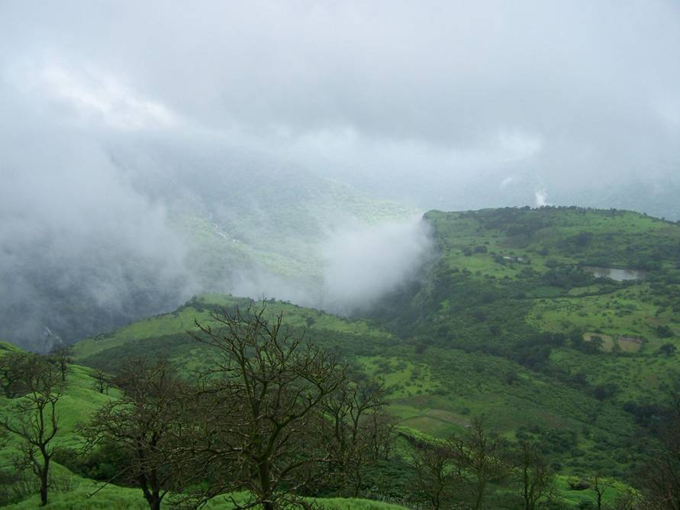

Slide 12
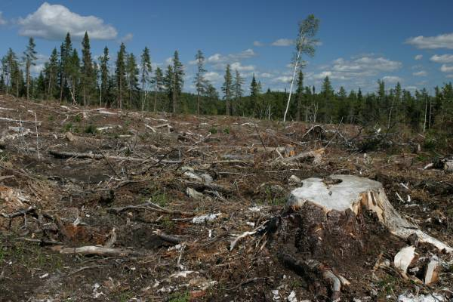
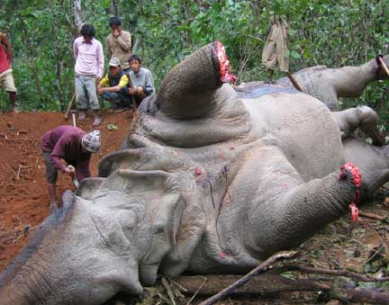
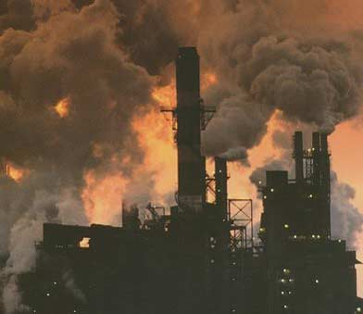
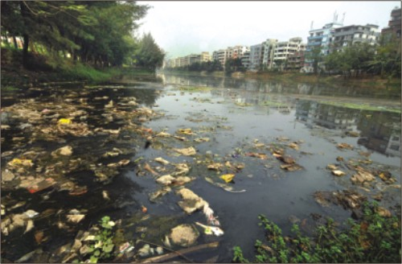

Slide 13
Environmental Legislation
ENVIRONMENTAL LEGISLATION
The Environment (protection) Act, 1986
Terms Related to Environment:
Environment includes water, air and land and the inter-relationships that exist among and between them, human beings, all other living organisms and property.
Environmental pollution means the presence of any solid, liquid or gaseous substance present in such concentration, as may be, or tend to be, injurious to environment.
Hazardous substance means any substance or preparation, which by its physico-chemical properties or handling is liable to cause harm to human beings, other living organisms, property or environment.

Slide 14
Environmental Legislation…contd.
The Environment (protection) Act, 1986
Functions of Central Government:
Setting up, the standards of quality of air, water or soil for various areas and purposes.
The maximum permissible limits of concentration of various environmental pollutants (including noise) for different areas.
The procedures and safeguards for the handling of hazardous substances.
The prohibition and restrictions on the handling hazardous substances in different areas.
The prohibition and restrictions on the location of industries and to carry on process and operations in different areas.
The procedure and safeguards for the prevention of accidents which may cause environmental pollution and providing for remedial measures for such accidents.

Slide 15
ENVIRONMENTAL LEGISLATION
Central/State pollution control Boards
Both the Boards have the objective of pollution control
Main functions of the Central pollution control Board
a) Advise the Central Govt. for control of pollution of water
b) Co-ordinate the activities of the State Boards

Slide 16
ENVIRONMENTAL LEGISLATION
c) Provide technical assistance and guidance to State Boards
d) Plan and organise training
e) Media program organising
f) To perform functions of the State Board in case of default
g) Collect and public technical date
h) Lay down standards for stream/well
i) Plan and organize pollution control programs
j) Establish laboratories for testing

Slide 17
ENVIRONMENTAL LEGISLATION
Functions of State Boards
Plan and control/abate pollution of water
Advise State Govt. on matters of water pollution
To collect and spread information
To investigate and conduct research in matters of pollution
To work in tune with CPCB
To inspect sewerage or trade effluents
To lay down standards of sewerage/trade effluents etc.

Slide 18
Environmental Legislation
The Environment (protection) Act, 1986
Guidelines to State Pollution Control Board:
They have to advise the industries for treating the wastewater and gases with the best available technology to achieve the prescribed standards.
The industries have to be encouraged for recycling and reusing the wastes.
They have to encourage the industries for recovery of biogas, energy and reusable materials.
While permitting the discharge of effluents and emissions into the environment, the State Boards have to take into account the assimilative capacity of the receiving water body.
The Central and State Boards have to emphasize on the implementation of clean technologies by the industries in order to increase fuel efficiency and reduce the generation of environmental pollutants.

Slide 19
Environmental Legislation
The Environment (protection) Act, 1986
Environmental Impact Assessment (EIA):
29 types of Industries under schedule I of the rule need Central Government clearance. While others require clearance form State Pollution Control Board (SPCB).
Clearance request / application must contain;
EIA report,
Risk analysis report,
NOC from the SPCB,
Commitment regarding availability of water and electricity,
Summary of project/feasibility report,
Filled in questionnaire for environment appraisal,
Comprehensive rehabilitation plan, if needed.

Slide 20
Environmental Legislation
The Environment (protection) Act, 1986
Hazardous Wastes (management and handling) Rules, 1989:
Identified 18 hazardous waste categories.
Responsibility of occupier,
Proper handling and disposal without adverse effects.
Guideline should be followed for handling, storage, treatment, transport and disposal.
Environmental Audit:
Checking whether or not a company is complying with the environmental laws and regulations.

Slide 21
Prevention and Control of Water Pollution
Under this act, State Government has power to restrict the application of the Act to certain areas
It has also power to obtain information
PCBs have power to take samples of effluents.
Report of analysis
PCBs have power to enter any factory and inspect
It can prohibit use of stream or well for disposal of polluting matter
It can regulate new outlets and new discharges

Slide 22
Cont…
PCBs to undertake emergency measures in case of pollution of stream or well
PCBs can also approach for restraining apprehended pollution of water in streams or wells
It can give directions

Slide 23
Cont…
Water Act – Chapter VII
Under this chapter penalties can be levied for certain acts
- Destruction of notices of PCBs
- Obstructing PCB persons from doing their duty
- damaging property of PCBs
- non furnishing of information

Slide 24
Cont…
- Failure to intimate accident
- for willful omission of information
- or making false statement etc.
- punishment including imprisonment with penalty – Rs.10,000 - 3 months

Slide 25
Cont…
Under this act Central water laboratory, State water Laboratories are set up
Analysts appointed for analyzing the samples
Reports are published by analysts
PCBs to take the help from local bodies also

Slide 26
Cont…
Section 63 of Water Act gives power to make rules to Central Government
Section 64 to State Government
States shall make rules on matters which are not dealt with by the Central Rules

Slide 27
Environmental Legislation
Non – Government Organizations (NGO’s):
Voluntary organization interacting between Government and local environmental issues.
With goodwill of people , motivated by a genuine concern for the environment.
Chipko movement for conservation of trees by Dasholi Gram Swarajya Mandal in Gopeshwar.
Narmada Bachao Andolan by Kalpavriksh.

Slide 28
Environmental Legislation
Non – Government Organizations (NGO’s):
India’s Environmental Programs,
National Environmental awareness campaign – through audio-visual programs, seminars, symposia, training program etc.,
Paryavarn vahinis, constituted in 184 districts – to prevent poaching, deforestation and environmental pollution.
More than 4000 NGO’s have been given financial assistance for creating environmental awareness.
An Environmental Information System (ENVIS) network has been setup to disseminate information on environmental issues.

Slide 29
Environmental Legislation
Non – Government Organizations (NGO’s)
Some of Environmental Organization in India:
Center for Science and Environment
CPR Environmental education centre
CYWEN Youth for Environment
Friends of the River Narmada
Haryana Environmental Society
Indian Environmental Association
People’s Commission on Environment and Development India

Slide 30
Environmental Education
Objective of Environmental Education:
Awareness
Knowledge
Attitude
Skill
Evaluation ability
Participation

Slide 31
Environmental Education
Guiding principle:
Consider the environment totally
Continuous life process
Inter disciplinary approach
Active participation
Examine
Focus
Environmental aspects in plan
Thinking and problem solving.
Cooperation
Teaching and learning
Discover symptoms and cause

Slide 32
Environmental Education
Environmental Education Program:
Environmental studies
Environmental science
Environmental engineering
Environmental education in India
Goals:
Improve the quality of environment.
To create an awareness among the people on environment problems and conservation.
To create an atmosphere so that people participate in decision-making and develop the capabilities to evaluate the developmental programs.

Slide 33
Women & Environment Sustainability
"Women have a vital role in environmental management and development. Their full participation is therefore is essential to achieving sustainable development"
If we talk of natural management from a global perspective, whom do we find in the forefront of the race for protection and preservation of the resources. The answer comes very naturally, it is the women. Women particularly those living in rural areas or mountain areas have special relationship with the environment.

Slide 34
Women & Environment Sustainability
All women have relationship with environment but the approach is different from Urban Areas.
They are more close to the nature than men and this very close relationship makes them perfect managers of an eco-system.
The life of mountain women is so much intertwined with the environment that whole ecosystem revolves around her and she can't even think of her survival without it.
For her forest is her mother's home as she is entirely dependent on the forest to meet her daily needs such as - water, fodder, fuels, minor forest product etc.

Slide 35
Women & Environment Sustainability
Role of Women in Conservation of Environment
More than 70% of the Indian population is rural based.
Traditionally, women have been responsible for subsistence and survival for water, food, fuel, fodder and habitat, though they rarely get the credit for nurturing these life support systems. Added to these environmental destruction, exacerbates women's problems in a way very difficult from that of men.
Women have always been the principal conservers of bio-diversity. Even today they perform duties such as seed selection, multiplication and conservation. The on-farm conservation traditions of rural and tribal women, with reference to agro-biodiversity are well known.

Slide 36
Women & Environment Sustainability
Traditionally, women have dealt with non-monetized biomass based subsistence economy of the household i.e. firewood, cow dung, crop wastes, organic manure, etc.
In comparison men tend to destroy nature to earn cash even if it means creating hardship in their own families for their womenfolk to collect fuel and fodder e.g. sale of herbs and wood.
In developing areas of the world, women are considered the primary users of natural resources (Land, Forest and water), because they are the ones who are responsible for gathering food, fuel and fodder.
Although in these countries, women mostly can't own the land and farms outright, they are the ones who spend most of their time working on the farms to feed the household.

Slide 37
Women & Environment Sustainability
Shouldering this responsibility leads them to learn more about soil, plants, and trees and not misuse them.
Although, technological inputs increase male involvement with land, many of them leave the farm to go to cities to find jobs; so women become increasingly responsible for an increasing portion of farm tasks.
These rural women tend to have a closer relationship with land and other natural resources, which promotes a new culture of respectful use and preservation of natural resources and the environment, ensuring that the following generations can meet their needs.

Slide 38
Women & Environment Sustainability
Keeping in view the inherent capabilities of women in the management as well as the need for women entrepreneurship, development, educational and vocational training in various fields, communication skills, creativity and innovation, quality management and control, inventory and production management need to be strengthened throughout the length and breadth of the country.
To achieve this, resources and strength of women need to be channelized to develop their full potential so as to take their rightful place as equal partners in all sphere.

Slide 39
Women & Environment Sustainability
As the world moves forward at a phenomenal speed with scientists and technological advances, there is a growing feeling that biotechnological empowerment of women is absolutely essential for progress.
With this in view and taking note of the potential of Biotechnology, the Department of Biotechnology has initiated programmes since 1998 to empower women and rural population by imparting skills for additional income generation.

Slide 40


