Slide 1
Sigma First Friday Features
{Monthname} 2026

Slide 2


Contents
Spotlight Features
Quick-Hits by Feature Category
New QuickStarts
Additional Resources

Slide 3
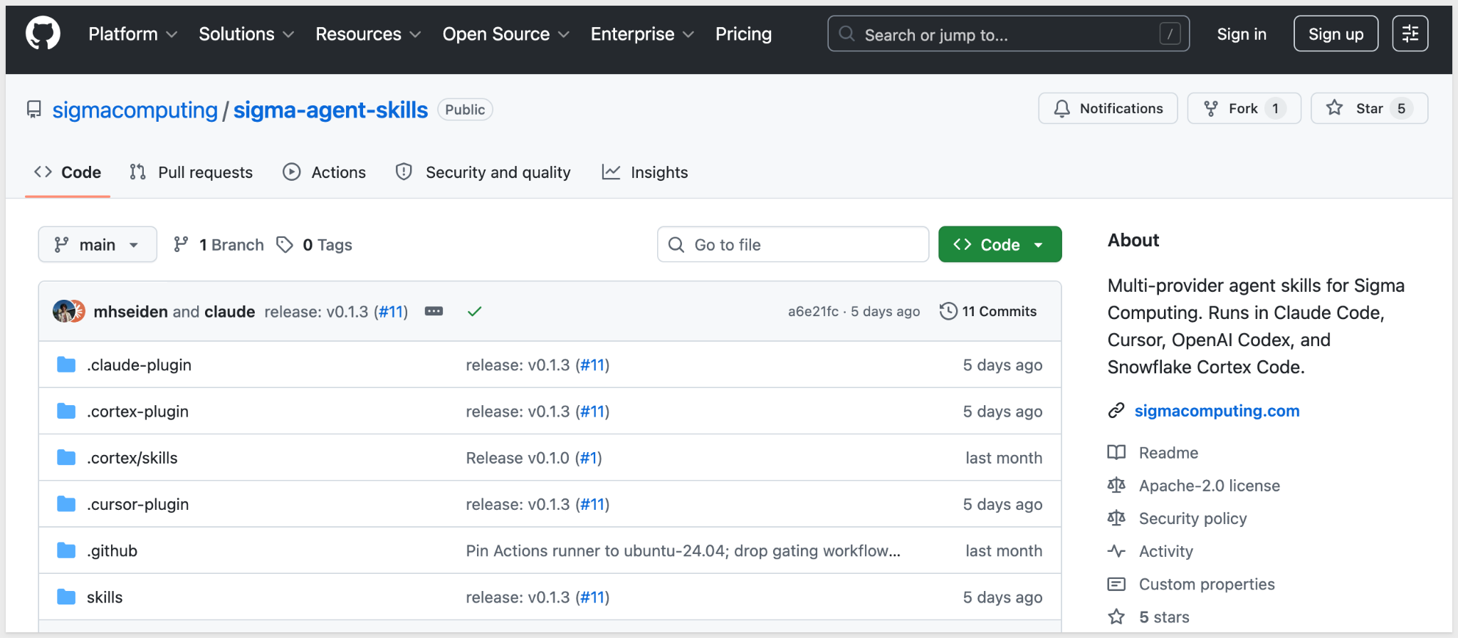
Agent Skills for Sigma
GA
An open-source multi-provider Github repository providing agent skills for Sigma.
Install agent skills to enable AI assistants to authenticate to the Sigma REST API and create Sigma documents as code. Skills are available through the public skills repository.
Why it matters:
This opens Sigma to AI-driven automation workflows — agents can authenticate and build Sigma content programmatically, extending what's possible for teams embedding AI assistants into their development and analytics pipelines.
QuickStart: Sigma Skills for AI Assistants

Slide 4
Administration - Quick Hits
Databricks Sample Connection
The Sigma Sample Catalog, a sample Databricks connection, is now available to all Sigma organizations upon request for testing and development purposes. This gives teams a ready-made environment to explore Sigma's Databricks integration without needing to configure their own connection.
Sigma Templates Refinement
To ensure that the available Sigma templates shared to every organization are relevant and high quality, some Sigma-provided templates are now hidden from the list.

Slide 5
New QuickStarts in May
Sigma Skills for AI Assistants
This QuickStart shows how to install and use Sigma's open-source agent skills in Claude Code so an AI assistant can authenticate to Sigma, call the REST API, and build data models through natural-language prompts.
Why it matters:
This is the "API + agent" pattern in practice — open-source skills give any supported AI assistant the context to handle authentication, call the right endpoints, and follow Sigma's conventions. Developers and technical analysts manage workbooks, members, and data models through plain-language prompts while permissions and audit trails stay with Sigma. Each data model edit becomes a versioned JSON artifact your team can diff, review, and redeploy.

Slide 6
Bug Fixes
Invalid Image URL Warning — The editor now displays an Invalid image URL alert when background image URLs are malformed.

Slide 7



Additional Resources
Blog
Community
Help Center
QuickStarts

