Slide 1
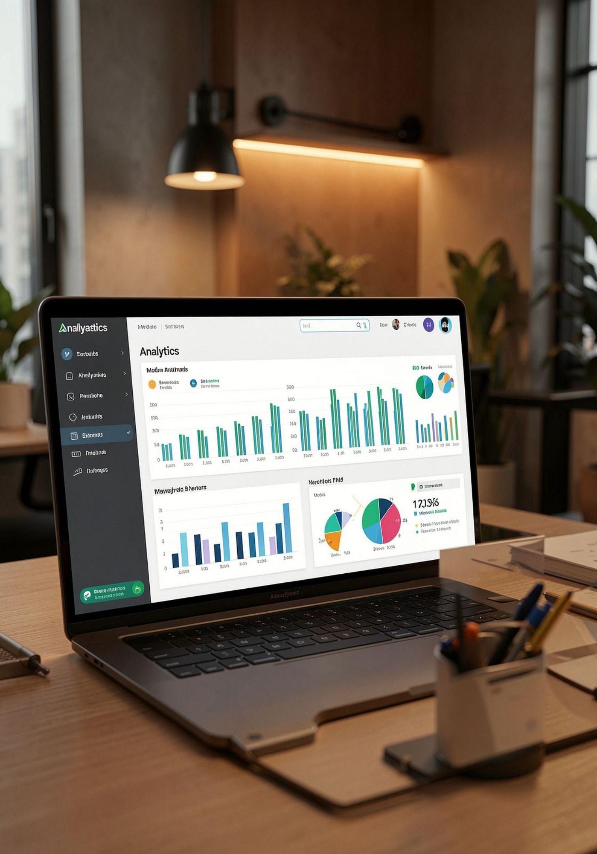
Customer Shopping Behavior — Executive Summary
Analysis of 3,900 transactions to reveal spending patterns, product preferences, subscription behavior, and customer segments to guide strategic decisions.

Slide 2
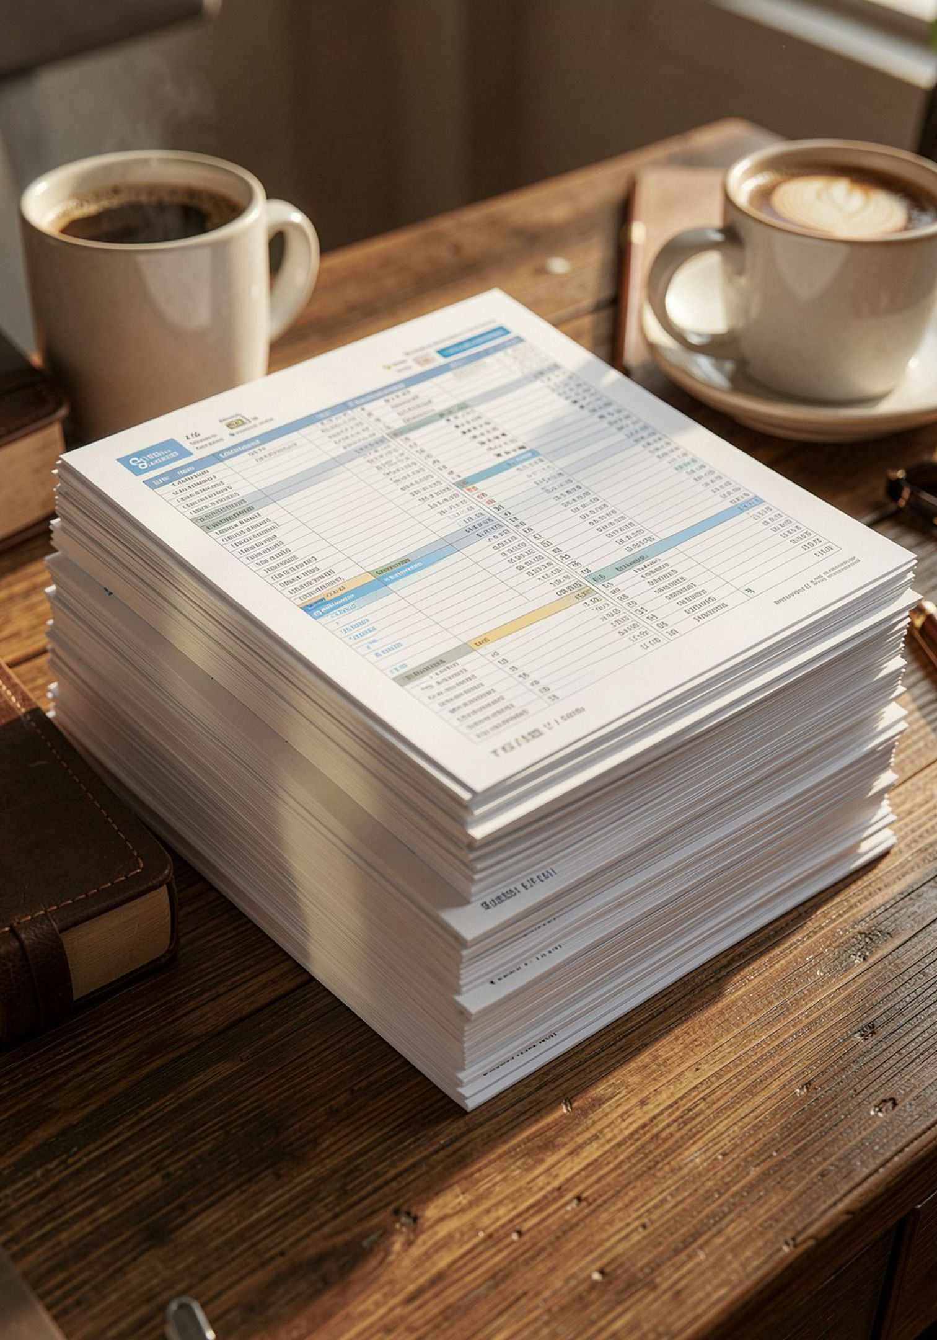
Dataset Snapshot
Rows & Columns
Key Features
3,900 rows · 18 columns
Demographics, purchase details, behavior, subscription, shipping, ratings
Missing Data
37 nulls in Review Rating — imputed with category median

Slide 3

Data Preparation & Engineering
Loaded with pandas; inspected using df.head(), df.info(), df.describe(). Standardized column names to snake_case. Imputed missing ratings by product category. Dropped redundant promo_code_used after consistency check.
Engineered features: age_group and purchase_frequency_days. Exported cleaned DataFrame to MySQL.

Slide 4
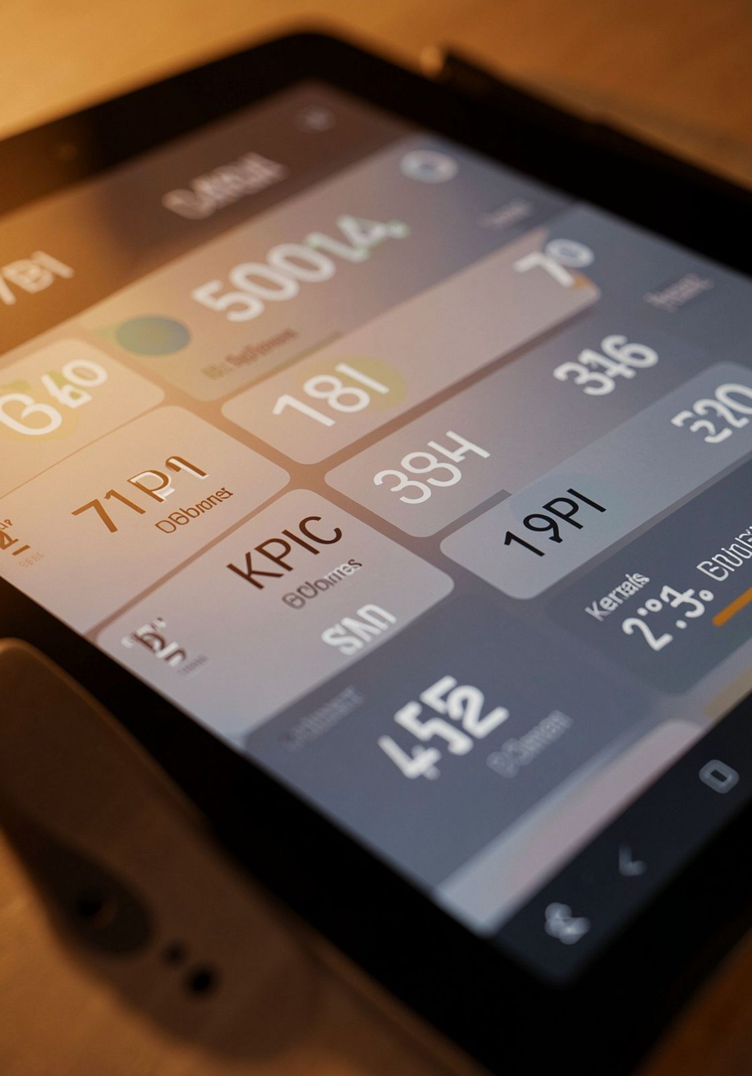
Top-Level Metrics
Customers
Avg Purchase
3,900 total
$59.76
Avg Rating
Subscription Rate
3.75 (after imputation)
27% subscribed · 73% not subscribed

Slide 5
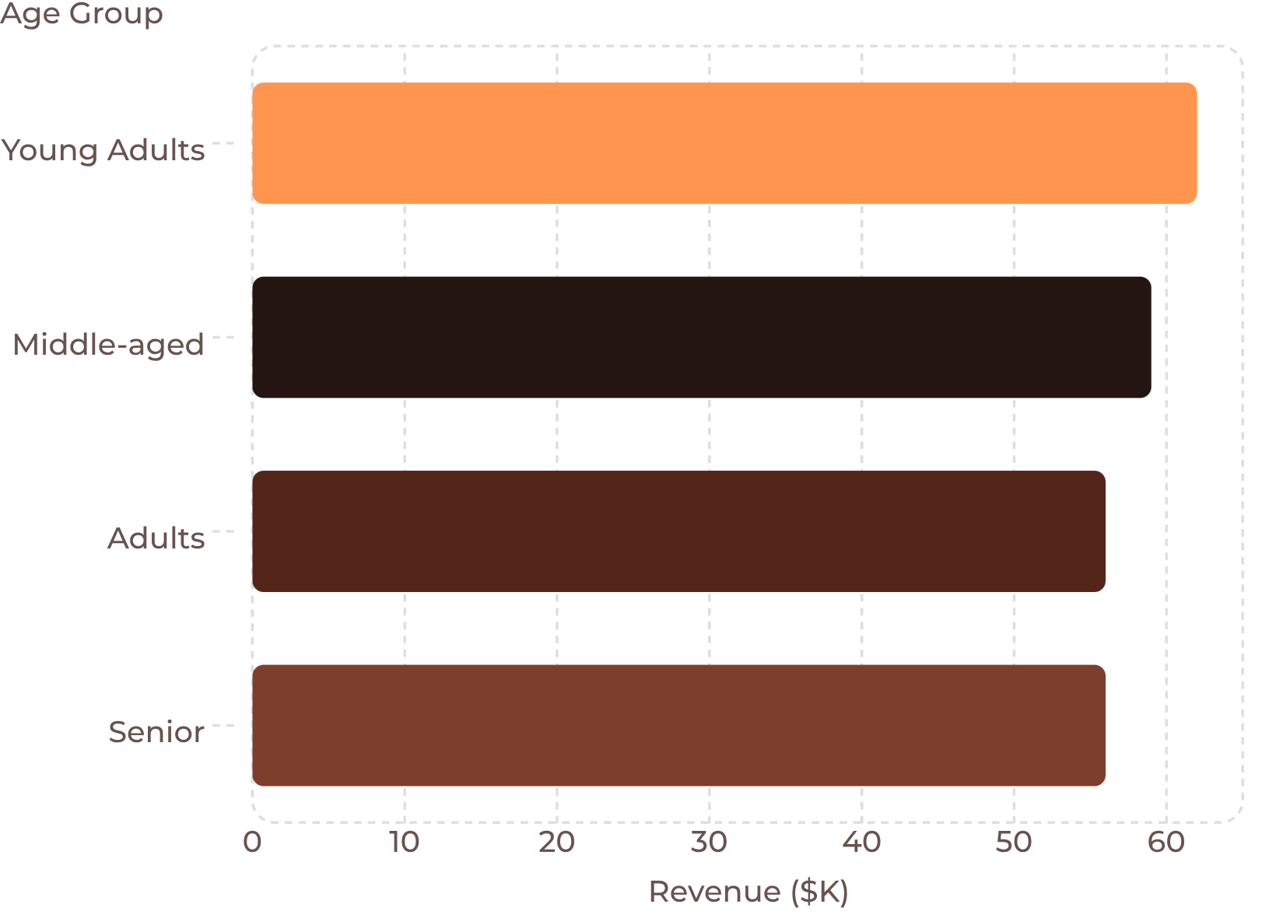
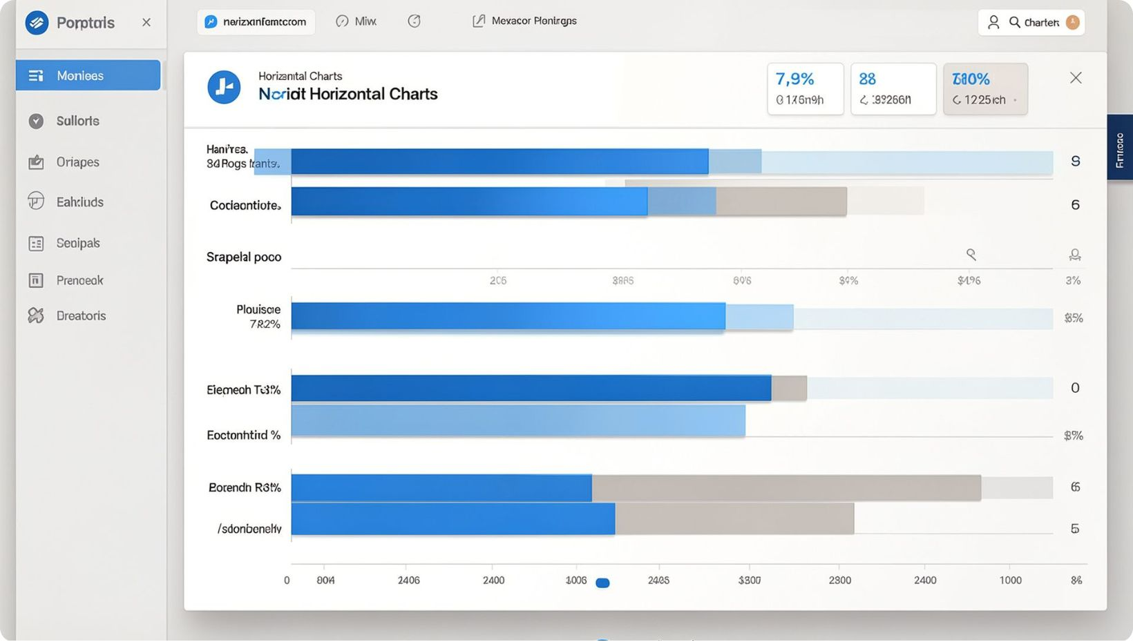
Revenue & Demographics
Revenue is concentrated in Young Adults and Middle-aged groups. Segment marketing to these cohorts for greater ROI.

Slide 6
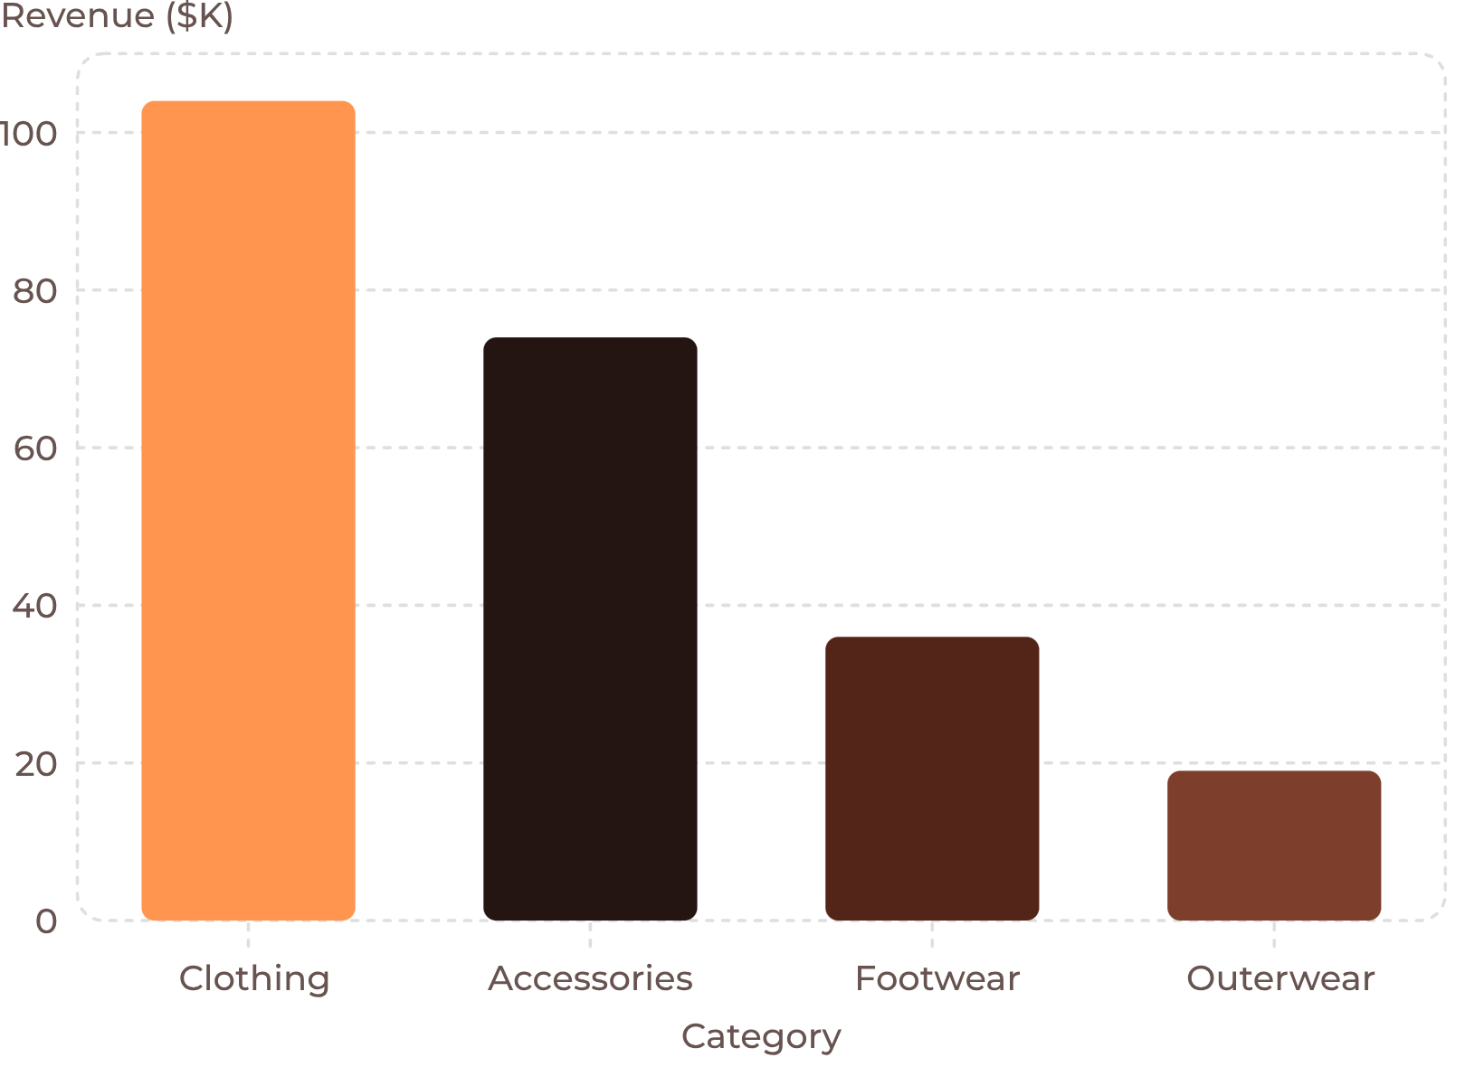
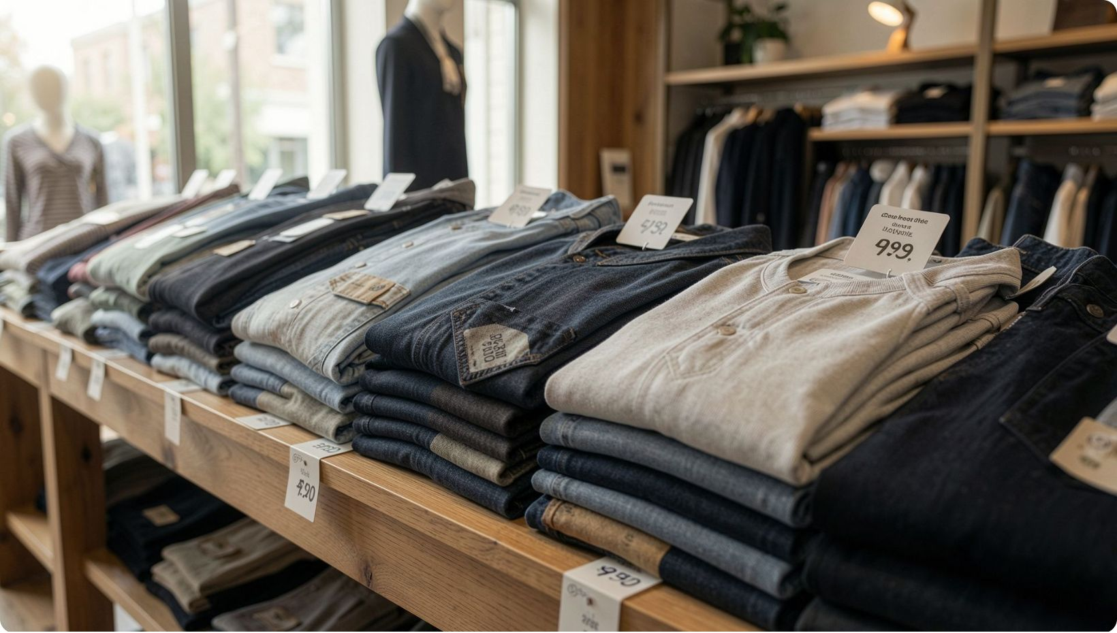
Category Performance
Top by revenue: Clothing leads. By unit sales: Clothing (1,737), Accessories (1,240), Footwear (599), Outerwear (324). Use promotions to protect margin while driving volume.

Slide 7



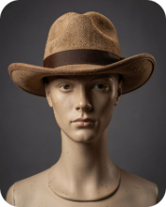

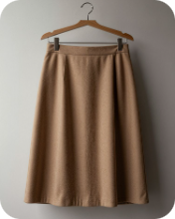
Product & Rating Highlights
Gloves — 3.86
Sandals — 3.84
Boots — 3.82
Hat — 3.80
Handbag — 3.78
Skirt — 3.78

Slide 8
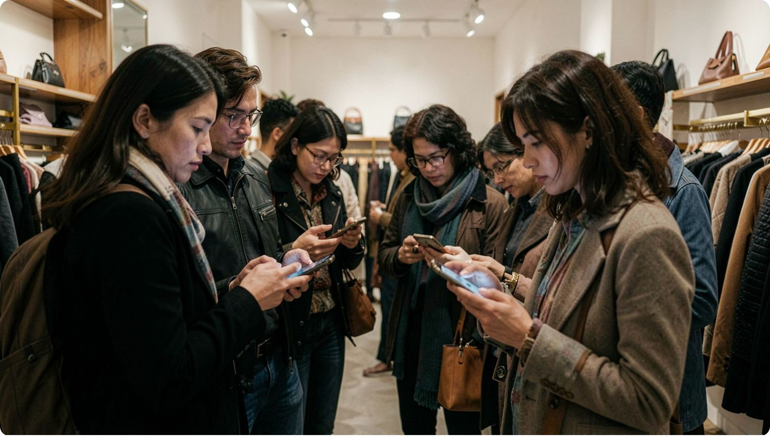
Behavioral Patterns & Segments
1
Customer Segments
Loyal: 3,116 · Returning: 701 · New: 83
2
Subscribers vs Non
Subscribers: 1,053 (avg $59.49, total $62,645). Non-subscribers: 2,847 (avg $59.87, total $170,436).
3
Discount Dependence
839 customers used discounts yet spent above average — indicates high-value discount users worth targeted loyalty offers.
Top discount-rate items: Hat 50%, Sneakers 49.66%, Coat 49.07%, Sweater 48.17%, Pants 47.37%.

Slide 9
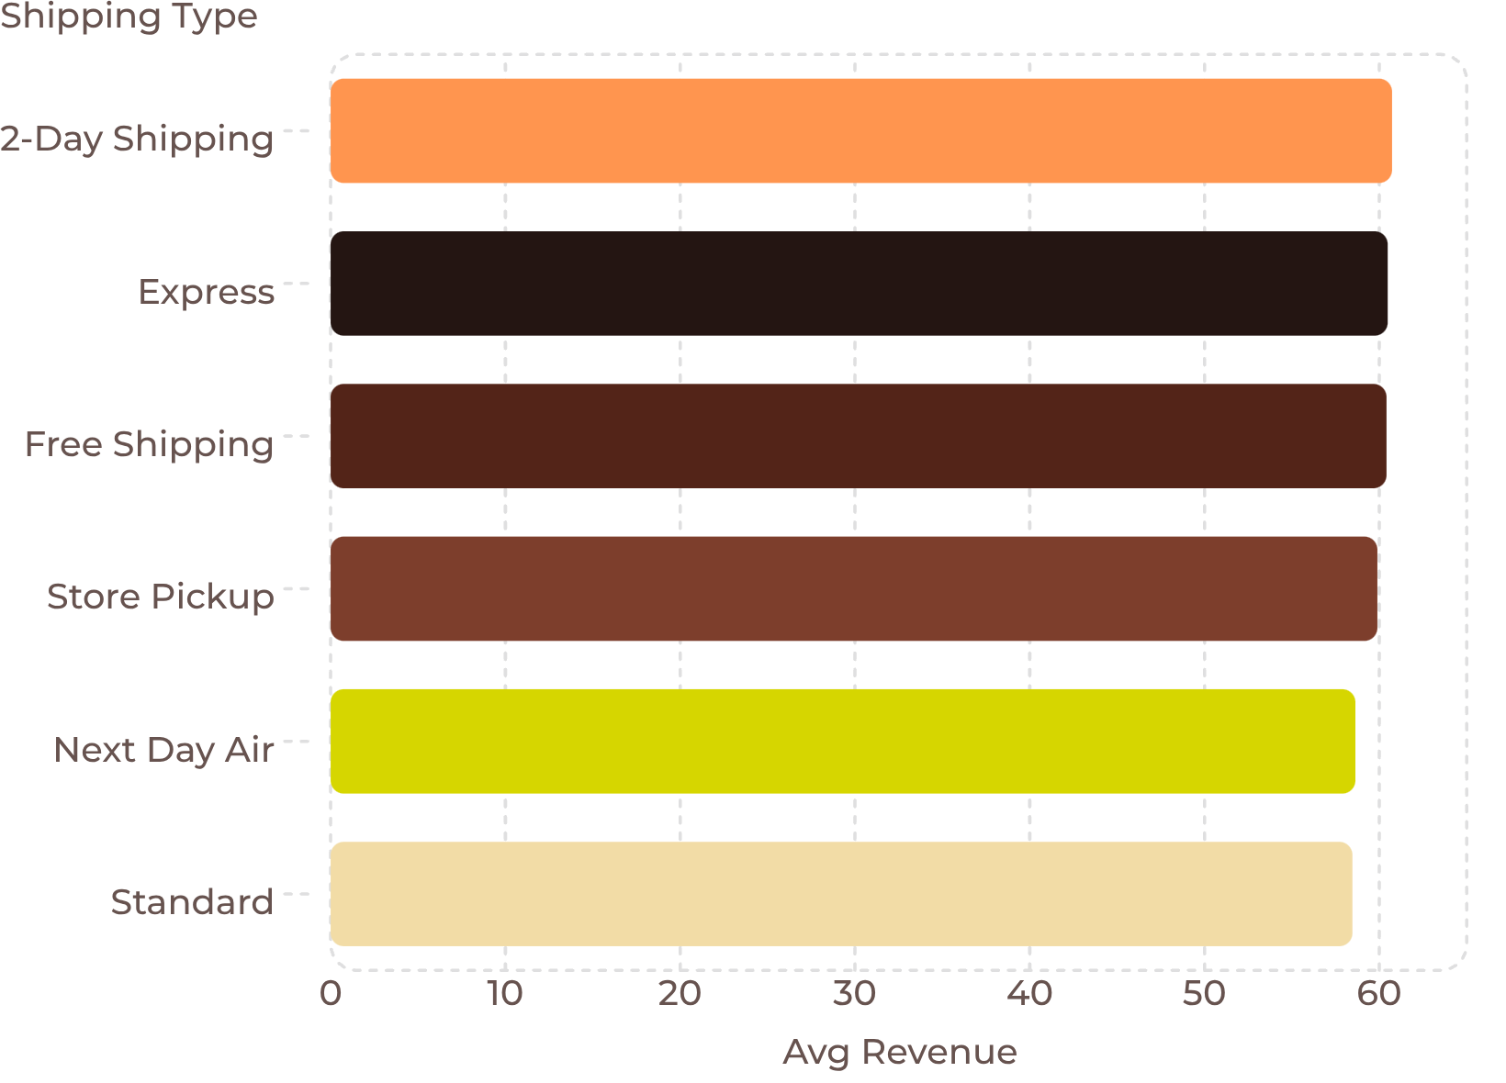
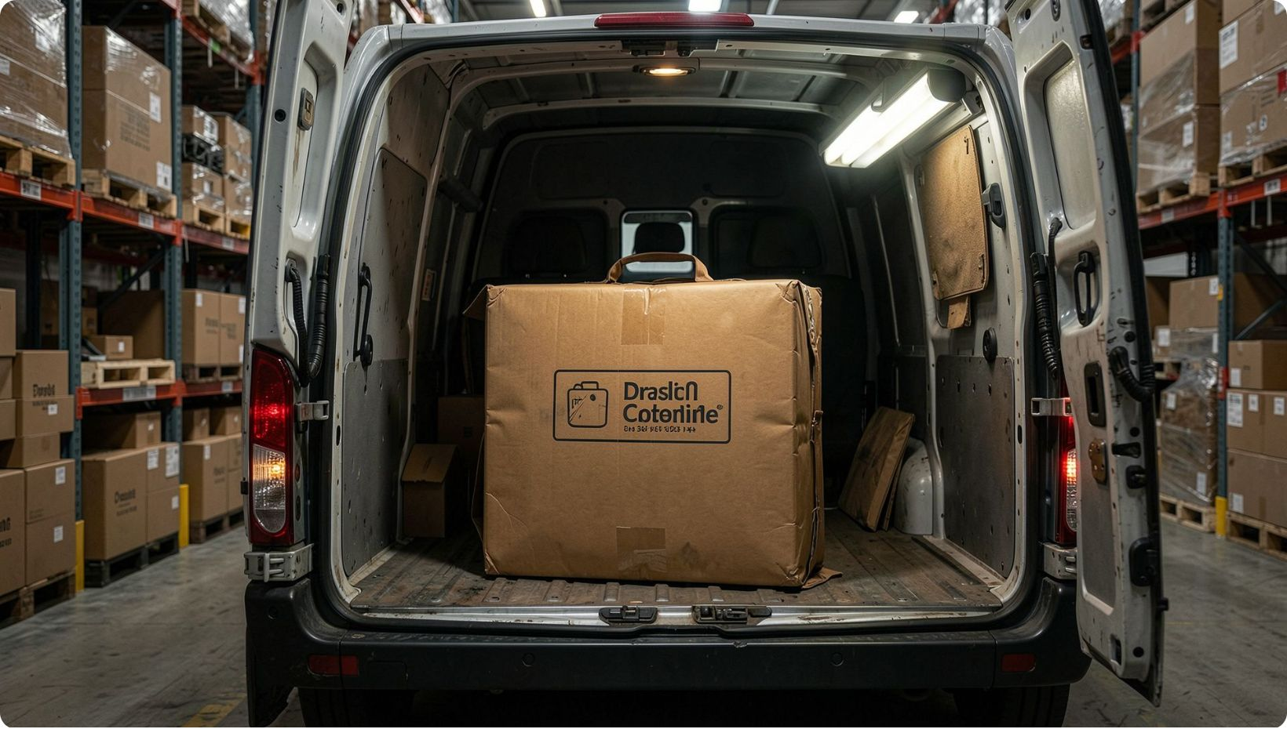
Shipping & Payment Insights
Minimal variation across shipping modes. Payment method top frequency: PayPal (most common). Consider optimizing shipping-cost strategies and promoted shipping options tied to conversion.

Slide 10

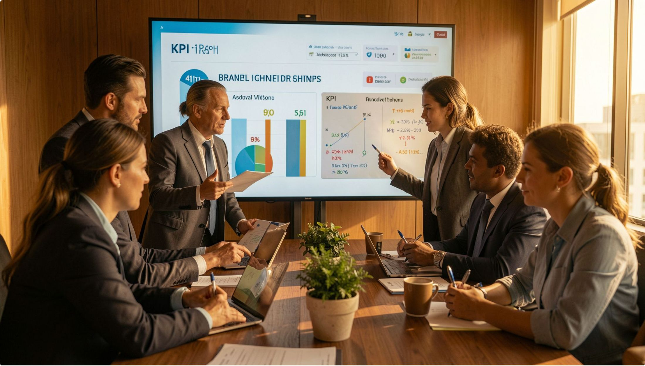
Recommendations & Next Steps
Boost Subscriptions
Loyalty Program
Discount Policy Review
Promote exclusive benefits and targeted messaging (focus female cohort) to raise conversion.
Reward returning customers to move them to Loyal segment and increase lifetime value.
Balance acquisition vs margin; identify high-value discount users for tailored offers.
Promote Top Products
Targeted Marketing
Market top-rated and top-selling items (Clothing, Gloves, Sandals) across age cohorts.
Prioritize Young Adults & Middle-aged segments and preferred shipping modes for campaigns.
Dashboard available in Power BI for interactive exploration. Next: A/B test subscription incentives and loyalty mechanics; monitor lift in revenue and retention.

