Slide 1
RETAIL PROFITABILITY REVIEW
DISCOUNTS ARE
ERASING RETAIL PROFIT
The next dollar of revenue must keep its margin.
Cap discounts at 20% before more revenue turns into loss.

Slide 2
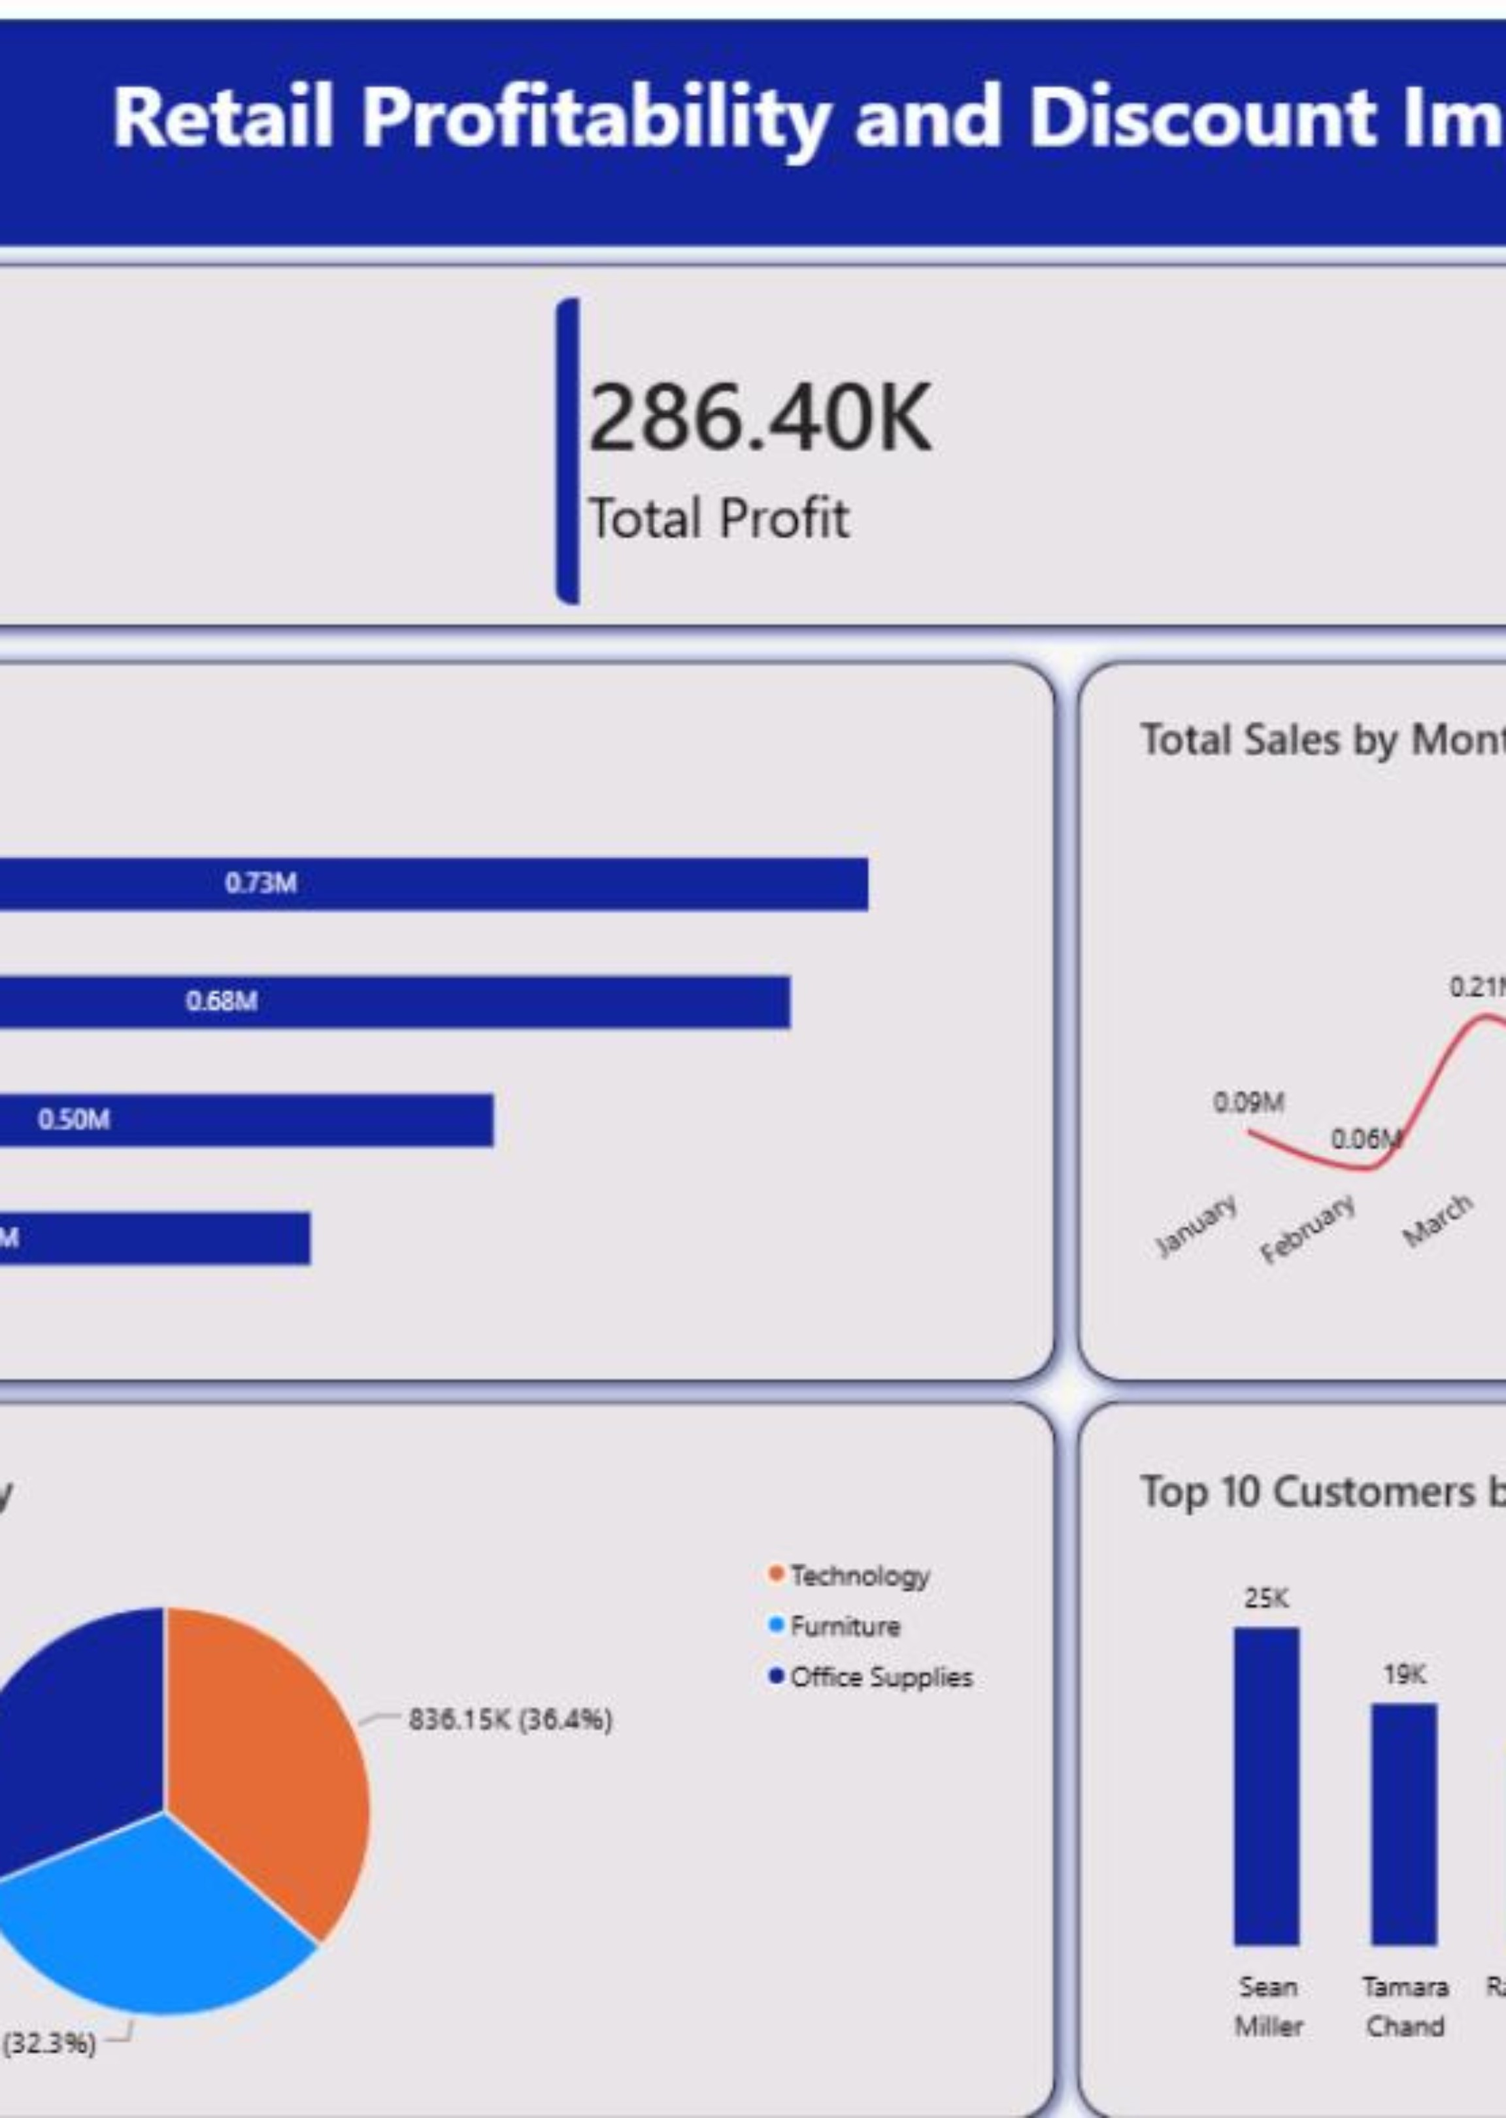
BUSINESS SIGNAL
A $2.30M business is losing $156K+ to unprofitable orders
Scale
9,994 orders and $2.30M in sales
Profit
$286.40K overall, but more than $156K in lost profit from unprofitable orders
Signal
Discounts above 20% are the consistent break point.

Slide 3
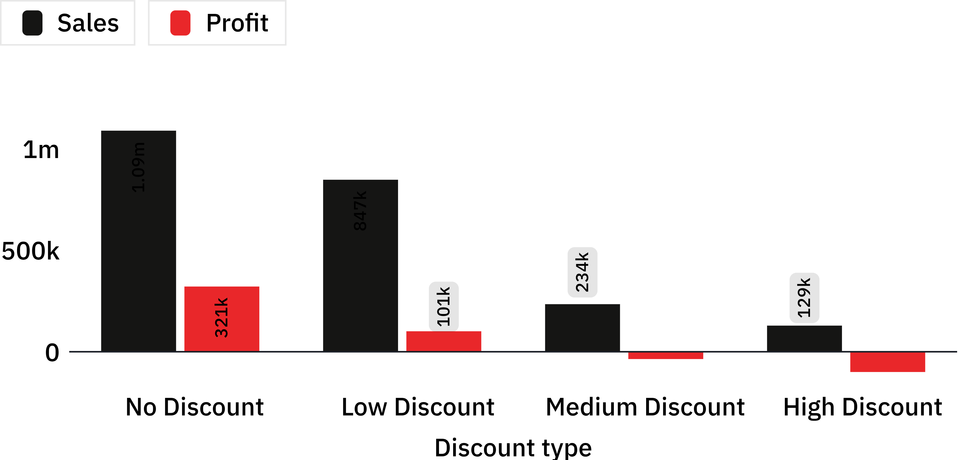
DISCOUNT IMPACT ON PROFIT
Every discount tier above 20% loses money
$421.77K
Profit from no-discount and low-discount orders
−$135.38K
Combined loss from medium and high discounts
Profit turns negative once discounts move beyond the low-discount tier.

Slide 4
EXCEPTION ECONOMICS
The loss is concentrated in a minority of orders
4,798
3,803
1,393
No discount
Low discount
Medium + high
Orders
Orders
Orders driving $135.38K in losses
Make the exception visible and governable instead of treating every order the same.

Slide 5
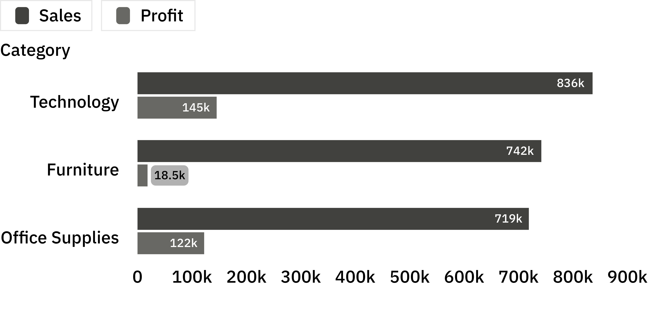
CATEGORY ECONOMICS
Furniture sells, but discounts leave almost no margin
2.49%
Furniture margin
Furniture produces $742.00K in sales but only $18.45K in profit.
Technology: $836.15K sales · $145.46K profit
Office Supplies: $719.05K sales · $122.49K profit

Slide 6
REGIONAL PERFORMANCE
West leads performance; Central is the warning sign
West
East
Central
South
$108.42K
$91.52K
$39.71K
$46.75K
Profit
$725.46K sales
Profit
$678.78K sales
Profit
$501.24K sales
Profit
$391.72K sales
Use profitable states such as California and New York as pricing benchmarks for underperforming markets.

Slide 7
SEASONAL DEMAND
Peak demand is seasonal, but profit quality still varies
2016
2018
September
July produced negative profit
December
1
2
3
4
2017
2019
November
January produced negative profit
November
NOVEMBER
Plan for peak demand, but protect margin during promotional periods.
Strongest sales month overall

Slide 8
OPERATING RESPONSE
Three moves can stop the leak
01
02
03
Cap standard discounts at 20%
Replace 70–80% clearance discounts
Reprice and realign incentives
Require approval for exceptions.
Use Buy 2, Get 1 bundles.
Reprice tables and bookcases, reduce heavy-furniture shipping subsidies, and reward salespeople on profit rather than sales.

Slide 9
Approve the operating rule
Approve a 20% discount ceiling as the default policy.
Assign exception owners for medium- and high-discount orders.
Review furniture pricing and Texas, Ohio, and Pennsylvania performance monthly.
LEADERSHIP DECISION
PROTECT THE NEXT DOLLAR
OF REVENUE
Growth is valuable only when the order keeps its margin.

