Slide 1
RETENTION AUDIT / CASE NO. TELCO-0426
THE $1.67M
REVENUE
LEAK IS A
RETENTION
PROBLEM.
FIELD REPORT / 2026

Slide 2
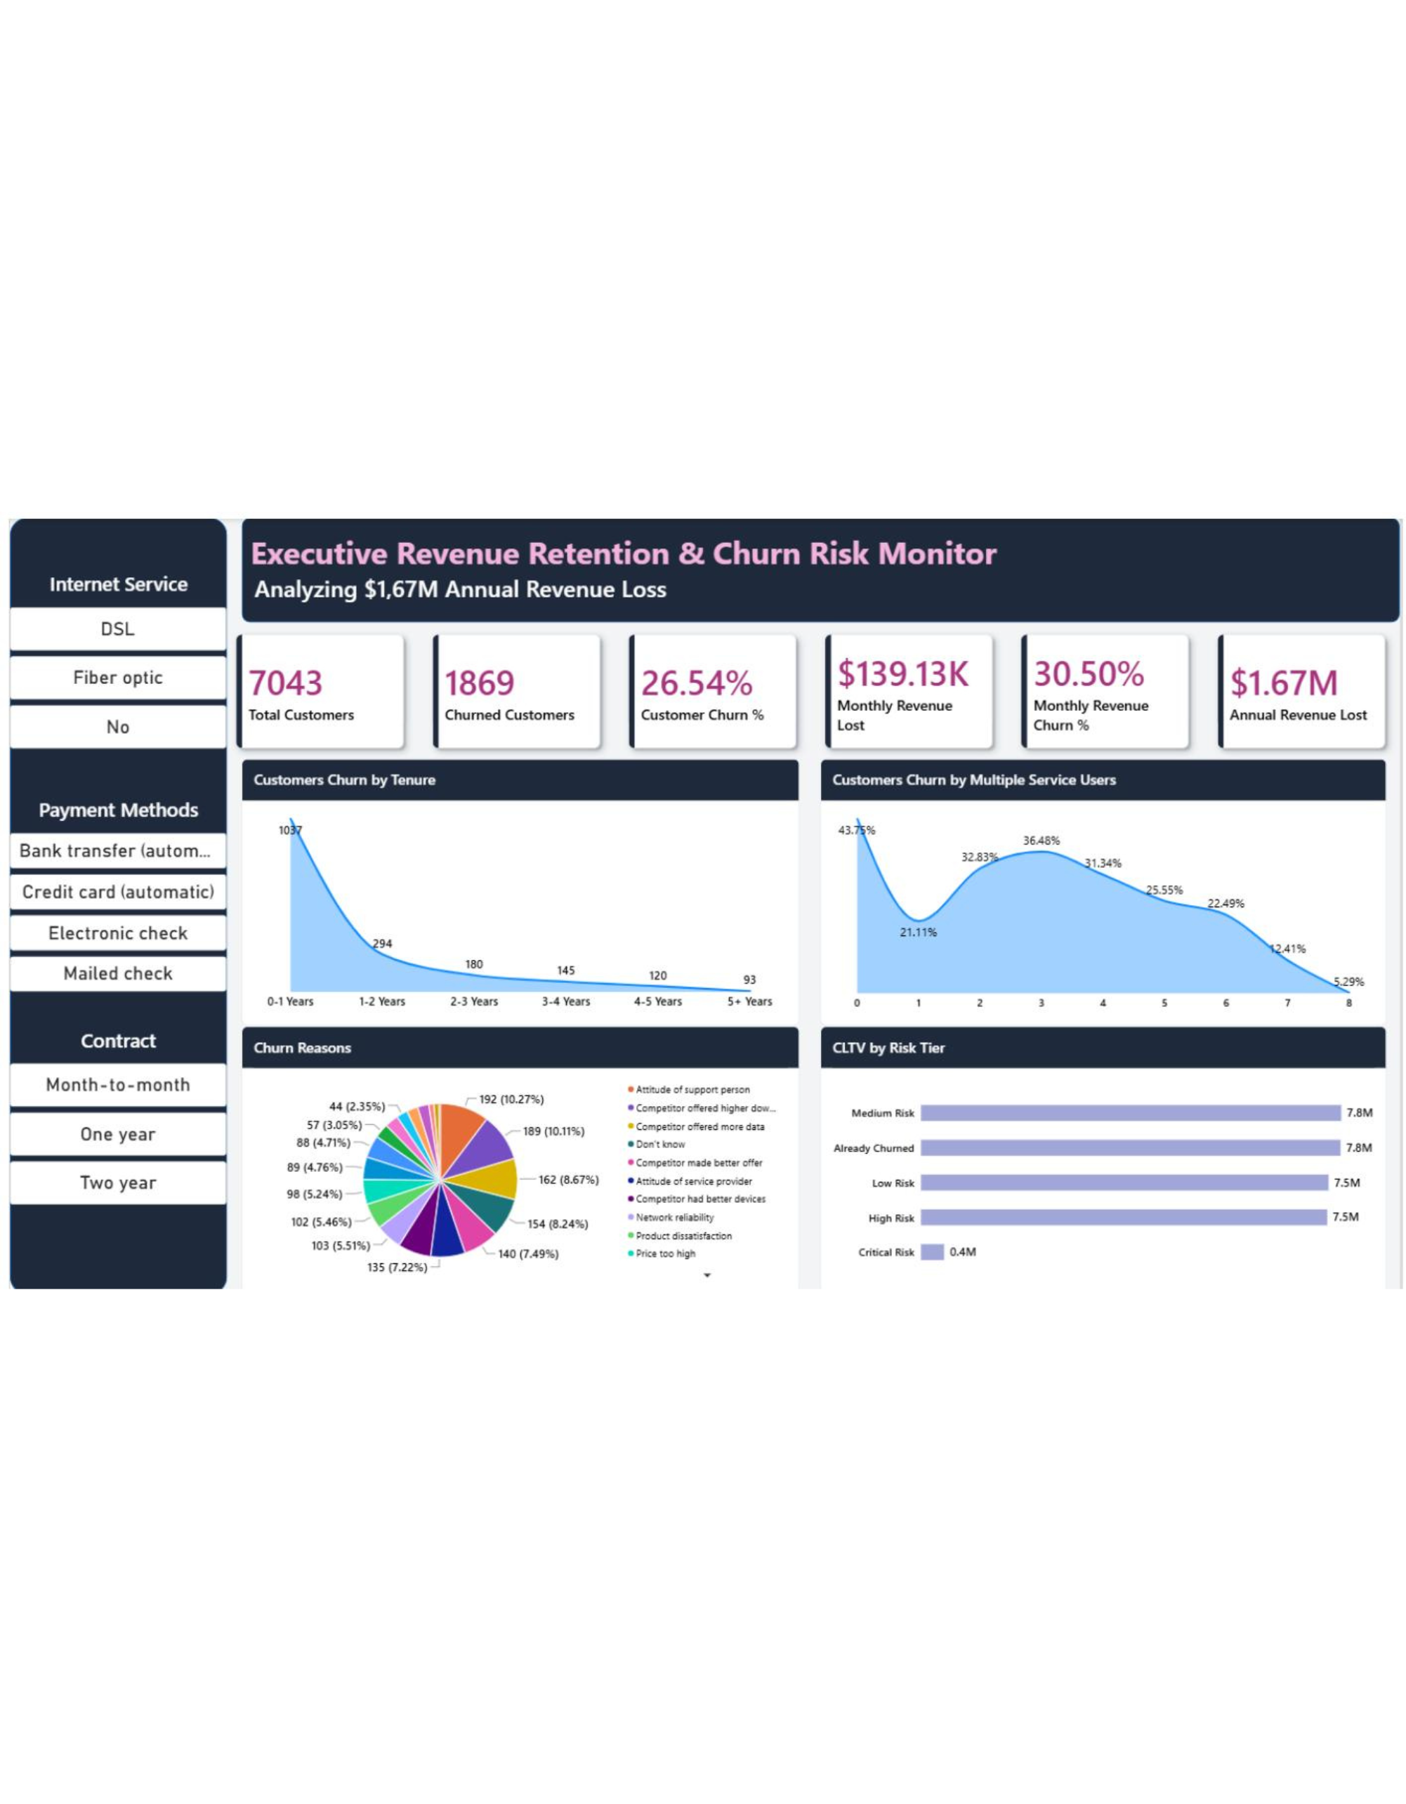
THE $1.67M REVENUE LEAK IS A RETENTION PROBLEM.
CASE FILE / REVENUE EXPOSURE
26.54% OF CUSTOMERS LEFT.
CHURNED CUSTOMERS | 1,869 of 7,043
MONTHLY REVENUE LOST | $139.13K 30.5% of monthly revenue
ANNUAL REVENUE LOST | $1.67M
SOURCE VISUAL / TELCO CUSTOMER CHURN REPORT
02 / 10

Slide 3

THE $1.67M REVENUE LEAK IS A RETENTION PROBLEM.
EARLY-TENURE SIGNAL
THE FIRST SIX MONTHS
ARE THE LEAKIEST.
784
17.98
$49.9K
customers left within six months
months stayed by churned customers
new-customer revenue lost per month
41.95% of all quitters
Loyal customers stayed 37.57 months on average. The gap is a prioritization signal, not proof of a single cause.
03 / 10

Slide 4
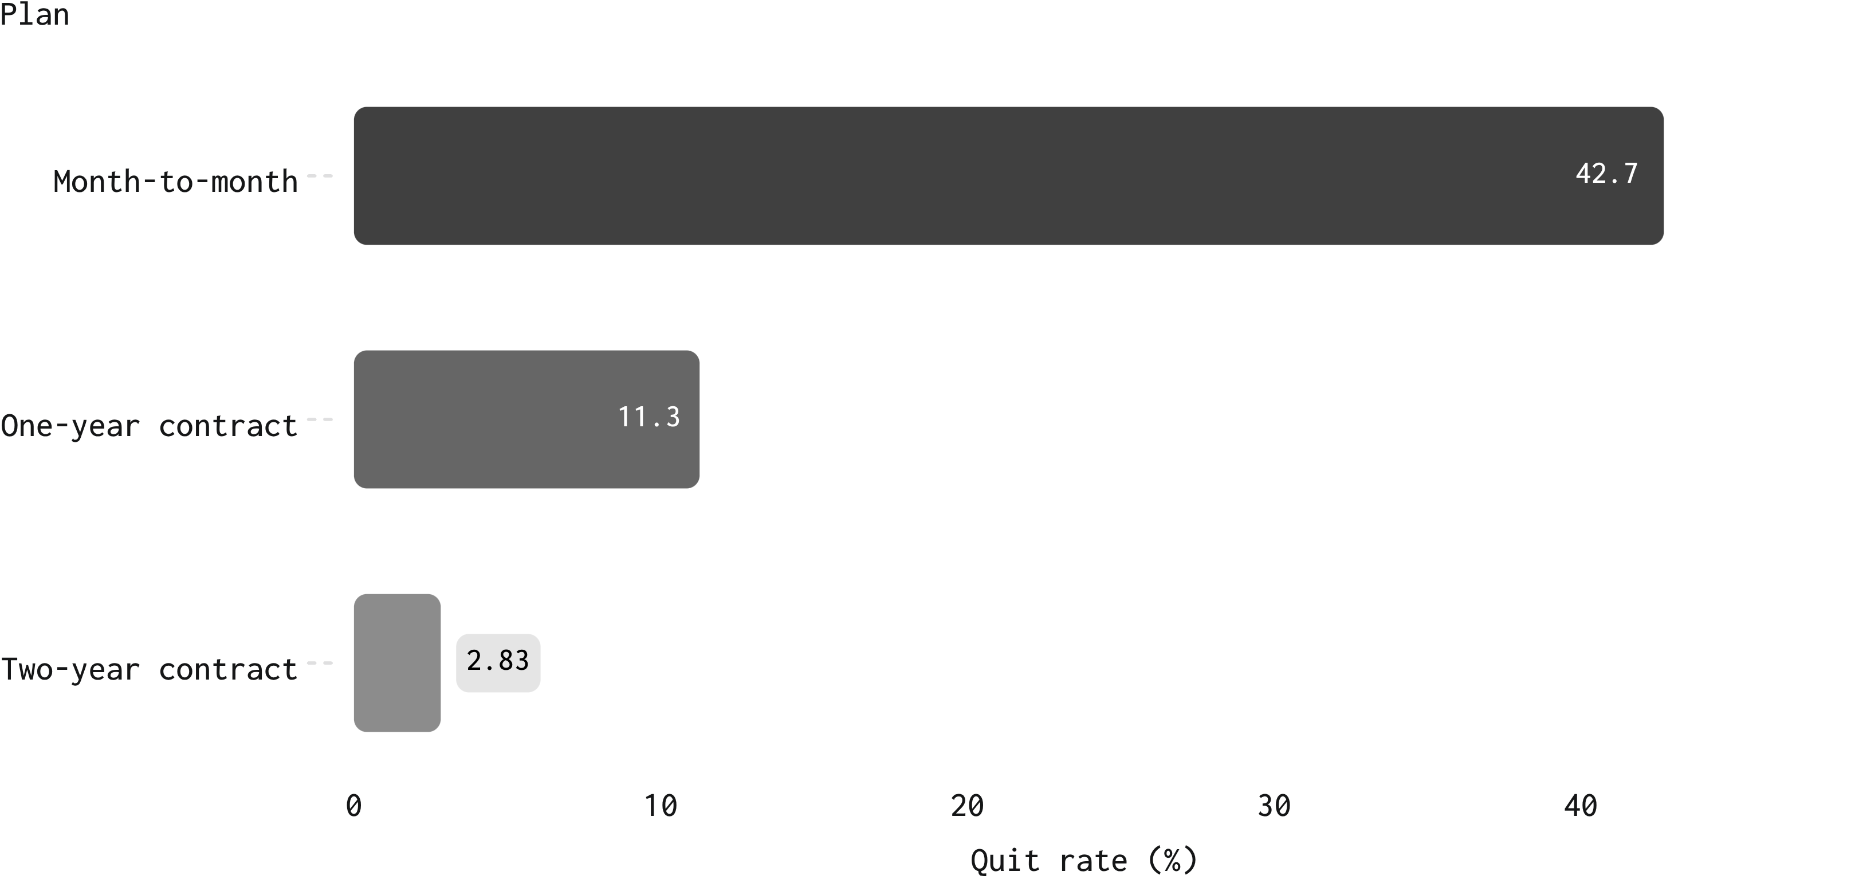
THE $1.67M REVENUE LEAK IS A RETENTION PROBLEM.
PLAN TENURE / QUIT RATE
MONTH-TO-MONTH PLANS
CARRY THE RISK.
$120.85K
monthly revenue lost from month-to-month churners
Observed segment difference. The contract relationship is a retention signal, not a causal conclusion.
04 / 10

Slide 5
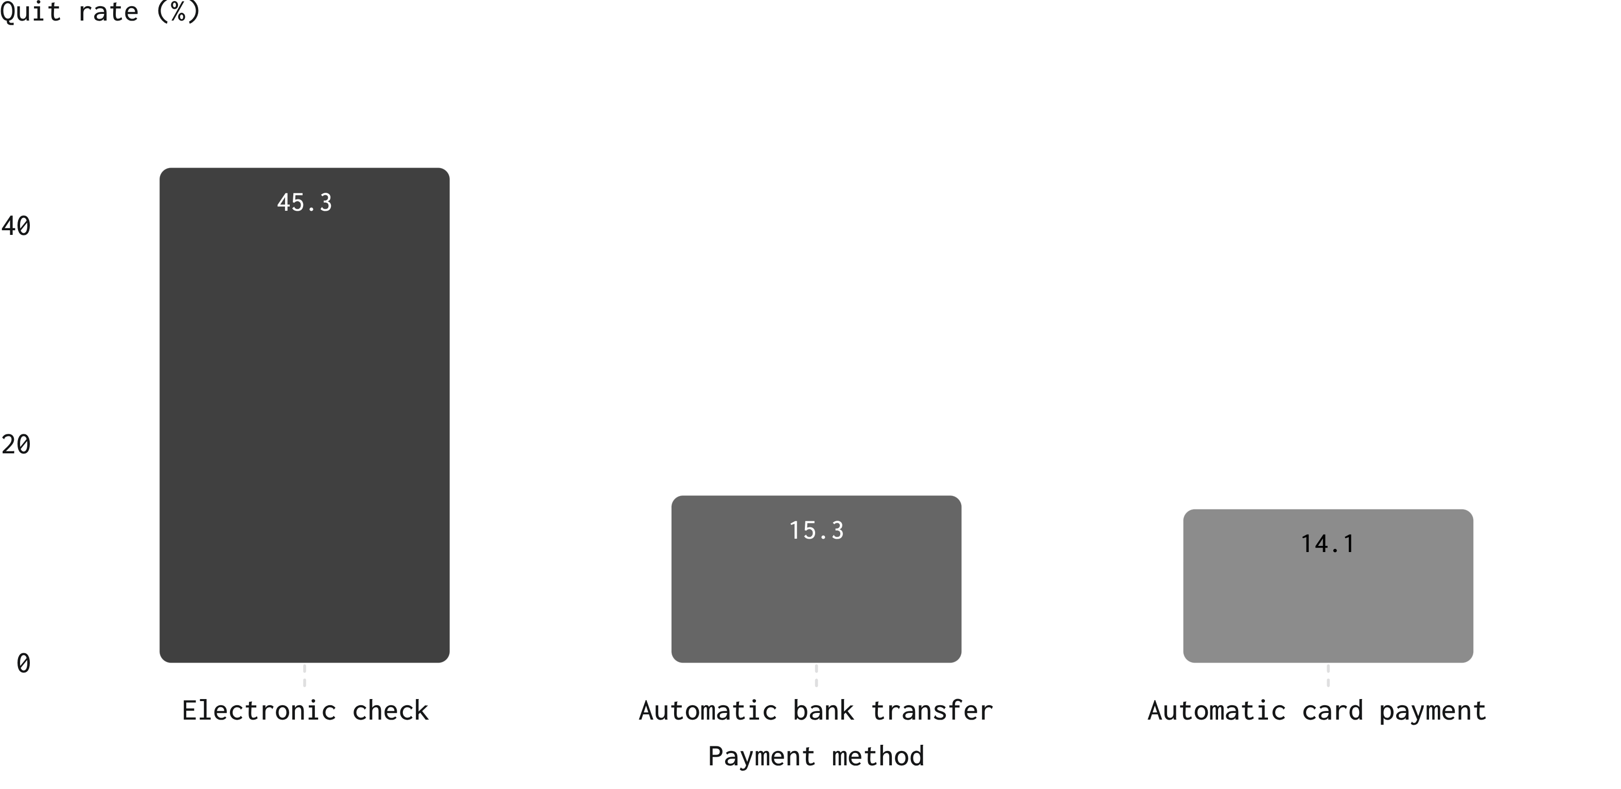
THE $1.67M REVENUE LEAK IS A RETENTION PROBLEM.
PAYMENT METHOD / QUIT RATE
ELECTRONIC CHECK IS A
HIGH-RISK PAYMENT SIGNAL.
$84.29K
monthly revenue lost from electronic-check customers
RETENTION MOVE
Make automatic payment migration easy and reward the switch.
05 / 10

Slide 6

THE $1.67M REVENUE LEAK IS A RETENTION PROBLEM.
SERVICE TYPE / CUSTOMER VALUE
FIBER OPTIC CUSTOMERS PAY MORE AND LEAVE FASTER.
Service type | Churn
Fiber optic | 41.89%
DSL | 18.96%
Without internet service | 7.40%
Revenue at stake: fiber accounts lose $114.3K per month
Average monthly bill: $91.50 for fiber customers
Segment differences identify where retention attention belongs; they do not establish a single cause.
06 / 10

Slide 7

THE $1.67M REVENUE LEAK IS A RETENTION PROBLEM.
FIBER CUSTOMER EXPERIENCE
SUPPORT AND SECURITY
CHANGE THE FIBER STORY.
NO SUPPORT OR SECURITY
BOTH SERVICES
55.01%
14.17%
churn among fiber customers
churn when fiber customers have tech support and online security
RETENTION MOVE Include both services in the first six months of fiber tenure.
07 / 10

Slide 8

THE $1.67M REVENUE LEAK IS A RETENTION PROBLEM.
QUIT REASONS / SIGNALS
THE REASONS POINT TO
EXPERIENCE AND COMPETITION.
RANK | SIGNAL | OBSERVED EVIDENCE
01 | SUPPORT ATTITUDE | Attitude of support person, 192 quitters
02 | COMPETITIVE PRESSURE | Higher download speeds, more data, or better offers account for 491 quitters across the listed reasons
03 | SERVICE SIGNALS | Network reliability, product dissatisfaction, and price too high also appear among the leading reasons
Observed reasons are signals for intervention. They do not prove a single cause.
08 / 10

Slide 9
THE $1.67M REVENUE LEAK IS A RETENTION PROBLEM.
RETENTION PROGRAM / FIVE PLAYS
FIVE RETENTION PLAYS
CAN TARGET THE LEAK.
01
02
03
04
05
PLAN TENURE
PAYMENT MIGRATION
FIRST 90 DAYS
FIBER ONBOARDING
SUPPORT RESET
Move month-to-month customers toward one- and two-year plans with a clear upgrade offer.
Set 30-, 60-, and 90-day check-ins for new customers.
Retrain support teams around service attitude, reliability, and competitive objections.
Incentivize migration from electronic checks to automatic bank or card payments.
Pair fiber onboarding with free tech support and online security.
09 / 10

Slide 10
THE $1.67M REVENUE LEAK IS A RETENTION PROBLEM.
CLOSING FINDING / RETENTION AUDIT
THE CASE FOR RETENTION IS ALREADY IN THE DATA.
Protect first | Early-tenure, month-to-month, electronic-check, and fiber customers.
Measure next | Upgrade conversion, payment migration, first-90-day saves, and support-driven churn.
Outcome | Turn a $1.67M annual leak into a prioritized retention program.
TELCO CHURN AUDIT / 2026
10 / 10

