Slide 1
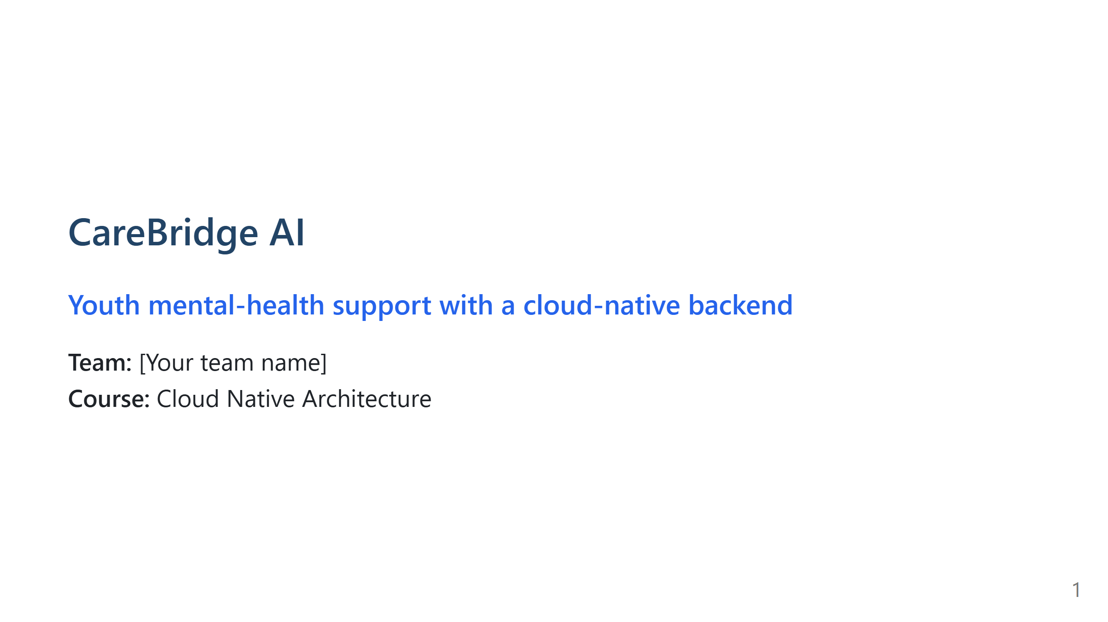
Notes:
SLIDE 1 — ~30 sec | Title

Slide 2
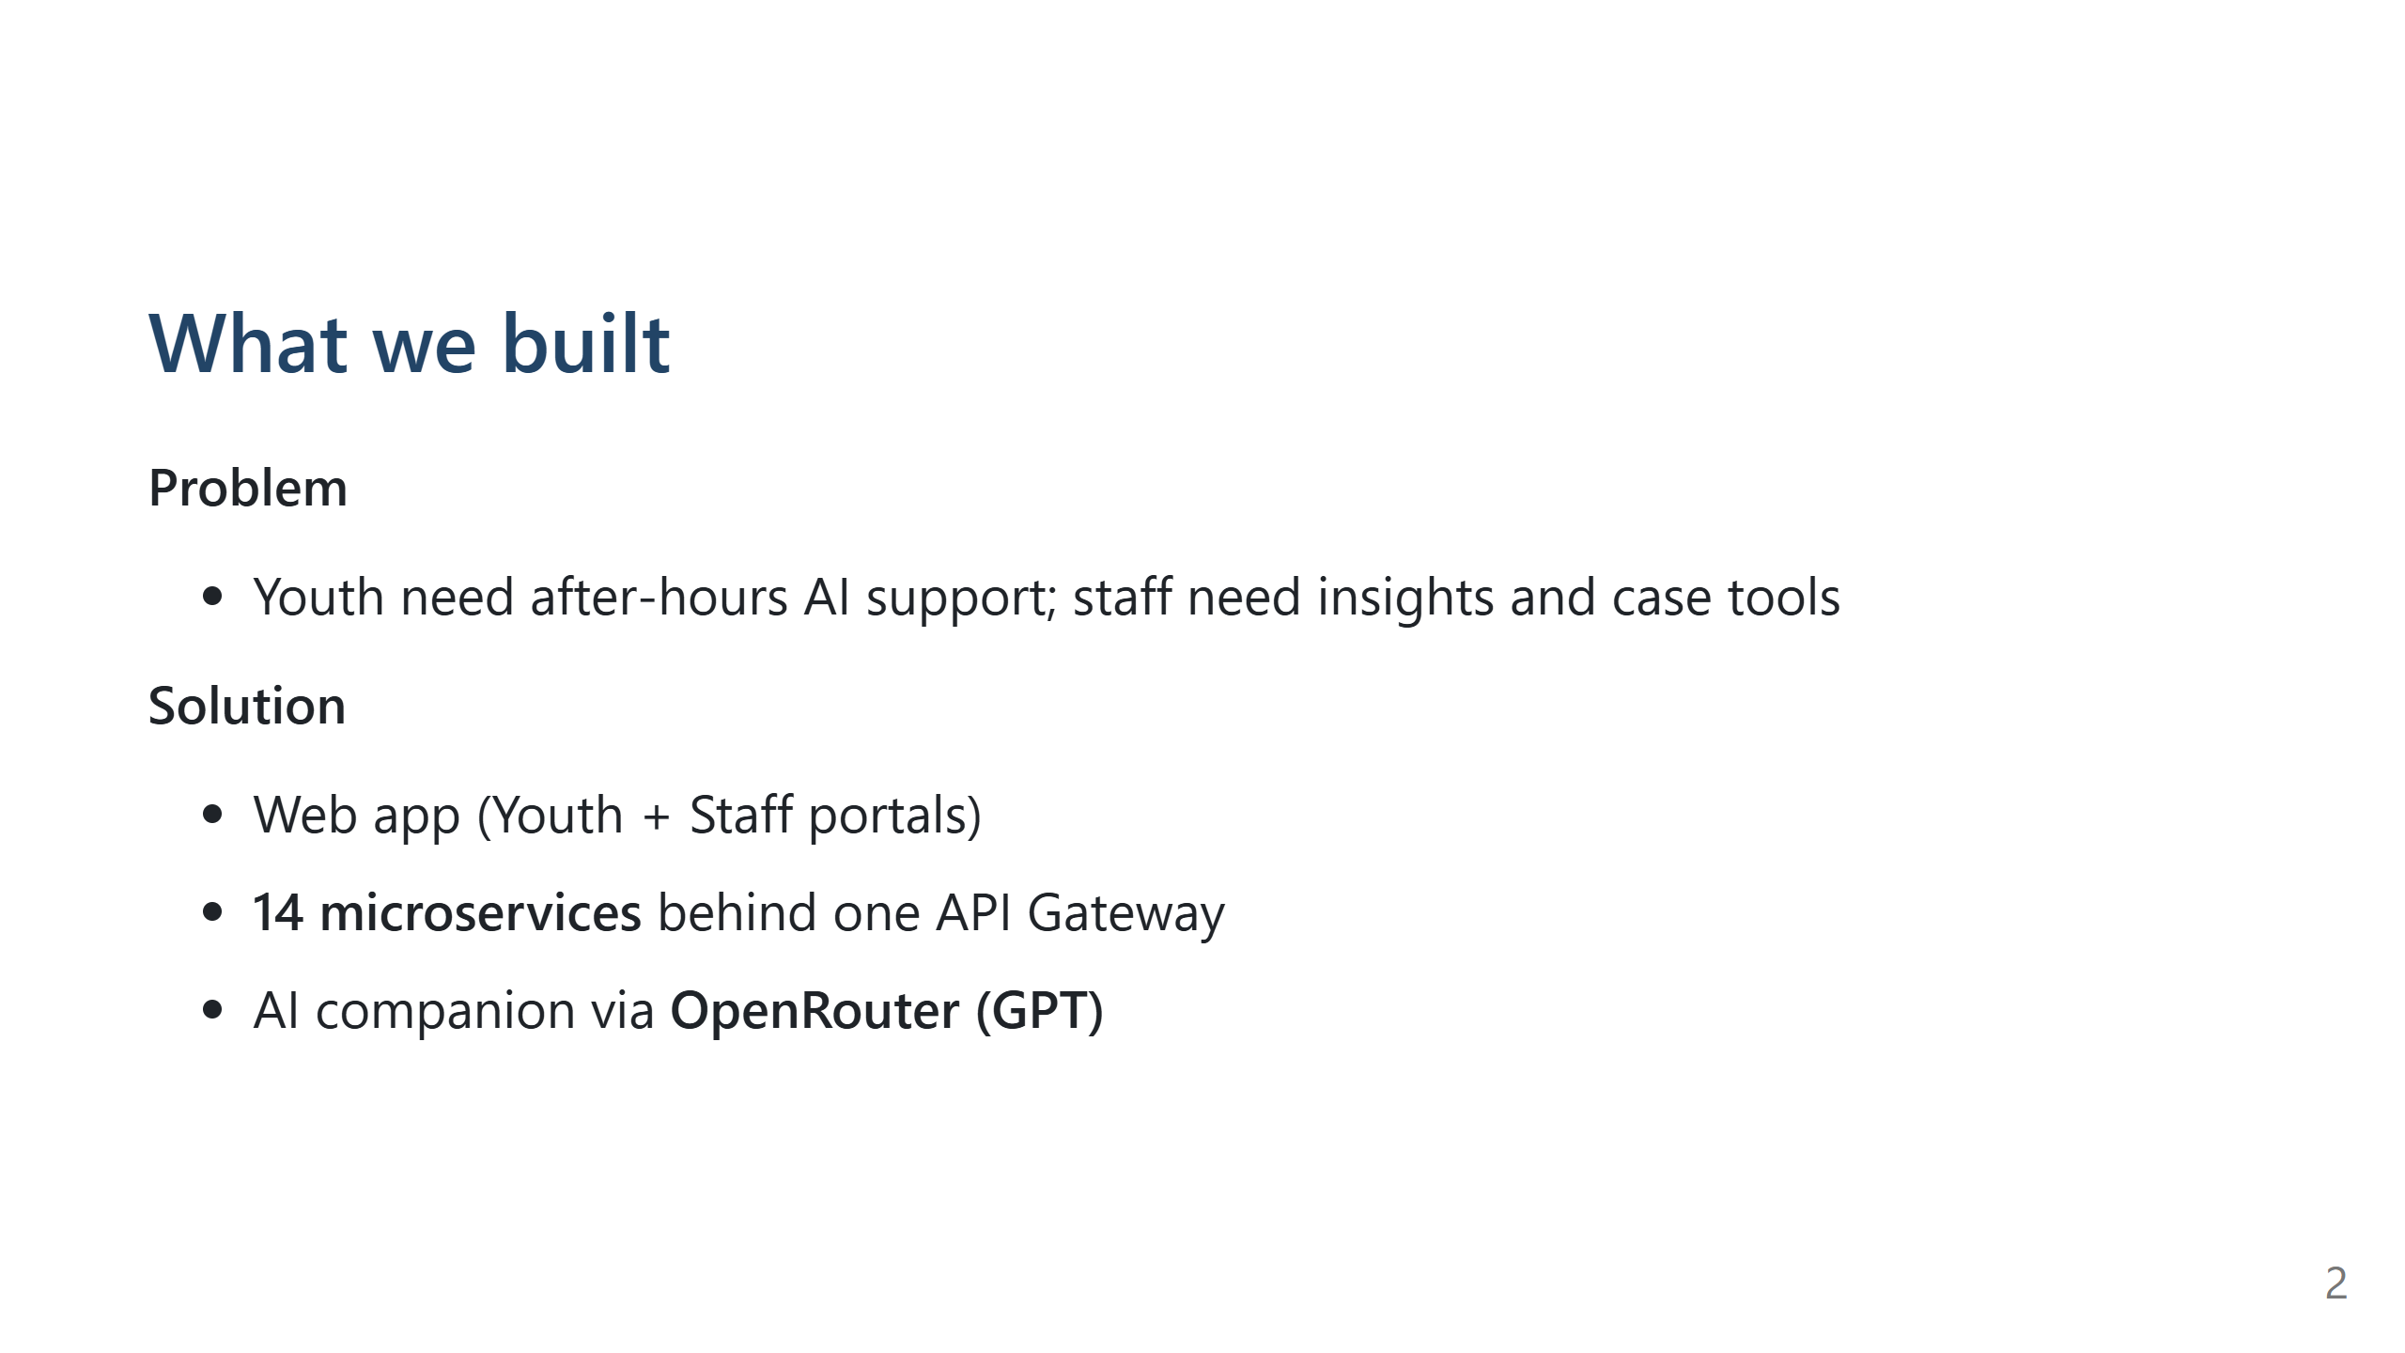
Notes:
SLIDE 2 — ~90 sec | Problem + solution (keep short) [OPTIONAL IMAGE: Landing page screenshot — http://localhost:8888/]

Slide 3
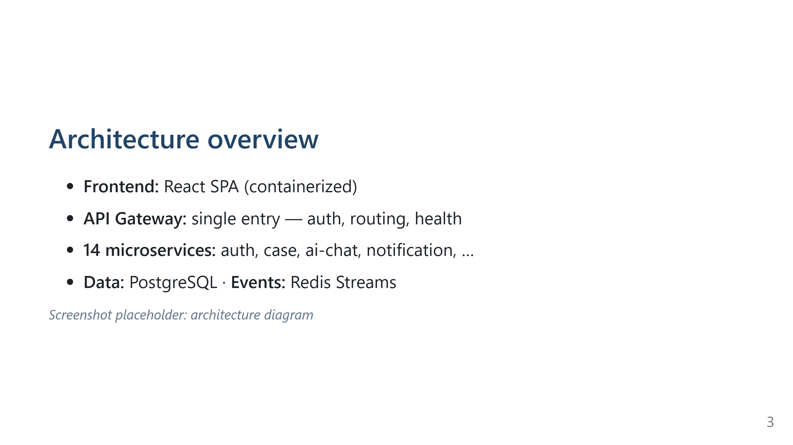
Notes:
SLIDE 3 — ~45 sec | Architecture [INSERT IMAGE: Architecture diagram — file: ARCHITECTURE.md (mermaid diagram)]

Slide 4
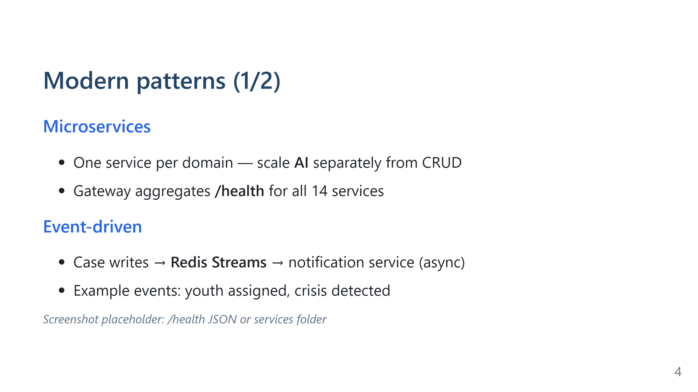
Notes:
SLIDE 4 — ~60 sec | Microservices + Event-driven [INSERT IMAGE: Browser — http://localhost:3016/health (all dependencies ok)] OR: folder screenshot — backend/services/ (14 folders)

Slide 5
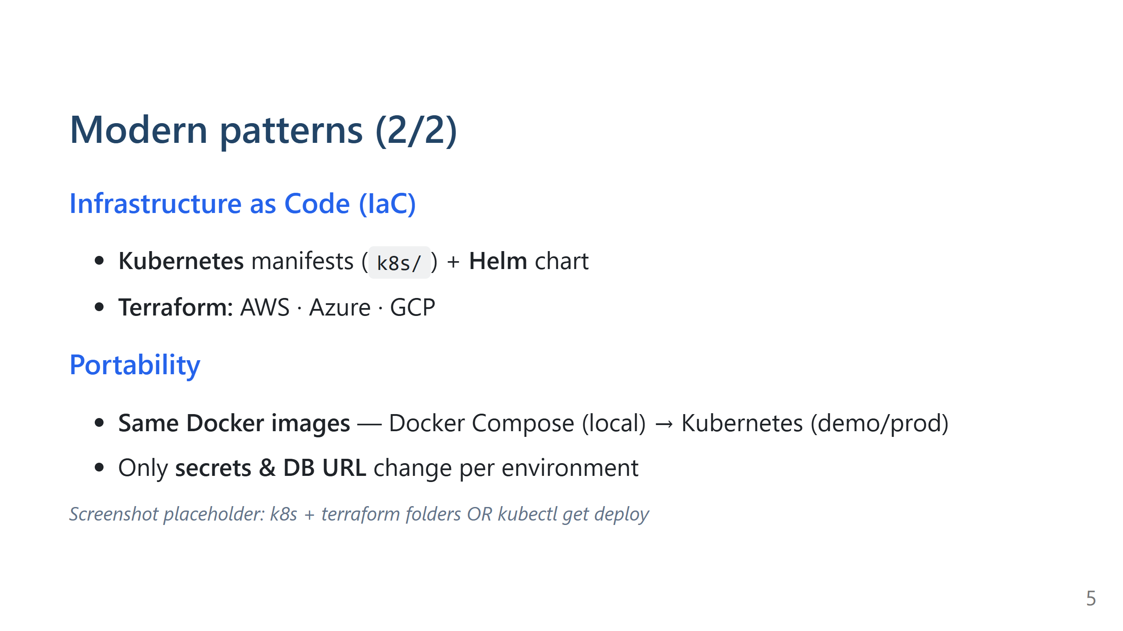
Notes:
SLIDE 5 — ~45 sec | IaC + Portability [INSERT IMAGE: IDE — k8s/ + terraform/aws|azure|gcp folders] OR: terminal — kubectl get deploy -n carebridge

Slide 6
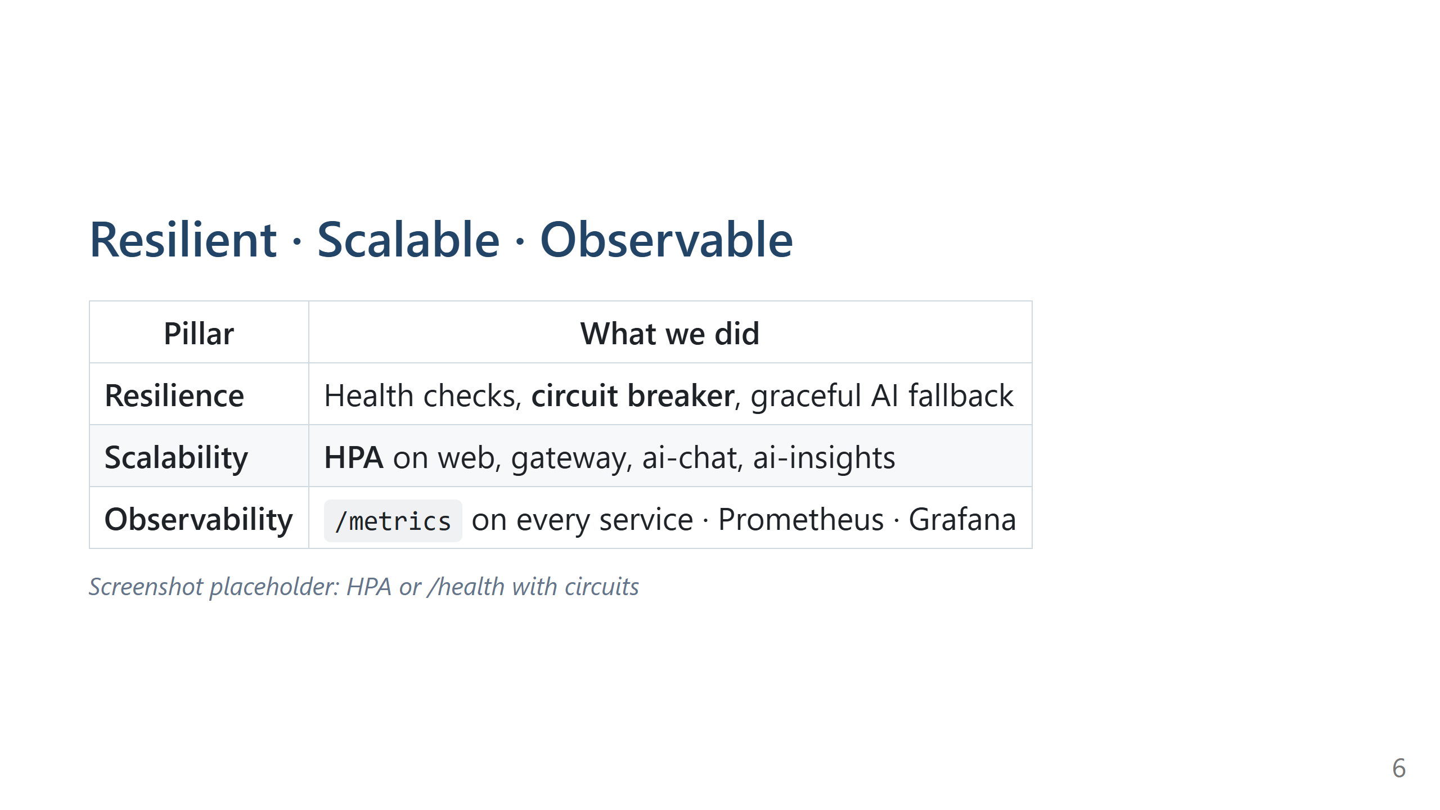
Notes:
SLIDE 6 — ~60 sec | Resilience + Scale + Observability [INSERT IMAGE: terminal — kubectl get hpa -n carebridge] OR: /health JSON showing "circuits" and "eventBus": "redis"

Slide 7
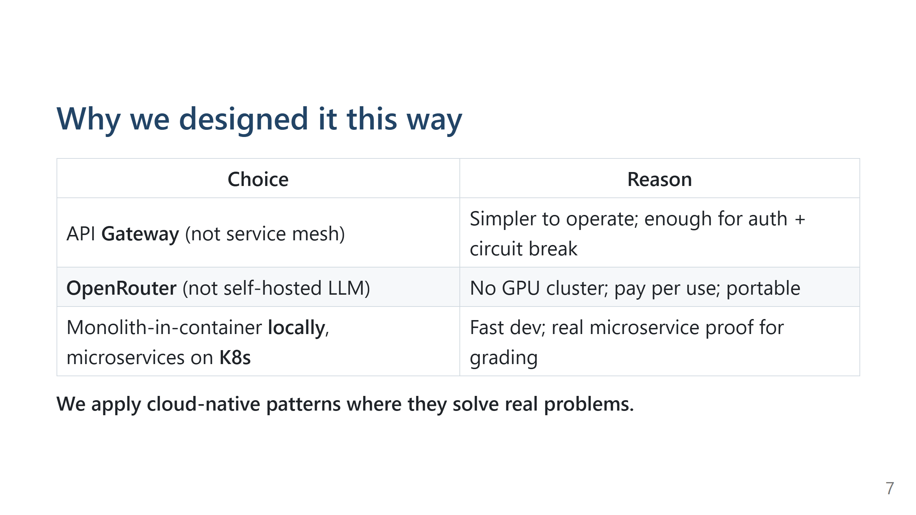
Notes:
SLIDE 7 — ~30 sec | Design reasoning (Exemplary)

Slide 8
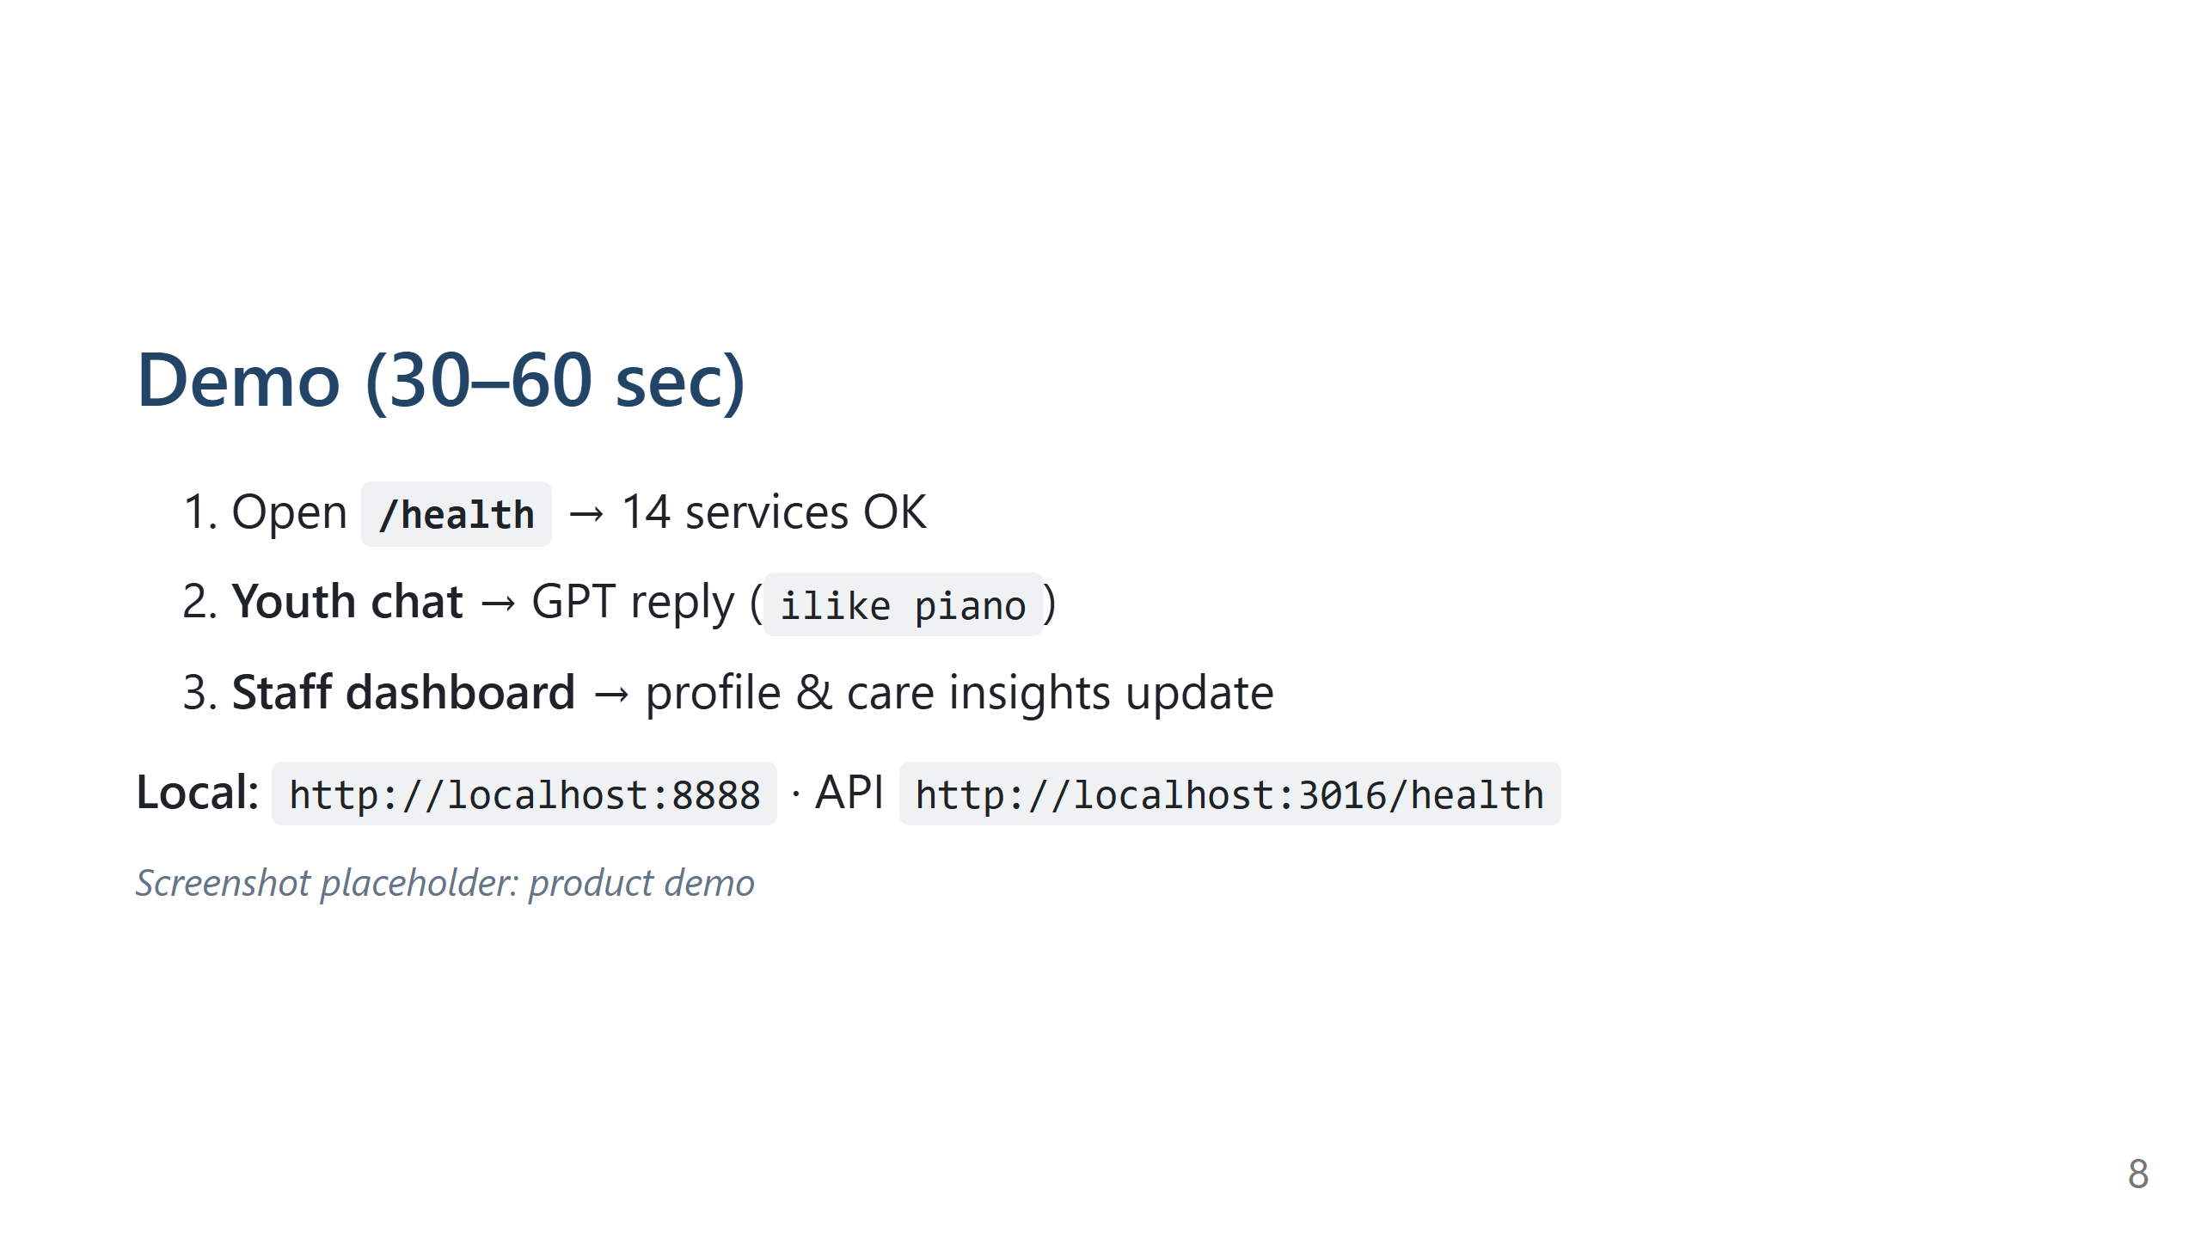
Notes:
SLIDE 8 — ~60 sec | Live demo cue (optional — or skip and use screenshots) [INSERT IMAGE: Youth chat + Staff insights — your best 1–2 screenshots]

Slide 9
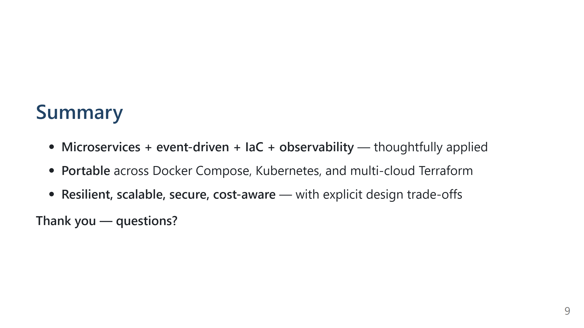
Notes:
SLIDE 9 — ~20 sec | Close

Slide 10
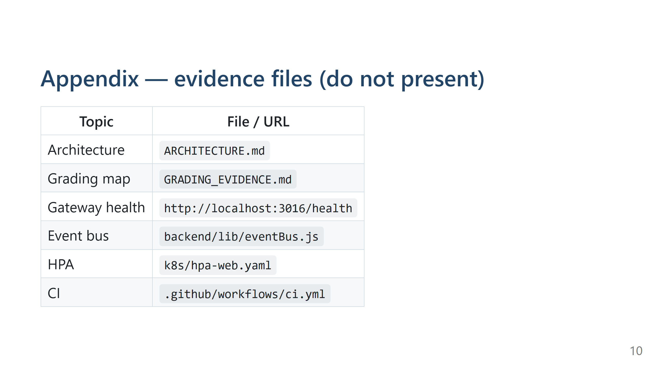
Notes:
APPENDIX — hide during talk unless asked

