Slide 1
Basic Tissues

Slide 2
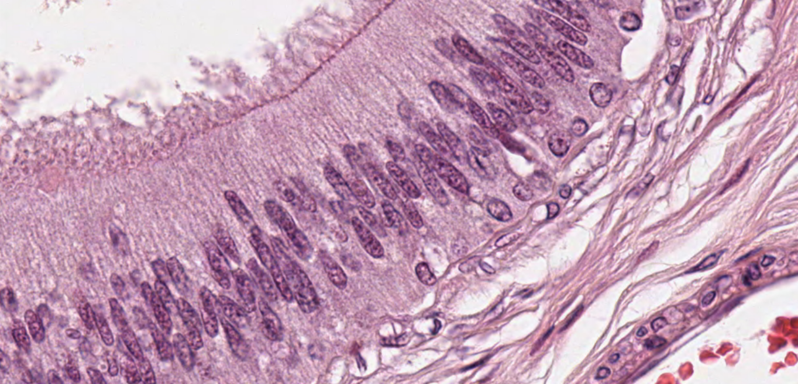
Epithelium and CT
CT
CT

Slide 3
Ordinary Connective Tissue Cells
Fixed (Resident) cells
Fibroblasts and fibrocytes
Reticular cells
Myofibroblasts (observed during wound healing)
Adipocytes/Fat cells (white or yellow and brown)
Mast cells
Fixed macrophages (histiocytes), mesenchymal cells
Transient or Wandering cells
  Plasma cells
  Neutrophils
  Eosinophils
  Basophils
  Lymphocytes, monocytes & Transient macrophages

Slide 4
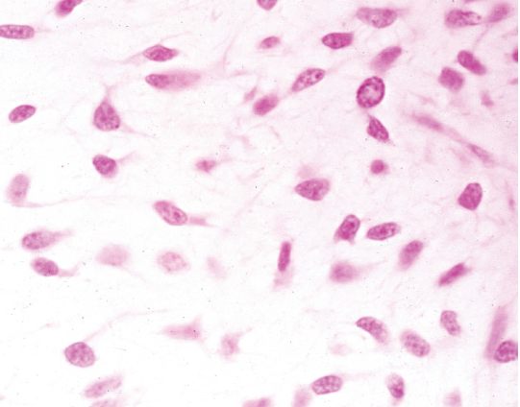
Mesenchyme: consists of mesenchymal cells surrounded by an extracellular matrix which they produced and which in turn consists largely of a simple loose ground substance rich in hyaluranon (hyaluronic acid). This section is stained with Masson trichrome which stains collagen fibers green and the lack of collagen in mesenchyme is apparent.

Slide 5
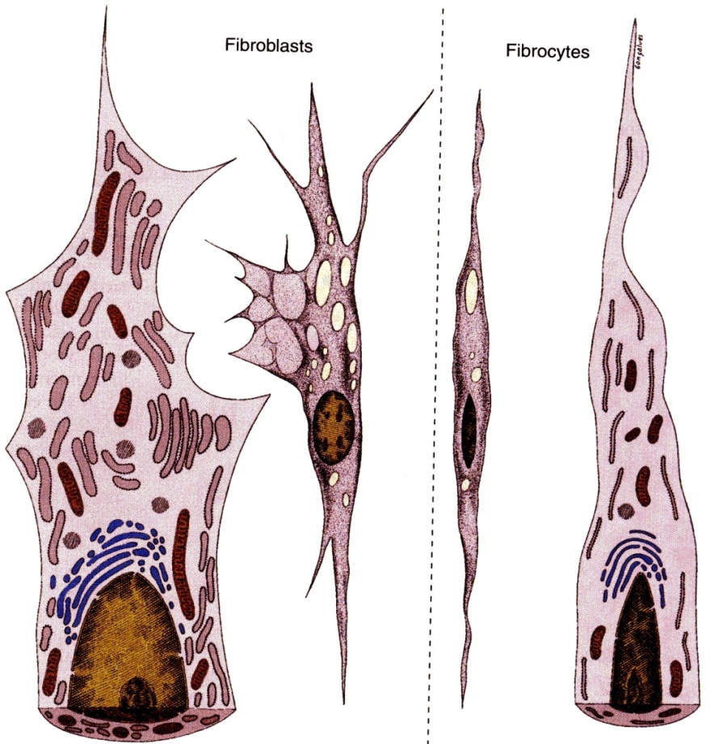
FIBROBLASTS
  Fibro = fiber, blast = forming/making
  Elongated fusiform cells with pale staining cytoplasm and large granular, ovoid nucleus with prominent nucleoli reflecting active protein synthesis.
  produce extracellular matrix (fibers and ground substance) in ordinary CTs.
derived from undifferentiated mesenchymal cells.
Present nearby collagen fibers.
  Fibrocytes are inactive/quiescent forms of fibroblasts characterized by flattened condensed nucleus.

Slide 6
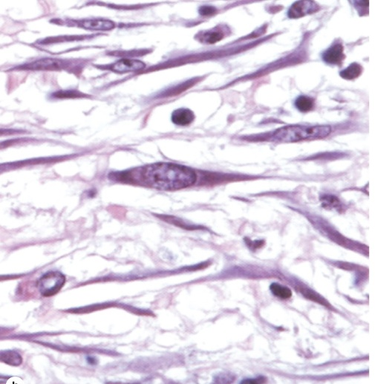
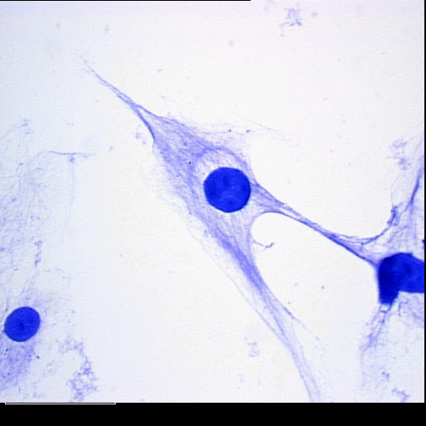
Both active (arrow) and quiescent fibroblasts (fibrocytes ) may sometimes be distinguished, as in this section of dermis. Active fibroblasts are large cells with large, euchromatic nuclei and basophilic cytoplasm, whereas inactive fibroblasts or fibrocytes are smaller with less prominent, heterochromatic nuclei. The very basophilic round cells are leukocytes.

Slide 7
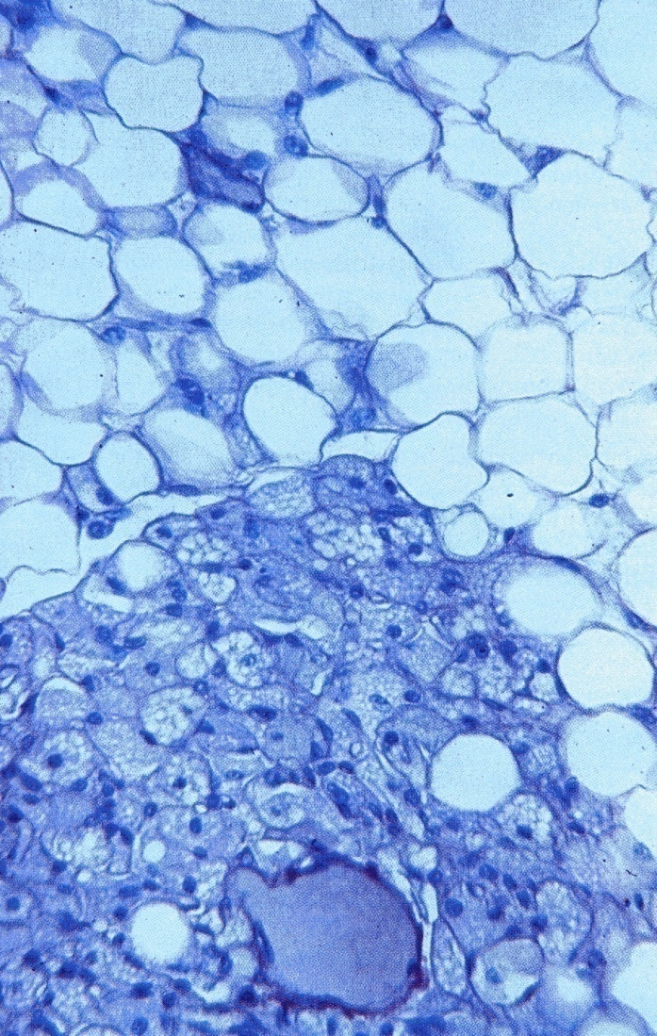
ADIPOCYTES (L. adeps, fat, cyte= cell)
  synthesize, store & release fat and leptin.
  appear individually or in small clusters in some fibrous CTs.
  If they dominate an area, we call that area adipose tissue.
  Contain huge droplet(s) of lipids for storage
derived from mesenchymal cells.
Each cell rests on an external lamina (homologous to basal lamina of epithelium) which consists of reticular fibers, capillaries & sympathetic nerves
they are of two types: white & brown adipocytes.

Slide 8
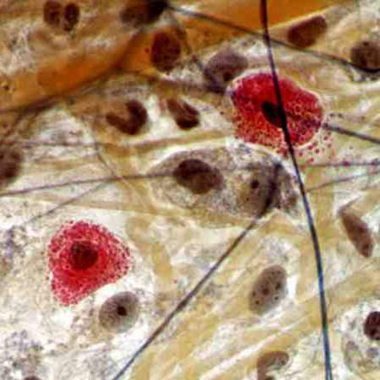
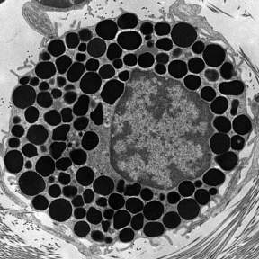
MAST CELLS/MASTOCYTES (HISTAMINOCYTES)
are large oval or round cells about 20 µm in diameter, whose cytoplasm is filled with basophilic secretory granules.
The rather small, spherical nucleus is centrally situated and may be obscured by the coarse cytoplasmic granules.
They are derived from precursors in bone marrow.
found in loose CT adjacent to blood vessels and body surfaces (dermis of skin and lamina propria of digestive and respiratory tracts).
Their cytoplasm have large basophilic metachromatic granules containing heparin, histamine and many other mediators.
LM
EM

Slide 9
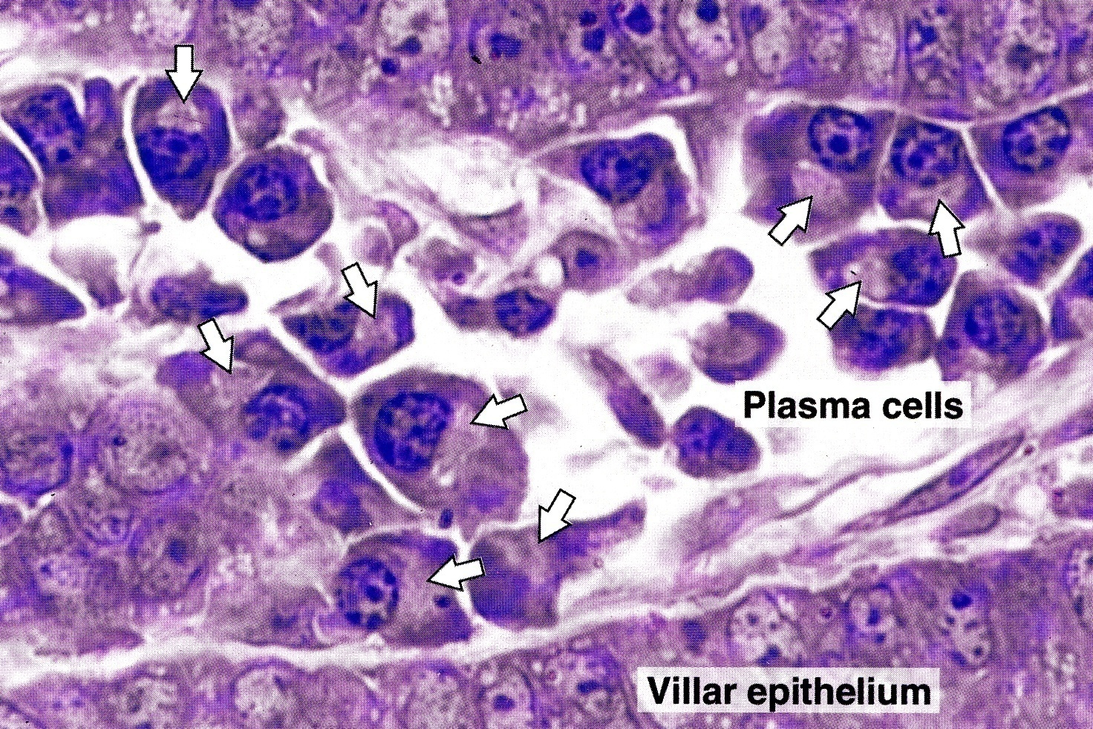
PLASMA CELLS
Large ovoid cells with eccentrically placed nucleus.
They are derived from activated B-lymphocytes.
reveal intensely basophilic cytoplasm due to abundant RER and ribosomes.
nucleus has the characteristic “clock-face” or “radial spoke” appearance.
present in areas of chronic inflammation and foreign bodies, where they manufacture and secrete antibodies.

Slide 10
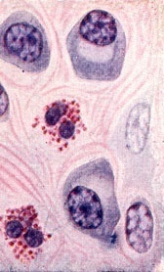
Features of Plasma cells
are typical protein secreting cells
basophilic cytoplasm
eccentrically placed radial spoke or clock face or cartwheel nucleus partially surrounded by a single large Golgi apparatus
effectors cells of immune system ferived from B cells
produce immunoglobulin antibodies

Slide 11
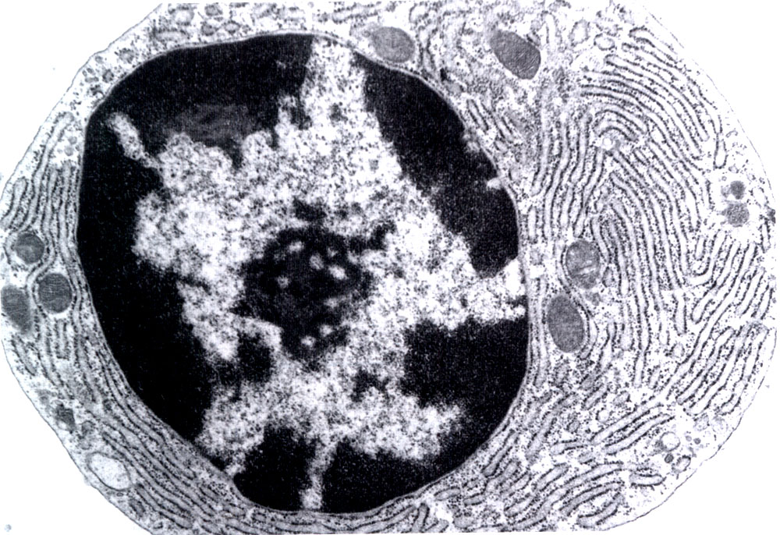
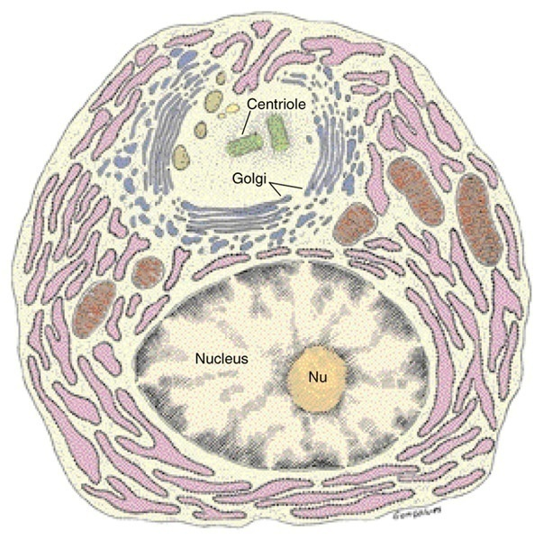
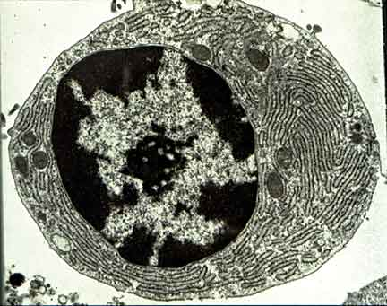
Plasma cell: typical protein secreting cell
Notes:
Plasma cell
Plasma cell เป็น Classical example of protein secreting cells โดยประกอบด้วย cytoplasmic organelles อย่างครบถ้วนและมากมายตามหน้าที่ของเซลล์
ลักษณะเมื่อศึกษาด้วย EM ของ plasma cell มีลักษณะดังนี้
○ เซลล์รูปไข่ Irregular shape หรือ ค่อนข้างกลม
○ Nucleus ขนาดเล็กอยู่ขอบๆ ของเซลล์ (Eccentric nucleus) ภายใน Nucleus มี large central nucleolus, ส่วน Chromatin granules หยาบจับตัวเป็นกลุ่มตามขอบของ Nuclear membrane ทำให้ Nucleus มีลักษณะคล้ายกงล้อเกวียน (Cartwheel appearance)หรือคล้ายหน้าปัดนาฬิกา (clock Face)
○ Cytoplasm มีorganelles ต่างๆจำนวนมากดังนี้
- space cistern of Rough endoplasmic reticulum มาก
- บริเวณใกล้ๆ กับ Nucleus จะมี Golgi apparatus และ Centrosphere อยู่
- mitochondria อยู่กระจาย
- ไม่พบ secretory granule เพราะสร้างเสร็จก็ปล่อยเข้าสู่กระแสเลือดโดยการ exocytosis ตลอดเวลา

Slide 12
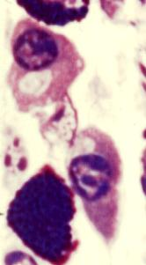
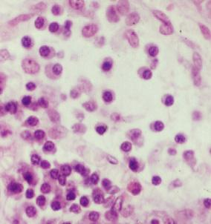
Plasma cells, lymphocytes, mast cells, ……..

Slide 13
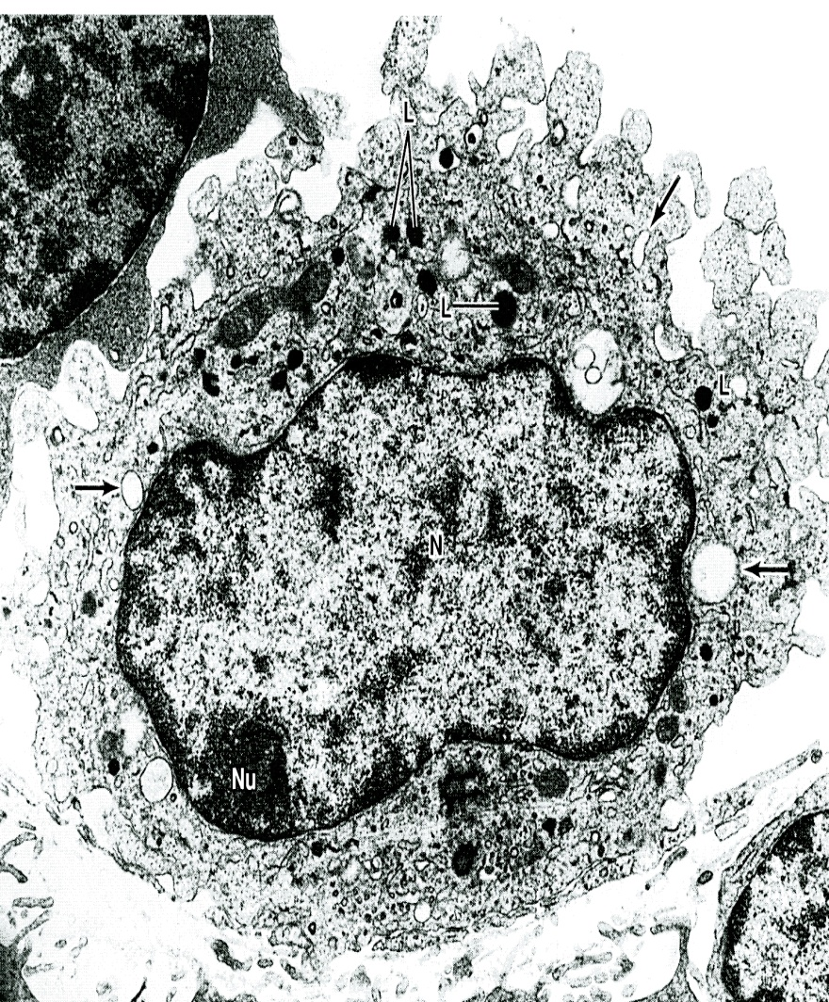
MACROPHAGES/HISTIOCYTES/CLASMATOCYTES
They may be fixed or transient.
They are derived from monocytes (transient) or from hematopoietic stem cells (fixed macrophages).
A typical macrophage measures between 10 and 30μm in diameter and has an oval or kidney-shaped nucleus located eccentrically.
Highly motile, irregular in shape with pseudopodia.
Have dark nucleus and basophilic cytoplasm containing numerous lysosomes, vacuoles and residual bodies.

Slide 14
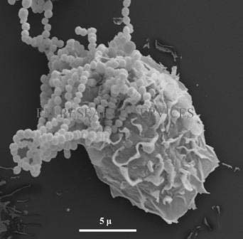
MACROPHAGE BY EM
They are active phagocytes removing cell debris and protecting the body against foreign invaders.
As shown here, a microphage is undergoing phagocytosis of streptococci bacteria

Slide 15
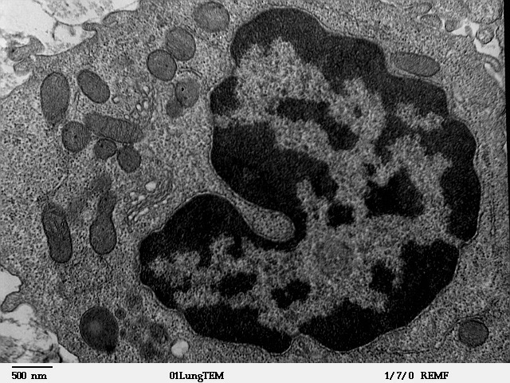
MACROPHAGE BY TEM
A macrophages characterized by an irregular surface with pleats, protrusions, and indentations, a morphologic expression of their active pinocytotic and phagocytic activities.
Has generally well-developed Golgi apparatus, many lysosomes, and rough ER.

Slide 16
Distribution & Main Functions of the Cells of the Mononuclear Phagocytic System
Cell Type | Location | Main Function
Monocytes | Blood | Precursor of macrophages
Tissue macrophages (Histiocytes) | All Connective tissues, lymphoid organs, bone marrow | Production of cytokines, chemotactic factors, and several other molecules that participate in inflammation (defence), antigen processing and presentation
Kupffer cell | Liver | Same as macrophages
Microglial cell | Nerve tissue of the CNS | Same as macrophages
Dust cells | Lung tissue | Same as macrophages
Langerhans cells | Epidermis of Skin | Antigen processing and presentation
Microfold cells | Peyer’s patch of GIT | Antigen processing and presentation
Dendritic cells | Lymph nodes | Antigen processing and presentation
Osteoclasts | Bone (formed by fusion of several macrophages) | Digestion of bone matrix to produce bone marrow cavities
Multinuclear giant cell | Connective tissue (fusion of several macrophages) | Segregation and digestion of foreign bodies

Slide 17
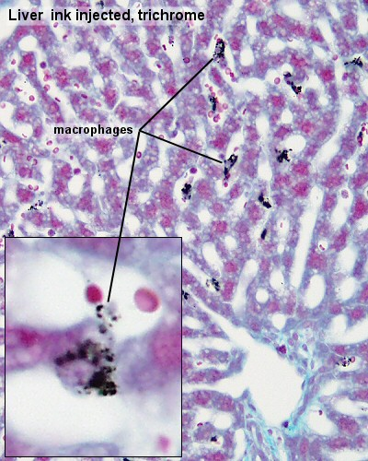

Slide 18
Classification of CT
I. Embryonic CTs:
  Mesenchyme
  Mucoid (Mucous CT)
B. Specialized CTs/ CTs with special properties:
  Blood tissue
  Bone tissue
  Cartilage
II. Mature CT proper:
A. Ordinary/Fibrous CTs
  Loose CT
    Loose areolar
    Adipose
    Reticular
  Dense CT
    Dense regular
      Collagenous
      Elastic
    Dense irregular
      Collagenous
      Fibroelastic

Slide 19
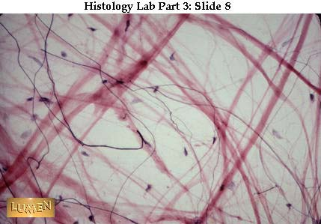
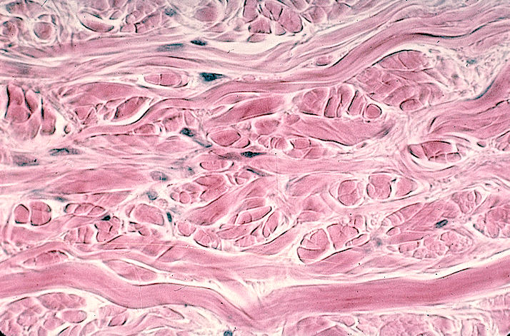
Types of Fibrous Connective Tissues
Two types based on the relative abundance of fibers:
  Loose Connective Tissue
    Lots of ground substance and cells. Fewer fibers.
    Leaves abundant empty spaces in tissue sections.
  Dense Connective Tissue
    Fibers are predominant constituents.
    Much lower number of cells and less ground substance.
    Fibers appear closely packed in tissue sections.

Slide 20
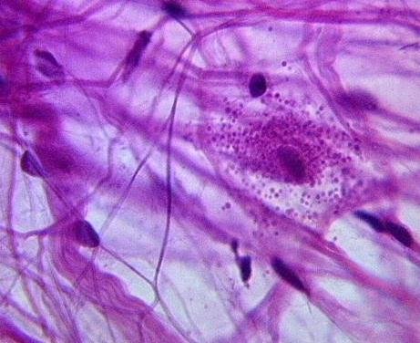
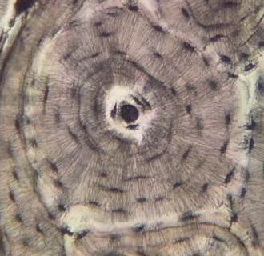
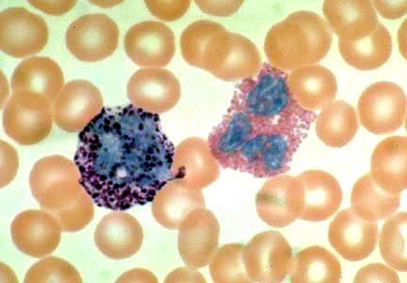
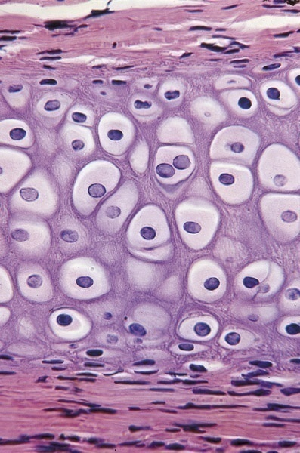
Categories of CT
Loose Areolar
Fibrous connective tissue (a.k.a. connective tissue proper)
Supportive/skeletal connective tissue
Fluid connective tissue
(Blood)
Bone
Cartilage

Slide 21
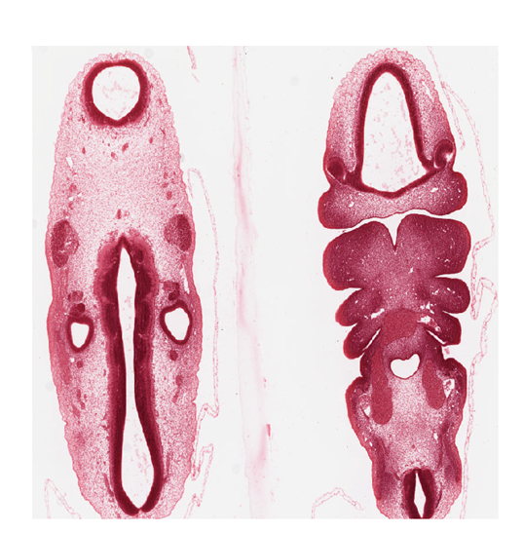
Mesenchyme, in embryonic body wall

Slide 22
Loose Areolar CT
The most numerous cells are fibroblasts and macrophages, but all other types of ordinary CT cells are also present.
less amount of all CT fibers also appear in this tissue.
With a moderate amount of ground substance, loose areolar connective tissue has a delicate consistency; it is flexible, well vascularized, and not resistant to stress.
Locations
  in papillary dermis of skin & subcutaneous tissue,
        lamina propria & submucosa of GIT & respiratory tracts,
        around blood vessels & organs and serous membranes, around muscle fibers (endomysium) and nerve fibers (endoneurium).
accumulates large amount of tissue fluid and leads to tissue swelling (Edema) in inflammatory conditions.

Slide 23
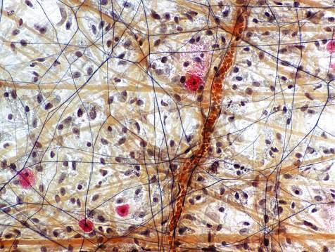
LOOSE AREOLAR CT

Slide 24
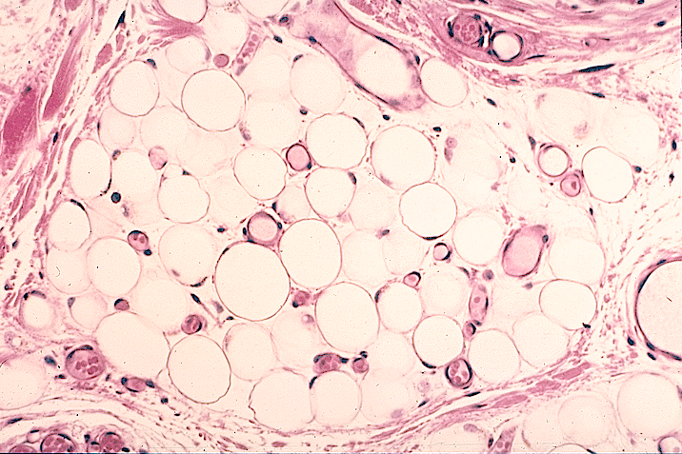
Functions of Adipose Tissue
Energy storage
Thermal insulation
Shock absorption
Protective cushioning for some organs
Accounts 15–20% of the body weight in men of normal weight; in women of normal weight, 20–25% of body weight.

Slide 25
White and Brown Adipose Tissues
The color of brown adipose tissue or brown fat is due to both the numerous mitochondria found in the adipocytes and the large number of blood capillaries in this tissue.
Adipocytes of brown fat are therefore called multilocular
The many small lipid droplets, abundant mitochondria, and rich vasculature all help mediate this tissue's principal function of heat production.
unlike white adipose tissue, which is present throughout the body, brown adipose tissue has a much more limited distribution.
White adipose tissue
Brown adipose tissue

Slide 26
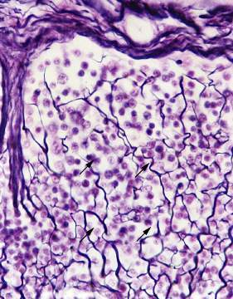
Reticular Ct
composed mainly of type III collagen fibers in a form of network or mesh, fibroblasts called reticular cells, and lymphocytes.
Forms supportive framework of liver sinusoids, red bone marrow, lymph nodes, spleen, smooth muscles, islet of Langerhans and adipose tissues.
Reticular cells - synthesize reticular fibers in lymphatic tissues; cell body and processes completely surround reticular fibers
Lymph node (silver stain)

Slide 27
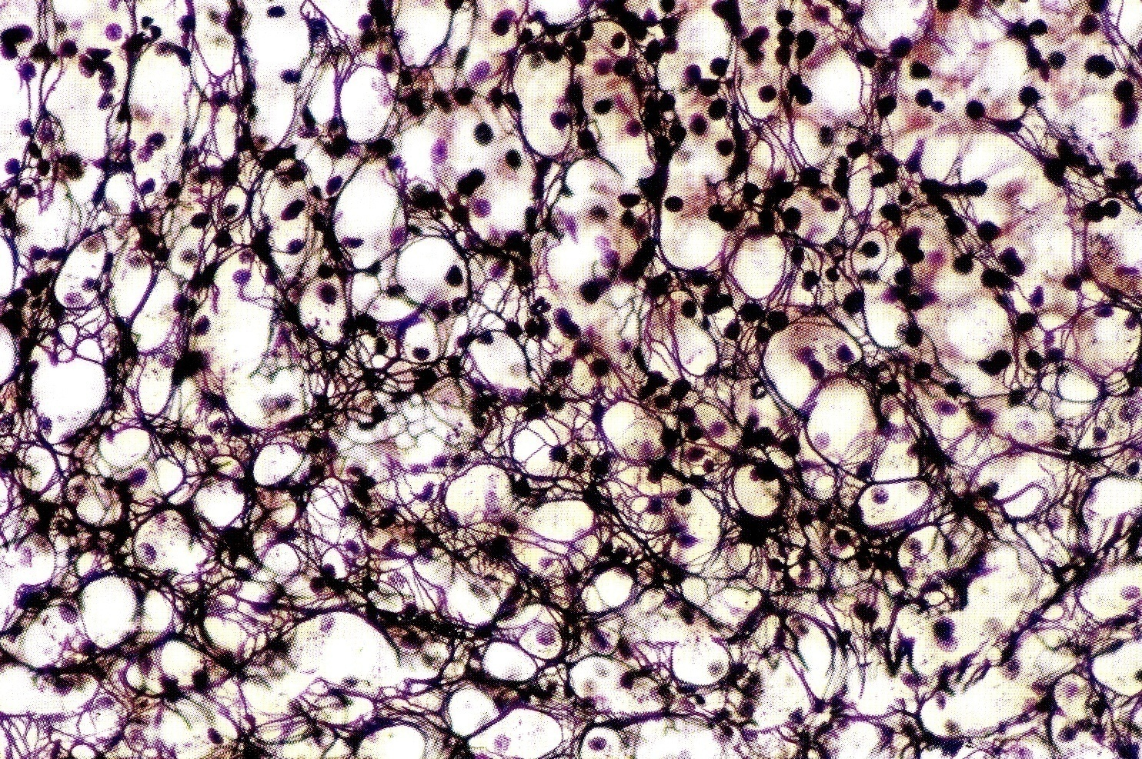
RETICULAR CT
reticular cells
Lymphocytes

Slide 28
2. DENSE CT
Contains abundant amount of fibers gathered into large bundles with fewer cells & ground substance.
a. DENSE REGULAR CT
      Has tightly packed coarse collagen bundles arranged in parallel fashion to form cord-like cylinders (tendons, retinacula & ligaments) or sheets (aponeurosis) & capsule of some glands (spleen, suprarenal, etc), interosseous membranes, fibrous sheaths around cartilage (perichondrium) and sheaths around bone (fibrous periosteum).
Fibroblasts and fibrocytes are arranged in rows between the collagen fibers so they appears elongated with their dash-like elongated nuclei.
It can be collagenous type (e.g. tendon, aponeurosis, retinacula, white ligaments) or elastic type (e.g. ligamentum nuchae, ligamentum flavum)
Dense collagenous CT type is also known as white fibrous CT.

Slide 29
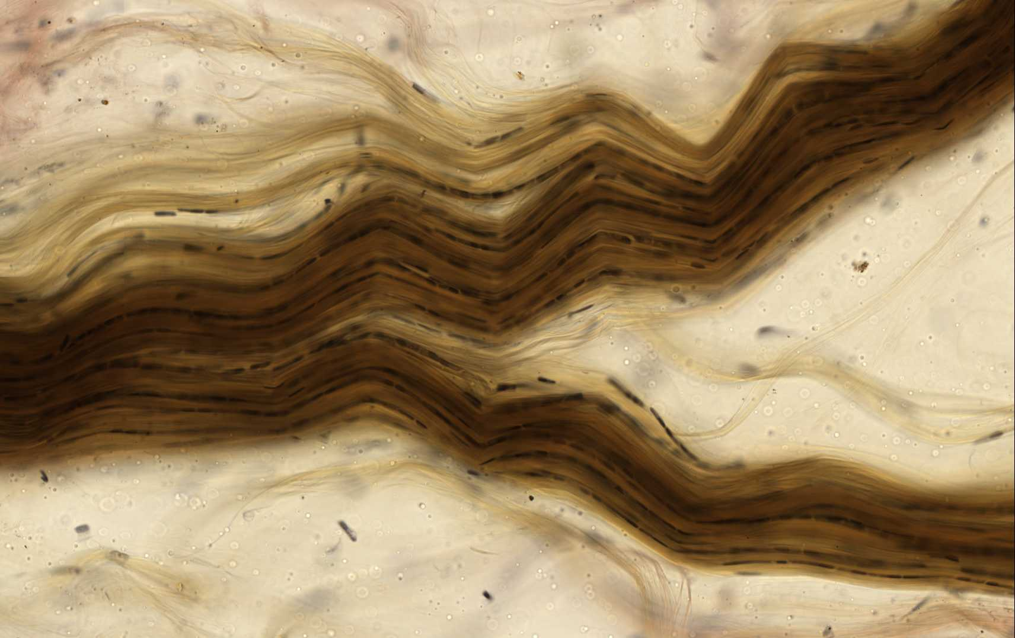
Dense Regular Collagenous C.T
Tendon, teased

Slide 30
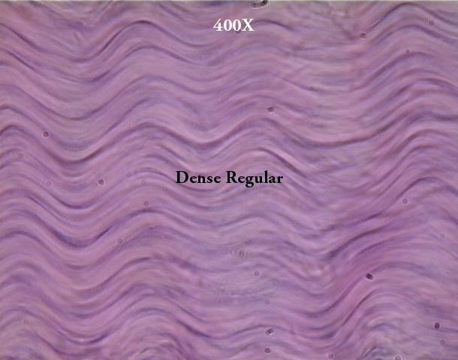
Dense Regular Connective Tissue
  The collagen bundles are arranged according to a definite pattern, with the linear orientation of fibroblasts in response to prolonged stresses exerted in the same direction.
  This arrangement offers great resistance to traction forces.
Tendon
NOTE the waviness of the fibers. What function could this structural aspect provide?

Slide 31
b. DENSE IRREGULAR CT
Contains abundant amounts of fibers with less cells and ground substances.
Has tightly packed coarse collagen bundles arranged randomly in all directions, with few elastic fibers.
Fibroblasts and other fewer cells are arranged between the collagen fibers.
Location
      reticular dermis (the deeper 4/5th of the dermis of skin),
      capsule of organs, trabecula of glands & fibrous joints
      Corpus Albicans (L., white body): a scar of white dense fibrous connective tissue in ovary
      Sheaths around skeletal muscles (epimysium), nerves (epineurium) and CNS (dura & arachnoid maters).

Slide 32
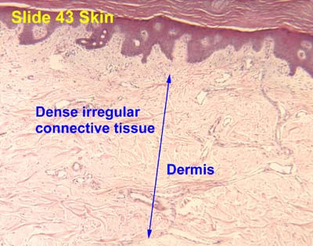
Dense Irregular CT
Locations:
  Deeper portion of dermis of skin.
  Capsules around some organs such as testes, lymph nodes, ganglia, sensory receptors, and trabeculae of some organs like spleen lymph node and glands.
  Stroma of some glands like inactive mammary gland

Slide 33
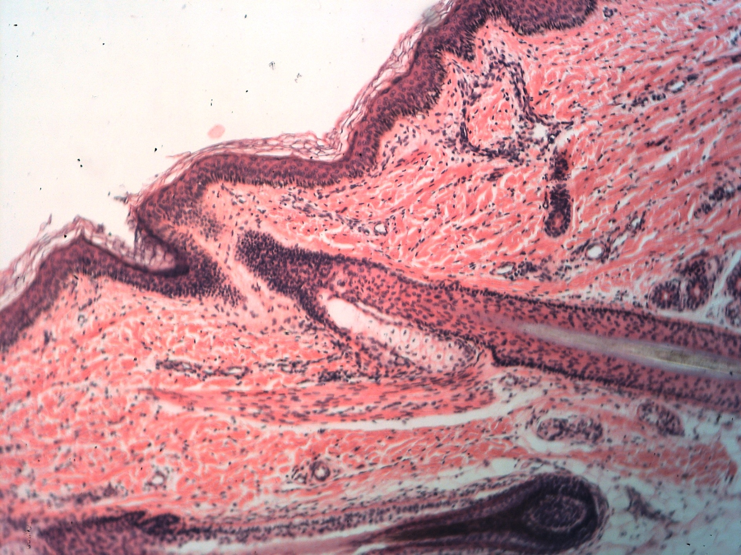
Dense Irregular CT of the lower dermis

Slide 34
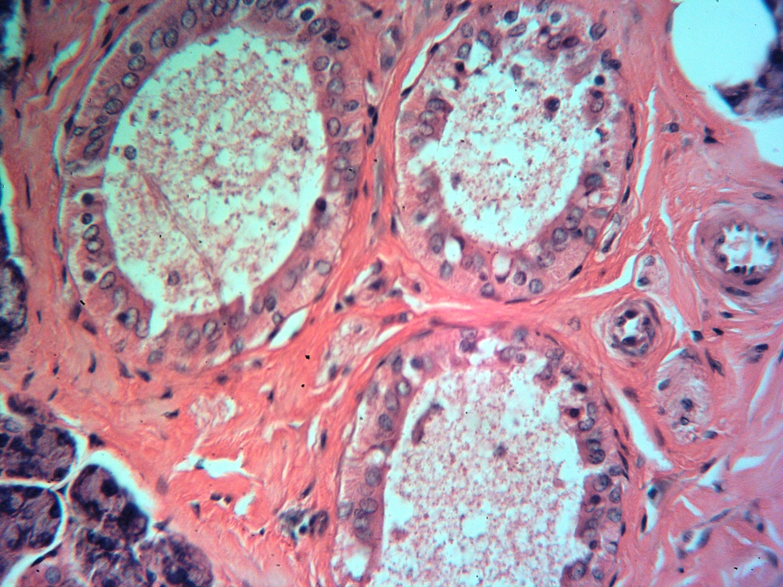
Dense Irregular CT trabecula of submandibular gland

Slide 35
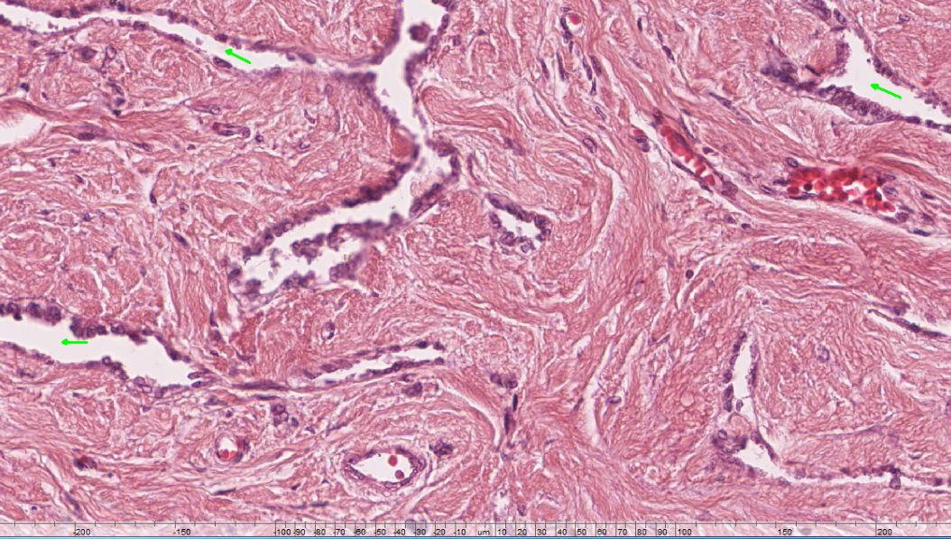
Dense Irregular CT of mediastinum testis

Slide 36
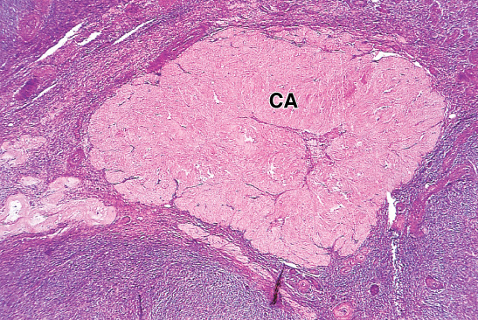
Corpus Albican (CA)

Slide 37
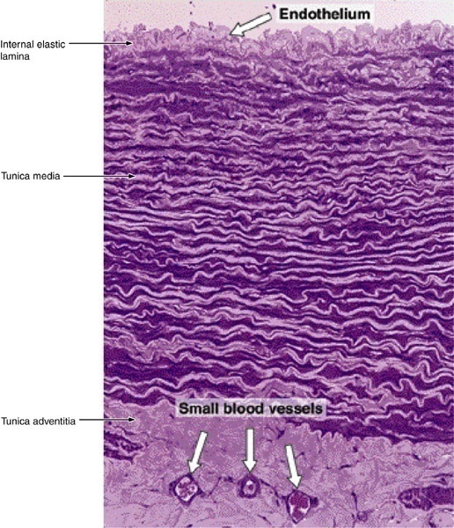
Elastic C T in the wall of large artery (Aorta)

Slide 38
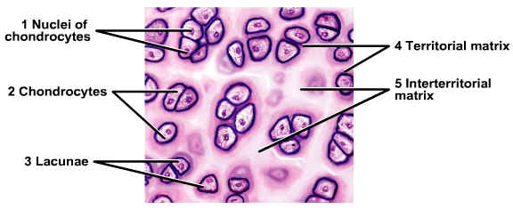
CONNECTIVE TISSUES WITH SPECIAL PROPERTIES
BONE TISSUE
BLOOD TISSUE
CARTILAGE

Slide 39
CARTILAGE
belongs to the skeletal (supportive) tissues which provide flexible support to some organs.
Cartilage consists of:-
1- Cartilage cells: chondroblasts and chondrocytes
chondrocytes are located in lacunae surrounded by an intercellular cartilage matrix.
Extracellular matrix:
  Collagenous and elastic fibers
  Ground substance: enriched with glycosaminoglycans and proteoglycan aggregates.

Slide 40
Characteristics of Cartilage
Cartilage is avascular (has no blood supply) so, healing is poor or slow after injury.
It has no lymphatic vessels or nerves either.
Chondroblasts and chondrocytes synthesize and secrete the cartilage matrix.
Chondrocytes are located in matrix cavities called lacunae.
Chondrocytes derived by mitotic division of one parent cell exist as clusters of 4 to 8 cells known as isogenous groups (cell nests).
Cytoplasm of chondrocytes is basophilic, rich in glycogen, lipids and phosphatase enzymes.
Cartilage is usually covered or surrounded by a capsule-like sheath of dense CT known as Perichondrium, formed of two layers: outer fibrous layer & inner chondrogenic layer.

Slide 41
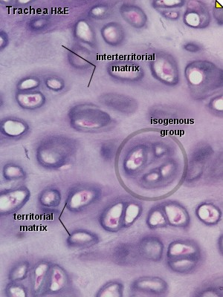

Slide 42


Slide 43
Variations in the composition of cartilage matrix components produce three types of cartilages adapted to local biomechanical needs:
      Hyaline cartilage
      Elastic cartilage
      Fibrocartilage

Slide 44
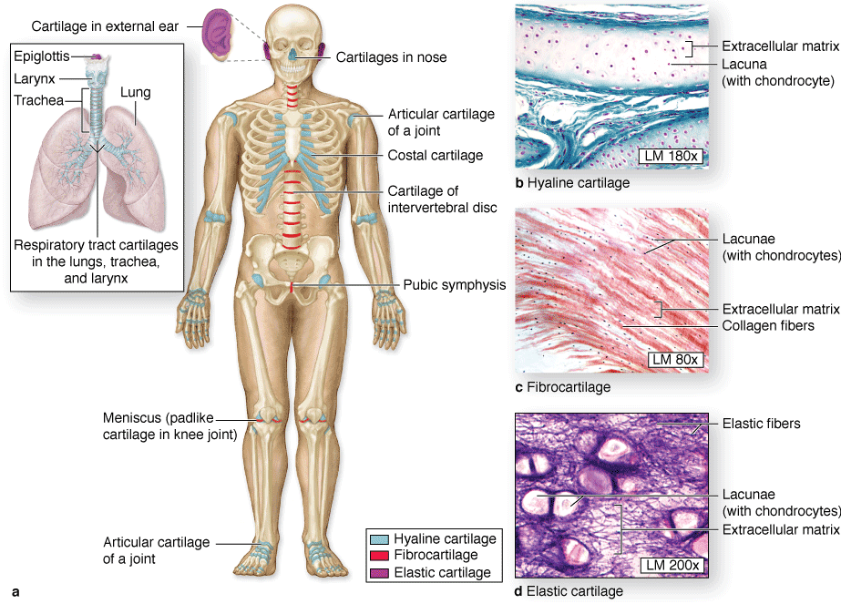

Slide 45
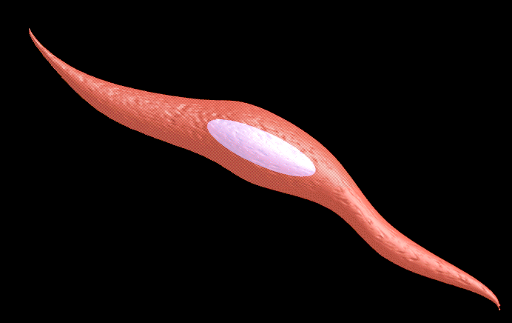
Muscular tissue
The cells of muscle tissue are long narrow called muscle fibers
The cell membrane of muscle fiber is called sarcolemma, the cytoplasm is called sarcoplasm, the smooth endoplasmic reticulum is called sarcoplasmic reticulum, the mitochondria is called sarcosome
Muscle fibers are either striated or non-striated according to whether or not they have transverse striations
Muscle fibers are either voluntary or involuntary
Types of Muscular Tissue:
  Skeletal muscle
  Cardiac muscle
  Smooth muscle

Slide 46
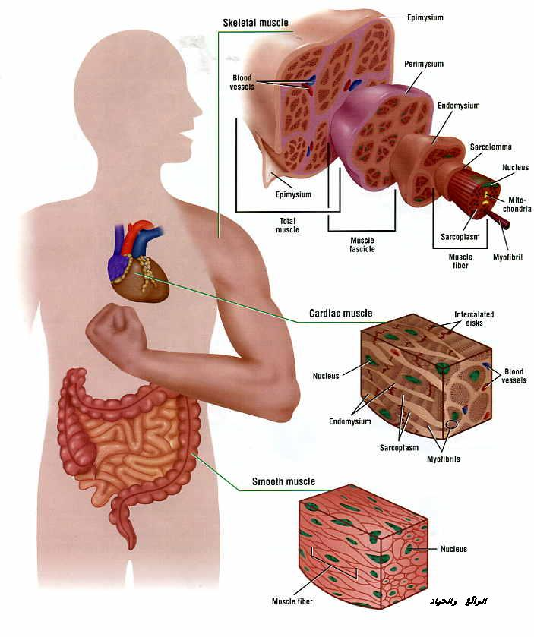
Muscular tissue
Skeletal muscle
Cardiac muscle
Smooth muscle

Slide 47
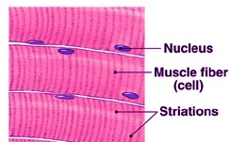
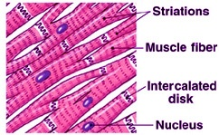
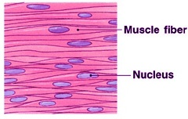
Muscular tissue
Skeletal muscle | Cardiac muscle | Smooth muscle
Attached to the skeleton | Found in the myocardium of the heart | Found in the blood vessels & viscera
Striated | Striated | Non-striated
Voluntary | Involuntary | Involuntary

Slide 48
Nervous tissue
The nervous tissue is the basic tissue from which the nervous system is made
The nervous system includes:
  Central nervous system: the brain and spinal cord
  Peripheral nervous system: peripheral nerves (spinal & cranial nerves) and nerve ganglia (spinal ganglion & autonomic ganglion)
Histologically, the nervous tissue is formed of neurons and neuroglia
The Neuron is the structural and functional unit of the nervous system.
Neuroglia is the interstitial tissue of the nervous system. It consists of large number of branching cells which bind and connect the neurons together and with the blood vessels

Slide 49
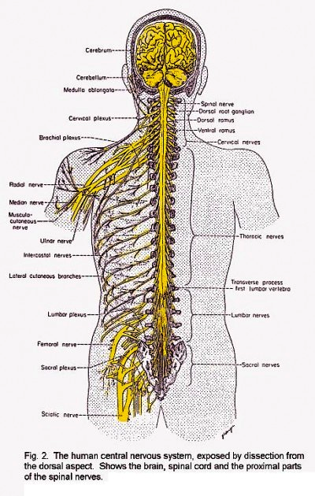
Nervous tissue
Central and peripheral nervous system

Slide 50
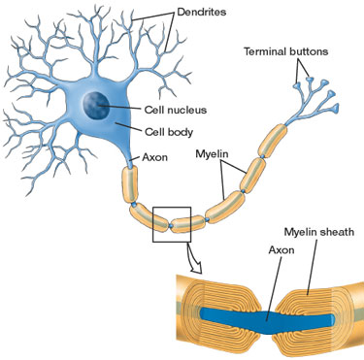
Nervous tissue
The Neuron
The neuron is the structural and functional unit of the nervous system
The neuron consists of:
  Cell body
  Processes (Axon & Dendrites)
The Neuroglia
They are classified into neuroglia proper & other types of neuroglia
Neuroglia proper:
  Astrocytes
  Microglia
  Oligodendroglia

Slide 51
GOOD LUCK

