Slide 1
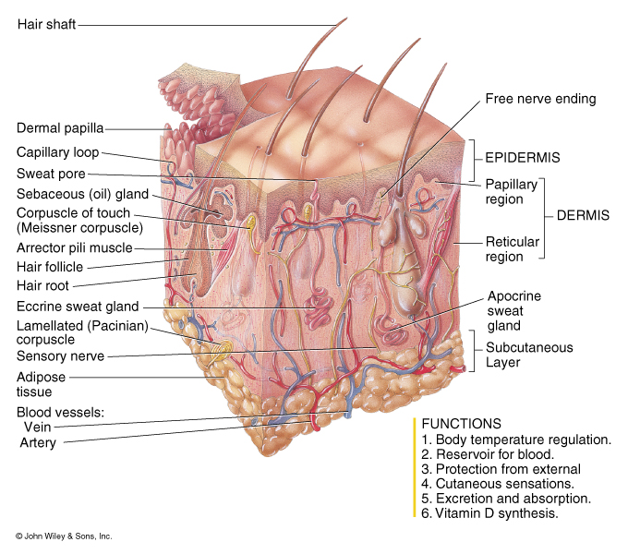
The Integumentary system
One of our 11 organ systems.
Consists of two parts
  skin (i.e., the cutaneous membrane)
  appendages (accessory)
    Sweat glands (sudoriferous glands)
    Sebaceous glands (oil glands)
    Hair
    Nails

Slide 2
Some Facts about Skin
Constitutes 16% of the body weight and largest system.
Surface area: 1.5-2.0 sq. meters
Thickness: 0.5-3.0 mm
Growth rate of nail: 0.1mm per day
Growth rate of hair: 1.5-2.2 mm per week
Life span of hair:
    Eyelashes, axilla- 4 months
    Scalp – 4 years

Slide 3
General Functions of the Integumentary System
Protection from
  mechanical injury
  Physical protection
  Chemical prevention of pathogen entry
Sensation
Thermoregulation
Excretion
Metabolic functions
Looking good/cosmetics

Slide 4
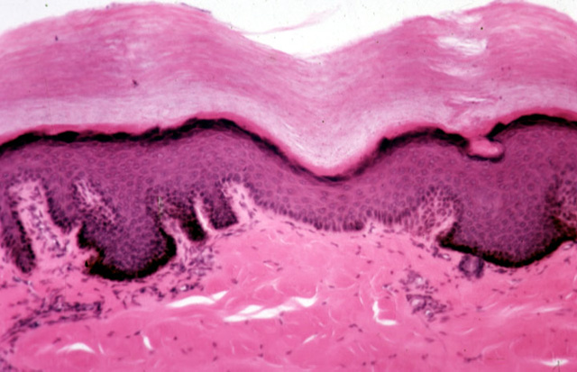
Skin Types
Thick Skin
  Found on soles of feet and palms of hands and corresponding parts of fingers and toes.
  Contains 5 epidermal layers or strata (“sheets”):
    Stratum basale
    Stratum spinosum
    Stratum granulosum
    Stratum lucidum
    Stratum corneum

Slide 5
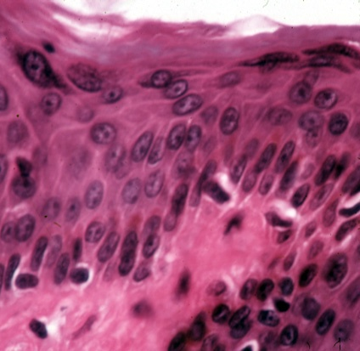
Thin skin
  Found everywhere else on the body.
  Contains only 4 layers. (lacks a stratum lucidum).
  The remaining 4 layers are thinner than those of thick skin.
Why is thick skin found on the palms and soles? What is the advantage of that?
Note: this slide is at a higher mag. than the thick skin slide on the previous page

Slide 6
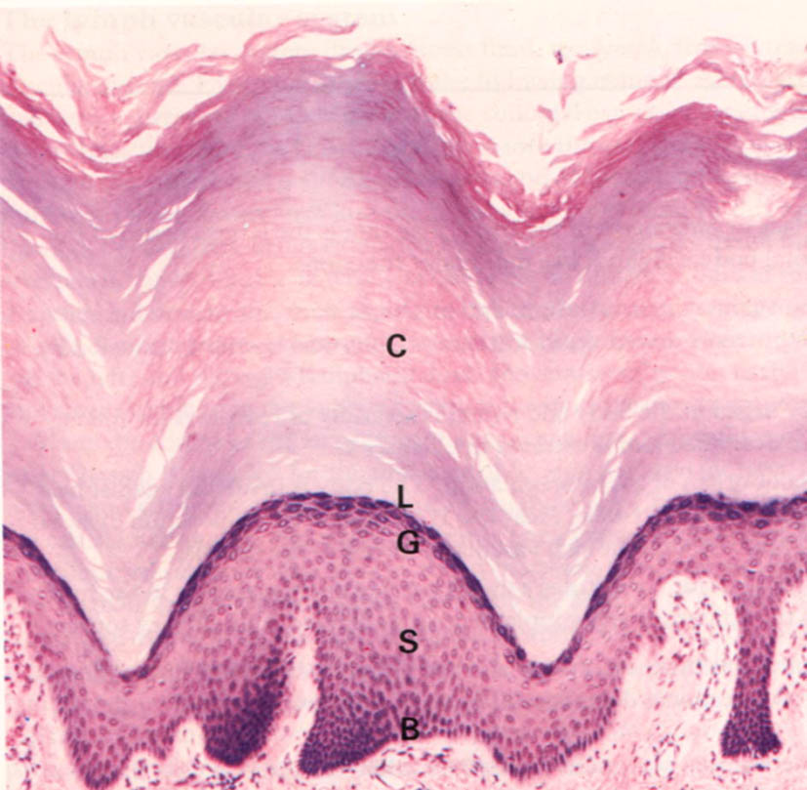
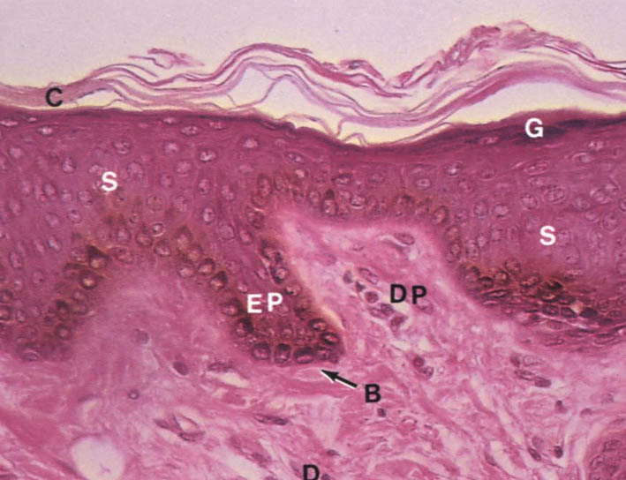
Thin skin
Thick skin

Slide 7
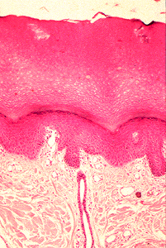
Basic Skin Structure
The skin has 2 main layers:
  The superficial, avascular epidermis (epi means “above” and dermis means “skin”) consisting of 4-5 layers of epithelial cells resting upon a basement membrane.
The deep, vascular dermis consisting of fibrous connective tissue. Contains multiple blood vessels, and the accessory appendages.

Slide 8
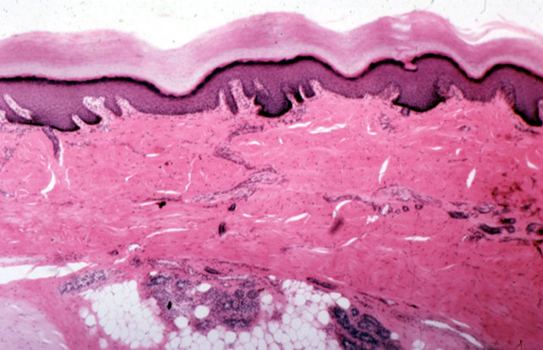
The Epidermis
Keratinized stratified squamous epithelium.
Avascular.
Consists of 4 distinct cell types arranged in 4 or 5 distinct layers.
Epidermal cell types:
Keratinocytes (structure)
Melanocytes (pigment)
Merkel cells (sensation)
Langerhans’ cells (phagocytes - immune cells)
Yellow arrow indicates the epidermis of thick skin

Slide 9
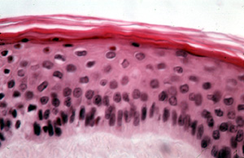
Keratinocytes
Most numerous epidermal cell – found in all layers of the epidermis.
Chief function is the production of keratin – a tough fibrous protein
that gives strength and confers a lot of protective ability.
Tightly connected to one another by desmosomes.
  Provides continuity, strength, and protection.
Almost all of the epidermal cells in this slide are keratinocytes

Slide 10
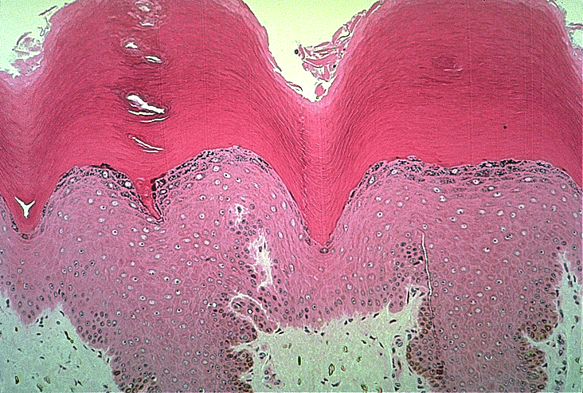
Keratinocytes
New cells are continuously made in the deepest layer pushing the older cells up.
As the keratinocytes move farther from the deepest layer, they make the keratin that eventually dominates their cell contents.
When they have reached the upper layer, they are nothing more than scale-like bags of keratin.

Slide 11
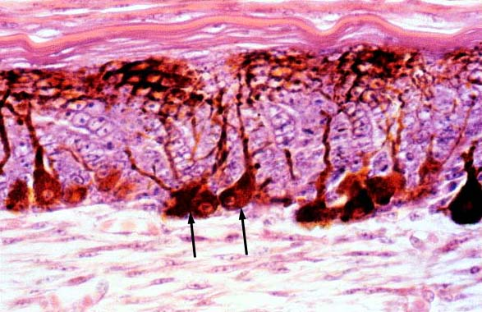
Melanocytes
Spider-shaped epithelial cells that synthesize the protein pigment melanin.
Found in the deepest layer of the epidermis.
Melanin is made and then packaged into membrane-bound granules called melanosomes.
Granules are transferred to the keratinocytes in the 2 deepest layers of the epidermis.
Arrows indicate 2 melanocytes.

Slide 12
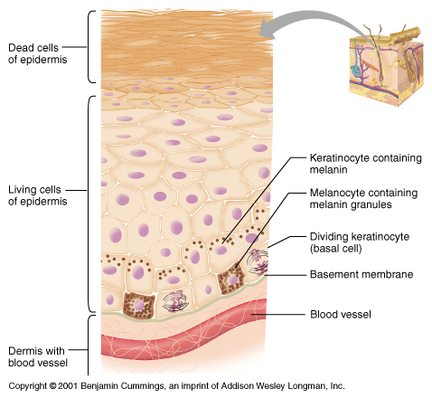
Melanocytes
Melanin granules accumulate on the “sunny side” of the nucleus of the keratinocytes.
  Would that be the apical or the basal side?
Melanin granules protect the DNA within the nucleus from being damaged by the ultraviolet radiation from the sun.

Slide 13
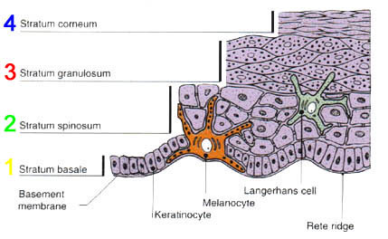
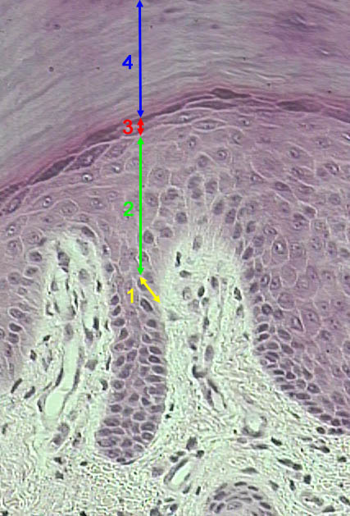
Notice the 4 layers of thin skin in both the cartoon and the photomicrograph.

Slide 14
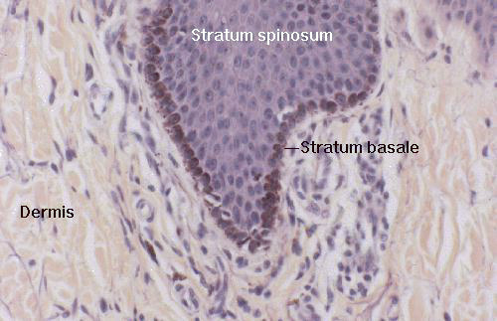
Stratum Basale
Single row of cuboidal
keratinocytes with melanocytes Merkel cells interspersed.
Cells in this layer are highly mitotic – they’re dividing often.
Due to this fact, this layer is a.k.a. the stratum germinativum.

Slide 15
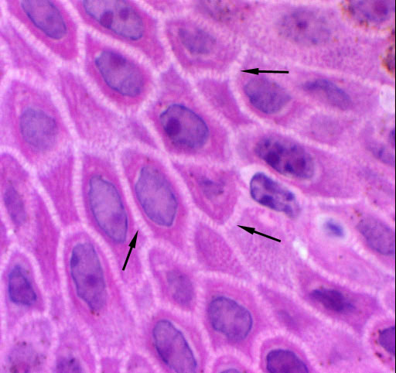
Stratum Spinosum
2nd deepest layer. Consists of 8-10 layers of cells.
Cells of the lower layers can still be mitotic.
As cells get pushed upward, they begin to flatten and begin to make the precursors of keratin.
A.k.a. the “prickly layer” because in tissue sections, they shrink and pull back.
This makes their exposed desmosomes connecting adjacent cells appear to resemble spikes or spines.
Do you see the spines?

Slide 16
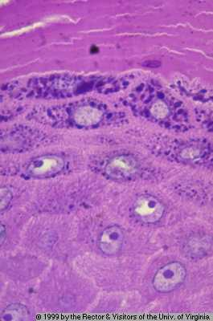
Stratum Granulosum
3-5 cell layers thick.
Cell morphology begins to change dramatically as cells continue to flatten and their nuclei and organelles disintegrate.
Accumulate granules containing a precursor of keratin and granules containing a waterproofing agent.
if water can’t diffuse upward, how would the cells above this layer receive nutrients? What would happen to them?

Slide 17
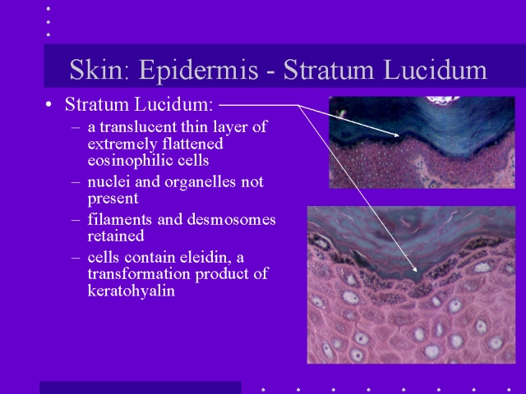
Stratum Lucidum
flat, dead keratinocytes appears clear in the light microscope
because it lacks nuclei and organelles which typically stain well.

Slide 18
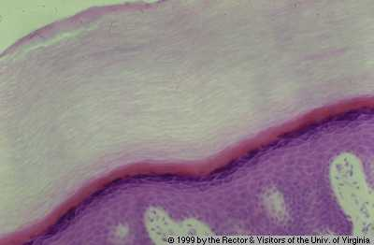
Stratum Corneum
Outermost stratum. 20 – 30 layers of flat (squamous), highly keratinized, dead cells.
Protects against mechanical abrasion
cells can absorb impacts and simply flake off if necessary. Prevents pathogen entry. Prevents desiccation (drying out).
A.k.a. the cornified layer.
The process by which cells in the stratum basale divide and then advance upward
becoming more and more keratinized and less and less alive as they go is known as cornification.

Slide 19
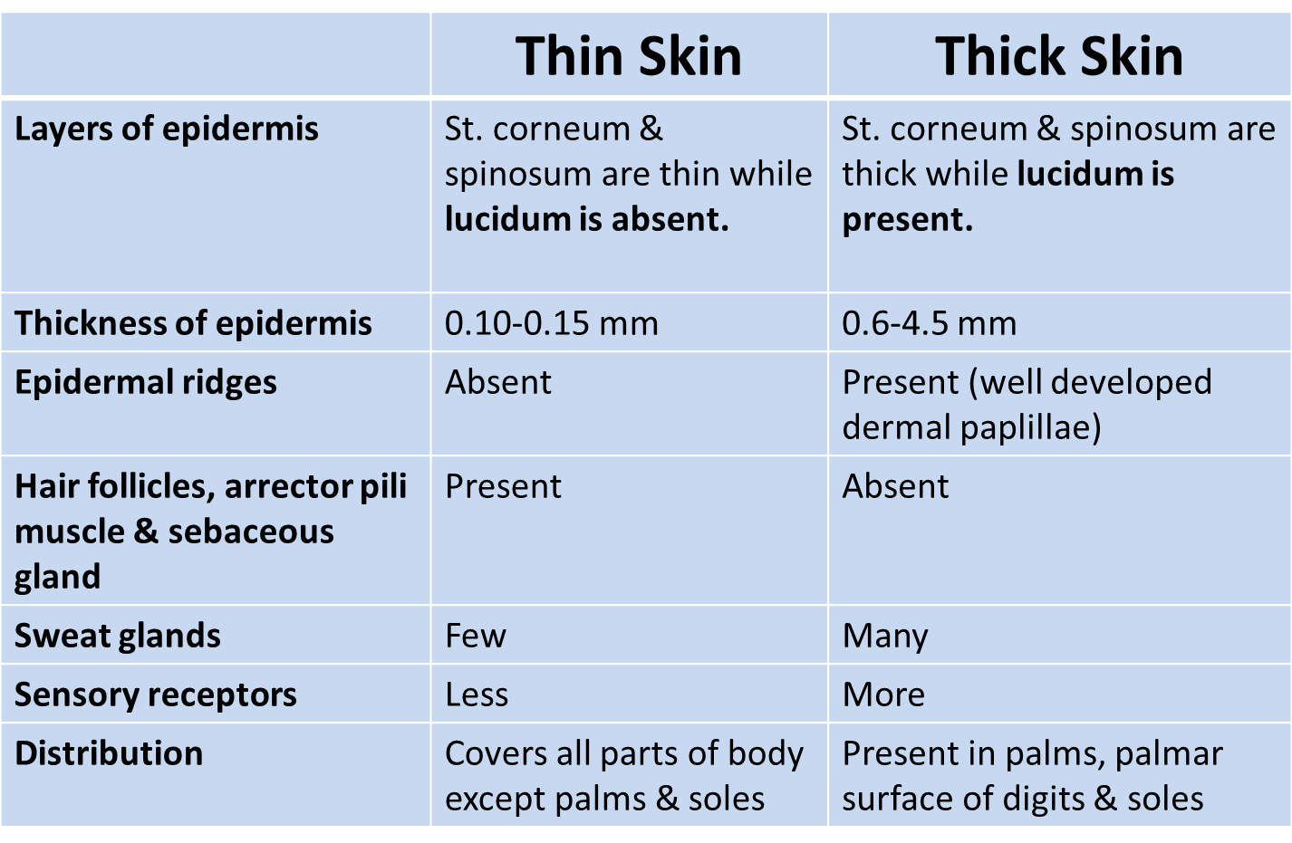
Thick and thin skin

Slide 20
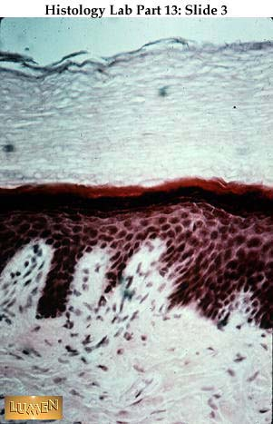
Identify the 2 layers indicated by the arrows

Slide 21
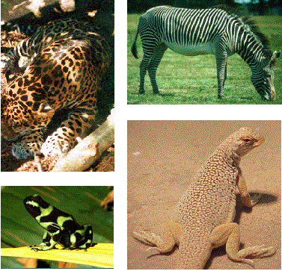
Skin Color
Due to 3 pigments:
  Melanin
  Carotene
  Hemoglobin
Of these, only melanin is made in the skin.
Melanin:
  Polymer of tyrosine amino acids. Its synthesis is catalyzed by an enzyme called tyrosinase. Albinos lack this enzyme.
  Ranges in color from yellow to reddish brown to black.
  All people have the same # of melanocytes, individual variations in skin color are due to how much and what type of melanin is made.
  Freckles and moles are local accumulations of melanin.

Slide 22
2. Carotene
  Yellow to orange pigment found in plant products such as carrots.
  When large amounts are eaten, it can be deposited in the stratum Corneum of thick skin.
3. Hemoglobin
  Pigmented protein that transports oxygen within the blood.
  In Caucasians, the fair skin allows the crimson color of oxygenated blood to make the skin have a somewhat pinkish hue.

Slide 23
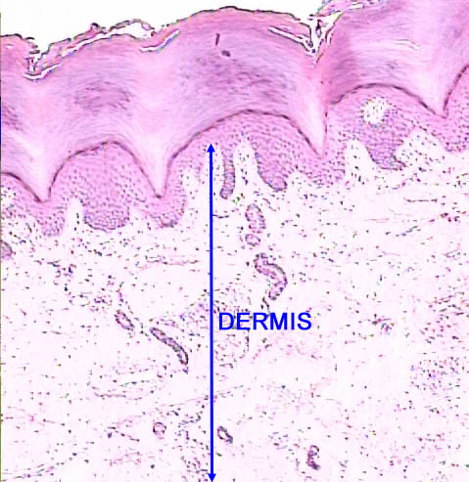
Dermis
Strong, flexible fibrous connective tissue.
Divided into papillary dermis and reticular dermis.
Papillary dermis is the upper 1/5 of the dermis and consists of loose (areolar) CT.
  Provides an area for immune cells to fight invaders.
  Projects upward (as) to interdigitate and form a strong connection with the epidermis.
  Heavily invested with blood vessels – they constrict in cold weather and dilate in warm weather. Why?
  Also contains multiple sensory receptors.
dermal papillae

Slide 24
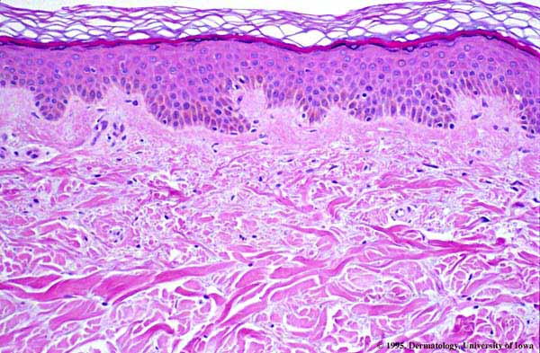
Dermis
Reticular dermis is lower 4/5 and consists of dense irregular connective tissue.
  The prominent, horizontally running collagenous fibers give the skin strength and resiliency.
  Elastic fibers give the skin the ability to stretch and recoil.
The majority of the appendages of the skin are contained within the dermis.
Red arrow indicates the papillary dermis and blue arrow indicates the reticular dermis

Slide 25
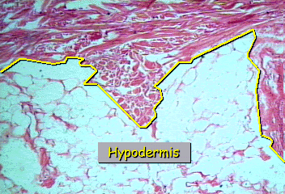
Subcutaneous Tissue
A.k.a. the hypodermis or the superficial fascia.
Deep to the dermis.
Consists of primarily adipose tissue plus some loose areolar connective tissue.
Stores energy, provides insulation and padding.
Anchors the skin to underlying structures, especially muscles.
Different distribution between the sexes.

Slide 26
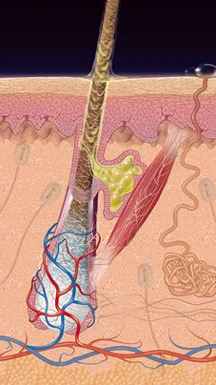
Appendages of the Skin
Hair
Nails
Skin glands
  Sebaceous glands
  Sudoriferous glands
  Apocrine sweat glands (e.g. Ceruminous glands)
1
4
2

Slide 27
Hair and Hair Follicles
Hair is a flexible strand made of highly keratinized dead cells.
The keratin in both hair and nails is hard keratin, a stiffer, more compact version of the soft keratin that dominates the epidermis.
It is tougher and its cells do not individually flake off.
The hair is made by the living hair follicle.

Slide 28
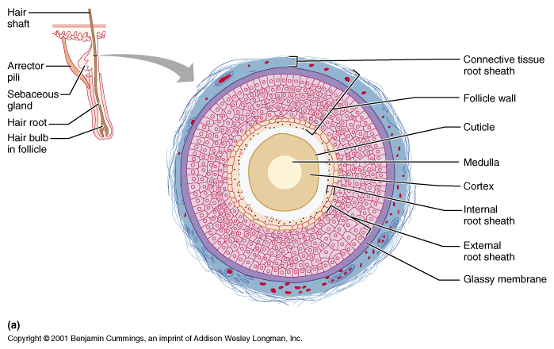
Hair and Hair Follicles
Hair consists of a shaft which protrudes from the skin and the root which is within the skin and base, the root gets wider forming the hair bulb.
The hair consists of 3 concentric regions:
  Medulla → the innermost region consisting of large cells and air spaces.
  Cortex → surrounds the medulla and consists of flattened keratinized cells
  Cuticle → outer layer of flat keratinized cells that overlap like shingles with their free edges pointing upward.

Slide 29
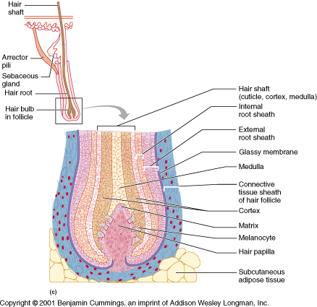
Hair and Hair Follicles
The hair follicle surrounds much of the hair root.
It contains an outer CT sheath & inner epithelial root sheath.
At the base of the hair follicle is a single layer of mitotic cells derived from the stratum basale. This is the hair matrix.
All the cells of the hair are derived from the hair matrix. Just beneath the hair matrix is an obvious dermal papilla called hair follicle.

Slide 30
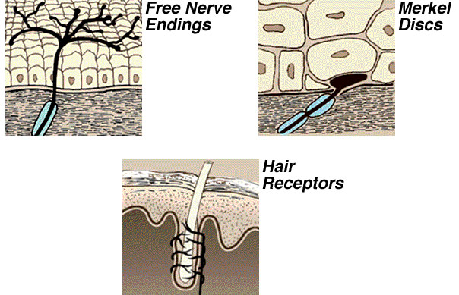
Hair and Hair Follicles
Wrapped around the bulb of the follicle is a network of sensory nerve endings known as the hair root plexus. Allow the hairs to serve a sensory function.
Attached to each hair is a bundle of smooth muscle known as an arrector pili muscle.
In times of fright or cold, these muscles contract and cause the hair to stand on end – and produces goose bumps.

Slide 31
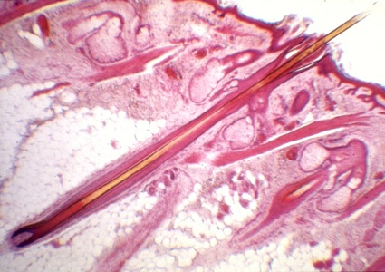
The arrow indicates an arrector pili muscle. In this picture, you should also try to identify the shaft, root, follicle, hair papilla, and sebaceous gland.

Slide 32
Types of hair
Not all hair is alike, even on one person. Over the course of our lives, we grow three kinds of hair; lanugo, vellus and terminal hair.
Lanugo is fine, downy, unpigmented hair that appears on the fetus in the last 3 months of development.
Vellus by the time of birth, most of it is replaced by similar fine, unpigmented hair called vellus.
Except for the eyebrows, eyelashes, and hair of the scalp, all of the hair of children, two-thirds of the hair of women and one-tenth of the hair of men is vellus.
Terminal hair is longer, coarser, and pigmented. It occurs on the scalp, eyebrow, and eyelashes; at puberty it replaces the vellus in the axillary and pubic regions, on the face of males (to from the beard), and to varying degrees on the trunk & limbs.)

Slide 33
Color of Hair
Hair color is due to pigment granules in the cells of the cortex.
Brown and black hair are colored by a form of melanin called Eumelanin.
Blond hair has a scanty amount of eumelanin but a moderate amount of sulfur-containing pigments called Pheomelanins.
Red has a slight amount of eumelanin but an aboundance of pheomelanins. White hair results from a lack of pigments in the cortex and a presence of air in the medulla.

Slide 34
NAILS
  Plates of stratified squamous epithelial cells with hard keratin
  Protect distal ends of phalanges
  Cells are keratinized in the nail root
  Nail growth occurs in the lunula
  Cuticle is a fold of stratum corneum on the proximal end of nail

Slide 35
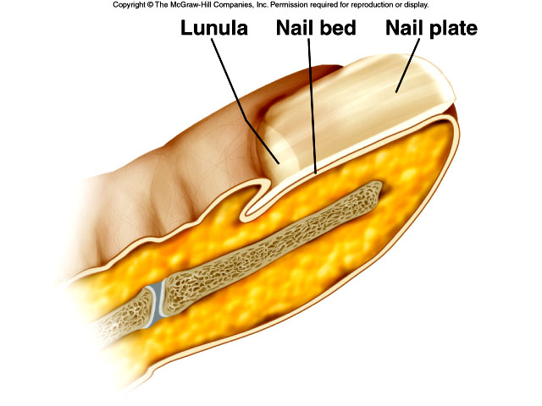
Nails
Nail bed overlaid by nail plate
Nail growth originates from root; cells become keratinized
Cuticle is formed from stratum corneum

Slide 36
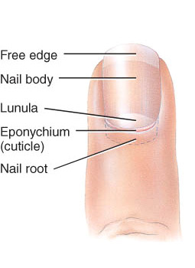
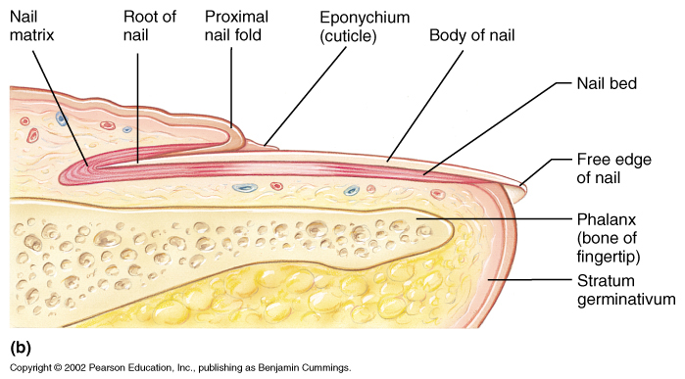
Structure of Nails
Tightly packed keratinized cells
Nail body: visible portion pink due to underlying capillaries
free edge appears white
Nail root: buried under skin layers
Lunula: is white due to thickened stratum basale
Eponychium (cuticle): stratum corneum layer
Hyponychium –the lower cuticle

Slide 37
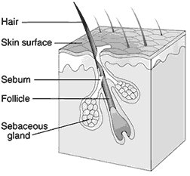
Sebaceous Glands
Simple alveolar glands found everywhere except palms of the hands and soles of the feet.
  Do the ducts of these glands branch?
  Are these glands exo- or endocrine?
Secrete an oily, lipid-rich secretion called sebum.
Sebum is typically secreted into a hair follicle or occasionally onto the body surface.
Sebum softens and lubricates the skin.
It also decreases the skin’s permeability to water and is quite bactericidal.

Slide 38
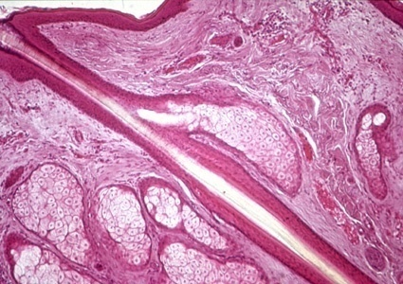
The sebaceous gland is indicated by the arrow. Note how its duct is unbranched and how it empties into a hair follicle.

Slide 39
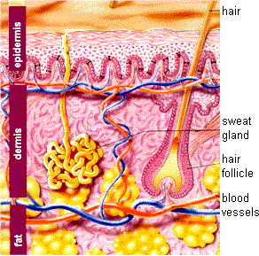
Sudoriferous Glands
Sweat glands.
Distributed over the entire body except the nipples and portions of the external genitalia.
Over 2.5 million per person.
Are 2 types:
  Merocrine sweat glands
  Apocrine sweat glands

Slide 40
Merocrine Sweat Glands
More numerous than apocrine sweat glands.
Especially prominent on the palms, soles, and forehead.
Simple, coiled, tubular glands.
Duct empties into a funnel-shaped pore at the skin surface.
Major function of merocrine sweating is to cool the body thermoregulation.

Slide 41
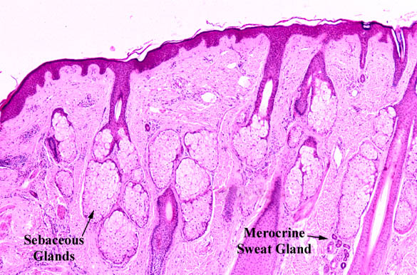
Merocrine sweat is a dilute watery solution of some salts (including NaCl), vitamin C, antibodies, small amounts of nitrogenous wastes (urea, uric acid, and ammonia), and lactic acid.
pH of sweat is 4-6 creating a film on the body known as the acid mantle.
Such an acidic environment is bacteriostatic – prevents bacterial reproduction and growth.

Slide 42
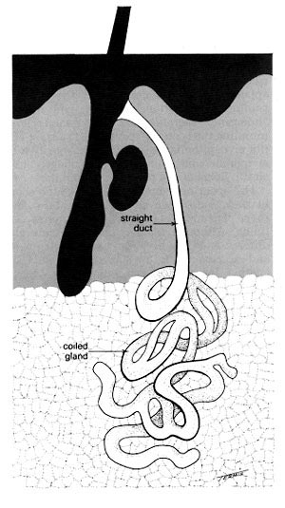
Apocrine Sweat Glands
Found primarily in the axillary, pubic, and anal regions of the body.
Also found in the facial region in men only.
Larger then merocrine sweat glands.
Ducts empty into hair follicles.
Apocrine sweat is thicker than merocrine sweat since it contains more lipids and proteins. When it’s degraded by epidermal bacteria, foul odors can be produced.

Slide 43
Apocrine Sweat Glands
Become active at puberty.
Secrete sweat during times of pain, stress, and sexual activity.
May (??) have a possible pheromone-like function.
Play no role in thermoregulation.
Remember: Glands are derivatives of epithelial tissue. So even though many reside in the dermis, they are not made from connective tissue.

Slide 44
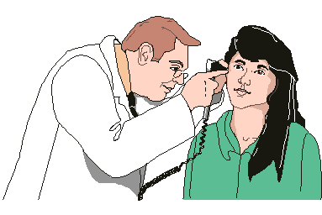
Ceruminous Glands
Modified apocrine glands found in the inner lining of the external ear canal.
Secrete a sticky waxy substance called cerumen (earwax).
It combines with sebum and dead epidermal cells to form a bitter compound that offers a barrier to entry of the ear.

Slide 45
Disorders of the Integumentary System
Acne vulgaris
– Caused by increased secretion of oil by sebaceous glands related to increased hormones during puberty
Albinism
– Inherited disorder in which melanin is not produced
Alopecia
– Baldness
Athlete’s foot
– Contagious fungal infection of the foot Cellulitis
– Bacterial infection of the dermis and subcutaneous layer of the skin
Chloasma
– Patchy discoloration of the face
Contact dermatitis
– Allergic reaction that may occur after initial contact or as an acquired response

Slide 46
Dandruff
– White flakes of dead skin cells from the scalp
Decubitus ulcers
– Sores or areas of inflammation that occur over bony prominences of the body
Eczema
– Group of disorders caused by allergic or irritant reactions
Fungal skin infections
– Skin infections that live on dead outer surface or epidermis
Furuncle
– Boil, or bacterial infection of a hair follicle
Hirsutism
– Abnormal amount of hair growth in unusual places
Impetigo
– Very contagious bacterial skin infection that occurs most often in children
Kaposi’s sarcoma
– Form of cancer that originates in blood vessels and spreads to skin

Slide 47
Vitiligo
– Condition that causes loss of pigment in the skin
Wart
– Papule caused by a viral infection
Skin cancer
– Three forms are basal, squamous, and melanoma
Skin lesions
– Differ in texture, color, location, and rate of growth
Streptococcus
– Non-motile bacteria that affect many parts of the body

Slide 48
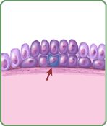
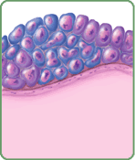
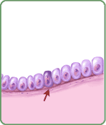
Skin Cancer
Because of its role as our external covering, the skin takes a tremendous amount of abuse.
One serious disorder that can result is skin cancer.
Cancer can be thought of as uncontrolled cell division and growth.
There are 3 types of skin cancers we will discuss:
  Basal cell carcinoma
  Squamous cell carcinoma
  Malignant melanoma
From abnormal cells, a cancerous cell develops
Cancerous cells spread, forming a tumor
An abnormal cell develops

Slide 49
Skin Cancer
Basal cell carcinoma
  Most common (70% of skin cancers)
  Least vicious
  Usually cured via surgical removal
  Consists of uncontrolled growth of cells of the stratum basale. They’ll proliferate and invade the dermis and hypodermis.
  Often occurs on sun-exposed areas of face and neck

Slide 50
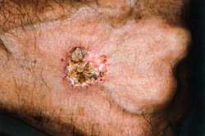
Squamous cell carcinoma
  Arises from keratinocytes of stratum spinosum.
  25% of cases.
  Good prognosis if caught and treated early (surgical excision or radiation).
  Can be fatal if it metastasizes to the lymph nodes.

Slide 51
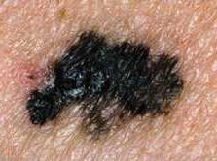
Malignant melanoma
  Least common and most dangerous.
  Cancer of melanocytes.
  Often arises from a pre-existing mole.
  Follow the ABCD rule for early detection:
  Asymmetry (2 sides do not match)
  Border irregularity
  Color (multiple)
  Diameter (>6mm is bad!)

Slide 52
Issues and Innovations
Skin and hair care
– Skin care products include soap, astringents, and cosmetics
– Ways to remove hair include wax, depilatory creams, and electrolysis
Sun and skin cancer
– Damage by ultraviolet rays
– Types of skin cancer

