Slide 1
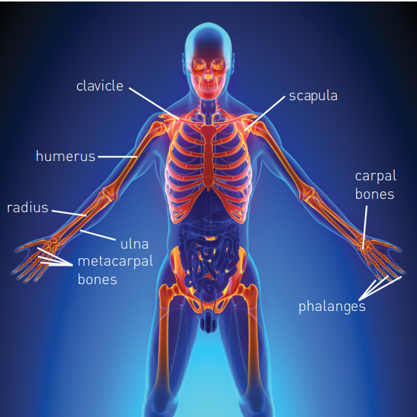
Upper Limb

Slide 2
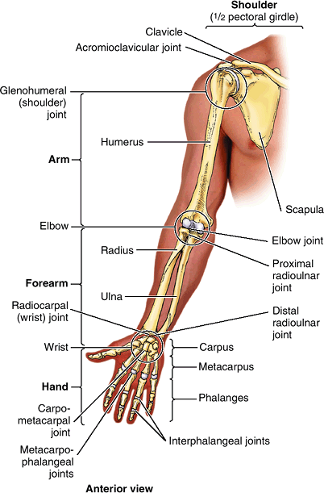
Bones of Upper Limb
The superior appendicular skeleton
  Composed of
    pectoral girdle
    bones of the free part of the upper limb
  Articulates with the axial skeleton only at the sternoclavicular joint
    allows great mobility

Slide 3
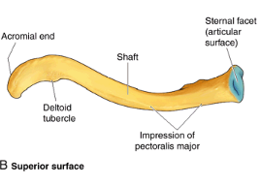
Bones of Upper Limb
Clavicle/ collar bone
Connects the upper limb to the trunk.
Sternal end/ sternoclavicular (SC) joint.
Acromial end: acromioclavicular (AC) joint.
The medial two thirds of the shaft convex anteriorly, the lateral third is flattened and concave anteriorly.

Slide 4
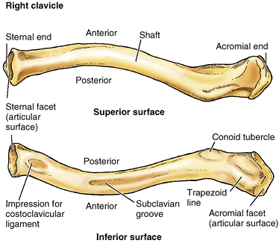

Slide 5
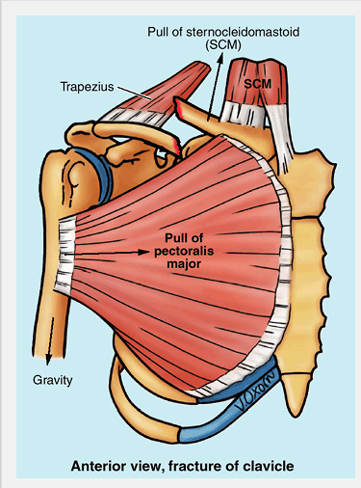
The weakest part is at the junction of its middle and lateral thirds
After fracture
  sternocleidomastoid (SCM) muscle elevates the medial fragment of bone
  trapezius muscle is unable to hold up the lateral fragment owing to the weight of the upper limb
  thus the shoulder drops

Slide 6
Bones of Upper Limb cont’ed…
Scapula
The scapula (shoulder blade) is a triangular flat bone that lies on the posterolateral aspect of the thorax, overlying the 2nd - 7th ribs
posterior surface
      Convex, divided by it spine in to small supraspinous fossa and large infraspinous fossa.
anterior or concave costal surface
      has a large subscapular fossa.
The triangular body (blade) of the scapula is thin and translucent superior and inferior to the scapular spine

Slide 7
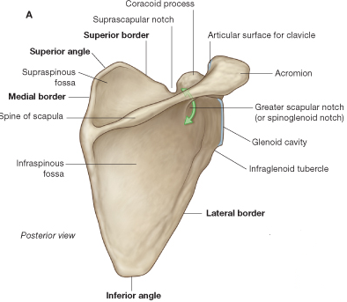
Scapula
The scapula has: two angles (superior, and inferior)
three borders (superior, lateral, and medial);
two surfaces (costal and posterior); and
Three processes (spine, acromion, and coracoid process

Slide 8
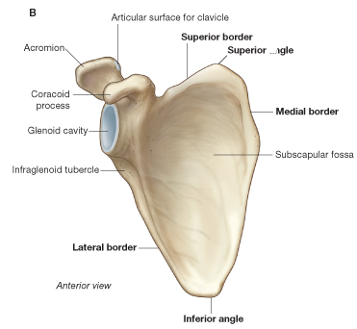
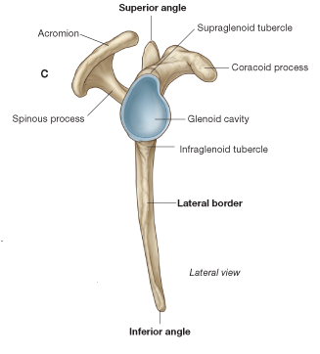
Scapula…
Clinically the arm is measured from the tip of the acromion to the lateral epicondyle of the humerus

Slide 9
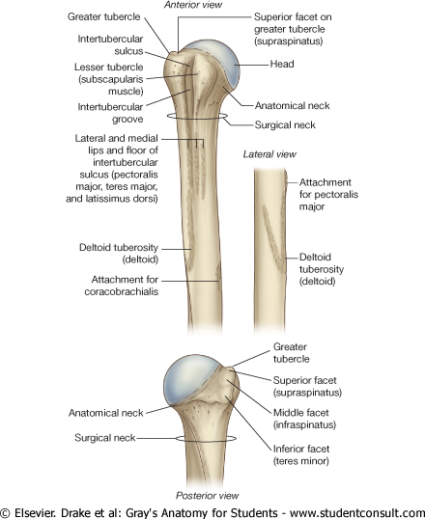
Humerus
The proximal end of the humerus consists of the head, the anatomical neck, the greater and lesser tubercles, the surgical neck, and the superior half of the shaft of humerus
Surgical neck- the most frequent site of fracture

Slide 10
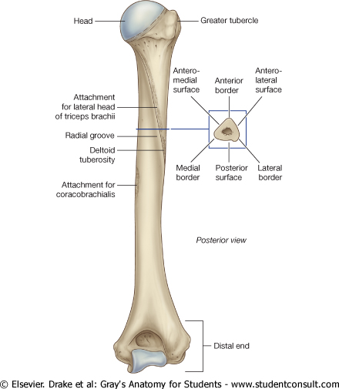
Humerus
Shaft (body):- features
Deltoid tuberosity
Radial groove
Inferior end
  medial and lateral supracondylar ridges
  medial and lateral epicondyles
  The radial, Olecranon, & Coronoid fossa
  Trochlea and capitulum
.

Slide 11
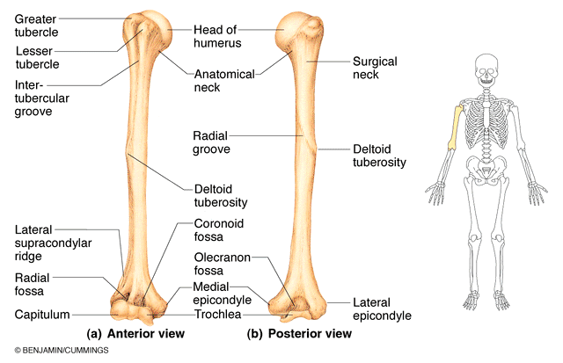

Slide 12
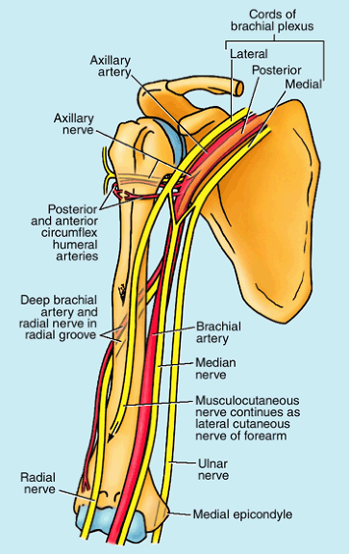
Because nerves are in contact with the humerus, they may be injured when the associated part of the humerus is fractured
  Surgical neck – axillary nerve
  Radial groove – radial nerve
  Distal humerus – median nerve
  Medial epicondyle – ulnar nerve

Slide 13
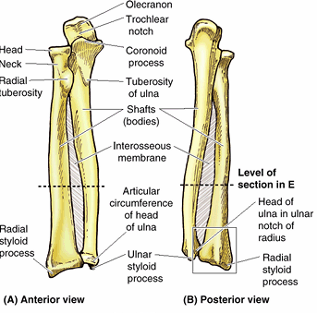
Ulna
The medial and longer of the two forearm bones
Its proximal end has two prominent projections
  olecranon posteriorly – resemble the upper jaw
  coronoid process anteriorly - form the walls of the trochlear notch
Trochlear notch -
  articulates with the trochlea of the humerus

Slide 14
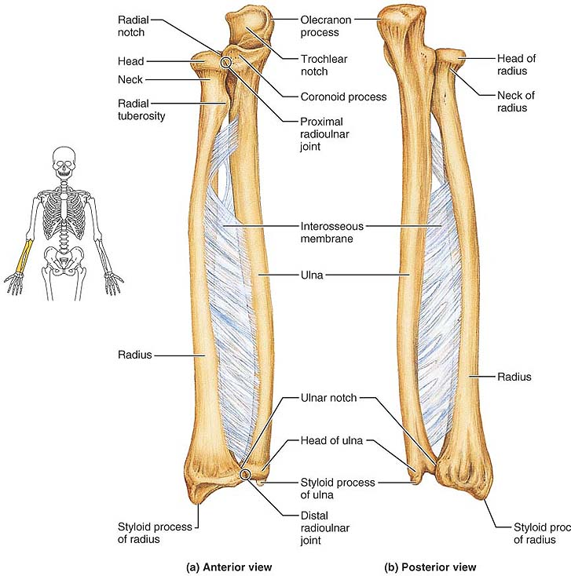
Ulna
Radial notch
  on the lateral side of the coronoid process
  articulates with the head of radius
Shaft (body)
  proximally it is thick, but it tapers distally
Head
  narrow distal end
  rounded with small, conical ulnar styloid process
The ulna does not reach, and therefore does not participate in the wrist (radiocarpal) joint

Slide 15
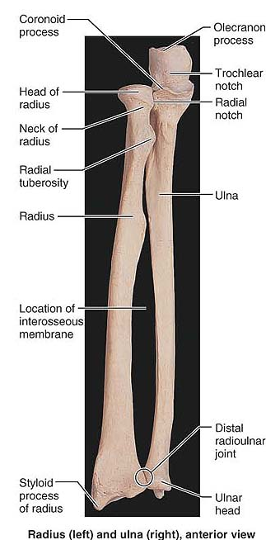
Radius
The lateral and shorter of the two forearm bones
Its proximal end consists of a cylindrical head, a short neck, a projection from the medial surface (radial tuberosity)
Head
  superior surface is concave for articulation with capitulum of humerus
  medially articulate with radial notch of ulna

Slide 16
Neck
  narrow part between head and radial tuberosity
Shaft (body)
  gradually enlarges distally
Distal end
  medially - ulnar notch for head of ulna
  laterally - radial styloid process

Slide 17
Colles fracture
  A complete fracture of the distal end of the radius
  The most common fracture of the forearm
  Results from forced dorsiflexion of the hand
  The distal fragment of the radius is displaced dorsally and often broken into pieces
  Often, the ulnar styloid process is avulsed (broken off)

Slide 18
Bones of the Hand
The wrist, or carpus, is composed of eight carpal bones (carpals) arranged in proximal and distal rows of four
The carpus is markedly convex from side to side posteriorly and concave anteriorly.
Proximal row from lateral to medial:
  Scaphoid: boat-shaped with scaphoid tubercle
  Lunate: moon-shaped
  Triquetrum: pyramidal
  Pisiform: pea-shaped; lies on palmar surface of triquetrum

Slide 19
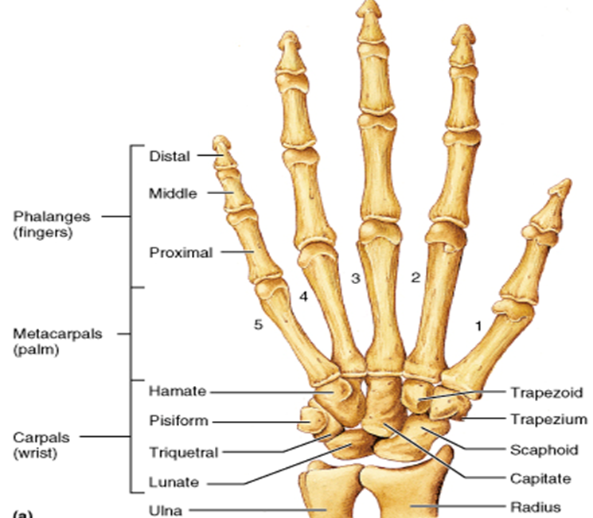

Slide 20
Distal row
  Articulate with proximal row of carpals proximally and metacarpals distally
  Distal row from lateral to medial:
    Trapezium: four sided
    Trapezoid: wedge-shaped
    Capitate: head like; largest
    Hamate: wedge-shaped, has hooked process (hook of hamate)

Slide 21
Metacarpals
Forms the skeleton of the palm
Composed of five metacarpal bones
Each metacarpal consists of a base, shaft, and head
The proximal bases of the metacarpals articulate with the carpal bones
The distal heads of the metacarpals articulate with the proximal phalanges and form the knuckles

Slide 22
Phalanges
14 bones; form the fingers
Each digit has three phalanges (proximal, middle, and distal) except for the first (thumb), which has only two (proximal and distal)
Each phalanx has a base proximally, a shaft (body), and a head distally
The distal phalanges are flattened and expanded at their distal ends, which underlie the nail beds

Slide 23
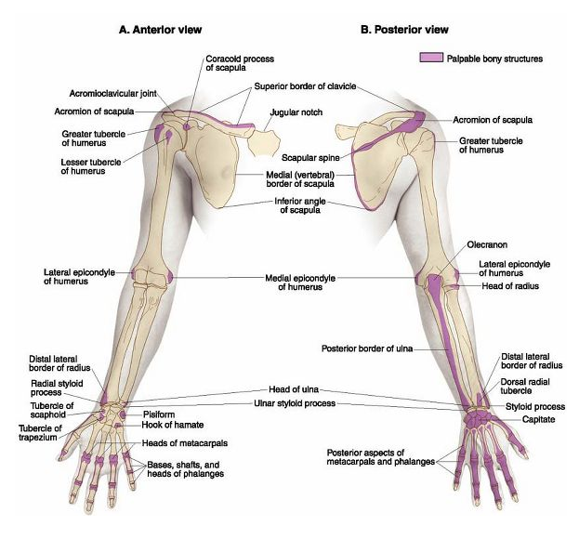
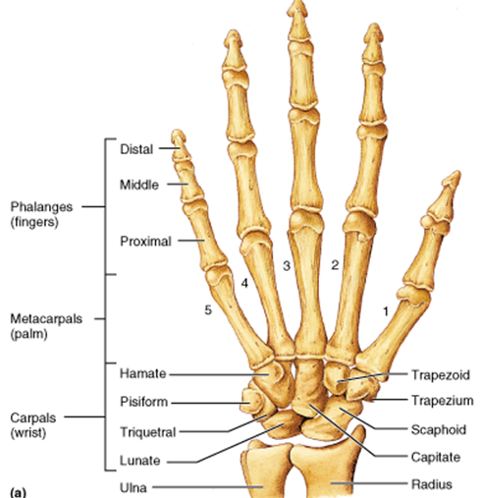
The Hand bones

Slide 24
Superficial structures of upper limb

Slide 25
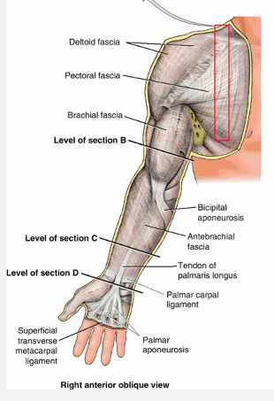
Fascia of upper limb
Pectoral fascia
  Invests the pectoralis major
  Continuous inferiorly with fascia of anterior abdominal wall
  Leaves lateral border of pectoralis major and becomes axillary fascia

Slide 26
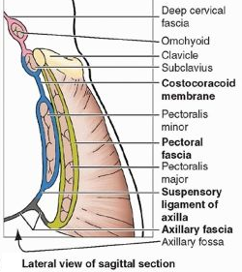
Clavipectoral fascia
  Deep to pectoralis major
  Descends from the clavicle, enclosing subclavius and then the pectoralis minor
  Becoming continuous inferiorly with the axillary fascia
  Costocoracoid membrane
    the part of clavipectoral fascia between pectoralis minor and subclavius
    pierced by lateral pectoral nerve
  Suspensory ligament of axilla
    the part of the clavipectoral fascia inferior to pectoralis minor
    supports the axillary fascia and pulls it upward and forms axillary fossa

Slide 27
Deltoid fascia
  Invests deltoid muscle
Brachial fascia
  encloses the arm
  continuous with deltoid, pectoral, axillary, infraspinous and antebrachial fasciae
  form two intermuscular septa
    medial and lateral
    extend from the deep surface of the brachial fascia and attach to the humerus
    divide the arm into anterior (flexor) and posterior (extensor) fascial compartments

Slide 28
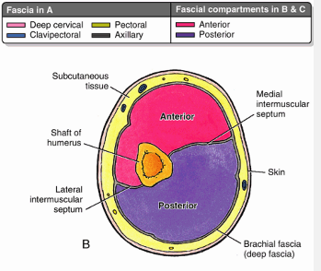
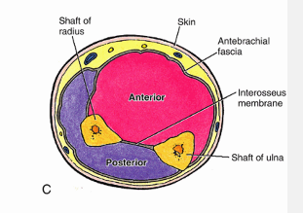

Slide 29
Antebrachial fascia
  In the forearm
  Surrounds fascial compartments separated by interosseous membrane
  Thickens posteriorly over the distal end to form a transverse band,
      Extensor retinaculum, which holds the extensor tendons in position
  Anteriorly at distal end forms an anterior thickenings,
      palmar carpal ligament and flexor retinaculum

Slide 30
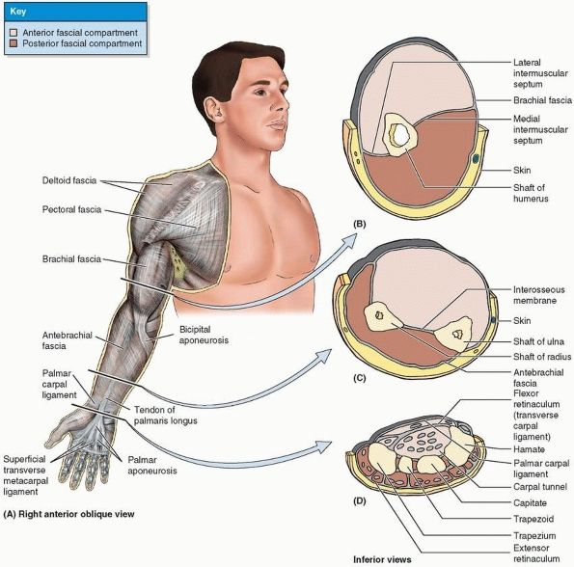

Slide 31
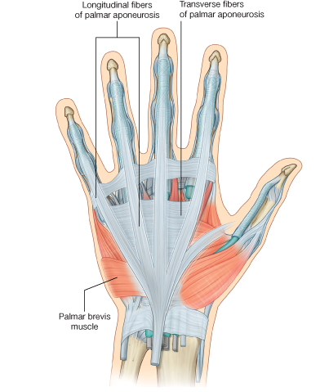
Palmar fascia
  Extension of deep fascia beyond retinacula
  Palmar aponeurosis
    Central part, thick, triangular
    Forms four thickenings that radiate to the base of fingers
    Superficial transverse metacarpal ligament: traverse bands distally and form the base of palmar aponeuroses
    Ligaments extend from aponeurosis to skin, hold the skin closer

Slide 32
Cutaneous nerves of upper limb
Developmentally the limbs grow as lateral protrusions of trunk, with thumb located on cranial side
Most cutaneous nerves of upper limb are derived from brachial plexus
Cutaneous nerves to shoulder are derived from cervical plexus
C4: base of the neck, shoulder
C5: arm laterally
C6: forearm laterally and thumb
C7: middle three fingers and middle of posterior surface
C8: little finger, the medial side
T1: middle of forearm to axilla
T2: small part of arm and axilla

Slide 33
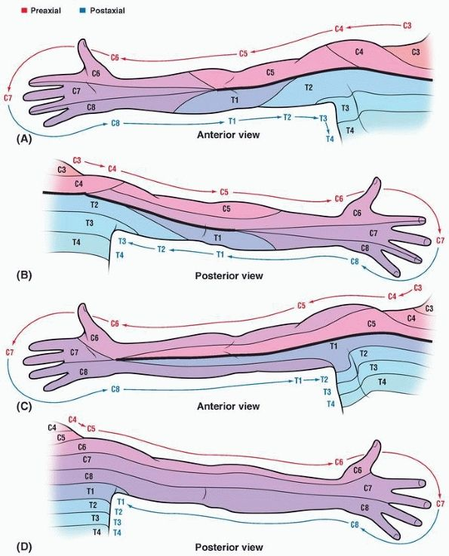
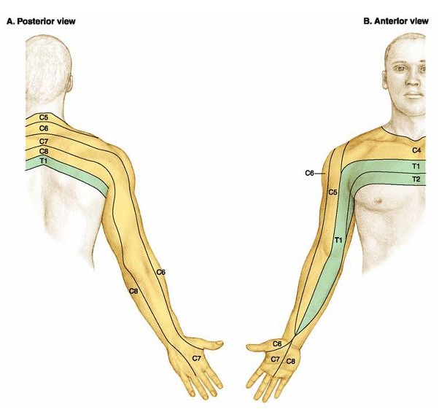

Slide 34
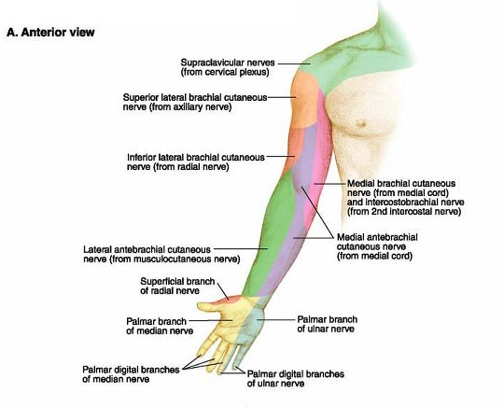

Slide 35
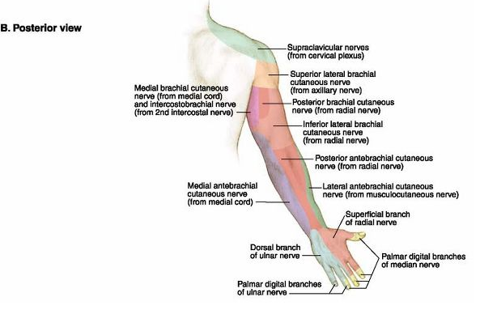

Slide 36
Superficial vessels of upper limb
Dorsal venous network
  On dorsum of the hand
  Give rise to cephalic and basilic veins
Cephalic vein
  Ascends from lateral part of dorsal venous network
  Proceed along anterolateral surface of forearm and arm
  Anterior to elbow communicate with median cubital vein
  Superiorly passes between deltoid and pectoralis major muscles and enters clavipectoral triangle
  Pierces clavipectoral fascia and joins axillary vein

Slide 37
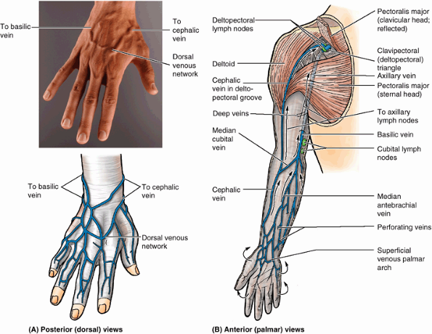

Slide 38
Basilic vein
  Ascends from medial part of dorsal venous network
  Proceed along medial side of forearm and inferior part of arm
  Passes deeply near the junction of the middle and inferior thirds of the arm, piercing the brachial fascia and running superiorly parallel to the brachial artery
  Merges with the accompanying veins (venae comitantes) of the axillary artery to form the axillary vein
Median antebrachial vein (median vein of forearm)
  Ascends in the middle of anterior aspect of forearm between cephalic and basilic veins

Slide 39
Lymphatic vessels of upper limb
Superficial lymphatic vessels
  Arise from lymphatic plexuses in the skin of fingers, palm, and dorsum of the hand
  Ascend mostly with superficial veins
  Some accompanying the basilic vein enter cubital lymph nodes
  Most lymphatic vessels accompanying the cephalic vein and enter apical axillary lymph nodes
Deep lymphatic vessels
  Accompany major veins and terminate in humeral axillary lymph nodes

Slide 40
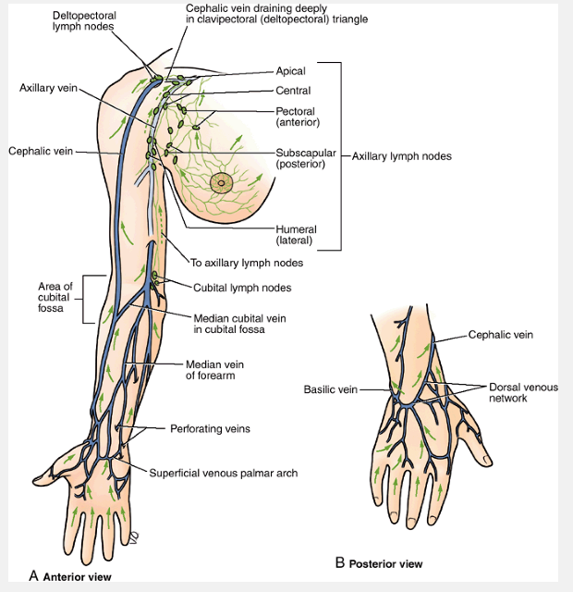

Slide 41
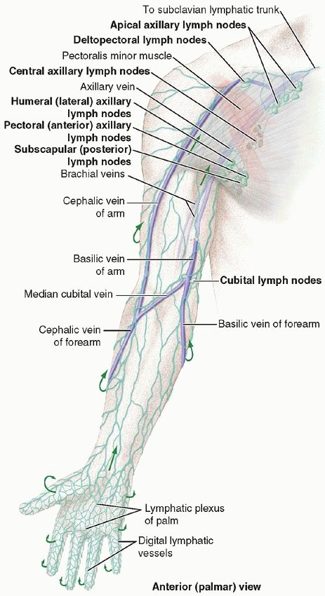
Venipuncture
Puncture of a vein to draw blood or inject a solution
Because of the prominence and accessibility of the superficial veins, they are commonly used for venipuncture
The median cubital vein is commonly used for venipuncture
The veins forming dorsal venous network and the cephalic and basilic veins arising from it are commonly used for long-term introduction of fluids

