Slide 1
Anterior Axio-Appendicular Muscles
Four muscles that move the pectoral girdle
  Pectoralis major
  Pectoralis minor
  Subclavius
  Serratus anterior

Slide 2
Pectoralis major
Fan-shaped
Covers superior part of thorax
Lateral border forms anterior wall of axilla (anterior axillary fold)
With deltoid form deltopectoral groove
    In which the cephalic vein runs
diverge slightly from deltoid superiorly and, along with the clavicle, form the clavipectoral (deltopectoral) triangle.
Origin
  Clavicular head: medial half of clavicle
  Sternocostal head: sternum, superior six costal cartilages, aponeurosis of external oblique muscle

Slide 3
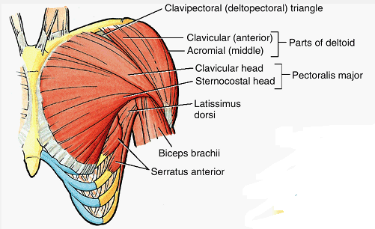
Pectoralis major

Slide 4
Insertion
  Intertubercular groove of humerus
Innervation
  Lateral and medial pectoral nerves
Action
  Adducts and medially rotates humerus; draws scapula anteriorly and inferiorly
  Acting alone, clavicular head flexes humerus and sternocostal head extends it from the flexed position

Slide 5
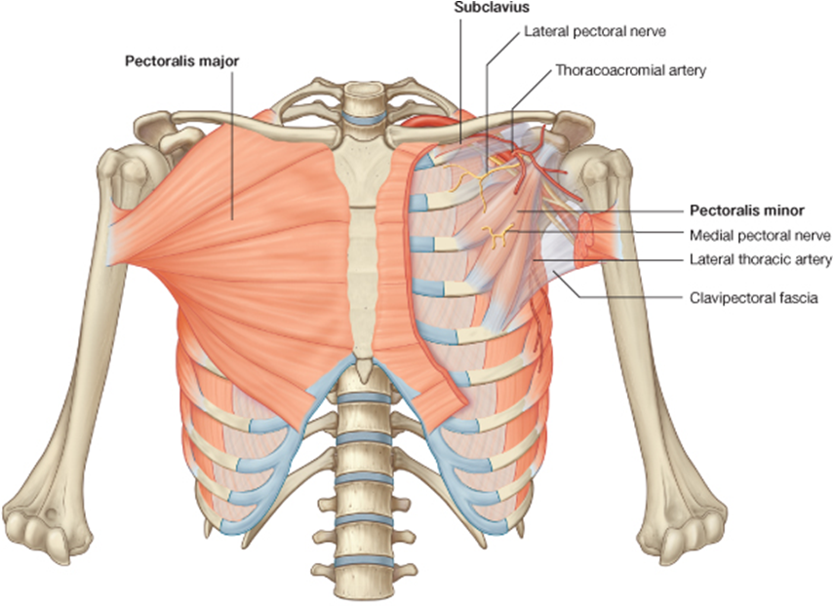

Slide 6
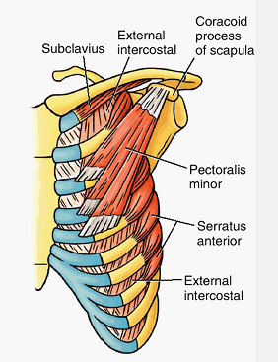
Pectoralis minor
Triangular
Lies in anterior wall of axilla
Covered by pectoralis major
Origin: 3rd to 5th ribs near their costal cartilages
Insertion: coracoid process of scapula
Innervation: Medial pectoral nerve
Action:
  Stabilizes scapula by drawing it inferiorly and anteriorly against thoracic wall
  Elevates ribs in forced inspiration
It is used when stretching the upper limb forward to touch an object that is just out of reach.

Slide 7
Subclavius
Lies horizontally inferior to clavicle
Small, round
Protect subclavian vessels and superior trunk of brachial plexus
Origin: Junction of 1st rib and its costal cartilage
Insertion: Inferior surface of middle third of clavicle
Innervation: Nerve to subclavius
Action: Anchors and depresses clavicle

Slide 8
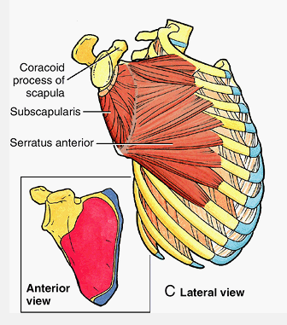
Serratus anterior
Overlies lateral part of thorax
Forms medial wall of axilla
Anchors scapula, enabling other muscles to use it as a fixed bone for movement of humerus
Origin: External surfaces of lateral parts of 1st to 8th ribs
Insertion: Anterior surface of medial border of scapula
Innervation: Long thoracic nerve
Action: Protracts scapula and holds it against thoracic wall; rotates scapula

Slide 9
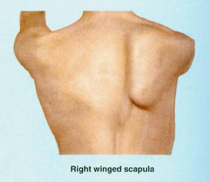
Paralysis of serratus anterior
long thoracic nerve pass on the superficial aspect of serratus anterior
Due to injury of long thoracic nerve
Medial border of the scapula moves laterally and posteriorly away from thoracic wall
  winged scapula
Arm cannot be abducted above horizontal position

Slide 10
Posterior Axioappendicular Muscles
Attach the superior appendicular skeleton to the axial skeleton
Divided into three groups
  Superficial (extrinsic shoulder) muscles : trapezius and latissimus dorsi
  Deep (extrinsic shoulder) muscles : levator scapulae and rhomboids
  Scapulohumeral (intrinsic shoulder) muscles: deltoid, teres major, and the four rotator cuff muscles (supraspinatus, infraspinatus, teres minor, and subscapularis)

Slide 11
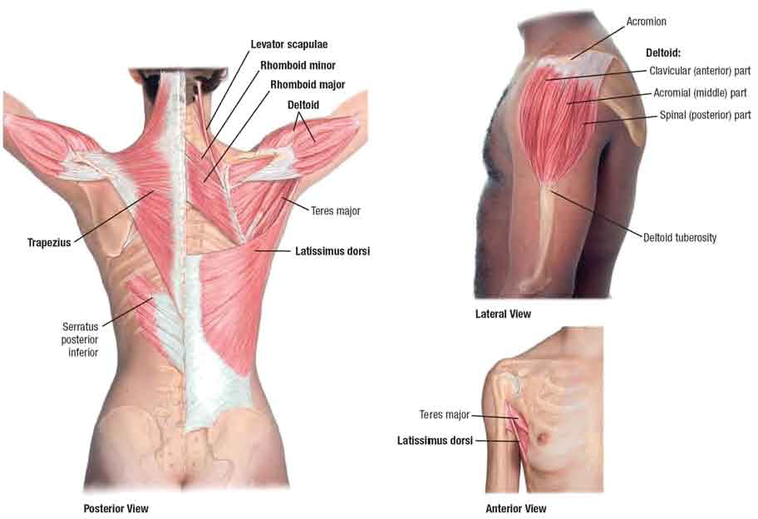

Slide 12
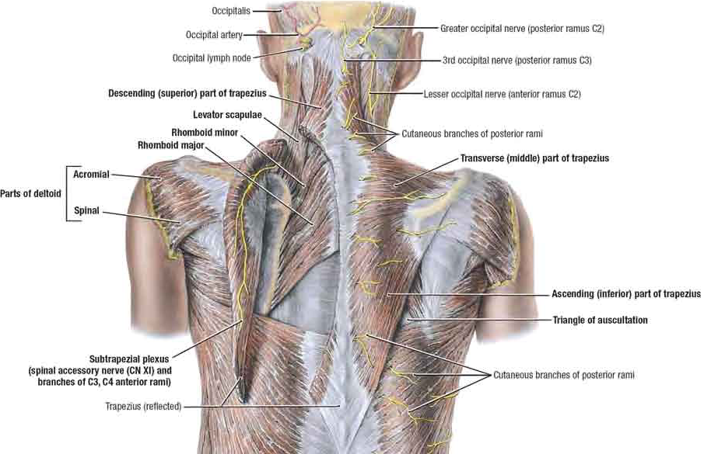
Superficial Muscles
Trapezius
Provides direct attachment of pectoral girdle to trunk
Covers posterior part of neck and superior half of trunk
Attach pectoral girdle to cranium and vertebral column
Fibers are divided into 3 parts
  Superior part
  Middle part
  Inferior part

Slide 13
Origin: Medial third of superior nuchal line; external occipital protuberance; nuchal ligament; spinous processes of C7 to T12 vertebrae
Insertion: Lateral third of clavicle; acromion and spine of scapula
Innervation: Accessory nerve (CN XI) (motor fibers) and C3, C4 spinal nerves (pain and proprioceptive fibers)
Action:
  descending part elevates scapula
  ascending part depresses scapula
  middle part (or all parts together) retracts scapula
  descending and ascending parts act together to rotate glenoid cavity superiorly

Slide 14
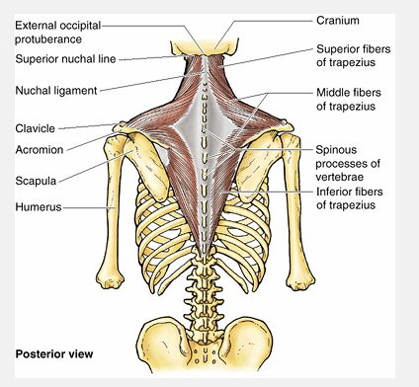

Slide 15
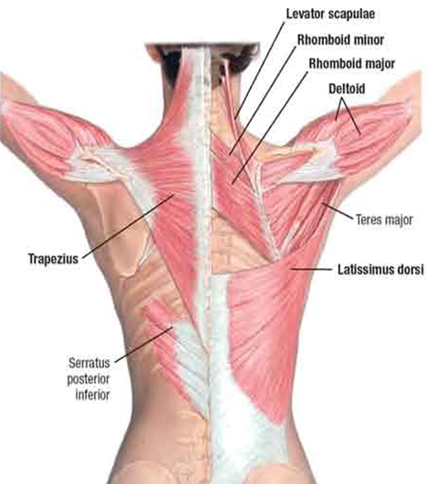
Latissimus dorsi
Fan-shaped
Covers wide area of back
Passes from trunk to humerus
Raises trunk to the arm
Origin: Spinous processes of inferior 6 thoracic vertebrae, thoracolumbar fascia, iliac crest, and inferior 3 or 4 ribs
Insertion: intertubercular groove of humerus
Innervation: Thoracodorsal nerve
Action: Extends, adducts, and medially rotates humerus; raises body toward arms during climbing

Slide 16
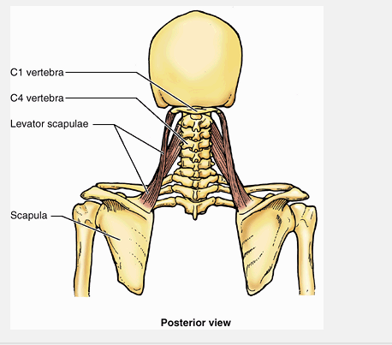
Deep Muscles
Levator scapulae
Lies deep to SCM and trapezius
Origin: Transverse processes of C1 to C4 vertebrae
Insertion: Medial border of scapula superior to root of spine
Innervation: Dorsal scapular (C5) and cervical (C3, C4) nerves
Action:
  Elevates scapula and tilts its glenoid cavity inferiorly by rotating scapula with the rhomboid and pectoralis minor
  Acting bilaterally, extend the neck
  Acting unilaterally, contribute to lateral flexion of the neck

Slide 17
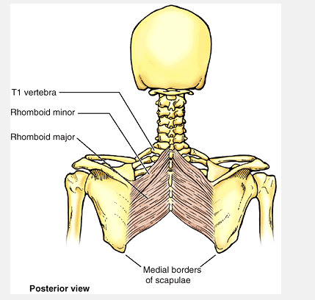
Rhomboids (major and minor)
Lie deep to trapezius
Form parallel bands that pass inferolaterally from vertebrae to medial border of the scapula
Origin:
  Minor: nuchal ligament; spinous processes of C7 and T1 vertebrae
  Major: spinous processes of T2 to T5 vertebrae
Insertion:
  Minor: medial end of scapular spine
  Major: medial border of scapula from level of spine to inferior angle
Innervation: Dorsal scapular nerve
Action:
  Retract scapula and rotate it to depress glenoid cavity
  fix scapula to thoracic wall during movements of upper limb

Slide 18
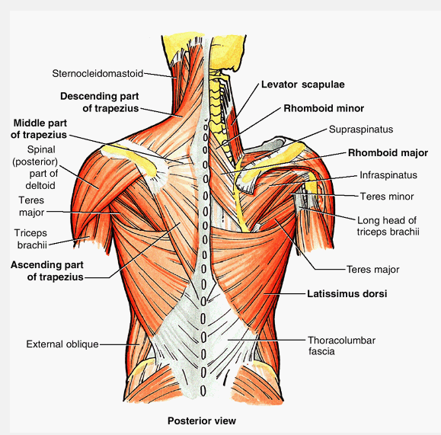
Scapulohumeral Muscles
Six muscles
  Deltoid
  Teres major
  Supraspinatus
  Infraspinatus
  Subscapularis
  Teres minor
Short muscles that pass from scapula to humerus
Act on glenohumeral joint

Slide 19
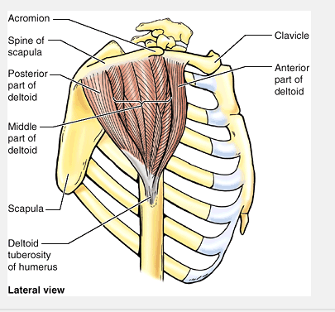
Deltoid muscle
Thick powerful muscle forming the rounded contour of the shoulder
Divided into clavicular (anterior), acromial (middle), and spinal (posterior) parts that can act separately or as a whole
When all three parts contract simultaneously, the arm is abducted
The clavicular and spinal parts steady the arm as it is abducted
Act as a shunt muscle, resisting inferior displacement of the head of the humerus from the glenoid cavity

Slide 20
Origin: Lateral third of clavicle; acromion and spine of scapula
Insertion: Deltoid tuberosity of humerus
Innervation: Axillary nerve
Action:
  Anterior part: flexes and medially rotates arm
  Middle part: abducts arm
  Posterior part: extends and laterally rotates arm

Slide 21
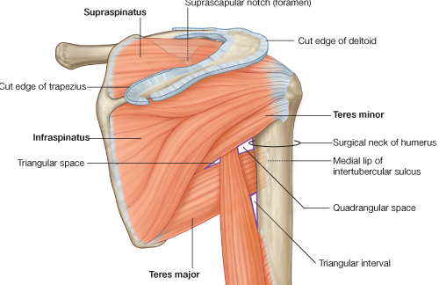
Teres major
Thick rounded muscle that lies on the inferolateral third of the scapula
Along with the deltoid and rotator cuff muscles it is an important stabilizer of the humeral head in the glenoid cavity during movement
Origin: Posterior surface of inferior angle of scapula
Insertion: Medial lip of intertubercular groove of humerus
Innervation: Lower subscapular nerve
Action: Adducts and medially rotates arm

Slide 22
Rotator cuff muscles – SITS mm
Four of the scapulohumeral muscles: supraspinatus, infraspinatus, teres minor, and subscapularis
Called rotator cuff because they form a musculotendinous cuff around glenohumeral joint
All except the supraspinatus are rotators of the humerus
The supraspinatus initiates and assists the deltoid in the abduction of the arm
The tendons of the rotator cuff muscles blend with the joint capsule of the glenohumeral joint, which protects the joint and gives it stability
Strengthen the shoulder joint anywhere, except inferiorly
Tonic contraction of these muscles holds the relatively large head of the humerus firmly against the small and shallow glenoid cavity during arm movements

Slide 23
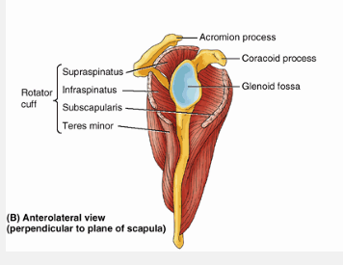

Slide 24
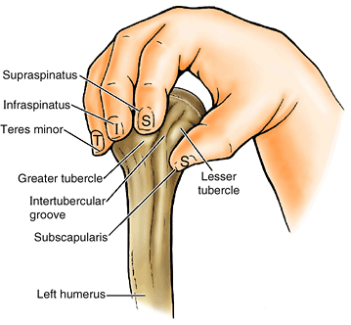
Rotator cuff muscles that provides active support for the glenohumeral joint

Slide 25
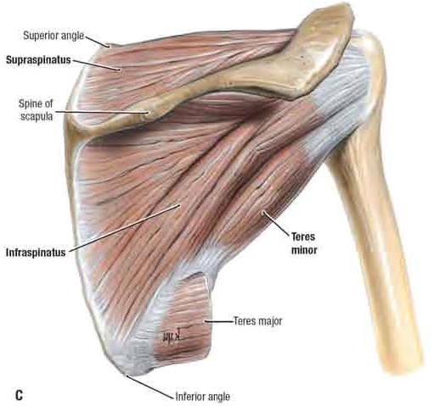
Supraspinatus
Origin: Supraspinous fossa of scapula
Insertion: greater tubercle of humerus
Innervation: Suprascapular nerve
Action: Initiates and assists deltoid in abduction of arm and acts with rotator cuff muscles
Infraspinatus
Origin: Infraspinous fossa of scapula
Insertion: greater tubercle of humerus
Innervation: Suprascapular nerve
Action: Laterally rotate arm; help hold humeral head in glenoid cavity of scapula

Slide 26
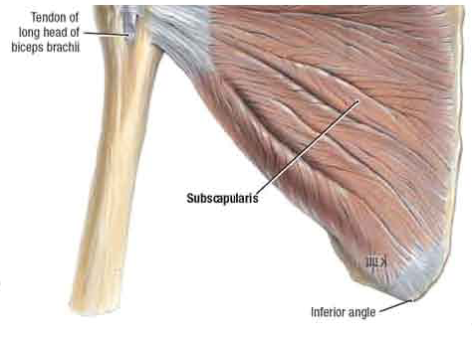
Teres minor
Origin: Middle part of lateral border of scapula
Insertion: greater tubercle of humerus
Innervation: Axillary nerve
Action: Laterally rotate arm; help hold humeral head in glenoid cavity of scapula
Subscapularis
Origin: Subscapular fossa
Insertion: Lesser tubercle of humerus
Innervation: Upper and lower subscapular nerves
Action: Medially rotates and adduct arm; helps hold humeral head in glenoid cavity

Slide 27
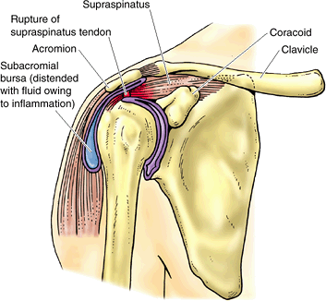
Injury to axillary nerve
Occur when surgical neck of humerus is fractured
Results in atrophy of deltoid
Rounded contour of shoulder disappears
To test deltoid (function of axillary nerve) the arm is abducted against resistance
Rotator cuff injuries
Produce instability of glenohumeral joint
Rapture of supraspinatus tendon is the most common injury
Rapture of supraspinous tendon

Slide 28
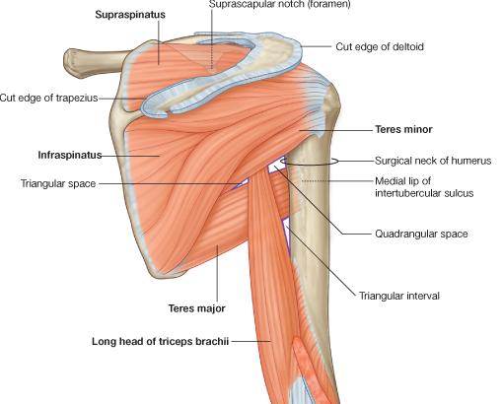
Anatomical space on the back of the shoulder
Quadrangular space:
a potential intermuscular space
Boundaries
    Superiorly- Teres minor
    Laterally- Surgical neck of the humerus
    Inferiorly - Teres major
    Medially- Long head of triceps brachii
Contents
  Axillary nerve
  posterior circumflex humeral aa pass

Slide 29
2. Triangular space
Boundaries
    superiorly- teres minor
    inferiorly – teres major
    laterally - long head of triceps
Contents
  circumflex scapular aa pass thought it

Slide 30
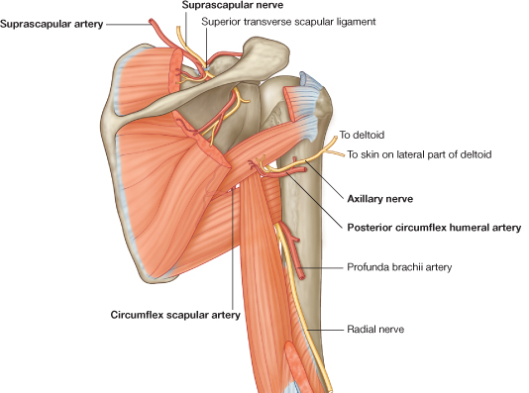
3. triangular interval
Boundaries
superior – teres major
medial– long head of triceps
lateral- lateral head of triceps / humerus
Contents
Radial n and profonda brachi aa pass in it

Slide 31
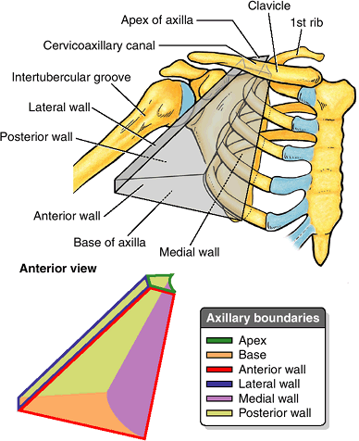
AXILLA
Is the pyramidal space b/n glenohumeral joint and skin and axillary fascia
provides a passageway for vessels and nerves going to and from the upper limb
Has an apex, base, and four walls
Apex
  Is cervicoaxillary canal
  Bounded by 1st rib, clavicle and superior edge of scapula
  Base (Axillary fossa)
  Formed by concave skin, subcutaneous tissue, and axillary fascia

Slide 32
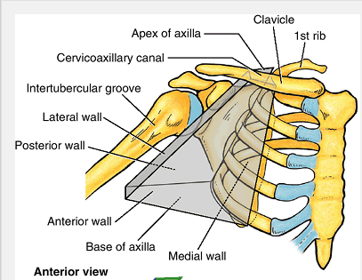
Axilla
Anterior wall
  Formed by pectoralis major and minor with their fascia
Posterior wall
  Formed by scapula and subscapularis and inferiorly by the teres major and latissimus dorsi
Medial wall
  Formed by the thoracic wall (1st-4th ribs and intercostal muscles) and serratus anterior
Lateral wall
  Formed by humerus

Slide 33
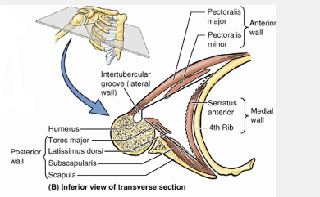

Slide 34
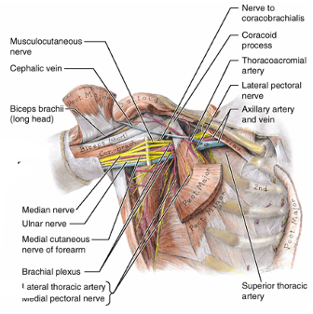
Contents of the axilla
The axilla contains
The axillary artery and its branches,
The axillary vein and its tributaries,
The nerves of the cords and branches of the brachial plexus, lymphatic vessels, and several groups of axillary lymph node

Slide 35
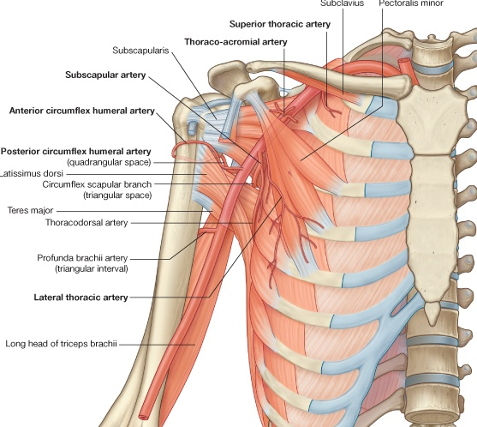
Contents contn…
Axillary artery
Extend from the first rib to inferior border of teres major
divided into three parts relative to the pectoralis minor
1st part -superior thoracic artery
2nd part - thoraco acromial artery and lateral thoracic artery
3rd part - subscapular artery, anterior circumflex humoral artery, posterior circumflex humoral artery

Slide 36
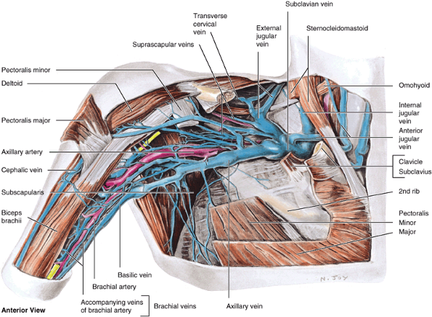
Contents contn…
Axillary vein
Anteromedial to axillary artery
Formed by the union of accompanying brachial vein and basilic vein
Ends at the lateral border of the 1st rib, where it becomes the subclavian vein

Slide 37
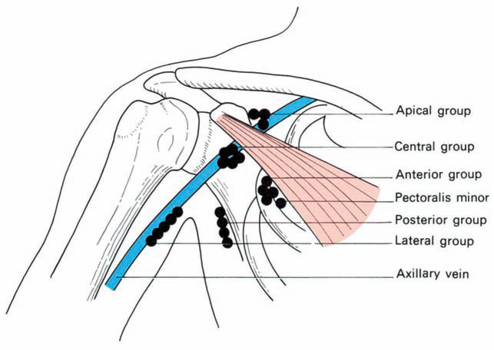
Contents contn…
AXILLARY LYMPH NODES
groups of axillary lymph nodes
pectoral (anterior) - from the lateral quadrants of the breast and superficial anterolateral abdominal wall above the umbilicus.
Subscapular (posterior) from the back, down as far as the level of the iliac crests.
Humeral (lateral) - from the upper limb
The central nodes - deep to the pectoralis minor near the base of the axilla, from the above three groups
The apical nodes - at the apex of the axilla , receive the efferent lymph vessels from all the other axillary nodes.

Slide 38
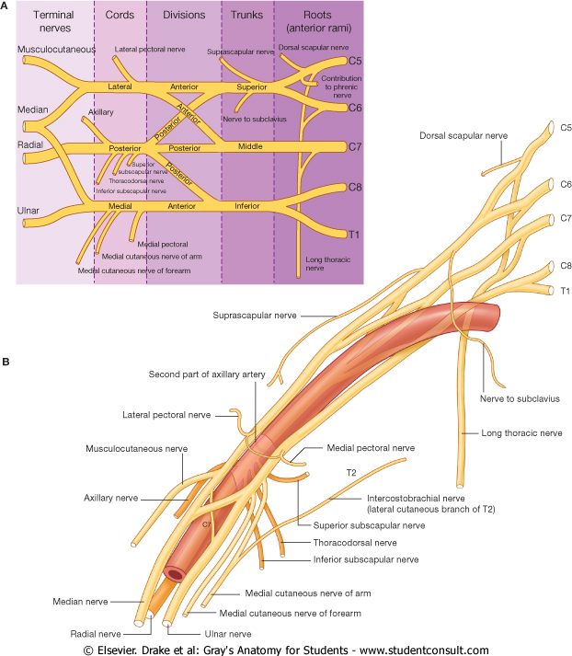
Contents contn…
BRACHIAL PLEXUS
is formed by the union of the anterior rami of the C5-T1 nerves, which constitute the roots of brachial plexus
the roots unite to form three trunks
A superior trunk, from the union of the C5 and C6 roots.
A middle trunk, which is a continuation of the C7 root.
An inferior trunk, from the union of the C8 and T1 roots

Slide 39
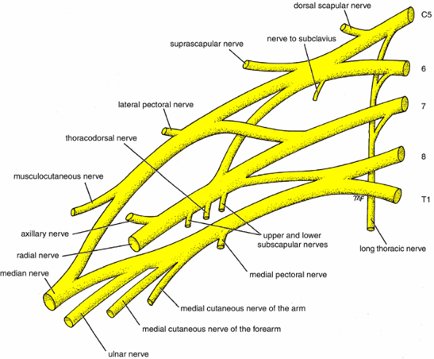
Roots, trunks, divisions, cords, and terminal branches of the brachial plexus

Slide 40
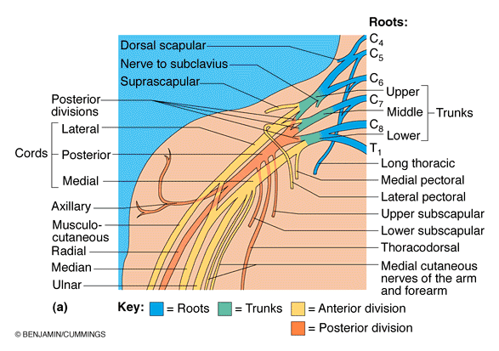

Slide 41
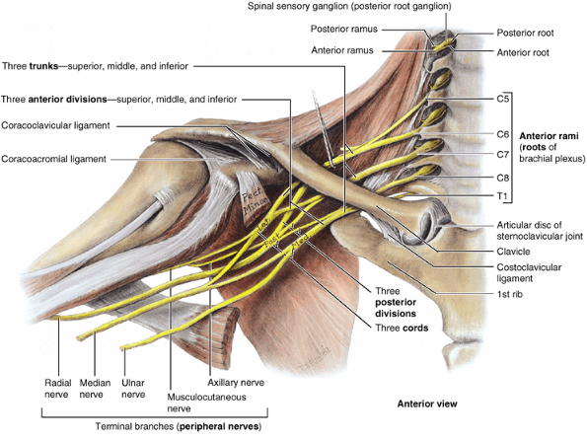
Brachial plexus
Each trunk divides into anterior and posterior divisions
The brachial plexus is divided into supraclavicular and infraclavicular parts by the clavicle
Four branches of the supraclavicular part of the plexus arise from the roots (anterior rami) and trunks of the brachial plexus (dorsal scapular nerve, long thoracic nerve, nerve to Subclavius, and suprascapular nerve)

Slide 42
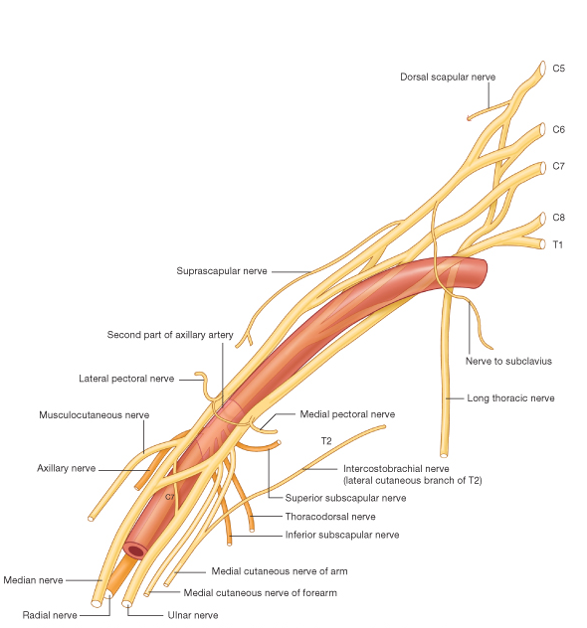

Slide 43
Brachial plexus
The divisions of the trunks form three cords of the brachial plexus, within the axilla
Anterior divisions of the superior and middle trunks unite to form the lateral cord.
Anterior division of the inferior trunk continues as the medial cord.
Posterior divisions of all three trunks unite to form the posterior cord.

Slide 44
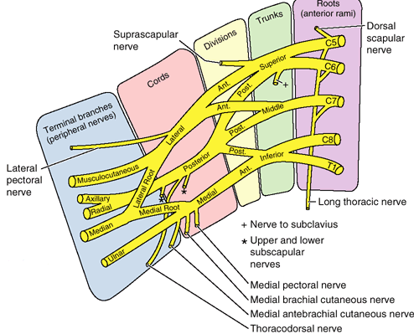
Branches of brachial plexus
Branches of the lateral cord.
Musculocutaneous nerve
Lateral pectoral nerve
Lateral root of median nerve
Branches of the Median cord
Medial pectoral nerve
Medial cutaneous nerve of arm
Medial cutaneous n.of forearm
Medial root of Median nerve
Ulnar nerve

Slide 45
Branches of brachial plexus
Branches of Posterior cord
  Superior subscapular n.
  Thoracodorsal n.
  Inferior subscapular n.
  Axillary n.
  Radial n.

Slide 46
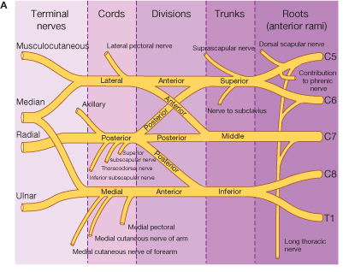

Slide 47
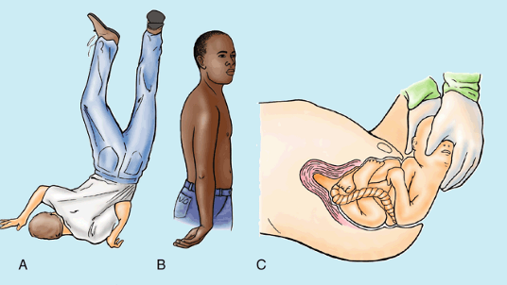
Brachial plexus Injury
Injuries to superior parts of the brachial plexus (C5 and C6) (Erb-Duchenne palsy), usually result from an excessive increase in the angle between the neck and the shoulder.
characteristic position of the limb waiter's tip position
The usual clinical appearance is an upper limb with an adducted shoulder, medially rotated arm, and extended elbow.

Slide 48
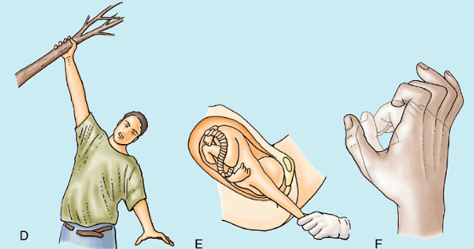
Brachial plexus Injury
Injuries to inferior parts of the brachial plexus (Klumpke paralysis)
The short muscles of the hand are affected and a claw hand results

Slide 49
Variations of the Brachial Plexus
Prefixed brachial plexus:- When the superiormost root (anterior ramus) of the plexus is C4 and the inferiormost root is C8
Postfixed brachial plexus:- when the superior root is C6 and the inferior root is T2

