Slide 1
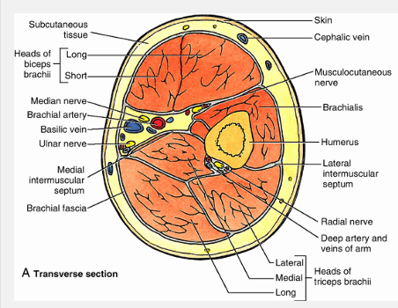
Arm
The muscles are divided into anterior (flexor) and posterior (extensor) groups by intermuscular septum
Three flexors
  biceps brachii, brachialis, and coracobrachialis
  supplied by musculocutaneous nerve
One extensor
  triceps brachi
  supplied by radial nerve
Anconeus

Slide 2
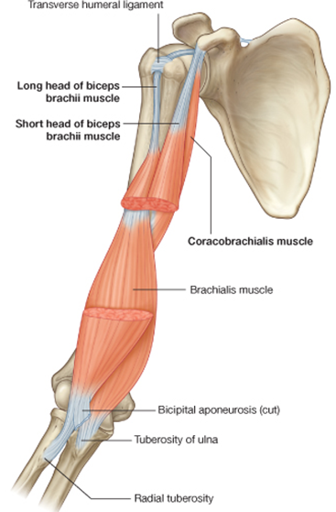
Biceps brachii
Has two heads; long head and short head
Origin:
  Short head: tip of coracoid process of scapula
  Long head: supraglenoid tubercle of scapula
Insertion: tuberosity of radius and fascia of forearm via bicipital aponeurosis
Innervation: Musculocutaneous nerve (C5, C6)
Action: Supinates forearm and, and when it is supine, flexes forearm; short head resists dislocation of shoulder

Slide 3
Brachialis
Lies posterior (deep) to the biceps
It is the only pure flexor
Origin: Distal half of anterior surface of humerus
Insertion: Coronoid process and tuberosity of ulna
Innervation: Musculocutaneous nerve (C5, C6)
Action: Flexes forearm in all positions
It is the workhorse among the flexor mm of the elbow joint.

Slide 4
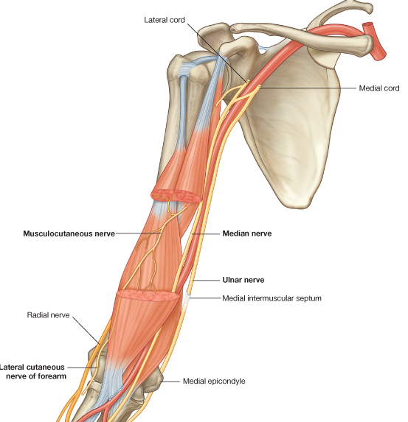
Coracobrachialis
Elongated muscle in the superomedial part of the arm
Useful landmark for locating other structures in the arm
  musculocutaneous nerve pierces it
  distal part of its attachment indicates the location of the nutrient foramen of the humerus
Origin: Tip of coracoid process of scapula
Insertion: Middle third of medial surface of humerus
Innervation: Musculocutaneous nerve
Action: Helps flex and adduct arm at the shoulder joint; stabilize shoulder joint

Slide 5
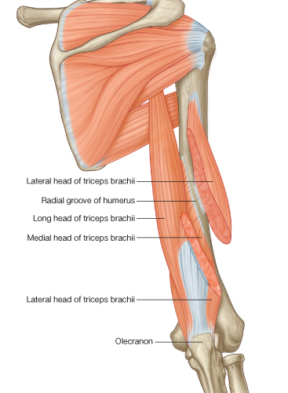
Triceps brachii
Origin:
  Long head: infra-glenoid tubercle of scapula
  Lateral head: posterior surface of humerus, superior to radial groove
  Medial head: posterior surface of humerus, inferior to radial groove
Insertion: Proximal end of olecranon of ulna and fascia of forearm
Innervation: Radial nerve
Action: Chief extensor of forearm; long head resists dislocation of humerus

Slide 6
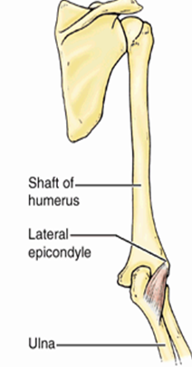
Anconeus
Origin: Lateral epicondyle of humerus
Insertion: Lateral surface of olecranon and superior part of posterior surface of ulna
Innervation: Radial nerve
Action: Assists triceps in extending forearm; stabilizes elbow joint; may abduct ulna during pronation

Slide 7
Cubital fossa
A triangular depression on anterior surface of the elbow
Boundaries
  Superiorly;- an imaginary line connecting the medial and lateral epicondyles
  Medially:- pronator teres
  Laterally:- brachioradialis
  Floor:- brachialis and supinator muscles
  Roof :-the continuity of brachial and antebrachial (deep) fascia, reinforced by the bicipital aponeurosis, subcutaneous tissue and skin

Slide 8
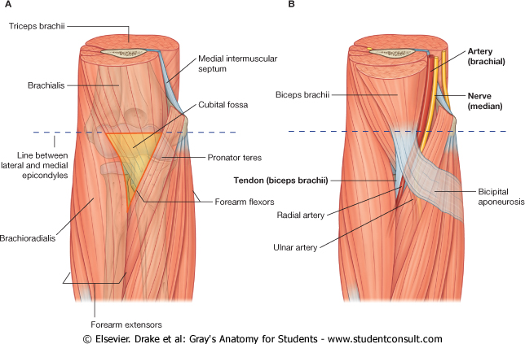

Slide 9
Contents
  Brachial artery and branches, radial and ulnar arteries
  Accompanying veins of the arteries
  Biceps brachii tendon
  Median nerve
  Radial nerve, dividing into its superficial and deep branches
  Median cubital vein, medial and lateral cutaneous nerves of the forearm- on the subcutaneous tissue overlying the cubital fossa

Slide 10
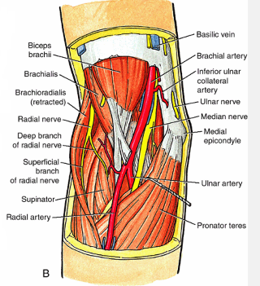

Slide 11
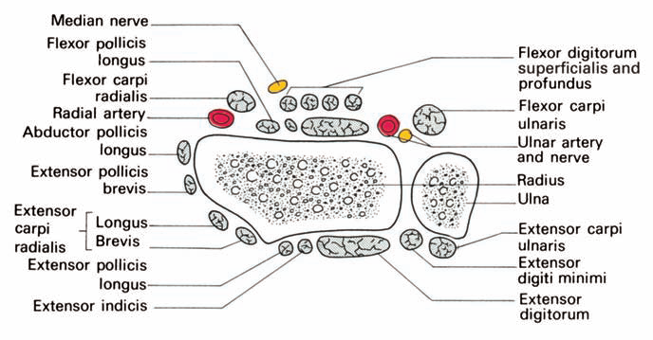
FOREARM
Muscles of Forearm
Anterior compartment:-flexors - pronators mm, and are served mainly by the median nerve
Posterior compartment:- extensor - supinators mm and innervated by the radial nerve

Slide 12
Anterior compartment muscles
Are arranged in three layers
    Superficial layers:-
          Have common origin- a flexor tendon on medial epicondyle of humerus
          Innervated by median nerve except flexor carpi ulnaris
          Pronator teres:- Inserted on middle of lateral surface of radius & is pronator and flexor of the forearm
          Flexor carpi radialis:- Inserted on bases of 2nd metacarpal, it flexes and abduct hand
          Palmaris longus:- insertion is on distal half of flexor retinaculum ; it flex hands
          Flexor carpi ulnaris:- inserted in to pisiform, hook of hamate, 5th metacarpal bones ; it flexes and abduct hand and is innervated by ulnar nerve

Slide 13
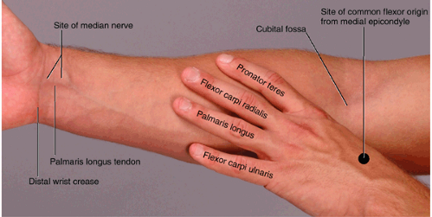

Slide 14
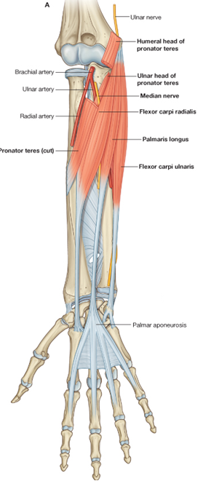
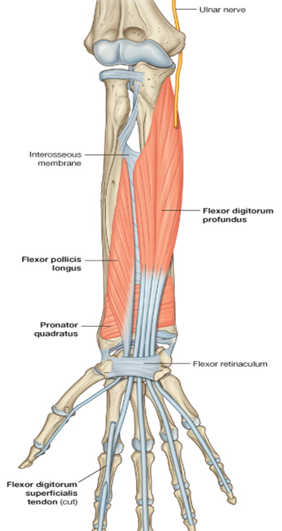
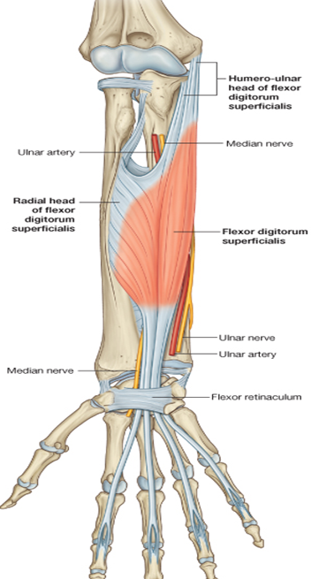

Slide 15
Intermediate layer
  Flexor digitorum superficialis :- arise from the common origin and inserted in to middle phalanges of medial four fingers; served by median nerve and is flexor of middle phalanges

Slide 16
Deep layer
    Flexor digitorum profundus:-
        Arise from proximal ¾ of ulna and interosseous membrane and inserted to bases of distal phalanges
        Served by ulnar and median nerves; is flexor of distal phalanges
    Flexor pollicis longus
        Arise from anterior surface of radius and interosseous membrane and inserted in to base of distal phalanx of thumb
        It flex the thumb and innervated by median nerve
    Pronator quadratus
        Originated from distal quarter of anterior surface of ulna and end on distal quarter of anterior surface of radius
        Is Pronator of the forearm , and served by median nerve

Slide 17
Muscles in the posterior compartment of the forearm
All are innervated by radial nerve
Superficial extensors
  Attached proximally by a common extensor tendon to lateral epicondyle
    Extensor carpi radialis brevis
    Extensor digitorum
    Extensor digiti minimi
    Extensor carpi ulnaris
    Brachioradialis
    Extensor carpi radialis longus
Deep extensors
      Abductor pollicis longus
      Extensor pollicis brevis
      Extensor pollicis longus
      Extensor indicis

Slide 18
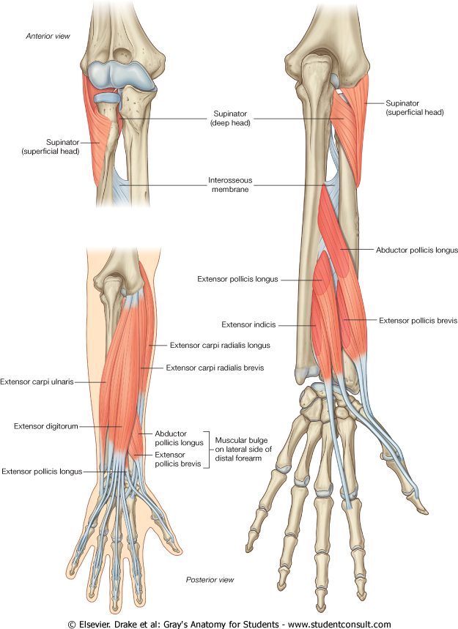

Slide 19
Superficial layer
  Brachioradialis
      Arise from supraepicondylar ridge of humerus and Inserted in to Lateral surface of distal end of radius proximal to styloid process
      Functionally is flexor of the forearm
  Extensor carpi radialis longus and brevis
      Originated from lateral supraepicondylar ridge and epicondyle of humerus and inserted in to base of 2nd and 3rd metacarpal bones
      They extend and abduct hand at wrist joint
  Extensor (digitorum & digiti minimi) muscle
      Extend from common extensor origin to extensor expansions of fingers
      They extends fingers at metacarpophalangeal and interphalangeal joints
  Extensor carpi ulnaris muscle
      Has common attachment with above
      It extend and abduct hand at wrist joint

Slide 20
Deep layer
Supinator
  Extend from common origin to proximal 3rd of radius
  Supinator of the forearm
Outcropping muscles
  Abductor pollicis longus
  Extensor pollicis longus
  Extensor pollicis brevis
      They extend from the posterior surface of ulna and radius up to phalanx of the thumb
      Are extensor and abductor of the phalanx of the thumb
Extensor indicis
      It covers the area b/n distal third of ulna to extensor expansion of 2nd finger ; it extends 2nd finger = “pointing position”

Slide 21
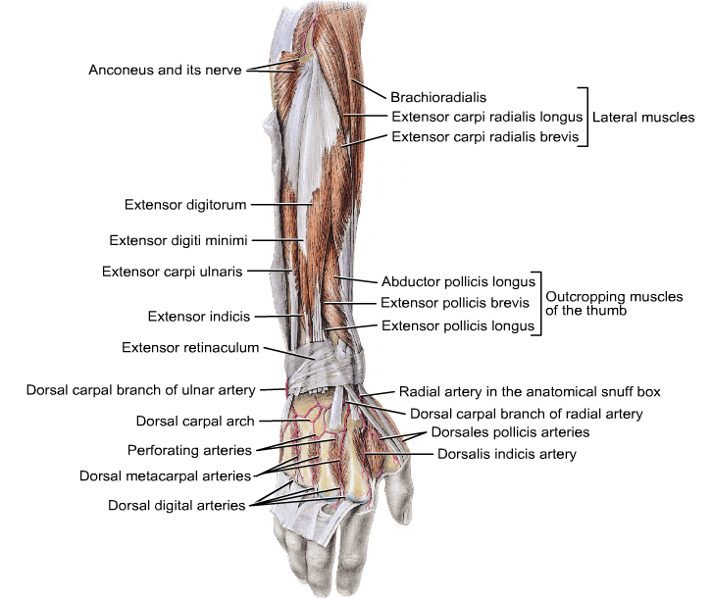

Slide 22
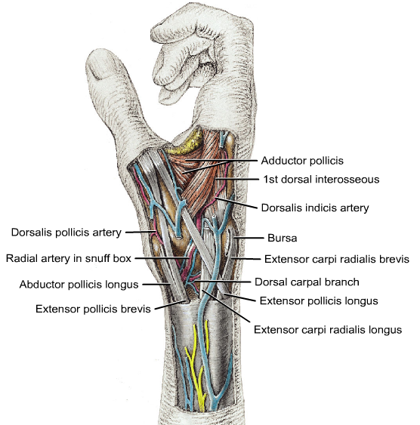
Anatomical snuff box
A triangular shallow depression on the lateral aspect of the wrist when the thumb is extended fully
The tendons of the abductor pollicis longus and extensor pollicis brevis bound anatomical snuff box laterally, and tendon of extensor pollicis longus bounds it medially
Radial artery lies on the floor of the snuffbox

Slide 23
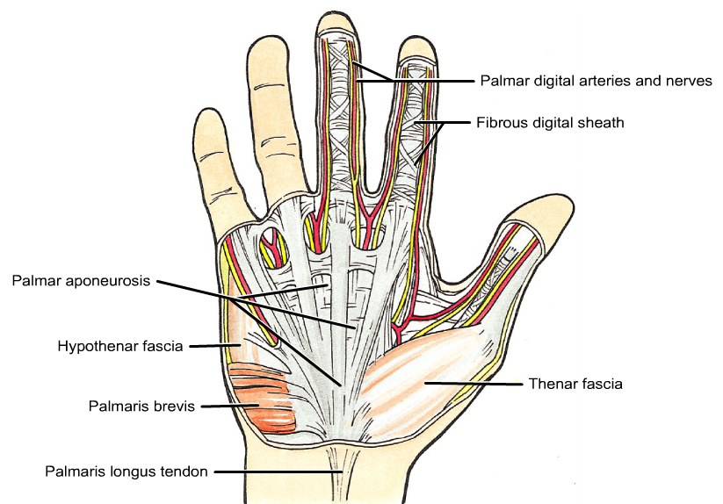
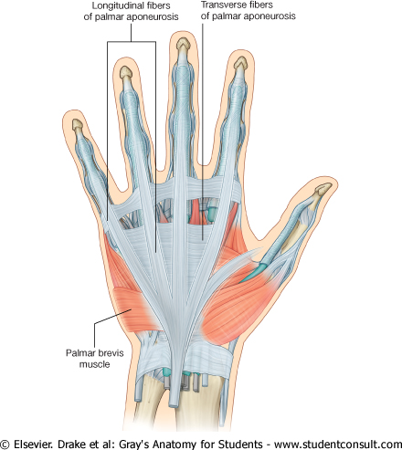
The hand
Fascia of palm:-
    Palmar aponeurosis
      Strong condensation of parts of the deep fascia of the palm
      Covers the soft tissues and overlies the flexor tendons
      Apex is continuous with the flexor retinaculum and palmaris longus tendon
      Four longitudinal digital bands radiate from the apex and attach distally to the bases of the proximal phalanges

Slide 24
Flexor retinaculum
Fibrous band covering anterior concavity of carpus and converts it into a carpal tunnel
Attached in to medially to pisiform and hook of hamate and laterally to scaphoid and trapezium
Relations
  Structures passing superficial to the retinaculum: tendon of palmaris longus, palmar cutaneous of medial and ulnar nerves, ulnar vessels and ulnar nerve
  Structures passing deep to the retinaculum: medial nerve, tendons of flexor digitorum superficialis, profundus, flexor pollicis longus

Slide 25
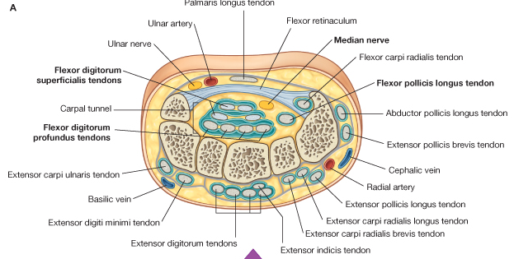
Carpal Tunnel Syndrome:-
  Reduces the size of the carpal tunnel
  Median nerve is the mostly affected
  Progressive loss of coordination and strength in the thumb

Slide 26
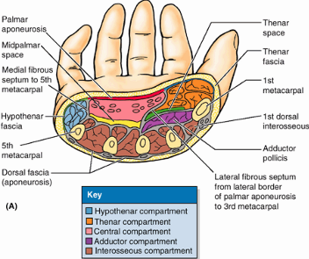
Muscles of the hand
The intrinsic muscles of the hand are located in five compartments
  Thenar muscles in thenar compartment: abductor pollicis brevis, flexor pollicis brevis, and opponens pollicis
  Hypothenar muscles in hypothenar compartment: abductor digiti minimi, flexor digiti minimi brevis and opponens digiti minimi
  Adductor pollicis in adductor compartment
  Lumbricals in central compartment
  Interossei in interosseous compartment

Slide 27
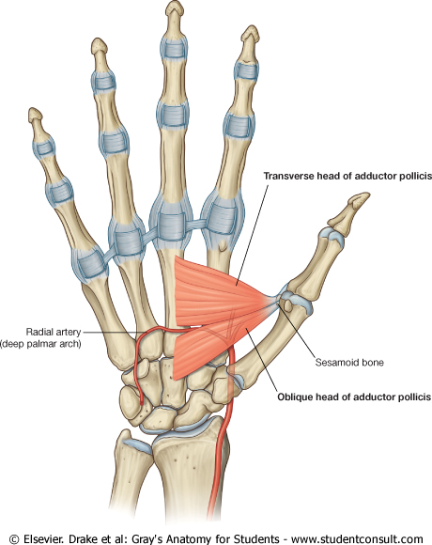
  Thenar muscles
    Abductor pollicis brevis, flexor pollicis brevis, and opponens pollicis
    Served by recurrent branch of median nerve
    They oppose abduct and flex the thumb
Adductor pollicis
  It adduct the thumb
  Innervated by deep branch of ulnar nerve

Slide 28
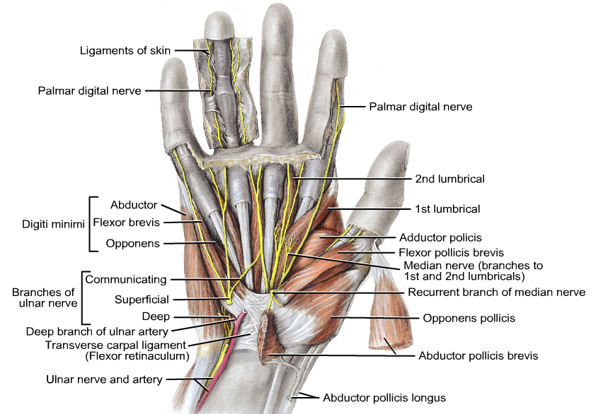

Slide 29
Hypothenar muscles
Abductor digiti minimi, flexor digiti minimi brevis and opponens digiti minimi
Supplied by deep branch of the ulnar nerve
Act on the smallest digit (abduct, flex and oppose)

Slide 30
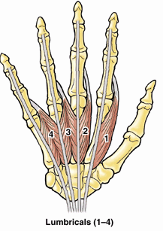
Lumbricals- 1st to 4th
Attached in to 2nd to 5th fingers and metacarpal bones
Innervation:
  1st and 2nd: Median nerve
  3rd and 4th: Deep branch of ulnar nerve
Action: Flex metacarpophalangeal joints; extend interphalangeal joints of 2nd - 5th fingers

Slide 31
Interossei
  Dorsal
      Attached to metacarpals and 2nd to 4th fingers
      Supplied by deep branch of ulnar nerve
      Abduct 2nd to 4th fingers
  Palmar
      Attached on to 2nd, 4th, and 5th metacarpals and fingers
      Supplied by deep branch of ulnar nerve
      Adduct 2nd, 4th, and 5th fingers

Slide 32
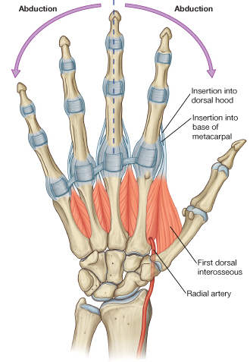
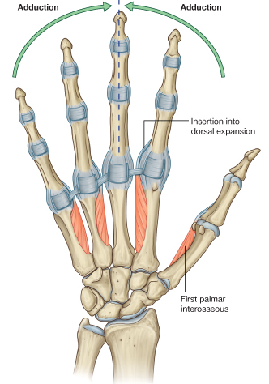
Dorsal interossei
Palmar interossei

Slide 33
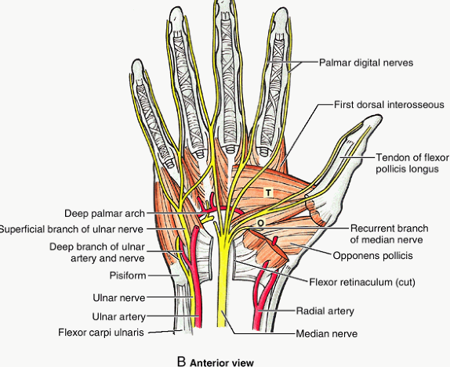
Nerves of hand
Median nerve
Enters the hand through carpal tunnel
Supplies
  Thenar muscles and the 1st and 2nd lumbricals
  Skin on the lateral palmar surface, the sides of the first three digits, the lateral half of the 4th digit, and the dorsum of the distal halves of these digits

Slide 35
Ulnar nerve
Leaves the forearm by emerging from deep to the tendon of the flexor carpi ulnaris
Just proximal to the wrist, the ulnar nerve gives off
  palmar cutaneous branch
    supplies skin on the medial side of the palm
  dorsal cutaneous branch
    supplies the medial half of dorsum of the hand, the 5th finger, and the medial half of the 4th finger
Ends at the flexor retinaculum by dividing into 2 branches
  superficial branch: supplies anterior surface of medial one and a half fingers
  deep branch: supplies hypothenar muscles, medial two lumbricals, adductor pollicis, and all the interossei

Slide 36
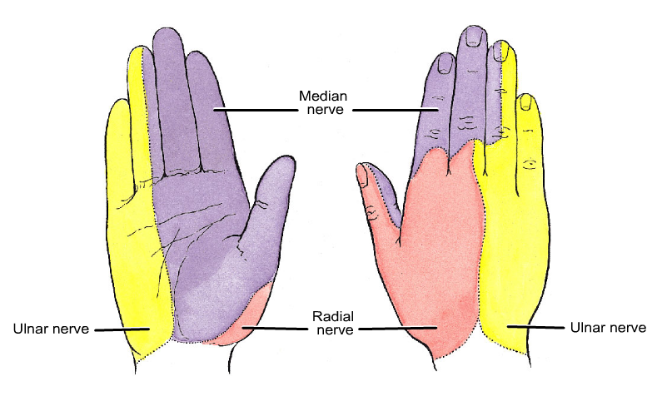
Radial nerve
Supplies no hand muscles
Supply the skin and fascia over the lateral two thirds of the dorsum of the hand, the thumb, and the proximal parts of the lateral two and a half digits

Slide 37
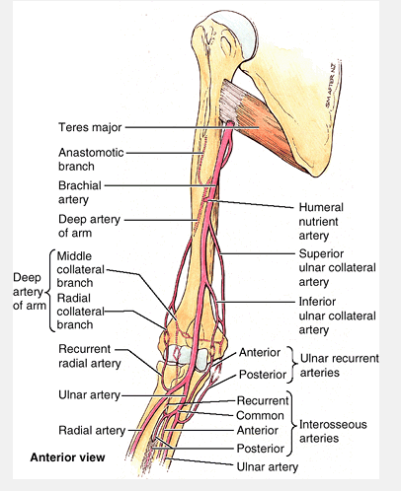
Arteries of the upper limb
Brachial artery
Provides the main arterial supply to the arm
Is the continuation of the axillary artery
Begins at the inferior border of teres major
Ends in the cubital fossa opposite the neck of the radius by dividing in to radial and ulnar arteries

Slide 38
Arteries of the upper limb
Brachial artery
Branches
  unnamed muscular branches
  humeral nutrient artery
  deep artery of arm / profunda brachi
  superior and inferior ulnar collateral arteries
  Radial and ulnar arteries

Slide 39
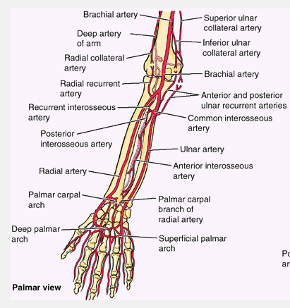
Artery of the forearm
Ulnar aa- from brachial aa
Branches
  Anterior and Posterior ulnar recurrent artery
  Common interosseous artery
  Anterior and Posterior interosseous artery
  Recurrent interosseous artery
  Palmar carpal branch
  Dorsal carpal branch

Slide 40
Artery of the forearm con’t
Radial aa:- branch of brachial artery
Branches
  Radial recurrent artery
  Palmar carpal branch
  Dorsal carpal branch

Slide 41
Arteries of Hand
Ulnar artery
Enters the hand anterior to the flexor retinaculum between the pisiform and the hook of hamate via the ulnar canal (Guyon canal)
Lies lateral to the ulnar nerve
Divides into two terminal branches
  Superficial palmar arch
  Deep palmar branch
Superficial palmar arch
  main termination of the ulnar artery
  gives rise to three common palmar digital arteries that anastomose with palmar metacarpal arteries from the deep palmar arch
  Each common palmar digital artery divides into a pair of proper palmar digital arteries that run along the adjacent side of the 2nd-4th fingers

Slide 42
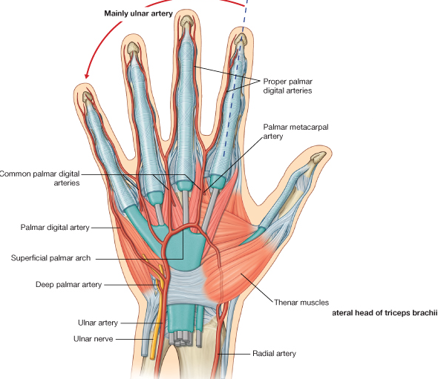

Slide 43
Radial artery
Curves dorsally around the scaphoid and trapezium in the floor of anatomical snuff box
Enters the palm by passing between the heads of 1st dorsal interosseous muscle
Turns medially and passes between the heads of the adductor pollicis
Ends by anastomosing with the deep branch of the ulnar artery to form the deep palmar arch
Deep palmar arch
  formed mainly by radial artery
  lies across the metacarpals just distal to their bases
  gives rise to three palmar metacarpal arteries, princeps pollicis artery and radialis indicis artery

Slide 44
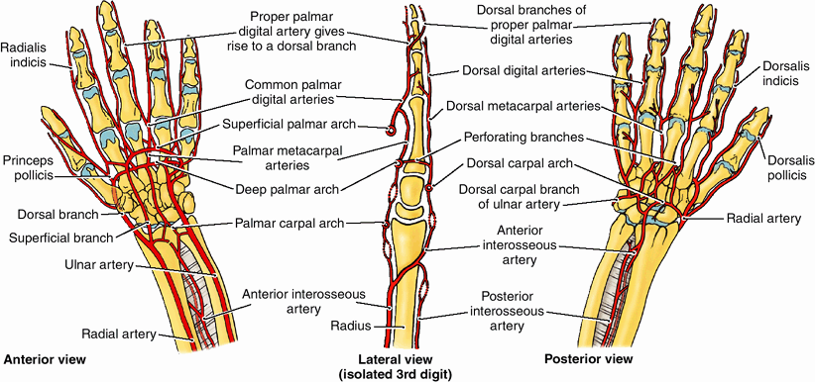

Slide 45
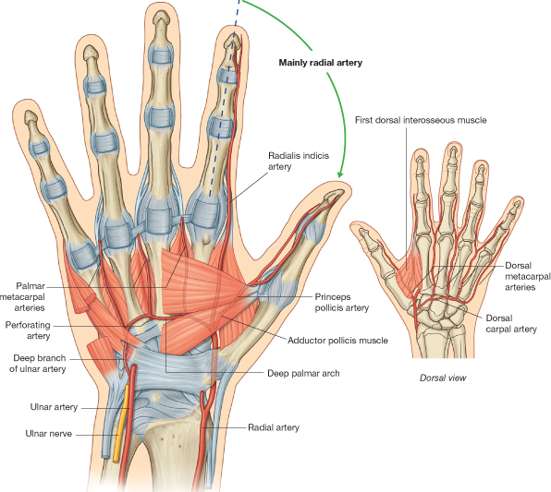

Slide 46
JOINTS OF UPPER LIMB
Glenohumeral Joint
Type: ball and socket synovial joint
  permits a wide range of movement
Articulation
  The humeral head articulates with shallow glenoid cavity of the scapula held in the cavity by musculotendinous rotator cuff

Slide 47
Joint capsule
  attached medially to the margins of the glenoid cavity and laterally to anatomical neck of the humerus
  superiorly it encloses tendon of long head of biceps brachii
  inferior part which is not reinforced by rotator cuff is weakest area
  synovial membrane lines the internal surface of fibrous capsule

Slide 48
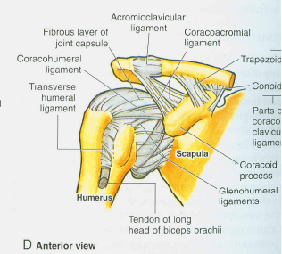
Ligaments
  Glenohumeral ligament
    Strengthen anterior aspect of the capsule
  Coracohumeral ligament
    Strengthen superiorly
  Coracoacromial arch
    Formed by inferior aspect of acromion and coracoid process
    Overlies the head of the humerus, prevents its superior displacement

Slide 49
Movements: flexion-extension, abduction-adduction, rotation and circumduction
Blood supply: anterior and posterior circumflex humeral arteries and branches of suprascapular artery
Innervation: suprascapular, axillary and lateral pectoral nerves

Slide 50
Elbow joint
Type: Hinge synovial joint
Articulation
  Trochlea and capitulum of humerus with trochlear notch of ulna and head of radius
Joint capsule
  Joint capsule surrounds the joint
  Weak anteriorly and posteriorly but strengthened on each side by ligaments

Slide 51
Ligaments
  Radial collateral ligament
    extends from the lateral epicondyle of the humerus and blends distally with annular ligament of the radius
    Encircles and holds the head of the radius in the radial notch of the ulna, forming the proximal radioulnar joint
  Ulnar collateral ligament
    extends from the medial epicondyle of the humerus to the coronoid process and olecranon of the ulna
Movements: Flexion and extension
Blood supply: derived from the anastomosis of arteries around the elbow joint
Innervation: musculocutaneous, radial, and ulnar nerves

Slide 52
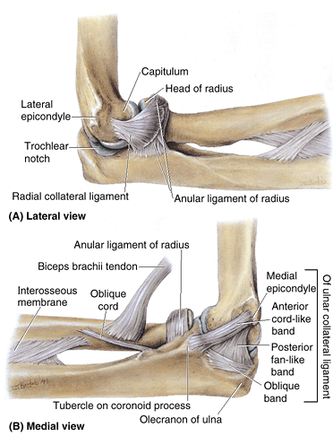

Slide 53
Proximal radio ulnar joint
Type: pivot synovial
Articulation
  The head of radius articulates with radial notch of ulna
  The radial head is held in place by the annular ligament
Joint capsule
  The fibrous layer of the joint capsule encloses the joint and is continuous with that of the elbow joint
  The synovial membrane lines the internal surface of the fibrous layer and non-articulating aspects of the bones
Ligaments
  Annular ligament
    attaches to the ulna, anterior and posterior to the radial notch, which forms a collar that, with the radial notch, forms a ring that completely encircles the head of the radius

Slide 54
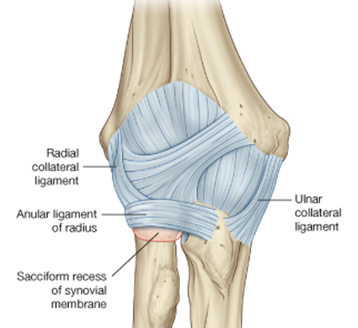
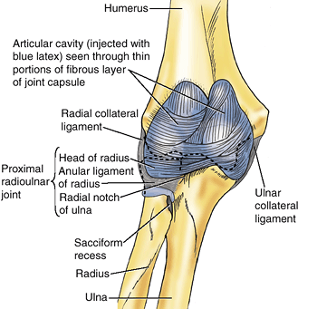
Movements: Pronation and supination
Blood supply: the radial portion of the arterial anastomosis of the elbow joint
Innervation: musculocutaneous, median, and radial nerves
  Pronation is essentially a function of the median nerve, whereas supination is a function of the musculocutaneous and radial nerve

Slide 55
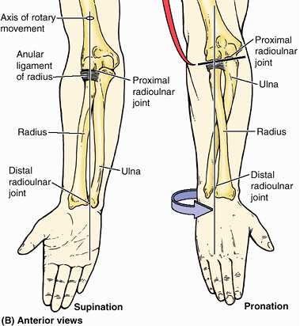
Movements of the Proximal Radioulnar Joint

Slide 56
Distal radio ulnar joint
Type: Pivot synovial
Articulation
  rounded head of ulna articulates with ulnar notch on the medial side of distal end of radius
  fibrocartilaginous articular disc binds ulna and radius together
  articular disc separates the cavity of the joint from the cavity of the wrist joint
Joint capsule
  The fibrous layer of the joint capsule encloses the joint but deficient superiorly
  The synovial membrane extends superiorly between the radius and the ulna to form the recess

Slide 57
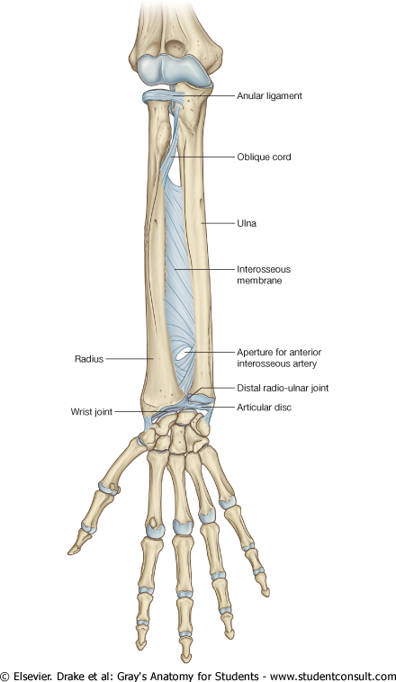

Slide 58
Ligaments
  Anterior and posterior ligaments strengthen the fibrous layer of the joint capsule
Movements
  The distal end of the radius rotates around the head of the ulna during pronation of the forearm and hand
Blood supply: anterior and posterior interosseous arteries
Innervation: anterior and posterior interosseous nerves

Slide 59
Wrist (radiocarpal) joint
Type: Condyloid synovial joint
Articulation
  Distal end of radius and its articular disc with proximal row of carpal bones (except pisiform)
Joint capsule
  Fibrous layer of joint capsule surrounds joint and attaches to distal ends of radius and ulna and proximal row of carpal bones; lined by synovial membrane

Slide 60
Ligaments
  Anterior and posterior ligaments strengthen fibrous capsule
  Ulnar collateral ligament attaches to styloid process of ulna and triquetrum
  Radial collateral ligament attaches to styloid process of radius and scaphoid
Movements: Flexion - extension, abduction - adduction, circumduction
Blood supply: Dorsal and palmar carpal arches
Innervation: Anterior interosseous branch of median nerve, posterior interosseous branch of radial nerve, and dorsal and deep branches of ulnar nerve

Slide 61
Pulse points in the upper limb
Axillary pulse: axillary artery in the axilla
Brachial pulse in mid-arm: brachial artery on the medial side of the arm. This is the position where a blood pressure cuff is placed
Brachial pulse in the cubital fossa: brachial artery medial to the tendon of the biceps brachii muscle. This is the position where a stethoscope is placed to hear the pulse of the vessel when taking a blood pressure reading
Radial pulse in the distal forearm: radial artery immediately lateral to the tendon of the flexor carpi radialis muscle. This is the most common site for 'taking a pulse
Ulnar pulse in the distal forearm: ulnar artery immediately under the lateral margin of the flexor carpi ulnaris tendon and proximal to the pisiform.
Radial pulse in the anatomical snuffbox: radial artery

Slide 62
