Slide 1

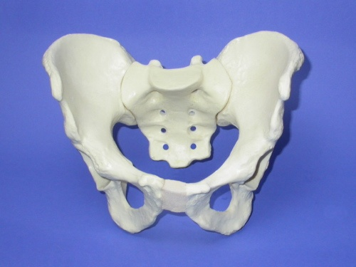
Pelvic Girdle
Ring of bones that connects the vertebral column to the femurs
Fun: transfer the weight of the upper body from the axial to the lower appendicular skeleton
  Contain and protect the pelvic viscera and the inferior abdominal viscera
Right and left hip bones with Sacrum form bony pelvis

Slide 2
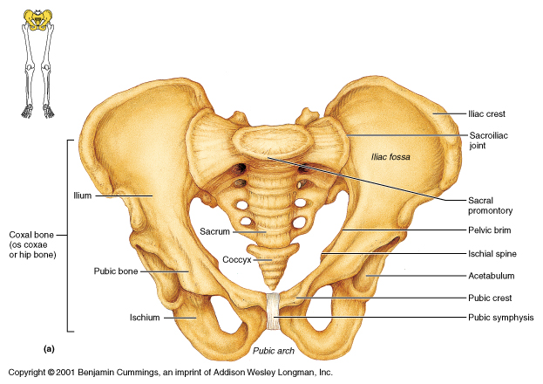

Slide 3

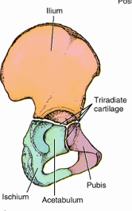
BONES OF THE LOWER LIMB
Hip Bone:
Each hip bone is formed by the fusion of three primary bones:
Ilium:
superior and largest
contributes to the superior part of the acetabulum
consists of a body, which joins the pubis and ischium to the acetabulum, and
Ala (wing), which is bordered superiorly by the iliac crest
Landmarks:
  Iliac crest
  Anterior iliac spine (superior & inferior )
  Posterior iliac spine (superior & inferior)
  Greater sciatic notch

Slide 4
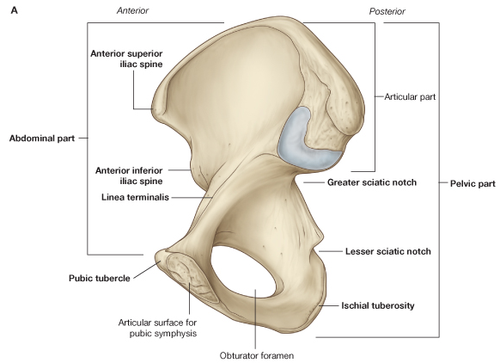

Slide 5
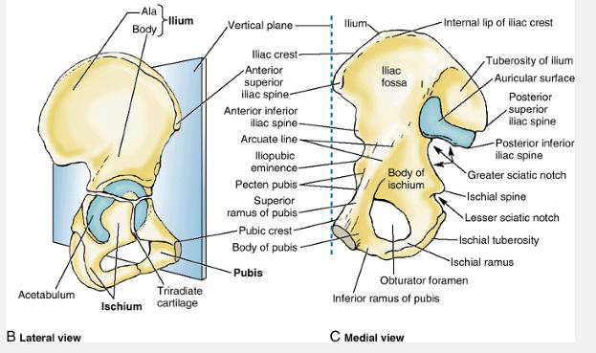

Slide 6
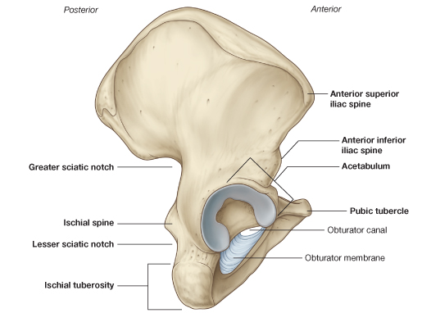

Slide 7
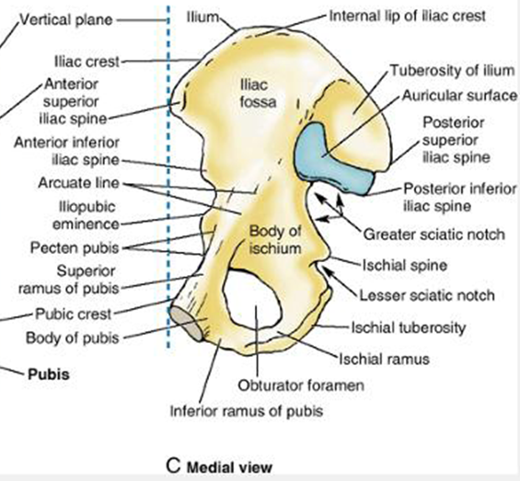
Ischium
forms the posteroinferior part of the acetabulum and hip bone
consists of a body, where it joins the ilium and superior and inferior ramus
Landmarks
  Ischial tuberosity
    large posteroinferior protuberance of the ischium
    supports body during sitting
  Ischial spine
    small pointed posterior projection near the junction of the ramus and body
  lesser sciatic notch

Slide 8
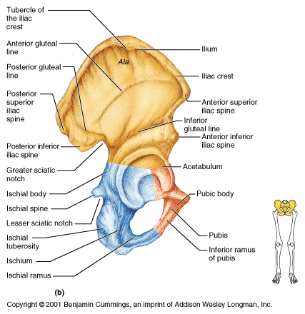

Slide 9
3.The pubis
forms the anterior part of the acetabulum and the anteromedial part of the hip bone.
has a body that articulates with the opposite pubis at the pubic symphysis
It also has two, superior and inferior rami
Landmarks
  Pecten pubis or pectineal line
  pubic crest
  pubic crest
  Pubic arch (sub pubic angle)

Slide 10
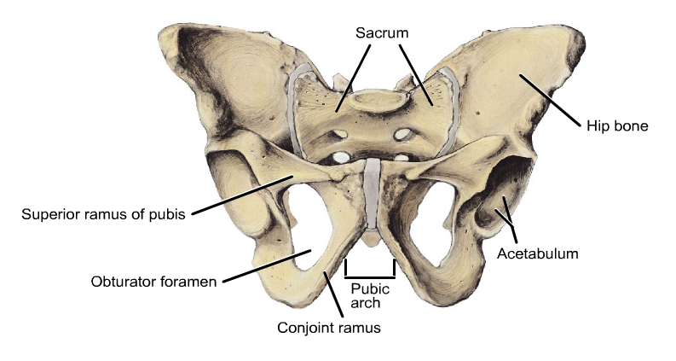

Slide 11
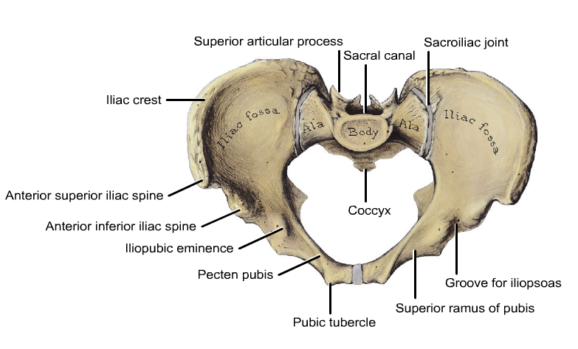

Slide 12
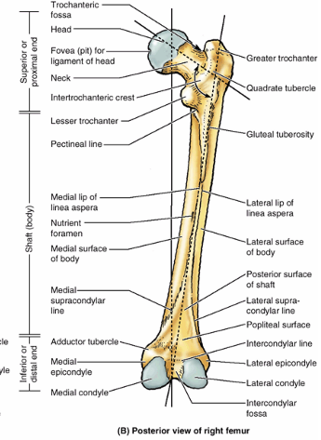

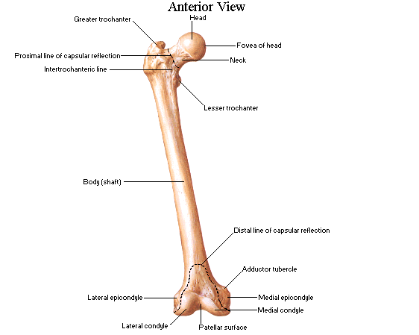
THE FEMUR
Is the longest and heaviest bone in the body
To support the erect bipedal posture, femurs are obliquely placed
Consists of a shaft (body) and proximal and distal ends
Most of the shaft is smoothly rounded (except linea aspera in the posterior surfaces)
The proximal end of the femur consists of a head, neck, and two trochanters (greater and lesser)
B/n the two trochanters is intertrochanteric line anteriorly and intertrochanteric crest posteriorly

Slide 13
The distal end of the femur ends in two spirally curved femoral condyles (medial and lateral)
  Patellar surface for articulation with the patella
The femoral condyles articulate with the tibial condyles to form the knee joint
  Femoral neck is the most commonly fractured site

Slide 14
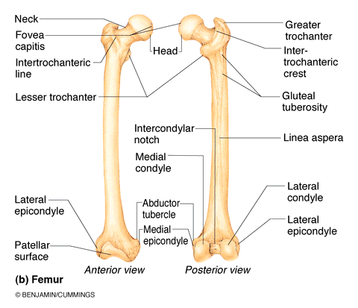

Slide 15
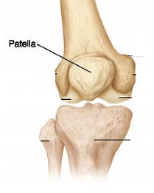
The patella
The patella (knee cap) is a large sesamoid bone
This triangular-shaped bone articulates with the patellar surface of the femur
Has
  Anterior surface is convex
  Posterior surface- articular surface
  Base – superior border
  Apex - Lateral and medial border

Slide 16
Tibia
Large, weight bearing bone
Articulate
  proximally with condyles of femur at knee joint
  distally with the talus of ankle
  laterally at its proximal and distal ends with fibula
Has medial & lateral condyles and tibial tuberosity
Medial malleolus - inferiorly directed projection from medial side of distal end
Shaft is narrowest at the junction of its inferior and middle thirds, which is the most frequent site of fracture

Slide 17
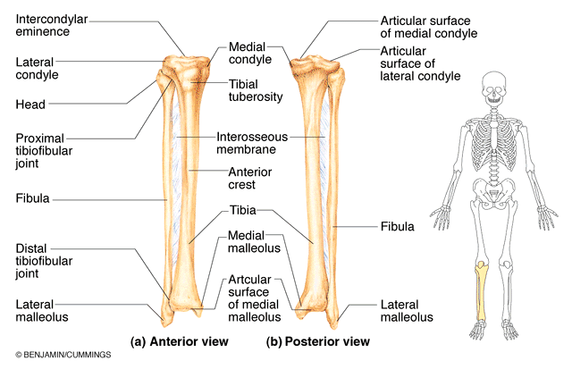

Slide 18
Fibula
Long, slender bone on the lateral side of leg
Serves mainly for muscle attachment than for support
Has head and neck at the proximal end
Distal end enlarges to form lateral malleolus
Fractures commonly occur just proximal to lateral malleolus and often are associated with dislocation of ankle joint
Fibula is a common source of bone for grafting

Slide 19

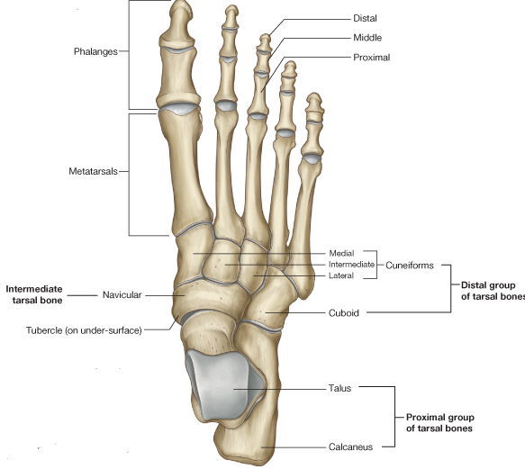
Tarsus, Metatarsus,& Phalanges
TARSUS:
The tarsus consists of seven bones:
Calcaneus- (heel bone)
Talus
Cuboid
Navicular
Three cuneiforms

Slide 20
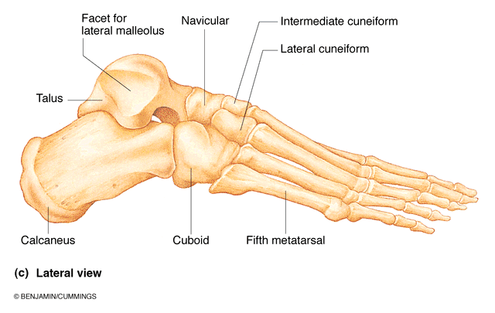

Slide 21
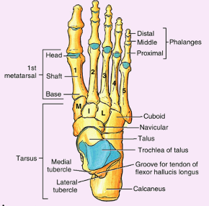
Metatarsus
The metatarsus consists of five metatarsals
connect the tarsus and phalanges
Phalanges
There are 14 phalanges.
The 1st digit (great toe) has two phalanges (proximal and distal);
the other four digits have three each: proximal, middle, and distal

Slide 22

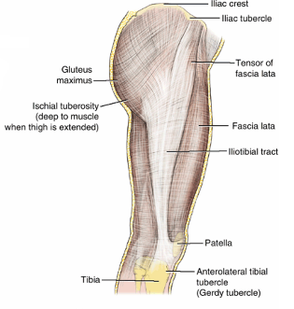
Superficial structure of Lower Limb
SUPERFICIAL FASCIA
Consists of loose connective tissue that contains fat, cutaneous nerves, superficial veins, lymphatic vessels, and lymph nodes
The subcutaneous tissue of the hip and thigh is continuous with that of the inferior part of the anterolateral abdominal wall and buttock
At the knee, it loses its fat and blends with the deep fascia; but fat is present in the subcutaneous tissue of the leg.

Slide 23
Superficial structure of Lower Limb
Fascia lata
Deep fascia of the thigh
Invest the limb like an elastic stocking
Limits outward extension of contracting muscles
Make muscular contraction more efficient in compressing veins to push blood toward the heart
Attaches to and continuous with all around to the root of the lower limb
Extends downwards over the subcutaneous surface of knee and the tibia
It is particularly dense laterally to form iliotibial tract

Slide 24
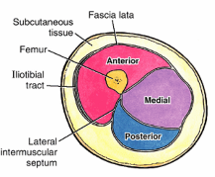
Fascial compartments
  3 intermuscular septa arise from fascia lata and attach to linea aspera
  Separate the thigh muscles into 3 compartments: anterior, medial and posterior

Slide 25
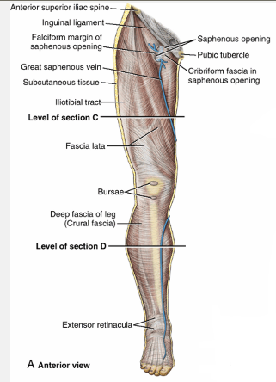
Saphenous opening
  A gap in the fascia lata inferior to medial part of inguinal ligament
  Great saphenous vein and some lymphatics pass through it

Slide 26
Venous Drainage of Lower Limb
The lower limb has superficial and deep veins
Superficial veins are in subcutaneous tissue and deep veins accompany arteries
The two major superficial veins are the great and small saphenous veins
The great saphenous vein is formed by the union of the dorsal digital vein of the great toe and the dorsal venous arch of the foot, Empties into the femoral vein.
  The small saphenous vein arises on the lateral side of the foot from the union of the dorsal digital vein of the fifth digit with the dorsal venous arch, empties into popliteal vein

Slide 27
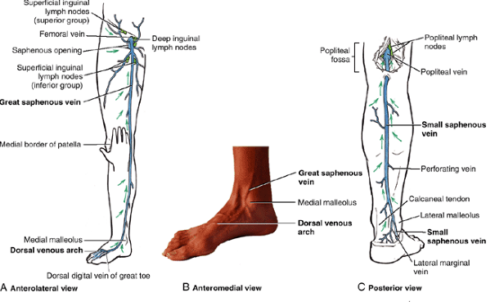

Slide 28
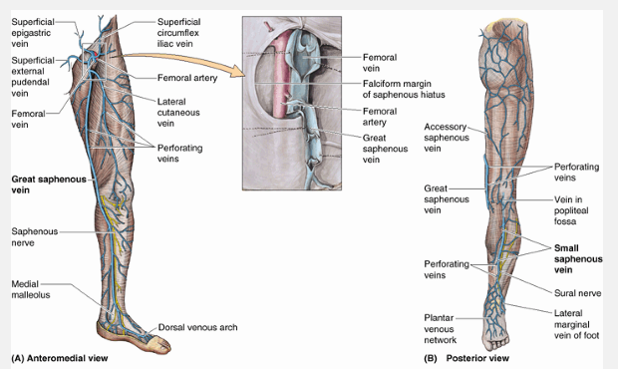

Slide 29
Deep veins of the lower limb
Accompany arteries
Usually paired contained within vascular sheath with the artery
  arterial pulsations help move the blood
In the leg they flow to popliteal vein, which become femoral vein in thigh which become external iliac vein in pelvis

Slide 30
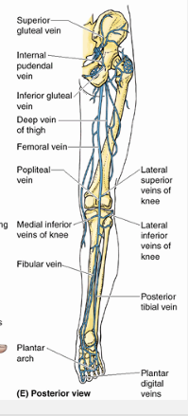
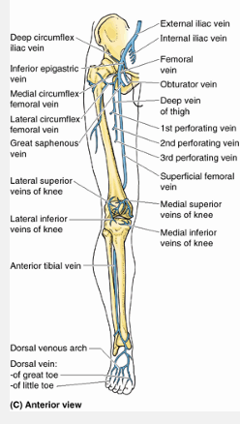

Slide 31
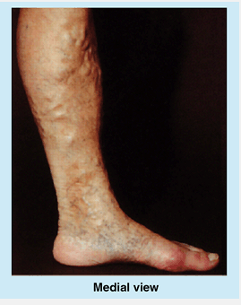
Clinical correlates
Varicose veins
  form when the valves that usually prevent blood flow from the deep veins through the perforating veins to the superficial veins are incompetent
  As a result, the superficial veins become varicose (dilated so that their cusps do not close) and tortuous

Slide 32
Lymphatic drainage of lower limb
Superficial and deep lymph vessels
Superficial lymph vessels
  There are more in number than the deep vessels
  Many of them follow the great saphenous vein and end in the superficial inguinal lymph nodes
  Few of them follow the small saphenous vein and end in to popliteal lymph nodes
Deep lymph vessels of the leg
  follow the deep veins and enter popliteal lymph nodes from which lymph drain into the deep inguinal lymph nodes
Finally deep and superficial lymph pass to external iliac lymph nodes

Slide 33
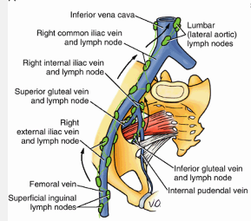

Slide 34
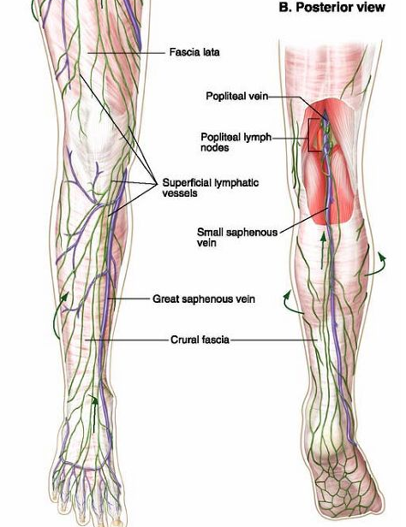
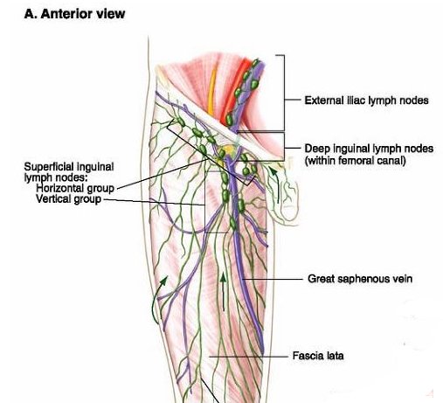

Slide 35
Cutaneous innervation of lower limb
Arise from 10 spinal cord segments – T12- S4
  Upper and lateral gluteal region - T12 & L1,2
  Front, medial and lateral thigh - L1,2,3
  Medial and front of the leg - L 4
  Lateral and front of the leg and intermediate of the dorsum of the foot - L5
  Lateral border of the foot - S1
  Sole of the foot medial part - L4
  Sole of the foot intermediate part - L5
  Sole of the foot lateral part - S1
  Back of the leg and thigh - S2
  Inferior and medial part of gluteal region and perianal region - S3,4

Slide 36
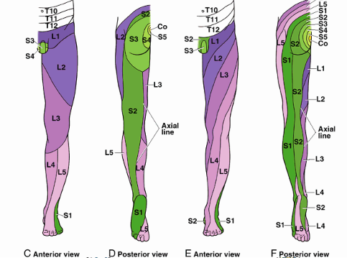
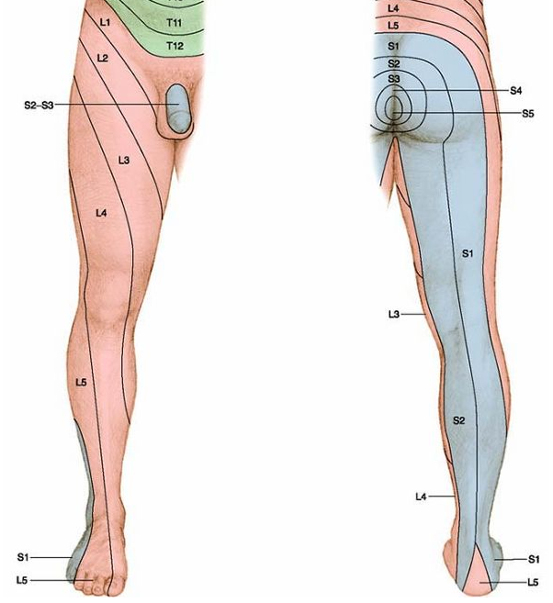

Slide 37
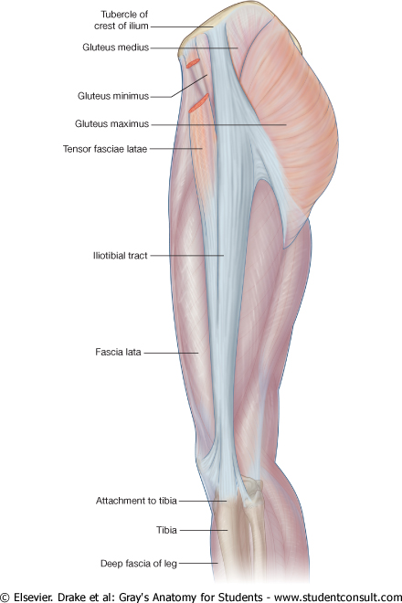
Muscles of the gluteal region
Organized into 2 layers: superficial and deep
Superficial layer: 3 gluteal muscles and tensor of fascia lata
Deep layer: piriformis, obturator internus, superior and inferior gemilli, and quadratus femoris

Slide 38
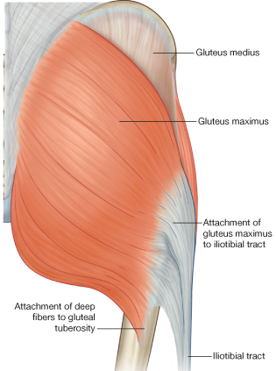
Gluteus maximus
Origin - dorsal surface of ilium, sacrum and coccyx
Insertion - iliotibial tract and gluteal tuberosity of femur
Action - thigh extension, lateral rotation, assists in rising from sitting position
Innervation: inferior gluteal nerves

Slide 39
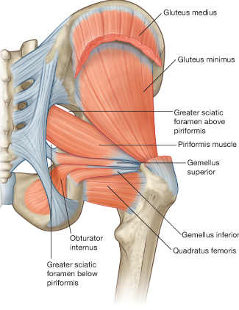
Gluteus medius
Origin - between anterior and posterior gluteal lines on lateral surface of ilium
Insertion - greater trochanter of femur on the lateral surface
Action - abducts and medially rotates thigh
Innervation - superior gluteal nerve

Slide 40
Gluteus minimus
Origin - between anterior and inferior gluteal lines on external surface of ilium
Insertion - greater trochanter of femur on the anterior surface
Action - abducts and medially rotates thigh and with gluteus medius prevent tilting of the pelvis
Innervation - superior gluteal nerve

Slide 41
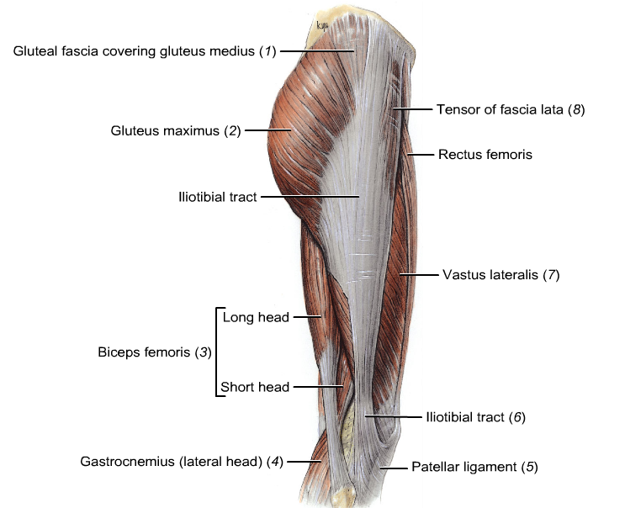
Tensor fascia lata
Origin - anterior superior iliac spine and the outer lip of the iliac crest
Insertion - iliotibial tract
Action - flexes and abducts thigh
Innervation - superior gluteal nerve

Slide 42
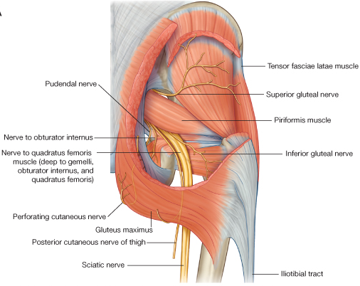
Piriformis
Key muscle – divide the greater sciatic foramen
  structures passing above the muscle
    superior gluteal nerve and vessels
  structures passing below the muscle
    nerves - inferior gluteal, sciatic, posterior femoral cutaneous, pudendal, nerve to quadratus femoris and obturator internus
    vessels - inferior gluteal and internal pudendal
Origin: pelvic surface of sacrum
Insertion: greater trochanter
Innervation - branches of ventral rami of S1 and S2
All the deep group laterally rotates thigh and steadies femoral head in acetabulum

Slide 43
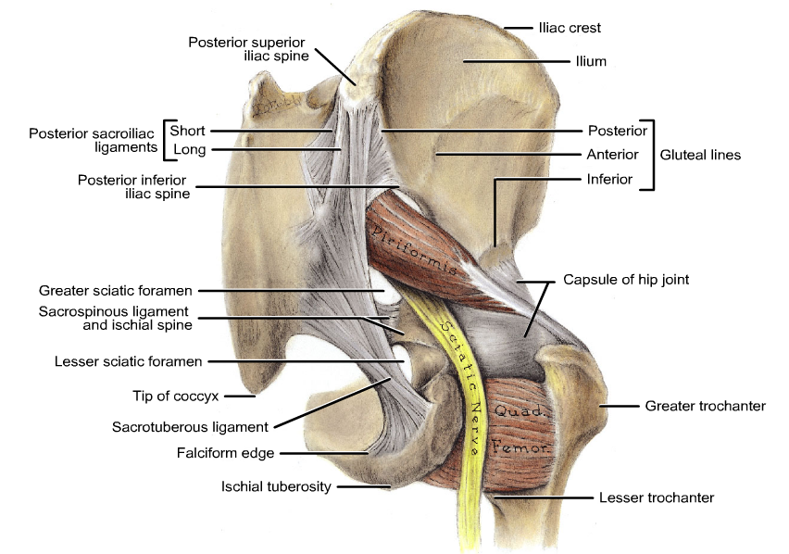

Slide 44
Quadratus femoris
Origin: ischial tuberosity
Insertion: intertrochanteric crest of femur
Innervation: nerve to quadratus femoris (L4, 5, S1)
Obturator internus
Origin: pelvic surface of the obturator membrane
Insertion: greater trochanter
Innervation: nerve to obturator internus (L5, S1, 2)
The only structure entering the gluteal region via the lesser sciatic foramen

Slide 45
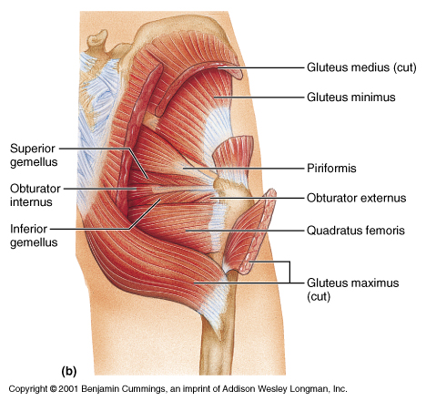

Slide 46
Superior gemillus
    Origin: ischial spine
    Insertion: greater trochanter
    Innervation: nerve to obturator internus
Inferior gemillus
    Origin: ischial tuberosity
    Insertion: greater trochanter
    Innervation: nerve to quadratus femoris

Slide 47
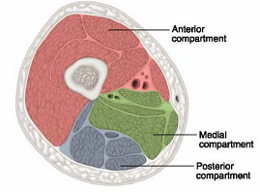
THE THIGH
Thigh muscles are organized into three compartments:
anterior or extensor,
medial or adductor, and
posterior or flexor by intermuscular septa

Slide 48
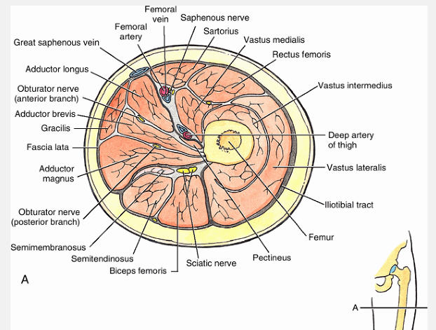

Slide 49
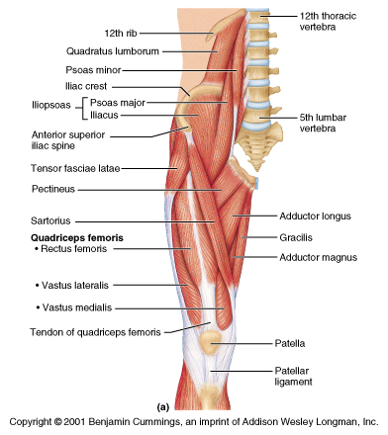
ANTERIOR COMPARTMENT OF THIGH
Contains the anterior thigh muscles, which are
Flexors of the hip and
Extensors of the knee
INCLUDE:
Quadriceps femoris (Rectus femoris, Vastus lateralis, Vastus intermedius, Vastus medialis)
Pectineus
Iliopsoas
Sartorius

Slide 50
Quadriceps femoris
Muscles | Proximal attachment | Distal attachment
Rectus femoris | anterior inferior iliac spine and Ilium superior to acetabulum | Quadriceps femoris tendon To patella and tibial tuberosity
Vastus lateralis | greater trochanter and lateral lip of the linea aspera | Quadriceps femoris tendon To patella and tibial tuberosity
Vastus intermedius | anterior and lateral surfaces of shaft of femur | Quadriceps femoris tendon and lateral margin of patella
Vastus medialis | intertrochanteric line and medial lip of the linea aspera | Quadriceps femoris tendon and medial border of patella

Slide 51
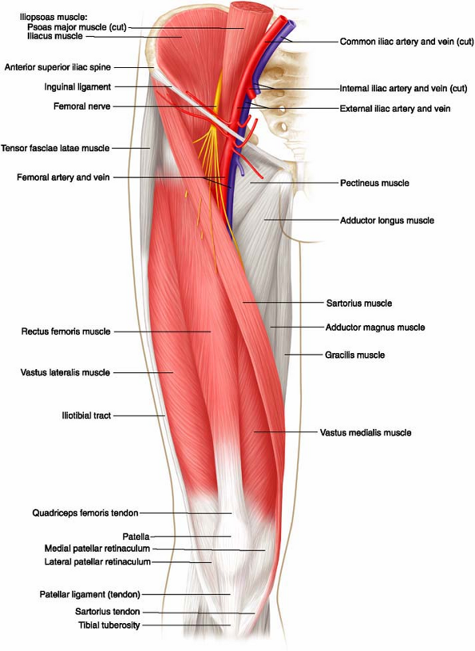
Quadriceps femoris
Innervation –all are innervated by Femoral nerve
Action- Rectus femoris flex the thigh at the hip & extend the leg at the knee joint. While the others only extend the leg at the knee joint

Slide 52
Muscles in the anterior compartment of the thigh
muscles | Proximal attachment | Distal attachment | innervation | action
Sartorius | Anterior superior iliac spine | superomedialsurface of tibia | Femoral nerve | Flexes , abduct and laterally rotate the thigh and flexes the leg at the knee joint
Psoas major | Posterior abdominal wall | Lesser trochanter of femur | Anterior rami of L2-L4 | Flexes the thigh at the hip joint
Iliacus | Posterior abdominal wall (iliac fossa) | Lesser trochanter of femur | Femoral nerve | Flexes the thigh at the hip joint
Pectineus | Superior ramus of pubis | Pectineal line of femur | Femoral nerve | Adducts and flexes thigh

Slide 53

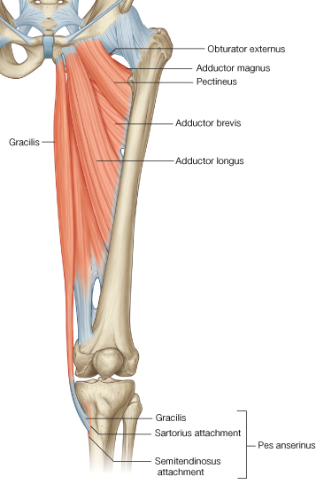
THE MEDIAL COMPARTMENT
Consists of:
Adductor longus: the most anterior muscle
Adductor brevis: deep to the pectineus and adductor longus muscles.
Adductor magnus: the largest, composed of adductor and hamstring parts;.
Gracilis: a long, strap-like muscle
Obturator externus: a deeply placed fan-shaped

Slide 54
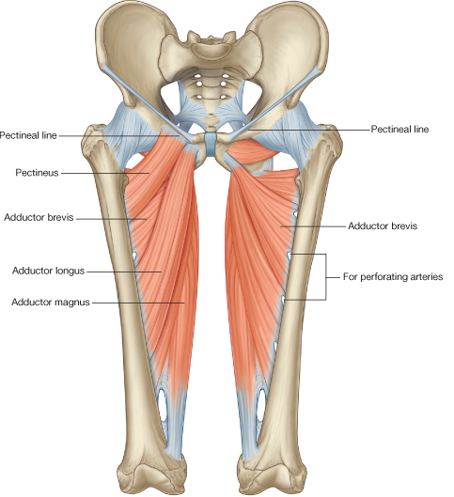

Slide 55
muscles | Proximal attachment | Distal attachment | innervation | action
Gracilis | the body and inferior pubic ramus, | Medial surface of proximal shaft of the tibia | Obturator nerve | Adducts thigh at hip joint and flexes leg at knee joint
Adductor magnus | Adductor part-ischiopubic ramus | Posterior surface of proximal femur, linea aspera, medial supracondylar line | Obturator nerve | Adducts and medially rotates thigh at hip joint
Adductor longus | External surface of body of pubis | Linea aspera on middle one-third of shaft of femur | Obturator nerve (anterior division) | Adducts and medially rotates thigh at hip joint
Adductor brevis | body and inferior pubic ramus | Pectineal line proximal part of linea aspera | Obturator nerve | Adducts thigh at hip joint
Obturator externus | External surface of obturator membrane and adjacent bone | Trochanteric fossa | Obturator nerve (posterior division) | Laterally rotates thigh, steadies head of femur in acetabulum

Slide 56

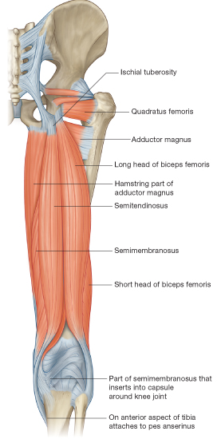
THE POSTERIOR COMPARTMENT
Three muscles in the posterior aspect of the thigh are hamstrings
Semitendinosus
Semimembranosus
Biceps femoris (long head)
  Arise from the ischial tuberosity
  Are innervated by the tibial division of the sciatic nerve.

Slide 57
Hamstring Muscles
muscles | Proximal attachment | Distal attachment | innervation | action
Biceps femoris | Long head-Ischial tuberosity; short head-lateral lip of linea aspera | Head of fibula | Sciatic nerve | flex leg, rotate it laterally ; when knee is flexed extends thigh
Semitendinosus | ischial tuberosity | Medial surface of proximal tibia | Sciatic nerve | Extend thigh & flex leg, rotate it medially; when thigh & leg are flexed can extends trunk
Semimembranosus | ischial tuberosity | medial and posterior surface of tibial condyle | Sciatic nerve

Slide 58

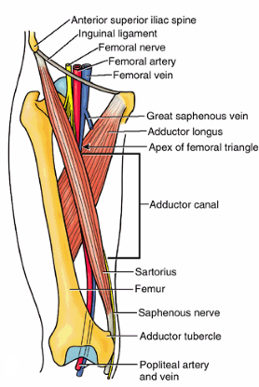
THE FEMORAL TRIANGLE
Boundary
  Medial - medial boarder of adductor longus
  Lateral - medial boarder of sartorius
  Superior - inguinal ligament
  Floor - iliopsoas laterally and pectineus medially
  Roof - fascia lata, cribriform fascia, subcutaneous tissue, and skin

Slide 59
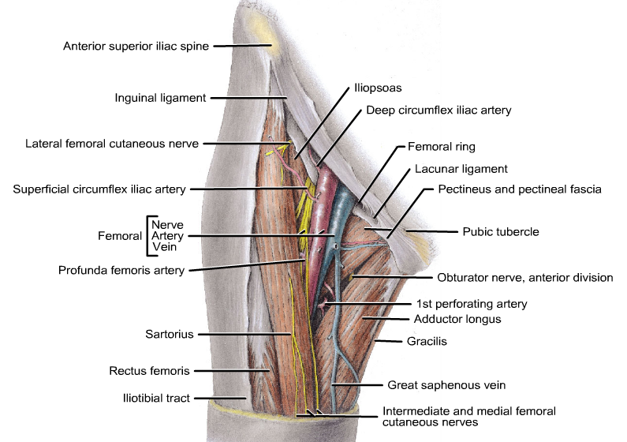

Slide 60
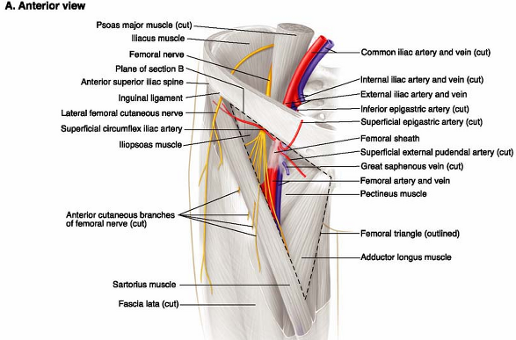
Contents
  femoral sheath
  femoral artery and its branch
  femoral vein and its tributaries
  femoral nerve and its branches
  deep inguinal lymph nodes
  profunda femoris artery and vein and their circumflex branches

Slide 61
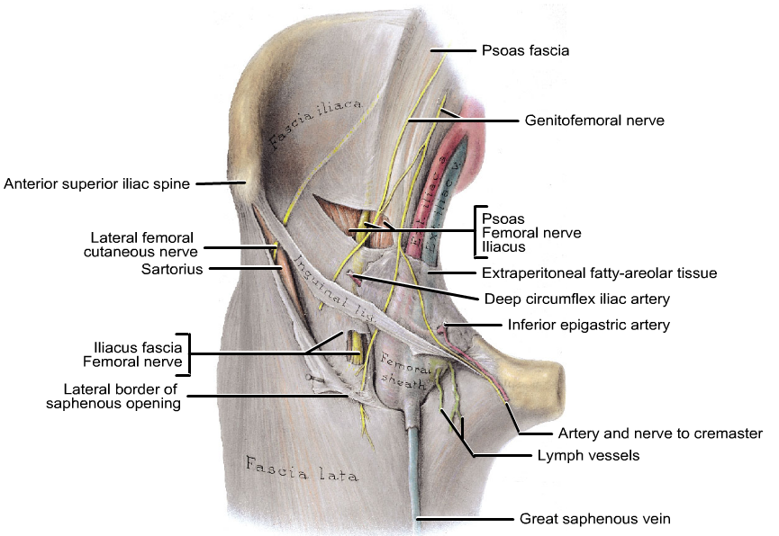
Femoral sheath
Derived from the extraperitoneal intra-abdominal fascia
  its anterior wall arising from the transversalis fascia
  its posterior wall from the fascia covering the iliacus
  Contain:- femoral artery and vein, genital branch of genitofemoral nerve and femoral canal (lymph vessels and deep lymph nodes)

Slide 62
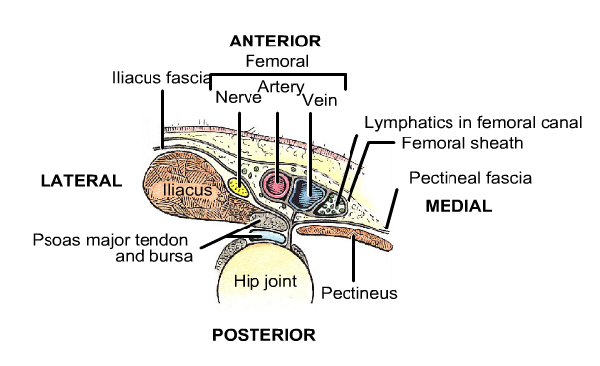
Femoral canal
A small, vertically placed gap on the medial part of the femoral sheath
about 0.5 inch in length, admits the tip of little finger
larger in female due to the greater width of the female pelvis
  Site of femoral hernia
  femoral hernias are more common in female
  Help for expansion of the distended femoral vein
  pathway for lymphatic vessel from the lower limb to the external iliac nodes

Slide 63


The adductor canal
Also termed as (subsartorial canal, Hunter canal)
Extends from the apex of the femoral triangle
BOUNDARY
anteriorly and laterally by the vastus medialis
posteriorly by the adductor longus and adductor magnus
medially by the sartorius
Contents
Femoral artery and vein, the saphenous nerve, and the nerve to vastus medialis

Slide 64


Slide 65

Neurovasculature in Anteromedial Thigh
The femoral artery
The chief aa to the lower limb
Branch of external iliac aa
Branches
    Superficial & deep external pudendal aa
      supply scrotum and labium majus
    Superficial epigastric artery
    Superficial circumflex iliac artery
    Deep femoral (profunda femoris) artery :- Medial & lateral circumflex femoral and perforating branch)

Slide 66


Slide 67

Femoral pulse
Palpable just inferior to the midpoint of the inguinal ligament
The femoral artery may be compressed here to control arterial bleeding after lower limb trauma
The femoral artery may be cannulated just inferior to the midpoint of the inguinal ligament (e.g., for cardioangiography, radiography of the heart and great vessels after the introduction of contrast material)

Slide 68

Obturator artery
Arises from internal iliac artery
Passes through obturator foramen
Enters medial compartment of the thigh
Divides into anterior and posterior branches
Supplies obturator externus and adductors of thigh
Posterior branch gives of acetabular branch to head of femur

Slide 69

The femoral vein
Is the continuation of the popliteal vein at adductor hiatus
Tributaries
  Descending genicular
  Profunda femoris
  circumflex femoral
  Deep external pudendal
  Great saphenous
Ends at external iliac vein

