Slide 1

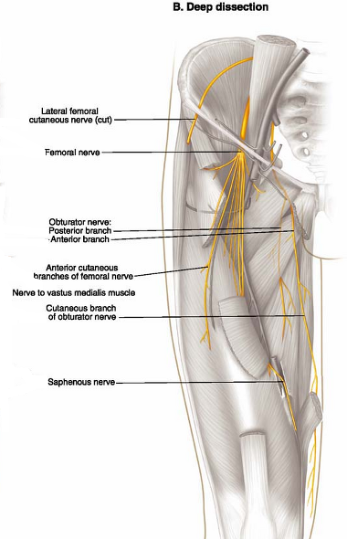
NERVES
Femoral Nerve:- L2- L4
is the largest branch of the lumbar plexus.
divides into several terminal branches to the anterior thigh muscles
sends articular branches to the hip and knee joints and
provides cutaneous branches to the anteromedial thigh
Terminal cutaneous branch -saphenous nerve

Slide 2

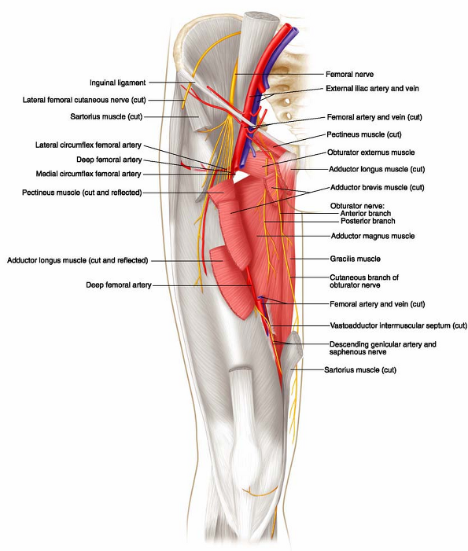
NERVE
The obturator nerve L2-L4
It divides into anterior and posterior branches,
The anterior branch supplies the adductor longus, adductor brevis, gracilis, and pectineus;
The posterior branch supplies the obturator externus and adductor magnus

Slide 3

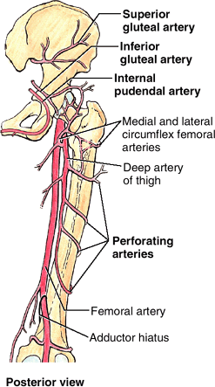
Vasculature of Gluteal Region and Posterior Thigh
Arteries
Superior gluteal aa
Inferior gluteal aa
Internal pudendal- supply perineum
  all arises from internal iliac aa
The deep artery of the thigh - giving off perforating arteries to posterior compartment of the thigh
Veins
  Accompany the arteries
  Have same name with arteries
  Are tributaries of the internal iliac veins

Slide 4
Nerves of Gluteal Region and Posterior Thigh
Several nerves arise from the sacral plexus (L4, L5, S1–S4 ) and supply the gluteal region and posterior thigh
Branches
    Superior gluteal nerve - gluteus medius, minimus, tensor fascia lata
    Inferior gluteal nerve – gluteus maximus
    Nerve to quadratus femoris
    Nerve to piriformis
    Nerve to obturator internus
    Posterior cutaneous nerve of the thigh
    Pudendal nerve
    Sciatic nerve

Slide 5

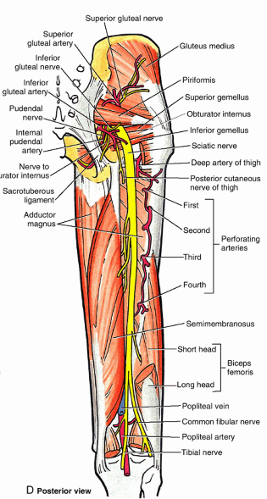
Nerves of Gluteal Region and Posterior Thigh
Sciatic nerve (L4-S3)
    the largest nerve in the body
    the continuation of the main part of the sacral plexus
    is really two nerves loosely bound together in the same connective tissue sheath: the tibial nerve, and the common fibular nerve
    Terminate in the middle of the thigh by dividing into tibial and common fibular nerves
  Supplies no structures in the gluteal region
  It supplies the posterior thigh muscles, all leg and foot muscles, and the skin of posterior thigh, most of the leg and the foot

Slide 6
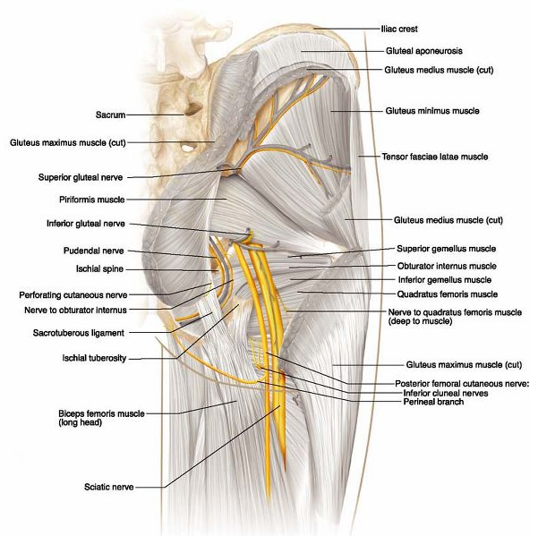

Slide 7
Intra-gluteal injections
The gluteal region is a common site for intramuscular injection of drugs
The gluteal region is a favorable injection site because the muscles are thick and large; consequently, they provide a substantial volume for absorption of injected substances by intramuscular veins
Complications of improper technique include nerve injury, hematoma, and abscess formation
Injections into the buttock are safe only in the superolateral quadrant of the buttock

Slide 8
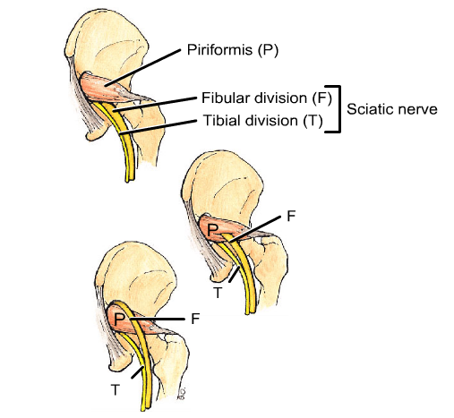

Slide 9

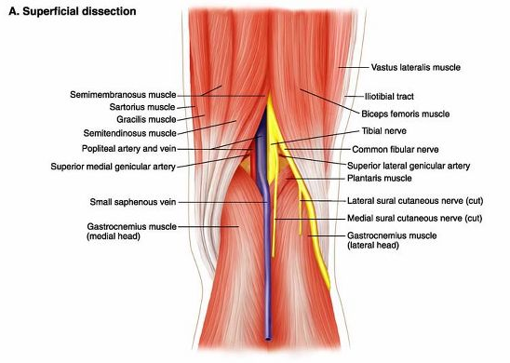
THE POPLITEAL FOSSA
Is a mostly fat-filled diamond-shaped space posterior to the knee
The popliteal fossa is bound
Superolateral - biceps femoris
Superomedially - semimembranosus,
Inferolateral and inferomedially by the lateral and medial heads of the gastrocnemius,
ROOF: Posteriorly by skin and popliteal fascia
FLOOR: Anteriorly by the popliteal surface of the femur, posterior capsule of the knee joint, and the popliteus fascia covering the popliteus muscle .

Slide 11
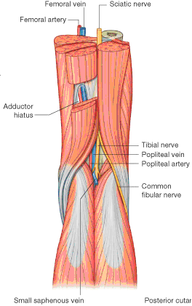
THE POPLITEAL FOSSA
The contents
Termination of the small saphenous vein.
Popliteal artery and vein and their branches and tributaries.
Tibial and common fibular nerves
Posterior cutaneous nerve of the thigh.
Popliteal lymph nodes and lymphatic vessels.

Slide 12
Popliteal artery
Continuation of the femoral artery
at the inferior border of the popliteus it divides into anterior and posterior tibial arteries
The deepest structure in the popliteal fossa
Branches
      Five genicular branches and of the popliteal artery supply the
          superior lateral
          superior medial
          Middle
          inferior lateral
          inferior medial
      Branch for muscles, joint capsule and ligaments of the knee joint
      Anterior and posterior tibial arteries

Slide 13
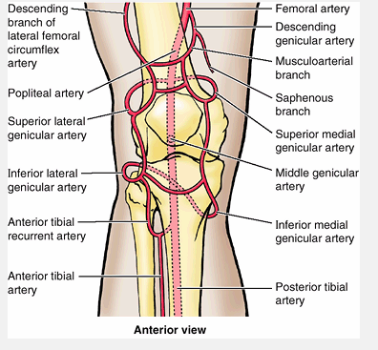

Slide 14
Popliteal vein
Begins as an assembly of venae comitantes below the knee
Formed at distal end of popliteus
Terminate in the adductor hiatus
Tributaries
  main – vena comitantes of anterior and posterior tibial artery
  muscular and cutaneous
  genicular veins
  small saphenous vein

Slide 15
Tibial nerve
  The medial, larger terminal branch of the sciatic nerve
  The most superficial of the three main central components of the popliteal fossa (nerve, vein, and artery)
  A medial sural cutaneous nerve is also derived from the tibial nerve joined by the sural communicating branch of the common fibular nerve to form the sural nerve
    This nerve supplies the lateral side of the leg and ankle
Common fibular nerve
  The lateral, smaller terminal branch of the sciatic nerve
  Winds around the fibular neck, where it is vulnerable to injury
  Here it divides into its terminal branches, the superficial and deep fibular nerves

Slide 16
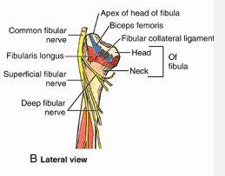

Slide 17
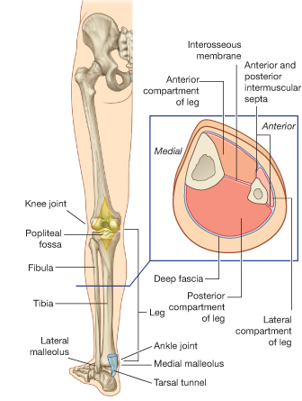
THE LEG
The leg is divided into three compartments by intermuscular septa interosseous membrane and two leg bones
    Anterior
    Lateral
    Posterior

Slide 18
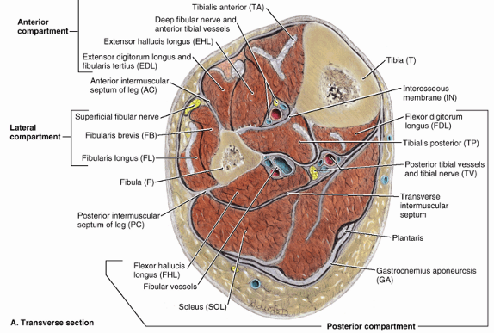
THE LEG

Slide 19
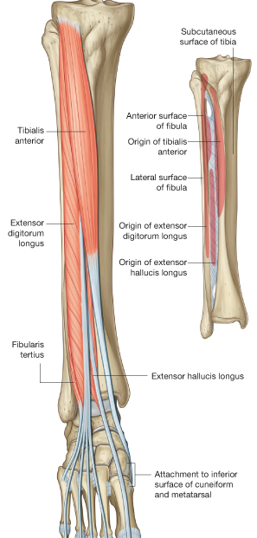
Anterior Compartment of Leg
Are Dorsiflexor (extensor) compartment) and located anterior to the interosseous membrane
Four muscles in the anterior compartment
Tibialis anterior
Extensor digitorum longus
Extensor hallucis longus
Fibularis tertius

Slide 20

Anterior Compartment of Leg
Muscle | Proximal attachment | Distal attachment | Innervation | action
Tibialis anterior | Lateral surface of tibia | medial cuneiform and base of metatarsal I | Deep fibular nerve | Dorsiflexion of foot at ankle joint; inversion of foot
Extensor hallucis longus | Middle one-half of medial surface of fibula | base of distal phalanx of great toe | Deep fibular nerve | Extension of great toe and dorsiflexion of foot
Extensor digitorum longus | Proximal one-half of medial surface of fibula and lateral tibial condyle | bases of distal and middle phalanges of lateral four toes | Deep fibular nerve | Extension of lateral four toes and dorsiflexion of foot
Fibularis tertius | Distal part of medial surface of fibula | base of metatarsal V | Deep fibular nerve | Dorsiflexion and eversion of foot

Slide 21


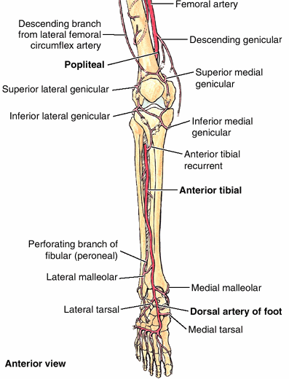
Neurovasculature in the ant. Comp.
Arteries
The anterior tibial artery supplies structures in the anterior compartment
It ends at the ankle joint, midway between the malleoli, where it becomes the dorsal artery of the foot
Veins
Deep veins follow the arteries and have similar names.

Slide 22
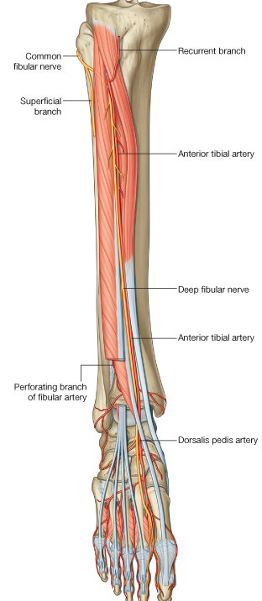
Neurovasculature in the ant. Comp.
Nerves
The deep fibular nerve, one of the two terminal branches of the common fibular nerve, is the nerve of the anterior compartment.

Slide 23

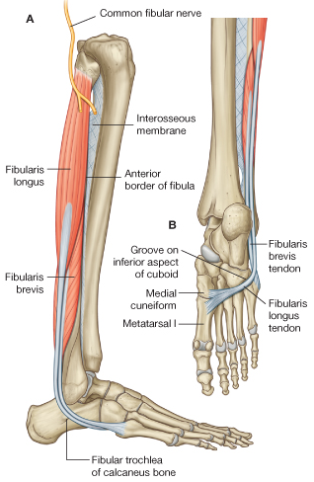
Lateral compartment of Leg
The lateral compartment
Is evertor compartment,
contains two muscles:
The fibularis longus and
The fibularis brevis

Slide 24
Lateral compartment of Leg
Muscle | Proximal attachment | Distal attachment | Innervation | action
Fibularis longus | Upper 2/3 of lateral surface of fibula | medial cuneiform and base of metatarsal I | Superficial fibular nerve | Eversion and plantarflexion of foot
Fibularis brevis | Lower two-thirds of lateral surface of fibula | Lateral tubercle at base of metatarsal V | Superficial fibular nerve | Eversion of foot

Slide 25
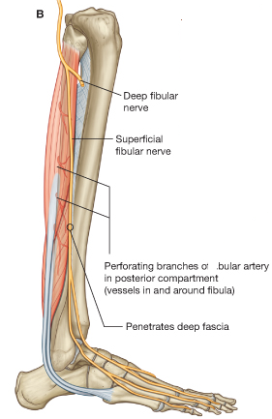
Neurovasculature in the lat. Comp.
The superficial fibular nerve, the nerve in the lateral compartment, is a terminal branch of the common fibular nerve
The lateral compartment of the leg does not have an artery coursing through it

Slide 26


Posterior Compartment of Leg
Is Plantar flexor compartment
is the largest of the three leg compartments
divided into superficial and deep sub compartments/muscle groups

Slide 27
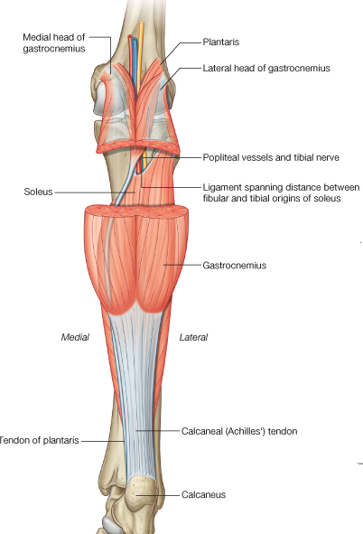
The superficial group
Includs the gastrocnemius, Soleus, and plantaris, and forms a powerful muscular mass in the calf.
The two-headed of gastrocnemius and the Soleus share a common tendon, the calcaneal tendon

Slide 28
Gastrocnemius
Origin: has 2 attachments just superior to the lateral and medial epicondyles of the femur
Insertion
  Ends in the tendo calcaneus (Achilles' tendon) which it shares with the soleus and plantaris
    These 3 muscles form triceps surae
  Tendo calcaneus inserts into the middle of the posterior surface of the calcaneus
Action - plantar flexes foot, flexes knee
Nerve supply: tibial nerve

Slide 29
Soleus
Origin - proximal part of the posterior surface of the fibula and the soleal line of the tibia and interosseus membrane
Insertion - calcaneus via calcaneal tendon
Action - plantar flexes ankle
Nerve supply: tibial nerve
Plantaris
lies between the gastrocnemius and the soleus
Origin - posterior femur above lateral condyle; near the lateral head of the gastrocnemius
Insertion - calcaneus via tendo calcaneus
Action - plantar flexion, knee flexion
Nerve supply: tibial nerve

Slide 30
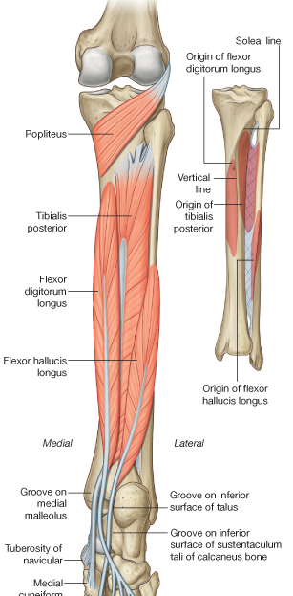
THE DEEP GROUP
Four muscles make up the deep group in the posterior compartment
Popliteus.
Flexor digitorum longus.
Flexor hallucis longus.
Tibialis posterior.

Slide 31
THE DEEP GROUP
Muscle | Proximal attachment | Distal attachment | Innervation | action
Popliteus | Lateral femoral condyle | Posterior surface of proximal tibia | Tibial nerve | Unlocks knee joint (laterally rotates femur on fixed tibia)
Flexor hallucis longus | Posterior surface of fibula | Base of distal phalanx of great toe | Tibial nerve | Flexes great toe, plantar flex ankle
Flexor digitorum longus | Medial side of posterior surface of the tibia | bases of distal phalanges of the lateral four toes | Tibial nerve | Flexes lateral four toes, plantar flex ankle
Tibialis posterior | Posterior surfaces of interosseous membrane and adjacent regions of tibia and fibula | Primarily Navicular and also on cuneiform, Cuboid, base of 2-4 metatarsal | Tibial nerve | Inversion and plantarflexion of foot

Slide 32
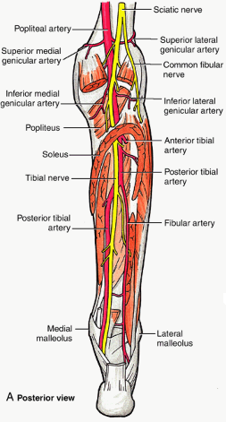
Blood vessel and nerves
Posterior tibial artery
It supplies the posterior and lateral compartments of the leg
Ends by dividing into medial and lateral plantar arteries
  Veins
Deep veins in the posterior compartment generally follow the arteries.

Slide 33
Neurovasculature in the pot. Comp
    Tibial nerve
The nerve associated with the posterior compartment of leg is the tibial nerve.

Slide 34
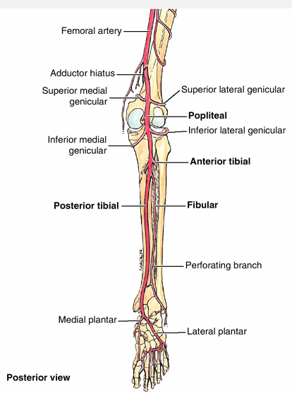
Arteries of the leg
    Popliteal
    Anterior tibial
    Posterior tibial
    Peroneal

Slide 35
Nerves of the leg
  Saphenous:- skin on medial leg and foot
  Sural:-from tibial and common fibular nerve; skin on posterior and lateral leg and lateral foot
  Tibial:- arise from sciatic nerve; Posterior compartment muscles of the leg and knee joint;
  Common fibular:- from sciatic nerve; skin on lateral leg and knee joint
  Superficial fibular:- fibularis longus, brevis and skin on distal lateral leg and dorsum of foot
  Deep fibular:- anterior muscles of leg, dorsum of foot and skin of first interdigital cleft and joints

Slide 36
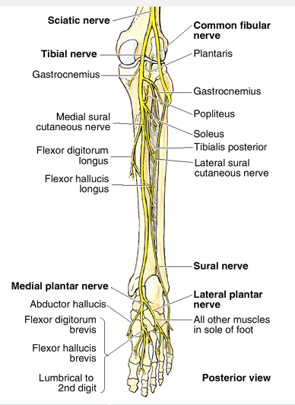
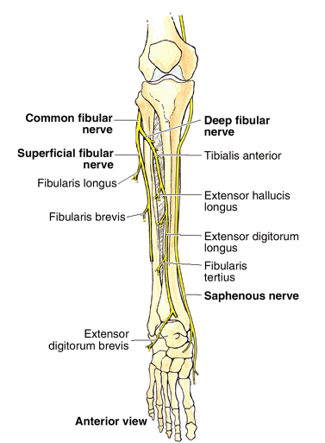

Slide 37
Injury to common fibular nerve
The common fibular nerve is the most commonly injured nerve in the lower limb, mainly because it winds superficially around the neck of the fibula, leaving it vulnerable to direct trauma
This nerve may also be severed during fracture of the fibular neck or severely stretched when the knee joint is injured or dislocated
Severance of the common fibular nerve results in paralysis of all muscles in the anterior and lateral compartments of the leg
The loss of dorsiflexion of the ankle causes foot drop, which is further exacerbated by unopposed inversion of the foot
The toes do not clear the ground during the swing phase of walking

Slide 38
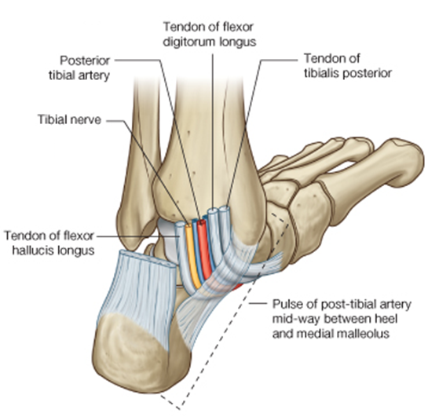
Flexor retinaculum
From Medial malleolus to calcaneus
Content – from medial to lateral
  Tendon of tibialis posterior
  Tendons of flexor digitorum longus
  Termination of posterior tibial artery and beginning of lateral and medial plantar arteries
  Termination of posterior tibial nerve and beginning of medial and lateral plantar nerves
  Tendon of flexor hallucis longus

Slide 39
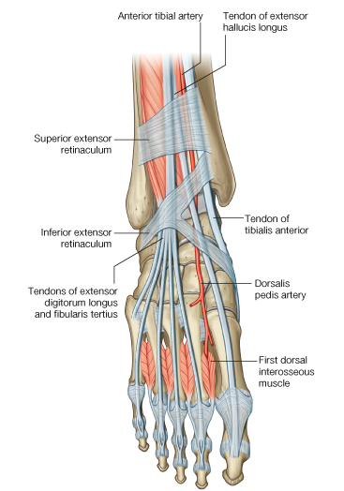
Extensor retinaculum
Has superior and inferior portions
Prevents the tendons of peroneus tertius, extensor hallucis longus and extensor digitorum longus from bowstringing during contraction

Slide 40
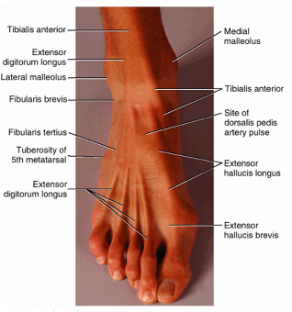
THE FOOT
The foot is the region of the lower limb distal to the ankle joint
provides a platform for supporting the weight of the body when standing.
has an important role in locomotion.
The foot has a superior surface (dorsum of foot) and an inferior surface (sole)

Slide 41
Deep fascia of foot
The deep fascia is thin on the dorsum of the foot, where it is continuous with the inferior extensor retinaculum
Over the lateral and posterior aspects, it is continuous with the plantar fascia, which has a thick central part (the plantar aponeurosis) and weaker medial and lateral parts
The plantar fascia holds parts of the foot together, helps protect the sole from injury, and helps support the longitudinal arches of the foot
Its intermuscular septum divide the sole in to three compartment
      Medial
      Central
      Lateral compartment of the sole

Slide 42
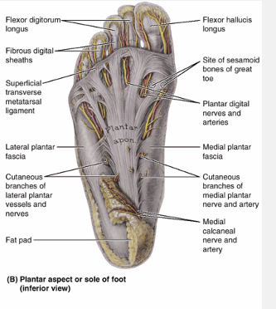

Slide 43

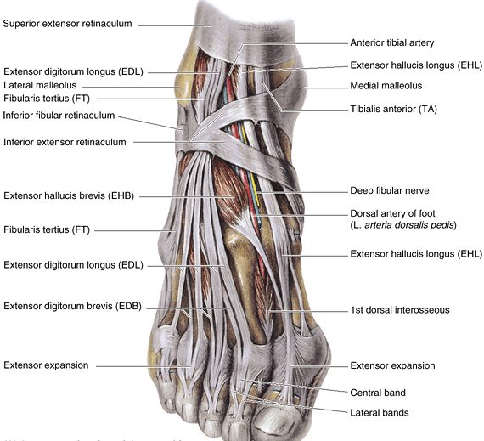
INTRINSIC MUSCLES OF THE FOOT
Originate and insert in the foot.
Intrinsic muscles mainly modify the actions of the long tendons and generate fine movements of the toes.
There are two intrinsic muscle on the dorsum of the foot-extensor digitorum brevis & extensor hallucis brevis.

Slide 44
Extensor digitorum brevis-on the dorsal aspect of the foot
Muscle | Proximal attachment | Distal attachment | Innervation | action
Extensor digitorum and hallucis brevis | Superolateral surface of the Calcaneus | Base of proximal phalanx of great toe and tendons of extensor digitorum longus of toes II to IV | Deep fibular nerve | Aid the extensor longus muscles

Slide 45
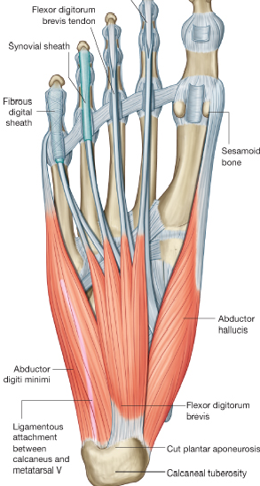
MUSCLES IN THE SOLE
The muscles in the sole of the foot are organized into four layers
The plantar muscles maintain the arches of the foot
They also refine further the efforts of the long muscles, producing supination and pronation in enabling the foot to adjust to uneven ground

Slide 46
FIRST LAYER
There are three components in the first layer of muscles
From medial to lateral, these muscles are
abductor hallucis,
flexor digitorum brevis, and
abductor digiti minimi.

Slide 47
Muscles in the first layer of the sole
Muscle | Proximal attachment | Distal attachment | Innervation | action
Abductor hallucis | Medial process of calcaneus | base of proximal phalanx of great toe | Medial plantar nerve | Abducts and flexes great toe at metatarsophalangeal joint
Flexor digitorum brevis | Medial process of calcaneus and plantar aponeurosis | middle phalanges of lateral four toes | Medial plantar nerve | Flexes lateral four toes at proximal interphalangeal joint
Abductor digiti minimi | Lateral and medial processes of calcaneus and Plantar aponeurosis | base of proximal phalanx of little toe | Lateral plantar nerve | Abducts little toe at the metatarsophalangeal joint

Slide 48
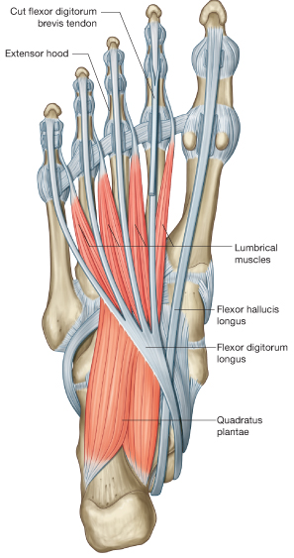
SECOND LAYER
Consists of the
Quadratus plantae and
Four lumbrical muscles

Slide 49
Muscles in the second layer of the sole
Muscles | Proximal attachment | Distal attachment | innervation | action
Quadratus plantae | Medial and lateral surface of calcaneus | tendon of flexor digitorum longus | Lateral plantar nerve | Assists flexor digitorum longus tendon in flexing toes II to V
Lumbricals | tendon of flexor digitorum longus | extensor expansion of toes II to V | First lumbrical-medial plantar nerve 2nd , 3rd and 4th lumbricals-lateral plantar nerve | Flexion of metatarsophalangeal joint and extension of interphalangeal joints

Slide 50
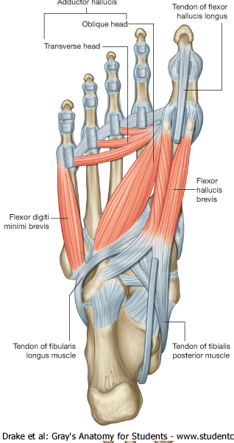
THIRD LAYER
Three muscles
Flexor hallucis brevis
    Arise fro cuboid and lateral cuneiform and insert in to base of proximal phalanx of the great toe
Adductor hallucis
    Extend from metatarsals bones 2-4 to base of proximal phalanx of great toe
Flexor digiti minimi brevis
  Extend from metatarsals bone 5th to base of proximal phalanx of little toe
All are innervated by Lateral plantar nerve except FHB(m.plantar)
They are adductor and flexor of the respective digits

Slide 51
Muscles in the third layer of the sole
Muscle | Proximal attachment | Distal attachment | Innervation | action
Flexor hallucis brevis | Plantar surface of cuboid and lateral cuneiform | Both sides of base of proximal phalanx of the great toe | Medial plantar nerve | Flexes metatar-sophalangeal joint of the great toe
Adductor hallucis | oblique head- bases of metatarsals 2-4 Transverse head-ligaments of metatarsophalangeal joints | Lateral side of base of proximal phalanx of great toe | Lateral plantar nerve | Adducts great toe at metatarsopha-langeal joint
Flexor digiti minimi brevis | Base of metatarsal V and related sheath of fibularis longus tendon | base of proximal phalanx of little toe | Lateral plantar nerve | Flexes little toe at metatarsophalangeal joint

Slide 52
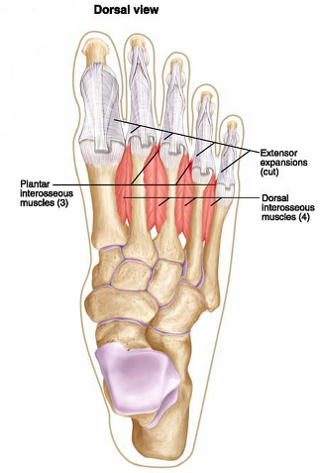
FOURTH LAYER
The dorsal interossei
    Extend from Sides of adjacent metatarsals to bases of proximal phalanges of toes II to IV
    Are abductor and flexor of 2-4 toes
    Are innervated by Lateral plantar nerve

Slide 53
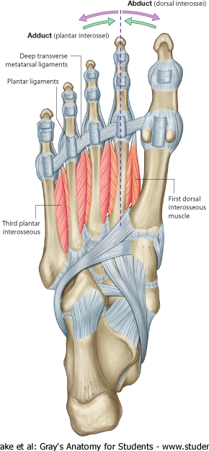
FOURTH LAYER cont…
Plantar interossei-3
    Extend from medial Sides of adjacent 3-5 metatarsals to bases of proximal phalanges of 3-5 toes
Are adductor and flexor of 3-5 toes
Are innervated by Lateral plantar nerve

Slide 54
Muscles in the fourth layer of the sole
Muscles | Proximal attachment | Distal attachment | innervation | action
Dorsal interossei | Sides of adjacent metatarsals | Dorsal expansions and bases of proximal phalanges of toes II to IV | Lateral plantar nerve | Abduction of toes II to IV Flex metatarsophalangeal joint
Plantar interossei | Medial sides of metatarsals of toes III toV | Dorsal expansions and bases of proximal phalanges of toes III to V | Lateral plantar nerve | Adduction of toes III to V Flex the metatarsophalangeal joint

Slide 55
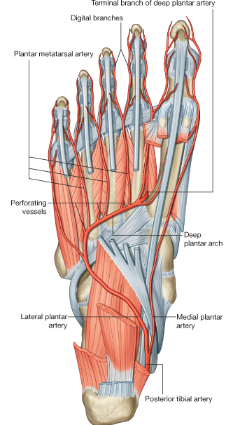
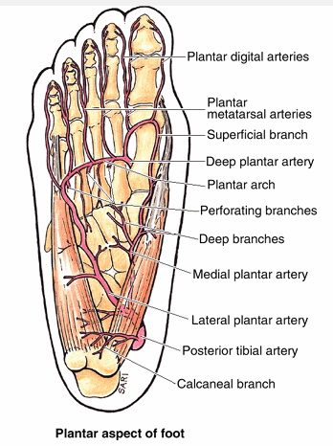
ARTERIES OF THE FOOT
Blood supply to the foot is by branches of the posterior tibial and dorsalis pedis (dorsal artery of the foot) arteries.
The posterior tibial artery enters the sole and bifurcates into lateral and medial plantar arteries.
The lateral plantar artery joins with the terminal end of the dorsalis pedis artery (the deep plantar artery) to form the deep plantar arch.

Slide 56
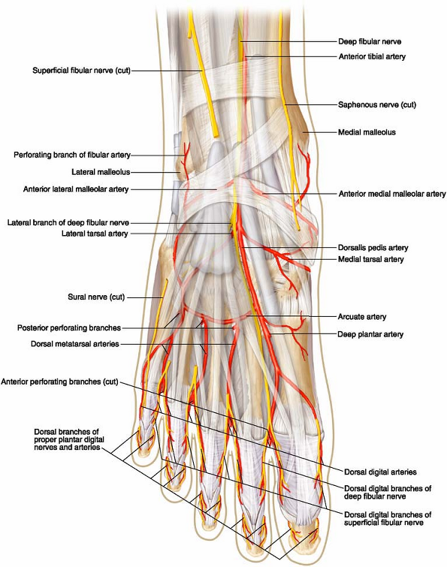
ARTERIES OF THE FOOT
The dorsalis pedis artery is the continuation of the anterior tibial artery, passes on the dorsal aspect of the foot and then inferiorly, as the deep plantar artery, between metatarsals I and II to enter the sole of the foot.
Branches of the dorsalis pedis artery include lateral and medial tarsal branches, an arcuate artery, and a first dorsal metatarsal artery.

Slide 57
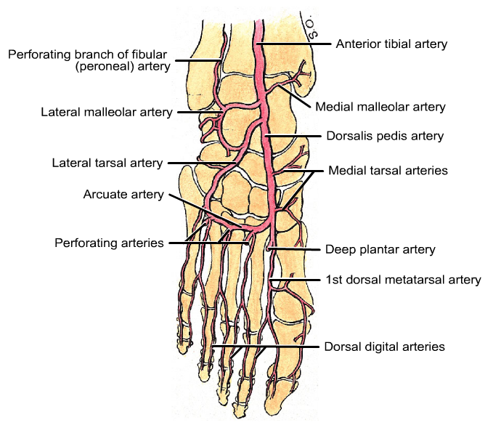

Slide 58

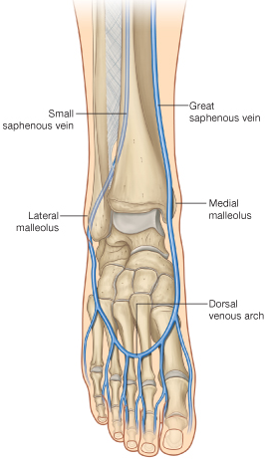
VEINS OF THE FOOT
There are interconnected networks of deep and superficial veins in the foot.
The deep veins follow the arteries.
Superficial veins drain into a dorsal venous arch
The great saphenous vein originates from the medial side of the arch and passes anterior to the medial malleolus and onto the medial side of the leg;
The small saphenous vein originates from the lateral side of the arch and passes posterior to the lateral malleolus and onto the back of the leg.

Slide 59
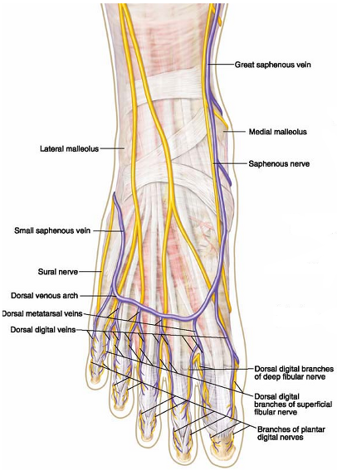
NERVES OF THE FOOT
The foot is supplied by the
Tibial
Deep fibular
Superficial fibular
Sural ( origin from tibial and common peroneal)and
Saphenous nerves(origin from femoral)

Slide 60

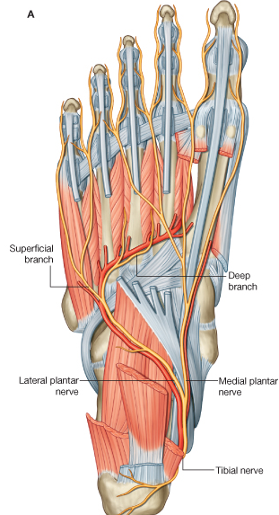
NERVES OF THE FOOT
Tibial nerve
Midway between the medial malleolus and the heel, the tibial nerve bifurcates with the posterior tibial artery into:
large medial plantar nerve;
a smaller lateral plantar nerve

Slide 61
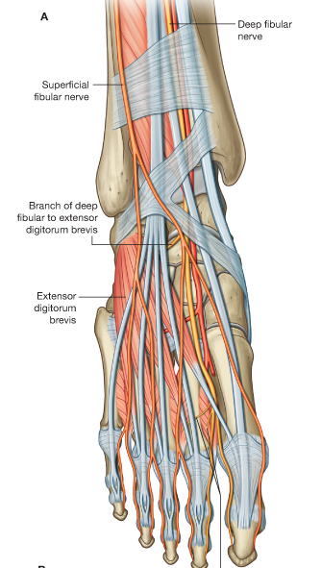
NERVES OF THE FOOT
The deep fibular nerve innervates :
extensor digitorum brevis & extensor hallucis brevis, and
supplies general sensory branches to the skin on the adjacent dorsal sides of the first and second toes and to the web space between them.

Slide 62
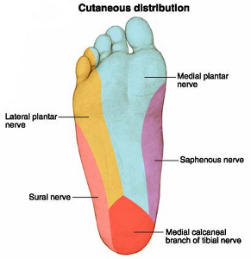
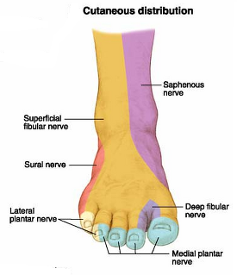
Cutaneous innervation of the foot

Slide 63
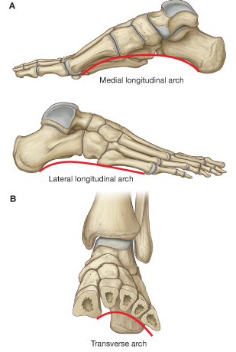
ARCHES OF THE FOOT
The bones of the foot do not lie in a horizontal plane.
There are longitudinal and transverse arches which absorb and distribute downward forces from the body during standing and moving on different surfaces

Slide 64
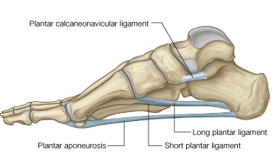
THE LONGITUDINAL ARCH
The longitudinal arch is formed between the posterior end of the calcaneus and the heads of the metatarsals
It is highest on the medial side and lowest on the lateral side

Slide 65
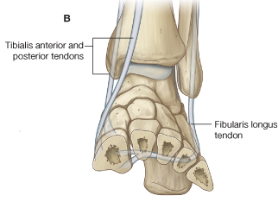
THE TRANSVERSE ARCH
is highest in a coronal plane that cuts through the head of the talus
Disappears near the heads of the metatarsals where these bones are held together by the deep transverse metatarsal ligaments

Slide 66
SUPPORTS OF THE ARCH
Ligaments and muscles support the arches of the foot
ligaments that support the arches include
plantar calcaneonavicular
plantar calcaneocuboid
long plantar ligaments
the plantar aponeurosis
Muscles that provide dynamic support for the arches during walking include
the tibialis anterior and posterior, and
the fibularis longus

Slide 67
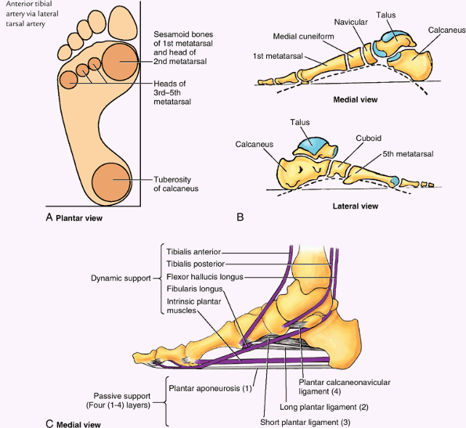

Slide 68
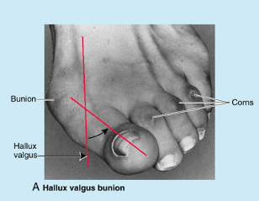
Hallux Valgus
is a foot deformity caused by pressure from footwear and degenerative joint disease; it is characterized by lateral deviation of the great toe.

Slide 69
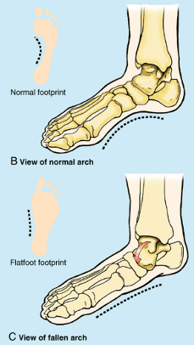
Pes Planus (Flatfeet)
Acquired flatfeet are likely to be secondary to dysfunction of the tibialis posterior owing to trauma, degeneration with age, or denervation

Slide 70
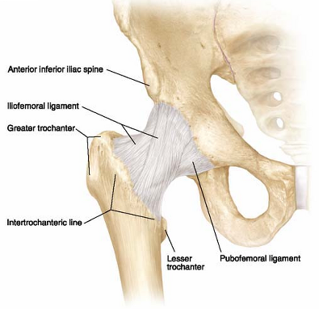
JOINTS OF THE LOWER LIMB
HIP JOINT
It is a strong, largest and stable multiaxial ball and socket type of synovial joint
Articular Surfaces
The head of the femur articulates with the cup-like acetabulum of the hip bone
Joint capsule
  attached proximally to the margins of the acetabulum and to the transverse acetabular ligament
  Distally, it is attached to the femoral neck
The hip joint is reinforced
Anteriorly and superiorly by the strong Y-shaped iliofemoral ligament :- prevents hyperextension of the hip joint during standing
Inferiorly and anteriorly by the pubofemoral ligament
Posteriorly by the weak ischiofemoral ligament

Slide 71

Blood supply of the hip joint
  Medial and Lateral femoral circumflex artery
  Obturator artery
  Inferior gluteal artery

Slide 72
Nerve supply of the hip joint
  Femoral nerve (by the branch to rectus femoris)
  Obturator nerve
  Nerve to quadratus femoris
  Superior gluteal nerve
Movements of the hip joint
  Flexion
  Extension
  Abduction
  Adduction
  Medial and lateral rotation
  Circumduction

Slide 73


Slide 74

JOINTS CONT…
2.KNEE JOINT
Hinge type of synovial joint
Movement:- flexion and extension
The articular surfaces
three articulations:
Two femorotibial articulations, between the lateral and the medial femoral and tibial condyles
One intermediate femoropatellar articulation between the patella and the femur

Slide 75

Ligaments of the knee
  Tibial (medial) collateral ligament
  Fibular (lateral) collateral ligament
  Anterior cruciate ligament
  Posterior cruciate ligament
  Patellar ligament

Slide 76


Slide 77

Blood supply of the knee joint
  Vessels form genicular anastomosis around the knee
  Genicular branches of
    Popliteal artery
    Femoral artery
    Anterior tibial recurrent artery
    Circumflex fibular artery
The nerve supply
  Articular branches from
    Femoral
    Tibial
    Common fibular
    Saphenous

Slide 78

JOINTS CONT…
3 THE ANKLE JOINT
Hinge synovial joint
Articulation:- talus with distal end of tibia and fibula
Movements :- dorsiflexion and plantarflexion of the foot

Slide 79

Ligaments of the ankle
Lateral ligament
  Anterior talofibular ligament
  Posterior talofibular ligament
  Calcanofibular ligament
Medial ligament
Blood supply
  Anterior and posterior tibial arteries
Nerve supply
  derived from the deep peroneal and tibial nerves

Slide 80


Slide 81
Peripheral pulses in the lower limb
Femoral pulse in the femoral triangle-femoral artery
Popliteal pulse in the popliteal fossa-popliteal artery
Posterior tibial pulse in the 'tarsal tunnel'-posterior tibial artery
Dorsalis pedis pulse on the dorsal aspect of the foot-dorsalis pedis artery

