Slide 1
IN791 presentation
Exploration of keystroke patterns
Sohhom Bandyopadhyay (15510011)
Supervisor:
Prof. Krishna Prasad Miyapuram
27 Nov 2018

Slide 2
Why explore patterns in keystrokes?
Cheap, unobtrusive to implement and collect
Reveal patterns of sequence learning and visuomotor commands
Diagnose diseases (Parkinson’s)

Slide 3
Datasets
Names:
From my MSc thesis demo
Each participant typed their name 20 times
Backspace and other edits were not allowed
Gun control essays:
Publicly released with (Banerjee et. al 2014)
Free form essay composition, then transcribe the same text
No restrictions on editing etc.
Minimum 100 words per participant
Internet (Amazon Mechanical Turk) based
Data format (both datasets):
Timestamp EventType KeyCode;
e.g.
2310 KeyDown 83;2366 KeyUp 83;2406 KeyDown 79;2486 KeyUp 79
To represent:
so
Banerjee, R., Feng, S., Kang, J. S., & Choi, Y. (2014). Keystroke patterns as prosody in digital writings: A case study with deceptive reviews and essays. In Proceedings of the 2014 Conference on Empirical Methods in Natural Language Processing (EMNLP) (pp. 1469-1473).

Slide 4
Tools
Hierarchical clustering
X means clustering
Kernel density estimation

Slide 5
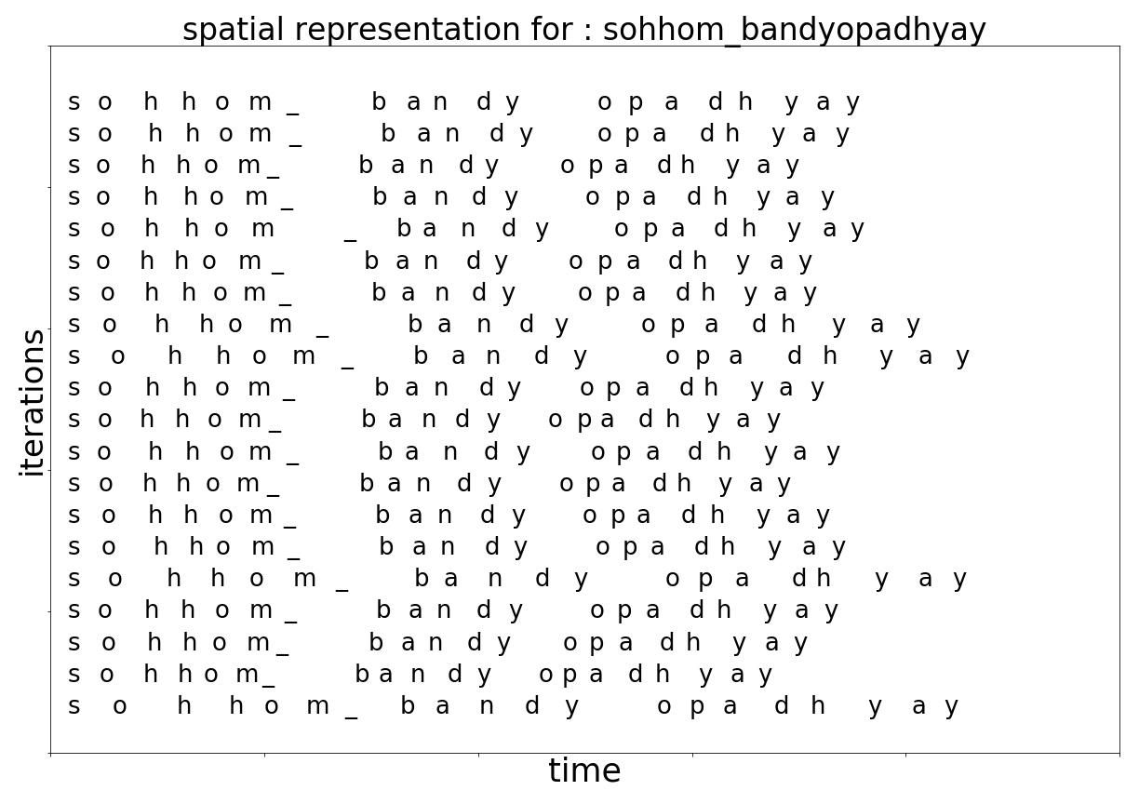
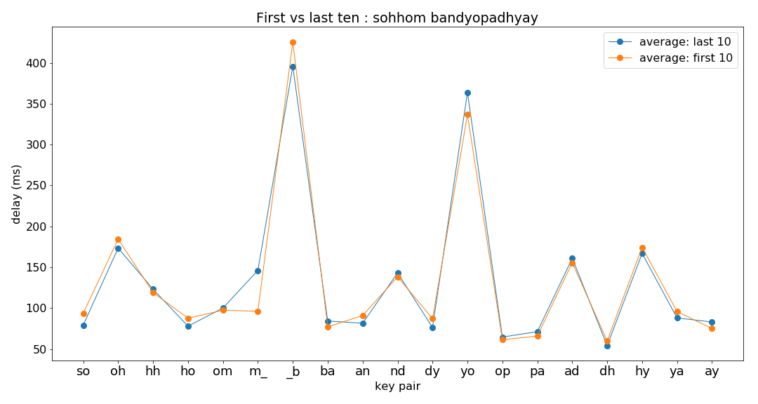
Names: Basic exploration

Slide 6
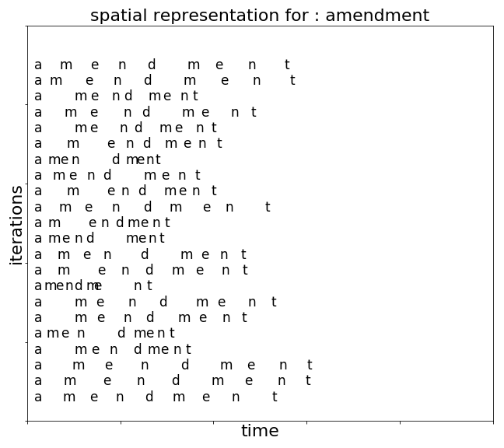
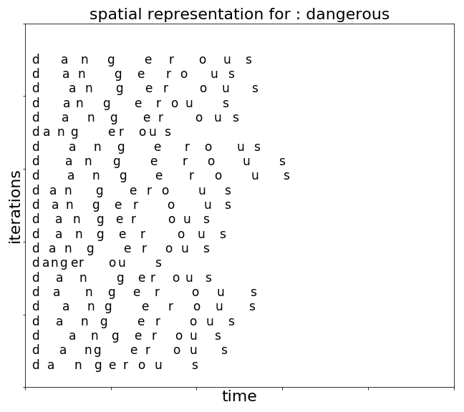
Guncontrol: Basic exploration

Slide 7
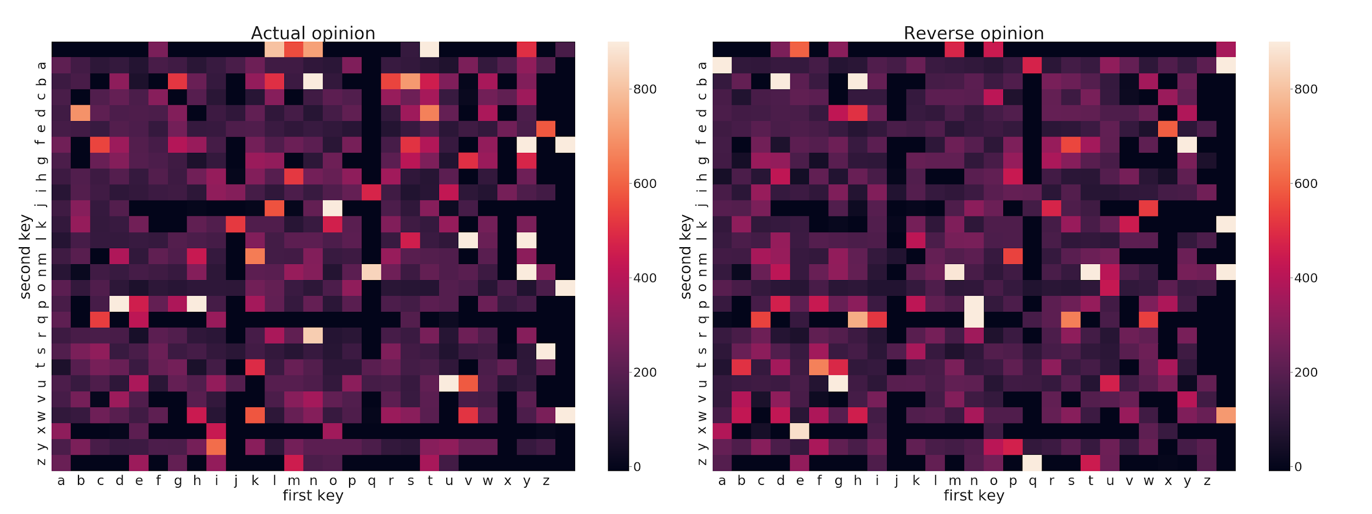
Guncontrol: Basic exploration

Slide 8
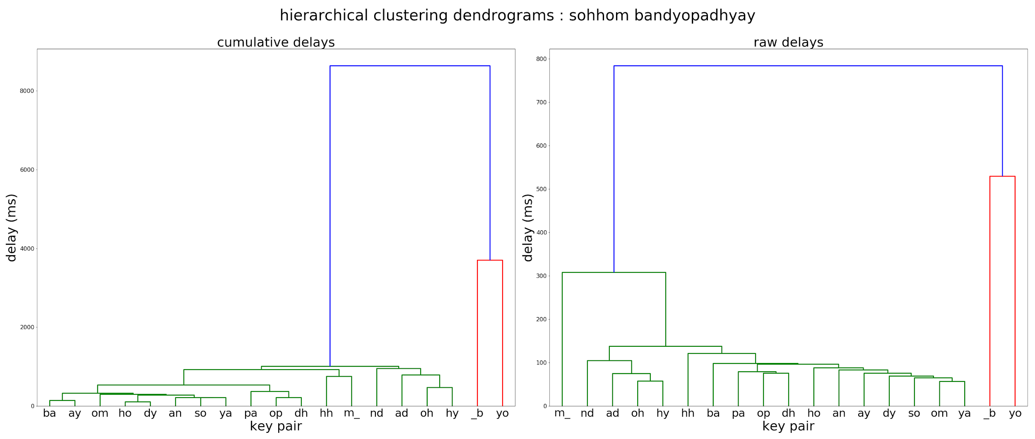
Names: Hierarchical clustering

Slide 9
Guncontrol: hierarchical clustering

Slide 10
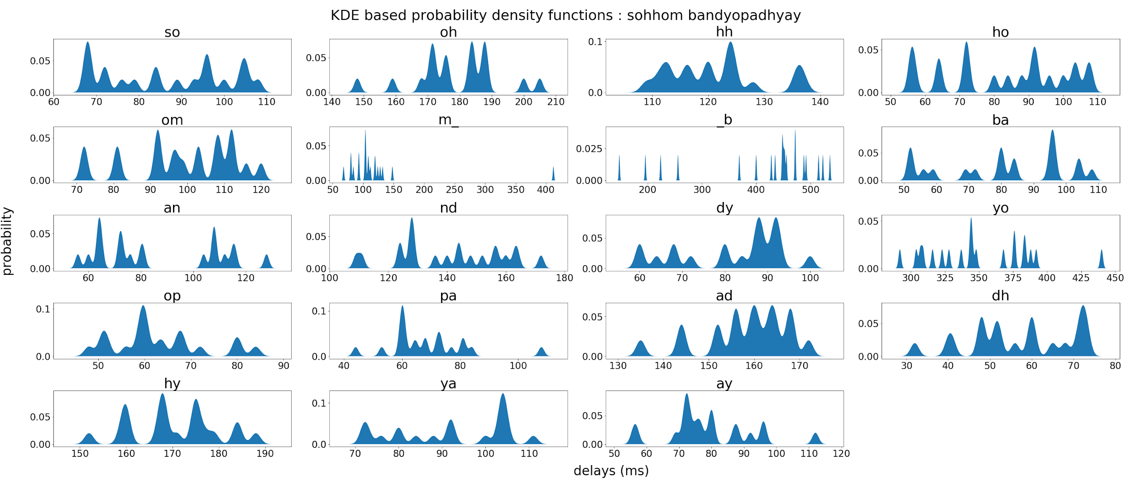
Names: KDE based PDF

Slide 11
Guncontrol: clustering users (x-means)

Slide 12
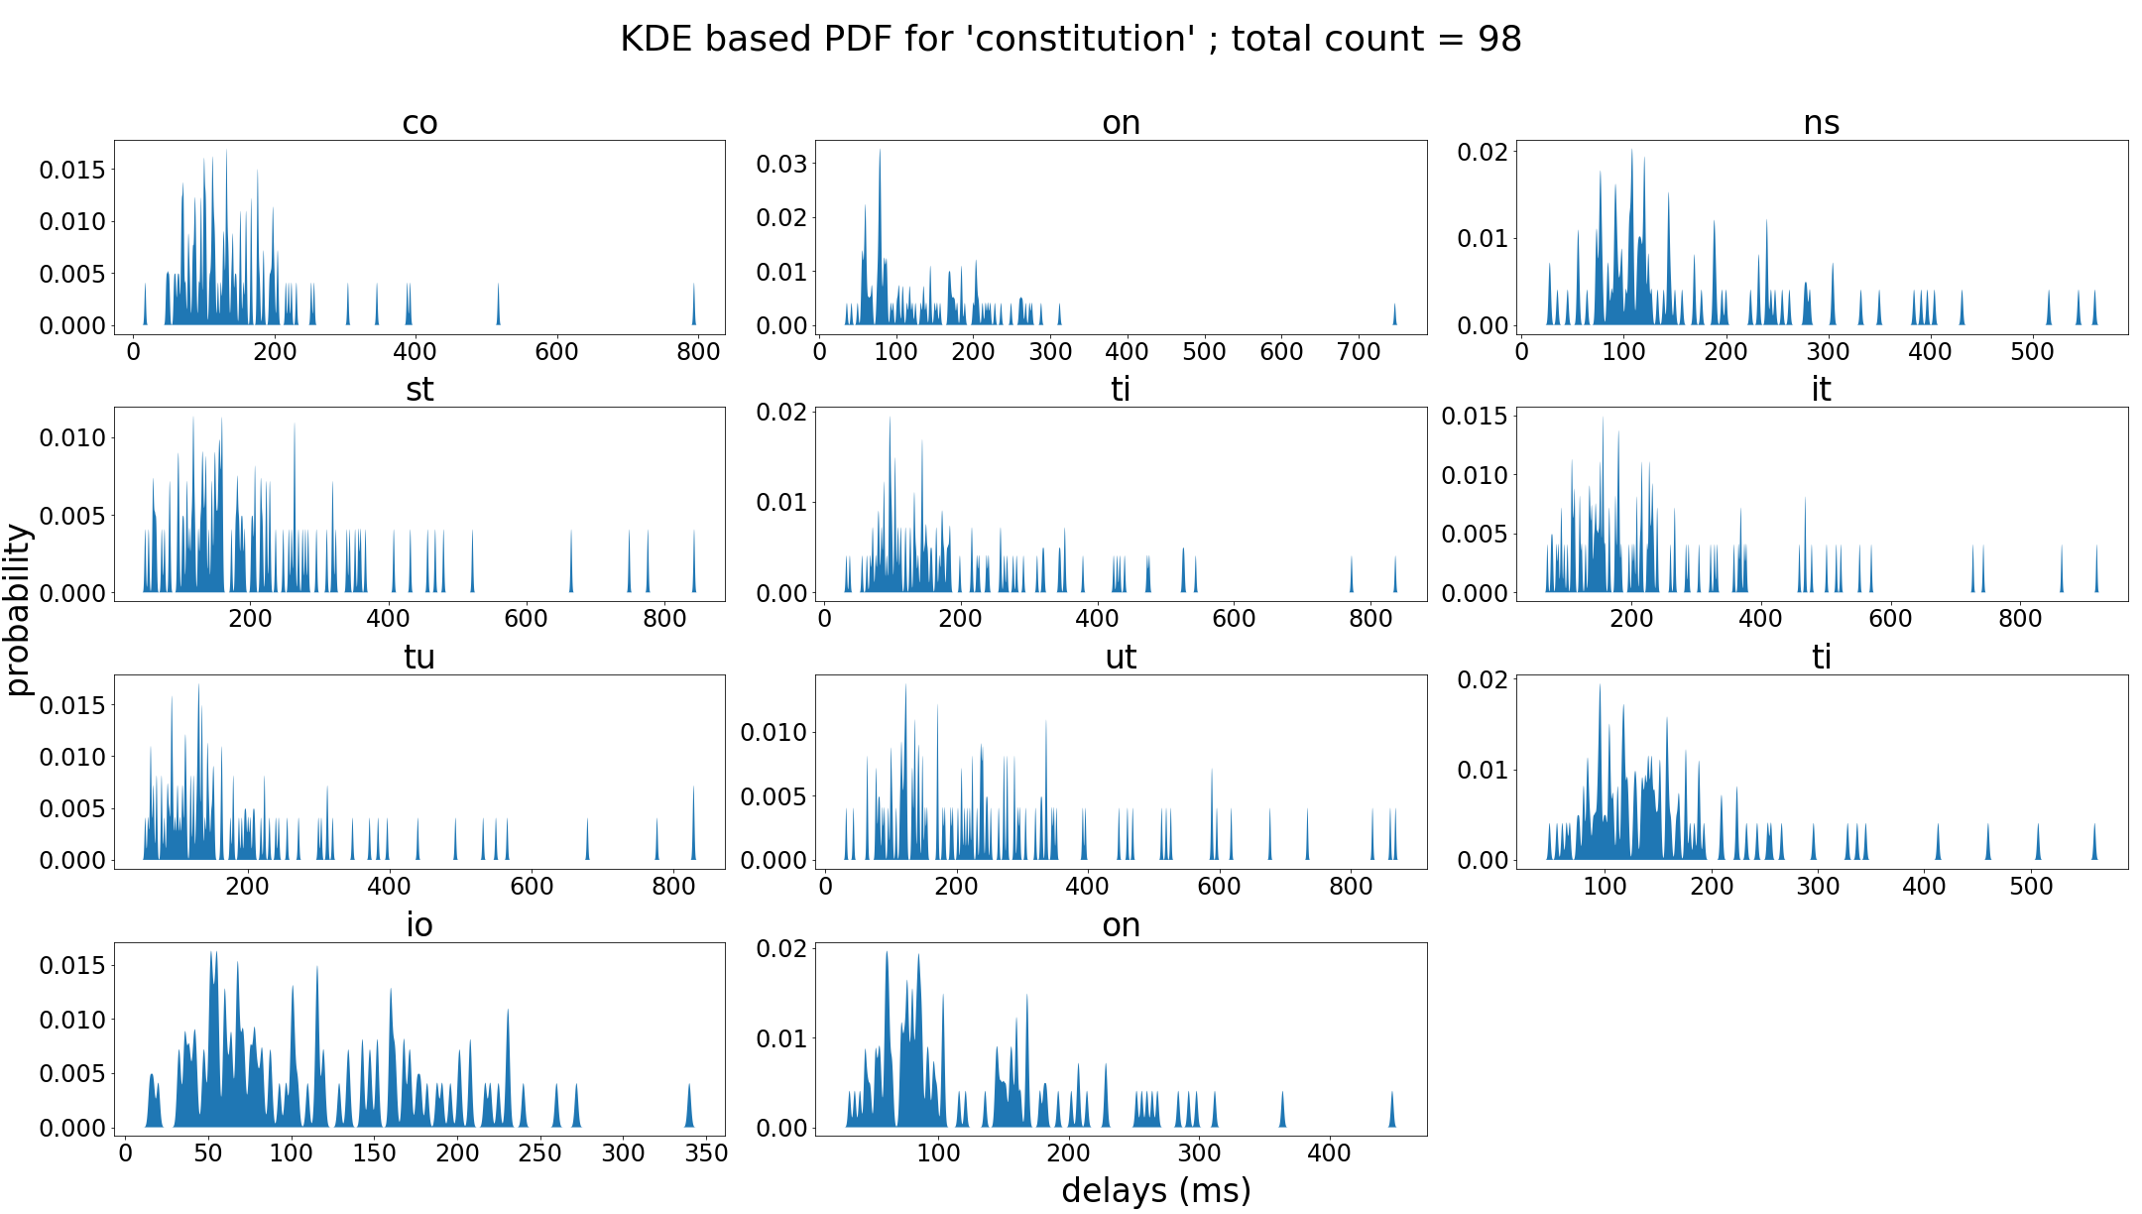
Guncontrol: KDE based PDF

Slide 13
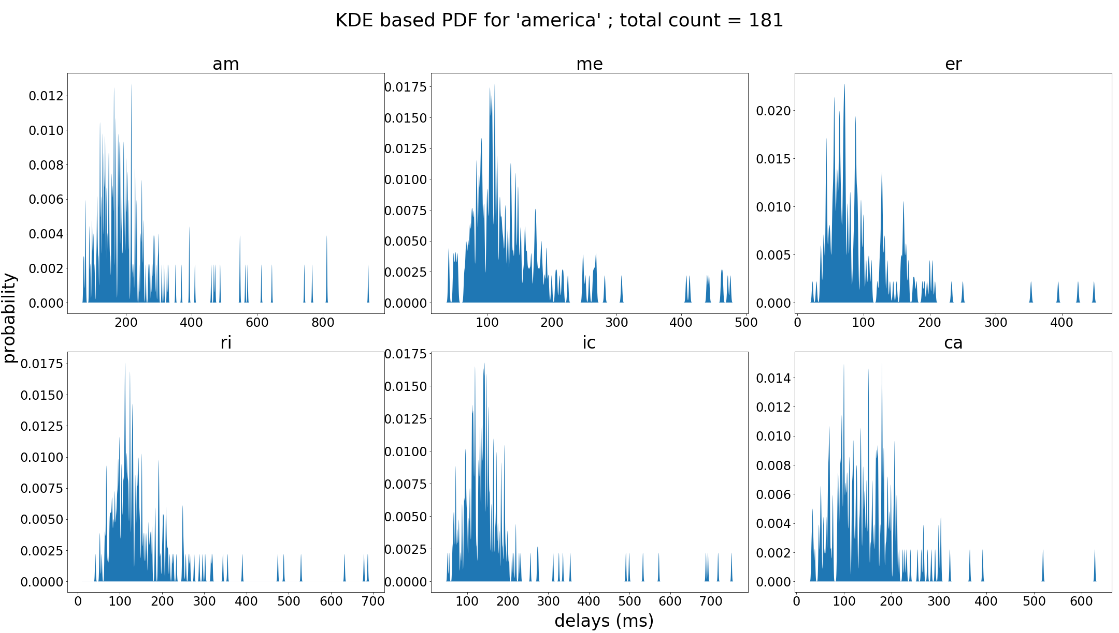
Guncontrol: KDE based PDF

Slide 14
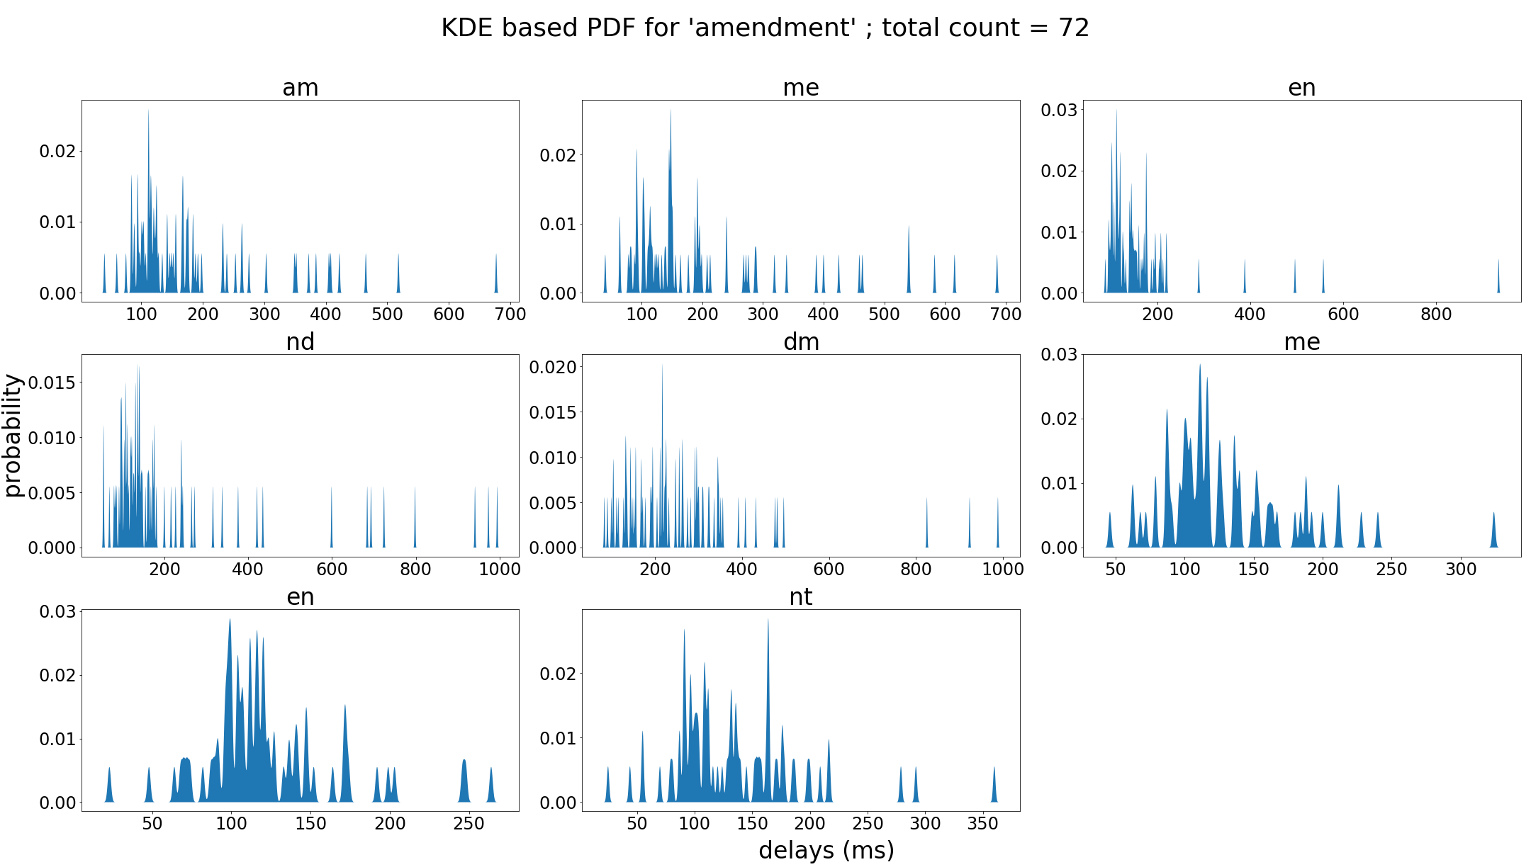
Guncontrol: KDE based PDF

Slide 15
Future work

Slide 16
Thank You
Questions??

