Slide 1
Financial Sentiment Analysis
with RNN+LSTM
Alan Wang
W266 Final Project
Dec. 2016

Slide 2
Goals (other than beating the Wall Street…)
New York Times annotated corpus (LCD2008T19)
Testing stock trends as a sentiment measurement
Applying RNN/LSTM (~Assignment 1/Part 2)

Slide 3
The Annotated New York Times Corpus (LCD2008T19)
01/01/1987 to 06/18/2007 (over 20 years)
1.8M overall articles in xml format by yy/mm/dd
1.5M articles manually tagged w/ organizations, etc.
275K of it algorithmically-tagged and hand verified

Slide 4
Data Preprocessing
Annotated NYT
1.8M xml articles
SP500 Mentioned
400K articles
SP500 Mentioned
130K sentences
Trend-Labeled
130K sentences
sp500
nltk
kibot

Slide 5
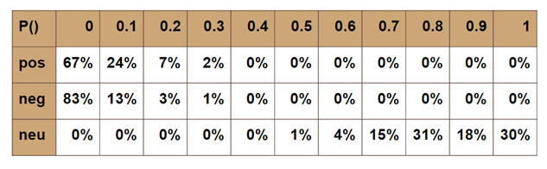
Challenges
Domain: Financial articles deviate from general opinion
  Lexicons: significantly different from general English
  Nltk.vader on these 130,051 sentences:
Model: RNN/LSTM

Slide 6
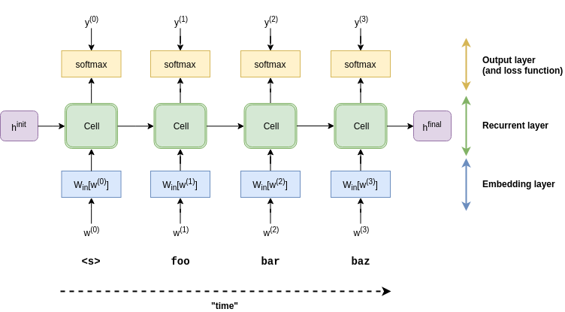
Model 1 => “brute-force” RNN/LSTM Approach
P P P P

Slide 7
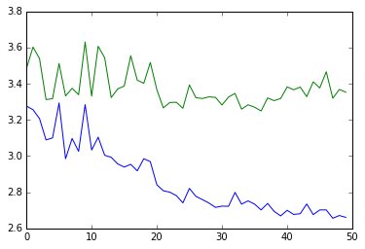
Model 1 Results & Issues
With 130K sents (p,n,0), V=1000, Z=3, H=100, epoch = 50
{'0': 333, 'n': 62551, 'p': 67167}
Issues
  Test doesn’t seem to converge, overfitting?
  Scoring is an ‘interesting’ issue to be addressed
  Not sure what is exactly being ‘learned’
Areas to improve:
  Annotation - labeling tends to be unrelated to ‘sentiments’
  Long-shot model

Slide 8
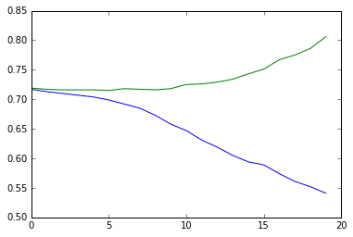
Model 2 => “2-step” RNN/LSTM Approach
To improve the ‘quality’ of the sentiment scoring, tried the following
First, redefined the ‘vader’ polarity, and declare a sentence is ‘p’ as long as the vader-pos > vader-neg. Is ‘n’ as long as the neg > pos. Otherwise it is ‘0’.
Declare a ‘p’ for a sentence only if it is a ‘p’ from the stock trend and a ‘p’ from the vader. A ‘n’ if it is both ‘n’ from the trend and vader. Otherwise, it is ‘0’
End up with {'0': 83584, 'n': 14869, 'p': 31598}

Slide 9
Model 3 => Applying LMs for Sentiment Analysis
Start with two exclusive doc sets: pos and neg
Each to train an independent LM as p-LM and n-LM
After training, use test docs from each set to cross test the other for ‘calibration’, ending with a comfortable threshold t
When a new doc comes in, score it in both p-LM and n-LM
Predict polarity with the higher score, if the diff > t
hot_train=24,000, hot_test= 7,598, not_train= 11,000, Not_test = 3,869
  average not_for_not: -196.691923093
  average not_for_hot: -203.287779757
  average hot_for_not: -192.209787729
  average hot_for_hot: -186.912382692
Pos Docs
Neg Docs
p-LM
n-LM
New Doc

Slide 10
Conclusion & Future work
Financial Analysts do write report with their target price. (then IMDB)
Hold financial analysts responsible for their words
ML crowdsourced market analysis
LMs approach is good in that no further annotation is actually needed. (SP500 or not).
LMs may have many potential NLP applications:
  Classification
  Cross-examination for cheating
  Cross-domain text generation

