Slide 1

A library of functions “à la OpenCV” (or IPL)
Written in ANSI C (not C++)
Freely available on sourceforge.net
http://camellia.sourceforge.net (BSD License)
Stable !!! (fully checked with valgrind)
Developed within the Camellia E.U. funded project by Ecole des Mines de Paris
A basis for a hardware implementation
(the Philips Camellia chip)
Notes:
11

Slide 2
CamelliaLib
Fully inter operable with OpenCV, though easier to use. Compatible with ^{RT}Maps
Object-oriented interface when using C++.
Full interface to Ruby, a nice scripting language, including garbage collection and exception support.
Support for 1-bit and 8-bits to 16-bits depth images, and RLE (Run-Length Encoded) images.
Support for in-place processing, Region of Interest (ROI) and bit masking in most functions.
Can be easily compiled on any 32-bits or 64-bits platform with a ANSI C compiler.
Notes:
11

Slide 3
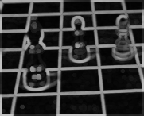
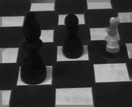
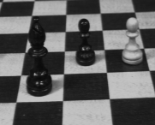
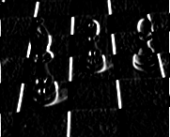
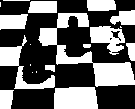
CamelliaLib : what’s inside ?
Classical image processing algorithms :
  Linear filtering, median filtering
  Morphological operations
  Arithmetics
Clean implementations
  ROI (Region of Interest) support
  In-place processing
  Smart optimizations (CamErodeCircle7) :
// Transfer data from right to left
valX[0]=tabX[0];
tabX[0]=tabX[1+(tabX[2] XOP tabX[1])];
tabX[1]=tabX[3];
tabX[2]=linesPtr[0][i+4];
tabX[3]=linesPtr[6][i+4];
tabX[2]=tabX[2+(tabX[3] XOP tabX[2])];
tabX[3]=tabX[4+(tabX[5] XOP tabX[4])];
tabX[4]=tabX[6];
tabX[5]=linesPtr[1][i+5];
tabX[6]=linesPtr[5][i+5];
tabX[5]=tabX[5+(tabX[6] XOP tabX[5])];
tabX[6]=tabX[7];
Notes:
11

Slide 4
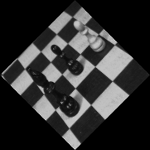
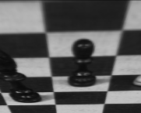

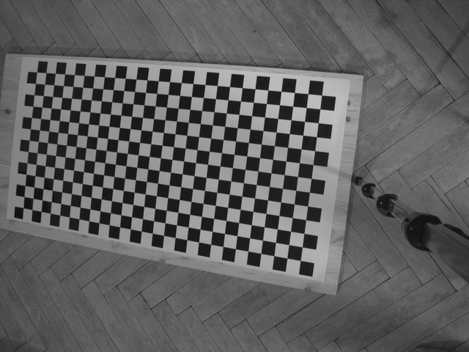

CamelliaLib: : what’s inside ?
Less common algorithms :
  Warping, Rotation, Scaling
  Distortion correction
Notes:
11

Slide 5
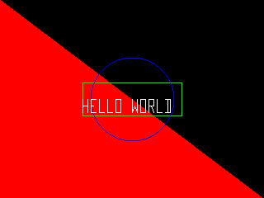
CamelliaLib : what’s inside ?
Nice utility functions :
  Loading/saving images
  Fast RGB/YUV conversion routines
  Line/Circle/Text drawing functions
Unique algorithms (not in OpenCV) :
  Hierarchical Watershed
  RLE (Run Length Encoded) images
    Labeling and sophisticated Blob Analysis
    Erosion/dilation on RLE Images (x7 speed-up)
  Projection / Retroprojection with constraints
    Compatible with Matlab Calibration Toolbox
  3DRS Motion Estimation (Optical Flow)
    Very fast. MMX optimized.
Notes:
11

Slide 6
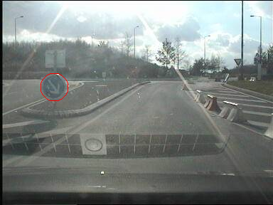
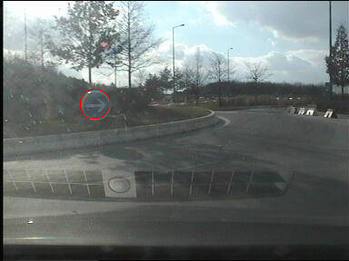
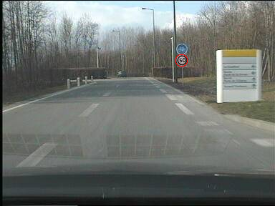
CamelliaLib : what’s inside ?
Circle Hough :
Notes:
11

Slide 7
CamelliaLib vs OpenCV
Benchmark
  Where you learn that CamelliaLib behaves better…
  How is this possible ?
Compiled with Intel C++ Compiler
Linear filter 3x3 = 631us
Sobel Filter 3x3 = 234us
Sobel Filter OpenCV 3x3 = 234us
Circle7 erosion OpenCV = 2298us
Circle7 erosion = 1410us
Circle5 erosion OpenCV = 1179us
Circle5 erosion = 905us
Square3 erosion OpenCV = 268us
Square3 erosion = 357us
Thresholding = 163us
Circle7 erosion = 675us
Circle5 erosion = 643us
Square3 erosion = 416us
Compiled with Intel C++ Compiler
Undistort = 16970us
Undistort OpenCV = 20470us
Notes:
11

Slide 8
CamelliaLib vs OpenCV
CamelliaLib :
  + Simple to setup and use (C++ and Ruby interface)
  + Can be compiled on virtually any system (32 bits)
  + Supports several image formats (1, 8, 10 to 16 bits, RLE)
  Not as comprehensive as OpenCV
  No MMX/SSE2 optimizations
OpenCV :
  + The standard
  + Very comprehensive
  + Uses Intel SIMD extensions
  - Only supports 8 bits and 32-bits floating point images
  - Not easy to use (badly documented)
  - Missing important algorithms (no blob analysis…)
  - Reliability (crashes every so often)
Notes:
11

Slide 9
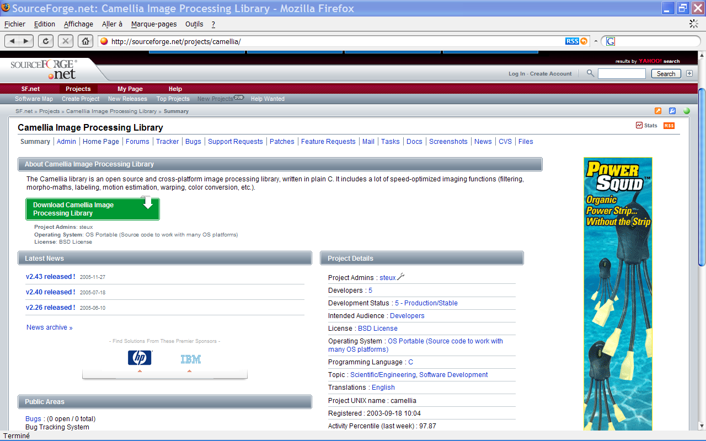
CamelliaLib on sourceforge.net
Notes:
11

Slide 10
Future developments
Better documentation (any volunteer?)
A Ruby GUI + a Ruby component on ^{RT}Maps
Stereovision algorithm (D. Demirdjian, MIT)
AdaBoost/GA ? Only detection ?
“Hardware Assisted” versions ?
Integrate OpenMorpho from CMM ?
But what the hell do you want ?
  Development on demand
  Participate !
Notes:
11

Slide 11

So what ?
A good add-on to OpenCV ?
Should we integrate the code as a contribution ?
A good advert for
Ecole des Mines ?
Downloaded 2300 times as of
May 2006.
A good way to capitalize on the low-level image processing algorithms developed in our labs
Notes:
11

