Slide 1
Efficient Anomaly Monitoring over Moving Object Trajectory Streams
Yingyi Bu (Microsoft)
joint work with
Lei Chen (HKUST) Ada Wai-Chee Fu (CUHK)
Dawei Liu (CUHK)

Slide 2
Outline
Introduction
Problem Statement
Batch Monitoring
Piecewise Index and Rescheduling
Experiments
Conclusion
Notes:
Here is the outline of this presentation
First, we will give an introduction on motivating examples and related problems
Second, we will propose our problem statement of monitoring anomalies over high speed stream time series
Third, we will introduce our solution by batch monitoring
Fourth, we will talk about using index structures to further speed up data processing
Fifth, we will demonstrate our experimental results
Finally, we will give the conclusion

Slide 3
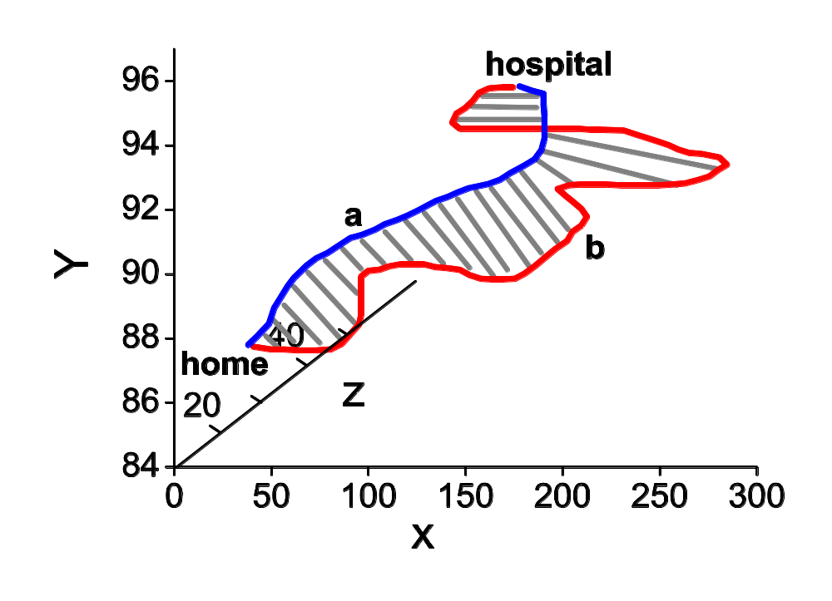
Motivating Example (1)
A strange trajectory!

Slide 4
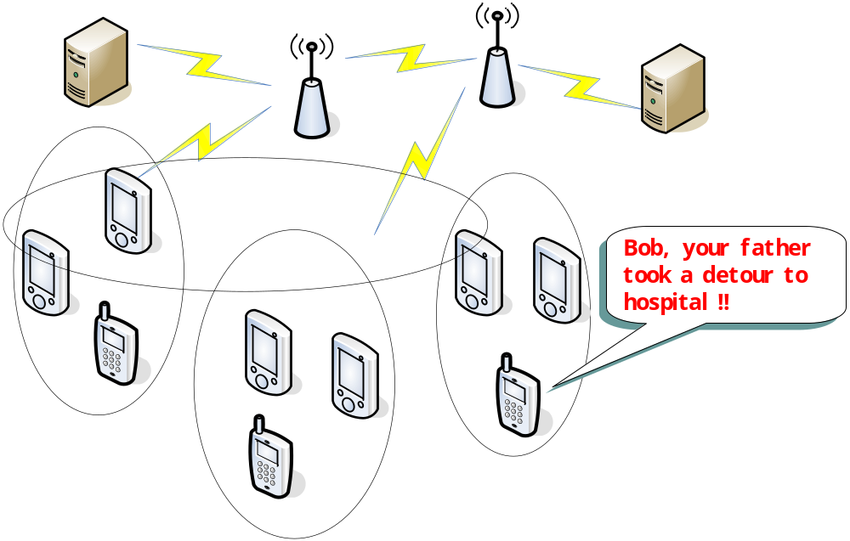
Motivating Example (2)

Slide 5
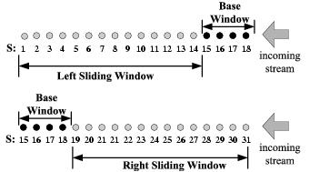
Problem Statement (1)
Base window – of length w_{b}
Left sliding window – of length w_{l}
Right sliding window – of length w_{r}
Detecting anomalies: look forward and backward
Notes:
Base window is a subsequence of the whole stream time series, which is of length wb
Left

Slide 6
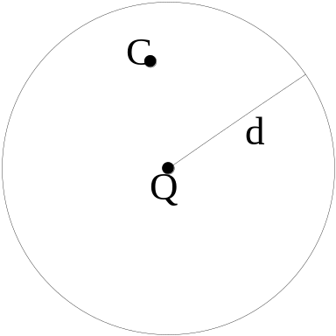
Problem Statement (2)
Distance between two base windows: Euclidean distance (to any metric)
Neighbor of Q: Distance (Q, C) < d
Trajecoty stream anomaly (for base window Q)
  N1: Q’s neighbor in its left sliding window
  N2: Q’s neighbor in its right sliding window
  If N1+N2<k, Q is anomaly
k and d are parameters
Problem: at every time tick, checking whether a base windows is an anomaly.

Slide 7
Simple Pruning: straight forward
For every anomaly candidate base window
  Randomly pick base windows, calculate distance
  Searching range is limited to its left and right sliding window
  Accumulate number of neighbors n
  When n≥k, stop (the candidate is certified to be non-anomaly)
Time cost
  E(Y) ≤ [k/F_{x}(d)]+ P_{a}N (Theorem 1) [Bay03]
    Y– number of distance computations
    P_{a}–anomaly rate
    F_{x}(d)—rate of points within distance range d to base window x
    N—sliding window length
  P_{a} is tiny, then E(Y) is not relevant to sliding window’s length
  Cost is still very high!

Slide 8
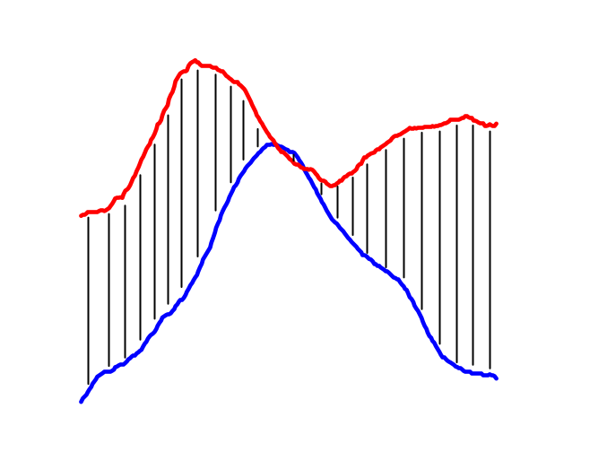
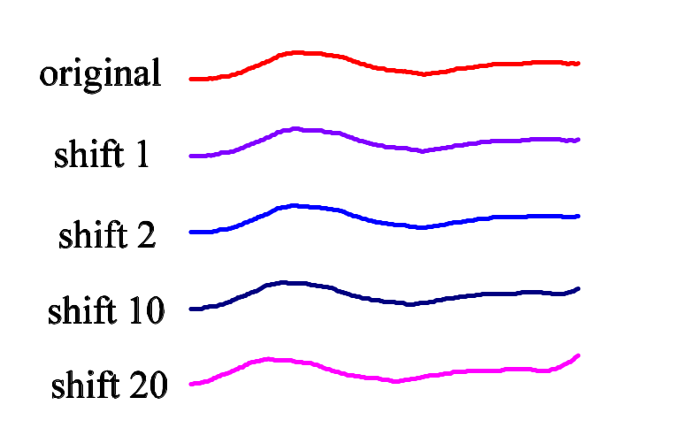
Can we prune some computations?
Temporally faraway base windows
Temporally close base windows
Observation
  Temporally close base windows usually are spatially close
  Local continuity exists in most trajectory data ☺
Hint
  Partition the stream and monitor by batch!

Slide 9

Local Clustering
Clustering Base Windows
  Temporally continuous (threshold m)
  Spatially close (threshold r)
Online Clustering Algorithm
  Incrementally decide whether a base window belong to previous local cluster or a new local cluster, upon its arrival

Slide 10
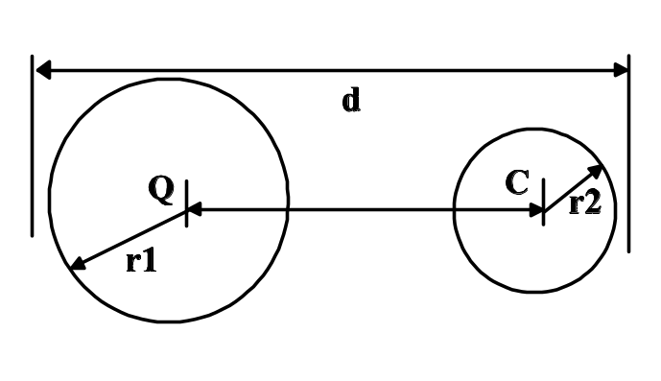
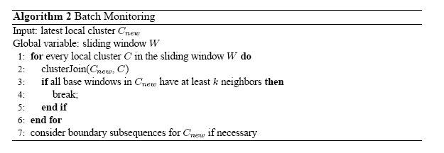
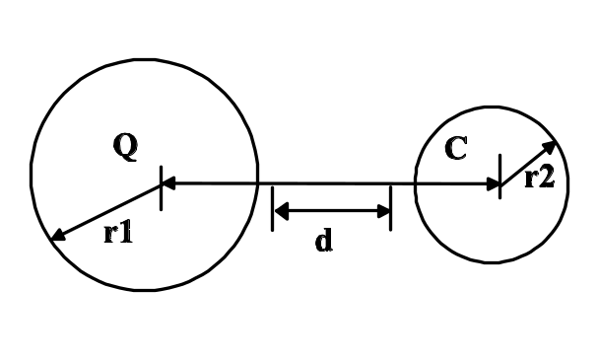
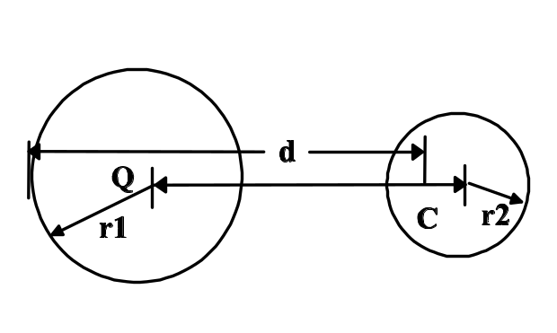
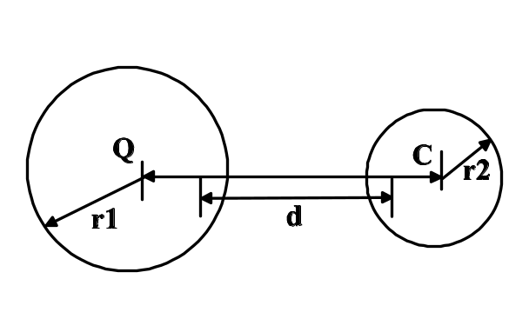
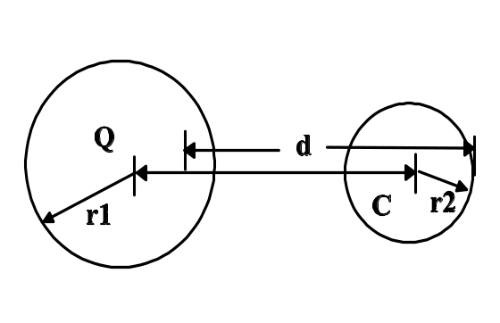
Batch Monitoring
One computation, Big growth!
Case 1
Case 2
Case 5
Case 3
Case 4

Slide 11
Further Improvement?
Sad fact: Most computations are for non-anomalies ☹
Not every cluster join is useful (e.g, “case 5”)
Always falling in “case 1” are DISIRED!
Measure the utility of cluster C for joining with Q
  Dist (C.centriod, Q.centriod) could be a good estimate of utility of C.
Bad!
Good!
Case 1
Case 5

Slide 12
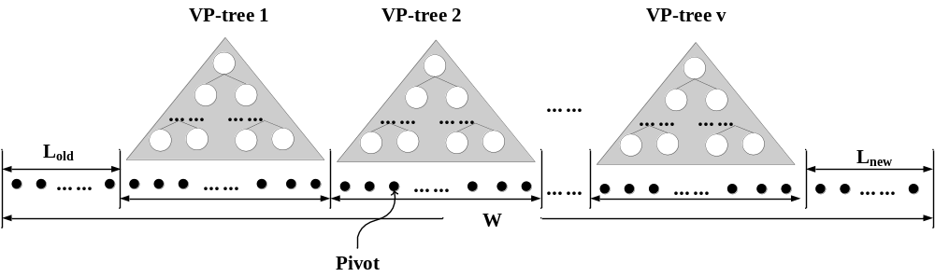
Index Clusters’ Pivots (centriods)
Single index: update cost!
No index: slow!
Trade off: piecewise VP-trees over trajectory streams
Benefit: efficient & zero update cost ☺

Slide 13
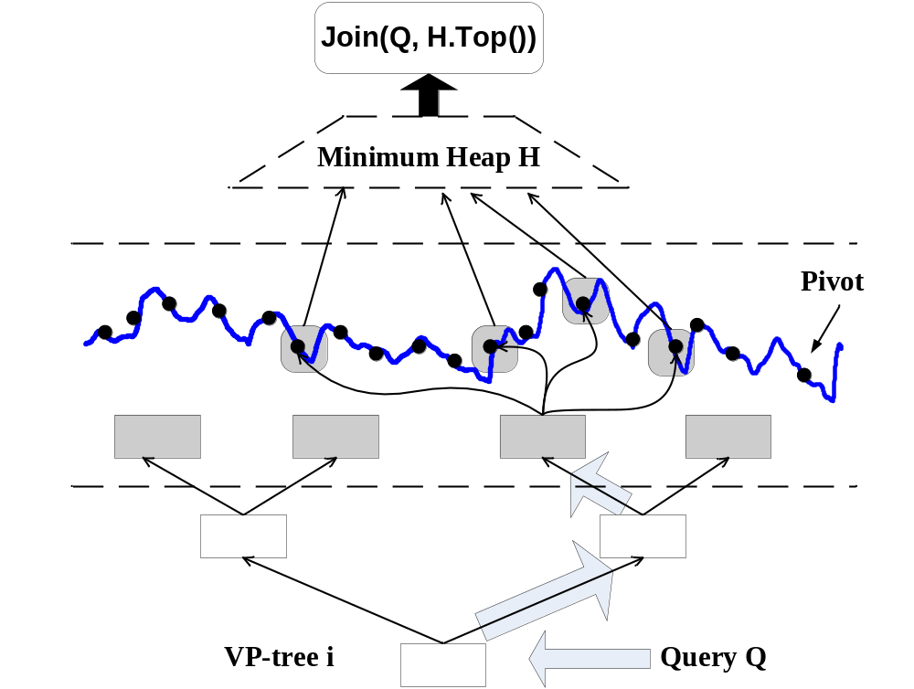

Rescheduling: stop earlier for non-anomalies!
Range query on a tree, with a larger range
Increase neighbor count more quickly!

Slide 14
Experiments
Datasets
  Real World: movement, GE stock
  Synthetic: random walk
  Link: http://www.cse.cuhk.edu.hk/~yybu/repository
Configurations
  Pentium IV 2.2GHz PC with 2GB RAM

Slide 15
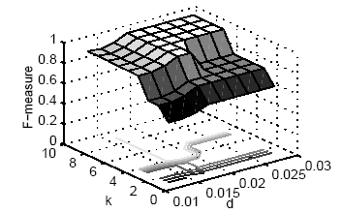
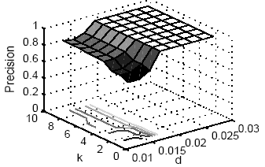
Effectiveness
Parameter k and d
F-measure Vs. (k, d)
F-measure Vs. (k, d)

Slide 16
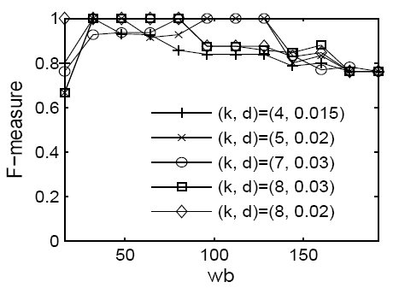
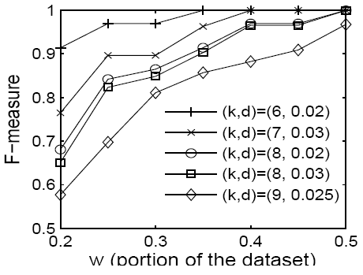


Parameters of w_{b} and W
Parameter setting: F-measure V.s. w_{b} and W
F-measure Vs. w_{b}
F-measure Vs. W

Slide 17
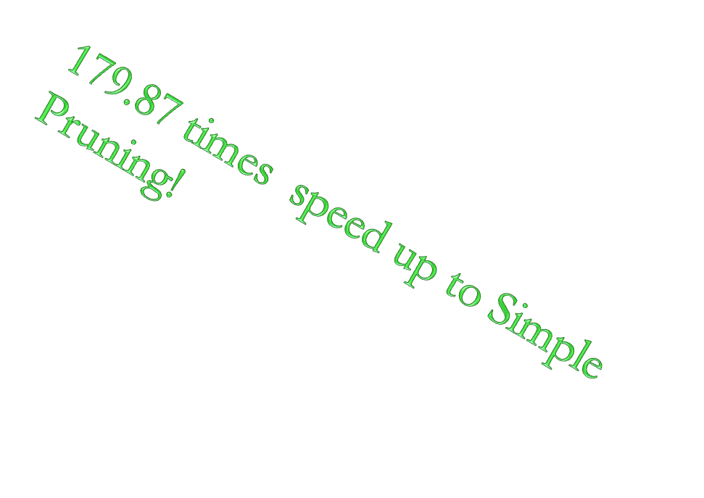

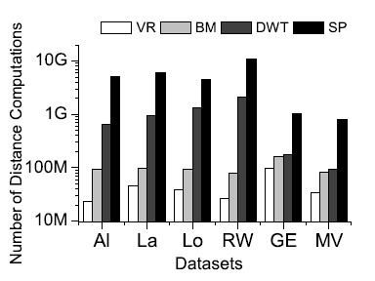
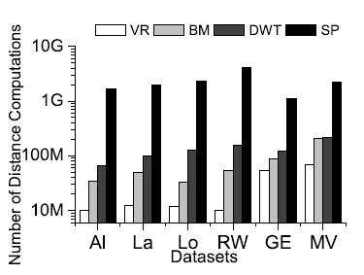
Experiments
Average pruning power V.s. (dataset, w_{b})
Peers: Simple Pruning and DWT
w_{b}= 128
w_{b}= 256

Slide 18


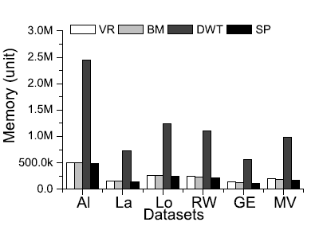
What about memory consumption?
Average memory cost
  Metric: unit (4 bytes)

Slide 19

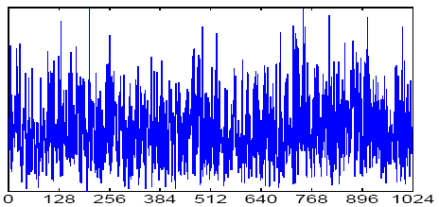
Discussions & Extensions
Local continuity
  Very important for almost any work on time series and trajectories
  DFT [Faloutsos94], DWT [Chan99], LB_Keogh [Keogh02] may encounter low pruning power without local continuity

Slide 20

Related Problems
Burst Detection [Zhu02]
  Could it capture general anomaly?
Discord Detection [Keogh05]
  Need global dataset
  Endless stream ?
Anomalies in traditional database
  K-d outlier [Knorr00]
  Density-based anomaly [Breunig00]
  Pruning by clustering [Tao06]
  Data are archived
Cannot apply on trajectory streams!
Notes:
A related problem is burst detection over time series,

Slide 21


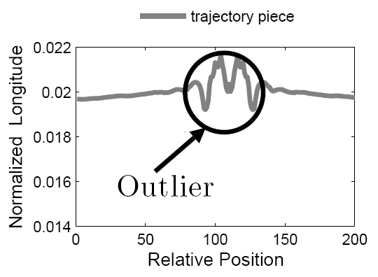
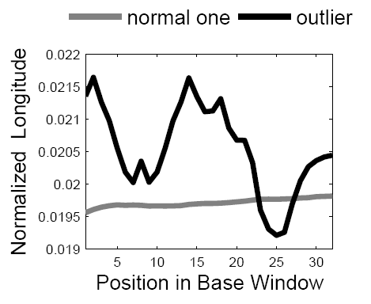


What kind of anomalies?
Visualized trajectory anomaly: from a GPS trajectory
Anomaly: A Detour
Zoomed Comparison

Slide 22
Conclusions
Frame the problem
Efficient monitoring by batch
Piecewise index
Experimental studies

Slide 23
Major references
[Zhu02] Yunyue Zhu, Dennis Shasha: StatStream: Statistical Monitoring of Thousands of Data Streams in Real Time. In VLDB, 2002.
[Keogh05] Eamonn J. Keogh, Jessica Lin, and AdaWai-Chee Fu. HOT SAX: Efficiently finding the most unusual time series subsequence. In ICDM, 2005.
[Knorr00] Edwin M. Knorr, Raymond T. Ng, and V.Tucakov. Distance-based anomalies: Algorithms and applications. In VLDB J., 2000.
[Breunig00] Markus M. Breunig, Hans-Peter Kriegel, Raymond T. Ng, Jörg Sander: LOF: identifying density-based local anomalies. In SIGMOD, 2000.
[Bay03] Stephen D. Bay, Mark Schwabacher: Mining distance-based anomalies in near linear time with randomization and a simple pruning rule. In KDD, 2003.
[Faloutsos94] Christos Faloutsos, M. Ranganathan, and Yannis Manolopoulos. Fast subsequence matching in time-series databases. In SIGMOD, 1994
[Chan99] Kin-Pong Chan and AdaWai-Chee Fu. Efficient time series matching by wavelets. In ICDE, 1999.
[Keogh02] Eamonn J. Keogh. Exact indexing of dynamic time warping. In VLDB, 2002.
[Tao06] Y. Tao, X. Xiao, and S. Zhou. Mining distance-based outliers from large databases in any metric space. In KDD, pages 394–403, 2006.

Slide 24
Thanks!
Q & A

