Slide 1



HaLoop: Efficient Iterative Data Processing On Large Scale Clusters
Horizon
Yingyi Bu, UC Irvine
Bill Howe, UW
Magda Balazinska, UW
Michael Ernst, UW
http://clue.cs.washington.edu/
Award IIS 0844572
Cluster Exploratory (CluE)
http://escience.washington.edu/
VLDB 2010, Singapore

Slide 2

Thesis in one slide
Observation: MapReduce has proven successful as a common runtime for non-recursive declarative languages
  HIVE (SQL)
  Pig (RA with nested types)
Observation: Many people roll their own loops
  Graphs, clustering, mining, recursive queries
  iteration managed by external script
Thesis: With minimal extensions, we can provide an efficient common runtime for recursive languages
  Map, Reduce, Fixpoint

Slide 3
Related Work: Twister [Ekanayake HPDC 2010]
Redesigned evaluation engine using pub/sub
Termination condition evaluated by main()
13. while(!complete){
14. monitor = driver.runMapReduceBCast(cData);
15. monitor.monitorTillCompletion();
16. DoubleVectorData newCData = ((KMeansCombiner) driver
.getCurrentCombiner()).getResults();
17. totalError = getError(cData, newCData);
18. cData = newCData;
19. if (totalError < THRESHOLD) {
20. complete = true;
21. break;
22. }
23. }
O(k)
Notes:
Programming Model

Slide 4
In Detail: PageRank (Twister)
while (!complete) {
// start the pagerank map reduce process
monitor = driver.runMapReduceBCast(new
BytesValue(tmpCompressedDvd.getBytes()));
monitor.monitorTillCompletion();
// get the result of process
newCompressedDvd = ((PageRankCombiner)
driver.getCurrentCombiner()).getResults();
// decompress the compressed pagerank values
newDvd = decompress(newCompressedDvd);
tmpDvd = decompress(tmpCompressedDvd);
totalError = getError(tmpDvd, newDvd);
// get the difference between new and old pagerank values
if (totalError < tolerance) {
complete = true;
}
tmpCompressedDvd = newCompressedDvd;
}
run MR
O(N) in the size of the graph
term. cond.

Slide 5
Related Work: Spark [Zaharia HotCloud 2010]
  Reduction output collected at driver program
    “…does not currently support a grouped reduce operation as in MapReduce”
val spark = new SparkContext(<Mesos master>)
var count = spark.accumulator(0)
for (i <- spark.parallelize(1 to 10000, 10)) {
val x = Math.random * 2 - 1
val y = Math.random * 2 - 1
if (x*x + y*y < 1) count += 1
}
println("Pi is roughly " + 4 * count.value / 10000.0)
all output sent to driver.
Notes:
Programming Model

Slide 6
Related Work: Pregel [Malewicz PODC 2009]
Graphs only
  clustering: k-means, canopy, DBScan
Assumes each vertex has access to outgoing edges
So an edge representation …
…requires offline preprocessing
  perhaps using MapReduce
Edge(from, to)

Slide 7
Related Work: Piccolo [Power OSDI 2010]
Partitioned table data model, with user-defined partitioning
Programming model:
  message-passing with global synchronization barriers
User can give locality hints
Worth exploring a direct comparison
GroupTables(curr, next, graph)

Slide 8
Related Work: BOOM [c.f. Alvaro EuroSys 10]
Distributed computing based on Overlog (Datalog + temporal logic + more)
Recursion supported naturally
  app: API-compliant implementation of MR
Worth exploring a direct comparison

Slide 9
Details
Architecture
Programming Model
Caching (and Indexing)
Scheduling

Slide 10
Example 1: PageRank
Rank Table R₀
url | rank
www.a.com | 1.0
www.b.com | 1.0
www.c.com | 1.0
www.d.com | 1.0
www.e.com | 1.0
Linkage Table L
url_src | url_dest
www.a.com | www.b.com
www.a.com | www.c.com
www.c.com | www.a.com
www.e.com | www.c.com
www.d.com | www.b.com
www.c.com | www.e.com
www.e.com | www.c.om
www.a.com | www.d.com
R_{i+1}
π(url_dest, γ_{url_dest}SUM(rank))
R_{i}.rank = R_{i}.rank/γ_{url}COUNT(url_dest)
Rank Table R₃
url | rank
www.a.com | 2.13
www.b.com | 3.89
www.c.com | 2.60
www.d.com | 2.60
www.e.com | 2.13
R_{i}.url = L.url_src
R_{i}
L

Slide 11
A MapReduce Implementation
Join & compute rank
Aggregate
fixpoint evaluation
R_{i}
M
r
M
r
M
r
L-split0
M
r
M
r
M
r
L-split1
M
i=i+1
Converged?
Client
done

Slide 12
What’s the problem?
R_{i}
m
r
M
r
M
r
L-split0
m
r
M
r
M
r
L-split1
3.
m
2.
1.
L is loop invariant, but
L is loaded on each iteration
L is shuffled on each iteration
Fixpoint evaluated as a separate MapReduce job per iteration
plus

Slide 13
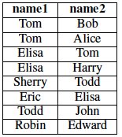
Example 2: Transitive Closure
Friend
Find all transitive friends of Eric
R₀
{Eric, Eric}
R₁
{Eric, Elisa}
R₂
{Eric, Tom
Eric, Harry}
R₃
{}
(semi-naïve evaluation)

Slide 14
Example 2 in MapReduce
(compute next generation of friends)
Join
(remove the ones we’ve already seen)
Dupe-elim
S_{i}
M
r
M
r
Friend0
M
r
M
r
Friend1
M
Anything new?
i=i+1
Client
done

Slide 15
What’s the problem?
(compute next generation of friends)
Join
(remove the ones we’ve already seen)
Dupe-elim
S_{i}
M
r
M
r
Friend0
M
r
M
r
Friend1
M
2.
1.
Friend is loop invariant, but
Friend is loaded on each iteration
Friend is shuffled on each iteration

Slide 16
Example 3: k-means
k_{i}
= k centroids at iteration i
k_{i}
P0
M
r
k_{i}
P1
M
k_{i+1}
r
k_{i}
P2
M
k_{i} - k_{i+1} < threshold?
Client
i=i+1
done

Slide 17
What’s the problem?
k_{i}
k_{i}
= k centroids at iteration i
P0
M
r
k_{i}
P1
M
k_{i+1}
r
k_{i}
P2
M
1.
k_{i} - k_{i+1} < threshold?
Client
i=i+1
done
P is loop invariant, but
P is loaded on each iteration

Slide 18
Approach: Inter-iteration caching
Loop body
M
…
r
M
r
M
Reducer output cache (RO)
Reducer input cache (RI)
Mapper output cache (MO)
Mapper input cache (MI)

Slide 19
RI: Reducer Input Cache
Provides:
  Access to loop invariant data without map/shuffle
Used By:
  Reducer function
Assumes:
  Mapper output for a given table constant across iterations
  Static partitioning (implies: no new nodes)
PageRank
  Avoid shuffling the network at every step
Transitive Closure
  Avoid shuffling the graph at every step
K-means
  No help
…

Slide 20
Reducer Input Cache Benefit
Transitive Closure
Billion Triples Dataset (120GB)
90 small instances on EC2
Overall run time

Slide 21
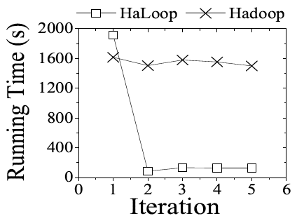
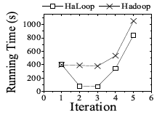
Reducer Input Cache Benefit
Transitive Closure
Billion Triples Dataset (120GB)
90 small instances on EC2
Livejournal, 12GB
Join step only

Slide 22
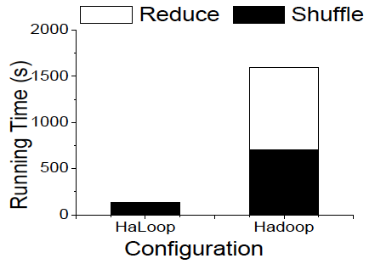
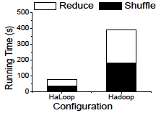
Reducer Input Cache Benefit
Transitive Closure
Billion Triples Dataset (120GB)
90 small instances on EC2
Livejournal, 12GB
Reduce and Shuffle of Join Step

Slide 23
Join & compute rank
Aggregate
fixpoint evaluation
R_{i}
M
r
M
r
M
r
L-split0
M
r
M
r
M
r
L-split1
M
Total

Slide 24
RO: Reducer Output Cache
Provides:
  Distributed access to output of previous iterations
Used By:
  Fixpoint evaluation
Assumes:
  Partitioning constant across iterations
  Reducer output key functionally determines Reducer input key
PageRank
  Allows distributed fixpoint evaluation
  Obviates extra MapReduce job
Transitive Closure
  No help
K-means
  No help
…

Slide 25
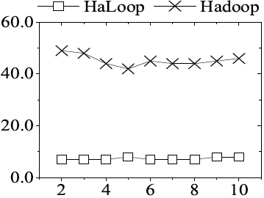
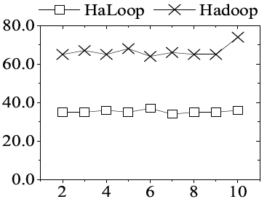
Reducer Output Cache Benefit
Fixpoint evaluation (s)
Iteration #
Iteration #
Livejournal dataset
50 EC2 small instances
Freebase dataset
90 EC2 small instances

Slide 26
MI: Mapper Input Cache
Provides:
  Access to non-local mapper input on later iterations
Used:
  During scheduling of map tasks
Assumes:
  Mapper input does not change
PageRank
  Subsumed by use of Reducer Input Cache
Transitive Closure
  Subsumed by use of Reducer Input Cache
K-means
  Avoids non-local data reads on iterations > 0
…

Slide 27
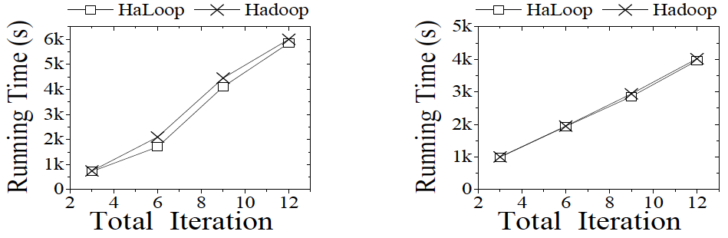
Mapper Input Cache Benefit
5% non-local data reads; ~5% improvement

Slide 28
Conclusions (last slide)
Relatively simple changes to MapReduce/Hadoop can support arbitrary recursive programs
  TaskTracker (Cache management)
  Scheduler (Cache awareness)
  Programming model (multi-step loop bodies, cache control)
Optimizations
  Caching loop invariant data realizes largest gain
  Good to eliminate extra MapReduce step for termination checks
  Mapper input cache benefit inconclusive; need a busier cluster
Future Work
  Analyze expressiveness of Map Reduce Fixpoint
  Consider a model of Map (Reduce⁺) Fixpoint

Slide 29

Data-Intensive Scalable Science
http://escience.washington.edu
Award IIS 0844572
Cluster Exploratory (CluE)
http://clue.cs.washington.edu

Slide 30
Motivation in One Slide
MapReduce can’t express recursion/iteration
Lots of interesting programs need loops
  graph algorithms
  clustering
  machine learning
  recursive queries (CTEs, datalog, WITH clause)
Dominant solution: Use a driver program outside of mapreduce
Hypothesis: making MapReduce loop-aware affords optimization
  …and lays a foundation for scalable implementations of recursive languages

Slide 31
Experiments
Amazon EC2
  20, 50, 90 default small instances
Datasets
  Billions of Triples (120GB) [1.5B nodes 1.6B edges]
  Freebase (12GB) [7M ndoes 154M edges]
  Livejournal social network (18GB) [4.8M nodes, 67M edges]
Queries
  Transitive Closure
  PageRank
  k-means
[VLDB 2010]

Slide 32
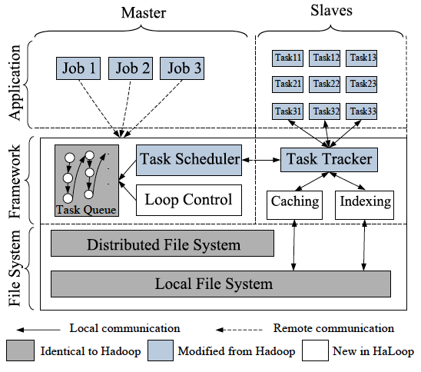
HaLoop Architecture

Slide 33
Scheduling Algorithm
Input: Node node
Global variable: HashMap<Node, List<Parition>> last, HashMaph<Node, List<Partition>> current
1: if (iteration ==0) {
2: Partition part = StandardMapReduceSchedule(node);
3: current.add(node, part);
4: }else{
5: if (node.hasFullLoad()) {
6: Node substitution = findNearbyNode(node);
7: last.get(substitution).addAll(last.remove(node));
8: return;
9: }
10: if (last.get(node).size()>0) {
11: Partition part = last.get(node).get(0);
12: schedule(part, node);
13: current.get(node).add(part);
14: list.remove(part);
15: }
16: }
The same as MapReduce
Find a substitution
Iteration-local Schedule

Slide 34
Programming Interface
Job job = new Job();
job.AddMap(Map Rank, 1);
job.AddReduce(Reduce Rank, 1);
job.AddMap(Map Aggregate, 2);
job.AddReduce(Reduce Aggregate, 2);
job.AddInvariantTable(#1);
job.SetInput(IterationInput);
job.SetFixedPointThreshold(0.1); job.SetDistanceMeasure(ResultDistance);
job.SetMaxNumOfIterations(10);
job.SetReducerInputCache(true); job.SetReducerOutputCache(true);
job.Submit();
define loop body
Declare an input as invariant
Specify loop body input, parameterized by iteration #
Termination condition
Turn on caches

Slide 35
Cache Infrastructure Details
Programmer control
Architecture for cache management
Scheduling for inter-iteration locality
Indexing the values in the cache

Slide 36
Other Extensions and Experiments
Distributed databases and Pig/Hadoop for Astronomy [IASDS 09]
Efficient “Friends of Friends” in Dryad [SSDBM 2010]
SkewReduce: Automated skew handling [SOCC 2010]
Image Stacking and Mosaicing with Hadoop [Hadoop Summit 2010]
HaLoop: Efficient iterative processing with Hadoop [VLDB2010]

Slide 37
MapReduce Broadly Applicable
Biology
  [Schatz 08, 09]
Astronomy
  [IASDS 09, SSDBM 10, SOCC 10, PASP 10]
Oceanography
  [UltraVis 09]
Visualization
  [UltraVis 09, EuroVis 10]

Slide 38
Key idea
When the loop output is large…
  transitive closure
  connected components
  PageRank (with a convergence test as the termination condition)
…need a distributed fixpoint operator
  typically implemented as yet another MapReduce job -- on every iteration

Slide 39
Background
Why is MapReduce popular?
  Because it’s fast?
  Because it scales to 1000s of commodity nodes?
  Because it’s fault tolerant?
Witness
  MapReduce on GPUs
  MapReduce on MPI
  MapReduce in main memory
  MapReduce on <10 nodes

Slide 40
So why is MapReduce popular?
The programming model
  Two serial functions, parallelism for free
  Easy and expressive
Compare this with MPI
  70+ operations
But it can’t express recursion
  graph algorithms
  clustering
  machine learning
  recursive queries (CTEs, datalog, WITH clause)
Notes:
User writes two serial functions, and MapReduce create a parallel program with fairly clear semantics and good scalability.

Slide 41
Fixpoint
A fixpoint of a function f is a value x such that f(x) = x
The fixpoint queries FIX can be expressed with the relational algebra plus a fixpoint operator
Map - Reduce - Fixpoint
  hypothesis: sufficient model for all recursive queries

