Slide 1

Image Encryption
By
Sigmund Vestergaard
&
MartinO'Sullivan

Slide 2
Background
Authentication
Two level of authentication for image sharing application.
Image Encryption
Develop an application that encrypts the image that can be used to encrypt as well as send images remotely to the intended receiver.

Slide 3
Objectives
Project Problem
to ensure that the images which are uploaded, downloaded are stored In the database. encrypted, so only registered users of the site can view them .
To allow secure delivery of images to the intended user.
Project Solution
the team decided to create the web application in Python,
The database is hosted locally.
What We Wanted to Achieve at the end of the Project.
the proper registration of users,
the facilities to securely logon and off
Encrypt all the traffic passing from the application to the database.

Slide 4
System Architecture
Client Side
allow users to log in to the application,
Encrypt Images
upload images to the database.
Allow users to decrypt images

Slide 5
CODE SNIPPET LOGIN
lass AESCipher():
def __init__(self, key): # the AESCipher class is initialised with a key
self.key = key
def encrypt(self, message):
if message is None or len(message) == 0:
return ''
iv = Random.new().read(AES.block_size) # A random IV is introduced
cipher = AES.new(self.key, AES.MODE_CFB, iv) # The AES cipher is instantiated
return base64.b64encode(iv + cipher.encrypt(message)) # Finally the decrypted message is returned base64 encoded
def decrypt(self, message):
if message is None or len(message) == 0:
return ''
message = base64.b64decode(message) # The encoded message is first base64 decoded
iv = message[:AES.block_size] # The IV that we stored with the encrypted message is taken out
cipher = AES.new(self.key, AES.MODE_CFB, iv) # The cipher is instantiated
return cipher.decrypt(message[AES.block_size:]) # The decrypted message is returned
key = Random.new().read(32) # We initialise the key to use for encrypting the images
aes = AESCipher(key) # We initialise the AES cipher with the key from above

Slide 6
demonstration of Project
And now for the action.

Slide 7
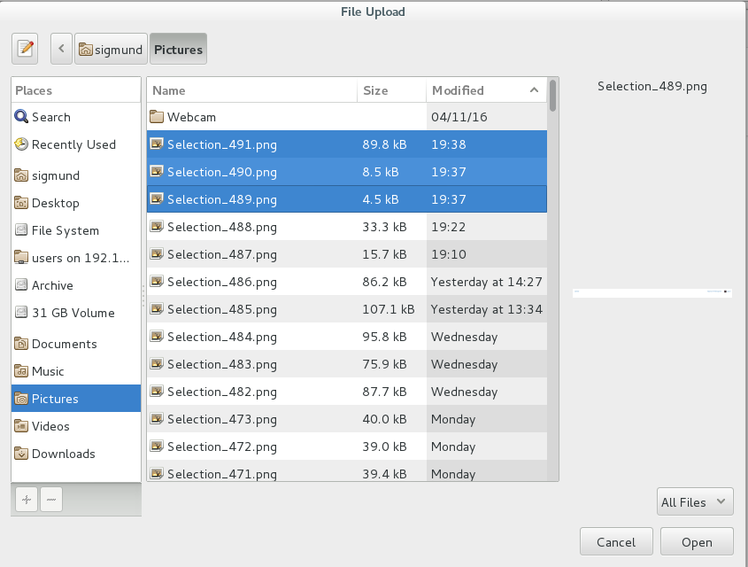

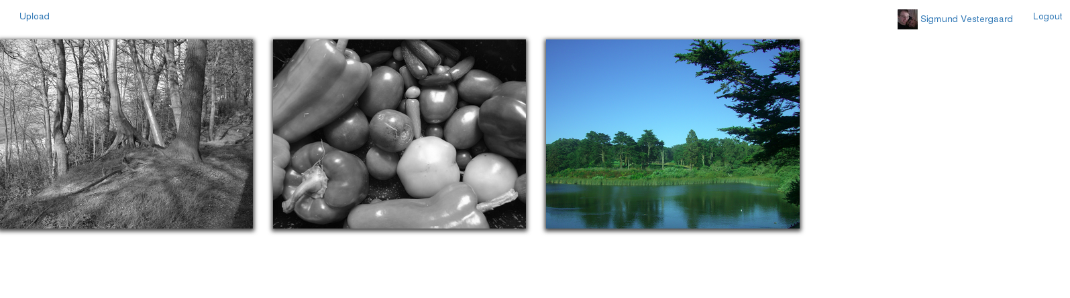
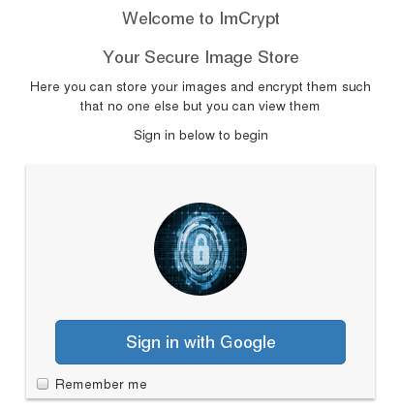
System Implementation

Slide 8
Conclusion
Lessons Learned
The development of this project gave us the opportunity to explore the encryption capabilities of Python,

Slide 9
Conclusion
Problems during Implementation:
Storage of the Images in the database
Configuring Google Auth

Slide 10

Questions
?

