Slide 1

Image Encryption
By
Sigmund Vestergaard
&
MartinO'Sullivan

Slide 2
Background
Authentication
Three level of authentication for image sharing application.
Image Encryption
Develop an application that encrypts the image that can be used to encrypt as well as send images remotely to the intended receiver.
Secure E-Voting
Develop a secure E-voting application.
Secure online booking ticket
Develop a secure web application for GAA ticket booking system.
Student registration with fingerprint reader
Develop an application which can use a fingerprint in the registration process

Slide 3
Objectives
Project Problem
to ensure that the images which are uploaded, downloaded are stored In the database. encrypted, so only registered users of the site can view them .
To allow secure delivery of images to the intended user.
Project Solution
the team decided to create the web application in Python,
The database is hosted locally.
What We Wanted to Achieve at the end of the Project.
the proper registration of users,
the facilities to securely logon and off
Encrypt all the traffic passing from the application to the database.

Slide 4
System Architecture
Client Side
allow users to log in to the application,
Encrypt Images
upload images to the database.
Allow users to decrypt images

Slide 5
CODE SNIPPET REGISTER

Slide 6
CODE SNIPPET LOGIN

Slide 7
System Architecture

Slide 8
demonstration of Project
And now for the action.

Slide 9
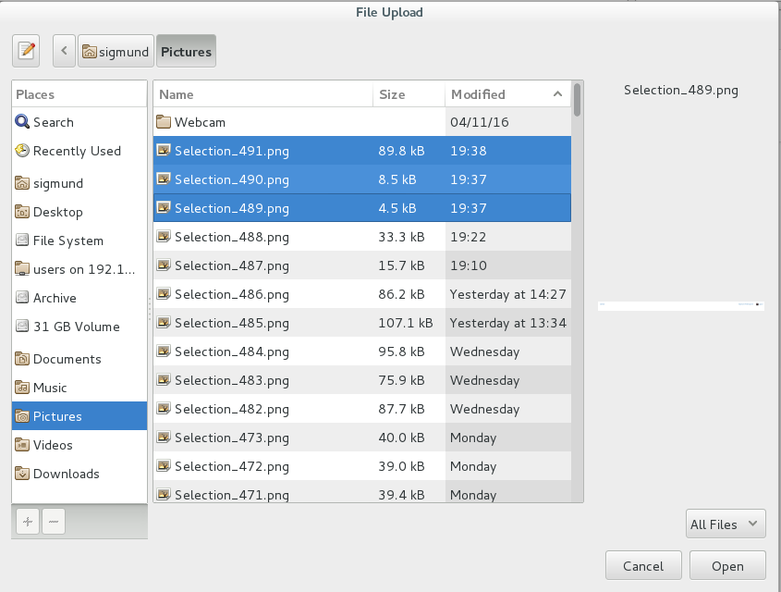

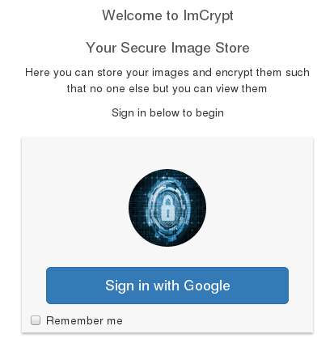
System Implementation

Slide 10
Conclusion
Lessons Learned
The development of this project gave us the opportunity to explore the encryption capabilities of Python,

Slide 11
Conclusion
Problems during Implementation:
Directory image encryption
IV creating a short string
File Transfer Protocol (ftp) to backend (Single User)

Slide 12
FURTHER INVESTIGATIONS
ISSUE | CURRENT METHOD | RESEARCH
UNABLE TO RETURN HASHED IMAGE FROM DATABASE | MD5 HASHING | AES ENCRYPTION
VIEWABLE IMAGES | MD5 HASHING | PIXEL SEPERATION
BOT ATTACKS | NONE PRESENT | HIDDEN CAPACHA

Slide 13

Questions
?

