Slide 1

Healthcare TPO Claims Anomaly & Pattern Detection Engine
A Hybrid Machine Learning Screening and Agentic AI Decision Support System
Sigmus Aimofumhe · Columbia University · Temp Intern, GenAI Sci · Cotiviti
Notes:
“Hello, my name is Sigmus Aimofumhe. I’m currently pursuing my Master’s in Applied Analytics at Columbia University, and I’m presenting my assessment for the Temporary Intern, GenAI Science position at Cotiviti.
The project I built is called the Healthcare Third-Party Organization, or TPO, Claims Anomaly and Pattern Detection Engine.
At a high level, it’s a hybrid system that combines machine learning to quickly screen high volumes of healthcare claims with agentic AI to help explain why a claim may be anomalous and what an auditor should look at next.
So, I’ll quickly walk through the problem, the architecture, the machine learning considerations, and then the working prototype.”

Slide 2
INDUSTRY CONTEXT
The Evolution of Healthcare Payment Integrity
From Post-Payment to Pre-Payment
The industry is shifting away from inefficient "pay-and-chase" audits toward real-time anomaly detection during claim adjudication, catching errors before payment is issued.
High-Volume Claim Bottlenecks
Manual audit teams face strict time constraints and auditor fatigue when reviewing complex claim documentation at scale, creating critical processing delays.
Data Complexity at Scale
Healthcare claims, EHRs, and CPT/ICD coding histories generate massive structured and unstructured datasets requiring multi-layered, intelligent analysis.
Notes:
“To start with the industry context, healthcare payment integrity is increasingly moving from what’s traditionally been called ‘pay-and-chase’—where issues are identified after payment—to more real-time, pre-payment detection.
The challenge is that healthcare organizations are processing enormous volumes of claims, and manually reviewing those claims can quickly become a bottleneck. Auditors have limited time, and complex coding and claim histories can also lead to fatigue and inconsistent review.
So the opportunity here is to use machine learning to identify the claims that deserve attention earlier, while giving auditors enough context to make that review faster and more effective.”

Slide 3
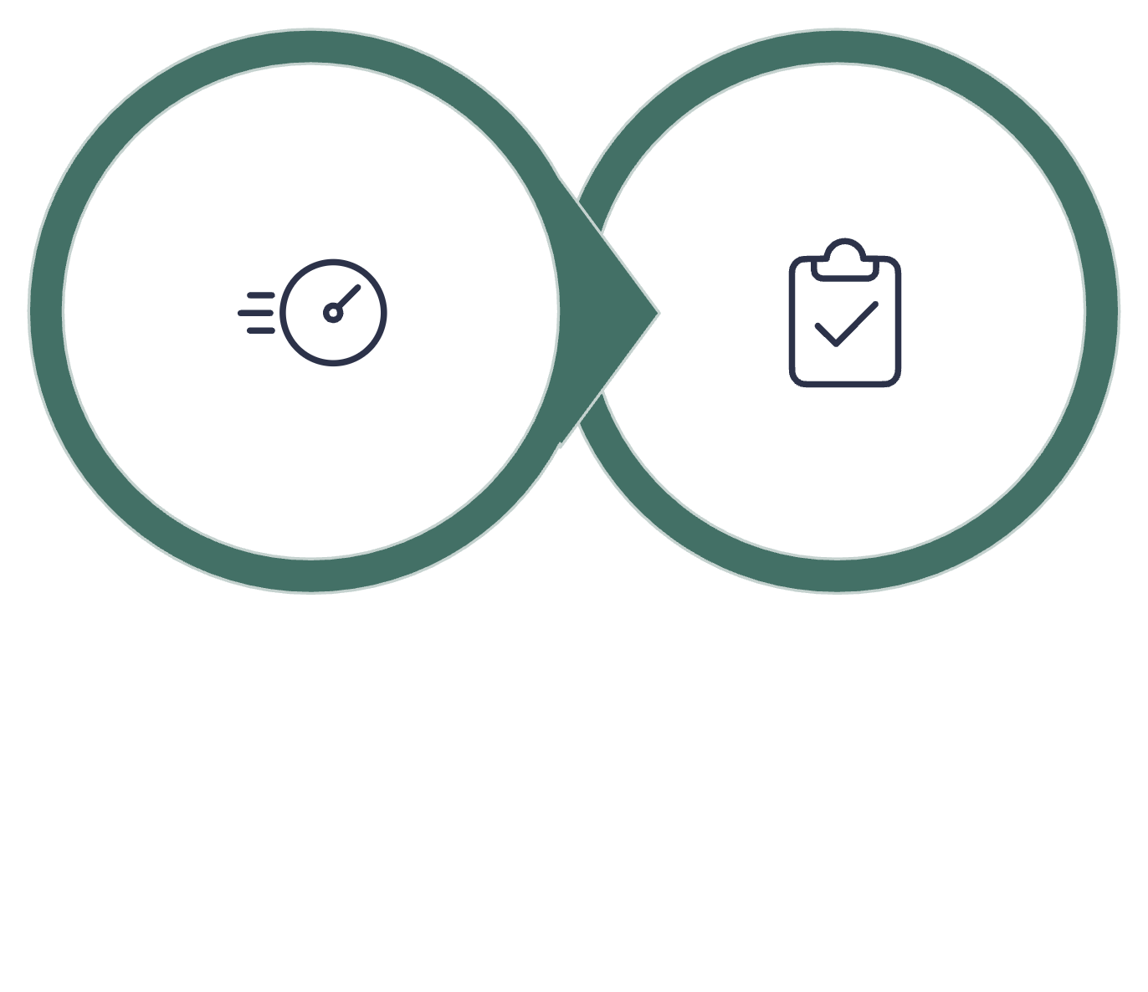
SOLUTION ARCHITECTURE
Two-Stage "Classify-and-Explain" Framework
Predictive Screening
Agentic Decision
Stage 1 screens claims at high throughput using gradient-boosted classifiers. Stage 2 activates only when risk thresholds are exceeded, delivering explainable, audit-ready rationale: with human-in-the-loop oversight ensuring final adjudication remains with medical auditors.
Notes:
“So, to address that problem, I designed the system around a two-stage ‘classify-and-explain’ framework.
The first stage is predictive screening. Here, a gradient-boosted classifier evaluates claims at high throughput and produces a risk score. The idea is that this stage can quickly process a very large number of claims and separate the claims that look relatively normal from the ones that need a closer look.
Then we have Stage 2, which is the agentic decision-support layer. This only activates when a claim crosses a defined risk threshold. Instead of just saying that a claim is high-risk, it provides an explainable, audit-ready rationale for why it was flagged.
And importantly, this remains human-in-the-loop. The system supports the medical auditor; it doesn't make the final adjudication decision.”

Slide 4

MODEL GOVERNANCE
Machine Learning Integrity & Technical Challenges
Class Imbalance (<1% Anomaly Rate)
Addressed via SMOTE-ENN sampling; evaluation prioritizes F_2 - score and PR-AUC over raw accuracy.
False Positive Calibration
Interactive thresholding lets auditors balance precision vs. recall dynamically, reducing alert fatigue.
Concept Drift Mitigation
MLOps infrastructure tracks feature shifts (CPT code spikes, policy updates), triggering automated retraining.
Notes:
“There were also three important machine learning challenges I had to account for.
First is class imbalance. With anomalies representing less than one percent of the data, accuracy alone can be very misleading. So I used SMOTE-ENN sampling and focused evaluation on metrics like F2-score and PR-AUC, which are more useful for this type of problem.
Second is false-positive calibration. Because too many alerts can overwhelm an audit team, I included interactive thresholding so the sensitivity of the system can be adjusted based on operational needs.
And third is concept drift. Healthcare coding patterns and policies can change over time, so the MLOps layer monitors feature shifts—such as changes in CPT-code patterns—and can trigger retraining when necessary.”

Slide 5
Interactive Streamlit Prototype Walkthrough

Slide 6
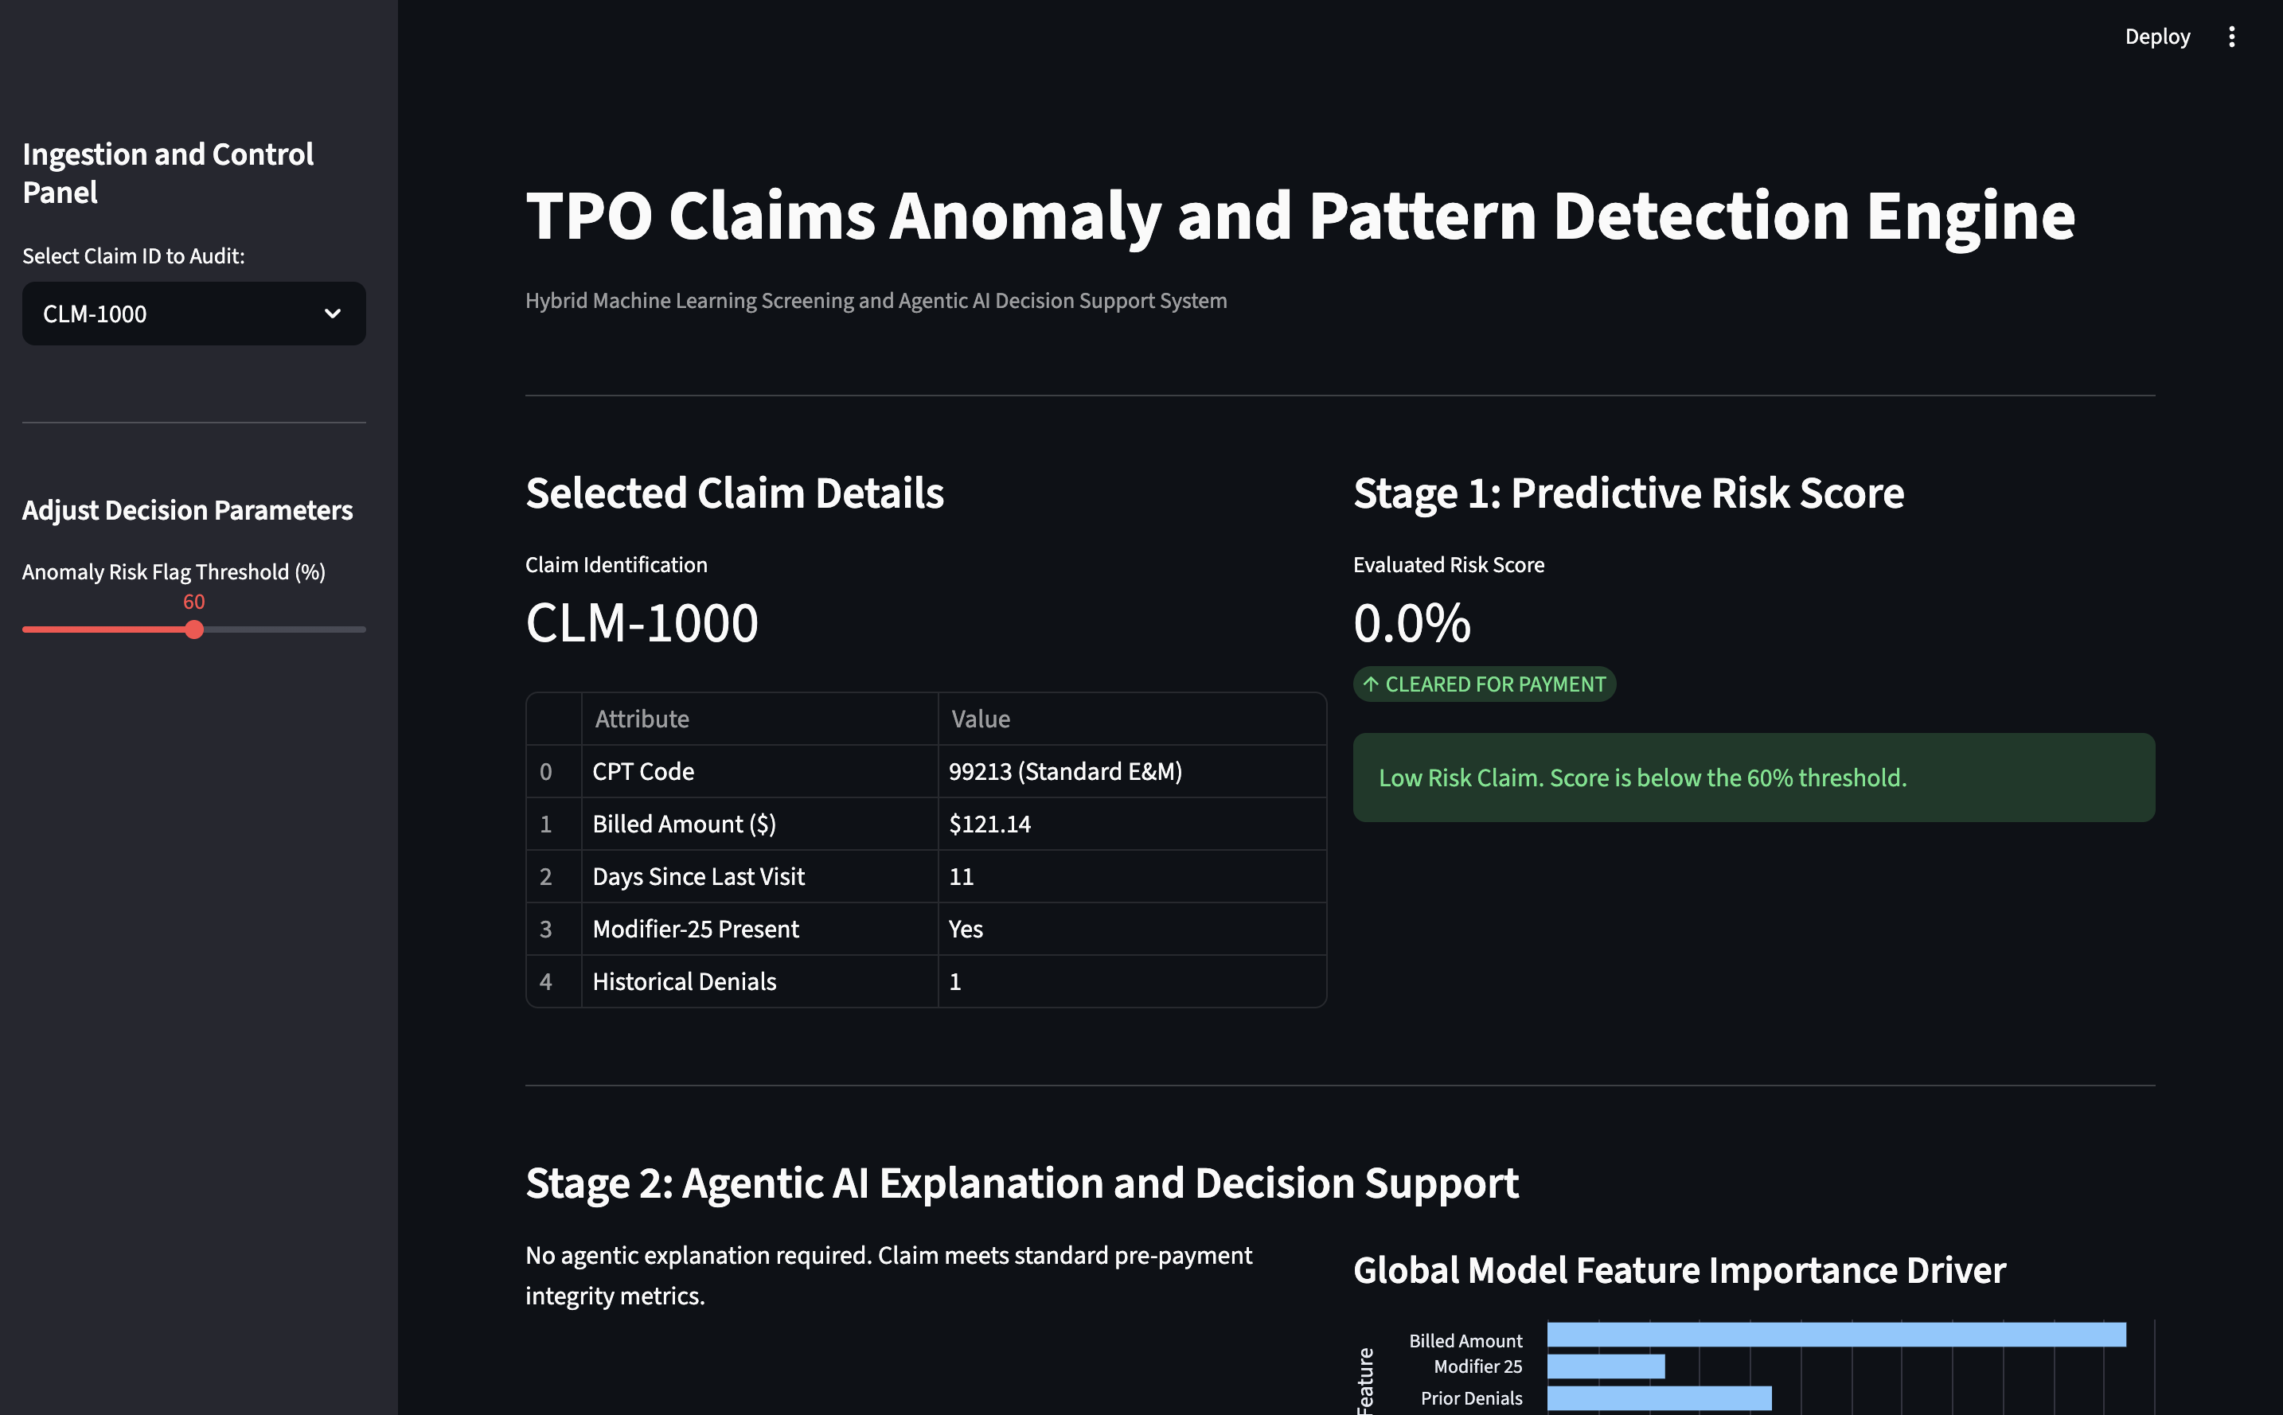
PROOF OF CONCEPT
Interactive Streamlit Prototype
Input Layer
Ingests structured claim records: CPT codes, billed amounts, Modifier 25 flags, and prior denial history.
Interactive Parameters
Live threshold slider adjusts decision boundaries in real time, enabling auditors to calibrate sensitivity on the fly.
Analytics Visualizations
Feature importance weights and batch anomaly frequency graphs by CPT category provide transparent, actionable insights.
Notes:
“Now I’ll show you the working prototype.
This is the Streamlit application, and the first thing we have is the input layer. On the left, I can select an individual claim record, and the application pulls in the relevant attributes—things like the CPT code, billed amount, modifier information, and prior denial history.
Once the claim is selected, Stage 1 evaluates it and produces a risk score. So, for example, with this claim, the model is essentially saying that there isn't enough evidence of an anomaly, so it can be cleared for payment.
What’s useful here is that the decision boundary isn't fixed. I can adjust the threshold in real time. So if I'm an auditor dealing with a higher-risk environment and I want the system to be more sensitive, I can lower that threshold and surface more claims for review.
Now, if I select a higher-risk claim, we can see the second stage come into play. Instead of simply telling me that the claim is anomalous, the system provides a rationale for the decision and highlights the factors contributing to that risk.
And on the right, I also have the analytics layer—showing feature importance and anomaly patterns across CPT categories. So the auditor gets both the individual claim explanation and the broader context around the data.”

Slide 7

STRATEGIC VALUE
Maximizing Speed to Value & Operational Impact
Scalability
Explainability
High-speed tabular models screen millions of claims without system latency, supporting enterprise-scale adjudication pipelines.
Transparent, SHAP-driven audit summaries build provider trust and reduce unnecessary claim appeals.
Actionable Intelligence
Answers three core audit questions: Is it anomalous? Why is it anomalous? What should the auditor inspect next?
Notes:
“So, stepping back, I designed this system around three things: scalability, explainability, and actionable intelligence.
Scalability comes from using high-speed tabular models that can screen large volumes of claims efficiently. Explainability comes from providing transparent, audit-ready reasoning rather than just giving an anomaly score.
And ultimately, the goal is actionable intelligence. The system should help answer three simple questions: Is this claim anomalous? Why is it anomalous? And what should the auditor look at next?
Thank you for taking the time to review my assessment. I appreciate the opportunity, and I’d be excited to contribute to Cotiviti’s GenAI and payment integrity work.”

