Slide 1

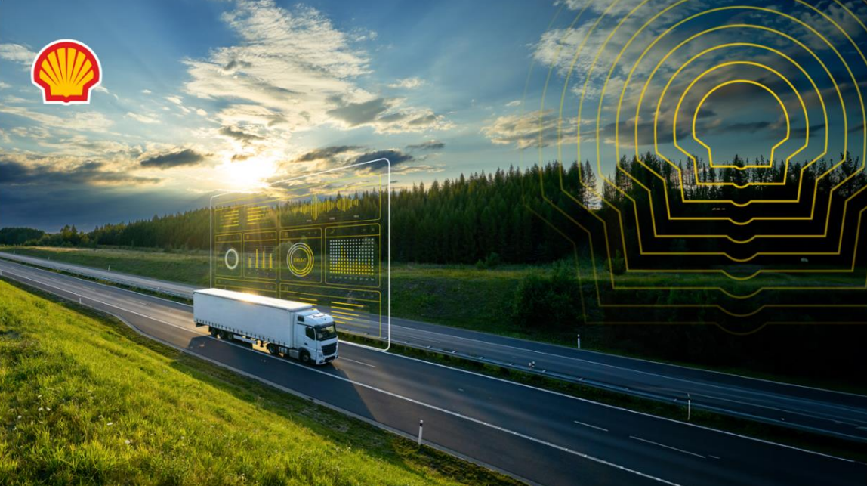

Team Sign of Fourier
Solution
Shell.ai Hackathon for Sustainable and Affordable Energy 2024

Slide 2

Team
Mark Shipman
M. S. Carnegie Mellon University
M.S. Columbia University
25 Years of ML/AI experience
Accelerated Optimization

Slide 3
PROBLEM STATEMENT
Efficient fleet management is crucial for meeting delivery demands in a cost-effective way while achieving efficiency goals.
The decisions surrounding vehicle acquisition, timely sales and fuel choices form an expansive complex web of possibilities with significant financial and environmental repercussions.
Moreover, the volatility of fuel costs compounds the challenge of minimizing costs, reducing environmental impact, and safeguarding financial stability.

Slide 4
SOLUTION
My solution formulates the problem as a Mixed Integer Program with a mathematical definition of optimality and solves it using AI accelerated branch and cut methodology.
The optimal solution will have the lowest cost while satisfying well defined annual decarbonization goals.
The quality of the solution is measured by total cost and feasability.
The solution is implemented on a 4 Tesla T4 GPU, 96 Ice Lake vCPU machine using Pytorch.
GPU is faster than CPU and is necessary for the deep learning portion of the solution. The solution also takes advantage of the CPU parallelization available for the MILP portion of the solution.
The solution is available as easy to use modules, documentation, tutorials and examples.
Due to the GPU, parallel format, this is the most scalable solution to MILP in the world.

Slide 5
METHODOLOGY
All Solutions
First Lower Bound
First Improvement
Eliminated
Less Possible Improvement
Formulate the problem as a well-defined Mixed Integer Linear Program to minimize cost with respect to the number of vehicles to purchase, when to sell them and which fuel to use. These variables are constrained by delivery demands, route requirements, vehicle ownership limits and efficiency goals.
Solve the problem using the standard branch-and-cut algorithm. This technique formulates the search space as a tree causing the search space to increase exponentially at each step. The algorithm relies on a heuristic to determine which solutions to evaluate and which to eliminate at each step.
Branch and Cut algorithm

Slide 6
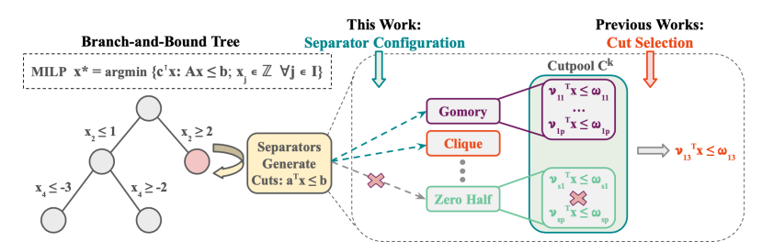
METHODOLOGY
Instead of existing heuristics, my solution uses a highly accurate deep learning model to determine which solutions have the best possibility of improvement at each step. Because it is implemented as a neural network, the evaluation is very efficient.
https://arxiv.org/pdf/2311.05650
Notes:
Branch and Cut algorithm is an extension of the branch and bound algorithm.
The AI Accelerated Branch and Cut algorithm uses Deep Learning to quickly evaluate the separators (the cuts) needed in the branch and cut algorithm.

Slide 7
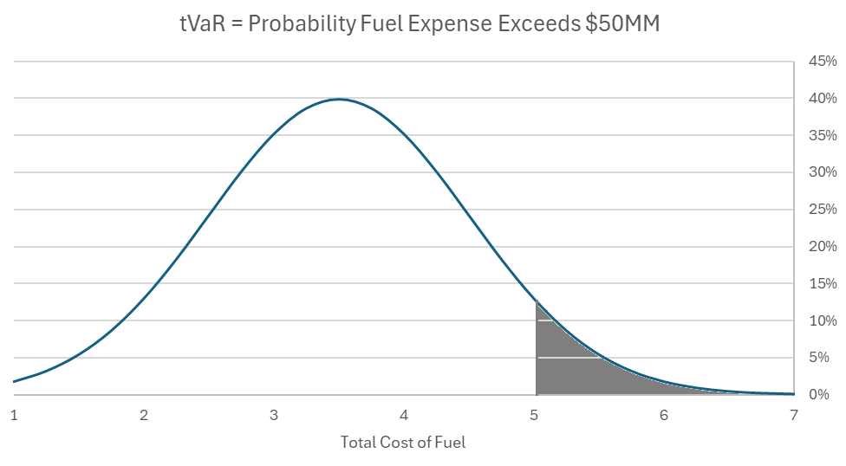
METHODOLOGY
In addition, my solution establishes a risk metric to account for the randomness of fuel prices.
Fuel price is defined as a geometric Brownian motion which implies a well–defined covariance between years.
The risk metric called tVaR is calculated to measure the fuel price randomness and has a market calibrated value that can be hedged using financial derivatives.
The risk metric can is included as a constraint in the MILP definition using Reliability Based Design Optimization (RBDO) technique.

Slide 8
Solution Steps
Step | Desc. | File | Source Location | Input | Output
1 | Define Linear Program | Shell_v0.2.ipynb | sign-of-fourier | Decisions, Objective Function and Constraints from HackerEarth problem statement | Python (SCIP/PuLP) Linear Program and LP Variables
2 | Build Accelerator | find_best_in agnostic.py | L2config | Python defined Linear Program | Separators
3 |  | explore subspace.py | L2config | Separators | Configured Separators
4 |  | get_actions.py | L2config | Configured Separators | Training File
5 | Train DL model | train.ipynb | sign-of-fourier | Single Configured Separator File | Trained DL model to estimate reward for separator configuration
6 | Solve final problem with acceleration | solve.ipynb | sign-of-fourier | Trained DL model Original Problem Separators | Solved MILP

Slide 9
Artifacts
Item | Location | Link
Code | github | https://github.com/sign-of-fourier/shell_ai/tree/main
pdf documentation | Github | https://github.com/sign-of-fourier/shell_ai/blob/main/Shell%20Fleet%20Decarbonization%20Solution.pdf
AI Acceleration Project | Github | https://github.com/mit-wu-lab/learning-to-configure-separators
This power point without the video | Github | https://github.com/sign-of-fourier/shell_ai/blob/main/sign_of_4ier.pptx
Video Demo | youtube | https://youtu.be/c1htw_cyp1g

Slide 10
Summary
Defined a Linear Program using Python Standard language.
Configure a set of separators for the cut-and-branch algorithm.
Trained a Deep Learning model to configure and prioritize separators.
Used that Deep Learning model to accelerate the cut step in the branch and cut algorithm.
Illustrated how to use RBDO to manage the financial risk associated with fuel uncertainty by adding the market, calibrated fair value of the hedging cost.

