Slide 1
System Software Crash Course
Block D: Java Virtual Machine
Sergey Ignatov

Slide 2
Virtual Machine
A Virtual Machine (VM) is software implementation of a machine (for example, a computer) that executes programs like a physical machine.
Virtual Machines are separated into to major classification:
System Virtual Machines (also termed Full Virtualization VMs) provide a substitute for a real machine. They provide functionality needed to execute entire operating systems.
Process Virtual Machines are designed to execute computer programs in a platform-independent environment.
(© S.Ignatov, 2018

Slide 3
Java Virtual Machine (JVM)
A Java Virtual Machine (JVM) is a Process Virtual Machine that can execute Java Byte Code.
JVM is converts Java Byte Code into Machine Language and executes it.
JVM is platform independent: JVMs are available for many hardware and software platforms.
JVM gives the flexibility of platform independence.
JVM enables a set of computer software programs and data structures to use a virtual machine model for the execution of other computer programs and scripts:
Not just Java and Java-clone languages now supports many languages: Ada, C/C++, Lisp, Python.
(© S.Ignatov, 2018

Slide 4
Why Java Virtual Machine&
A Java platform was initially developed to address the problems of building software for networked consumer devices.
It was designed to support multiple host architectures and to allow secure delivery of software components.
To meet these requirements, compiled code had to survive transport across networks, operate on any client, and assure the client that if was safe to run.
“Write Once, Run Anywhere”.
(© S.Ignatov, 2018

Slide 5
Java Principles
Sun Microsystems set five primary goals in the creation of the Java language:
It should be “simple, object oriented, and familiar”.
It should be “robust and secure”.
It should be “architecture neutral and portable”.
It should execute with “high performance”.
It should be “interpreted, threaded, and dynamic”.
(© S.Ignatov, 2018

Slide 6
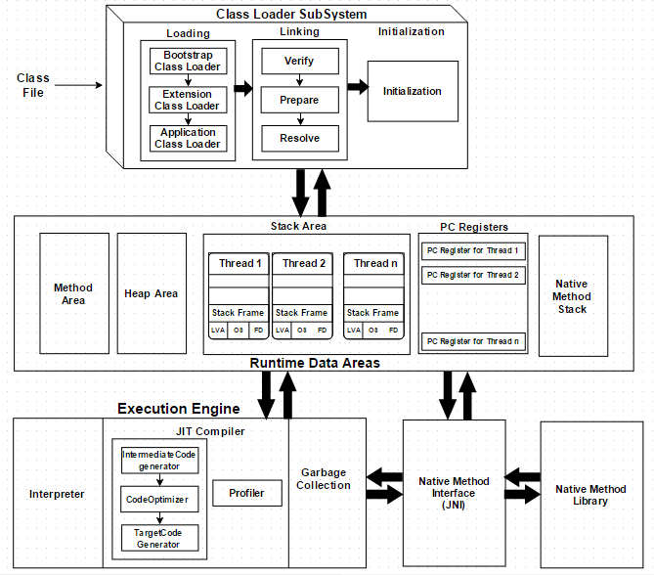
Java Run-Time System
(© S.Ignatov, 2018

Slide 7
Java Class File
Java compilers generate class file:
Magic number (0xCAFEBABE).
Minor version/major version.
Constant pool.
Access flags.
This class.
Super class.
Interfaces.
Fields.
Methods.
Attributes (extra hints for the JVM or other applications).
(© S.Ignatov, 2018

Slide 8
Java Class Loading
Classes are loaded laizily when first accessed.
Class name must match file name.
Super classes are loaded first (transitively).
The bytecode is verified.
Static fields are allocated and given default values.
Static initializers are executed.
(© S.Ignatov, 2018

Slide 9
Java Virtual Machine Principles
Target Hardware – all CISC and RISC.
Machine Type – Stack Machine.
“Big Endian” encoding – large order bits in the lower address.
Instructions are byte aligned for memory efficiency.
Instructions are closely related to Java sources.
(© S.Ignatov, 2018

Slide 10
Java Virtual Machine Registers
pc – Program Counter.
optop – Pointer to the top of the operand stack.
frame – Pointer to the current execution environment.
vars – Pointer to the first (0th) local variable in the current execution environment.
(© S.Ignatov, 2018

Slide 11
JVM Instruction Set Architecture
JVM instruction consists of a one-byte opcode specifying the operation to be performed, followed by zero or more operands supplying arguments or data that are used by the operation.
Operands are not required, there are many instructions that consist of only the opcode.
One-byte instructions allow for up to 256 instructions.
Each instruction has a mnemonic name which is mapped to the binary one-byte opcode.
(© S.Ignatov, 2018

Slide 12
Java Bytecode Instructions
The JVM ISA (Instruction Set Architecture) is a CISC architecture.
The JVM has 256 instructions for (see the JVM specification for the full list):
Arithmetic and logic operations.
Type conversion.
Branch operations (control transfer).
Constant loading operations.
Local operations (load and store).
Stack operations (stack operand management).
Class and object operations (creation and manipulation)
Method operations (invocation and return).
(© S.Ignatov, 2018

Slide 13
JVM Data Types
The JVM operates on two kinds of types: primitive types and reference types.
Integral Types:
Byte – 8bit signed integers.
Short – 16bit signed integers.
Int – 32bit signed integers.
Long – 64bit signed integers.
Char – 16bit unsigned integers representing Unicode charecters.
Byte – 8bit signed integers.
Floation Point Types:
Float – 32bit single-precision float.
Double – 64bit single-precision float.
Boolean – values true and false.
returnAddress – pointers to the opcodes of JVM instructions.
(© S.Ignatov, 2018

Slide 14
JVM Data Types
Three kinds of reference types:
Class types.
Array types.
Interface types.
These reference dynamically created classes, arrays or interface implementations.
Can be set to null when not referencing anything and then cast to any type.
(© S.Ignatov, 2018

Slide 15
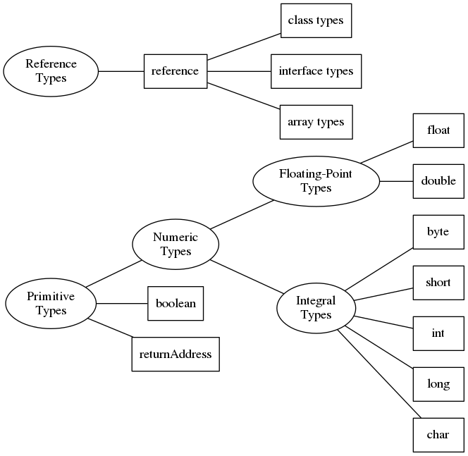
JVM Data Types
(© S.Ignatov, 2018

Slide 16
JVM Stack Frame
As threads are created each thread get a Java Stack and pc register.
JVM creates a stack frame for each method of a class. Each method Stack Frame consists of:
Local Variables.
Execution Environment.
Operand Stack.
(© S.Ignatov, 2018

Slide 17
JVM Stack Frame
Local Variables form array of 32-bit variables:
Types longer than 32-bit (double) use consecutive cells.
Pointed at by vars register.
Loaded onto and stored from the operand stack.
Execution Environment is info about the current state of the JVM stack and consists of:
Pointer to the previous method invoked.
Pointer to the local variables.
Pointers to the top and the bottom of the operand stack.
JVM Operand Stack:
Is 32-bit FIFO.
Holds the argument for opcodes.
Is a subsection of the JVM Stack: primary area for the current status of bytecode execution.
(© S.Ignatov, 2018

Slide 18
JVM Memory
JVM Garbage Collected Heap:
Memory from which class instances are allocated.
Interpreter monitors memory usage and reclaims memory when no longer in use.
Garbage Collection is automatic.
Method Area - bytecodes for all Java Methods.
Constant Pool – class names, method and fields names, strings, constants.
JVM Limitaions:
4GB internal addressing dut to 32bit wide stack implementation.
Methods are limited to 32Kb due to 16bit offset addressing used for branching.
256 local variables/stack (8bit field).
32KB constant pool entries for a method.
(© S.Ignatov, 2018

