Slide 1
System Software Crash Course
Block D: .NET Framework
Sergey Ignatov

Slide 2
What Is .NET Framework
The infrastructure for the overall .NET Platform.
A computing platform designed to simplify application development.
A consistent object-oriented programming environment.
A code-execution environment that minimizes software deployment and versioning conflicts.
(© S.Ignatov, 2018

Slide 3
Major Components of .NET
Common Language Runtime (CLR)
Manages code execution at runtime
Manages memory, threads, etc
Code designed for the CLR is referred to as Managed Code
Object oriented
Cross-language integration
Cross-language exception handling
Multiple version support
Base Class Library (Framework Class Library – FCL)
Object-oriented collection of reusable types
Sits on-top of the Common Language Runtime (CLR)
Common Type System (CTS)
Common Language Specification (CLS)
(© S.Ignatov, 2018

Slide 4
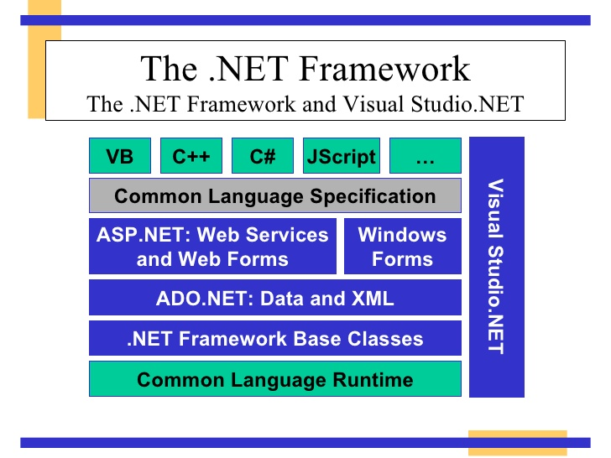
.NET Framework Structure
(© S.Ignatov, 2018

Slide 5
Common Language Runtime (CLR)
Common Language Runtime (CLR) works like a virtual machine in executing all languages.
Checking and enforcing security restrictions on the running code.
Manages memory through an extremely efficient garbage collector.
Common Type System (CTS).
Conversion from IL into code native to the platform being executed on.
(© S.Ignatov, 2018

Slide 6
Common Language Runtime (CLR)
All .NET languages must obey the rules and standard imposed by CLR. Examples:
Object declaration, creation and use.
Data types, language libraries.
Error and exception handling.
Interactive Development Environment (IDE).
(© S.Ignatov, 2018

Slide 7
Common Language Runtime (CLR)
CLR manages object layout and references to objects.
Objects whose lifetimes are managed by the CLR are referred to as Mana-ged Data.
Automatic memory management reduces memory leaks.
In Managed Code you can use:
Manages Data.
Unmanages Data.
Both.
(© S.Ignatov, 2018

Slide 8
Common Language Runtime (CLR)
All CLR compliant compilers use a common type system:
Allows for cross-language inheritance.
Passing object instances across language barriers.
Invoking methods across language barriers.
Managed components exposes metadata.
Metadata includes:
Resource components was compiled against.
Information about types and dependencies.
Signatures of each type’s method.
Members that your code references.
Other runtime data for CLR.
(© S.Ignatov, 2018

Slide 9
One Runtime for Many Languages
CLR is on open standard.
Any language can make use of CLR services.
Any language can make classes written in any other language.
Any language can inherit classes written in any other language.
(© S.Ignatov, 2018

Slide 10
Common Type System (CTS)
CTS is a rich type system built into the CLR:
Implements various types (int, double, etc.).
Strictly enforces type safety.
Ensures that classes are compatible with each other by describing them in a common way.
Enables types in one language to interoperate with types in another language.
(© S.Ignatov, 2018

Slide 11
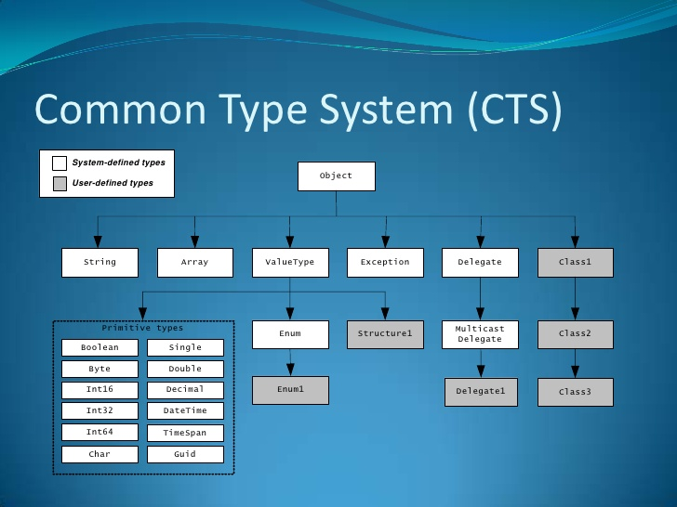
Common Type System (CTS)
(© S.Ignatov, 2018

Slide 12
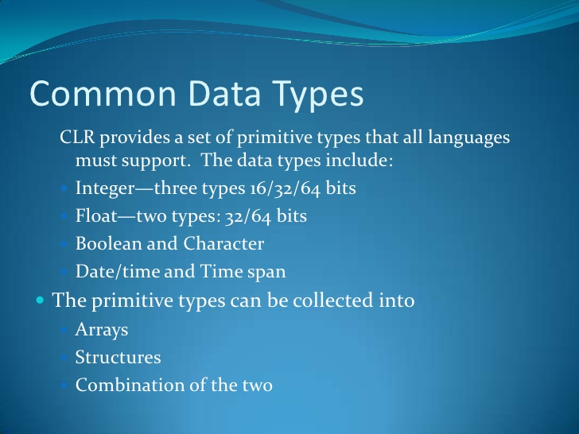
Common Data Type
(© S.Ignatov, 2018

Slide 13
Common Language Specification(CLS)
CLS is a set of specifications that language an library designers need to follow:
This will ensure interoperability between langua-ges.
Specification that a language must conform to, to be accepted into the .NET framework.
The specification are detailed at https://www.ecma-international.org/publications/standards/Ecma-335.html
(© S.Ignatov, 2018

Slide 14
Intermediate Language (IL)
.NET languages are not compiled to machine code. They are compiled to an Intermediate Language (IL).
CLR accepts the IL code and recompiles it to machine code. The recompilation is Just-In-Time (JIT) meaning it is done as soon as a function or subroutine is called.
The JIT code stays in memory for subsequent calls. In cases where there is not enough memory it is discarded thus making JIT process interpretive.
(© S.Ignatov, 2018

Slide 15
.NET Framework Class Libraries
Sit on top of the CLR.
Reusable types that tightly integrate with the CLR.
Object oriented – inheritance, polymorphism, etc.
Provide functionality for ASP.NET, XML Web Services, ADO.NET, Windows Forms, basic system functionality (IO, XML, etc.).
(© S.Ignatov, 2018

Slide 16
.NET Assemblies
Assemblies are the smallest unit of code distribution, deployment and versioning.
Individual components are packaged into unit called assemblies.
Can be dynamically loaded into the executon engine on demand.
Contains Control Intermediate Language (CIL) code to be executed.
Security boundary – permissions are granted at the assembly level.
Type boundary – all types include the assembly name they are a part of.
(© S.Ignatov, 2018

Slide 17
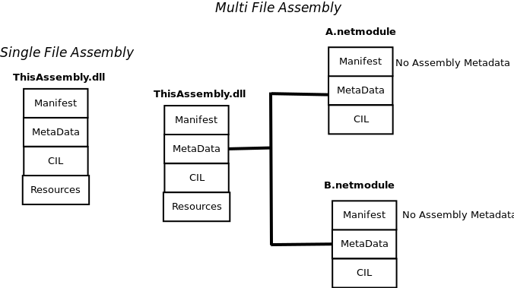
Single File & Multi File Assemblies
(© S.Ignatov, 2018

Slide 18
Assembly Charactreistics
Self-describing:
To enable data-driven execution.
Platform-independent.
Bounded by name:
Locate assemblies by querying four-part tuple that consist of a human-friendly name, an international culture, a multipart version number, an a public key token.
Assembly loading is sensitive to version and policy:
Assemblies are loaded using tunable binding rules, which allow programmers and administrators to contribute policy to assembly-loading behavior.
Validated:
Each time an assembly is loaded, it is subjected to a series of checks to ensure the assembly’s integrity.
(© S.Ignatov, 2018

Slide 19
Self-describing of Assemblies
Modules:
Blueprint for types in the form of metadata and CIL.
Single file containing the structure and behavior for some or all the types and/or resources found in the assembly.
An assembly always contains at least one module but has the capacity to include more.
Assemblies themselves have metadata that describe their structure: manifest.
(© S.Ignatov, 2018

Slide 20
Manifest
Compounds name for the assembly.
Describes the public types that the assembly exports.
Describes types that the assembly will import from other assemblies.
(© S.Ignatov, 2018

Slide 21
Reflection
Programmatically gain access to Metadata at runtime.
Used to make ultra-flexible code.
Components often perform reflection to find about derivations: custom attributes.
Late and loose binding are possible with reflection: Instantiate objects, call methods, etc.
Reflection Emit: Possible to emit IL at runtime, JIT compile & execute.
(© S.Ignatov, 2018

Slide 22
Microsoft Intermediate Language
Managed Code is compiled into Common Intermediate Language (CIL).
CPU-independent set of instructions:
Loading, storing, initializing and caling methods.
Arithmetic and logical operations, etc.
Control flow, exception handling, direct memory access.
Is Object-Oriented.
Is Stack-Based.
(© S.Ignatov, 2018

Slide 23
Execution Process in .NET
Source code is converted in CIL which is equivalent to assembly language for a CPU.
CIL is then assembled into a for of so-called bytecode and .NET assembly is created.
Upon execution of a .NET assembly, its code is passed through the runtime’s JIT compiler to generate native code.
Ahead-of-time compilation may also be used, which eliminates the JIT step, but at the cost of executable-file portability.
The computer’s processor executes the native code.
(© S.Ignatov, 2018

Slide 24
Object-Oriented Concepts
CIL may create objects, call methods and use other types of class members such as fields.
CIL is designed to be Object-Oriented and every method (with some exception) needs to reside in a class.
Instance classes:
An instance class contains at least one constructor and some instance members.
CIL has instructions for creating objects.
CIL has instructions for invoking instance methods.
(© S.Ignatov, 2018

Slide 25
CIL Instruction Groups
CIL bytecode has instructions for the following groups of tasks:
Load and store.
Arithmetic.
Type conversion.
Object creation and manipulation.
Operand stack management (push, pop).
Control transfer (branching).
Method invocation and return.
Throwing exceptions.
Monitor-based concurrency.
Data and function pointers manipulation needed for C++ and unsafe C# code.
(© S.Ignatov, 2018

Slide 26
Minimal Hello Program in CIL
.assembly Hello {}
.method public static void Main() cil managed
{
.entrypoint
.maxstack 1
ldstr "Hello, world!"
call void [mscorlib]System.Console::WriteLine(string)
ret
}
(© S.Ignatov, 2018

Slide 27
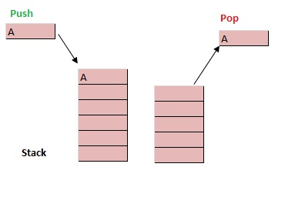
CIL Evaluation Stack
Stack is the data structure that follows Last In and First Out (LIFO) kind of data storing method, i.e. the type present at the top are the first one to be removed from it. The below example makes it clear.
(© S.Ignatov, 2018

Slide 28
CIL Evaluation Stack
Evaluation Stack is used to hold the local variable or the method argument before they are evaluated. Before the start of every method the evaluation stack is empty and during the execution of the method the CIL instructions adds/removes the items from the evaluation stack, the end result of which is an empty evaluation stack at the end of that method execution.
Instruction that copy values from memory to the evaluation stack are called load and the instruction that copy values from the evaluation stack are called store. All the opcodes starting with ld are used for loading the item on the stack and the opcodes starting with st are used for storing the item in the memory. The instruction used for storing the data in memory also result in popping of the item from the evaluation stack.
(© S.Ignatov, 2018

Slide 29
CIL Evaluation Stack
At the beginning of the function it is required to provide the maximum items that would be present on that stack at any particular time, this is done using .maxstack directive. If this is not provided the .maxstack value would be defaulted ot 8. We can easily provide the size of the stack by staci analysis of the method, Also it should be noted that maxstack doesn’t represent the size of the stack frame, it is just the number of items on the evaluation stack. The maxstack value can be easily determined by analyzing the method and seeing how many variables an parameters it has.
(© S.Ignatov, 2018

Slide 30
CIL Evaluation Stack Example
C# code:
static void add()
{
int value1 = 10;
int value2 = 20;
int value3 = value1 + value2; }
(© S.Ignatov, 2018

Slide 31
CIL Evaluation Stack Example
CIL code:
0.method private hidebysig static void 'add'() cil managed {
// Code size 12 (0xc)
.maxstack 2
.locals init ([0] int32 value1,
[1] int32 value2,
[2] int32 value3) // three int32 local variables are declared
IL_0000: nop // no operation ( no push or pop on the stack)
IL_0001: ldc.i4.s 10 //loads the int32 value(10) on the stack. Item on Stack=1
IL_0003: stloc.0 // pops off the item from the stack and stores in first local variable.
//Item on Stack=0
IL_0004: ldc.i4.s 20 //loads the int32 value(20) on the stack.Item on the stack =1
(© S.Ignatov, 2018

Slide 32
CIL Evaluation Stack Example
CIL code:
IL_0006: stloc.1 0 // pops off the item from the stack and stores in second local variable .
//Item on Stack=0
IL_0007: ldloc.0 // Loads the value of first local variable on the stack. Item on Stack=1
IL_0008: ldloc.1 // Loads the value of second local variable on the stack. Item on Stack=2
IL_0009: add //(Pops off first two numeric value from the stack and sends the result
// back to the stack)
// Item on stack=2-2+1=1
IL_000a: stloc.2 //(Pop off the item from the stack and store it in local variable [3].
//Item on the Stack=0
IL_000b: ret
} // end of method Program::'add'
(© S.Ignatov, 2018

Slide 33
Just-In-Time (JIT) Compiling
Assemblies are compiled to native code by a JIT compiler before executing.
Compiled assemblies include metadata.
No Type Libraries or Interface Definition Language (IDL).
JIT compilers are built into the CLR for every supported CPU architecture.
JIT compilers conver CIL to native on demand.
Resulting native code is stored for reuse.
JIT compiling occurs for each method after the application is restarted.
(© S.Ignatov, 2018

Slide 34
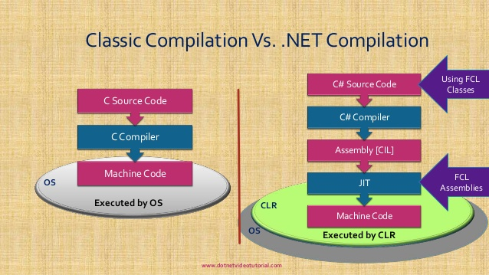
Classic Compiler vs .NET Compiler
(© S.Ignatov, 2018

