Slide 1
Fluid detection in OCT
Jan Wälchli, Dominik Meise, Mario Moser
Group project in Introduction to Signal and Image Processing

Slide 2
General idea
Preprocessing
Template matching
Images
Evaluation
change methods
change parameters

Slide 3
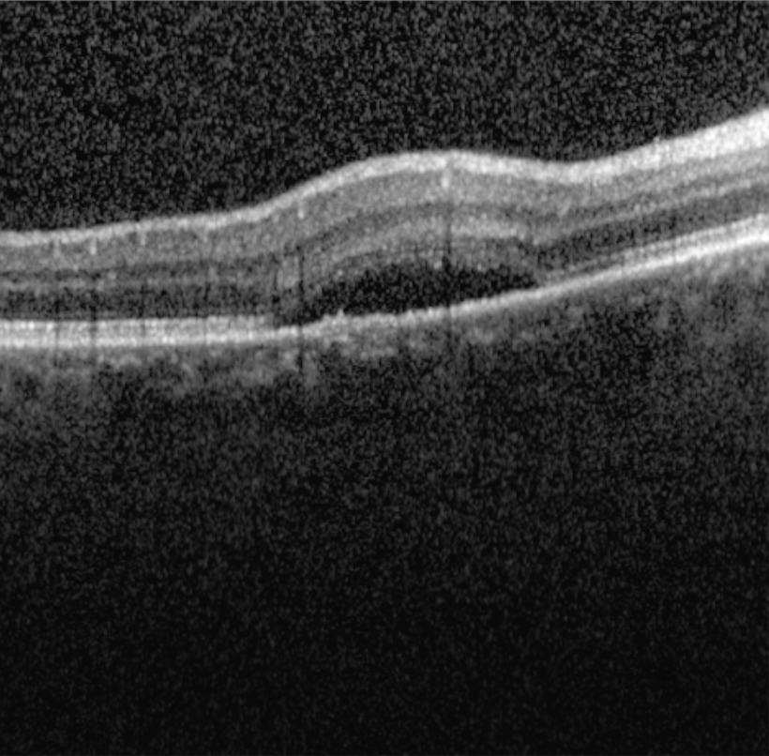
Images
Images
Preprocessing
Template matching
Evaluation

Slide 4
Preprocessing
Template matching
Preprocessing
Images
Evaluation
Cropping

Slide 5
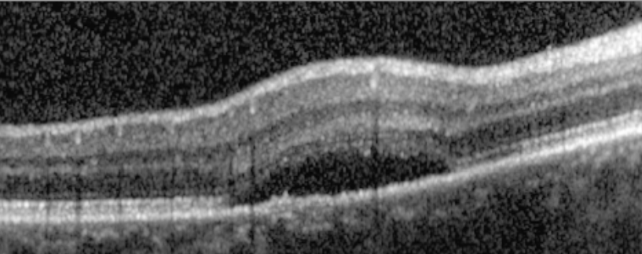
Preprocessing
Template matching
Preprocessing
Images
Evaluation
Cropping

Slide 6
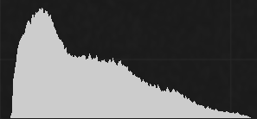
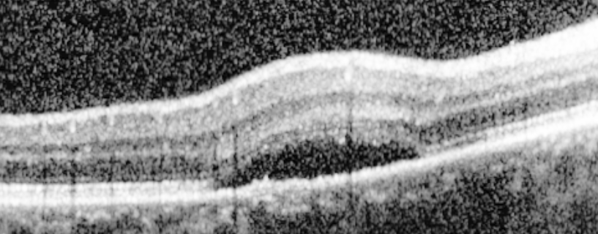
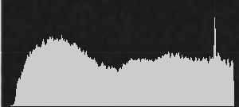
Preprocessing
Template matching
Preprocessing
Images
Evaluation
Cropping
Histogram Equalization

Slide 7
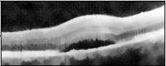

Preprocessing
Template matching
Preprocessing
Images
Evaluation
Cropping
Histogram Equalization
Denoising

Slide 8
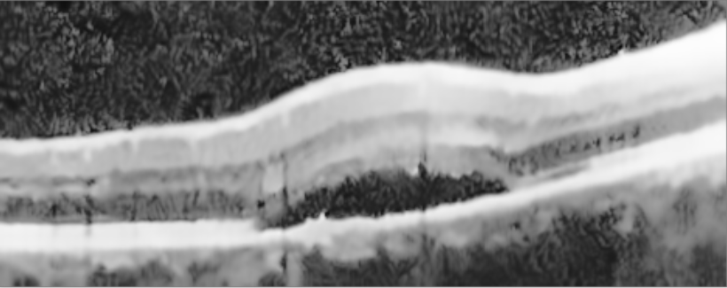
Preprocessing
Template matching
Preprocessing
Images
Evaluation
Cropping
Histogram Equalization
Denoising

Slide 9
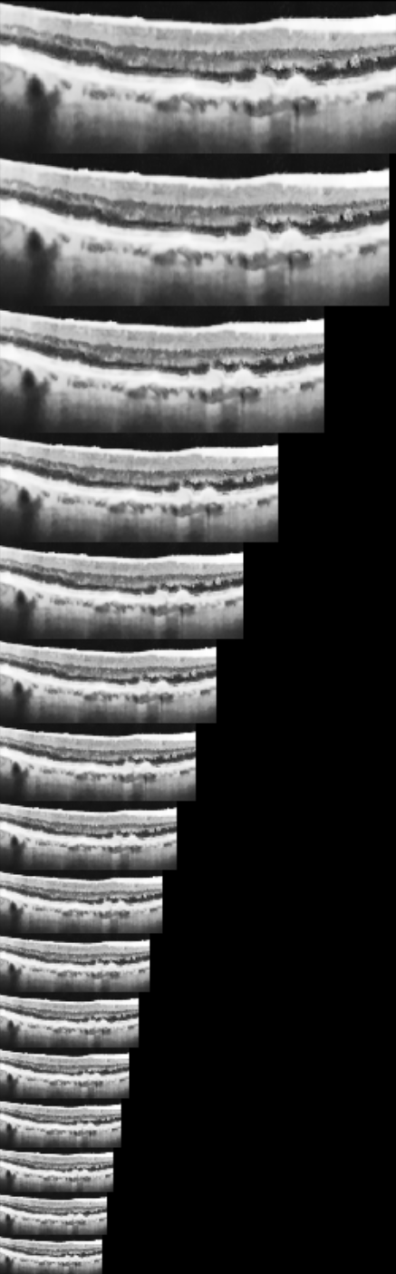
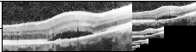
Preprocessing
Template matching
Template matching
Images
Evaluation
Image pyramid

Slide 10
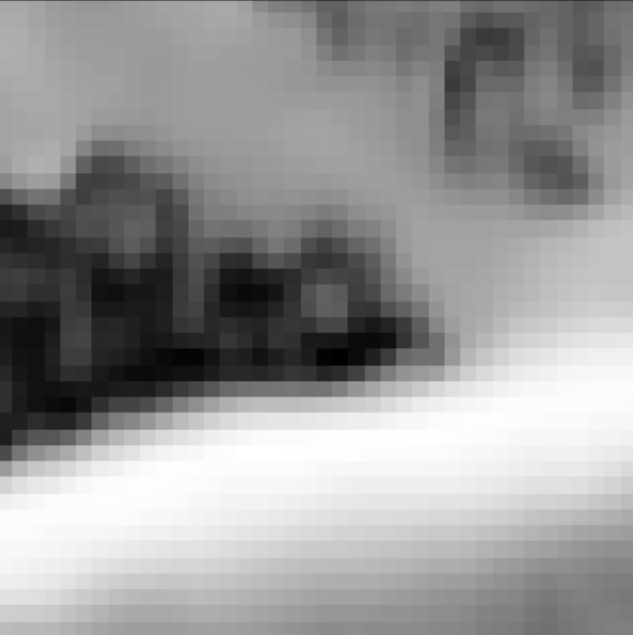
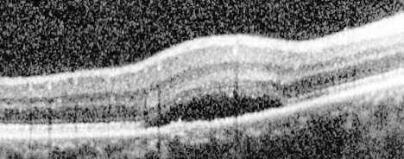
Preprocessing
Template matching
Template matching
Images
Evaluation
Image pyramid
Template choice

Slide 11
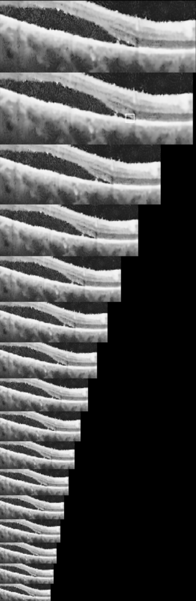

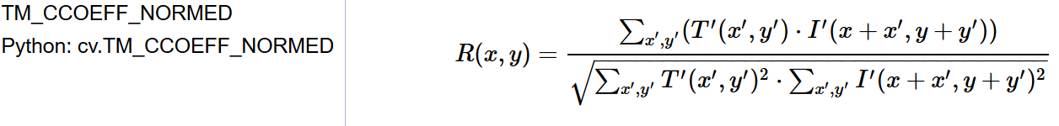
Preprocessing
Template matching
Template matching
Images
Evaluation
Image pyramid
Template choice
Matching method

Slide 12
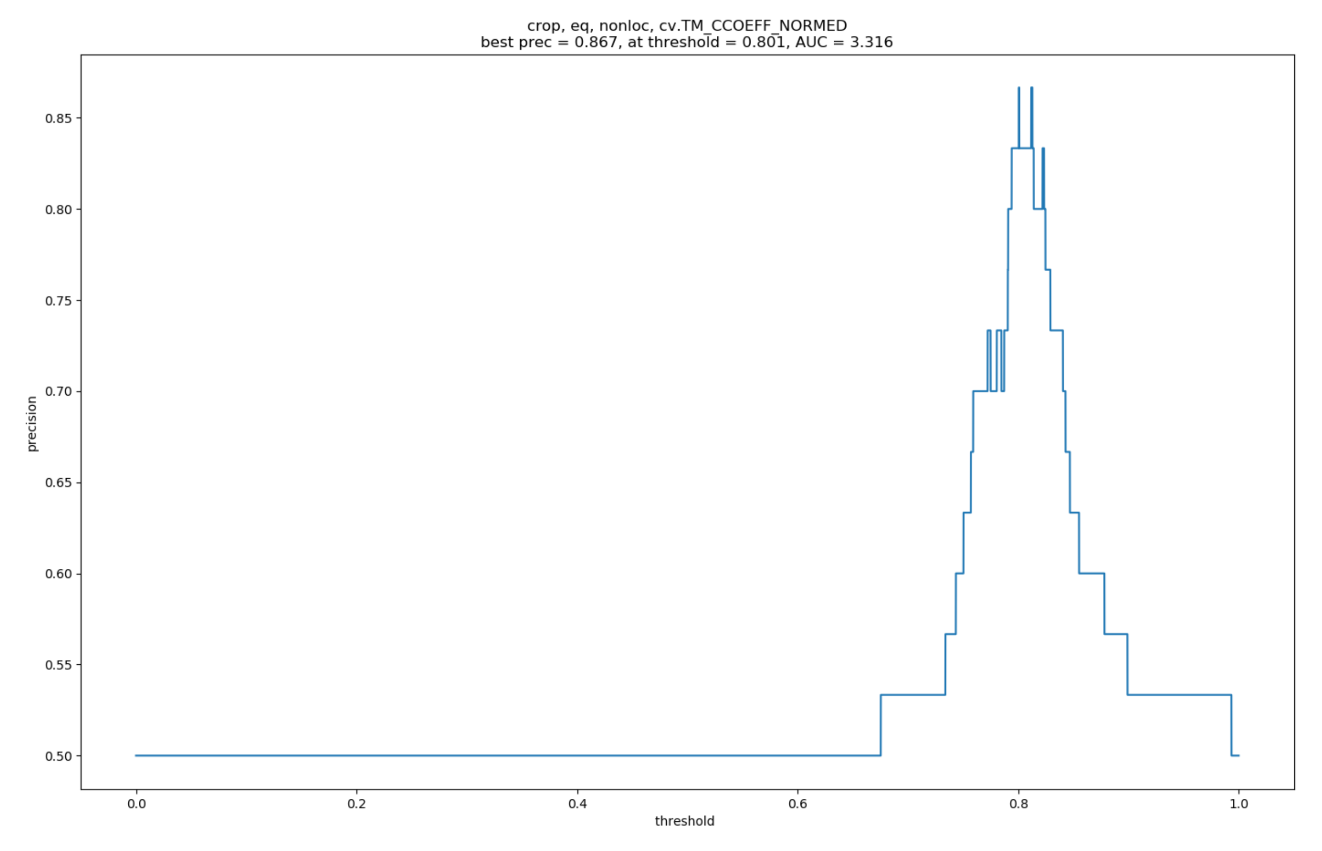
Preprocessing
Template matching
Evaluation
Images
Evaluation
Precision with different thresholds

Slide 13
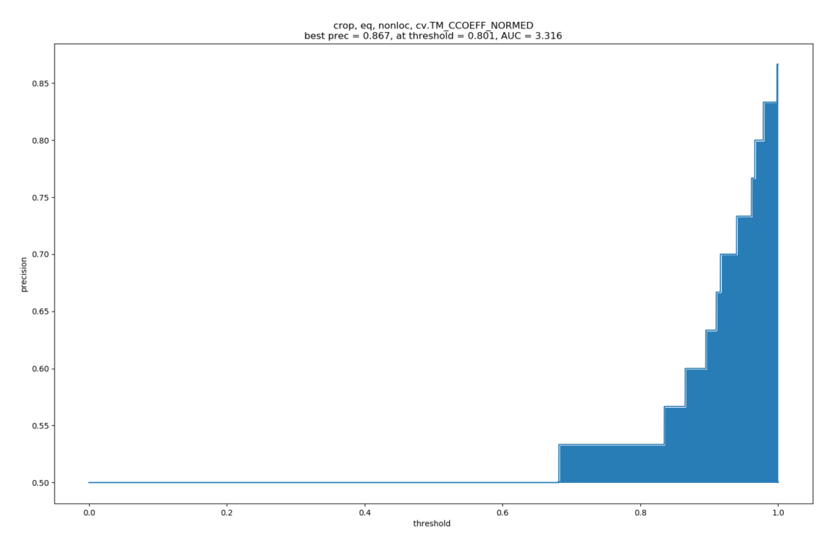
Preprocessing
Template matching
Evaluation
Images
Evaluation
Precision with different thresholds
AUC calculation

Slide 14
Thank you
Jan Wälchli, Dominik Meise, Mario Moser
Group project in Introduction to Signal and Image Processing

