Slide 1
INTRODUCTION TO MODULAR SYNTHESIS
Signal Flux x Pioneer Works
September 2019
Week 3: Sculpting Timbre and Time

Slide 2
Agenda
Review
Controlling Timbre
Spectrum
Waveshape
Filters
Wavefolding
Effects
Delay
Reverb
Distortion
Slew Limiters, Sample + Hold
Pattern Generators
Clock Modulators/Euclidean Rhythms
Phasing LFOs and Polyrhythms
Turing Machines? Controlled Randomness and Chance?

Slide 3
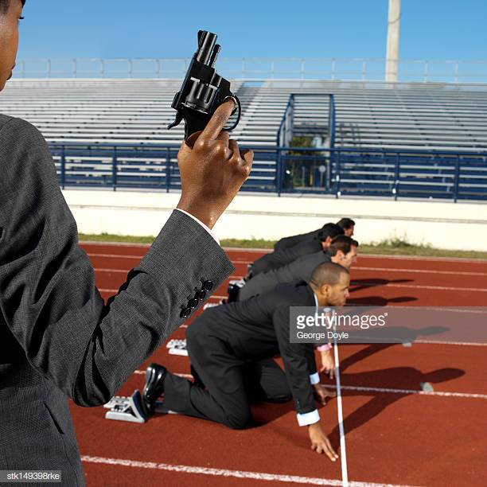
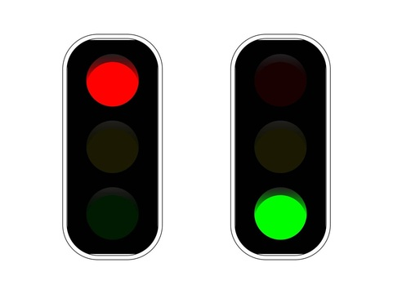
Gates & Triggers
Gates and Triggers are special signals in the modular world. Instead of directly modulating a parameter, they tell other modules to start and stop actions.
- Triggers can be thought of like the starting signal for a race. The trigger is an impulse which makes an event begin; the event then goes to completion.
- Gates can be thought of like stoplights. An action begins and continues as long as the gate is held high (green light), but stops as soon as the gate goes low (red light).

Slide 4
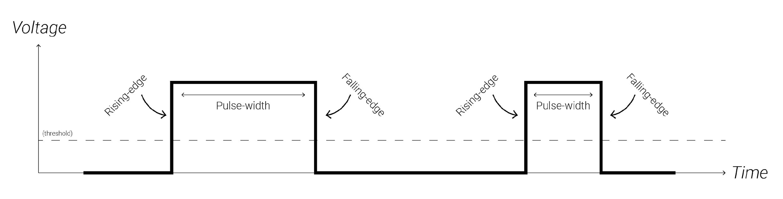
Gates & Triggers

Slide 5
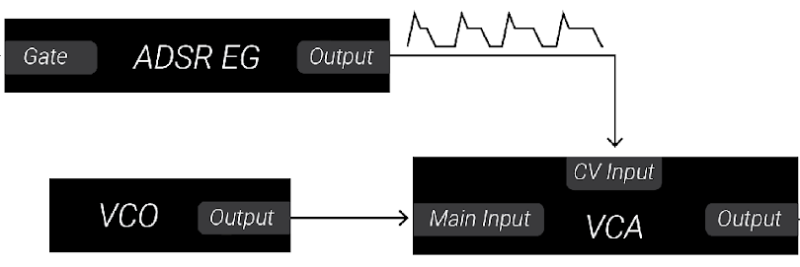
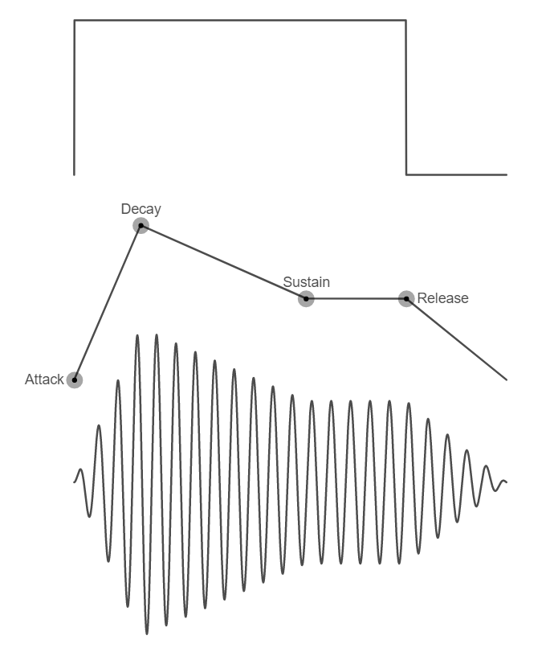
EGs
Envelope Generators (or EGs) create a voltage which rises and falls in response to a trigger or gate. EGs are useful for creating control voltage signals which have a beginning, middle, and end so that you can create distinct musical events.
EGs are often used to control a VCA processing a sound source, as depicted in the adjacent graph. This gives the sound source an “amplitude envelope” which can be heard as the sound source getting louder and quieter.

Slide 6
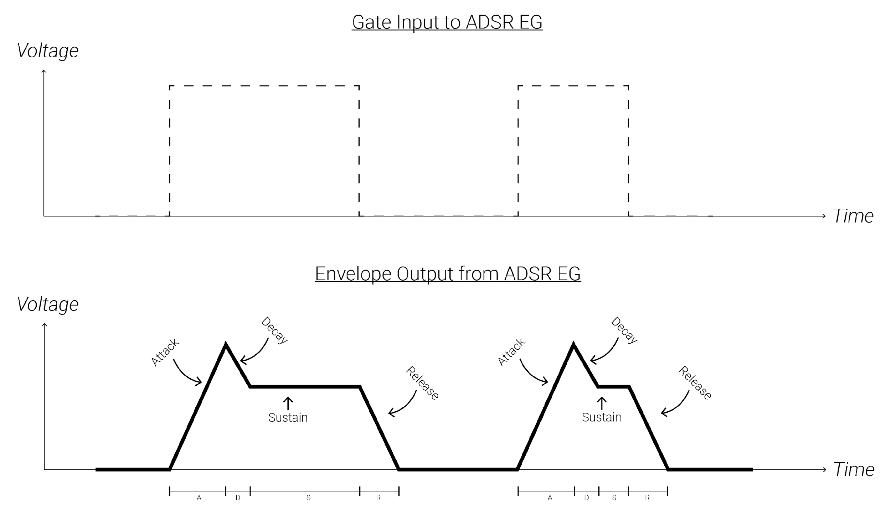
ADSR EGs
When an ADSR EG receives a gate, it begins an envelope.
Attack: the initial portion of an envelope where the envelope ramps from its resting voltage (0V) to its maximum voltage.
Decay: the envelope falls from its maximum to its sustain level.
Sustain: the envelope holds at the sustain level as long as the gate is still high.
Release: the envelope falls from its sustain level to its resting level (0V).
ADSR Demo

Slide 7
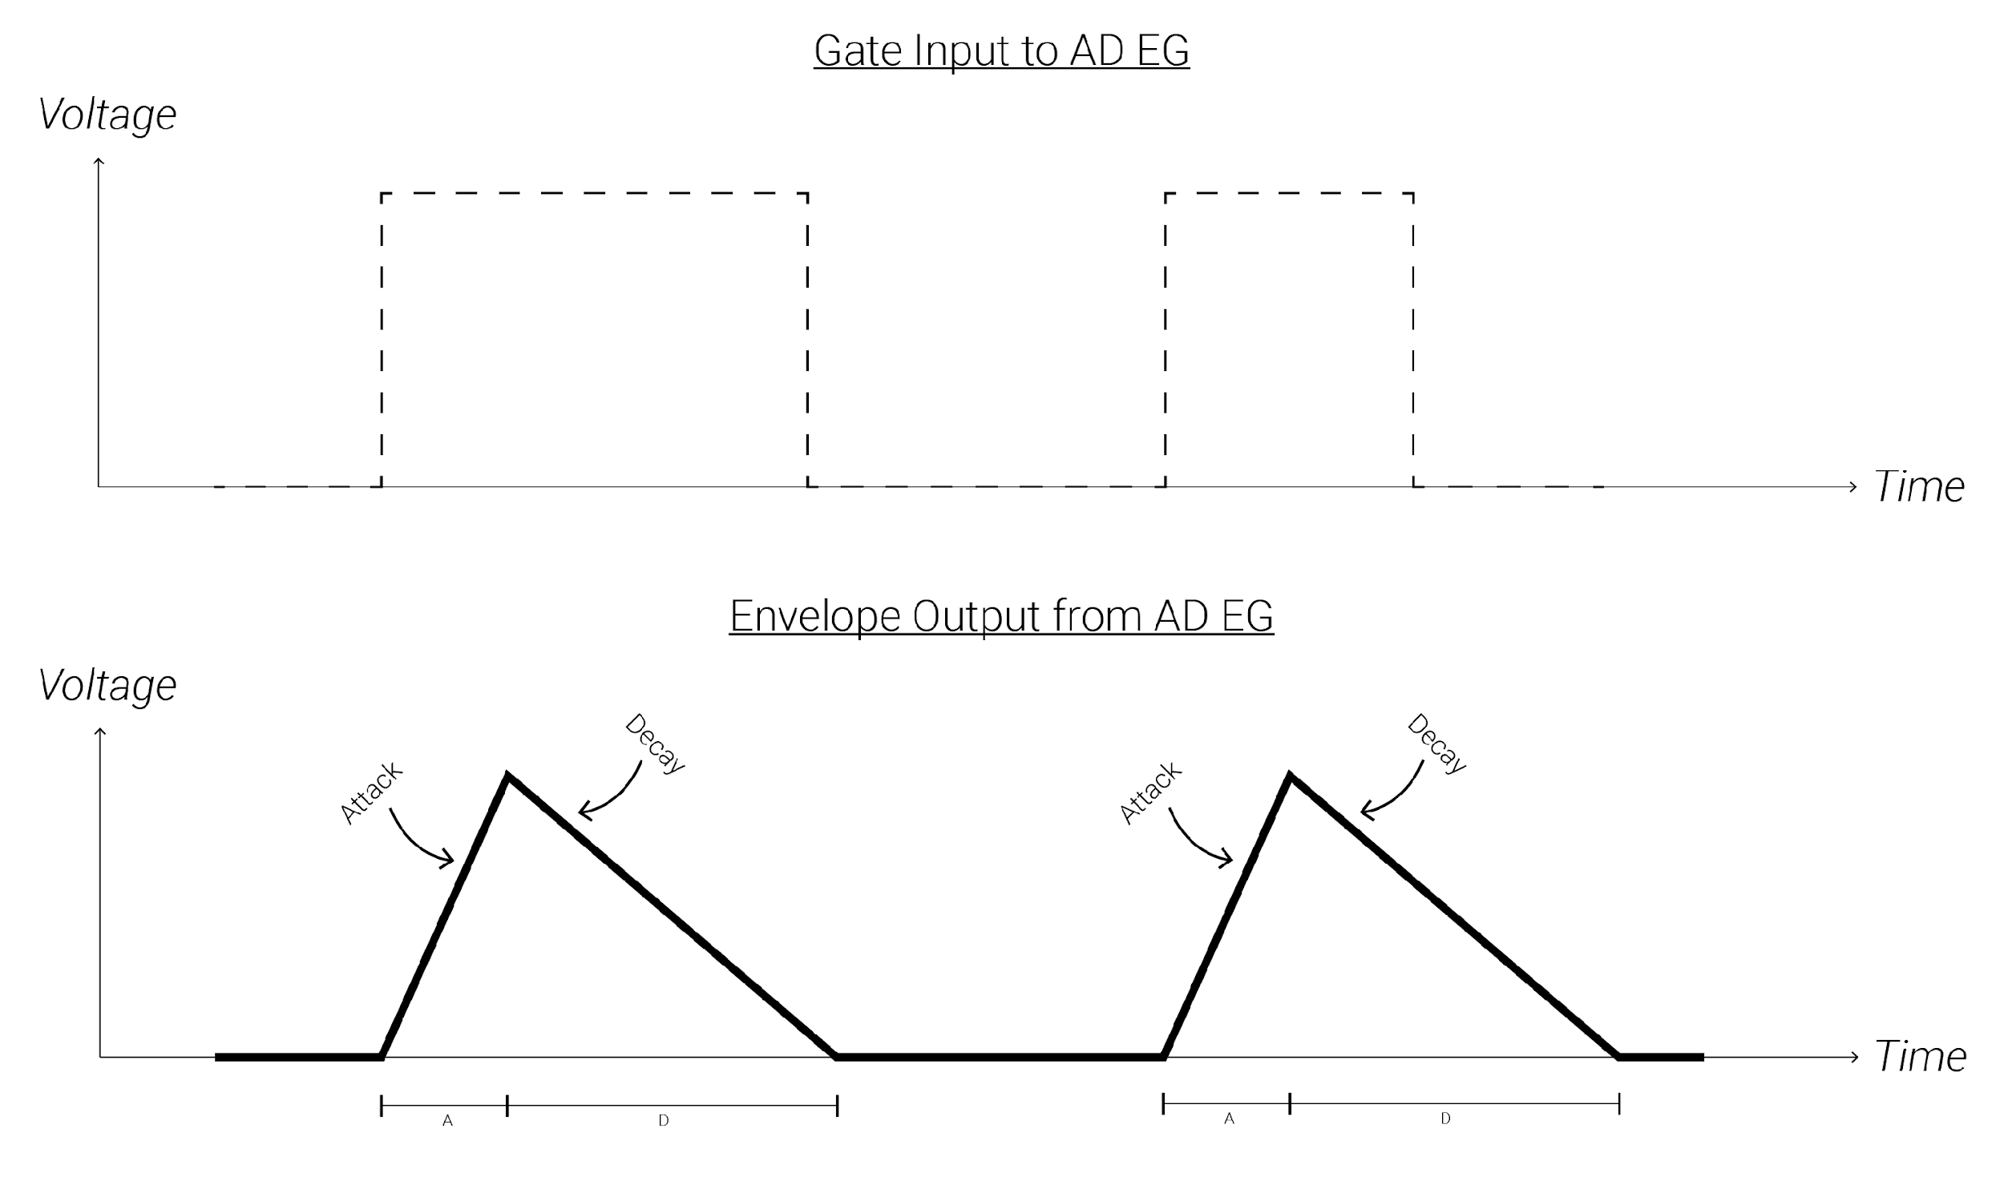
AD EGs
AD EGs are like ADSRs, except they do not respond to the pulse-width of a gate. Instead, they only treat input gates as triggers.

Slide 8
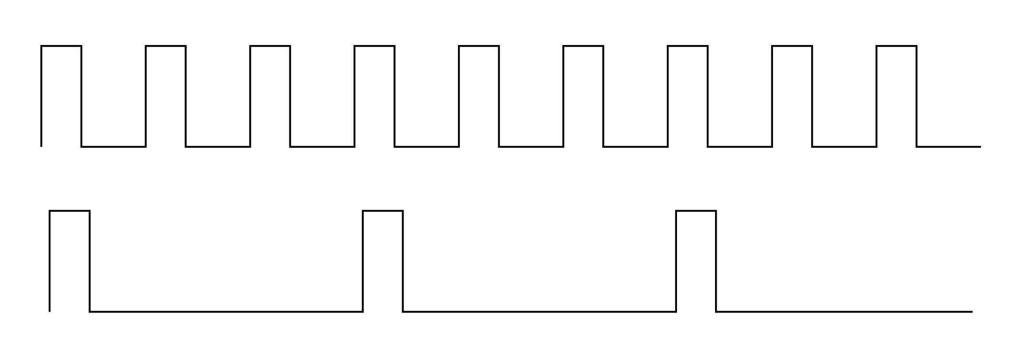
Clocks
Clocks are steady streams of gates (or triggers) that are generated at a constant rate.
Clock Modulation is the act of deriving a new rhythm of gate pulses based off a constant stream of clock pulses.
A single clock source is often used to synchronize many modules together so that actions all occur simultaneously.

Slide 9
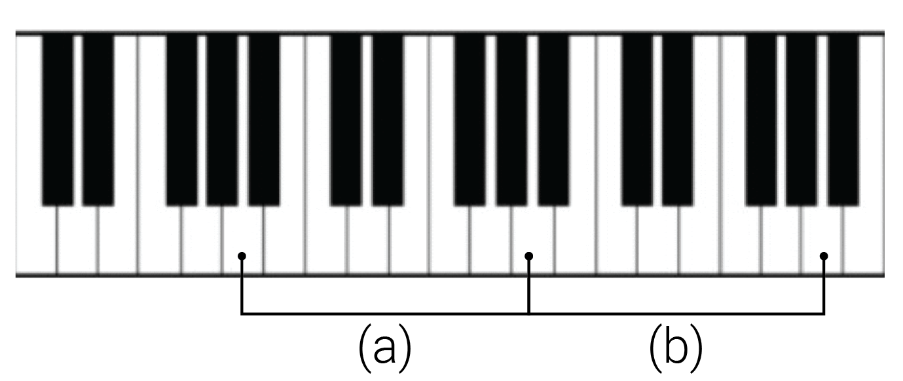
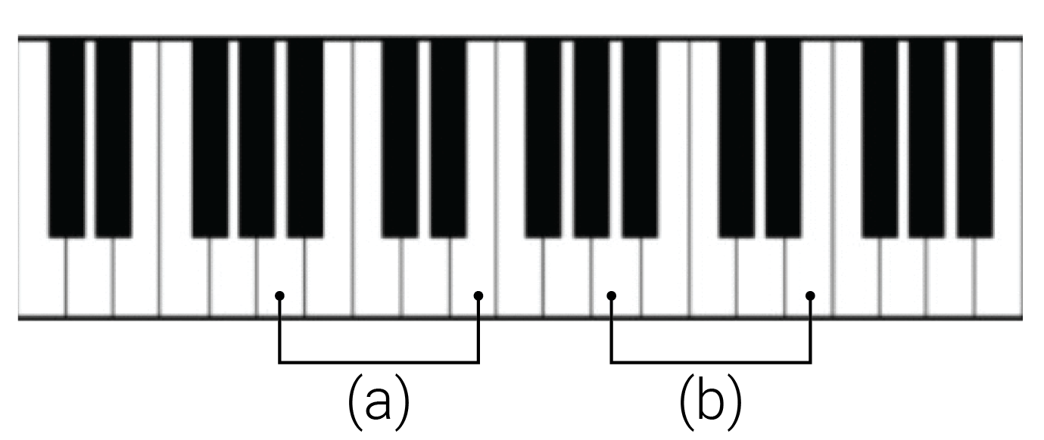
Intervals
Interval: the “distance” between two pitches (aka frequencies); not the absolute difference of the frequencies, but rather the ratio of the frequencies.
Octave: a 1:2 ratio between frequencies, e.g. 100Hz and 200Hz
Pitch class: A group of pitches whose ratios form powers of 2, e.g. 100Hz, 200Hz, 400Hz, 800Hz (i.e. chains of octave intervals).
Pitches in the same pitch class are said to be the same “note” but in different “octaves.”
Interval (a)
- Octave
- 220Hz to 440Hz
- 1:2
Interval (b)
- Octave
- 440Hz to 880Hz
- 1:2
Interval (a)
- Perfect 5th
- 220Hz to 330Hz
- 1:1.5
Interval (b)
- Perfect 5th
- 440Hz to 660Hz
- 1:1.5

Slide 10
V/Oct
Initial | V/Oct | Ratio | Final
100Hz | 0V | 1:1 | 100Hz
100Hz | +1V | 1:2 | 200Hz
100Hz | +2V | 1:4 | 400Hz
100Hz | +3V | 1:8 | 800Hz
100Hz | -1V | 2:1 | 50Hz
Volt-per-Octave (V/oct) is a special tuning system used for precisely changing oscillators frequencies.
It allows you to move oscillators up and down by exact intervals.
Every 1V increase at an oscillator’s V/Oct input results in the oscillator doubling its frequency – i.e. 1V increases moves it up an octave.
For those with a western music notation background a semitone would then be a 1/12V = 0.083V increase.
Initial | V/Oct | Ratio | Final
60Hz | 0V | 1:1 | 60Hz
60Hz | +1V | 1:2 | 120Hz
60Hz | +2V | 1:4 | 240Hz
60Hz | +3V | 1:8 | 480Hz
60Hz | -1V | 2:1 | 30Hz

Slide 11
Scales
A scale is a collection of intervals (usually less than an octave) to be paired with a root or tonic note; the collection is chosen to be somehow musically or sonically interesting.
Since scales are just collections of intervals, a scale can even be expressed in terms of V/Oct voltage levels.
Once a root note is chosen, the intervals in the scale define a collection of pitches above the root note (and all the other pitches within the same pitch classes).
Scale 1 = {root, major 2nd, major 3rd, 4th, 5th, major 6th, major 7th}
Scale 2 = {1x, 1.125x, 1.2x, 1.33x, 1.5x, 1.66x, 1.8x}
Scale 3 = {shadja, rishabh, gandhar, madhyam, pancham, dhaivat, nishad}
Scale 4 = {do, re, mi, fa, so, la, ti}
Scale 5 = {0V, +0.167V, +0.333V, +0.417V, +0.5833V, +0.75V, +0.833V}

Slide 12

Quantizers
Root | Maj. 2nd | Maj. 3rd | 4th | 5th | Maj. 6th | Maj. 7th
0 st | 2 st | 4 st | 5 st | 7 st | 9 st | 11 st
1:2^{0/12} | 1:2^{2/12} | 1:2^{4/12} | 1:2^{5/12} | 1:2^{7/12} | 1:2^{9/12} | 1:2^{11/12}
0/12 V | 2/12 V | 4/12 V | 5/12 V | 7/12 V | 9/12 V | 11/12 V
0V | 0.167V | 0.333V | 0.417V | 0.583V | 0.750V | 0.917V
A quantizer allows the user to specify a scale (aka a collection of allowed intervals) and transform an input voltage into the closest voltage which corresponds to a V/Oct interval from the specified scale.
It internally creates a table of voltages corresponding to the V/Oct levels for the scale.
It compares an input signal to the table and outputs the closest voltage in the table.
All the octaves of each interval are also included in the table of allowed voltages.
Input | Output | Interval
0.3V | 0.333V | Maj. 3rd
0.7V | 0.750V | Maj. 6th
0.6V | 0.583V | 5th
1.3V | 1.333V | Maj. 3rd+Octave

Slide 13
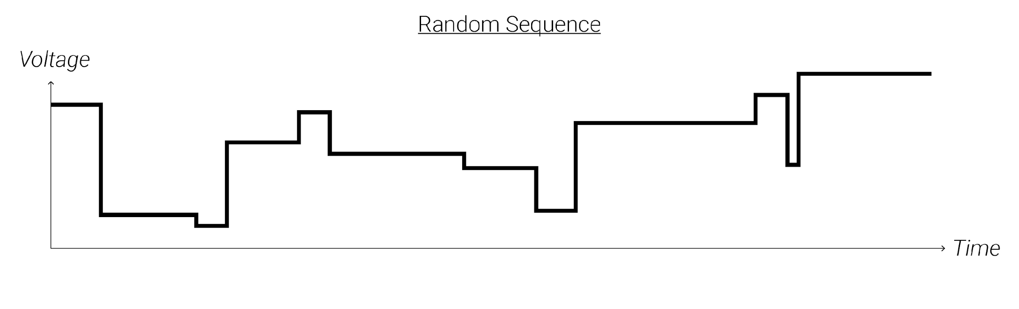
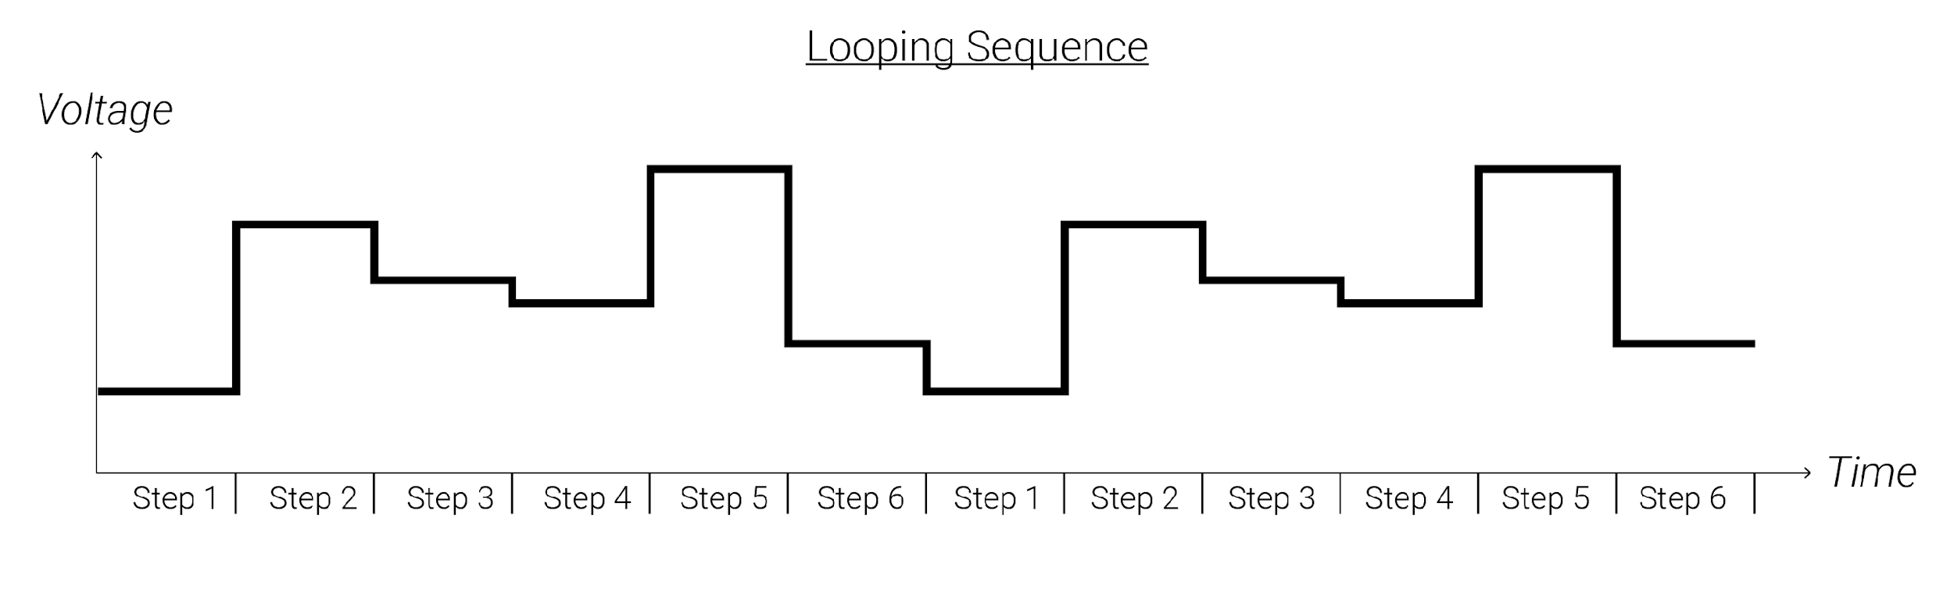
Sequences
A sequence is a control voltage signal which steps through different voltage levels. A sequence stays at each step's voltage for some amount of time before advancing to the next step.
When it changes steps, it jumps instantaneously from the current step's voltage to the next step's voltage.
A rhythmic stream of triggers or a clock source is usually needed to advance a sequencer from one step to the next, though many times sequencers will have built in clocks.

Slide 14
Mixers
Mixers mathematically add two signals together – the output is always the sum of the input voltages.
For CV signals, this allows you to combine multiple different modulation sources together to modulate a single target parameter.
For audio signals, this allows you to layer sound or process multiple sounds together in a single chain as a group (or bus).
Some mixers may include attenuators (or even VCAs) to control the level of each signal.
Mixing Demo

Slide 15
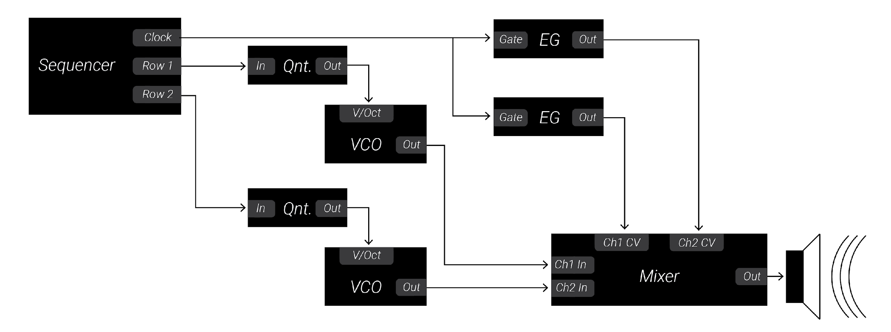
Patch Analysis
Audio Path
Sound Sources
Sound Processors/Effects
Mixers
Modulation Sources
LFOs
Sequencers, Sample and Hold
Quantizers
Envelopes
Random/Chance
Slews
Clocks
Clock Sources
Clock Modulation
Leaders & Followers

Slide 16
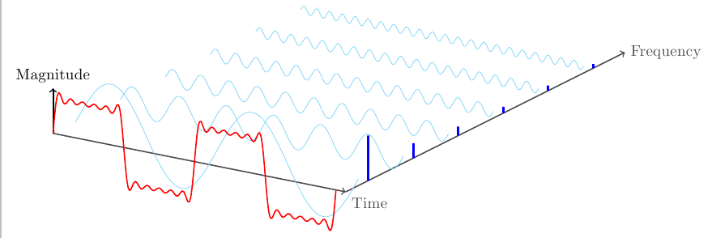
Fourier Series
The waveshape of an oscillator determines its timbre.
Any periodic waveform (i.e. a repeating oscillation) can be created by mixing sine waves whose frequencies are all multiples of the original periodic waveform’s frequency. By carefully controlling the amplitude of each of the sine waves, any other waveform can be created.
The original frequency of the waveform is known as the fundamental frequency. The integer multiples of the fundamental are known as harmonics.
Sounds which are more complex than an oscillation, like a percussive hit or spoken language, may include many more sine waves that are not harmonic multiples of a fundamental frequency. These are known as partials.
Demo

Slide 17
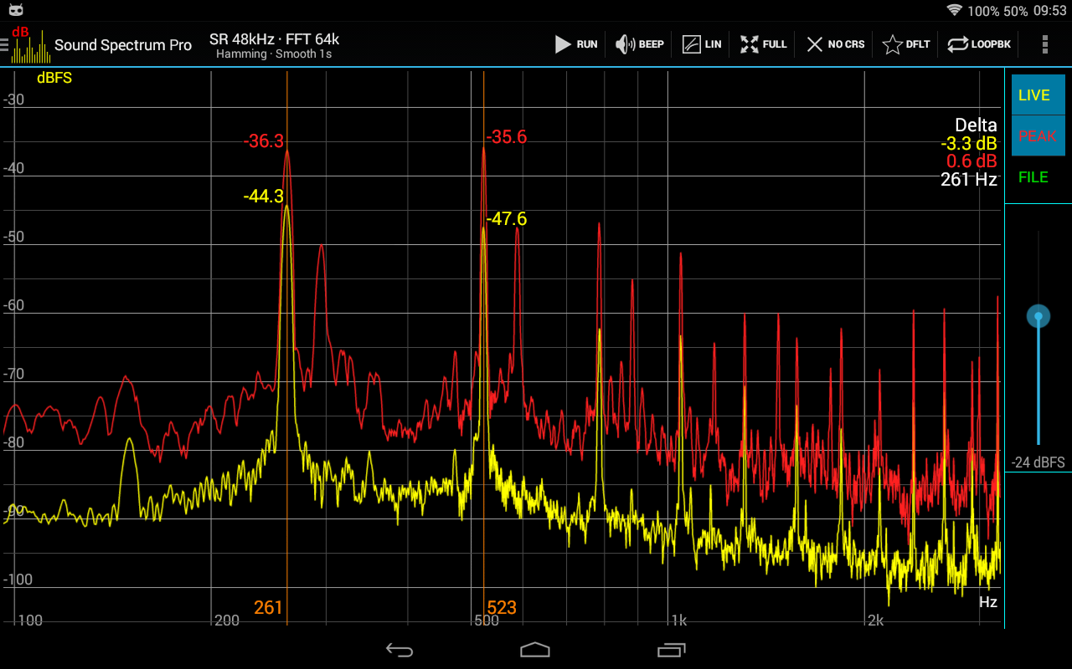
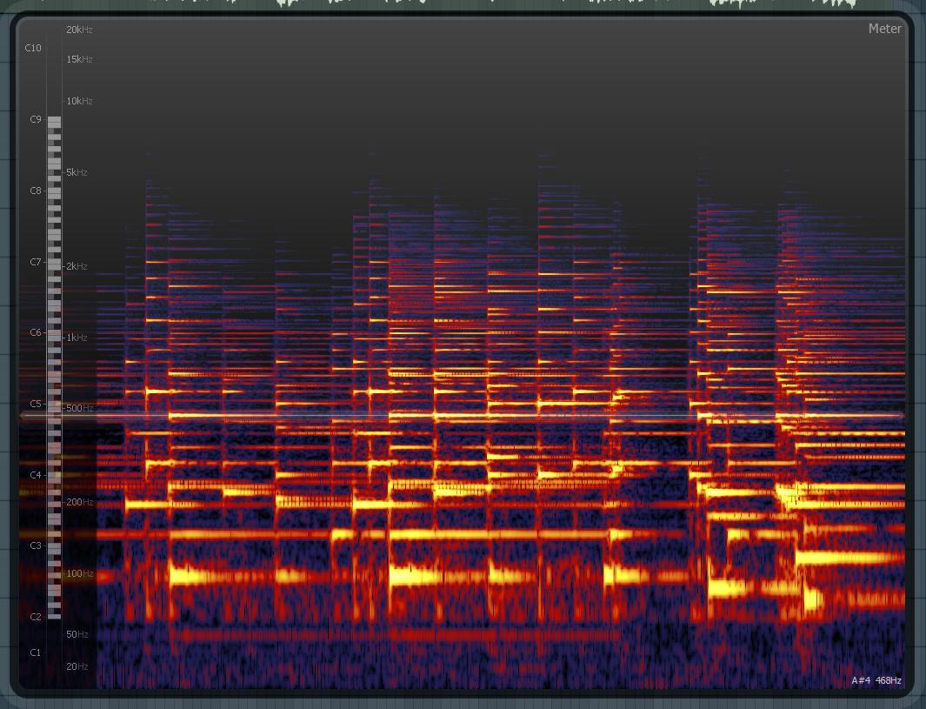
Spectrum
The frequency domain is used to understand the harmonic content of a sound: the x-axis is frequency, while the y-axis measures the amount of energy at each frequency.
A sound’s spectrum is its representation in the frequency domain: it shows the energy at all the individual frequencies that make up a sound.
A spectrogram uses three dimensions to show how a sound’s spectrum changes over time. The x-axis is time, the y-axis is frequency, and the z-axis is energy.

Slide 18
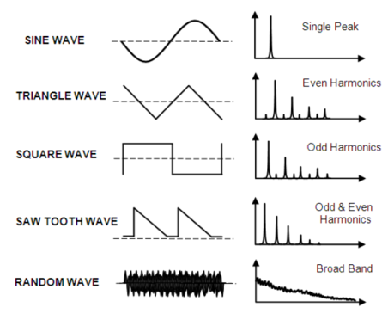
Waveshape
The time domain visualizes a changing voltage: the x-axis is time, while the y-axis is voltage. The waveshape of a signal is a graph of its changing voltage as a function of time.
Sine waves are the simplest of all wave shapes, containing only a single fundamental frequency and no additional harmonics.
Square waves contain additional odd harmonic context.
Triangle waves contain a fundamental sound plus odd harmonics.
Square waves contain both odd and even harmonics.
Noise is made up of energy at every frequency.

Slide 19
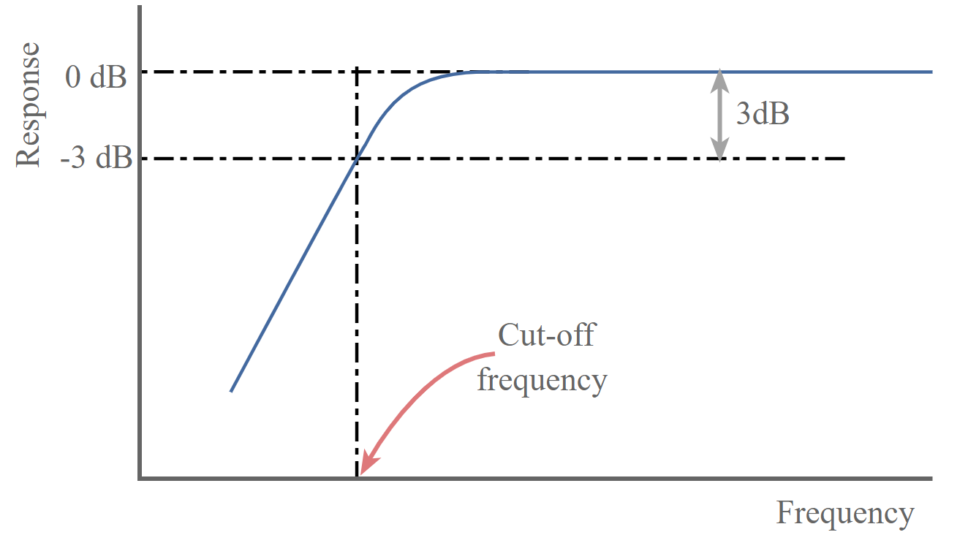
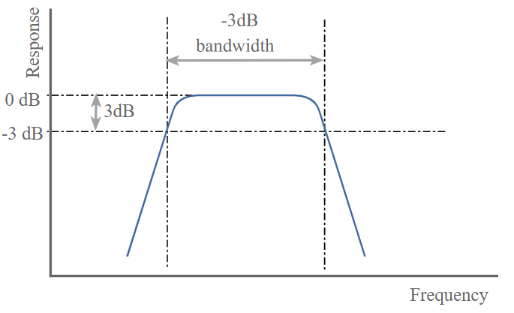
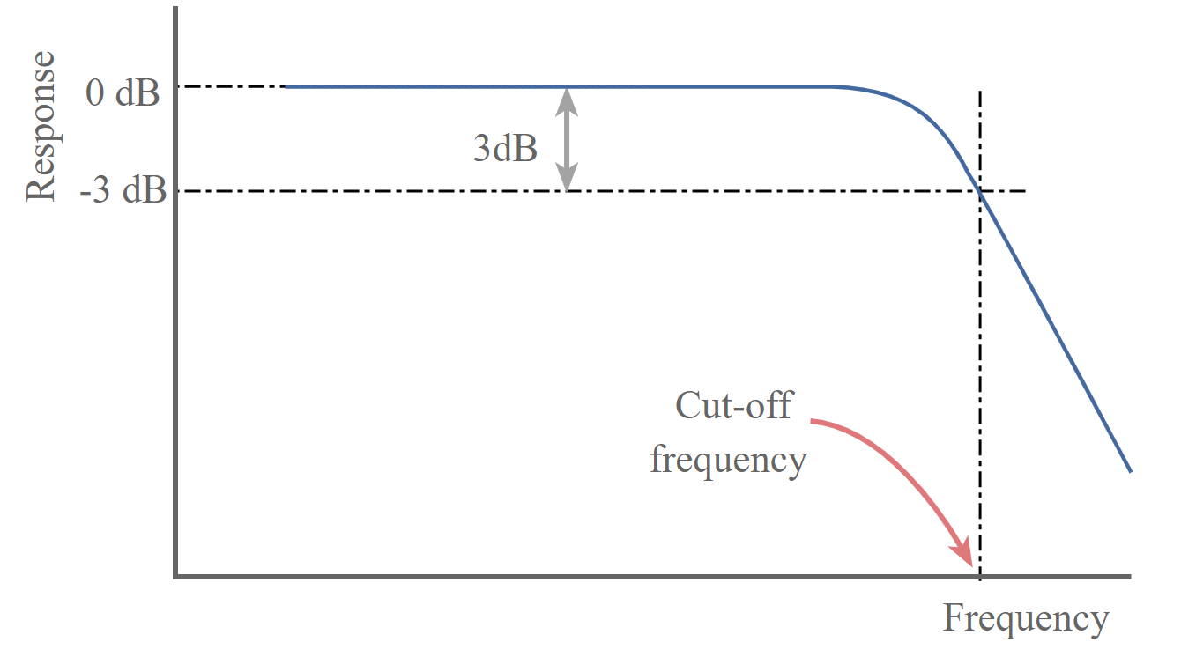
Filters
Subtractive synthesis adjusts the timbre of a sound by removing harmonic content.
A filter attenuates frequencies above or below a specific threshold or cutoff frequency.
A lowpass filter passes all of the harmonics below its cutoff and reduces the level of higher harmonics above that cutoff.
A highpass filter passes all harmonics above its cutoff and attenuates the lower harmonics below the cutoff.
A bandpass filter allows harmonics around the cutoff to pass through and reduces frequencies that are above and below the cutoff.
The strength of filter is determined by its slope: the lower the slope, the less aggressively it attenuates filters below or above its cut off.

Slide 20
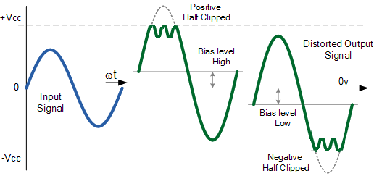
Wavefolding
Wavefolding is a type of wave shaping where signal peaks above a threshold are inverted in a series of folds, resulting in new harmonics being added.

Slide 21
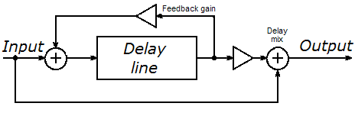
Delay
Delay is a time-based audio effect that mimics echos. An “echo” occurs when a sound is repeated multiple times after it first occurs, usually at a decreasing volume each time.
A delay line works by receiving a signal, holding it for some amount of time (the delay time) before sending it to the output.
The delayed signal is also sent back to the input at a lower volume, resulting in the sound being delayed a second time but at a lower volume. The number of repeats or echos is determined by the feedback gain.
Effects (including delays) often have a dry/wet mix, which allows the user to control the amount of the original “dry” signal heard and the amount of the processed “wet” signal heard.

Slide 22
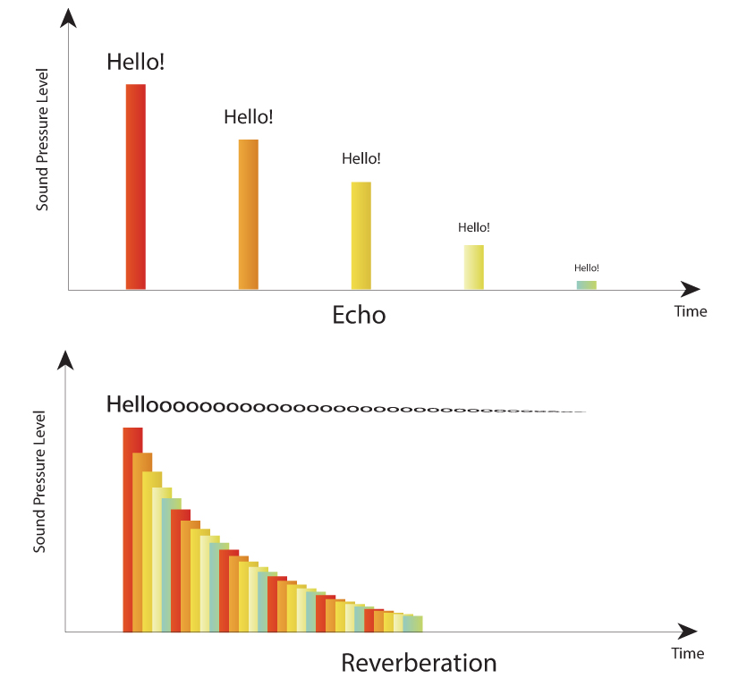
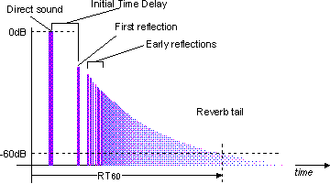
Reverb
Reverb naturally occurs when a sound hits many surfaces and reflects back to the listener. Each reflection takes a slightly different amount of time to reach the listener. Each reflection will also have a slightly different amplitude and filtered waveshape depending on the material it reflected off of. Together, these clouds of reflections create the reverberant ambience of a space; they sound like a smeared, diffused echoing tail of the original sound.
Reverb can also be applied artificially to a sound to give it a sense of space.
Pre-Delay controls the amount of time it takes for the first reflection to reach the listener.
Decay Time controls the amount of time it takes for the reflections to entirely fade out.
Dry/Wet controls the balance between the original sound and the effected sound.

Slide 23
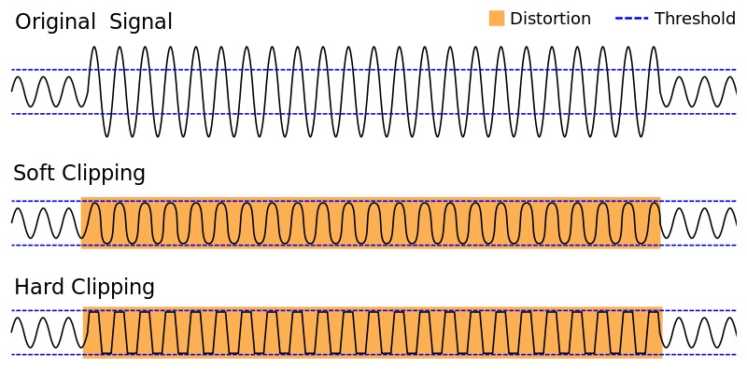
Distortion
A gain effect achieved by overloading the input. The result is usually a compressed, gritty tone.

Slide 24
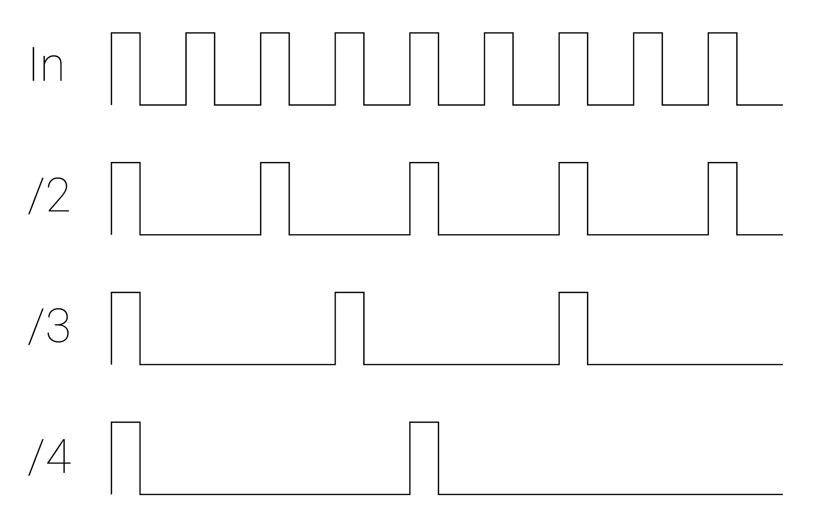
Clock Modulation
Demo
Clock modulation converts a steady streams of gates/triggers, aka a clock, into a new pattern or "rhythm" of pulses which is somehow synchronized to the original clock.
Clock Dividers: output 1 pulse for n input pulses
Clock Multipliers: output n pulses for every 1 input pulse

Slide 25
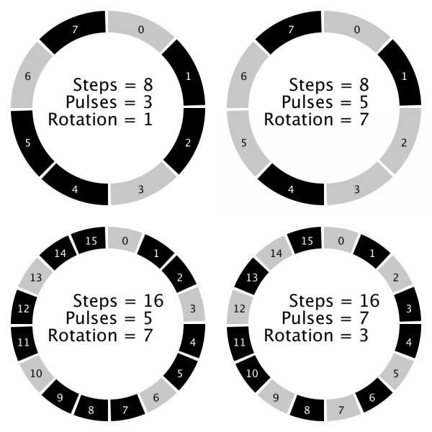
Euclidean Rhythms
Demo
Euclidean rhythms are a unique form of clock modulation generated by distributing a determined number of pulses as evenly as possible across a determined number of steps.
Euclidean Length: The number of steps in the pattern
Euclidean Fill/Trigs: The number of pulses in the pattern.
Euclidean Rotation: Determines where the first hit in the pattern occurs (shifts the pattern forward/backward in time)
Combinations of Euclidean rhythms are core elements of many musical traditions from all over the world.
Demo

Slide 26
Phasing LFOs and Polyrhythms
Polyrhythms generate complex patterns by combining one or more different sets of rhythms played against each other which do not subdivide into each other evenly, e.g. a pattern with a length of 4 steps and a pattern with a length of 7 steps.
Similarly, LFOs with unequal frequencies can creating evolving relationships between parameters.

Slide 27
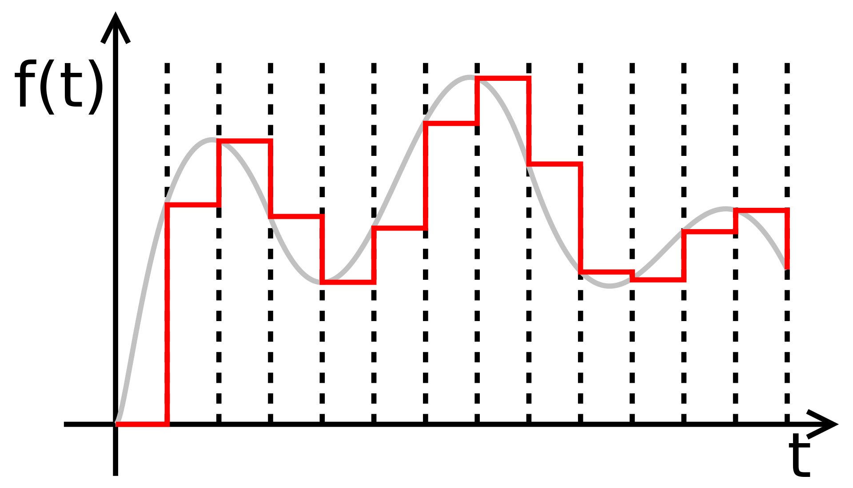
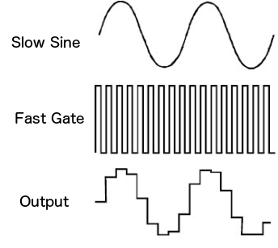
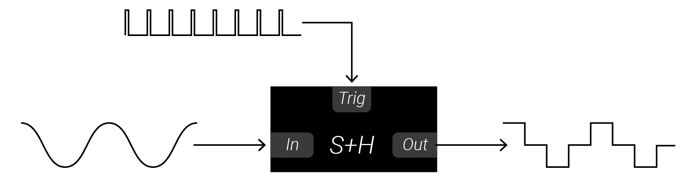
Sample + Hold
Sample+Hold modules expect two inputs: a voltage to sample and a trigger.
When a trigger arrives, the main voltage is checked, frozen instantaneously and sent to the output.The output voltage does not change until another trigger occurs.
S+H modules allow you to turn any signal into a stepped sequence of voltages.
Pairing a S+H with two phasing LFOs is a great way to generate evolving sequences.
S+H can even be used as sample-rate reduction distortion when used with an audio signal and fast clock!

Slide 28
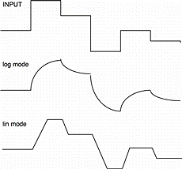
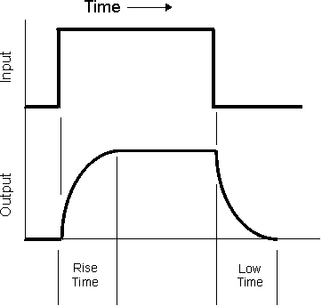
Slew Limiters
Slew limiters smooth out changes in a voltage. The output voltage is like a “laggy” version of the input voltage: it takes time to catch up (slew) to the input.
A slew limiter has two main parameters: the rise-time and fall-time.
When the input voltage increases, the output voltage rises to the new voltage in the amount of time specified by rise.
When the input voltage decreases, the output voltage falls to the new voltage in the amount of time specified by fall.
SLs can be used to smooth out random sequences, create glissando/slides, and much more!
SLs can even be used as lowpass filters since removing sharp transitions = rounding edges = removing HF content.

