Slide 1
Least Squares Regression
Andrew Ho
Signal Data Science

Slide 2
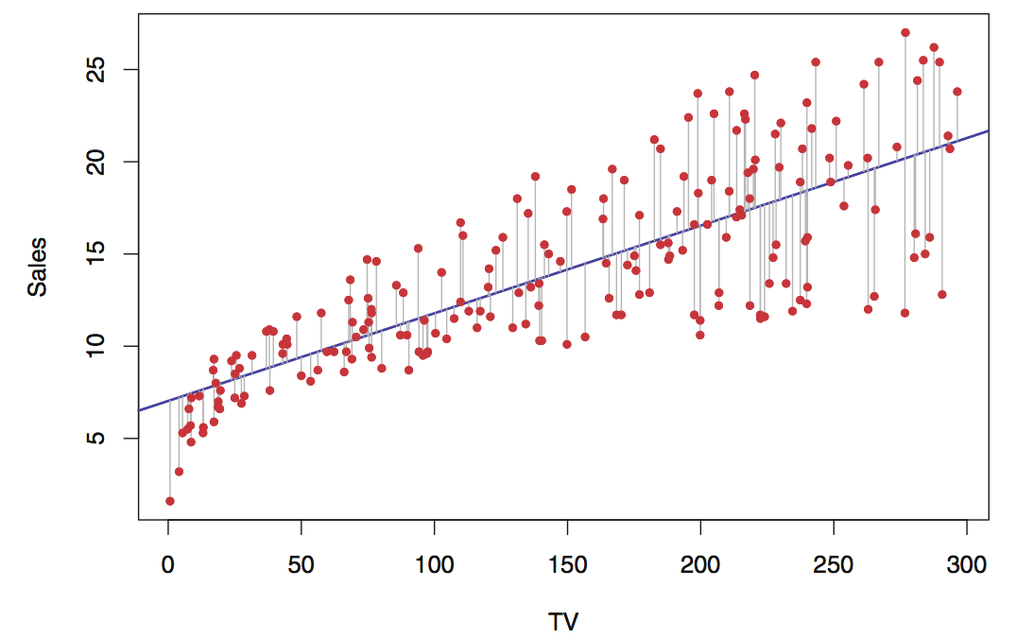

Slide 3
Why is linear regression important?
Linear methods are simple and easy to calculate
A surprising number of things are linear
For many nonlinear things, linear methods get us pretty decent results
Easily interpreted

Slide 4
Linearity in Nature
“Complex nonlinear genetic systems certainly exist … However, quantitative differences between individuals … may be largely due to independent linear effects … As noted, linear effects are the most readily evolvable in selection, whereas nonlinear gadgets are more likely to be fragile to small changes. … [T]o first approximation, Biology = linear combinations of nonlinear gadgets”
From Steve Hsu’s “On the genetic architecture of intelligence and other quantitative traits”, 2014

Slide 5
Least squares for regression
Linear models can be fit with many different cost functions
Method of least squares = minimize the sum of squared errors
Why do we do this? Why not something else?

Slide 6
Gauss
“Therefore, that will be the most probable system of values of the unknown quantities … in which the sum of the squares of the differences between the observed and computed values … is a minimum … This principle, which promises to be of most frequent use in all applications of the mathematics to natural philosophy, must, everywhere, be considered an axiom ...”
From Gauss’s “Theory of the motion of heavenly bodies”, 1809

Slide 7
Gauss
“It is very remarkable that the free movements, if they cannot coexist with the necessary conditions, are modified by Nature in exactly the same way in which the calculating mathematician, according to the method of least squares, reconciles observations which are connected to each other by necessary dependencies.”
From Gauss’s “Werke”, Vol. 5, a paper on an extremal principle in mechanics

Slide 8
Assumptions
Intuition: assume that errors are normally distributed with mean 0 and identical variance & independent
Result: probability of observing our observations is maximized
Maximum likelihood argument
(Whiteboard math time!)
Final theorem is even stronger, removing dependence on normality

Slide 9
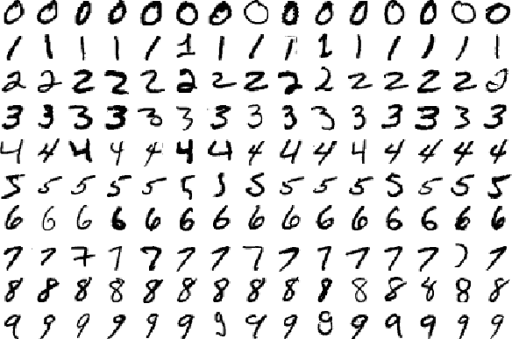
Where do linear models fail?
Linear model: 90%
4 layer CNN: 99%

Slide 10
References
W.K. Buhler, “Gauss: A Biographical Study”, Interchapter IX, 1979
C.F. Gauss, “Theory of the Motion of the Heavenly Bodies”, Book II, Third Section, 1809
C.F. Gauss, “Theory of the Combination of Observations Least Subject to Errors”, 1823
M. Merriman, “On the History of the Method of Least Squares”, 1877

