Slide 1
Regularized Linear Regression
Signal Data Science

Slide 2
Motivation for regularization
MSE = (intrinsic error)² + (bias)² + variance
Ordinary least squares is unbiased
Isn’t the model with the lowest MSE in general
Introducing some bias can reduce variance
Two major problems result in inflated coefficients
Collinearity among predictors
Overfitting

Slide 3
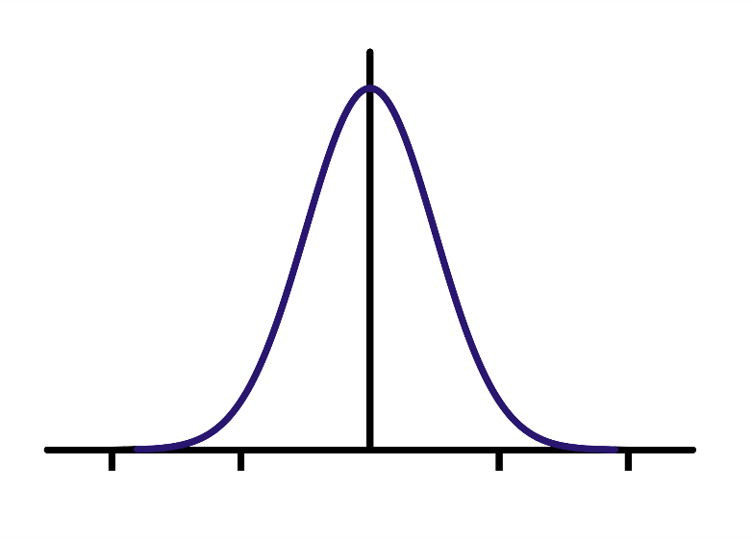
Two equivalent formulations
Penalize large coefficients
Instead of minimizing sum of squared errors (SSE), minimize SSE + λ*sum(|coefficients|)
Or minimize SSE + λ*sum(|coefficients|²)
Impose Bayesian prior on coefficients
Use a Gaussian or Laplacian prior for coefficients being closer to 0

Slide 4
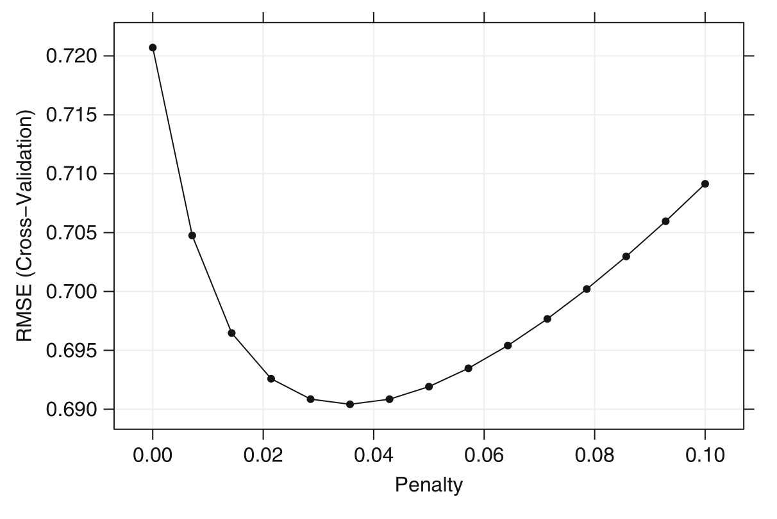
Penalty leads to lower RMSE
(Applied Predictive Modeling, p. 125)

Slide 5
Lasso and ridge regression
Minimizing SSE + λ*sum(|coefficients|)
Called “LASSO” or “L¹ penalization”
Tends to shrink some coefficients to 0 and leave others
Easy to interpret
Minimizing SSE + λ*sum(|coefficients|²)
Called “ridge regression” or “L² penalization”
Tends to shrink coefficients uniformly
“L^{p} penalization” comes from notion of p-norm
|x|_{p} = (|x₁|^{p} + |x₂|^{p} + … + |x_{n}|^{p})^{1/p}

Slide 6
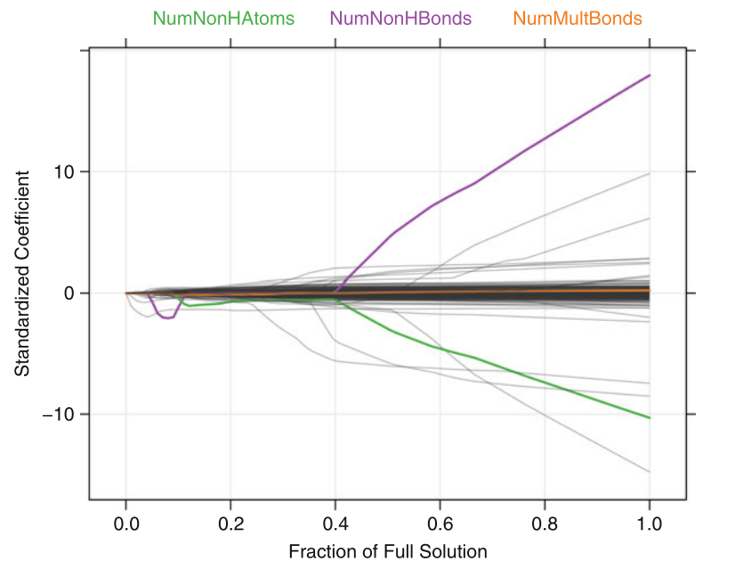
L¹ coefficient shrinkage
(Applied Predictive Learning, p. 126)

Slide 7
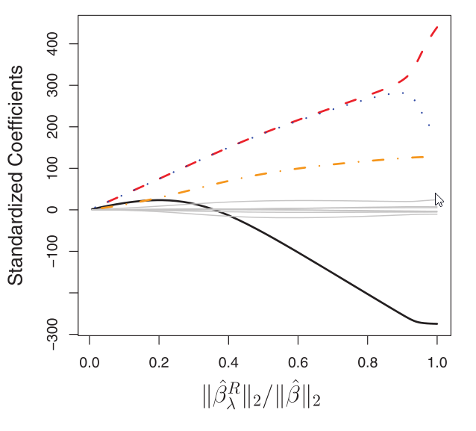
L² coefficient shrinkage
(Introduction to Statistical Learning, p. 216)

Slide 8
Duality of optimization
Two equivalent mathematical formulations
Minimizing SSE + λ*sum(|coefficients|)
Minimizing SSE subject to sum(|coefficients|) ≤ s₁(λ)
Same for ridge regression
Minimizing SSE + λ*sum(|coefficients|²)
Minimizing SSE subject to sum(|coefficients|²) ≤ s₂(λ)

Slide 9
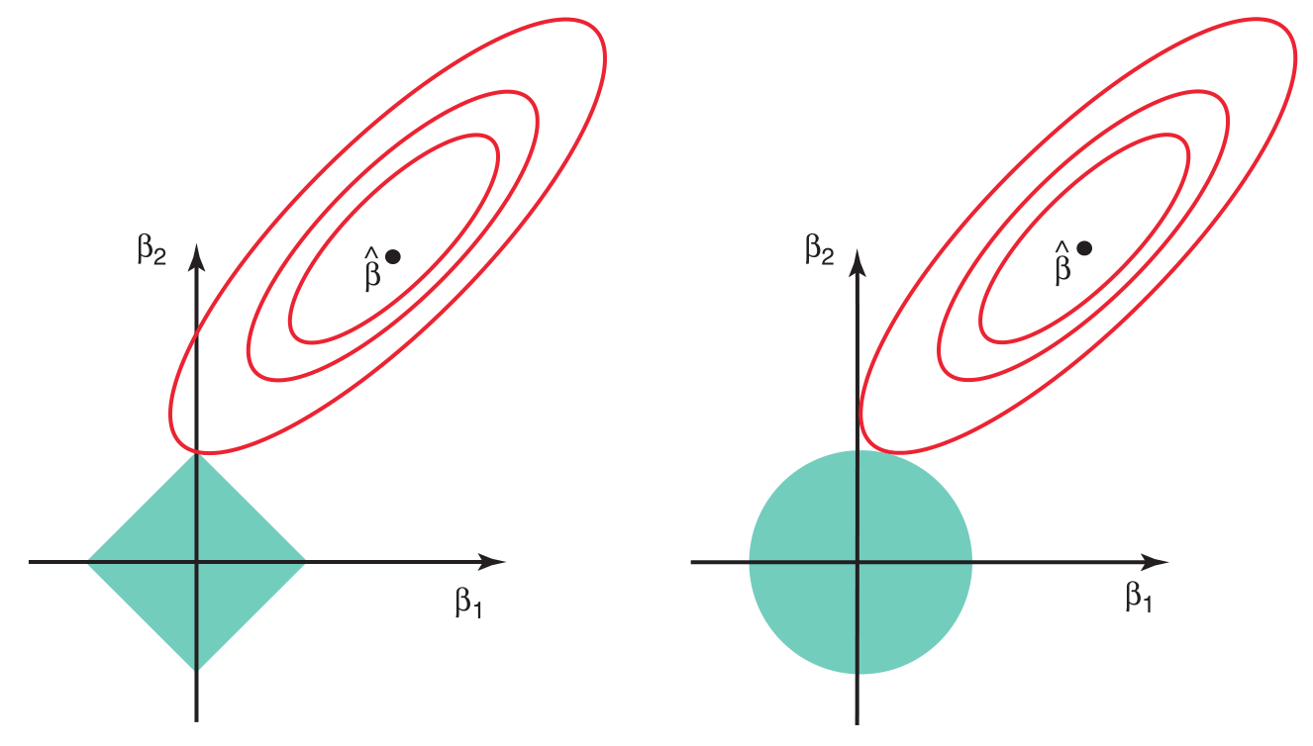
Visual intuition

Slide 10
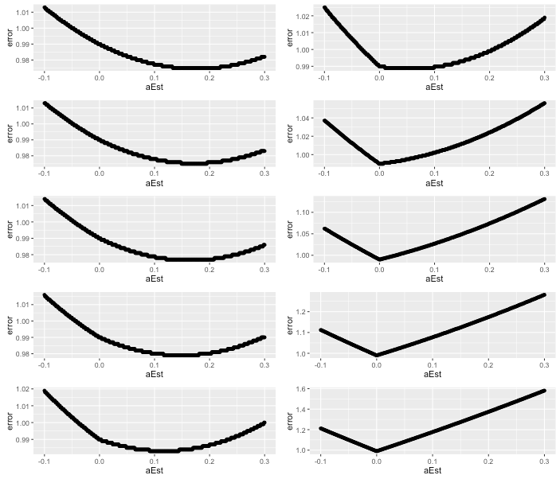
L¹ regularization

Slide 11
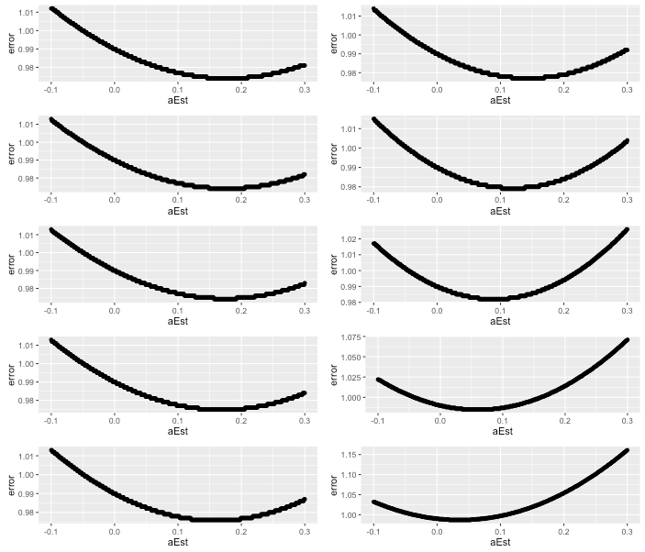
L² regularization

